Slide 1

Project Title Presentation
Full-Custom Design of Successive Approximation Register ADC
Group No: 34
Group Members:
Sambhav Saxena (2100910310121)
Shivanshu Singh (2100910310137)
Sidhant Singh (2000910310162)
Name of Faculty Mentor: Dr. Chandra Shankar

Slide 2
Presentation Outline
Title of the Project
Problem Statement
Objectives of the Project
Social Impact of the Project
References

Slide 3
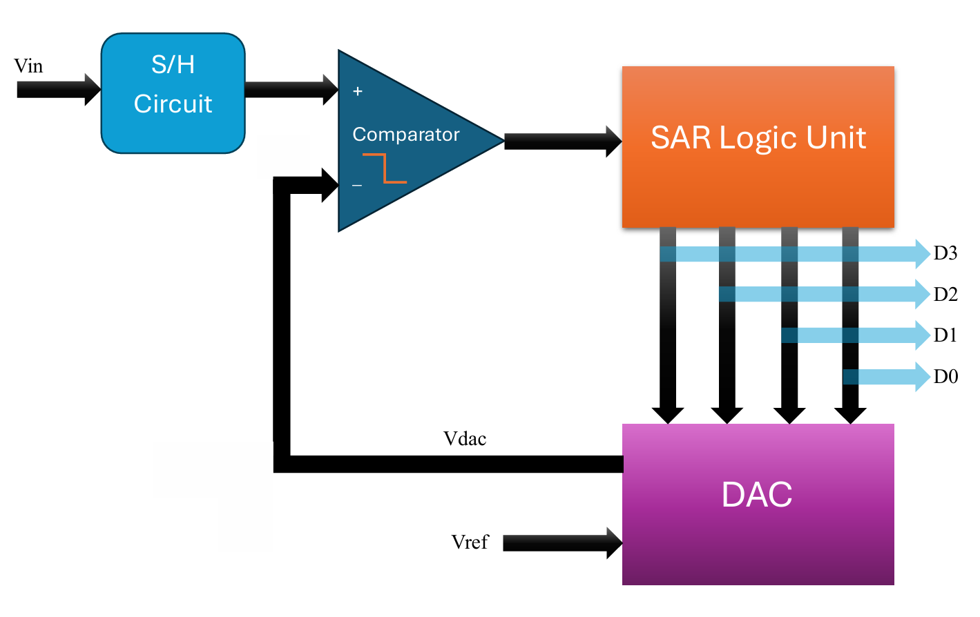
Title of the Project: SAR ADC Full Custom Design

Slide 4
Problem Statement
Need for High-Performance ADCs: Modern applications require ADCs that combine high resolution, compact size. These requirements are critical in fields such as medical devices, automotive systems, and portable electronics.
Limitations of Standard ADCs: Standard ADCs may not meet specific design requirements for power, speed, or integration in custom applications.
Need for Ultra-Low Power Consumption: Many battery-powered or portable devices require ADCs with ultra-low power consumption to extend battery life, while maintaining sufficient speed and resolution for real-time data acquisition.

Slide 5
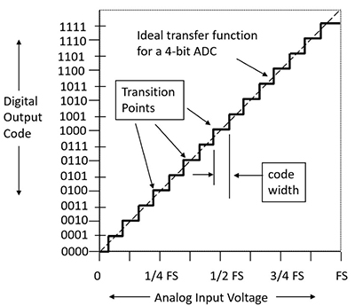
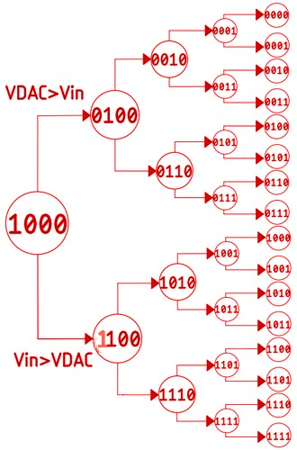
Successive Approximation Register (SAR) type ADC

Slide 6
Objectives of the Project
Low Power Consumption
Low Noise Performance
Compact Design
Wide Application Range
Ease of Integration

Slide 7
Social Impact of the Project
Improved Healthcare Outcomes: Custom SAR ADCs can enhance the performance of medical devices like portable ECG monitors, imaging equipment and wearable health trackers, improving patient outcomes.
Energy Efficiency and Environmental Impact: The development of low-power ADCs reduces energy consumption of electronic devices, lowering their carbon footprint and promoting environmental sustainability.
Advancing IoT and Industrial Automation: Custom-designed ADCs can improve the accuracy and responsiveness of IoT devices and industrial sensors, driving innovation in sectors such as agriculture, manufacturing, and logistics.

Slide 8
References
Kiran Kumar Mandrumaka; Fazal Noorbasha, “A low power 10 bit SAR ADC with variable threshold technique for biomedical applications” in Department of ECE, Koneru Lakshmaiah Education Foundation, Vaddeswaram, Guntur, A.P., SN Applied Sciences Springer Journal, Volume 1, article number 918, 2019
Suva Banik; M.M.H Rasel; Tanjir Mahmud; Md. Hasanuzzaman, “Design and implementation of a low-power 1V, 77.26µW 6-bit SAR ADC in Cadence 90nm CMOS process for biomedical application” in 2020 IEEE Region 10 Symposium (TENSYMP), 2020
Maxwell Kazuki Fukada, “Signal ADC Converter Simulation on Cadence Virtuoso for Audio Applications” in a Thesis at Electrical Engineering Department, California Polytechnic State University, San Luis Obispo, 2022

