Slide 1

Project Synopsis Presentation
Full-Custom Design of Successive Approximation Register ADC
Group No: 34
Project Supervisor: Dr. Chandra Shankar
Group Members:
Sambhav Saxena (2100910310121)
Shivanshu Singh (2100910310137)
Sidhant Singh (2000910310162)

Slide 2
Presentation Outline
Title of the Project
Problem Statement
Literature Survey
Objectives of the Project
Block Diagram
Software Used
Gantt Chart
References

Slide 3
Full-Custom Design of Successive Approximation Register ADC

Slide 4
Problem Statement
Need for High-Performance ADCs
Limitations of Standard ADCs
Power Constraints in Portable Devices
Design Challenges
Applications in Critical Fields

Slide 5
Literature Survey
Author(s) & Year | Title/Focus | Key Findings | Applications
Kiran Kumar Mandrumaka & Fazal Noorbasha (2019) | 10-bit SAR ADC for Biomedical Applications | Introduces a variable threshold technique to reduce power consumption. Maintains accuracy despite lower power usage. | Portable ECG monitors, wearable health trackers
Suva Banik, M.M.H Rasel, Tanjir Mahmud & Md. Hasanuzzaman (2020) | 6-bit SAR ADC Using Cadence 90nm CMOS Technology | Achieves ultra-low power consumption of 77.26µW at 1V. Optimizes design to lower power footprint in ADCs. | Low-power portable devices
Maxwell Kazuki Fukada (2022) | ADC Converter Simulations for Audio Applications | Explores custom ADC design and simulation methodologies. Focuses on practical design constraints. | Audio systems (insights applicable to SAR ADCs)

Slide 6
Objectives of the Project
Low Power Consumption
Low Noise Performance
Compact Design
Wide Application Range
Ease of Integration

Slide 7
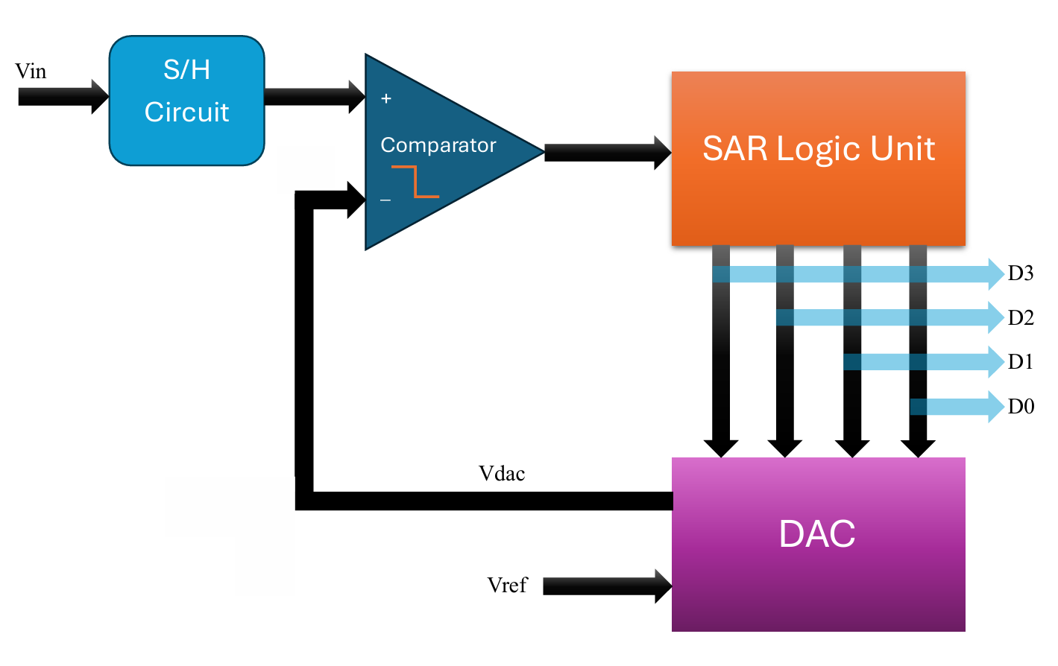
Block Diagram: Successive Approximation Register ADC

Slide 8
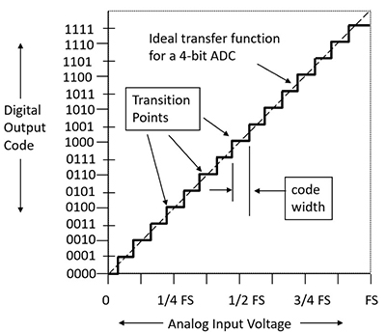
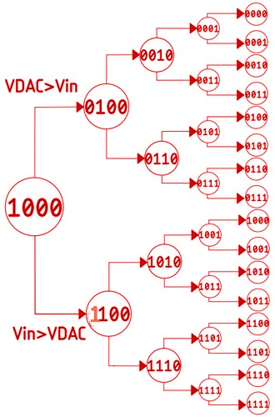
Software Used: Cadence Virtuoso Tool
Successive Approximation Register (SAR) ADC Working

Slide 9
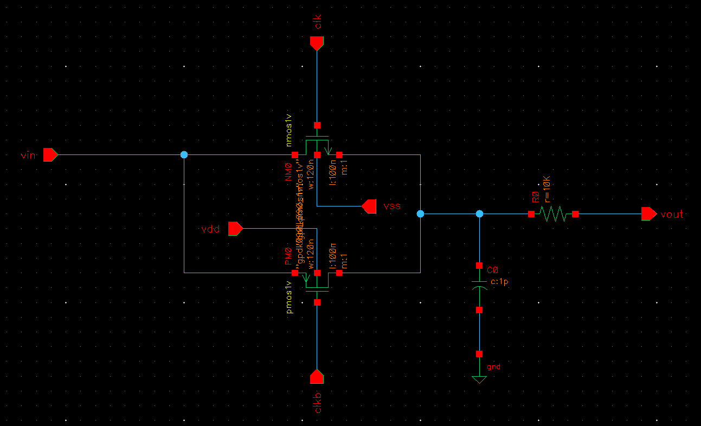
Sample and Hold Circuit (Schematic)

Slide 10
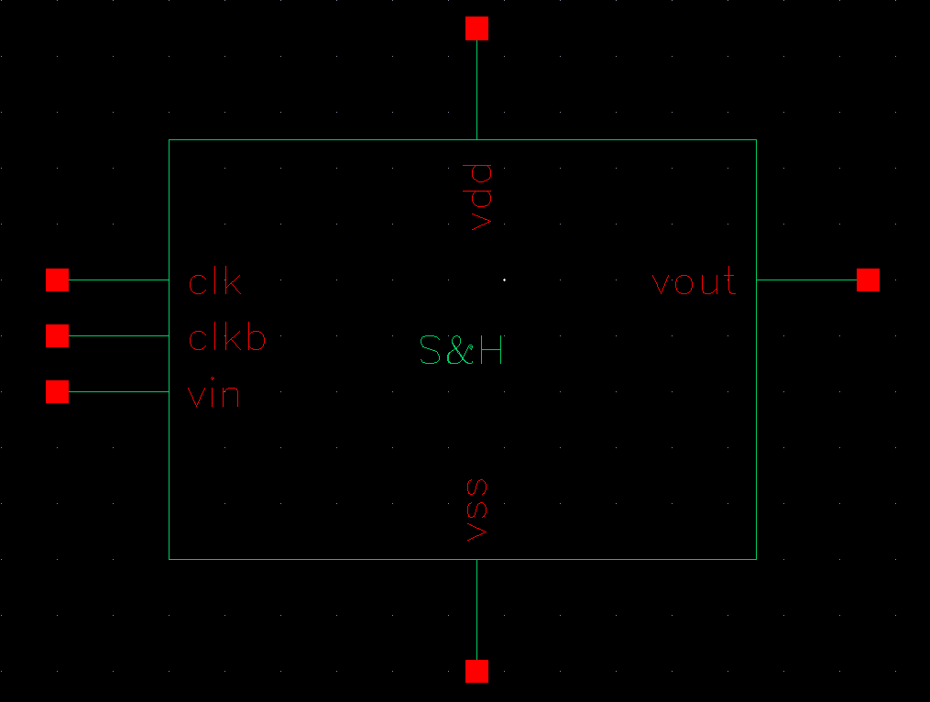
Sample and Hold Circuit (Symbol)

Slide 11
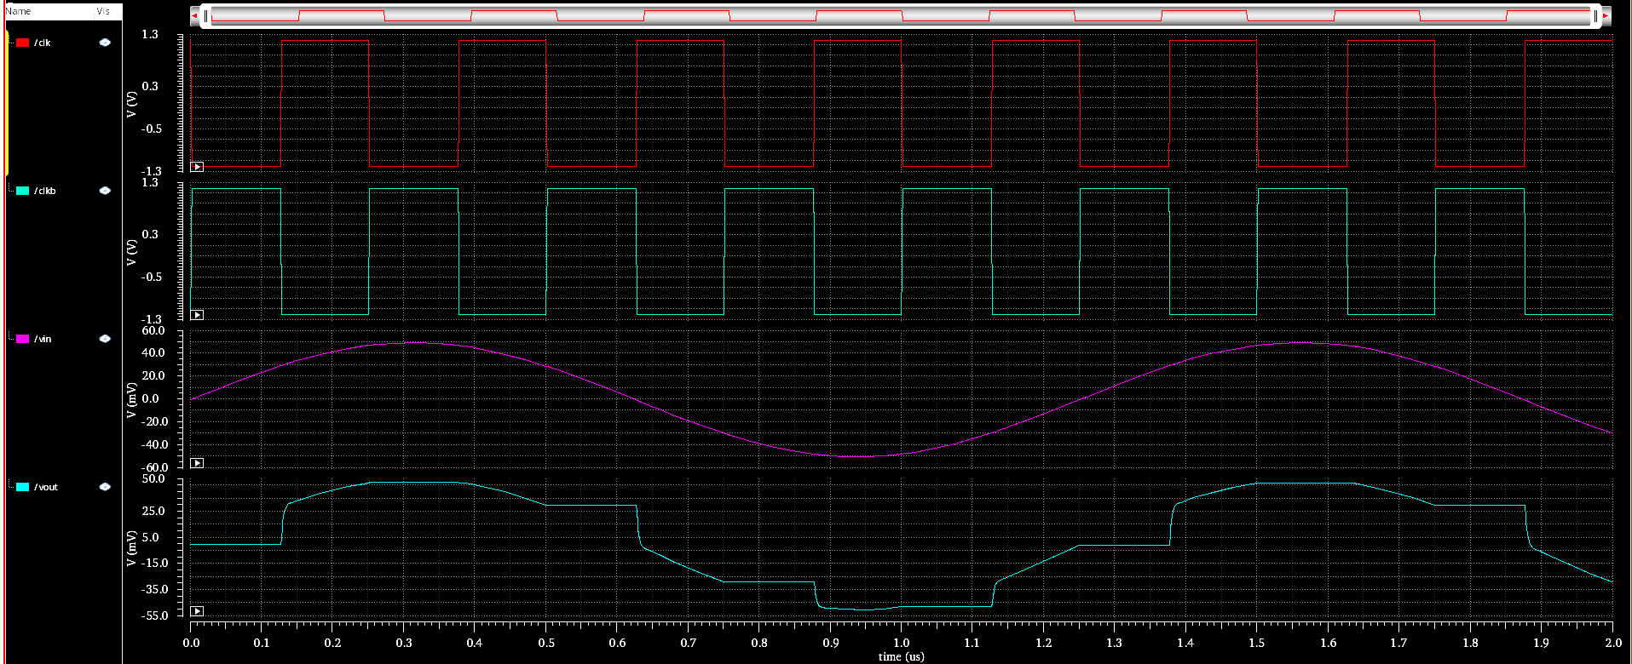
Sample and Hold Circuit (Simulation)

Slide 12
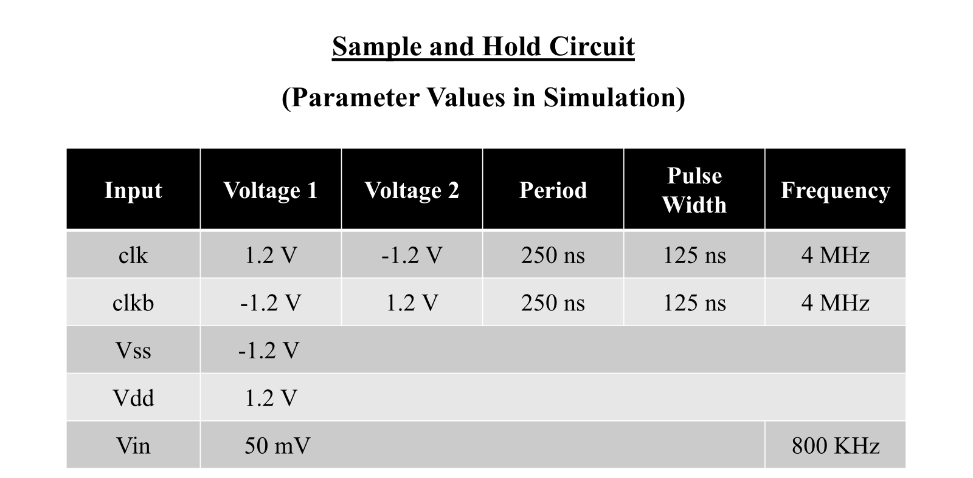

Slide 13
Gantt Chart
Tasks | Aug |  | Sept |  | Oct |  | Nov |  | Dec |  | Jan |  | Feb |  | Mar |  | Apr
Project Planning
S&H Circuit Design
Comparator Design
SAR Logic Design
DAC Unit Design
Interconnection of Blocks
Final Testing and Simulation
Report Writing

Slide 14
References
Kiran Kumar Mandrumaka; Fazal Noorbasha, “A low power 10 bit SAR ADC with variable threshold technique for biomedical applications” in Department of ECE, Koneru Lakshmaiah Education Foundation, Vaddeswaram, Guntur, A.P., SN Applied Sciences Springer Journal, Volume 1, article number 918, 2019
Suva Banik; M.M.H Rasel; Tanjir Mahmud; Md. Hasanuzzaman, “Design and implementation of a low-power 1V, 77.26µW 6-bit SAR ADC in Cadence 90nm CMOS process for biomedical application” in 2020 IEEE Region 10 Symposium (TENSYMP), 2020
Maxwell Kazuki Fukada, “Signal ADC Converter Simulation on Cadence Virtuoso for Audio Applications” in a Thesis at Electrical Engineering Department, California Polytechnic State University, San Luis Obispo, 2022

