Slide 1

Hotel Booking
TEAM MEMBERS
RIYA CHOUDHARI
SAHANA VITTAL
SAMBHAV JAIN
SOURABH GOMARE
SHAKIL E S
THANISHQ MADDI

Slide 2

PROBLEM STATEMENT
Digitalizing the Room Booking of a Hotel through a web application.

Slide 3

DESIGN
Book the Room Available
Booking Page
USER​
Thank You
Payment

Slide 4
DESIGN
Add Rooms/Delete Room
LOGIN
Book the Room
ADMIN​
Add Admin

Slide 5
TECHNOLOGIES USED
BACKEND:
PHP
MYSQL
AMAZON WEB SERVICE
FRONTEND:
HTML
CSS
JAVASCRIPT

Slide 6
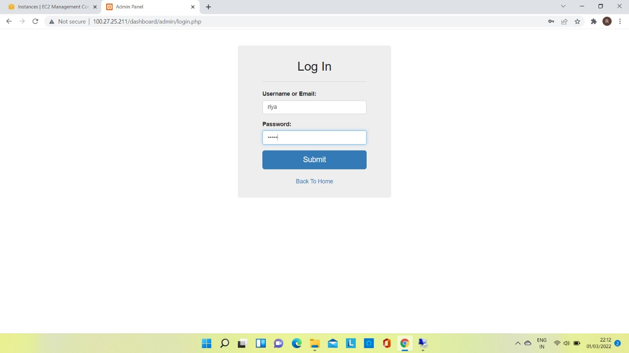
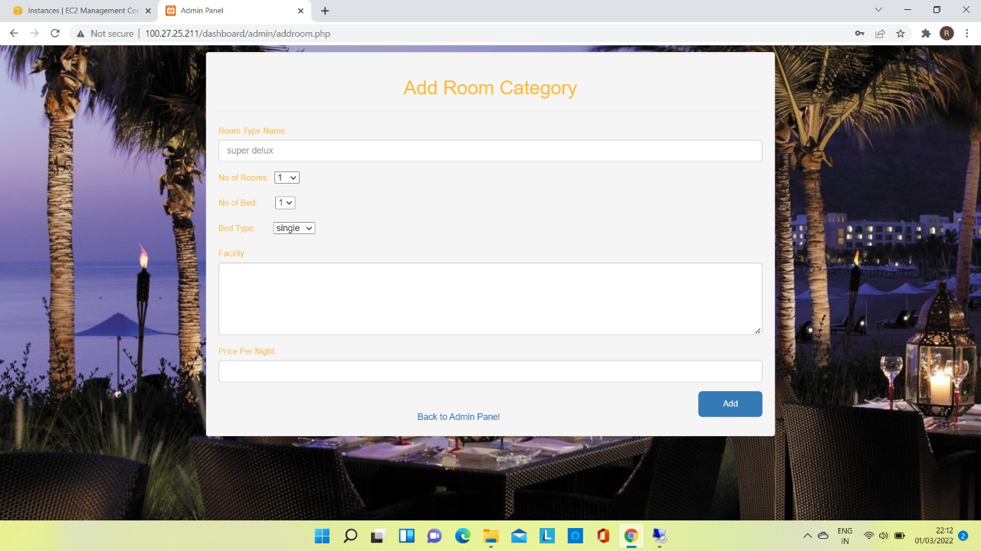
RESULT

Slide 7
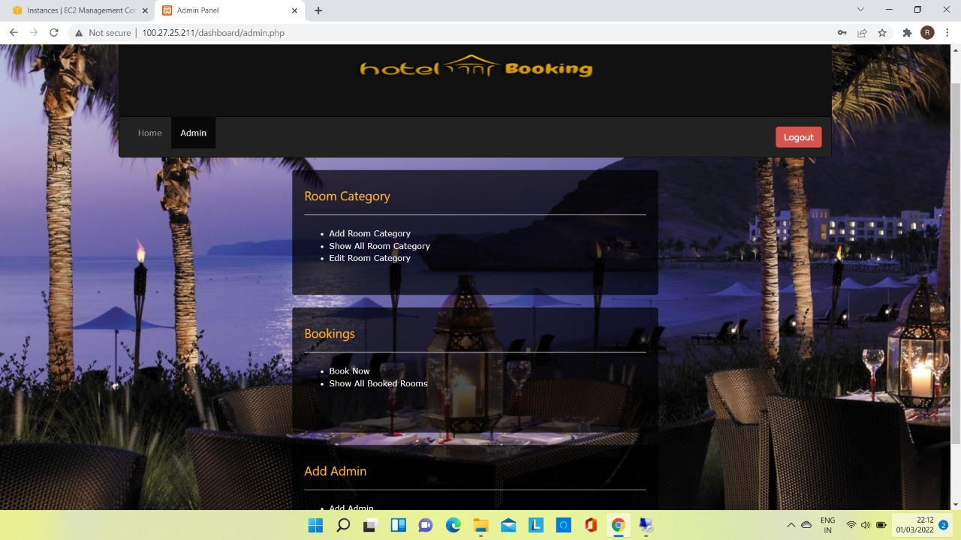

Slide 8
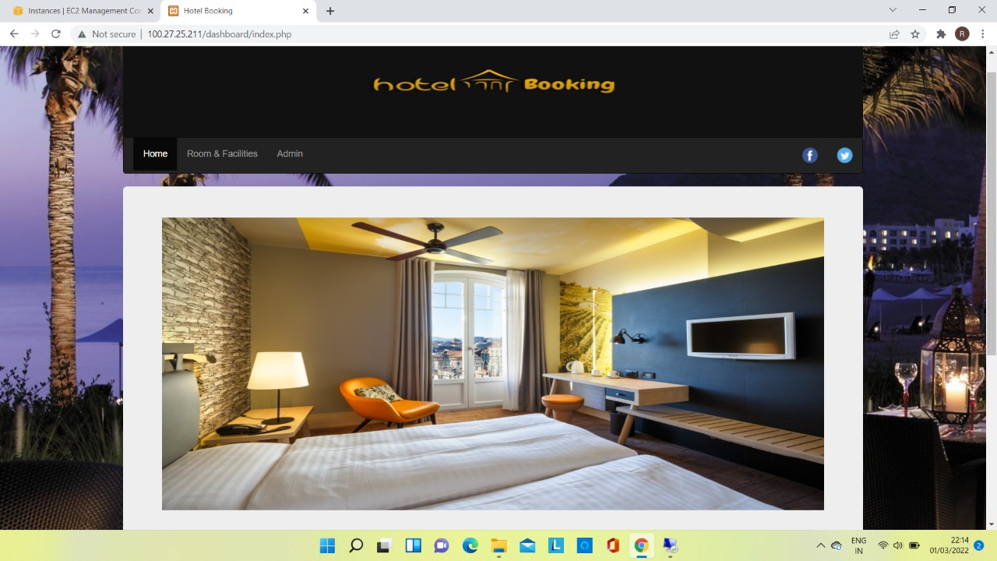
RESULT

Slide 9
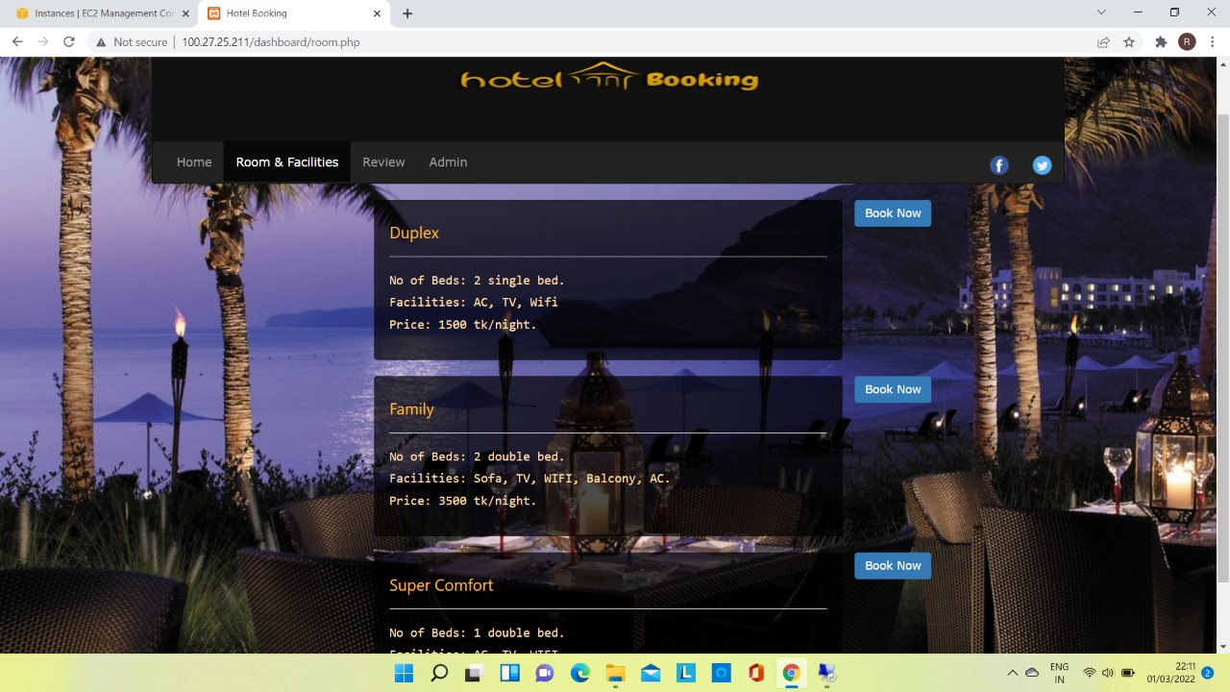

Slide 10
Future Enhancement
Make it more User Friendly
Real time authentication
Make the website more secure

