Slide 1
ZIPPY
SAMBIT KUMAR PADHY

Slide 2
CONTENTS
What is “ZIPPY” ?
Motivation
Existing Applications
Technologies Used
How “ZIPPY” works ?
Conclusion

Slide 3
WHAT IS “ZIPPY” ?
ZIPPY is a peer-to-peer (P2P) application
It enables users to text chat, place audio calls and share files.
No external servers required
Supports cross platform systems

Slide 4
CONTENTS
What is “ZIPPY” ?
Motivation
Existing Applications
Technologies Used
How “ZIPPY” works ?
Conclusion

Slide 5
MOTIVATION
Availability of VOIP applications
Internet Dependent
Wastage of Internet bandwidth
Delay increases

Slide 6
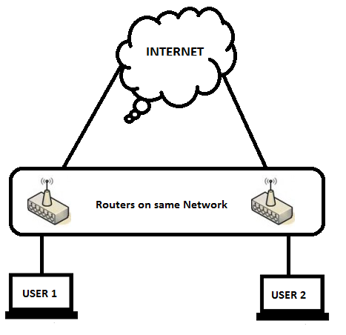

Slide 7
CONTENTS
What is “ZIPPY” ?
Motivation
Existing Applications
Technologies Used
How “ZIPPY” works ?
Conclusion

Slide 8
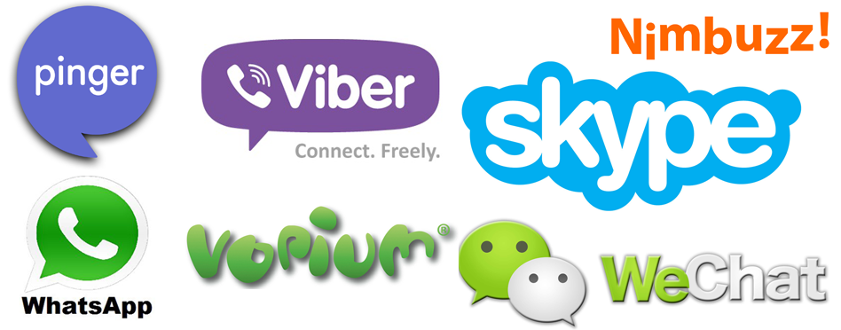
EXISTING APPLICATIONS

Slide 9
CONTENTS
What is “ZIPPY” ?
Motivation
Existing Applications
Technologies Used
How “ZIPPY” works ?
Conclusion

Slide 10
TECHNOLOGIES USED
JAVA Socket Programming
JAVA Swing
Eclipse

Slide 11
CONTENTS
What is “ZIPPY” ?
Motivation
Existing Applications
Technologies Used
How “ZIPPY” works ?
Conclusion

Slide 12
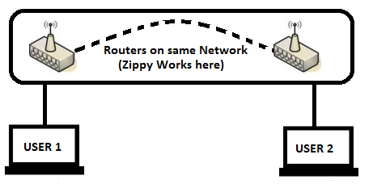
WHERE ZIPPY WORKS ?

Slide 13
HOW ZIPPY WORKS ?
User 1 sends request and user 2 confirms request
User 1 or 2 selects the mode of operation
Text chat
Audio call
File transfer
User 1 or 2 terminate the connection

Slide 14
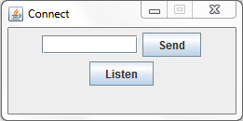
CONNECTION
172.17.8.176

Slide 15
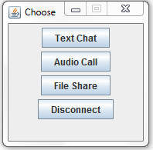
OPERATION SELECTION

Slide 16
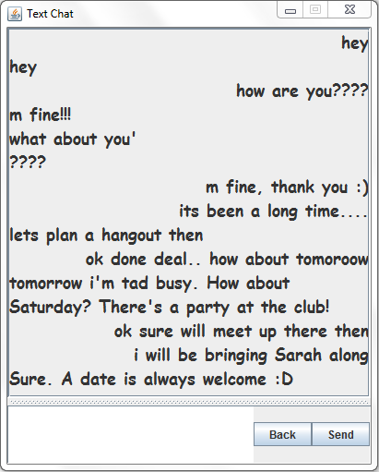
TEXT CHAT

Slide 17
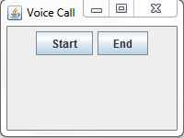
AUDIO CALL

Slide 18
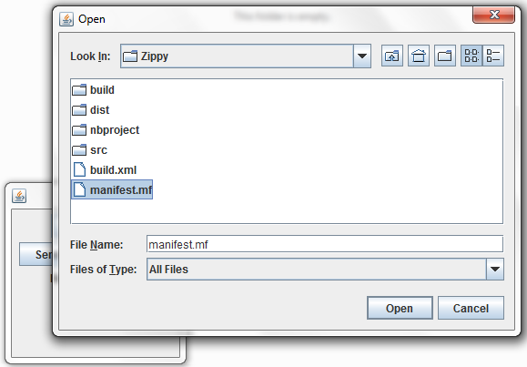
FILE TRANSFER

Slide 19
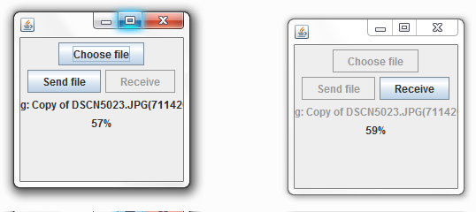
FILE TRANSFER (CONTD…)

Slide 20
CONTENTS
What is “ZIPPY” ?
Motivation
Existing Applications
Technologies Used
How “ZIPPY” works ?
Conclusion

Slide 21
THANK YOU!!

