Slide 1

VIRTUAL PERSONAL ASSISTANT (VPA) J.A.R.V.I.S.
PRESENTED BY:-
MASTER SAMBIT KUMAR SAHU
REGN. NO.:- 202121107
GUIDED BY:-
DR. SANJIBANI SUDHA PATTANAYAK
DR. RASMI RANJAN PATRA

Slide 2
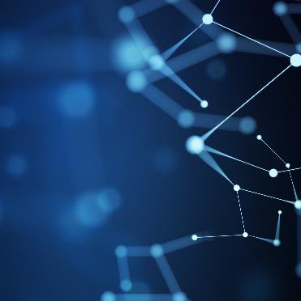
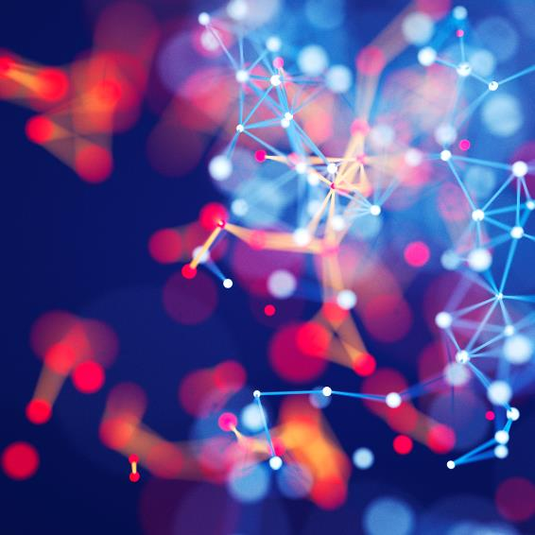

Agenda
Introduction
11. Objective
11-(a). Basic Concepts Used
111. Architectural Model
1V. Working Principles
V. Practical Demonstration
V. Benefits and Drawbacks
VI. Future Scope
VII. Summary

Slide 3

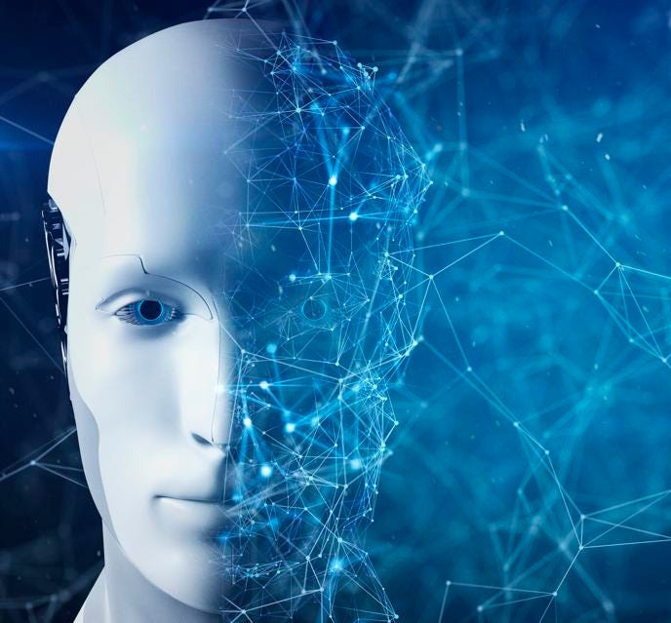

Introduction
Virtual Assistants are software programs that help you ease your day-to-day tasks, such as showing weather report, providing news, opening apps, and many more. They can take command via voice. This system is designed to be used efficiently on desktops. Personal assistant software improves user productivity by managing routine tasks of the user and by providing information from online sources within seconds, to the user.

Slide 4

Objective
The project aims to develop a personal-assistant for desktop. JARVIS draws its inspiration from virtual assistants like google assistant for android, and Siri for iOS. It has been designed to provide a user-friendly interface for carrying out a variety of tasks by employing certain well-defined commands. JARVIS assists the end user with day-to-day activities like general human conservation, searching queries in google, searching for videos, live weather conditions and so on.

Slide 5

Basic Concepts
The working of Virtual Assistant uses following principles:
Natural Language Processing – To understand user’s speech input.
Automatic Speech Recognition – To understand command according to user’s input.
Artificial Intelligence – To learn things and to store all information
Inter Process Communication – To get information from other software applications.

Slide 6
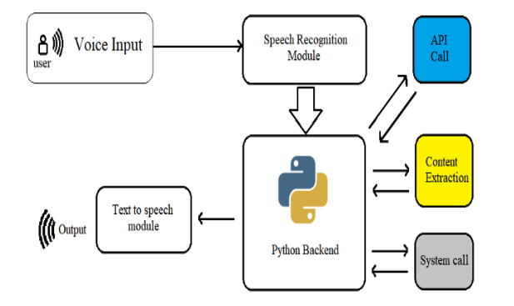
Architectural Layout

Slide 7
Working Principles
Speech to Text – Python Speech Recognition Module (speechrecognition) used that converts audio to text. Few other packages like PyAudio, pyttsx3 are taken into consideration.
Text Analyzing – Maps the words to functions and parameters to create a command that computer can understand. Best known python package being NLTK.
Interpret Commands – Your speech evaluated locally, check weather command will be best handle locally or not.

Slide 8
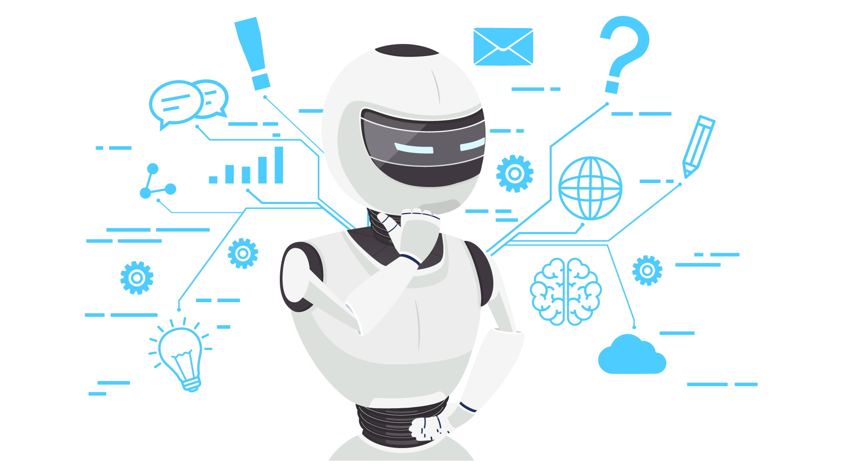
THE WORLD NEEDS DEMONSTRATION MORE THAN IT NEEDS TEACHING.
WALLACE D. WATTLES

Slide 9
Benefits & Drawbacks
Benefits:-
Drawbacks:-
Recognizes voice commands.
Control various applications of device.
Saves time by automating repetitive tasks.
These application make device to combine multiple features.
Provides services.
Listening Problem
Silent Mode Support
Navigation languages
Internet Access

Slide 10
Future Scope
Strip back the physical hardware as far as possible.
With the intelligence of the Virtual Personal Assistant, getting pulled in, and pushing its way into our lives on multiple devices on our bodies and in our homes, workplaces and vehicles.
Your Virtual Personal Assistant will be continually prompting you with suggestions and taking instructions, and will know more about you than perhaps you do yourself.
We can expect this device to be implanted and permanent.

Slide 11

Summary
Virtual Personal Assistant are very effective way to organize schedule. There are many Smart Personal Digital Assistant available for various device platforms. VPAs are also reliable than Human Personal Assistant because, VPAs are more portable, and you can use them anytime. They also have lot of information than any assistant as they are connected with Internet.

Slide 12
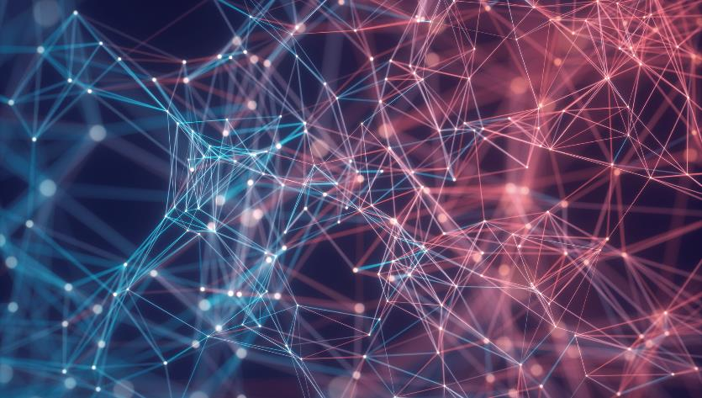
Thank You
Master Sambit Kumar Sahu
sambitkumarsahuofficial@gmail.com
www.watchoutsambit.wixsite.com/sambitsahuwebsite

