Slide 1
E-retail factors for customer activation and retention: A case study from Indian e-commerce customers
Prepared by,
Sampada Sambrani
Internship batch-34

Slide 2
Introduction
A case study from Indian e-commerce customers
Customer satisfaction is one of the most important factors that guarantee the success of online store
Five major factors that contributed to the success of an e-commerce store have been identified as:
service quality, system quality, information quality, trust and net benefit.
What percentage of people shop online , and how do they enjoy it
From the Indian cities , which part do the people shop online mostly ?
Does online shopping fulfil the needs and give satisfaction for the buyers ?
If yes , then which Indian retail store do the shoppers prefer ?

Slide 3
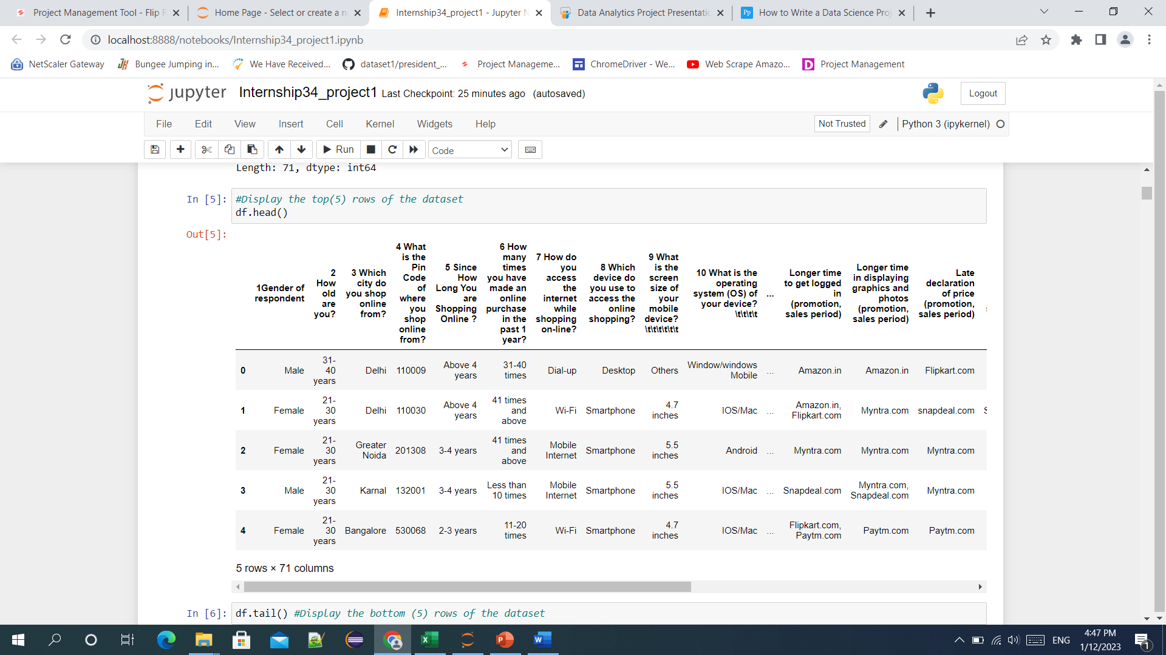
DataSet

Slide 4
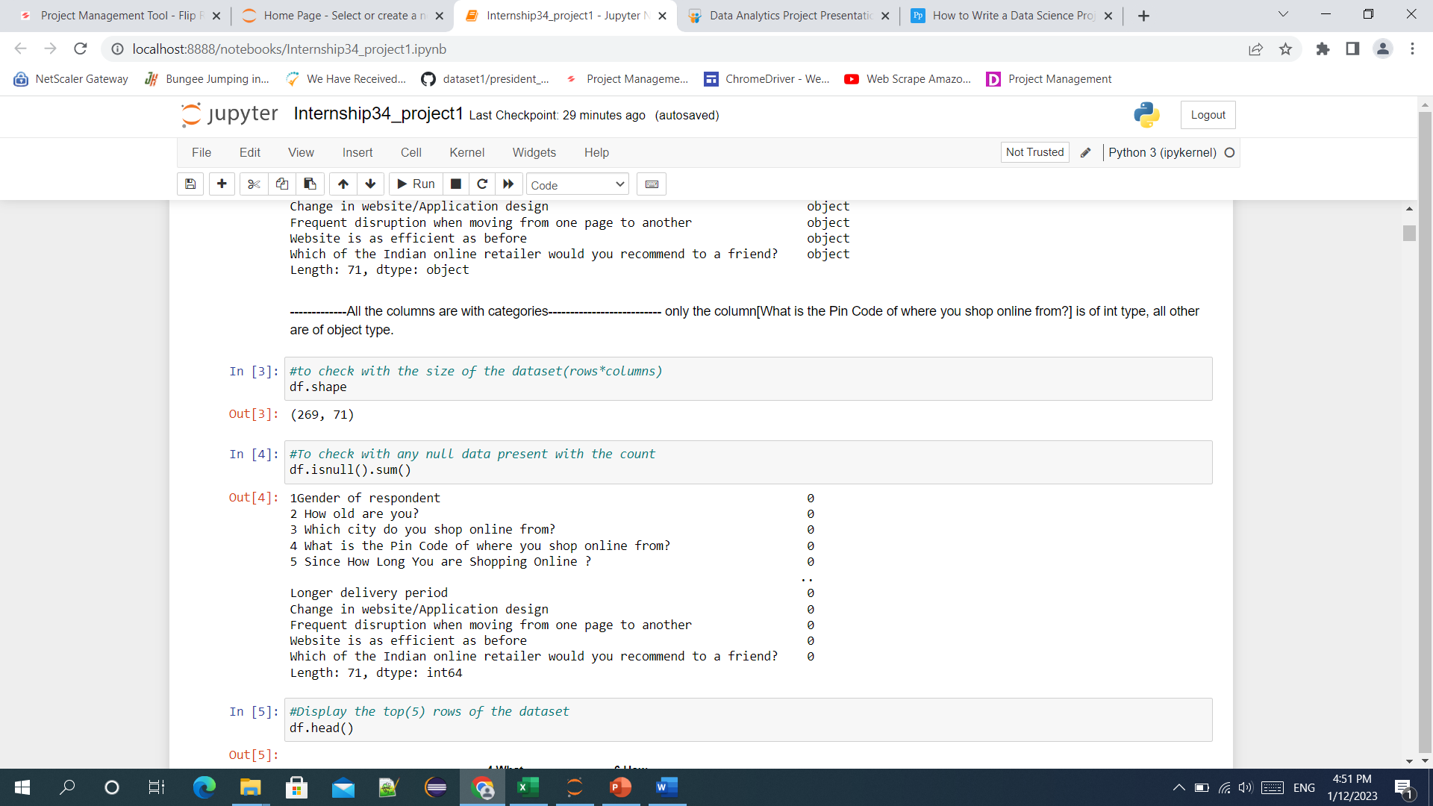
Check for missing values

Slide 5
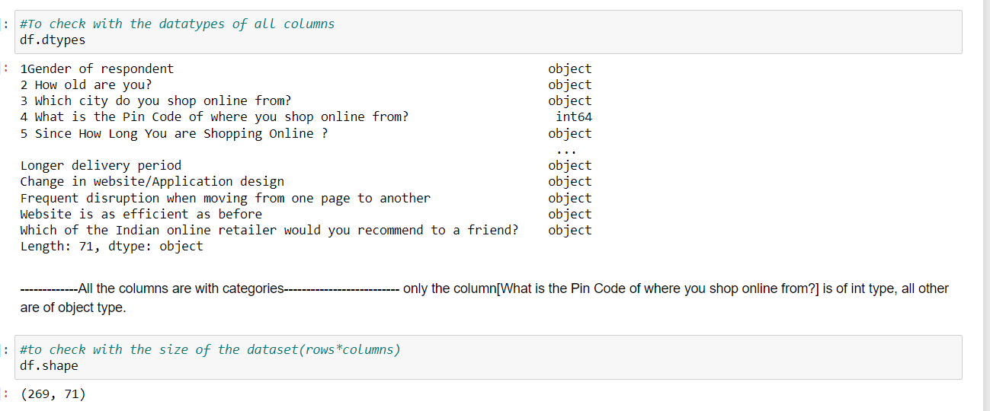
Check for the datatypes

Slide 6
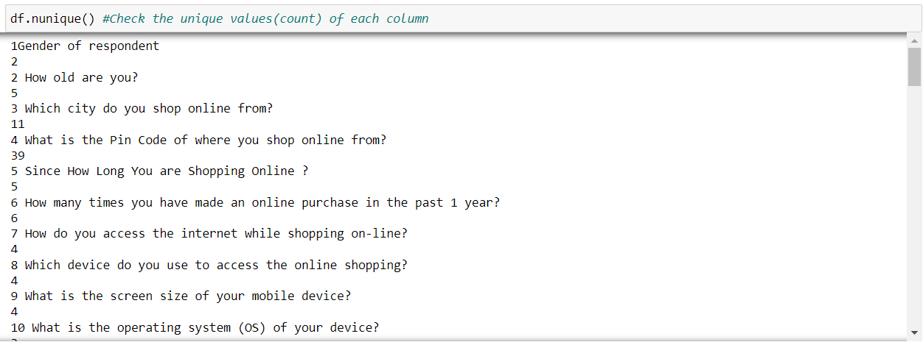
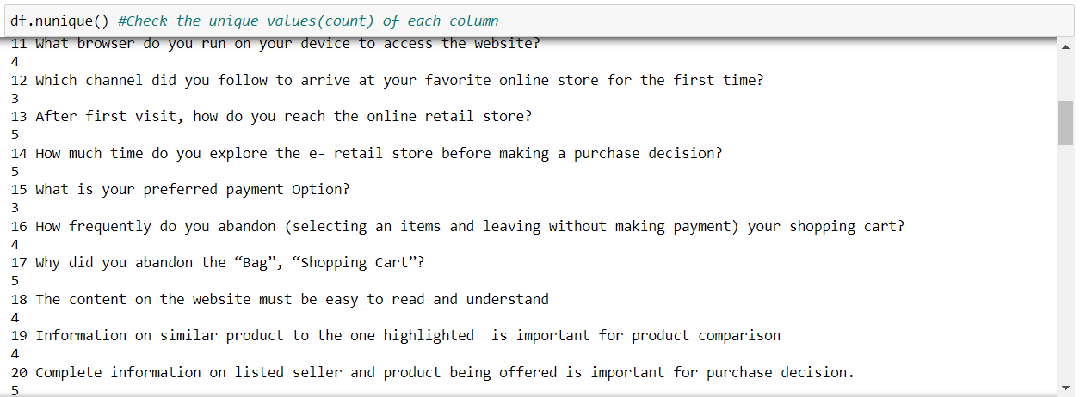
Checking with nunique values

Slide 7
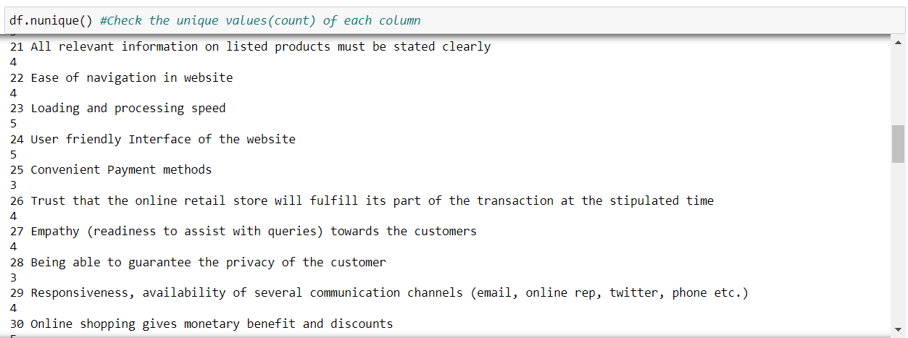
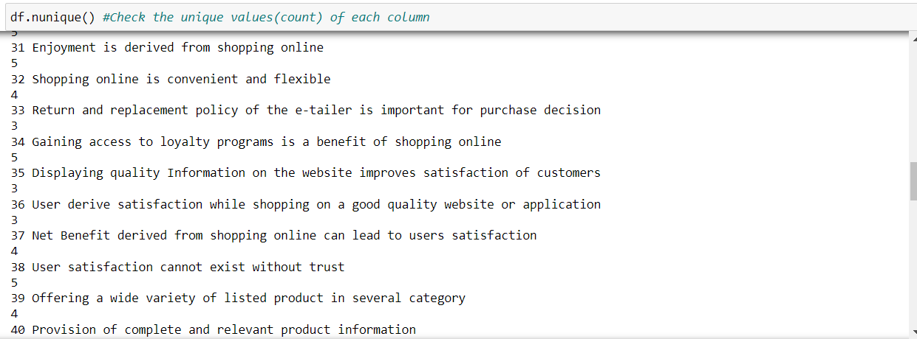
Checking with nunique values

Slide 8
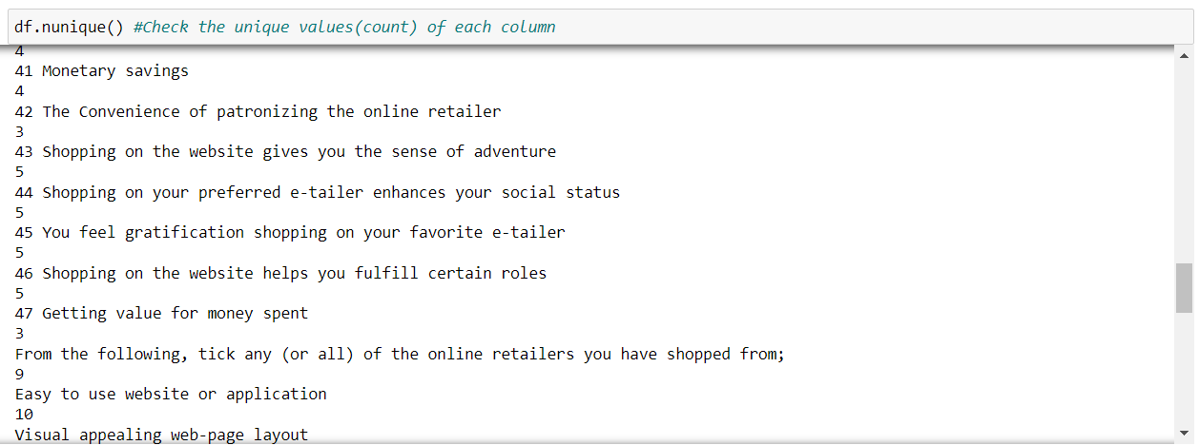
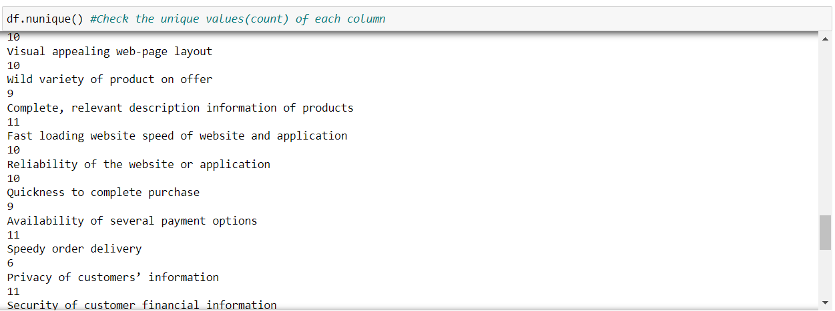
Checking with nunique values

Slide 9
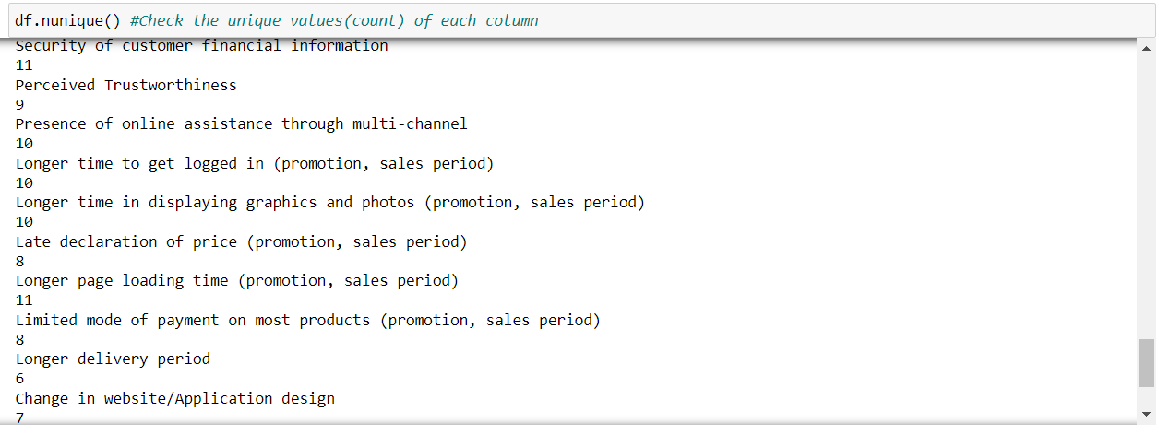
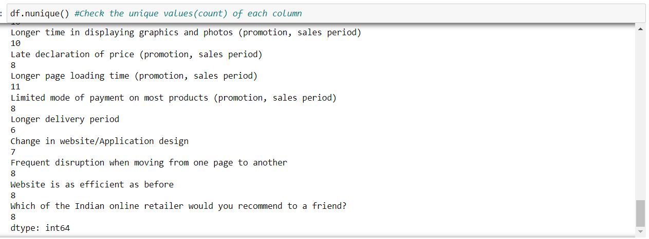
Checking with nunique values

Slide 10
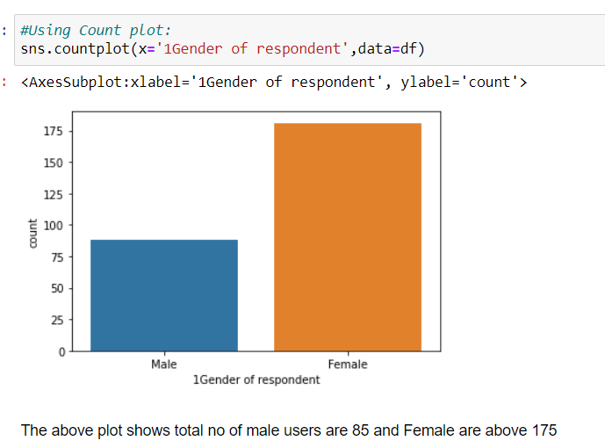
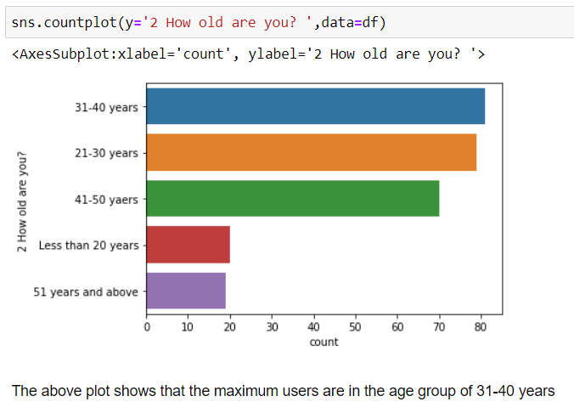
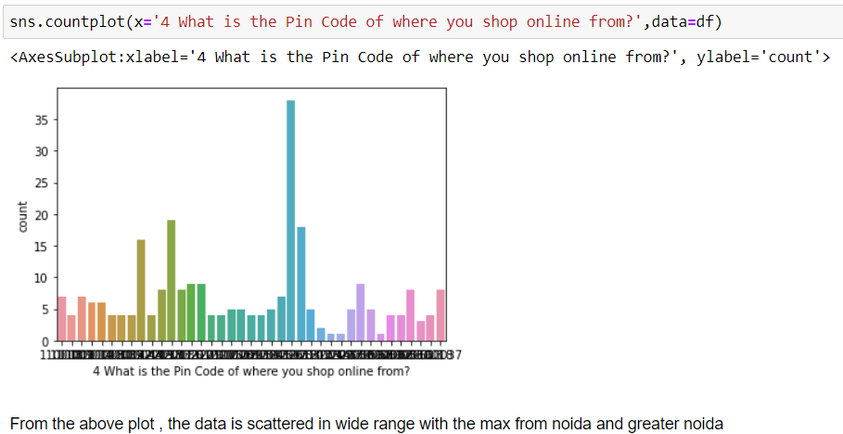
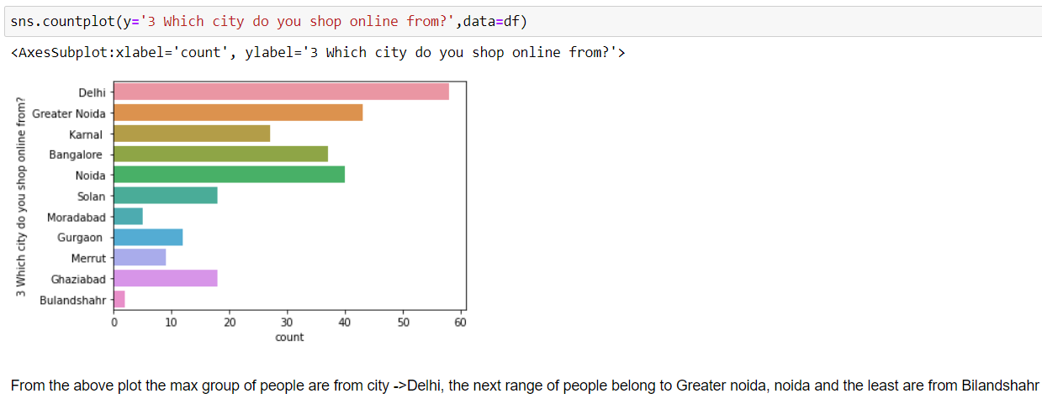
Data Visualization

Slide 11
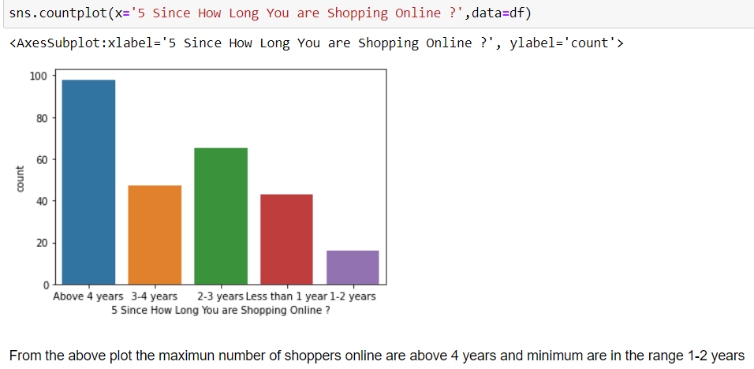
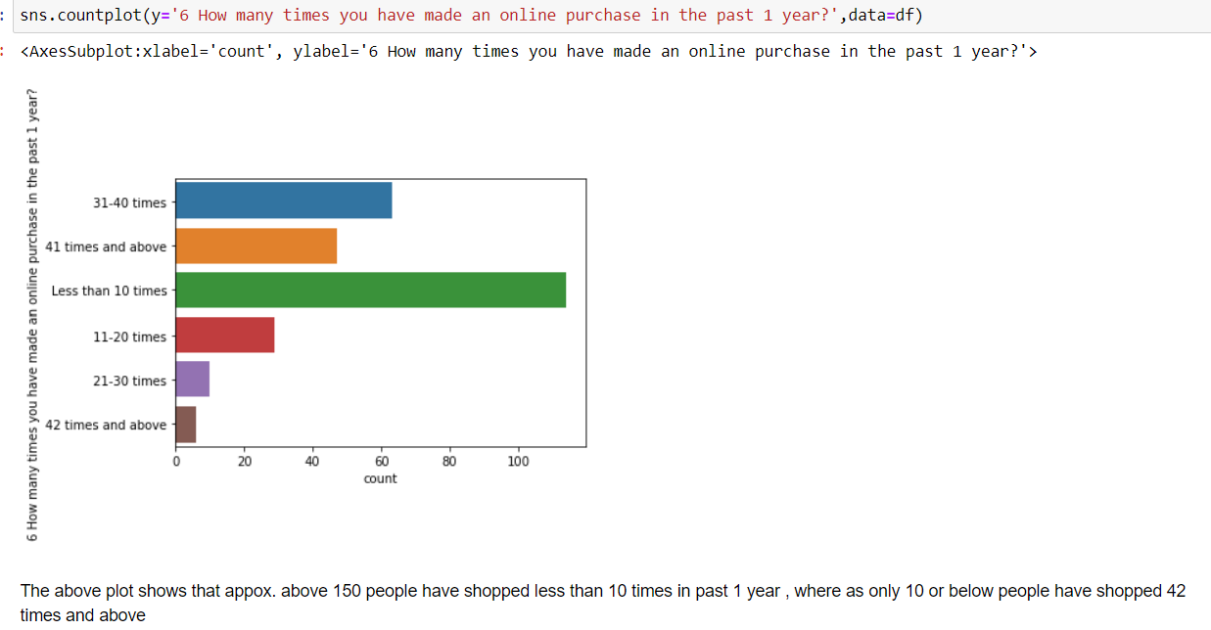
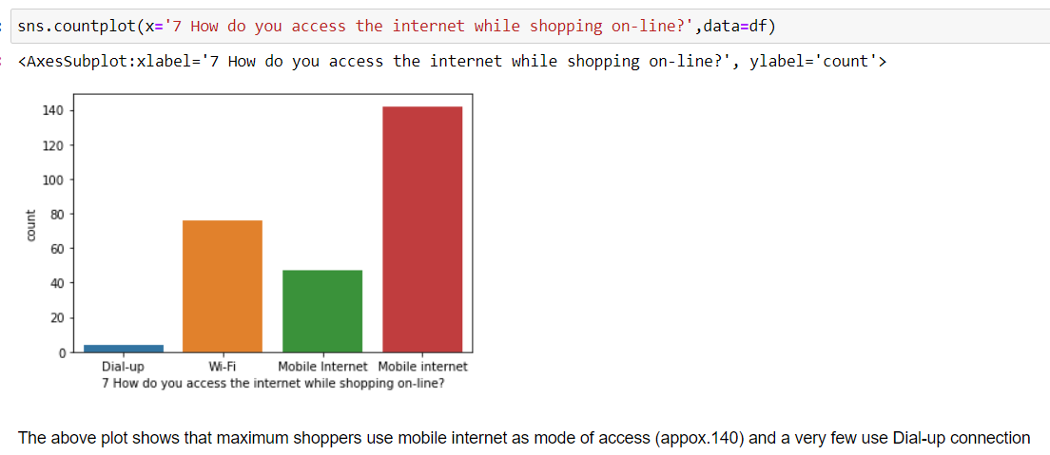
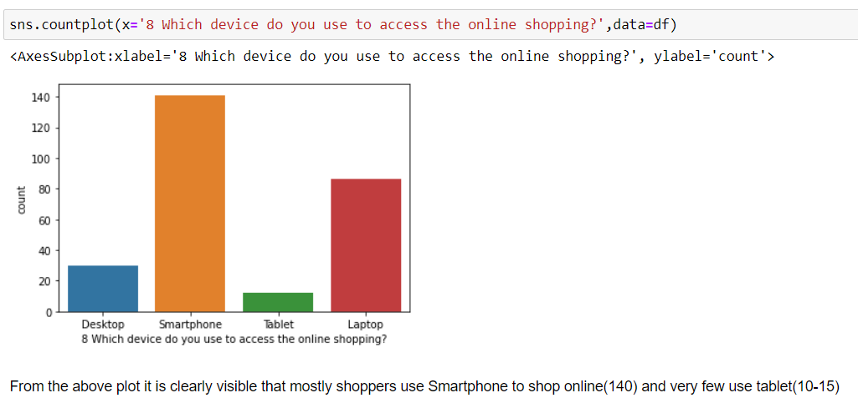
Data Visualization

Slide 12
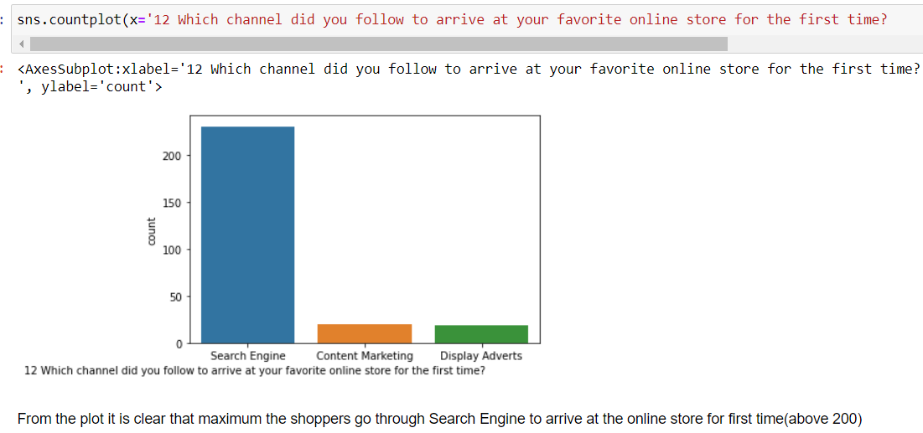
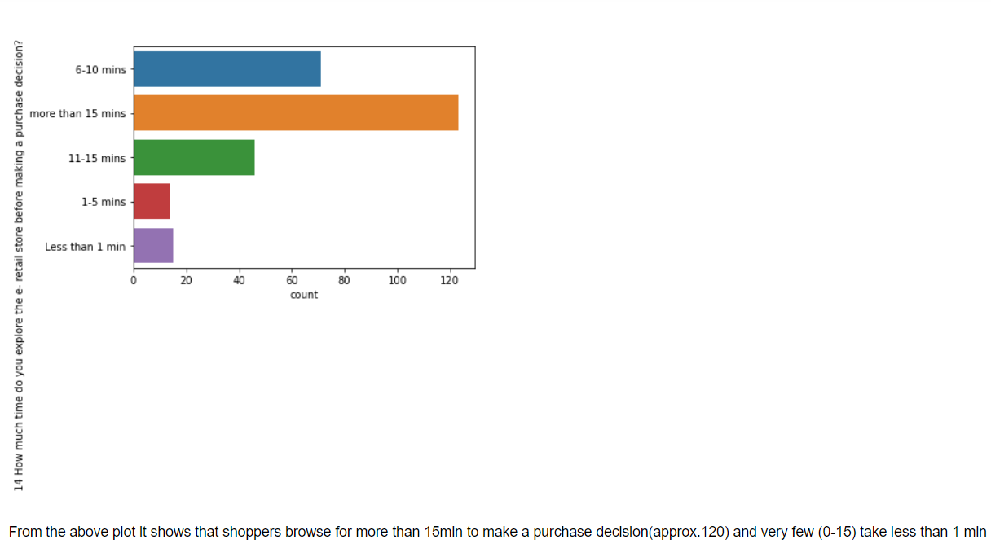
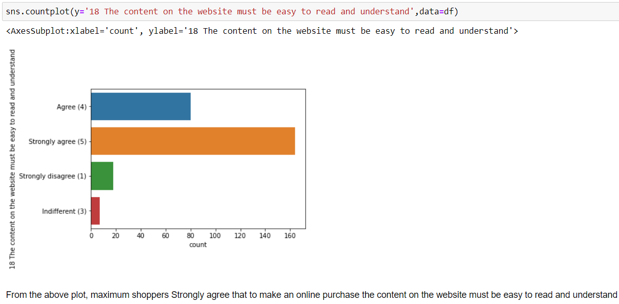
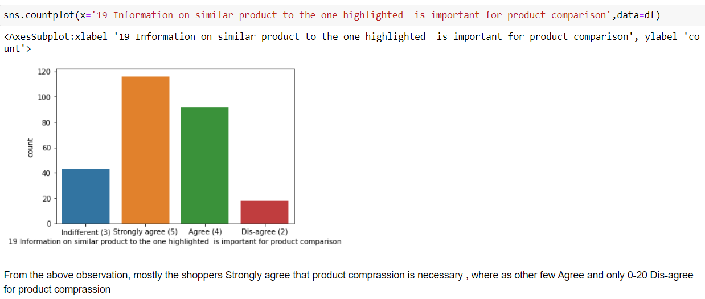
Data Visualization

Slide 13
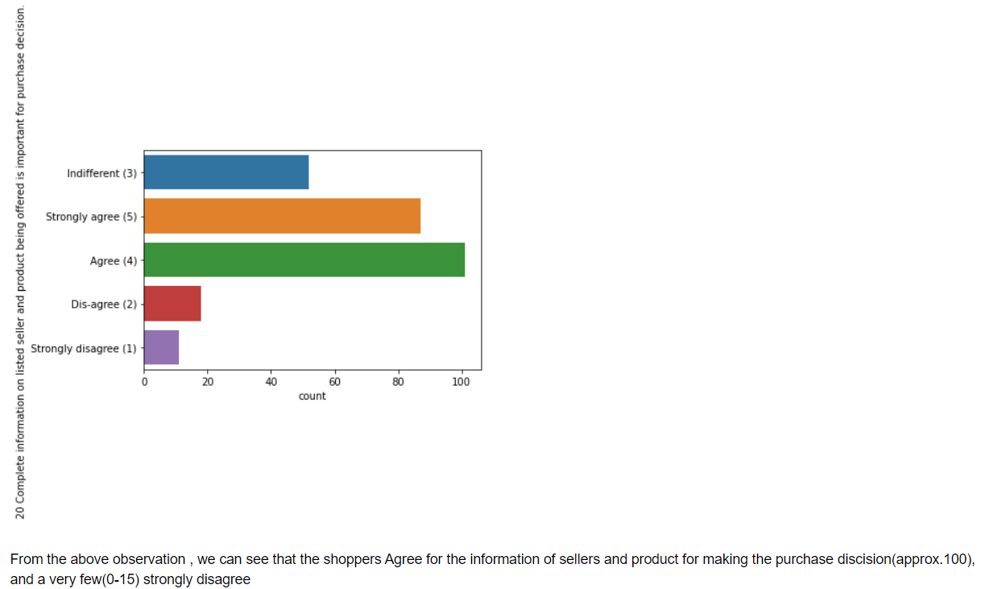
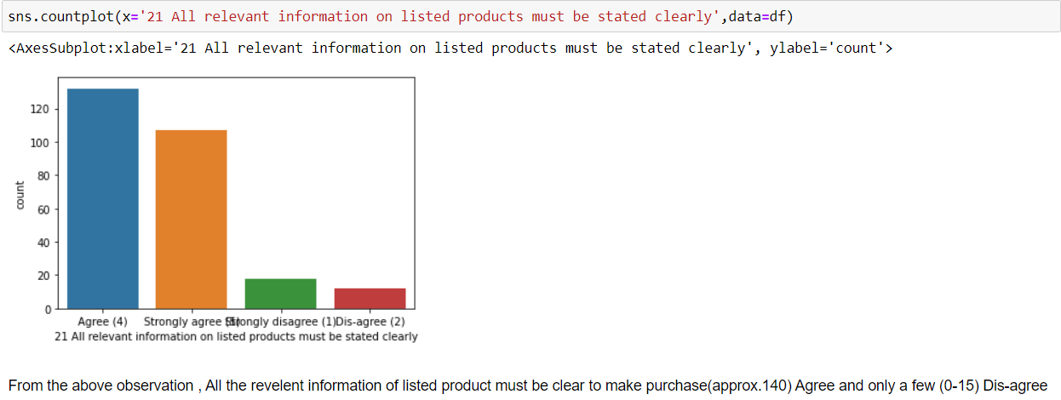
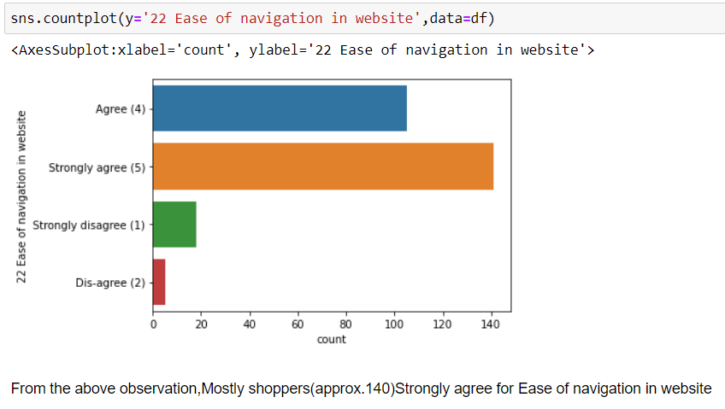
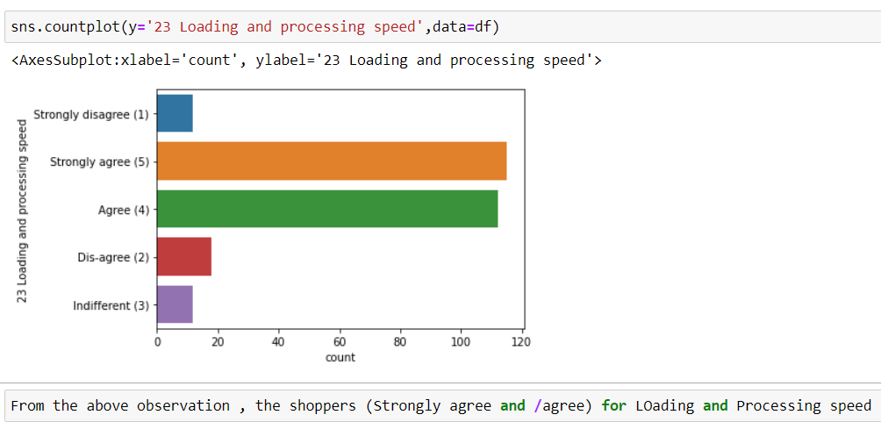
Data Visualization

Slide 14
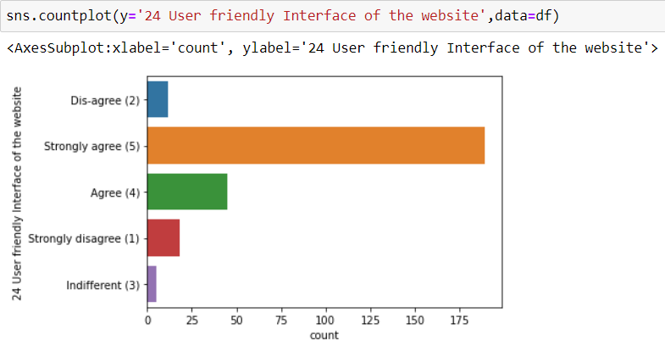
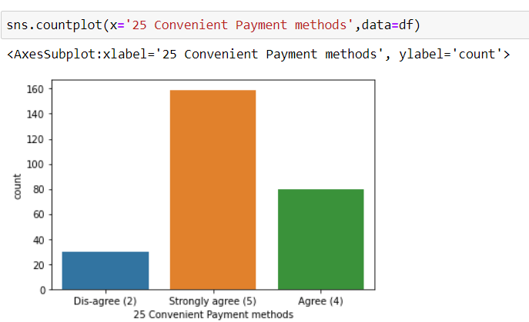
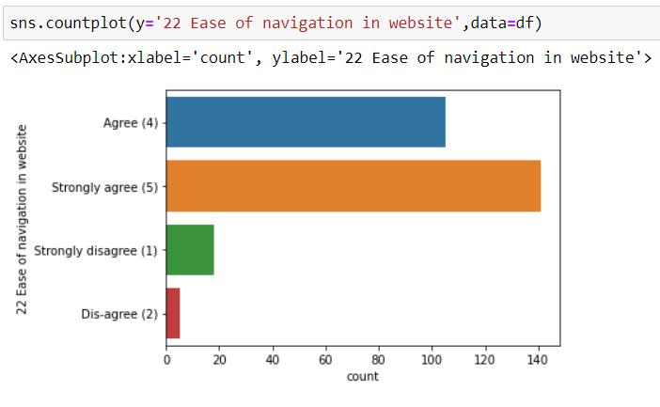
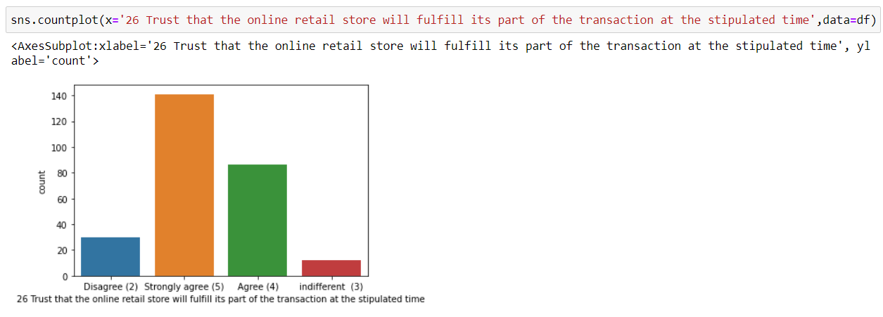
Data Visualization

Slide 15
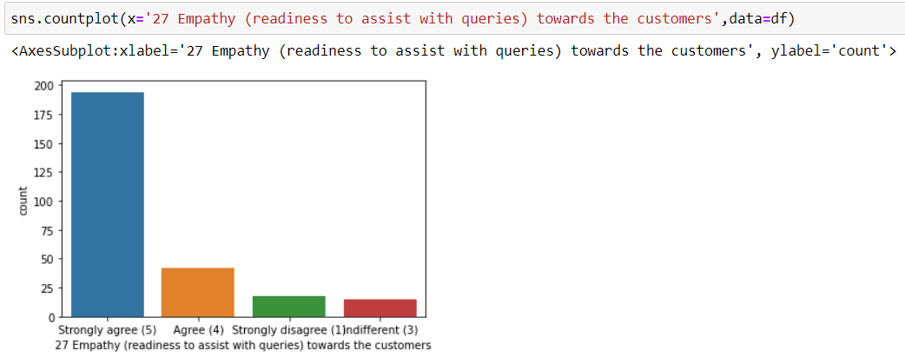
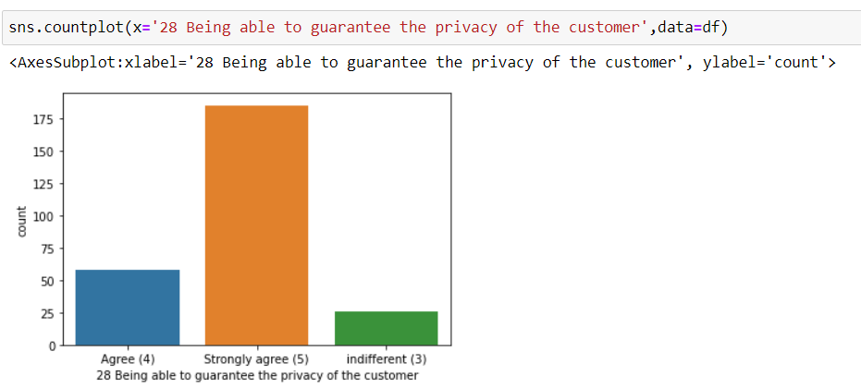
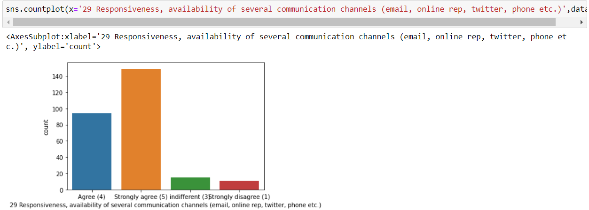
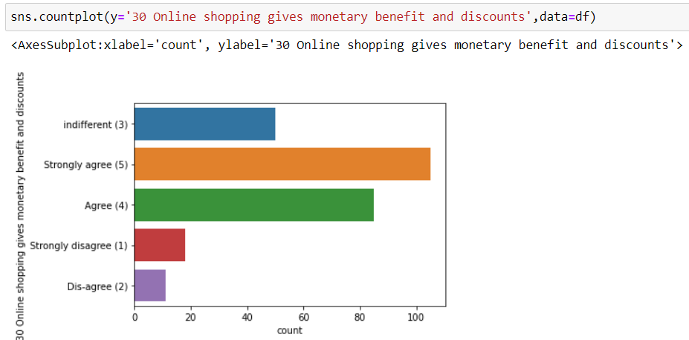
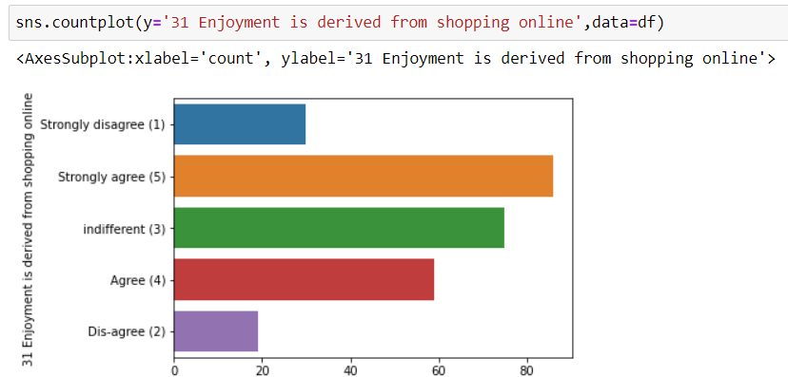
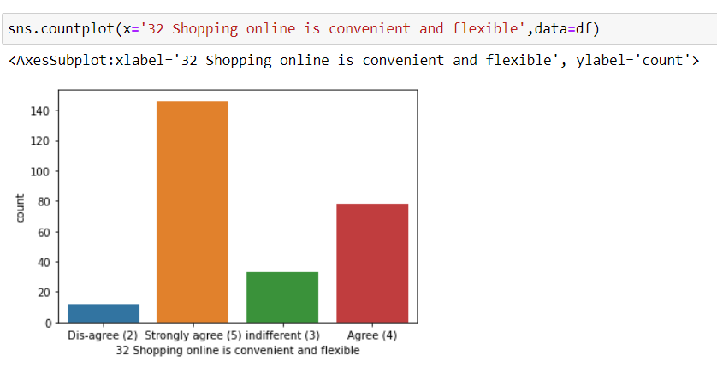
Data Visualization

Slide 16
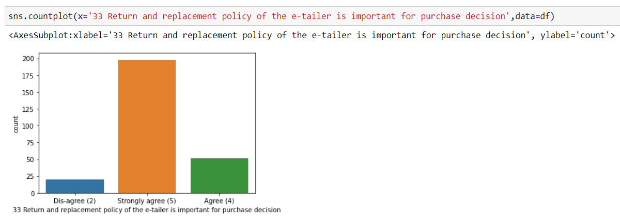
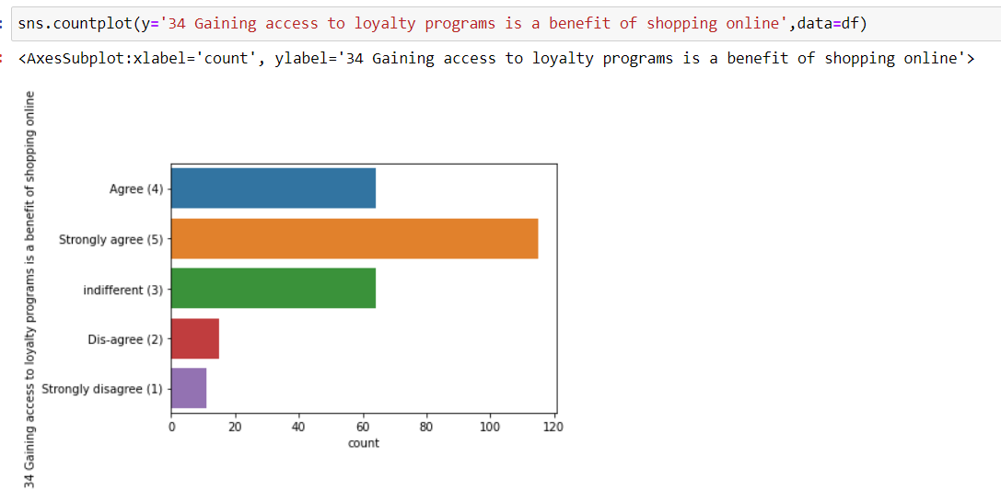
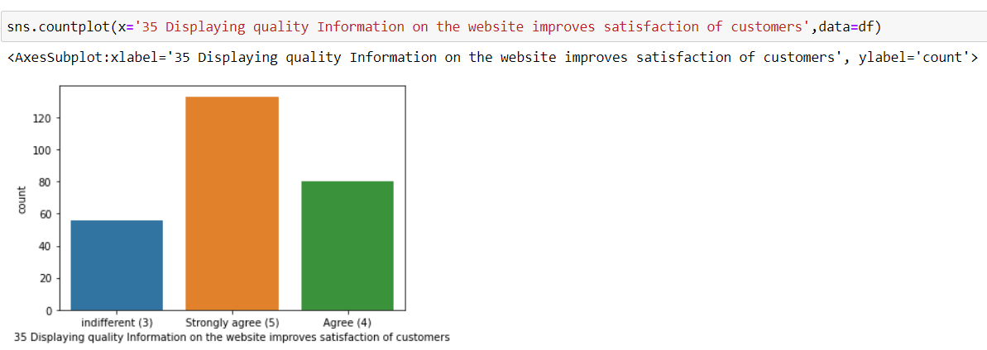
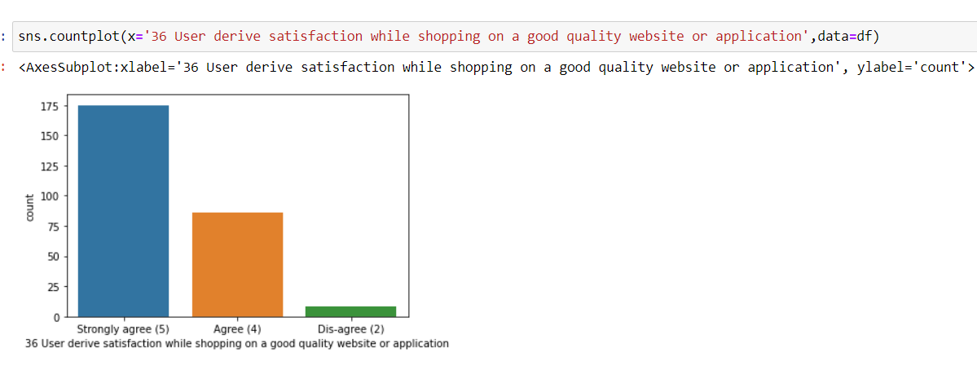
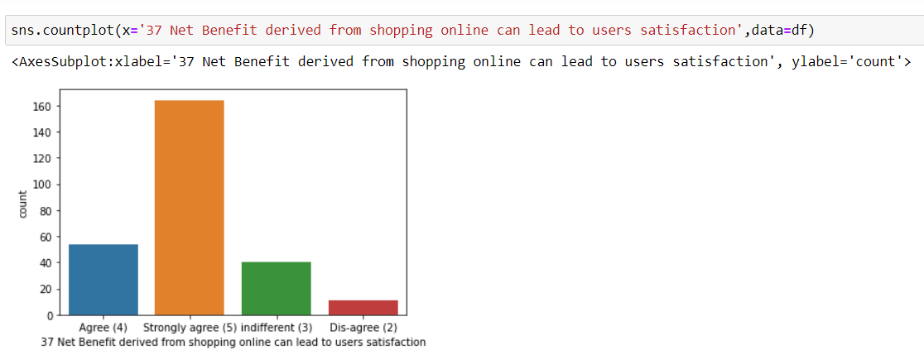
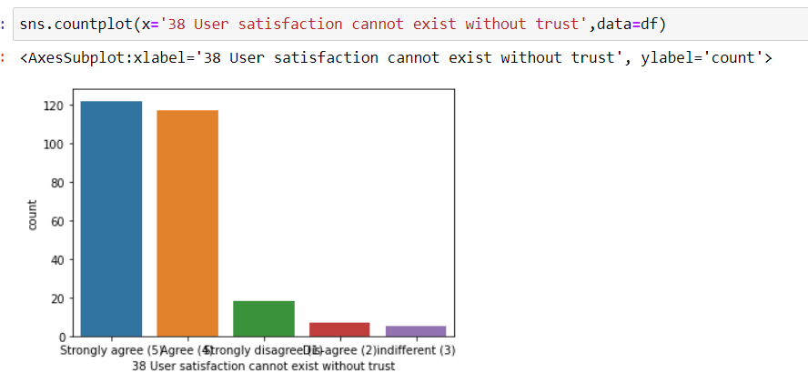
Data Visualization

Slide 17
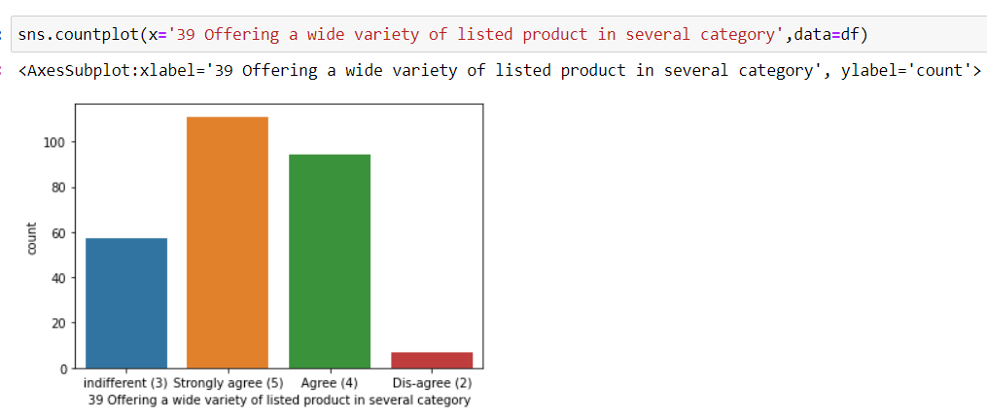
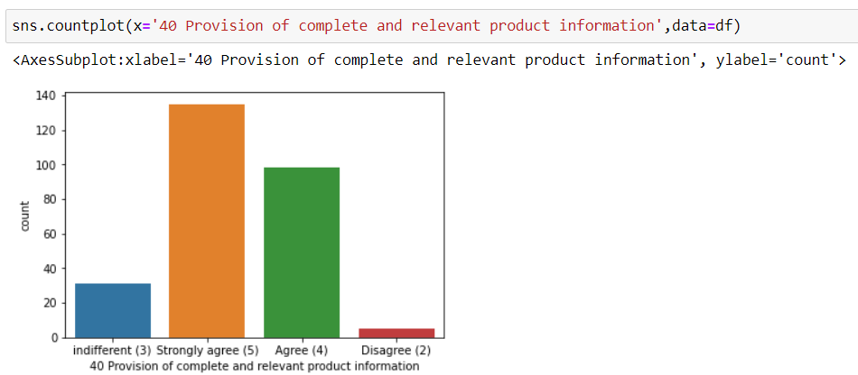
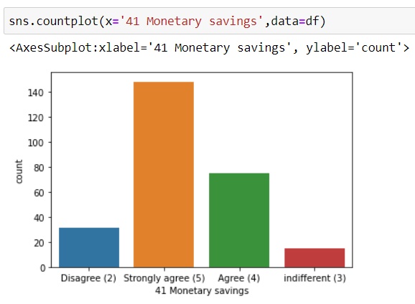
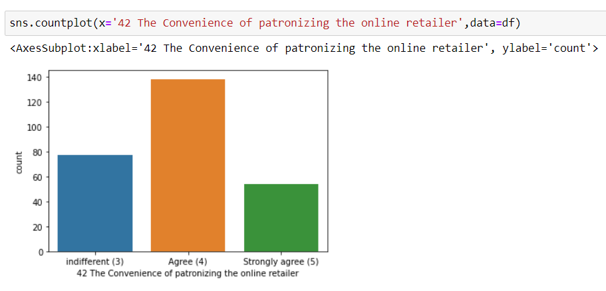
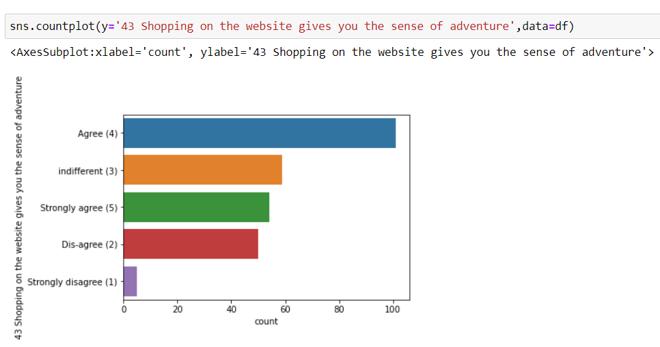
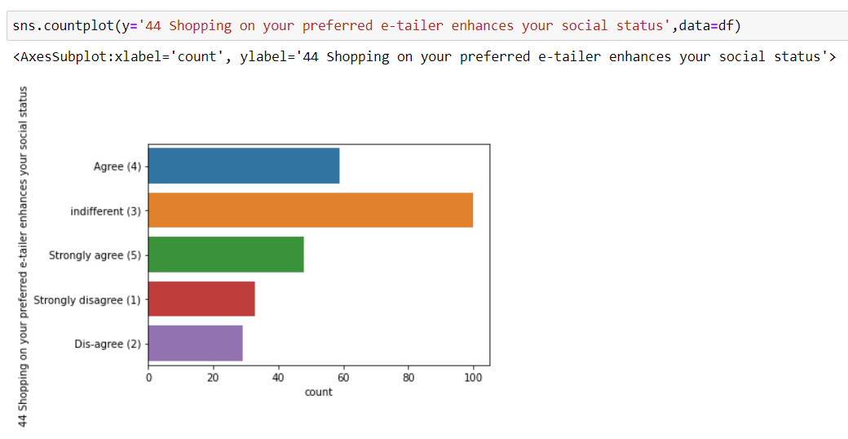
Data Visualization

Slide 18
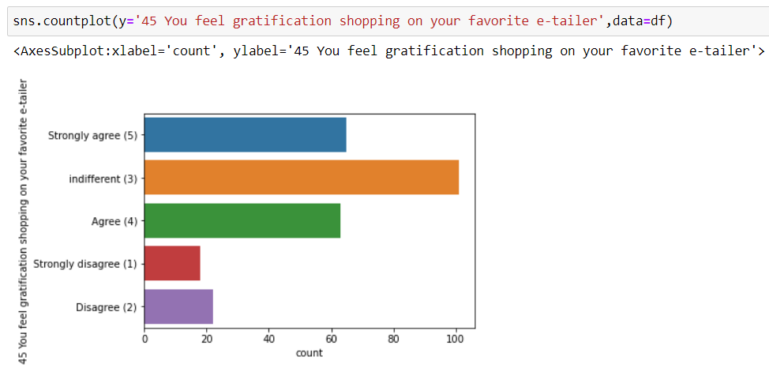





Data Visualization

Slide 19






Data Visualization

Slide 20






Data Visualization

Slide 21






Data Visualization

Slide 22



Data Visualization

Slide 23
From the observations , we can see that there are very less outliers present in the columns such as –
4 What is the Pin Code of where you shop online from?,
7 How do you access the internet while shopping on-line?
24 User friendly Interface of the website 27 Empathy (readiness to assist with queries) towards the customers
28 Being able to guarantee the privacy of the customer
29 Responsiveness, availability of several communication channels (email, online rep, twitter, phone etc.)
37 Net Benefit derived from shopping online can lead to users satisfaction
Result --When the outliers are present in categorical columns , then we do not remove them

Slide 24
To check the Skewness-- acceptable range is -0.5 to +0.5
df.skew()
From the result the columns with high skewness are:
1Gender of respondent ,
2 How old are you?,
4 What is the Pin Code of where you shop online from? ,
9 What is the screen size of your mobile device?,
11 What browser do you run on your device to access the website? ,
12 Which channel did you follow to arrive at your favorite online store for the first time?,
16 How frequently do you abandon (selecting an items and leaving without making payment) your shopping cart,
17 Why did you abandon the “Bag”, “Shopping Cart”? ,
24 User friendly Interface of the website ,
25 Convenient Payment methods ,
27 Empathy (readiness to assist with queries) towards the customers,
29 Responsiveness, availability of several communication channels (email, online rep, twitter, phone etc.) ,
33 Return and replacement policy of the e-tailer is important for purchase decision ,
36 User derive satisfaction while shopping on a good quality website or application,
37 Net Benefit derived from shopping online can lead to users satisfaction ,
47 Getting value for money spent,Visual appealing web-page layout ,
Wild variety of product on offer,Complete, relevant description information of products,
Quickness to complete purchase,
Availability of several payment options,Speedy order delivery,
Privacy of customers’ information,
Longer page loading time (promotion, sales period),
Website is as efficient as before ,

Slide 25
Thank You

