Slide 1


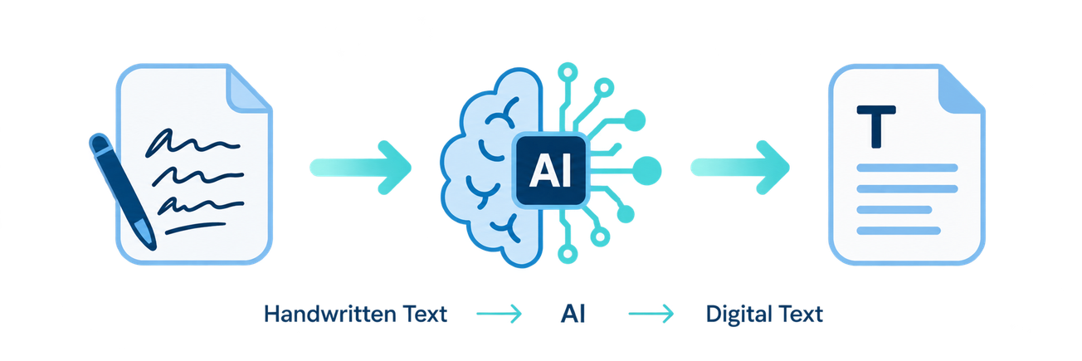
SECOND PROJECT REVIEW
AI-Powered
Handwritten Text
Recognition System
Engineering Project Presentation
TEAM MEMBERS
M. Satya Charan Reddy | 2420030166
R. Sai Charan | 2420030140
S. Sai Rishik | 2420030121
M. Satya Charan Reddy
R. Sai Charan
S. Sai Rishik
M. Satya Charan Reddy
R. Sai Charan
S. Sai Rishik
2420030166
2420030140
2420030121
N. Sunandha Ma’am
2420030166
2420030140
2420030121
N. Sunandha Ma’am
PROJECT GUIDE
N. Sunandha Ma’am
CSE • K L DEEMED TO BE UNIVERSITY
Notes:
1

Slide 2
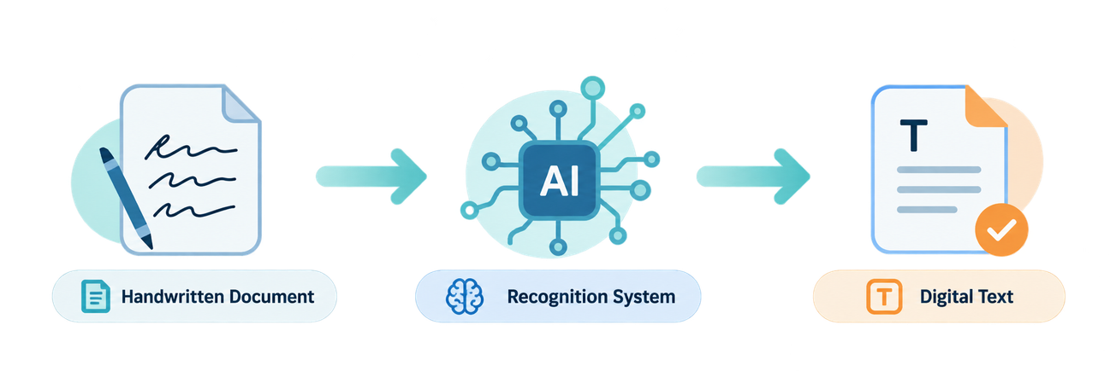
01 PROBLEM STATEMENT
Handwriting remains difficult to digitize
The challenge is reliable recognition across varied handwriting styles and image quality.
Clearly Defined Problem
Handwriting varies significantly across character shape, size, spacing, writing style and alignment. Manual transcription is time-consuming, repetitive and prone to errors.
Existing OCR systems are generally stronger for printed text and may struggle with cursive, irregular or low-quality handwriting.
Digitization
Editable notes
Convert paper records
Reduce retyping
Motivation
Make handwritten information easier to digitize, edit, store, search and process.
Searchable data
Automated entry
Store and retrieve
Lower manual effort
02
Notes:
2

Slide 3
02 OBJECTIVES
Four measurable objectives define the build
The project moves from image preparation to recognition, evaluation and usable digital output.
01
02
03
04
Image Processing
Text Recognition
Performance Evaluation
Digital Text Generation
Prepare handwritten images using resizing, normalization and noise reduction.
Develop or integrate an AI model for handwritten character, word or line recognition.
Evaluate CER, WER and recognition accuracy on a representative test set.
Generate clear, editable and searchable digital text.
EXPECTED OUTCOMES
✓
Functional prototype
✓
Automatic conversion
✓
Measurable accuracy
✓
Reduced transcription effort
✓
User-friendly output
03
Notes:
3

Slide 4
03 LITERATURE SURVEY / EXISTING SYSTEM
Existing approaches trade simplicity against sequence robustness
The comparison motivates a practical design that balances accuracy, robustness and computational efficiency.
APPROACH
TECHNIQUE
ADVANTAGES
LIMITATIONS
Traditional OCR
Image processing and handcrafted features
Simple; lightweight
Mainly printed text; weak to handwriting variation
CNN-Based Recognition
CNN-based visual feature extraction
Effective for character/image recognition
Limited for long sequences; needs prepared input
CNN + LSTM + CTC
CNN extraction + LSTM sequence model + CTC alignment
Handles variable-length sequences; suitable for words/lines
Higher compute; complex training
Transformer-Based HTR
Vision/text Transformer architecture
Captures contextual dependencies
Often requires substantial data and compute
Selected literature: AlKendi et al. (2024) • de Sousa Neto et al. (2024) • Li et al., TrOCR (AAAI 2023)
04
Notes:
4

Slide 5
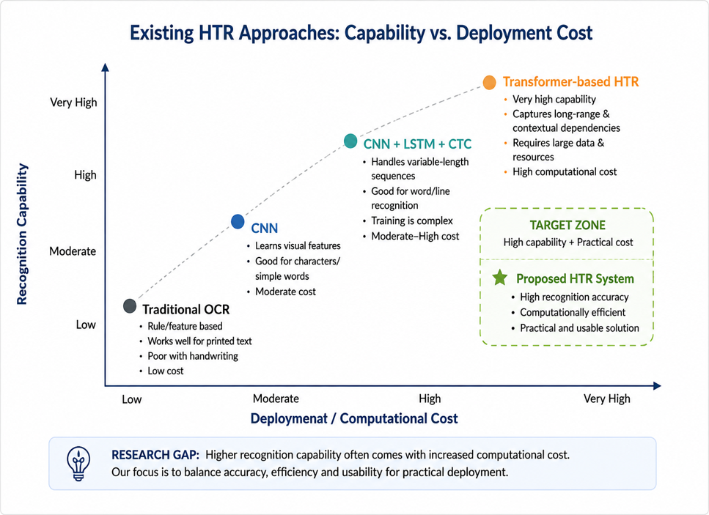
03 LITERATURE SURVEY / EXISTING SYSTEM
The Research Gap is practical: Robustness, Cost and Usability
A practical HTR system should remain robust on imperfect handwriting while keeping deployment requirements manageable.
LIMITATIONS / RESEARCH GAP
01
High variation in handwriting styles
02
Cursive and irregular text is difficult
03
Noisy or low-quality images reduce reliability
04
Advanced models can be computationally heavy
05
Practical deployment needs user-friendly workflows
Target balance: accuracy • robustness • efficiency
05
Notes:
5

Slide 6



04 PROPOSED SYSTEM RESPONSE
Proposed system: an end-to-end HTR pipeline
The workflow combines preprocessing, AI recognition and evaluation to produce editable digital text.
Input Image
Preprocessing
AI Recognition
Digital Output
Handwritten document or note
Resize, normalize, reduce noise
Characters, words or sequences
Editable and searchable text
COMMON CHALLENGES :
PROPOSED RESPONSE :
Limited handwriting robustness
AI-based handwriting recognition
Manual or inconsistent preprocessing
Image preprocessing pipeline
May require high computational resources
CER / WER / accuracy evaluation
Deployment can be resource-intensive
Editable digital output
Project focus: robust recognition • measurable evaluation • practical usability
06
Notes:
6

