Slide 1

Recruitment and HR Resume Management System for Efficient Hiring
SOA Project Review-3
 | Under the Guidance of Dr. Venkateswari Mam Department of Computer Science and Engineering, KLH CSE Bowrampet Campus
Team Members - BATCH - 9 Chaitanya – 2420030721 Sai Rishik -2420030121 Vaman - 2420030736

Slide 2
Outline of Project Work
Introduction and Project Overview
Project Objectives and Achievements
System Architecture
Technologies Used
Modules Implemented
Working Methodology
AI Resume–Job Match and Skill Gap Analysis
Testing and Results
Challenges and Solutions
Conclusion and Future Work

Slide 3
Problem Statement
Recruitment involves time-consuming manual resume screening.
Candidate details and resumes need centralized storage.
Finding candidates with the required skills can be difficult.
HR needs a consistent way to track application stages.
Manual comparison of resumes with job descriptions can be inconsistent.
The implemented system addresses these issues through integrated services and explainable skill matching.

Slide 4
Objectives and Implementation Achievements
To centralize resume and recruitment information.
Implemented resume upload and PDF, DOCX, and TXT text extraction.
Implemented candidate profiles and job posting management.
Added candidate search, filtering, and job-based ranking.
Implemented application tracking, shortlisting, and status updates.
Added notifications for recruitment-related events.
Implemented explainable resume–job matching with matched skills, missing skills, and recommendations.

Slide 5
Working Methodology
Implemented Resume–Job Matching
Resume Upload
↓
Text Extraction
↓
Required Skill Extraction
↓
Skill Normalization
↓
Candidate–Job Comparison
↓
Match Score Calculation
↓
Skill Gap Analysis
↓
Results Displayed to HR
Output
Match percentage
Matched skills
Missing skills
Explanation and recommendations
HR can review the result and decide whether to shortlist the candidate. The score supports decision-making; it does not replace human review.

Slide 6
Literature Survey
Authors | Title of the Paper | Methodology | Inferences | Limitation/Future work
Gan et al. | Application of LLM Agents in Recruitment: A Novel Framework for Automated Resume Screening, 2024 | • NLP-based resume processing • LLM agents for resume summarization, grading and decision-making | The framework automates resume screening and was reported to be 11 times faster than manual screening. Fine-tuned models achieved an 87.73% F1 score for resume sentence classification. | The study focuses mainly on automated resume screening. Future work can integrate screening with complete recruitment workflows such as job posting, application tracking and HR management.
Chavan et al. [2] | Enhancing Recruitment Efficiency: An Advanced Applicant Tracking System (ATS), 2024 | • Natural Language Processing • KNN algorithm • Automated resume parsing and classification • Applicant tracking | The ATS improves recruitment activities including candidate screening, interview scheduling and hiring-process management. | The work focuses mainly on ATS functionality. A modular SOA/microservice architecture can improve scalability and independent service management.
Paranthaman et al. [3] | Resume Screening Automation: Enhancing Recruitment Efficiency with Machine Learning Algorithms, 2024 | • NLP • Machine Learning • Random Forest • Support Vector Machine | The automated system uses contextual information from resumes and job descriptions and reported 88.3% accuracy, 90.1% precision and 86.7% recall. | Automated screening can still face issues related to data imbalance and fairness. Future systems should include human oversight and broader recruitment functionality.

Slide 7
Implementation: Problem Gaps Addressed
Implemented Features:
Centralized resume and candidate information management.
PDF, DOCX, and TXT resume text extraction.
Job posting and required-skill management.
Candidate search and filtering.
Explainable skill-based matching and candidate ranking.
Application status tracking, shortlisting, and notifications.
How the system addresses the gaps:
The six backend microservices separate recruitment responsibilities and expose REST APIs.
Resume Management + Candidate Management + Job Posting + Matching + ATS + Notifications
Integrated through a modular service-oriented architecture.

Slide 8
Innovation, Creativity, and Novelty
Innovation:
Uses Java and Spring Boot microservices for recruitment management.
Separates resume, job, candidate, application, notification, and matching functions.
Extracts text from common resume formats.
Provides candidate ranking and application tracking.
Creativity:
Interactive HR dashboard for recruitment activities.
Visual match score with matched and missing skill indicators.
Human-readable explanation for the calculated score.
Skill improvement recommendations based on missing required skills.
Novelty:
The key added feature is Explainable Resume–Job Match and Skill Gap Analysis.
It shows why a candidate matches a job and identifies missing required skills using a transparent scoring method.

Slide 9
Implementation Stack and Feasibility
Technical Implementation
Frontend: HTML5, CSS3, and JavaScript.
Backend: Java 17, Spring Boot, REST APIs, and Spring Data JPA.
Resume parsing: Apache PDFBox, Apache POI, and UTF-8 text processing.
Database: H2 for the current demonstration configuration; SQL schema provided.
Service Ports
Resume 8081; Job 8082; Candidate 8083.
Application 8084; Notification 8085; Matching 8086.
Build and Testing
Maven clean test passed during verification; all 9 matching-engine unit tests passed.

Slide 10
Final Implementation and Verification
Phase 1 – Core Services
Implemented six Spring Boot microservices.
Resume, job, candidate, ATS, notification, and matching modules.
Phase 2 – Frontend Integration
Connected dashboard views to service APIs.
Added resume upload, candidate/job management, and matching views.
Phase 3 – Matching Feature
Implemented skill extraction, alias normalization, match score, and gap explanation.
Generated matched skills, missing skills, and recommendations.
Phase 4 – Recruitment Workflow
Implemented candidate ranking, shortlisting, application statuses, and notifications.
Phase 5 – Testing
Maven clean test completed successfully in the reported verification run.
Nine matching-engine unit tests passed; runtime services were checked for demonstration.
Phase 6 – Demonstration
Run six backend services and serve the frontend on port 5500.
Expected Outcome
A working recruitment prototype that supports HR screening with explainable skill matching.

Slide 11
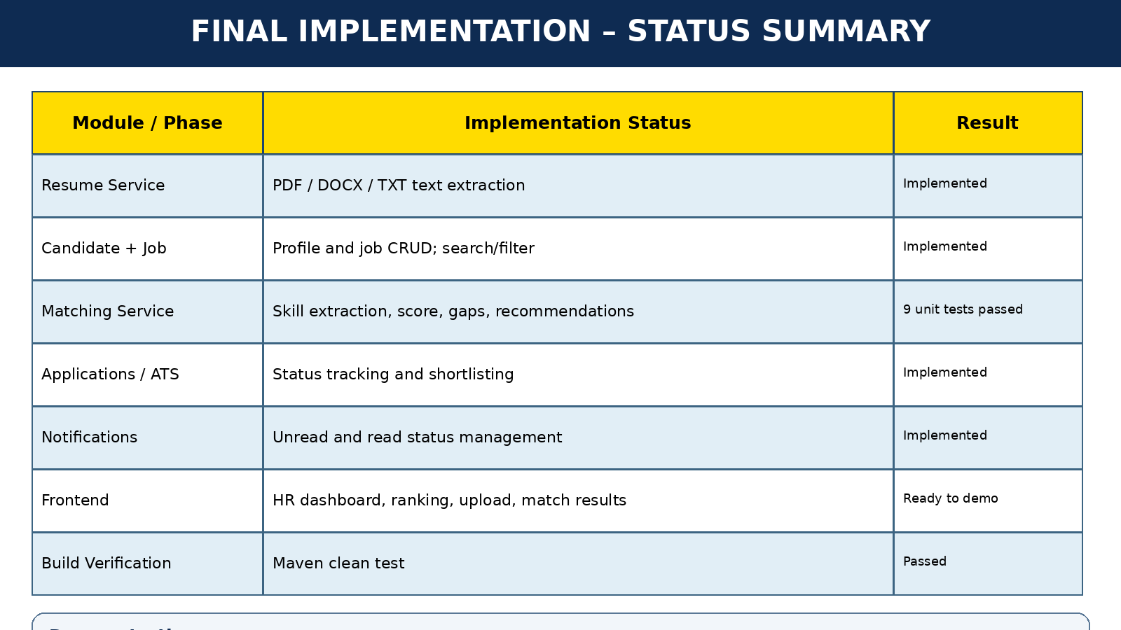
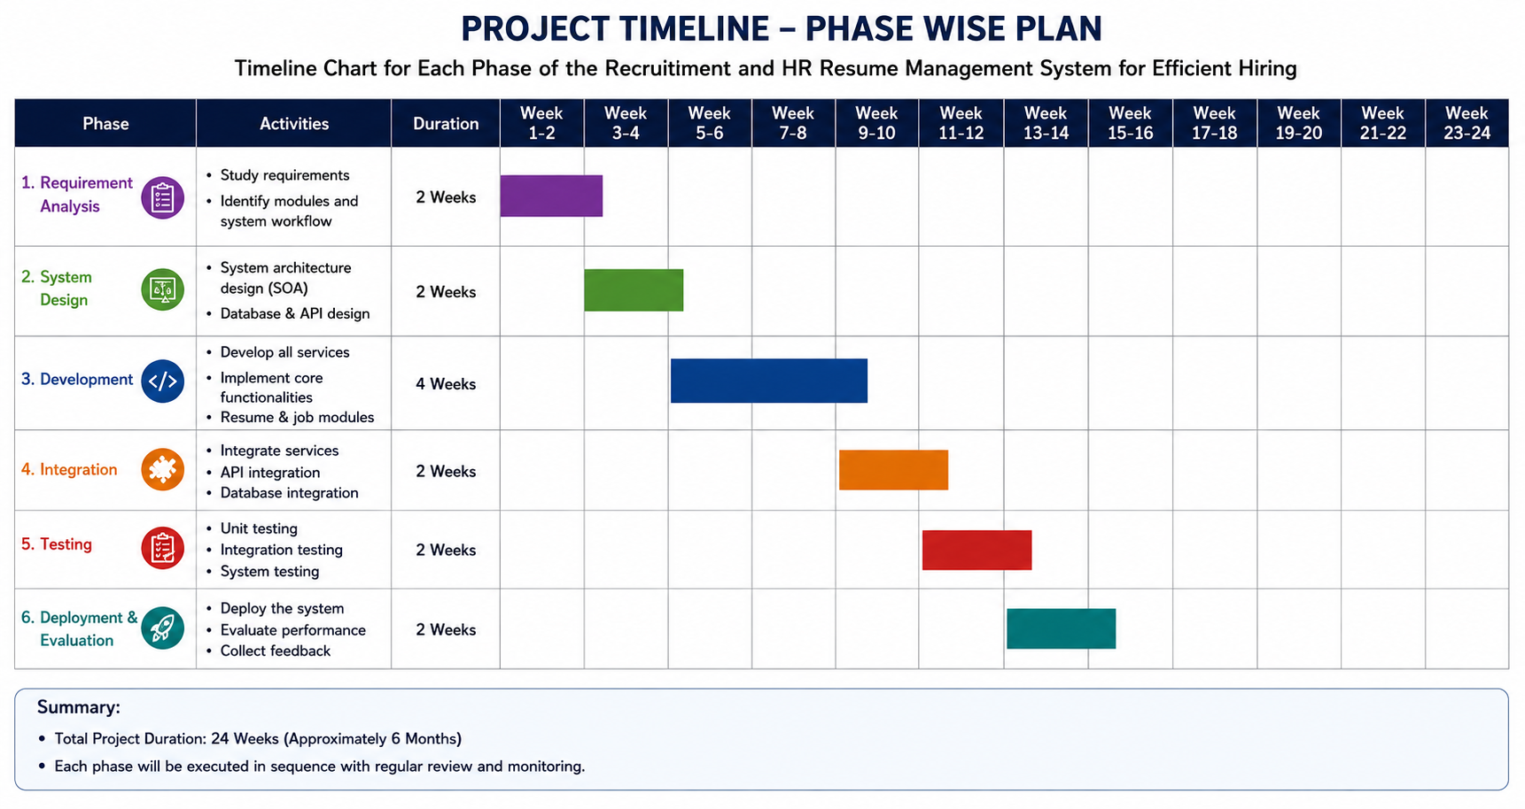

Slide 12
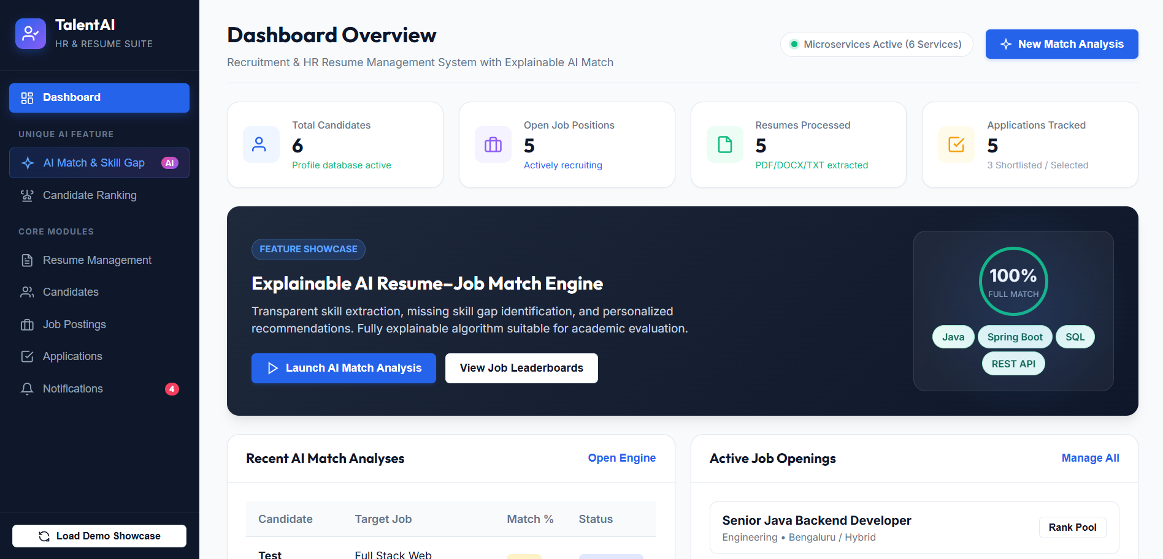
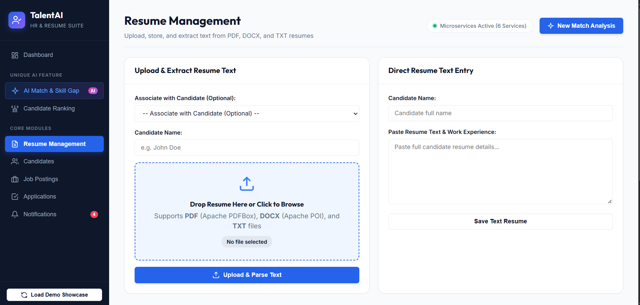
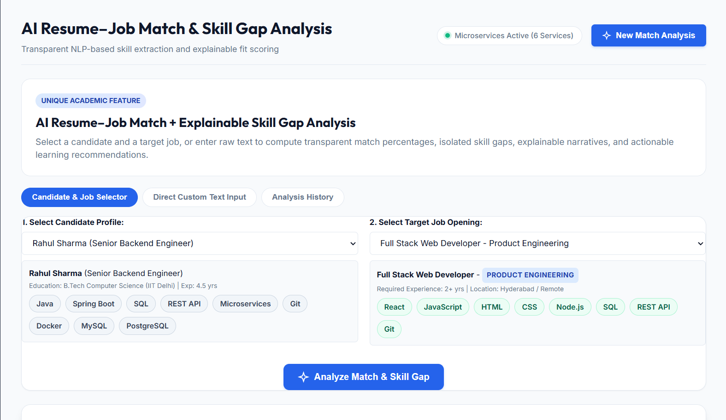
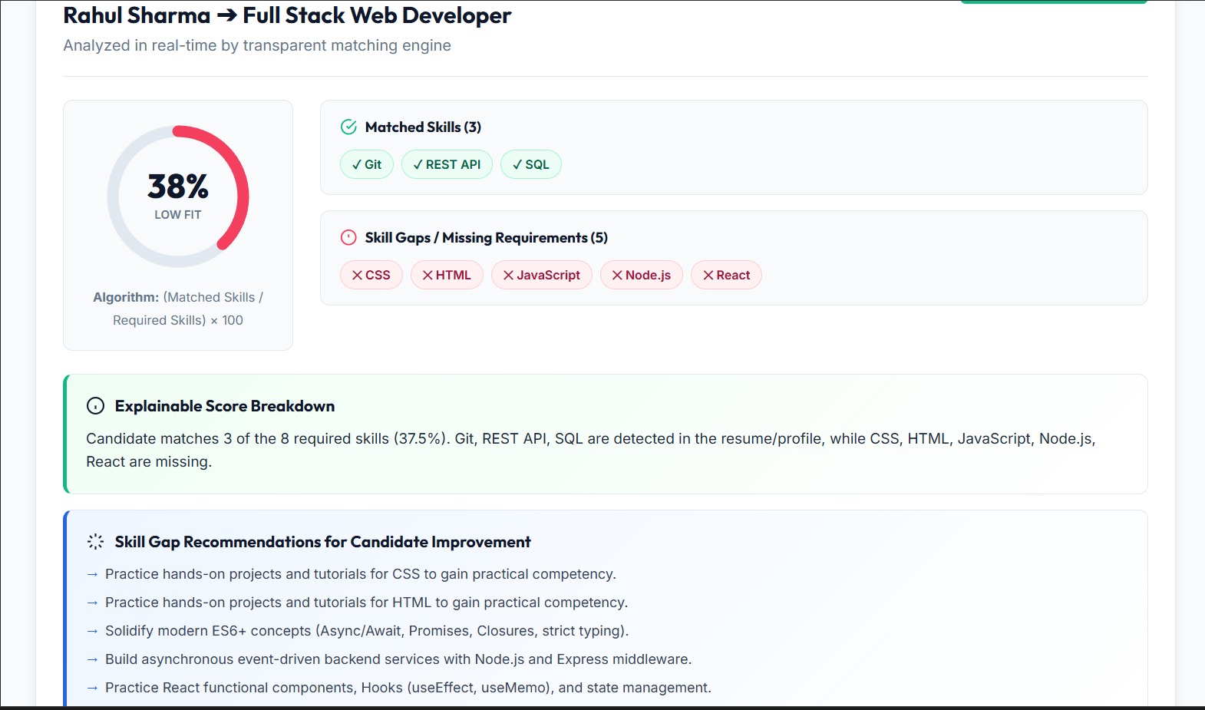
Implementation Results – Application Screenshots
1. HR Dashboard
2. Resume Management
3. AI Match – Candidate and Job Selection
4. Match Results – Skill Gap Analysis
12

