Slide 1
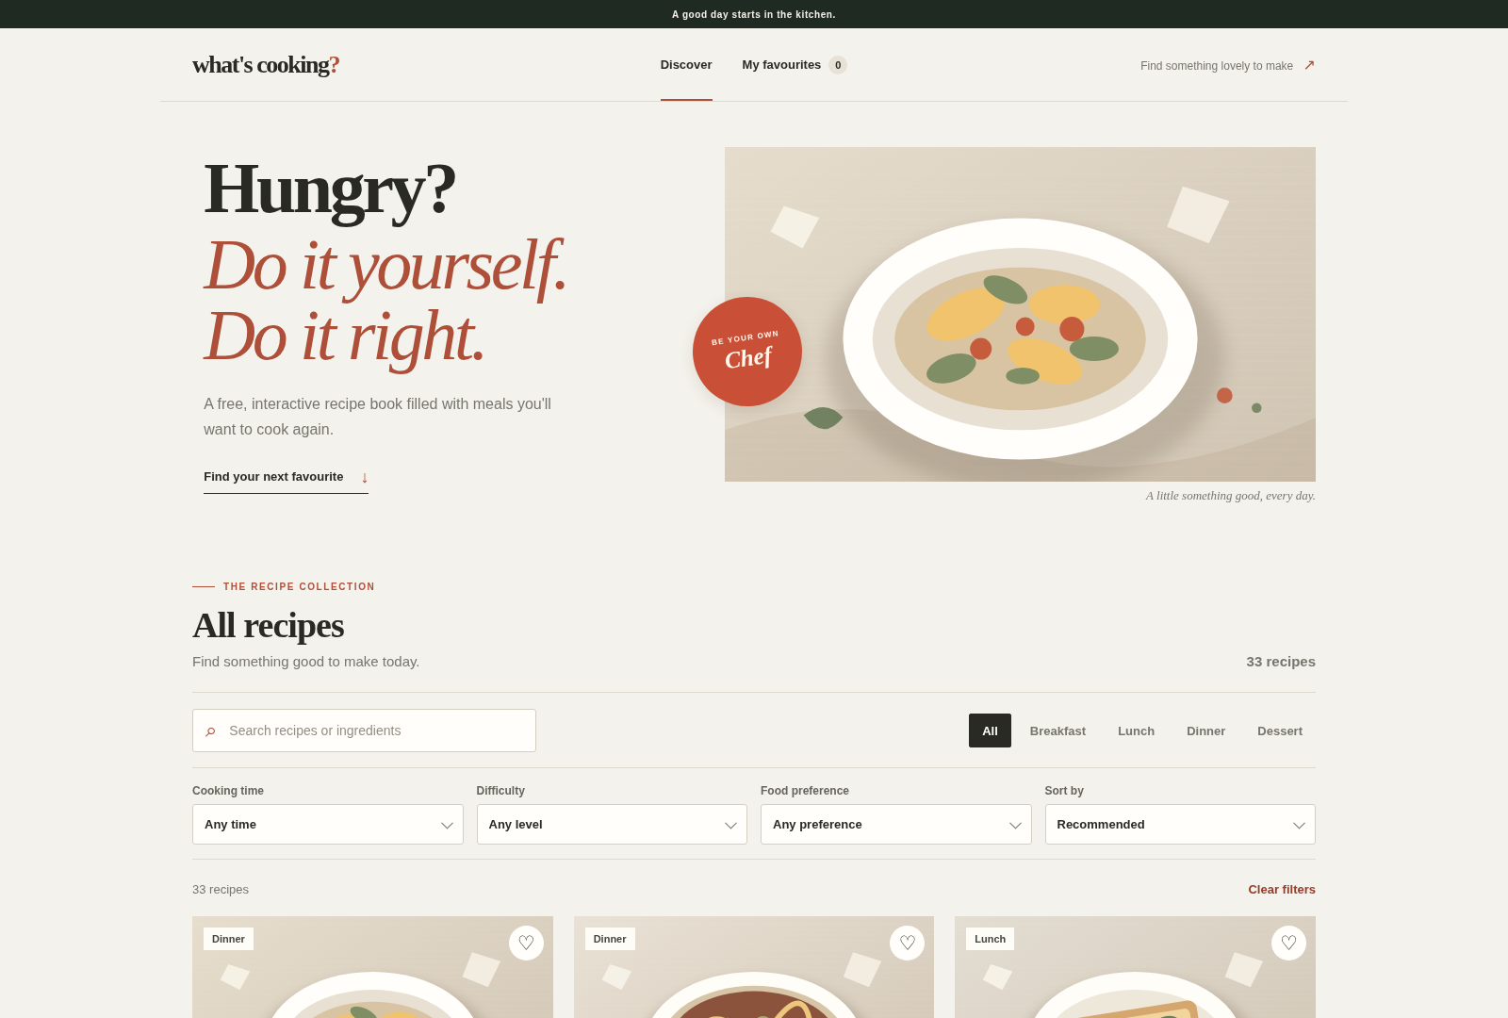
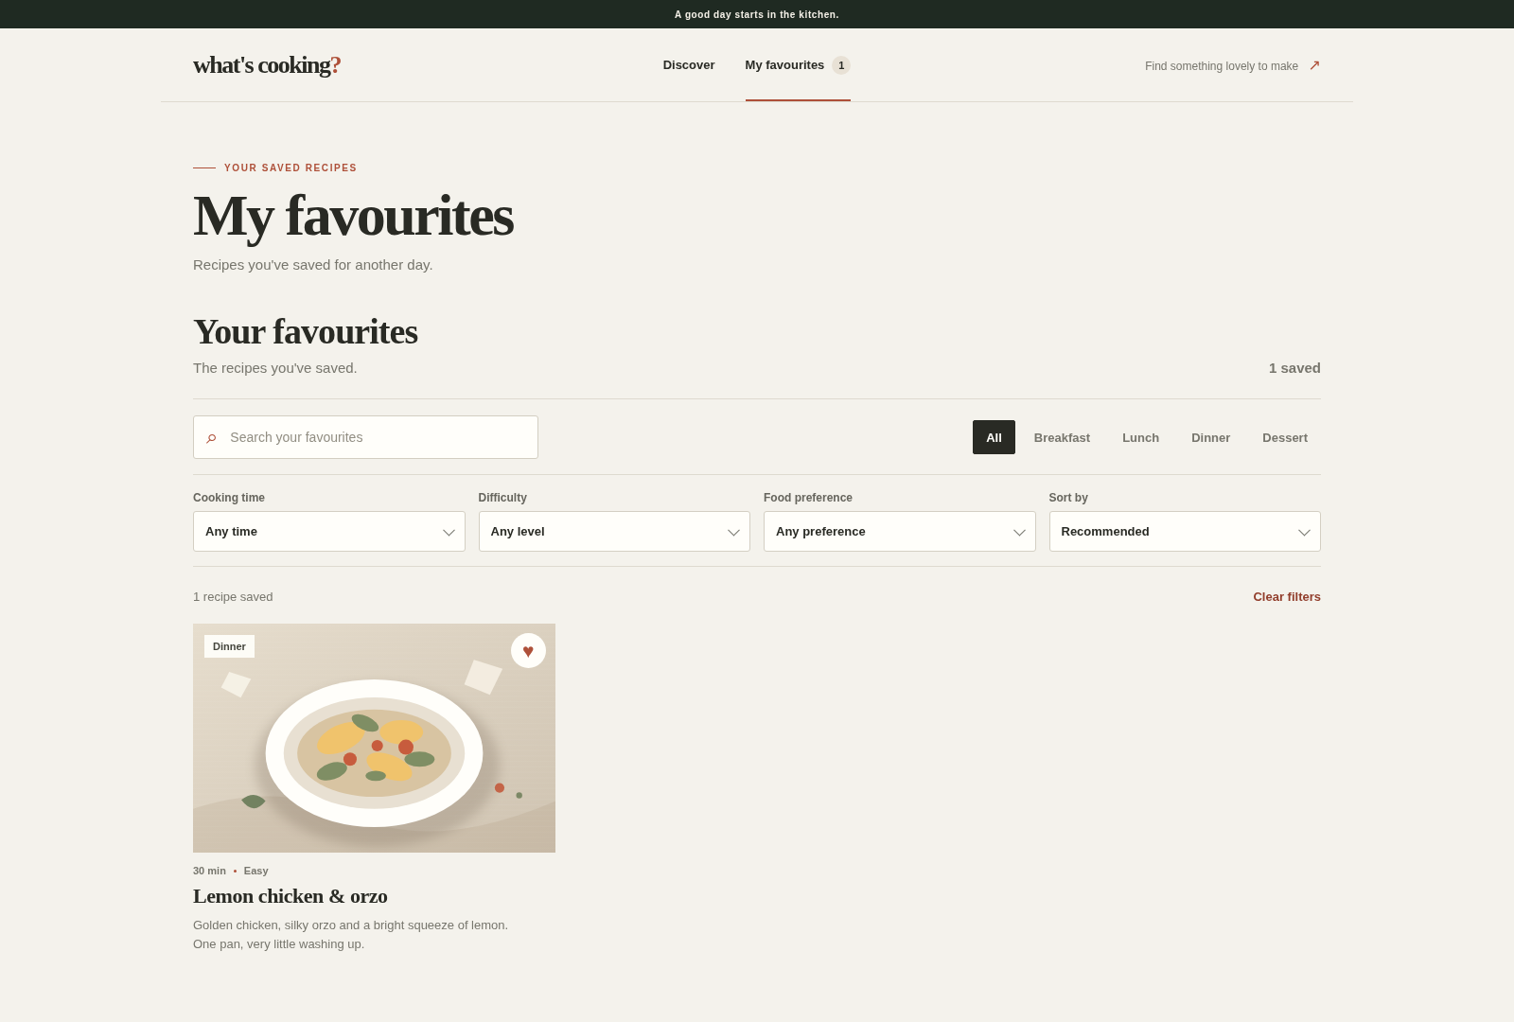
WEB DEVELOPMENT / TEAM PROJECT
what's cooking?
Project Research Proposal
A browser-based recipe book for discovering everyday meals, following clear cooking steps and saving favourites for later.
Team Members
ERDENETSOGT DELGERBAT / 202539430
BATNASAN ERDENESAMBUU / 202539462
CHINGUN / 202539480
Notes:
This presentation introduces What's Cooking?, our proposed recipe discovery website. The goal is to give people one clear place to find everyday meal ideas, understand how to prepare them, and keep recipes they want to make again.

Slide 2
PROJECT OVERVIEW
One place to find the next thing to cook.
The project is a free, browser-based recipe book focused on everyday cooking.
01
DISCOVER
WHAT WE ARE BUILDING
Browse meals by category or search.
Discover a recipe.
Understand the steps.
Save it for another day.
02
CHOOSE
Narrow options with practical filters.
03
COOK
Follow ingredients and instructions.
04
SAVE
Keep favourites in the same browser.
No account, subscription or AI service is required.
Notes:
What's Cooking? is designed around a simple sequence. Visitors discover recipes, narrow the choices, open a recipe to cook, and save useful dishes for later. It is intentionally a lightweight front-end website rather than a platform that requires accounts or a backend.

Slide 3
BACKGROUND
The problem is not a lack of recipes. It is choosing one.
We are designing around three practical moments in everyday meal planning.
1
2
3
Too many choices
Not enough context
Hard to return to a good find
Someone may have an idea of what they want but needs a quick way to narrow a large list.
Time, difficulty and food preference can affect whether a recipe is realistic for that day.
A recipe worth repeating should be easy to save and revisit.
WHAT WE DID:
Brought discovery, recipe details and meal preferences in one simple interface.
Notes:
The project starts from a practical user need rather than a claim that existing recipe websites do not work. People often need to narrow a choice by time or preference, understand the steps before starting, and return to a recipe later. Our site brings those activities into one straightforward experience.

Slide 4
PROJECT OBJECTIVES
Make recipe discovery clear, useful and repeatable.
The website is intended for people who cook at home and want practical inspiration.
1
Improve discovery
Help visitors locate recipes by name, ingredient, category and useful filters.
INTENDED USERS
Home cooks
2
Support the cooking process
People looking for a new everyday meal.
Present ingredient quantities and step-by-step instructions in a readable format.
Beginners
Visitors who benefit from clear steps and ingredient lists.
3
Make good finds easy to revisit
Let visitors save favourites and view recently opened recipes.
Busy students
People who want to know how long it will take before deciding.
Notes:
Our objectives are to make recipes easier to discover, make recipe details usable while cooking, and make it simple to return to saved meals. The intended audience includes everyday home cooks, people who are still learning, and busy students who need to consider preparation time.

Slide 5
PROPOSED SOLUTION
A focused set of features, built around the recipe.
The current build contains 33 recipes across four meal categories.
FIND
BROWSE
FILTER
Search by recipe name or ingredient.
Breakfast, lunch, dinner and dessert categories.
Narrow by time, difficulty and food preference.
SORT
COOK
KEEP
Order by recommended, quickest, longest or A–Z.
View ingredients, instructions, tips and adjust servings.
Check ingredients, save favourites, revisit and share or print.
33
RECIPES IN THE CURRENT CATALOGUE
Notes:
The current catalogue contains 33 recipes across breakfast, lunch, dinner and dessert. Visitors can search by recipe or ingredient, filter and sort the list, then open a recipe for ingredients and instructions. The detail view also supports serving adjustments, ingredient checkboxes, saving, sharing and printing.

Slide 6
WEBSITE INTERFACE
The Discover page brings the collection together.
The homepage is designed to make browsing and narrowing options feel straightforward.
1
Search and categories
Start with a dish name, ingredient or meal type.
2
Practical filters
Narrow choices by time, difficulty and food preference.
3
Recipe cards
Compare quick details before opening a recipe.
Notes:
This is the main Discover page. The top area introduces the site, and the collection below gives visitors several ways to find something to cook. Search and category controls provide a quick starting point, while the additional filters and sorting help narrow the full catalogue.

Slide 7
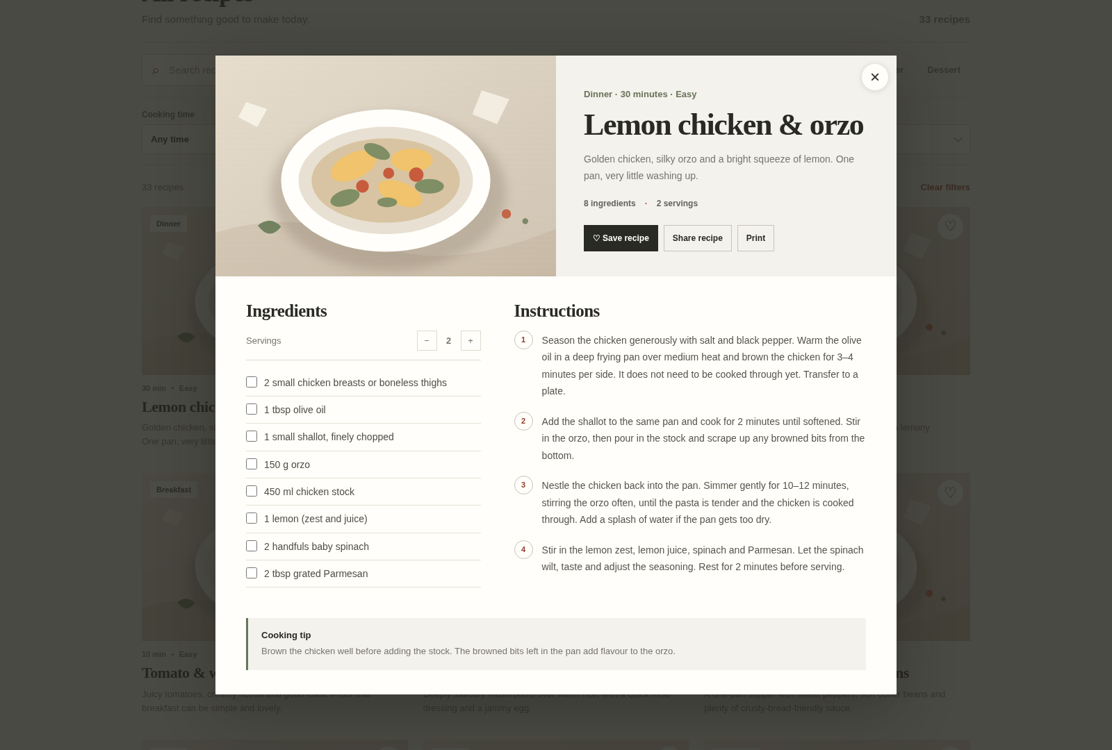
RECIPE EXPERIENCE
A recipe opens into a practical cooking view.
The detail screen keeps the ingredients and method visible together.
RECIPE DETAILS
More than a title and a photo.
Each recipe includes a clear ingredient list, adjustable servings, step-by-step instructions and a practical cooking tip.
*
Scale servings
*
Check ingredients
*
Save, share or print
Notes:
Selecting a recipe opens the detailed cooking view. The visitor can adjust the number of servings and ingredient quantities update with it. They can check off ingredients as they prepare, follow numbered instructions, read a cooking tip, and save, share or print the recipe.

Slide 8
USER JOURNEY
From “what to eat?” to a saved favourite.
A simple path keeps the experience easy to understand.
DISCOVER
NARROW
OPEN
PREPARE
SAVE
Open the recipe collection.
Search, filter or sort the list.
Choose a recipe and review details.
Adjust servings and check ingredients.
Keep it in My Favourites.
RETURN VISIT
Recently viewed and My Favourites help visitors pick up where they left off.
Notes:
The intended user journey begins on the Discover page. A visitor can narrow the list, open a recipe, prepare it using the detailed view and save it. On a later visit in the same browser, recently viewed recipes and My Favourites make it easier to return to previous choices.

Slide 9
IMPLEMENTATION
A lightweight static website.
The project uses browser-native implementations and stores recipe content locally.
PROJECT FILES
VISITOR
index.html
Discover page and recipe dialog
Web browser / HTML + CSS + JavaScript
favorites.html
Saved-recipe page
styles.css
Layout, visual design and responsive rules
recipes.js
localStorage
33 recipe records
Favourites + recent views
recipes.js
Recipe data and instructions
app.js
Search, filters, storage and interactions
Static hosting
GitHub Pages
No server, database, login system or AI service is needed
Notes:
The site is built with HTML5, CSS3 and vanilla JavaScript. Recipe content is kept in recipes.js, while app.js handles search, filters, recipe details and browser storage. localStorage keeps favourites and recently viewed recipes in the same browser. The project can be hosted as a static site on GitHub Pages and does not require a server or database.

Slide 10
EXPECTED OUTCOME
A useful recipe book, without unnecessary complexity.
The project aims to deliver a complete and approachable everyday cooking experience.
RESULTS
IN SCOPE
Recipe discovery, detail views, filters, favourites and recently viewed recipes.
A clear place to
find, cook and save
everyday recipes.
CURRENT LIMITATIONS
Saved items stay in one browser and do not sync between devices. Food images and web fonts need an internet connection. There are no accounts or cloud database.
THANK YOU
Notes:
The expected outcome is a simple, complete website for discovering and preparing everyday recipes. The project also demonstrates core front-end concepts: rendering content from a local data file, responding to user input, storing preferences in the browser and adapting the interface to different screens. The current scope stays focused; it does not include accounts, cloud synchronization or AI recommendations.

