Slide 1
SEEM – Symbolic Regression
for Constitutive Law Discovery
SEEM/LYS Meeting - September 4, 2026

Slide 2
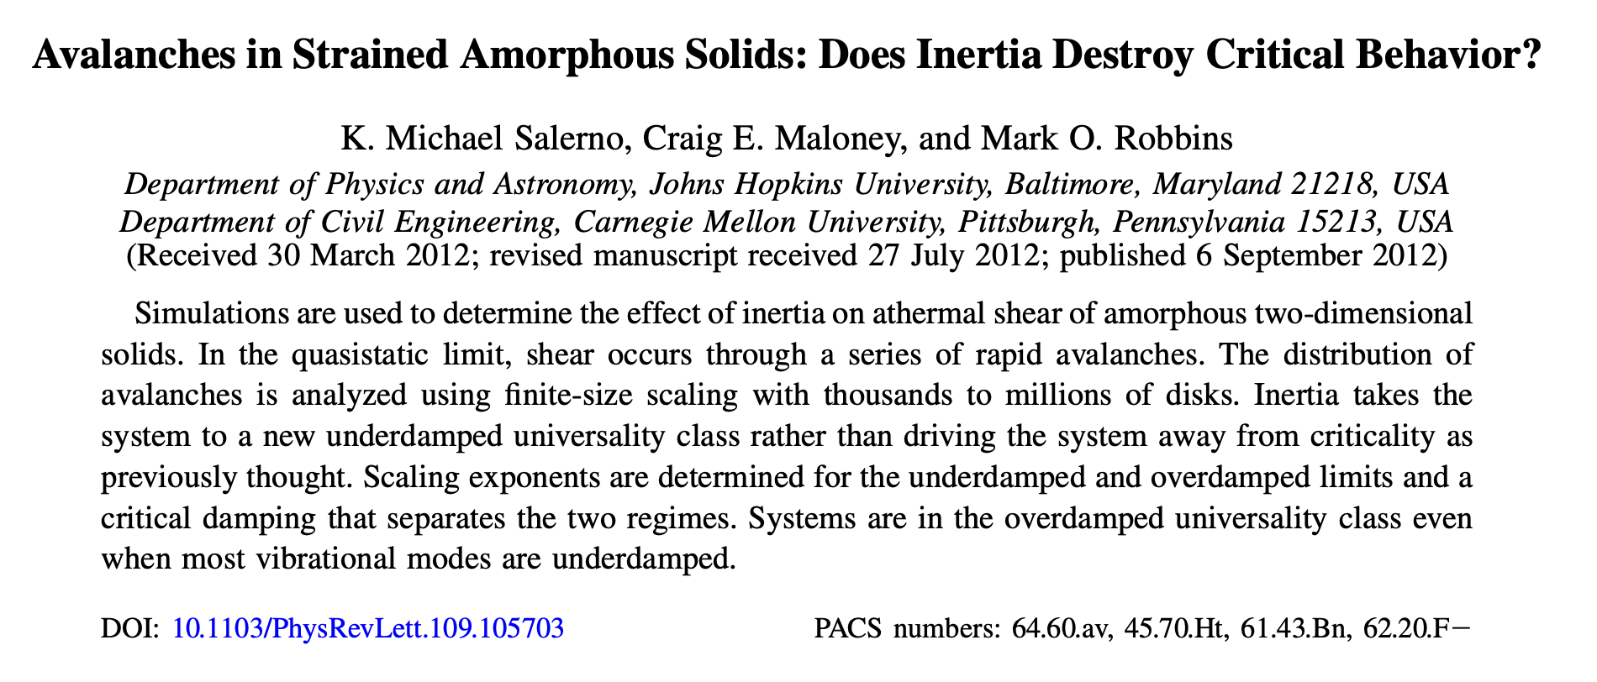

Slide 3


Slide 4


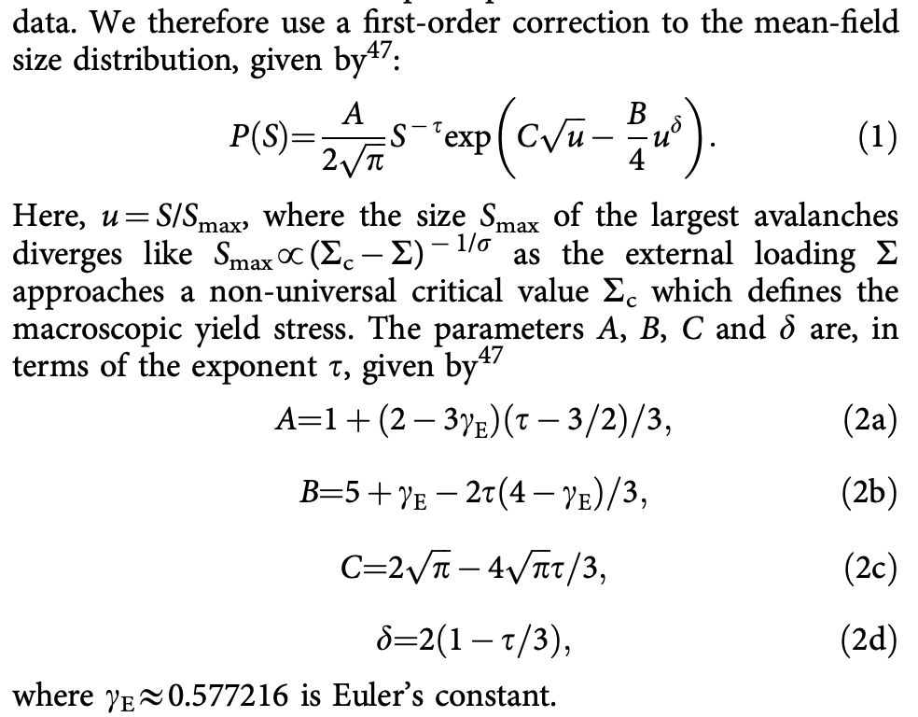
Truncated power law
“we find that a simple exponential tail does not fit our data.”

Slide 5
Variables
γ applied shear strain; one step is 10⁻⁵, runs go to 0.5
τ shear stress (raw stress ÷ 10⁴)
u = pe − u₀ PE/atom above the reference u₀ = −4.60752
(u, τ) two-coordinate state of a run; 20 × 20 grid
2μ(u, τ) elastic modulus
s = −Δτ an event: a step where the stress drops, of size s
ρ(s) density of events of size s
p(u, τ) probability per step that an event occurs
P(s | u, τ) size distribution of events at a given state
s_c(u, τ) the largest event a state can produce
k, m, ε constants
q(u, τ) plastic fraction of the strain rate: 0->elastic, 1->steady state
eq.-> q = 1 − (dτ/dγ)/2μ
aging event a step where u drops but τ does not (105,188); it relaxes energy without releasing stress

Slide 6
The symbolic-regression library (library/symreg.py)
What it does
Given points (x, y), it searches for a formula y = a·f(x) + b
Uses a library of operators (exp, log, 1/x, x², √x, and + − × ÷) with up to two fitted constants inside f
Enumerates every formula up to a complexity budget
Returns the exact Pareto front: the best misfit at each complexity
How it was used here
Target: the (20)binned log-density ln ρ(s) in one grid cell
Run on 12 cells spanning the state plane (700 - 7,600 events each), plus variants with unweighted bins and a wider size window
Budget a complexity of 8: 624,936 formula trees per cell, ~10,300 distinct admissible functions
Just to check – another run at complexity 9 (4.5 million trees) shows only mild improvement

Slide 7
Symbolic Regression at Each Complexity
budget | form found | misfit | what it is
1 | s | 1.22 | a straight line
3 | log s | 0.30 | pure power law, ρ ∝ s⁻ᵏ
5 | log(s + 4.6×10⁻⁴) | 0.21 | power law rounded off at small s
6 | √log(1/s) | 0.143 | fails the likelihood test (ΔAIC ≈ +20,000) [Akaike information criterion, for next time]
7 | √log(0.79/s) | 0.142 | same as above
8 | log(1/(s + 1.6×10⁻⁴) − 2.25) | 0.118 | the ceiling law (below)
9 | s + √(−0.93 − log s) | 0.103 | same as earlier, now with another term; still loses under likelihood
How the complexity-8 form becomes the law
The fit is ln ρ = a·f(s) + b with f = log(1/(s + ε) − C). Exponentiating: ρ ∝ [1/(s + ε) − C]ᵃ = [C(s_c − s)/(s + ε)]ᵃ with s_c = 1/C − ε
So the search hands over a bounded form with tied exponents, m = k = a. The likelihood stage then frees m from k (8 of 8 cells prefer it)
Complexity 9 still lowers the misfit, but only by promoting a family the likelihood had already rejected. No new family appears, and the complexity-8 knee is unchanged

Slide 8
The discovered law
P(s | u, τ) = (1/Z) · (s_c(u, τ) − s)ᵐ / (s + ε)ᵏ , 0 < s < s_c
k = 0.88, m = 2.3, ε = 2.8 × 10⁻⁵
(s + ε)⁻ᵏ power-law decay with exponent k ≈ 0.9; ε rounds it off below about 3 × 10⁻⁵, so there is no lower cutoff
(s_c − s)ᵐ hard ceiling: density is zero at s = s_c. With m ≈ 2 it vanishes gently, so the largest observed event sits a few percent below s_c
s_c(u, τ) the only place the state enters: 146× range over the plane (0.02 cold and unloaded, 3 in flow); ln s_c ≈ (u-part) + (τ-part) at 95.5% of the variance
Z normalization, computed numerically
Versus the literature forms (slide 4)
Truncated power law s⁻ᵏ e^(−s/s*): an exponential tail suppresses large events but never forbids them. It sits inside the search space at complexity 7, never made a Pareto front, and loses every likelihood contest that follows
Budrikis et al. (2017) eq. 1, fitted the same way: behind the TPL in all eight large cells (ΔAIC +130 to +268 vs the ceiling law; TPL +67 to +120)

Slide 9
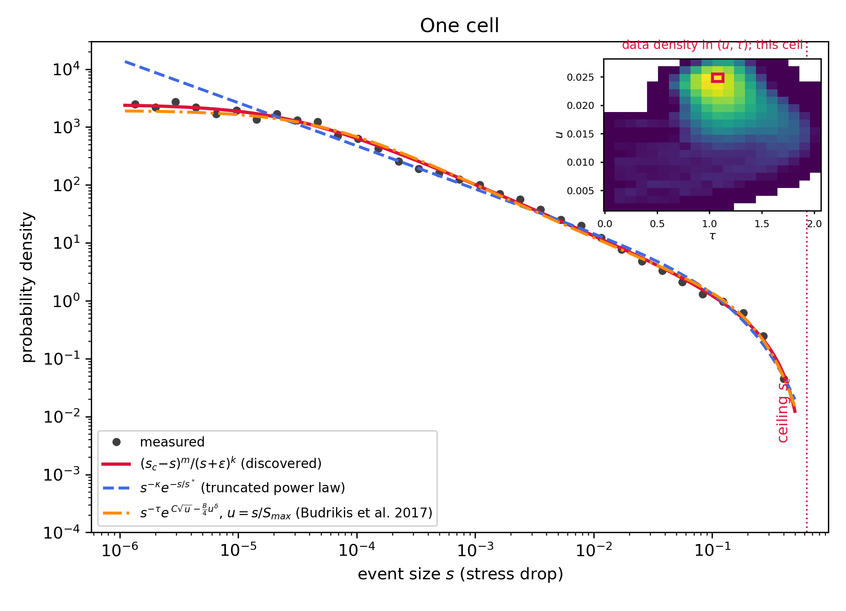
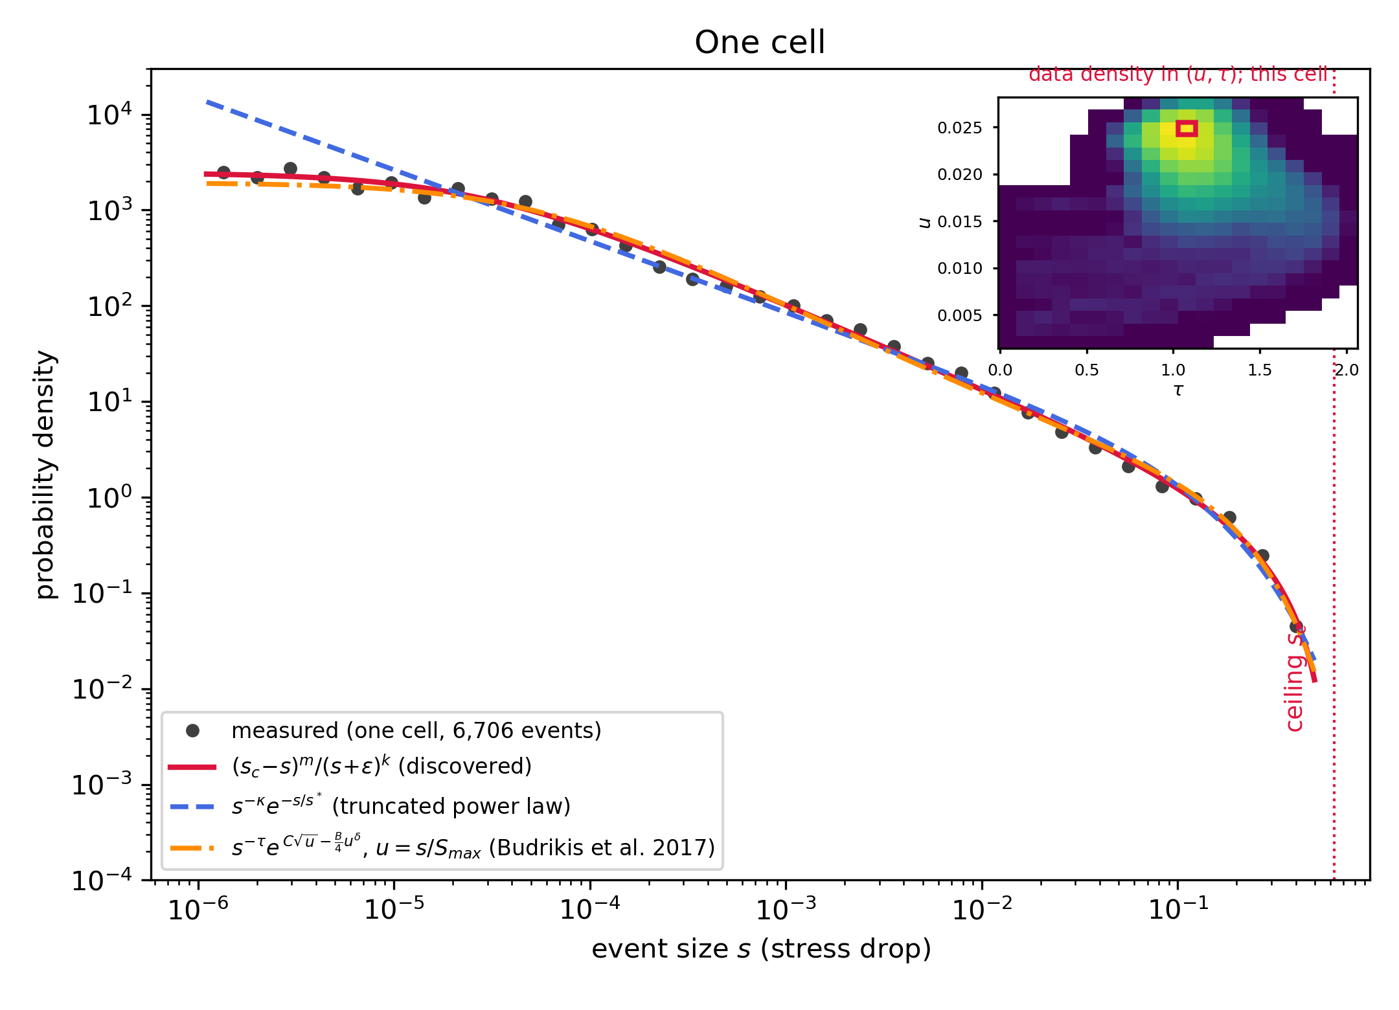
Performance: one cell, three candidate laws
The largest cell, 6,706 events, five decades of s
Black: measured density. Red: ceiling law. Blue dashed: best truncated power law (TPL). Green dotted: best lognormal
All three are maximum-likelihood fits of proper densities on the same events
Only the ceiling law gets both ends: the flattening below 3 × 10⁻⁵ and the stop at the dotted line (s_c)
The TPL tail decays too softly and overshoots
Full range: ceiling law over TPL by ΔAIC 200 to 345

Slide 10
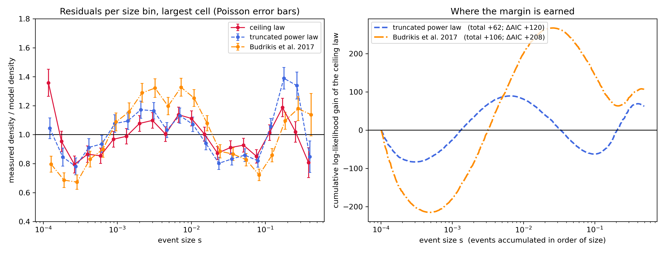
Where the likelihood margin comes from
Left: residuals per size bin, largest cell
Measured density divided by each fitted density, with Poisson error bars. The Budrikis form runs 30% low at 3 × 10⁻⁴ and 30% high through 10⁻³ to 10⁻², the bend the exp(C√u) factor puts in; the TPL has the same wave, smaller
Right: log-likelihood gain of the ceiling law, accumulated over events
Both rivals win below 10⁻³ and lose it back, and more, between 10⁻³ and 10⁻¹, where most events sit. Totals: +62 over the TPL (ΔAIC +120), +106 over Budrikis (ΔAIC +208)

Slide 11
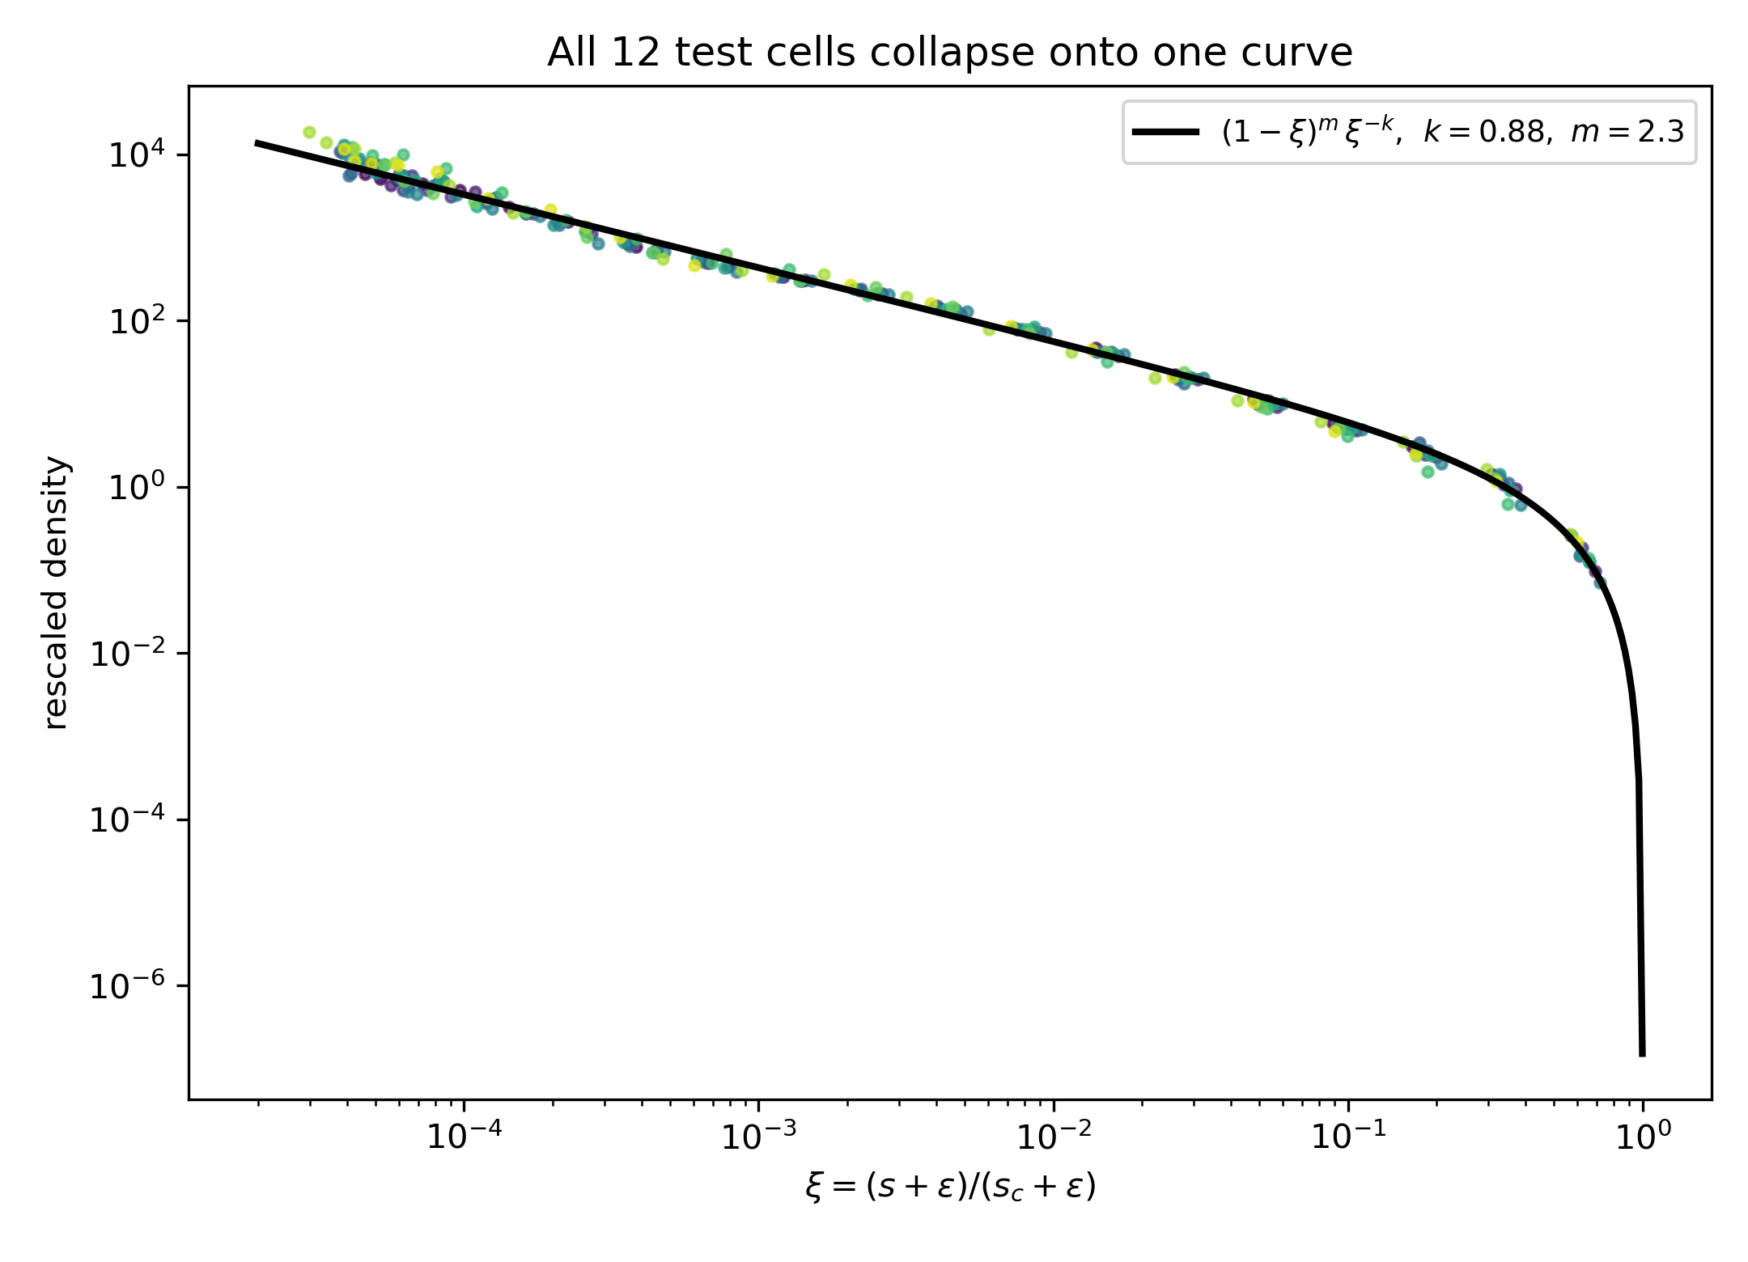
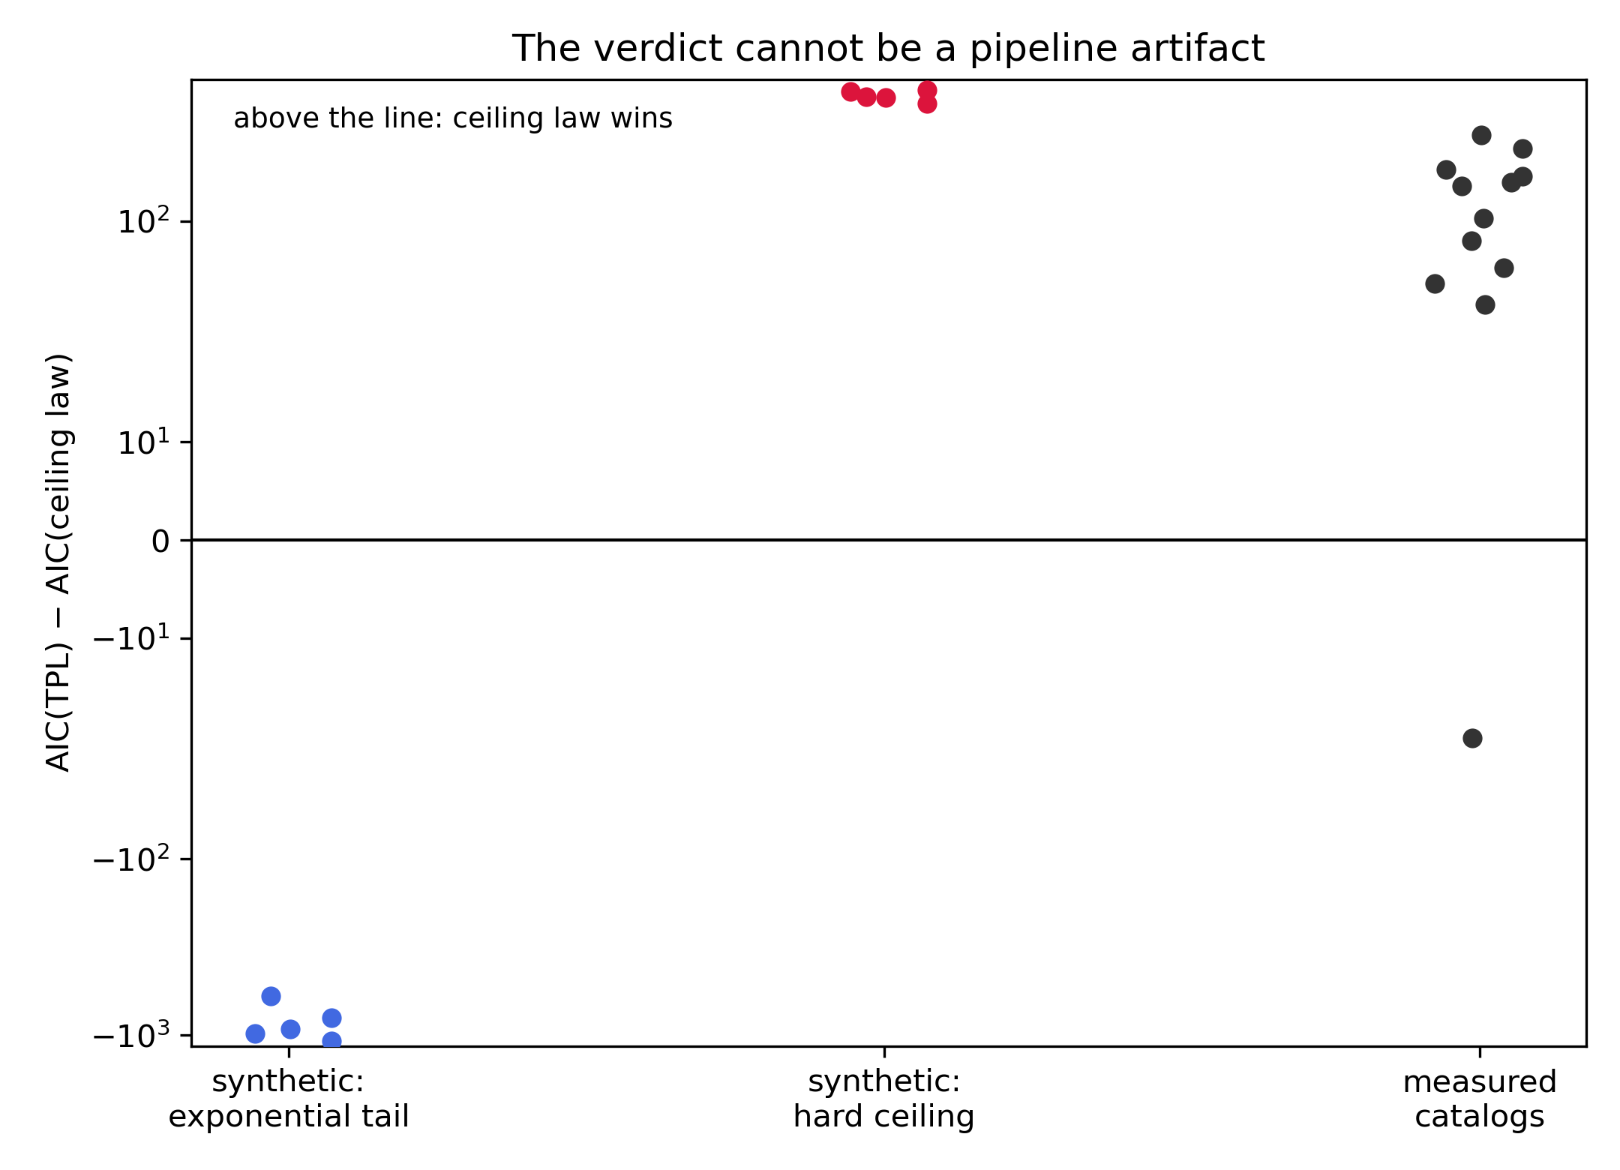
Performance: every cell, and a control
Left: the collapse
Twelve cells, 100× apart in scale, plotted against ξ = (s+ε)/(s_c+ε) with the global (k, m, ε): one curve, including the bend into the ceiling
Right: the same machinery on synthetic data
TPL-generated catalogs return a TPL verdict, 5 of 5; ceiling-generated return the ceiling, 5 of 5
Measured cells sit on the ceiling side; in the 8 largest, AIC 8 of 8 (ΔAIC 67 to 120 over TPL, 300 to 754 over lognormal)

Slide 12
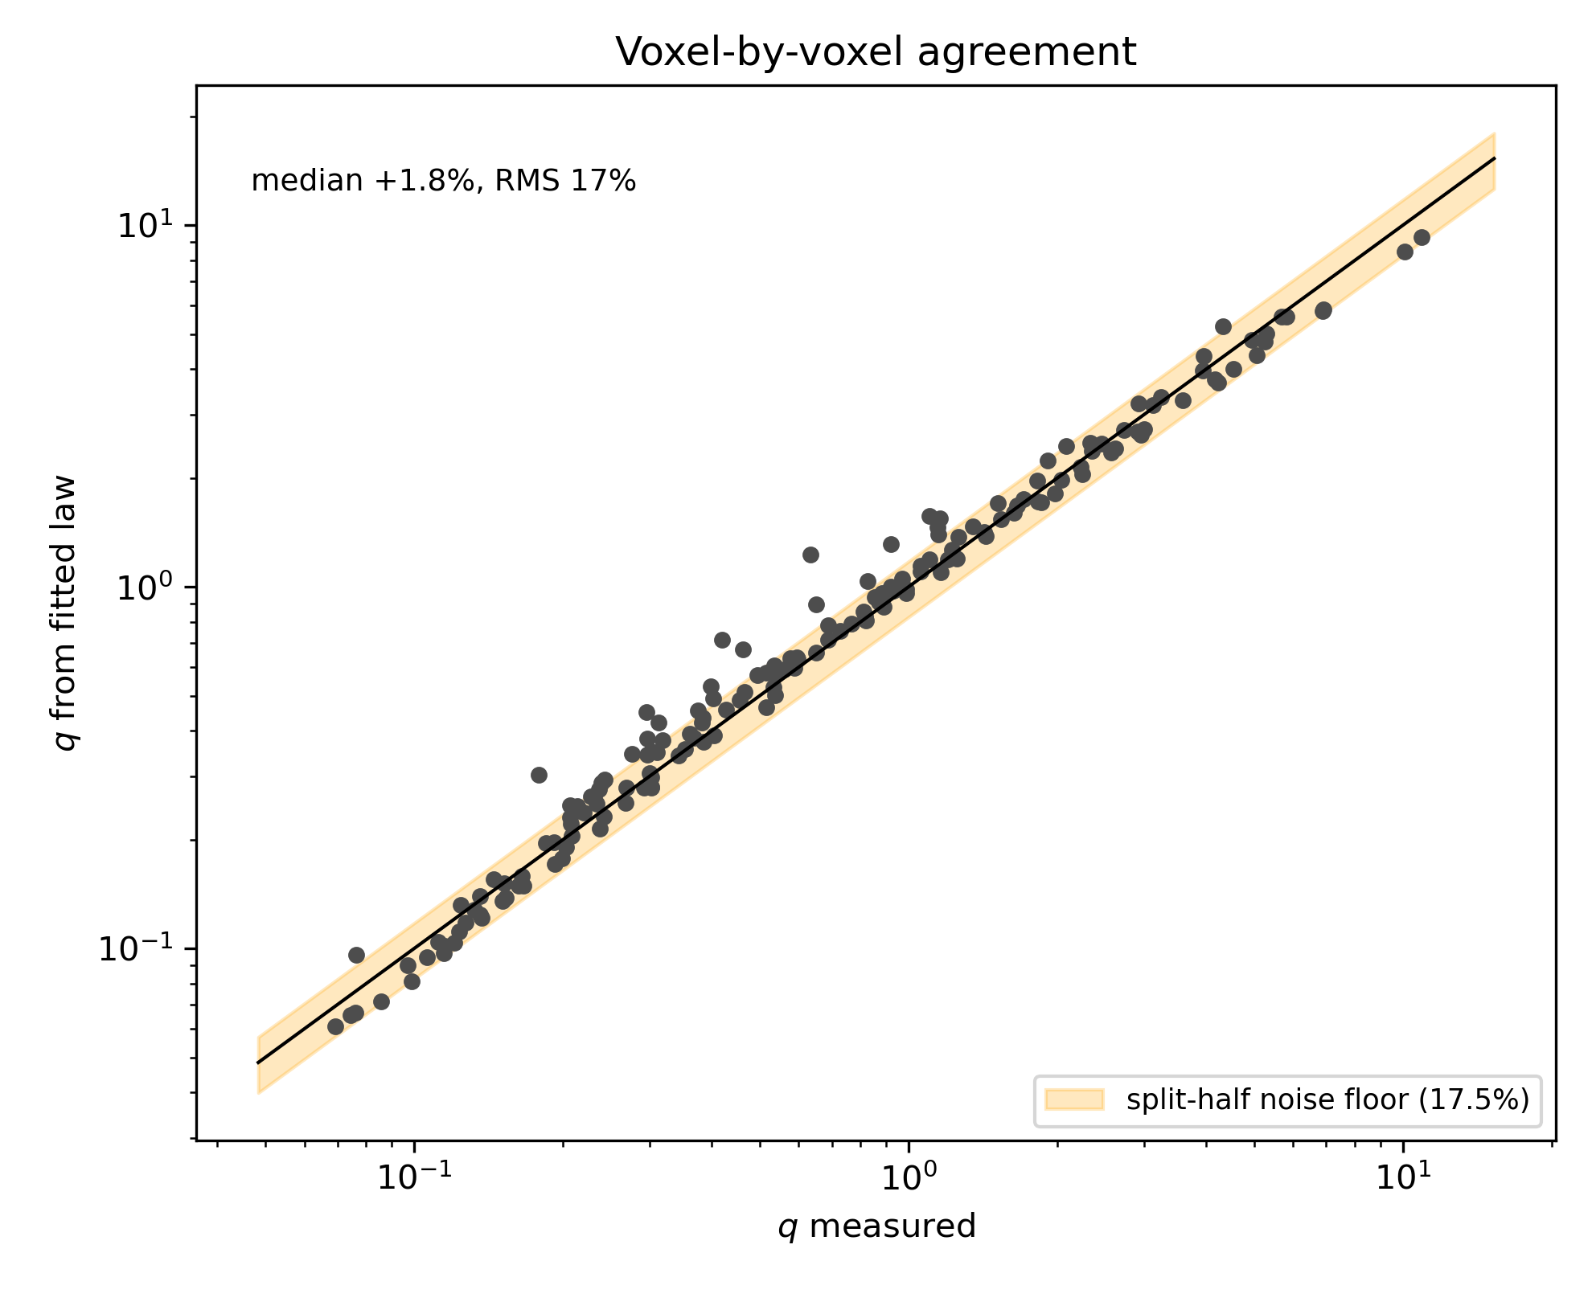
Performance: the plastic-rate field, rebuilt from the law
Measured q against q from the law
Measured: q = 1 − (dτ/dγ)/2μ per cell, first pass
From the law: hazard × mean event size, the mean taken from the fitted P(s | u, τ)
One dot per cell, two decades of q; band = statistical noise floor of this grid, 17.5% (split-half ensembles)
Rebuilt field: median +1.8%, RMS 17%, within the noise. A better law could not score better here
Same factor structure: both versions factorize at 96%, same SR knee, nearly the same constants

Slide 13
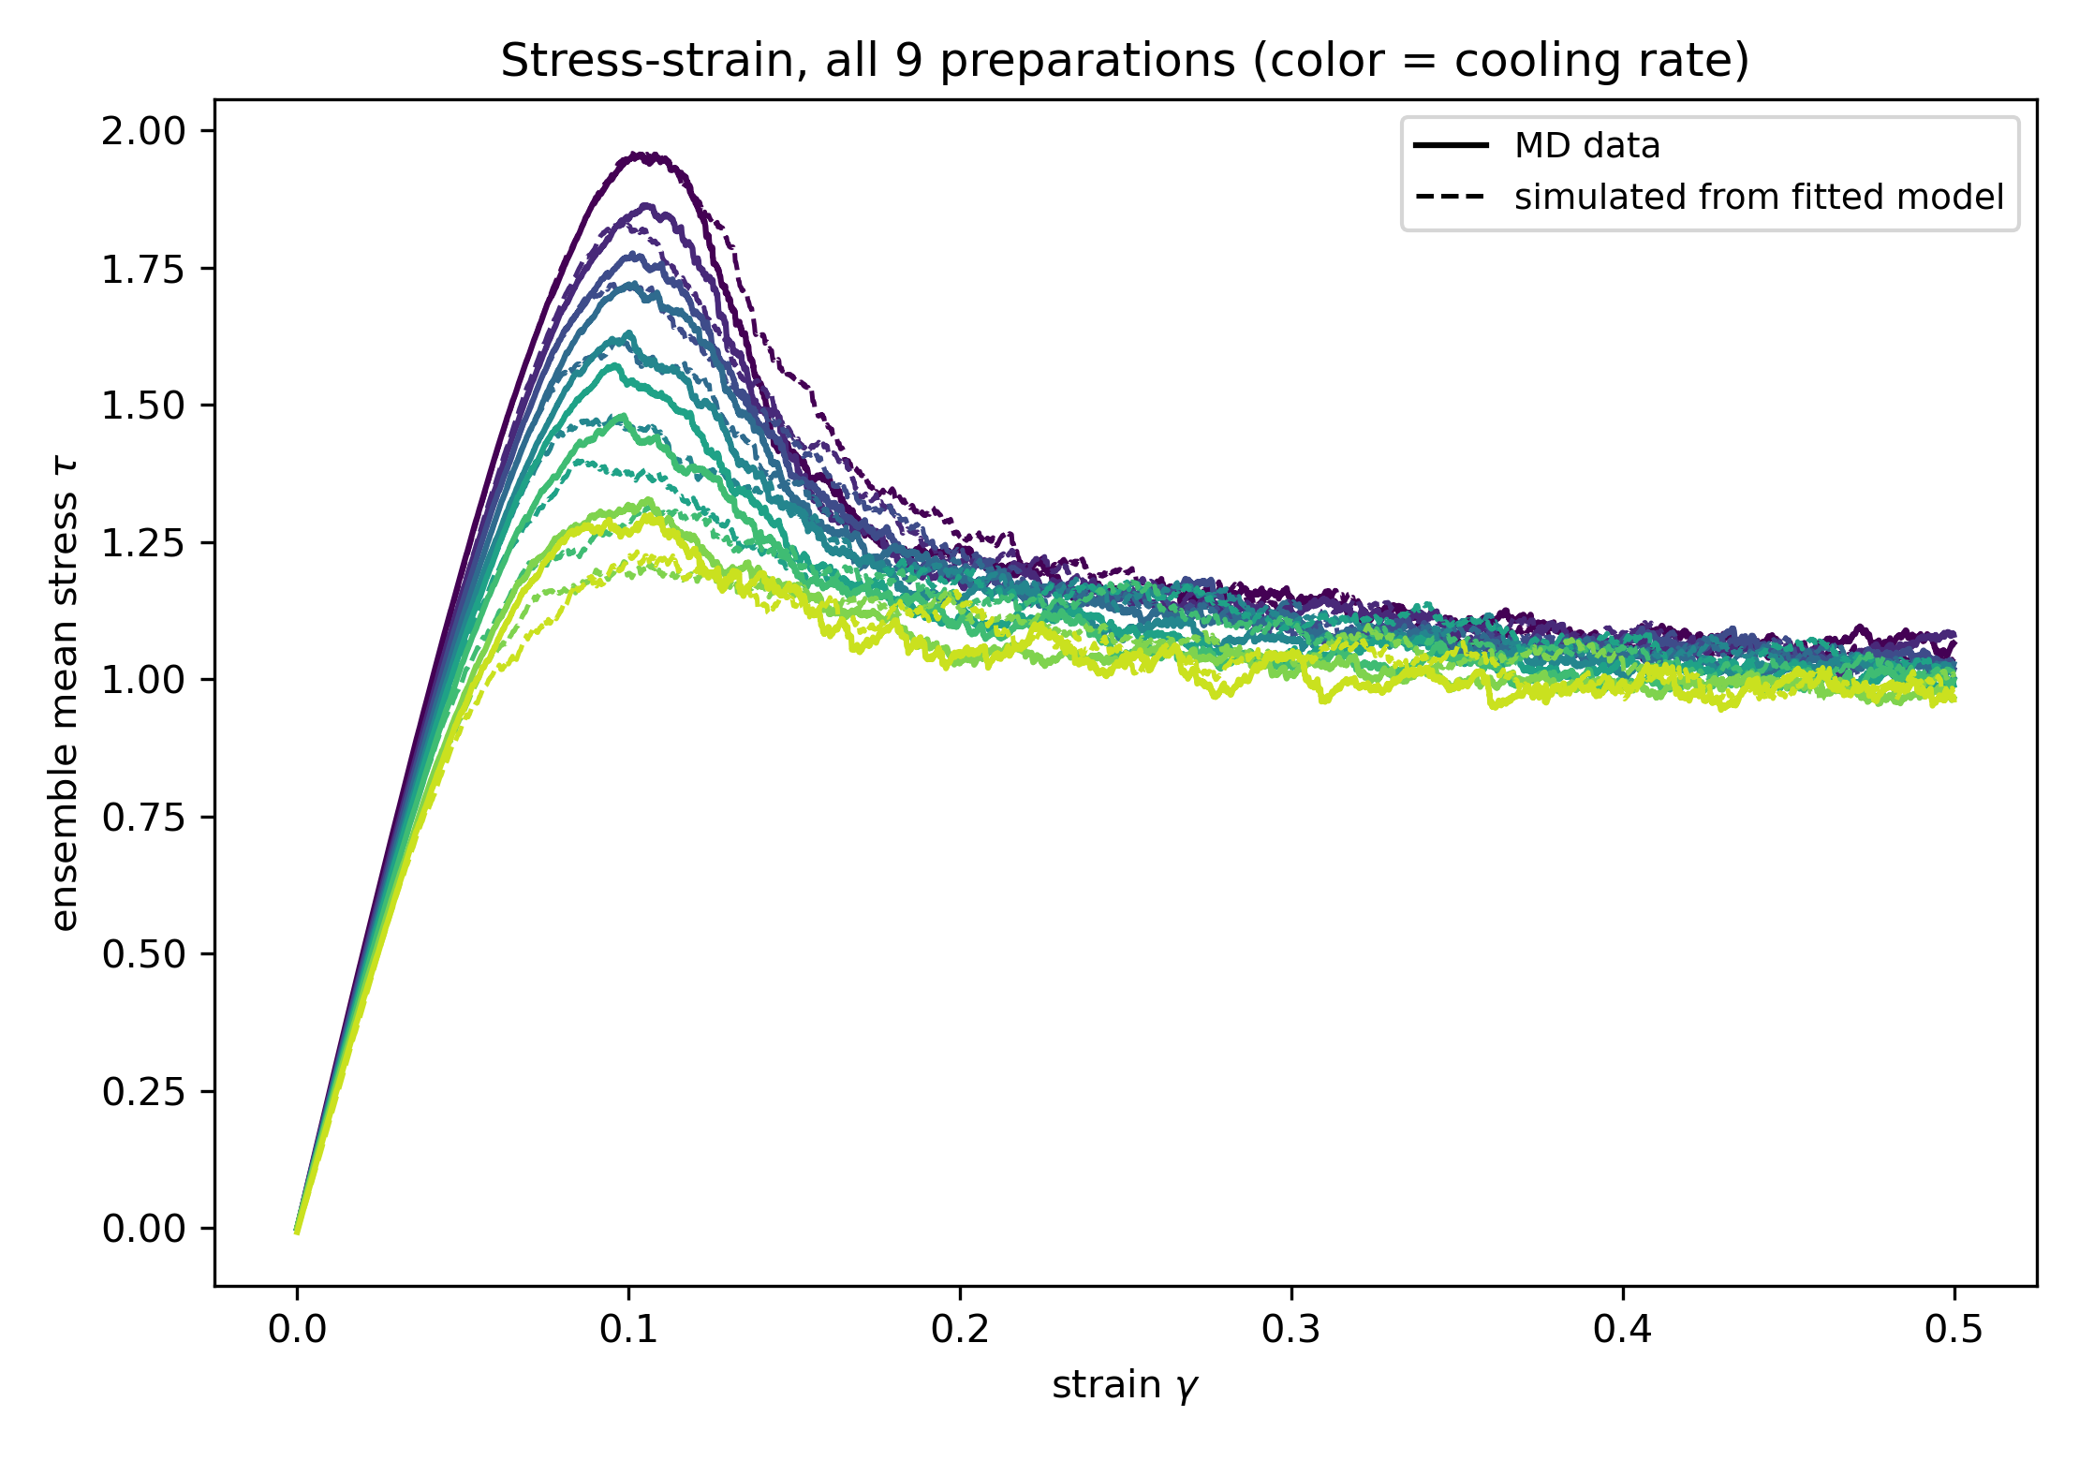
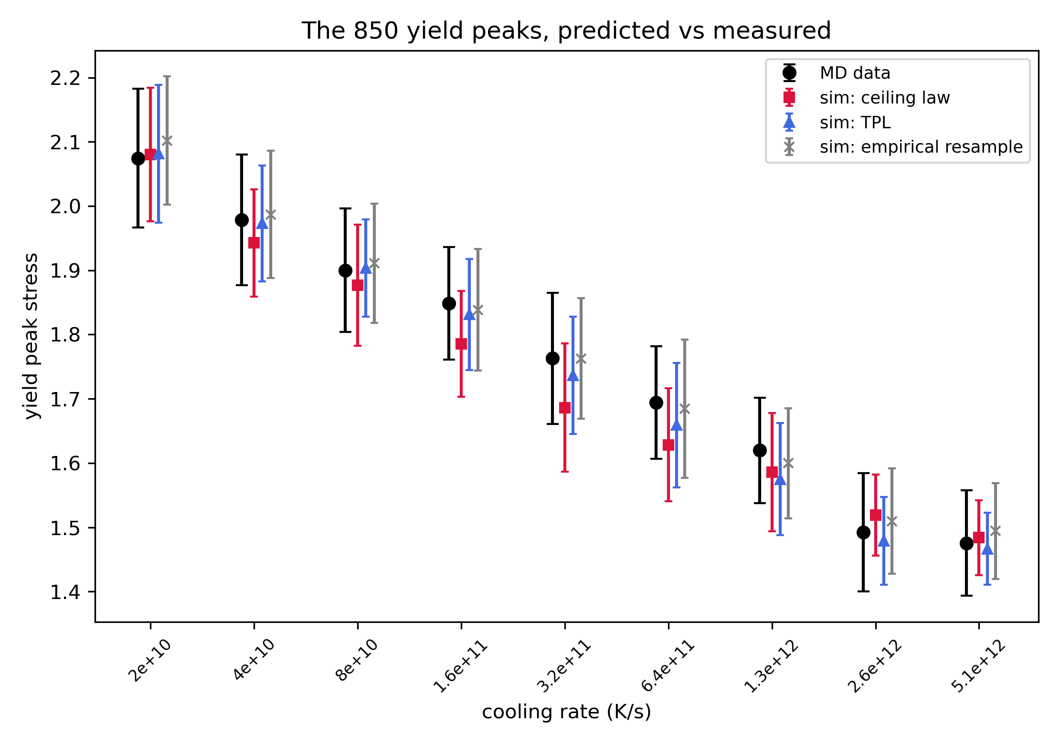
Running the model with the discovered law
All 850 runs, forward from their measured initial states
Each step at Δγ = 10⁻⁵: elastic drift at 2μ, an event with probability p(u, τ), size drawn from the law
MD solid, model dashed: elastic rise, yield overshoot across 256× in cooling rate, post-yield decay, flow stress (±5%)
The 850 yield peaks
Ceiling law RMS 2.5% (worst rate 4.3%); TPL 1.4%; raw-event resampling 0.9%
Peaks feel only the mean event size, so they do not discriminate size laws

Slide 14
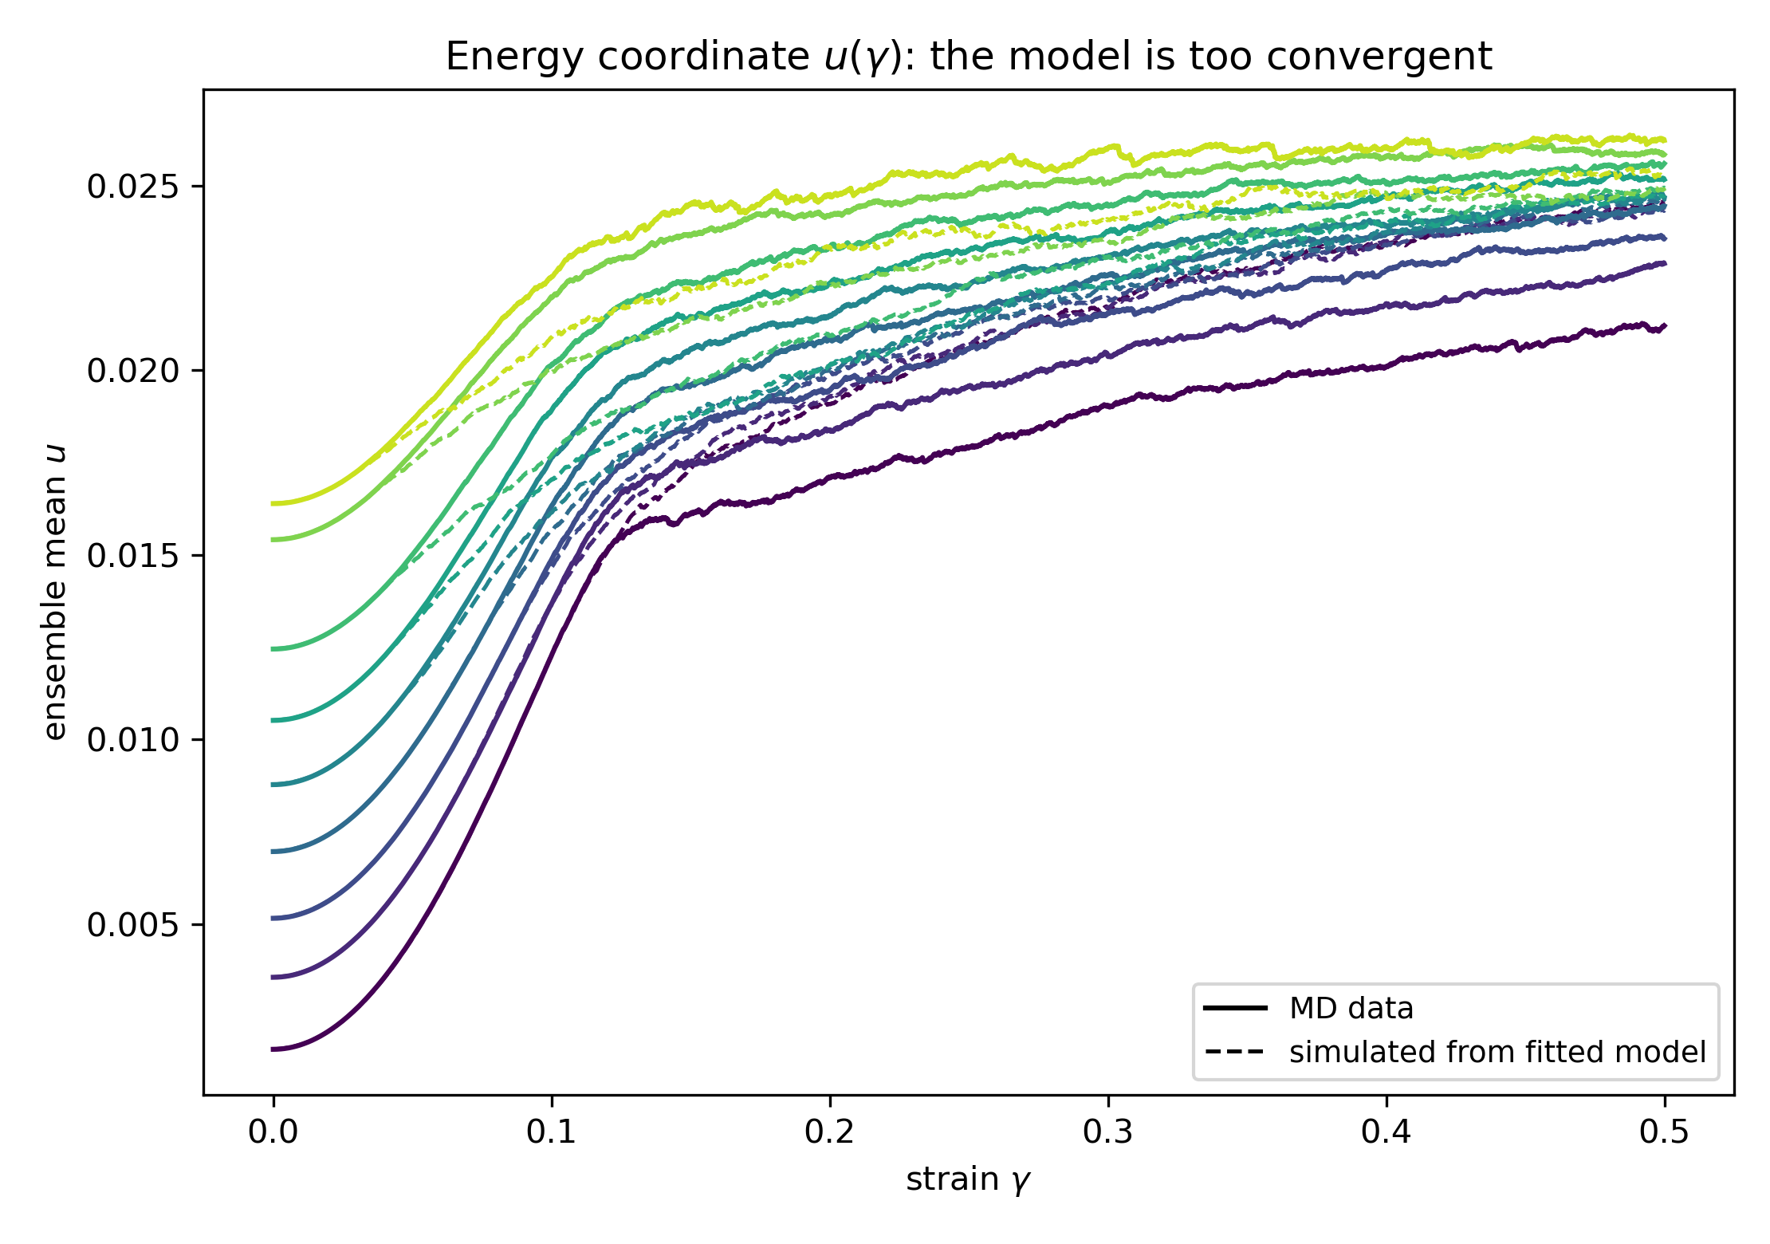
The energy-convergence problem
The same comparison for u(γ)
Early: right. Late: the dashed curves pinch together
Spread of mean u across preparations at γ = 0.5: 24% in the data, 4% in the model
The fields are one map for all histories, so two runs at the same (u, τ) evolve identically however they got there
The data disagree: at the same (u, τ), slow-cooled glass has a 1.71× higher ceiling than fast-cooled
So (u, τ) is not a sufficient state. Which channel carries the missing information?

Slide 15
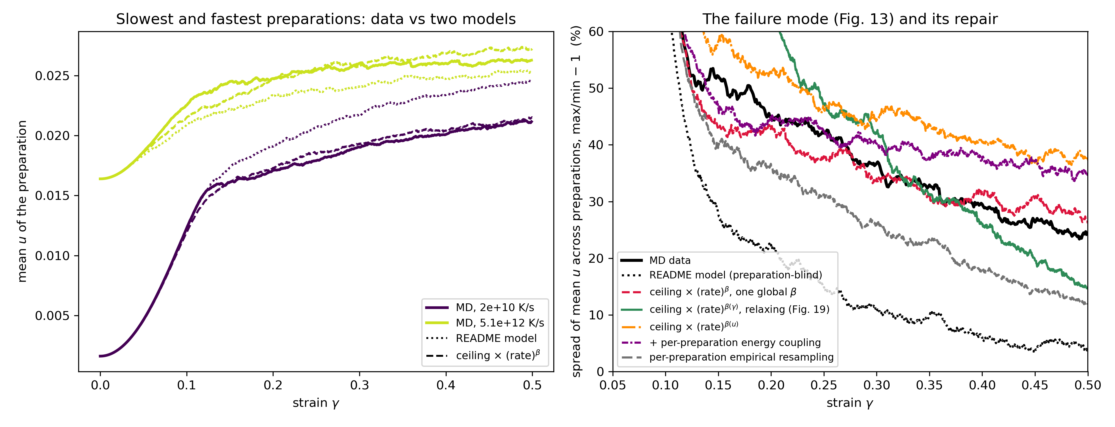
The fix: a one-parameter preparation memory in the ceiling
s_c(u, τ; rate) = s_c(u, τ) · (rate / rate_mid)^β , β = −0.117 ± 0.005
Reading the equation
Only the ceiling is scaled per preparation; hazard, drift, aging, energy coupling unchanged
β: slope of ln(mean event size) on ln(cooling rate) at fixed cell, with cell fixed effects
rate_mid: the middle of the nine rates; factors run 1.38 (slowest) to 0.72 (fastest)
Why the ceiling: the hazard has β = −0.012 ± 0.002 and the drift does not move; the memory is in event size, in the tail
Result
Spread of mean u at γ = 0.5: 4.1% → 26.5%, against 24% in the data, tracking the data across the strain window; yield peaks unchanged (RMS 2.5% → 2.8%)
Within a preparation the same relation, exp(κ·δu₀) with κ = β · d ln(rate)/du₀ = −43 and no new parameter, predicts how long a run remembers its initial energy: 0.44 / 0.27 / 0.22 / 0.17 at γ = 0.1 / 0.2 / 0.3 / 0.5 (data 0.63 / 0.27 / 0.24 / 0.18). The memory relaxes with strain, γ_r ≈ 0.2

