Slide 1
SEEM – Symbolic Regression
for Constitutive Law Discovery
SEEM/LYS Meeting - September 4, 2026

Slide 2
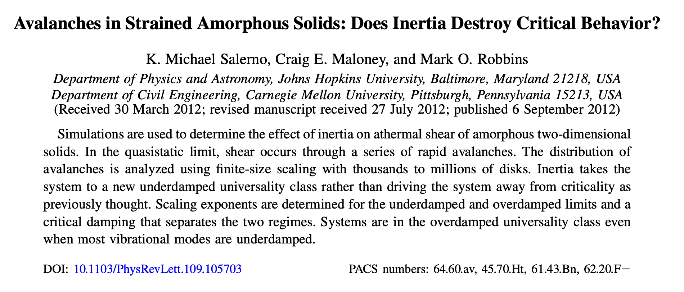

Slide 3


Slide 4


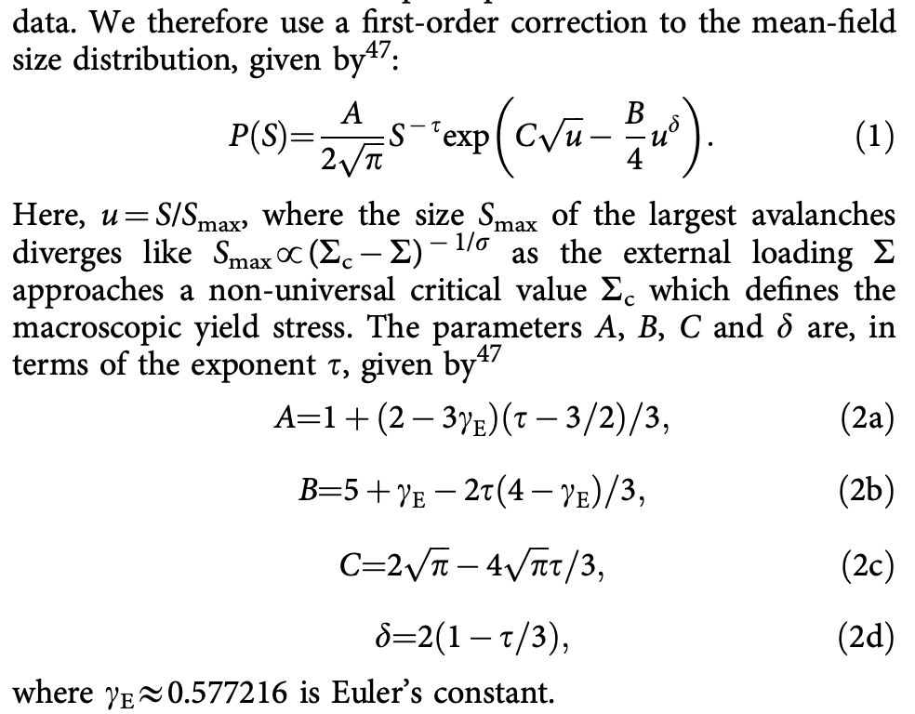
Truncated power law
“we find that a simple exponential tail does not fit our data.”

Slide 5
Variables
γ applied shear strain; one step is 10⁻⁵, runs go to 0.5
τ shear stress (raw stress ÷ 10⁴)
u = pe − u₀ PE/atom above the reference u₀ = −4.60752
(u, τ) two-coordinate state of a run; 20 × 20 grid
2μ(u, τ) elastic modulus
s = −Δτ an event: a step where the stress drops, of size s
ρ(s) density of events of size s
p(u, τ) probability per step that an event occurs
P(s | u, τ) size distribution of events at a given state
s_c(u, τ) the largest event a state can produce
k, m, ε constants
q(u, τ) plastic fraction of the strain rate: 0->elastic, 1->steady state
eq.-> q = 1 − (dτ/dγ)/2μ
aging event a step where u drops but τ does not (105,188); it relaxes energy without releasing stress

Slide 6
The symbolic-regression library (library/symreg.py)
What it does
Given points (x, y), it searches for a formula y = a·f(x) + b
Uses a library of operators (exp, log, 1/x, x², √x, and + − × ÷) with up to two fitted constants inside f
Enumerates every formula up to a complexity budget
Returns the exact Pareto front: the best misfit at each complexity
How it was used here
Target: the (20)binned log-density ln ρ(s) in one grid cell
Run on 12 cells spanning the state plane (700 - 7,600 events each), plus variants with unweighted bins and a wider size window
Budget a complexity of 8: 624,936 formula trees per cell, ~10,300 distinct admissible functions
Just to check – another run at complexity 9 (4.5 million trees) shows only mild improvement

Slide 7
Symbolic Regression at Each Complexity
budget | form found | misfit | what it is
1 | s | 1.22 | a straight line
3 | log s | 0.30 | pure power law, ρ ∝ s⁻ᵏ
5 | log(s + 4.6×10⁻⁴) | 0.21 | power law rounded off at small s
6 | √log(1/s) | 0.143 | fails the likelihood test (ΔAIC ≈ +20,000) [Akaike information criterion, for next time]
7 | √log(0.79/s) | 0.142 | same as above
8 | log(1/(s + 1.6×10⁻⁴) − 2.25) | 0.118 | the ceiling law (below)
9 | s + √(−0.93 − log s) | 0.103 | same as earlier, now with another term; still loses under likelihood
How the complexity-8 form becomes the law
The fit is ln ρ = a·f(s) + b with f = log(1/(s + ε) − C). Exponentiating: ρ ∝ [1/(s + ε) − C]ᵃ = [C(s_c − s)/(s + ε)]ᵃ with s_c = 1/C − ε
So the search hands over a bounded form with tied exponents, m = k = a. The likelihood stage then frees m from k (8 of 8 cells prefer it)
Complexity 9 still lowers the misfit, but only by promoting a family the likelihood had already rejected. No new family appears, and the complexity-8 knee is unchanged

Slide 8
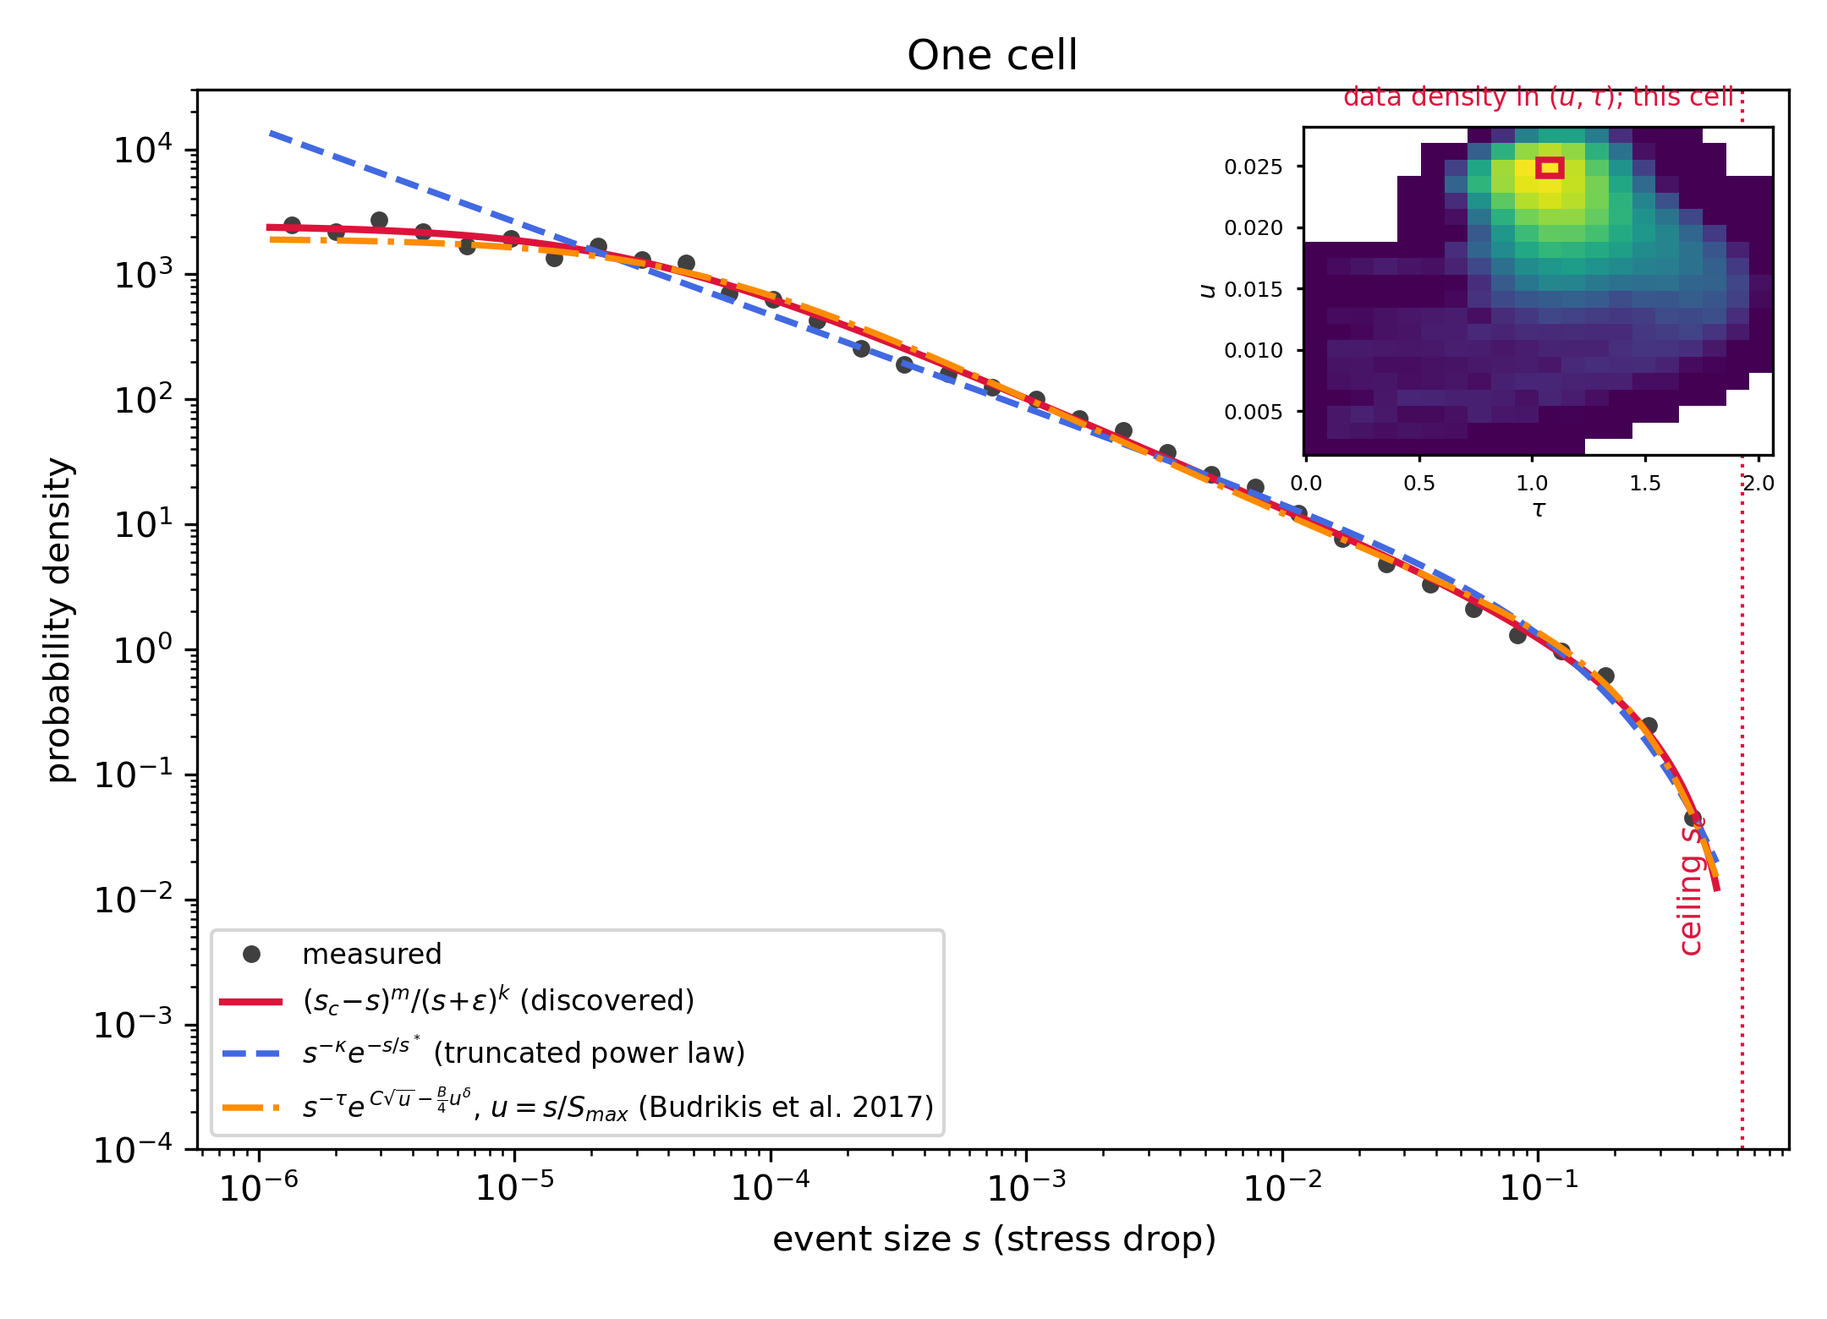
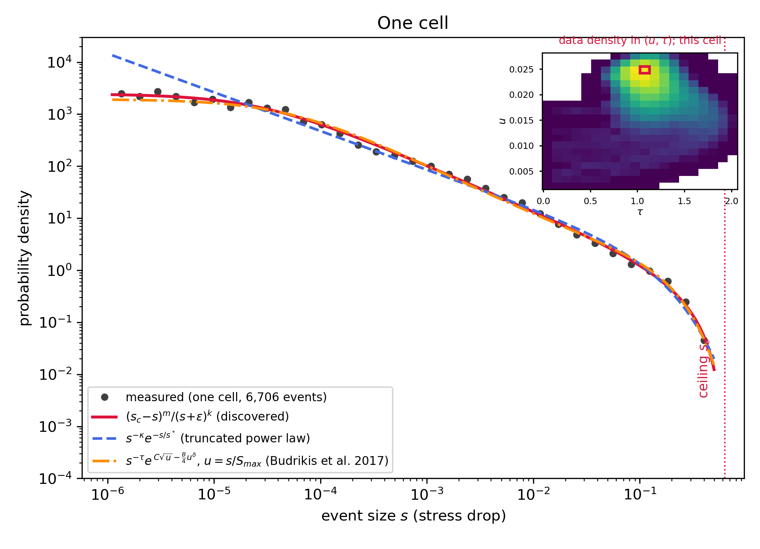
Performance: one cell, three candidate laws
The largest cell, 6,706 events, five decades of s
Black: measured density. Red: ceiling law. Blue dashed: best truncated power law (TPL). Green dotted: best lognormal
All three are maximum-likelihood fits of proper densities on the same events
Only the ceiling law gets both ends: the flattening below 3 × 10⁻⁵ and the stop at the dotted line (s_c)
The TPL tail decays too softly and overshoots
Full range: ceiling law over TPL by ΔAIC 200 to 345

