Slide 1

CCS356-OBJECT ORIENTED SOFTWARE ENGINEERING Railway reservation system
TEAM MEMBERS
K.SABARISH(2330)
F.SAM CHARLES(2333)
U.ERSHAD AHAMED(2308)

Slide 2
PROBLEM STATEMENT
The existing railway reservation system faces various challenges and limitations, necessitating the development of an advanced and efficient Railway Reservation System. The current system is plagued by issues such as manual ticket booking, long queues, data inconsistencies, and limited accessibility. The current system has allotted our seats automatically so we recover this problem and book exact seats our wishes like a movie tickets. Some additional facility like current ticket booking system and order foods while traveling. Limited online reservation will be recover.

Slide 3
ABSTRACT
The Indian Railway Reservation System is a web-based platform designed to simplify the process of booking railway tickets and managing reservations online. As the backbone of transportation in India, the Indian Railways faces challenges related to seat availability, real-time charting, and passenger convenience. Our project aims to address these issues by implementing dynamic seat allocation and real-time charting. Passengers can book tickets from anywhere, even while the train is in motion, and ticket collectors receive live updates on bookings. By leveraging modern technology, we enhance efficiency, convenience, and passenger experience within the Indian Railway System.

Slide 4
LITERATURE SURVEY
Reference IEEE papers
Advanced Train Reservation And Passenger Intimation With Safety System
online booking and purchase of travel tickets for railway
Railway E-Verification Information and tickting system

Slide 5
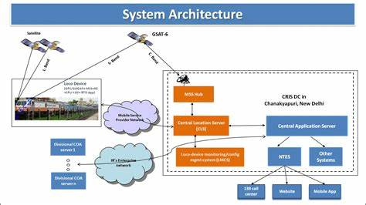
ARCHITECTURE

Slide 6
PROPOSED SYSTEM
1.Front-End Development:
- HTML
- CSS
- Bootstrap
2. Back-End Development
- Java [J2EE]
- JDBC
- Servlet
- Oracle ( SQL )
3.Software And Tools Required
- : Git
- : Java JDK 8+
- : Eclipse EE
- : Apache Maven
- : Tomcat v8.0+
- : Oracle (SQL) / SQL PLUS
- : Oracle SQL Developer

Slide 7
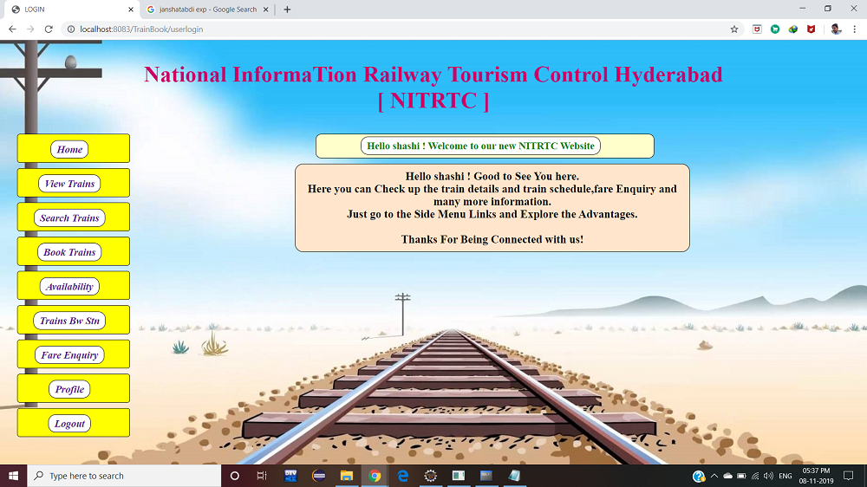
Home

Slide 8
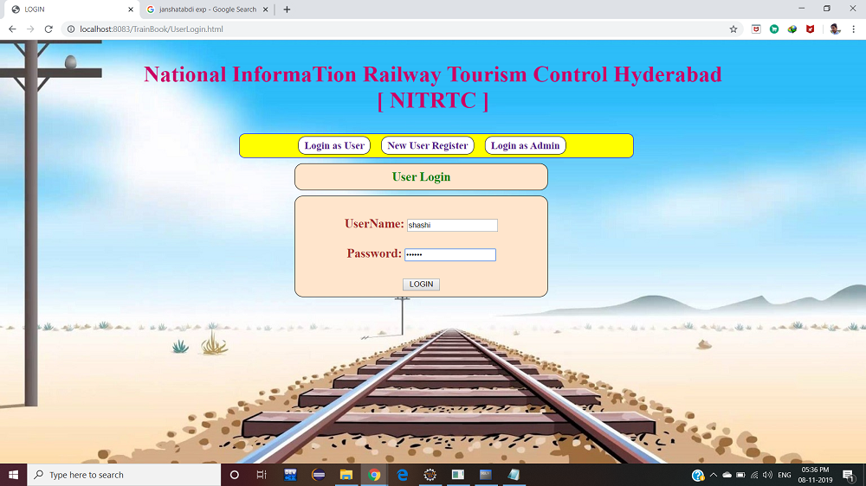
Login

Slide 9
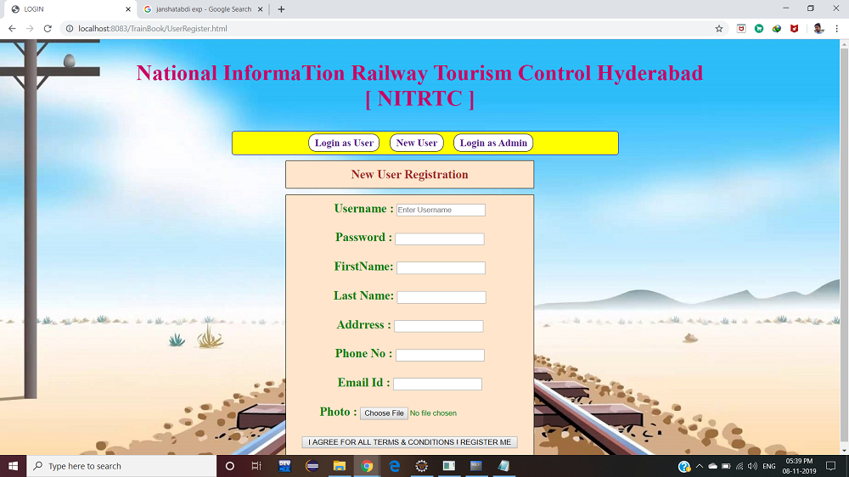
New user

Slide 10
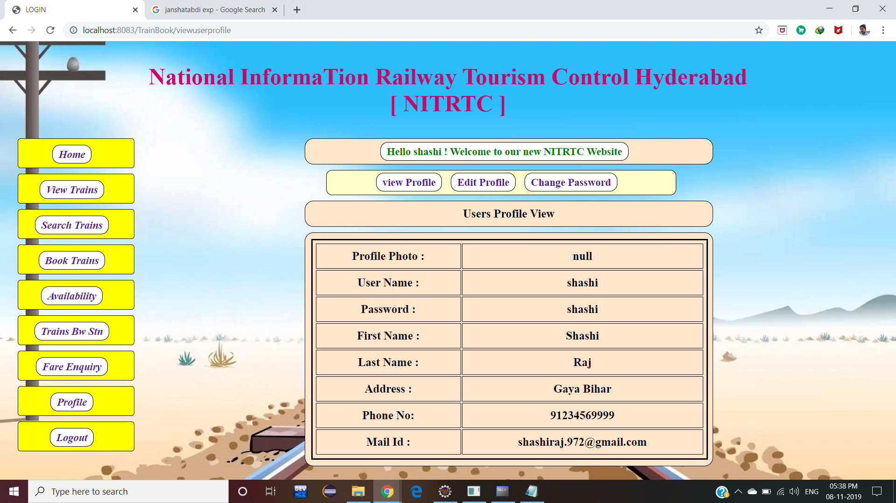
Profile

Slide 11
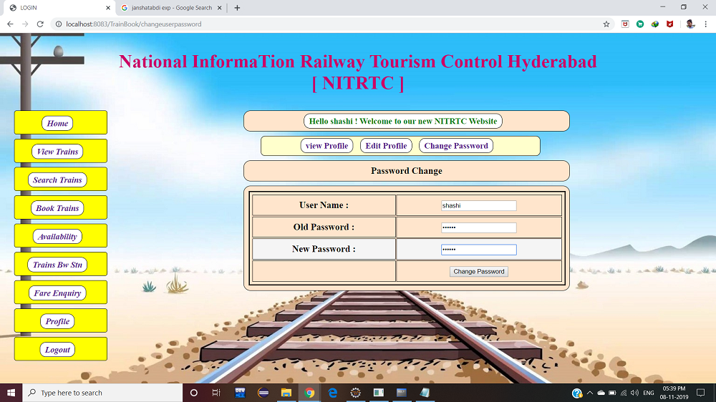
Change Password

Slide 12
THANK YOU

