Slide 1
IIT-MADRAS BUSINESS DATA MANAGEMENT
CAPSTONE PROJECT
Case Study of “TRIPATHI Kirana Store”
(RETAIL METRICS UNVEILED: A DEEP DIVE INTO GENERAL STORE PERFORMANCE)
By: SAURABH YADAV 23F1003171
(23F1003171@ds.study.iitm.ac.in)

Slide 2
CONTENTS
Executive Summary
Introduction to Business
Data Collection & Cleaning
Data collection & cleaning steps
Data Analysis
Analysis done in respect to the challenges
Findings
Recommendations
Important Insights about business
Solutions / Recommendations for business

Slide 3
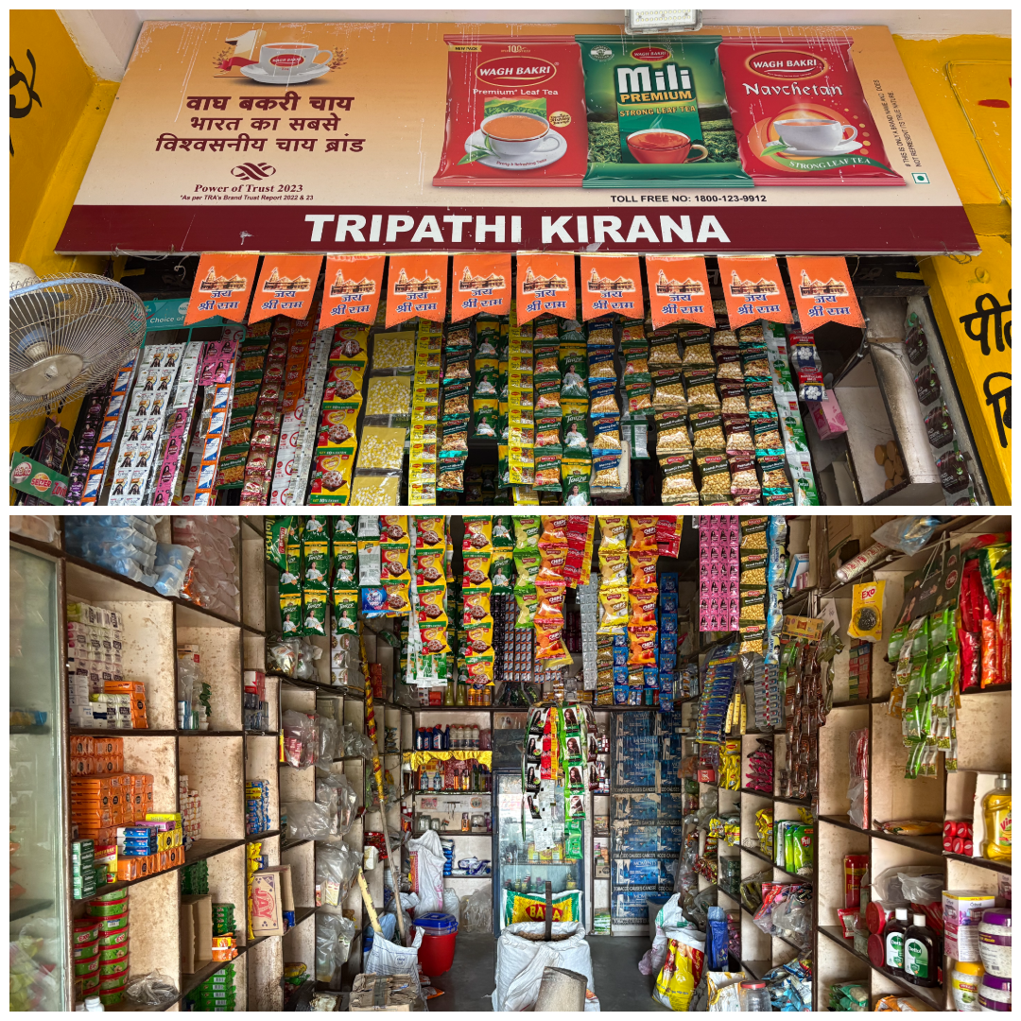
Introduction to Business
The business from where I collected data is a medium-sized retailer grocery shop, started by “Mr. Harvendra Tripathi” in early 2005.
The business deals primarily in grocery products such as Atta, Arhar Dal, Urad Dal, Rice, Ghee and many more
Unfortunately, the shop has been facing challenges in terms of Profit, Sales & Inventory Management

Slide 4
Data Collection and Cleaning
I collected data from informal bills and previous records, but since it's from an unorganized business, the data is in an unorganized manner.
I extracted data for 9 products from a long list.
The collected data for analysis was “Primary data”, mostly in an informal way, as it was from an unorganized business.
To clean the data, I used an Excel spreadsheet. Additionally, I used Excel for all my data manipulation and analysis.

Slide 5
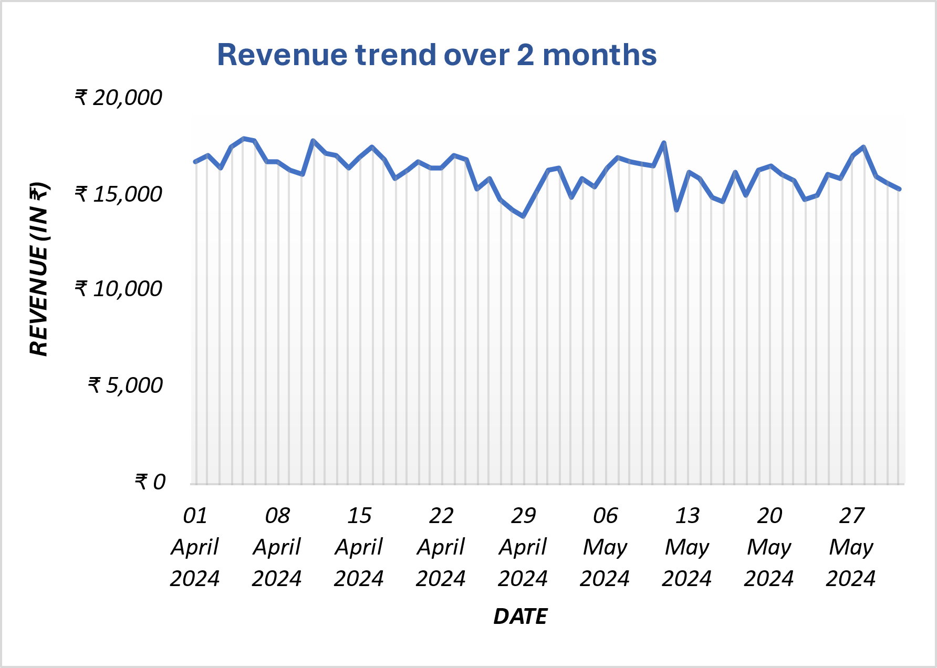
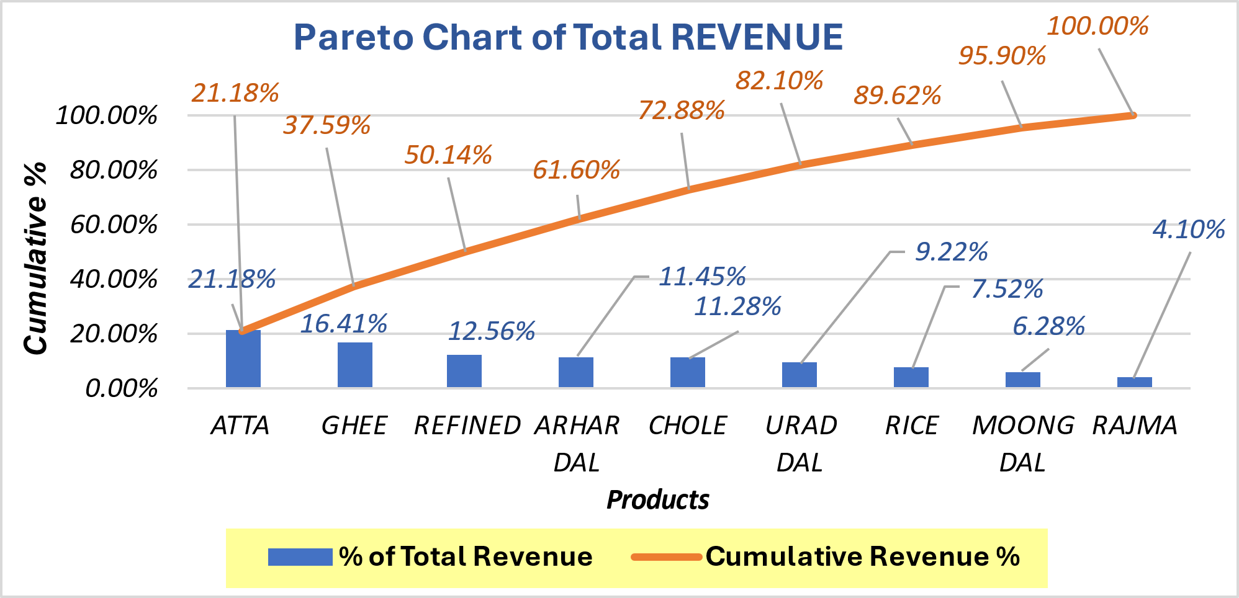
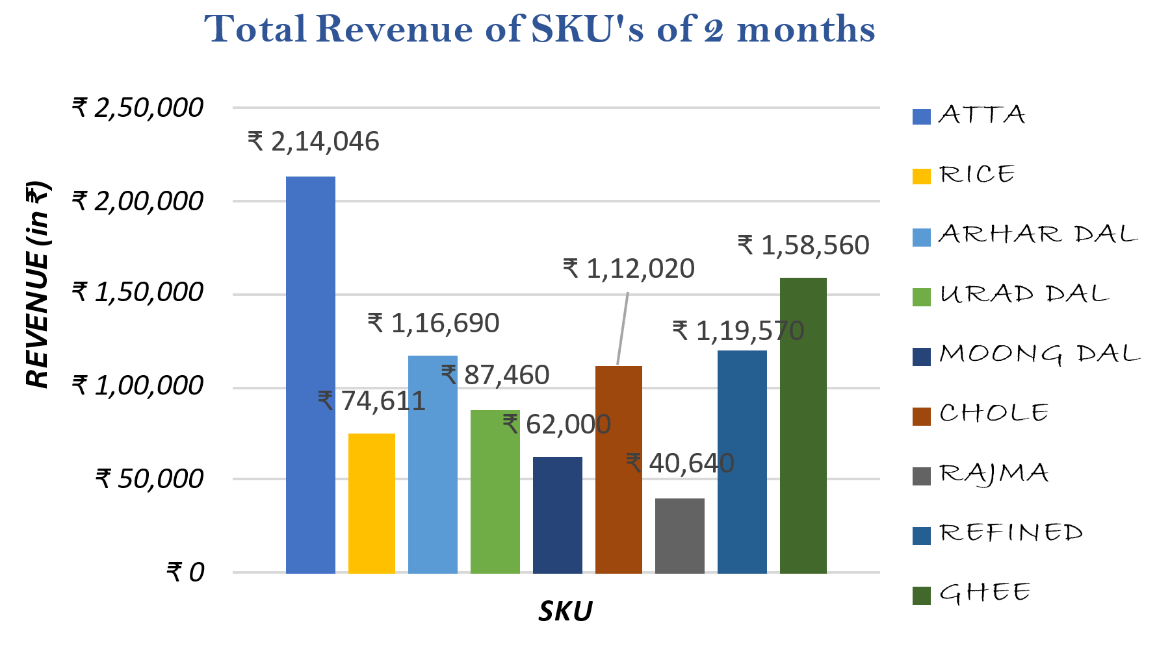
Data Analysis - Sales
Average Daily Revenue | ₹ 16,157.33
Std. Deviation | ₹951.14
Min Revenue | ₹13,825
Max Revenue | ₹17,904
Range | ₹4,079
Atta, Ghee, Refined, Arhar Dal & Chole contribute approx. 80% to total revenue
Atta, Ghee & Refined are the main revenue generating SKU’s

Slide 6
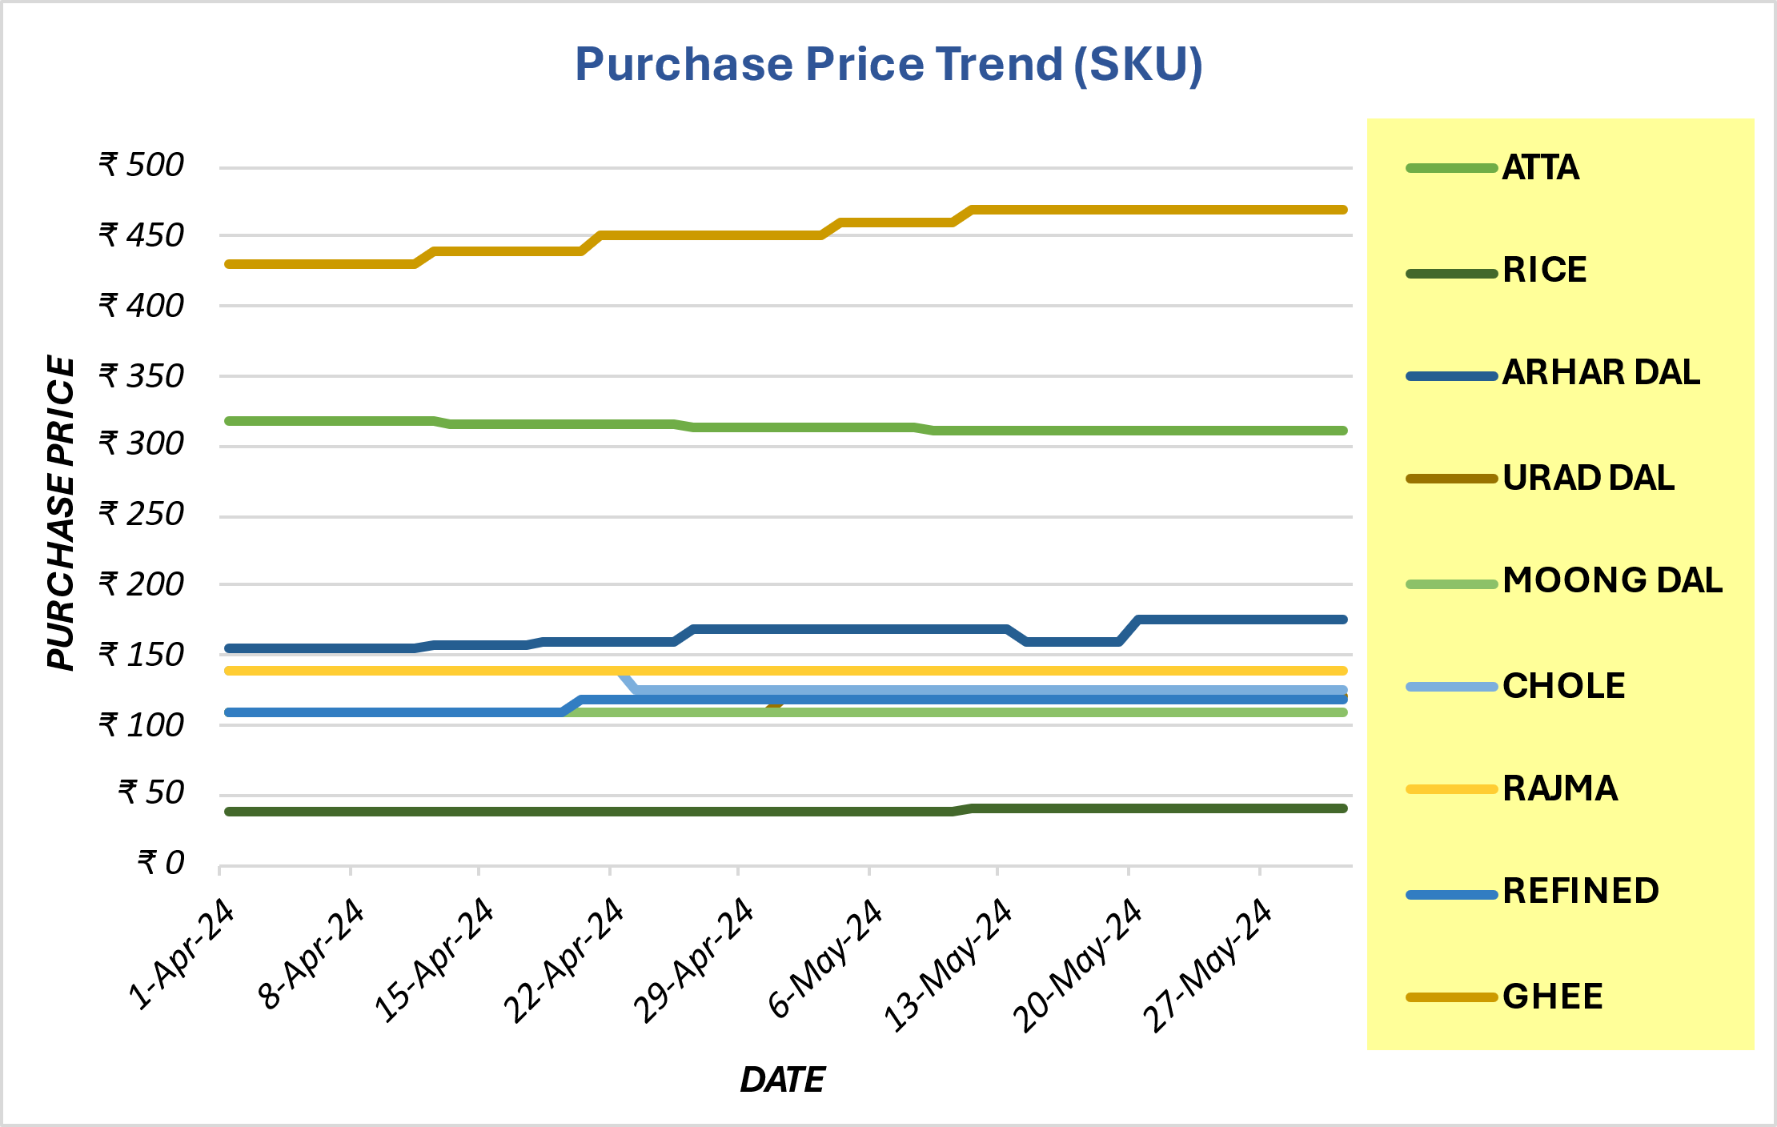
Data Analysis - Purchases
Stable Prices
Minimal variation in Rice, Rajma, Urad Dal & Refined ensures consistent supplier pricing for budgeting.
Increasing Trends
Upward trend in Ghee indicates higher demand or supply issues.
Decreasing Trends
Downward trend in Atta & Chole suggests lower demand or improved supply.
Fluctuations
Price dips and rises in Arhar Dal point to unstable supply or seasonal pricing.
Flat but High Prices
Steady high prices in Moong Dal impact profitability despite predictability.

Slide 7
Data Analysis – Profit/Loss
Ghee & Chole are the SKU’s that holds maximum profit generating capacity.
Rice (5%), Refined (5%) & Arhar Dal (5%) profit margin % needs to be improved to maximize its Net Profit.
Ghee, Chole, Urad Dal, Arhar Dal & Moong Dal contribute approx. 80% to total profit.

Slide 8
Data Analysis – Inventory
Chole, Moong Dal, Rajma & Ghee have stock levels significantly higher than their average sales, indicating potential overstocking.
ABNORMALITIES !!
Yes, the owner’s claim of inventory overstock is correct.

Slide 9
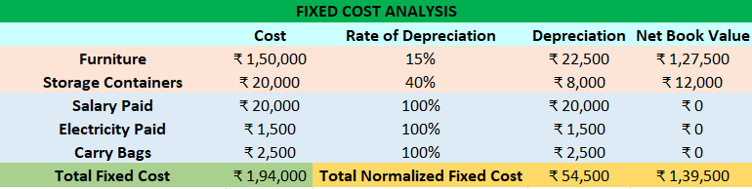
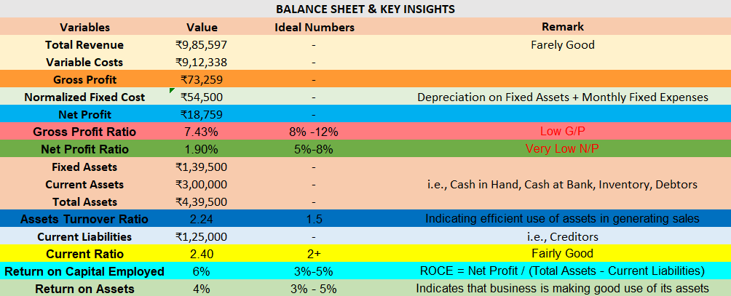
Findings – P/L & Insights

Slide 10
Solutions / Recommendations
Solutions to tackle with the business challenges
Increase sales of High-Profit items (e.g., Rajma & Moong Dal)
Enhance Financial Health
Adjust Inventory Re-order Level Before High Sales Periods
Optimize Inventory Levels (e.g., Chole, Moong Dal, Rajma & Ghee)
THANKYOU

