Slide 1
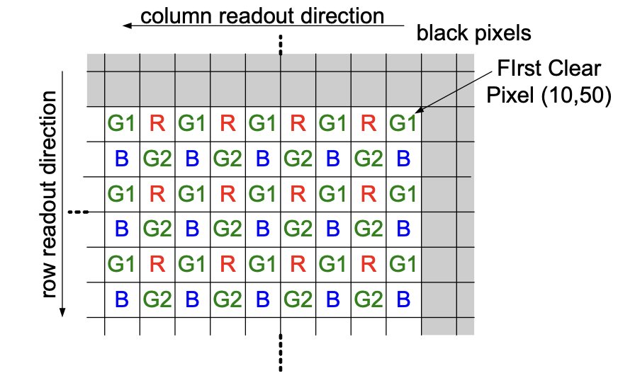
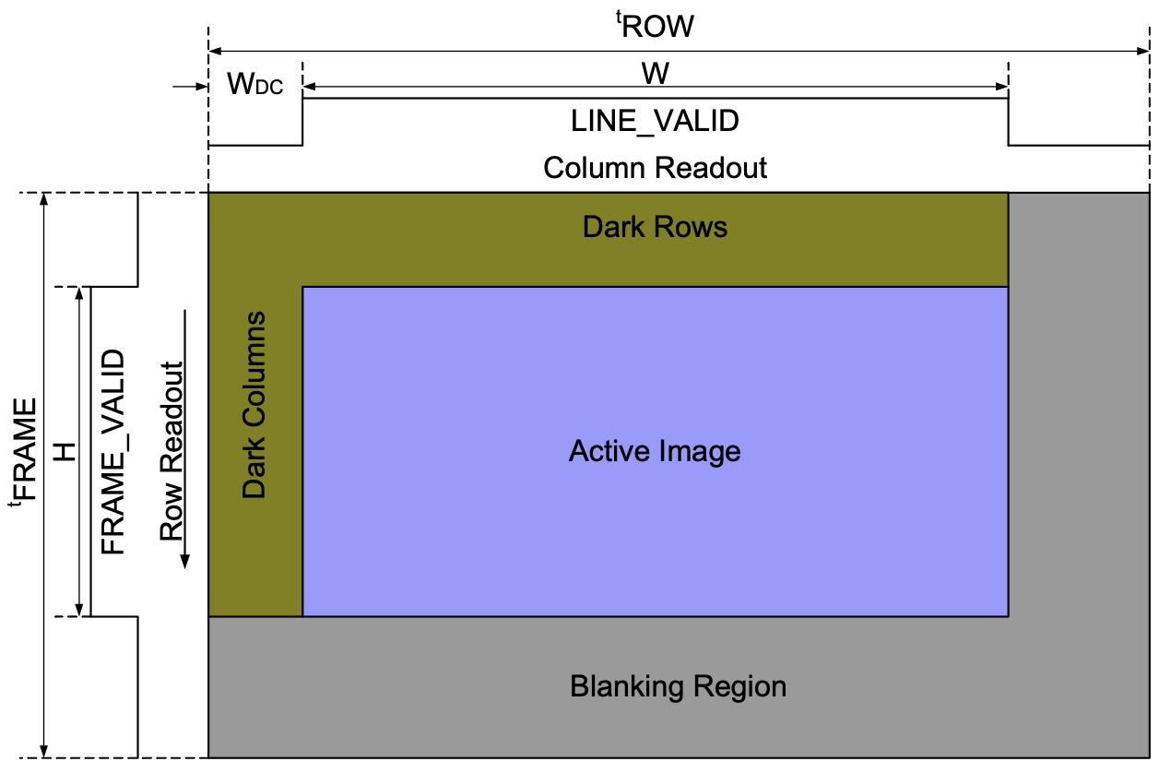
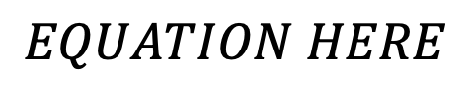
ECE 554
School Seeker
Sam Cooper
Jake Neau
Cullen Krasselt
Nathan Woolf
Harrison Doll
ECE ???
<Team Name>
Project Background
Object Detection
Hardware
The basis of our object detection depends on reading input from the Terasic TRDB-D5M camera and manipulating the camera module into detecting objects. The camera is connected via GPIO on the FPGA and converts analog data to digital in the form of a Bayer pixel array. The array alternates in a pattern of G1RG1R and BG2BG2 as shown in Figure 1.
Figure 1
The pixel readout from the camera to the VGA controller happens at the rising edge of PIXLCLK. To determine whether a complete frame has been shown, we need to detect the falling edge of FRAME_VALID, as shown in Figure 2. With this information, we decided on a simple frame differencing formula (Figure 3) for determining whether there was a moving object in the camera or not.
Object Detection
Figure 2
$$EQUATION HERE$$
Figure 3
Blah blah blah talk about the frame storing/differencing diagram
Servo Driver
Went from YOLO algorithm & Color tracking to singular pixel tracking
Went from differencing every other frame to every frame by shrinking buffers in half, losing half the pixels stored, to store every frame to compare.
ECE Capstone Open House 2024

