Slide 1
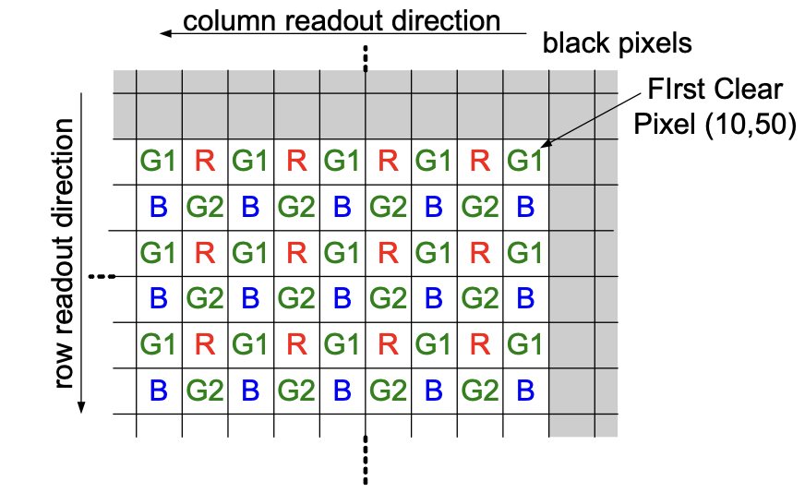
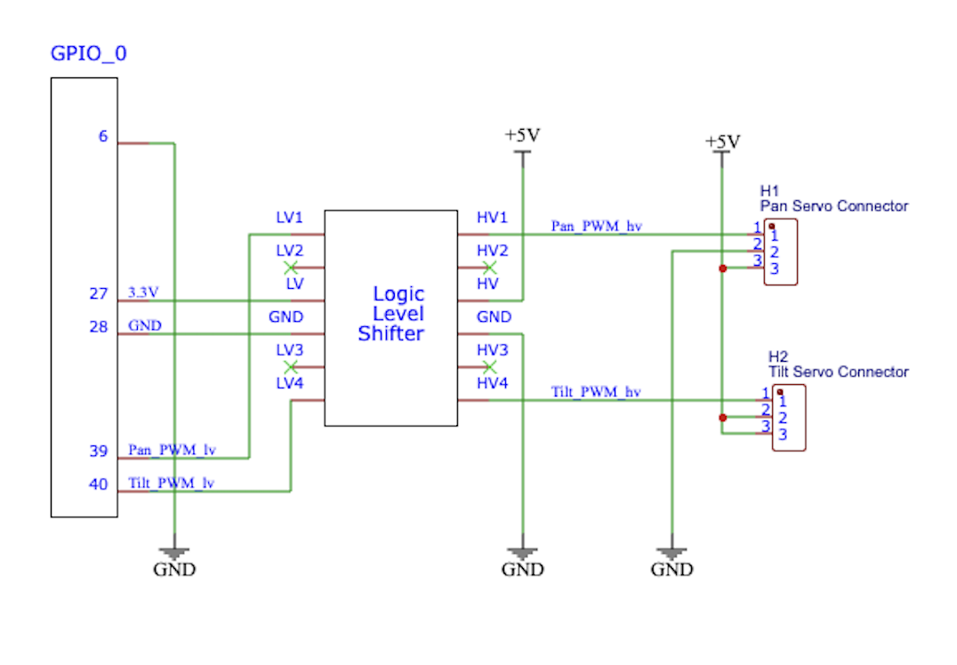
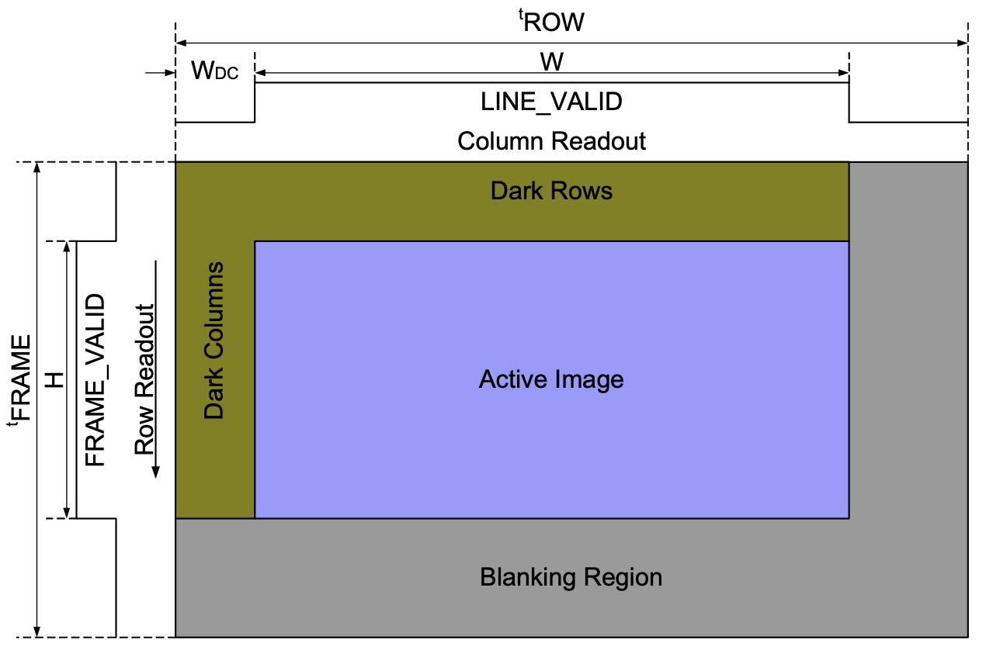
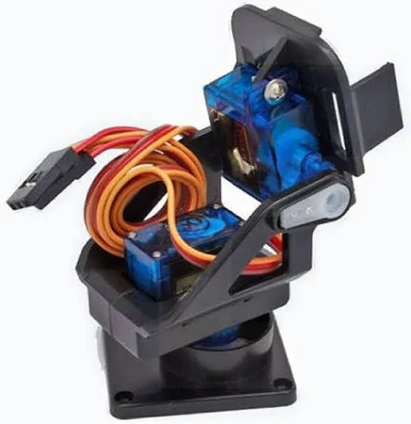
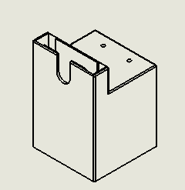
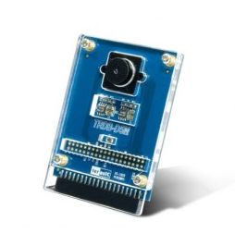
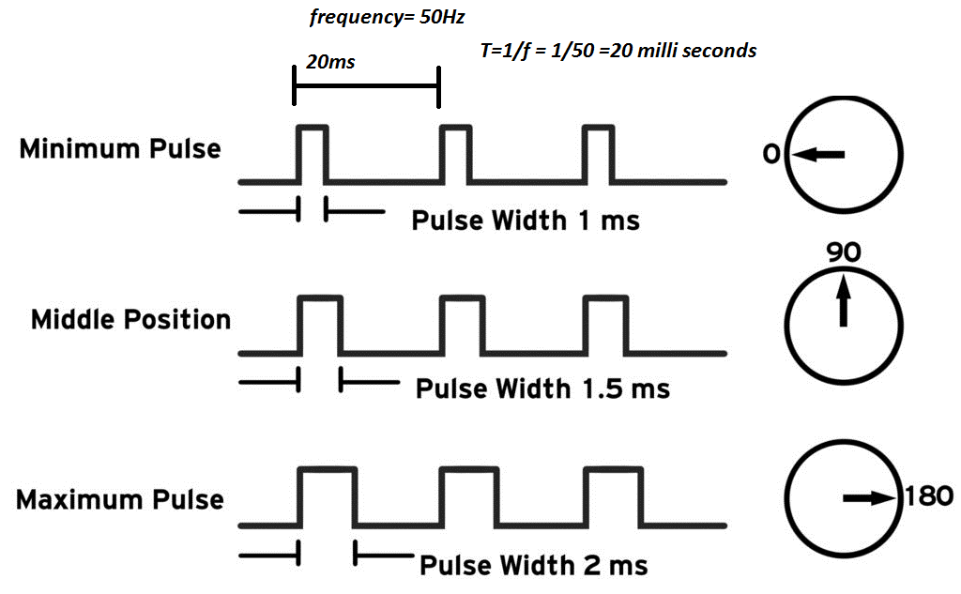
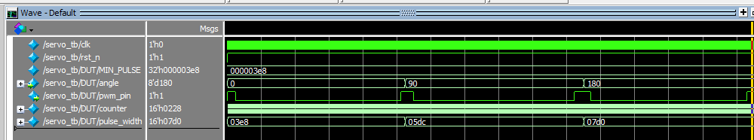
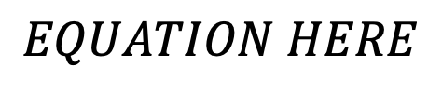
ECE 554
School Seeker
Sam Cooper
Jake Neau
Cullen Krasselt
Nathan Woolf
Harrison Doll
ECE ???
<Team Name>
Project Background
Object Detection
Hardware
The basis of our object detection depends on reading input from the Terasic TRDB-D5M camera and manipulating the camera module into detecting objects. The camera is connected via GPIO on the FPGA and converts analog data to digital in the form of a Bayer pixel array. The array alternates in a pattern of G1RG1R and BG2BG2 as shown in Figure 1.
In order to make this project possible, a handful of hardware and peripherals were required. All peripherals are interfaced through GPIO signal pins.
Logic Level Shifter:
In support of FPGA logic, we were required to implement an external digital circuit to step-up the PWM logic levels for the servos. Due to the physical limitation of the FPGA’s GPIO output maximum voltage-current rating being set to 3.3V/1.5A, we were not able to drive the servo motors to their demanded 5V.
Figure 1
Logic Level Shifter High Level Schematic
The pixel readout from the camera to the VGA controller happens at the rising edge of PIXLCLK. To determine whether a complete frame has been shown, we need to detect the falling edge of FRAME_VALID, as shown in Figure 2. With this information, we decided on a simple frame differencing formula (Figure 3) for determining whether there was a moving object in the camera or not.
Additionally, this project integrated an off-the-shelf pan-tilt servo mount composed of two SG90 servo motors. One motor is responsible for moving in the horizontal direction, while the other controls the vertical position. As shown in the picture to the right
One of the important hardware components of our project was aligning the camera and laser setup so they were relatively in the same spatial planes. Therefore, the team decided to 3D model a mount for both the camera and the pan-tilt servo apparatus. The model was 3D printed at the Makerspace.
Translation Layer
Figure 2
$$EQUATION HERE$$
Figure 3
The project also made use of an off the shelf laser module for assigning the directionality of the system. We decided this sufficiently emulated the targeting nature of the system without using a projectile.
Blah blah blah talk about the frame storing/differencing diagram
Servo Driver
To control the servos, the team decided to assemble servo driver modules to make their control simplified regardless of how position was communicated from image processing. The image to the right briefly describes how a servo motors PMW signal should be structured to achieve the desired servo horn position. The bounds of this specification were the motivating factoid to our servo driver. The formula relating servo horn position to duty cycle can be seen here:
Duty Cycle = 1000 + ( (degree_val * 1000.00) / 180)
The resulting duty cycle has units of microseconds, this ultimately gives a greater degree of accuracy than if we used floating point or another means of data representation. Successful simulation waveforms can be seen below highlighting the duty cycles from the image above
Went from YOLO algorithm & Color tracking to singular pixel tracking
Went from differencing every other frame to every frame by shrinking buffers in half, losing half the pixels stored, to store every frame to compare.
Furthermore, the driver modules are parametrized to enable “overclocking” of the PWM signal frequency. Since the duty cycle, or the high pulse, of the period is constant (i.e 1ms for 0 degrees and 2ms for 180 degrees) we can shorten the low pulse of the period. This low period is in place to allow the internal comparator of the servo to correct its position. However, within in our application, the servo is constantly receiving new positional commands and thus we can afford the sacrifice in accuracy of position in exchange for greater speeds. For reference, typical hobbyist servo motors operate at 50Hz (hence the 20ms period in the image above). In this application, we were able to push our servos closer to 100Hz with no apparent fallbacks on accuracy.
ECE Capstone Open House 2024

