Slide 1
Artificial Intelligence
AI Challenges & Responsible AI

Slide 2
AI challenges

Slide 3
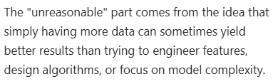
Data Challenges
Data Size: Unreasonable effectiveness of data:
Data Quality: Ensuring the data is free from errors/outliers/missing values/irrelevant features (multicollinearity) and biases is important for reliable model performance.
Data sampling bias: It occurs when certain groups or individuals in the population are more likely to be included in the sample than others. This can happen due to flawed sampling methods, like non-random sampling, or the way the data is collected.
Data sampling noise: It arises because of the random nature of sampling. Even if you sample multiple times from the same population, the results can vary slightly due to chance.
Data drift:
Data leakage:

Slide 4
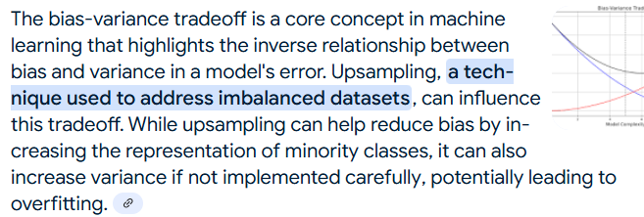
Imbalanced data: Sampling bias/noise Mitigation
Over sampling
Under sampling
Smoke
Enw
Adasyn
Class weight
Bias-variance tradeoff : Both low required (Up/Downsampling)

Slide 5
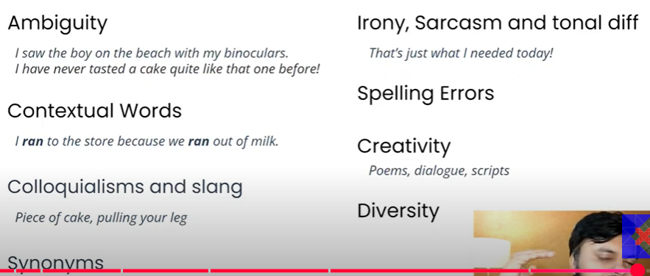
NLP Challenges

Slide 6
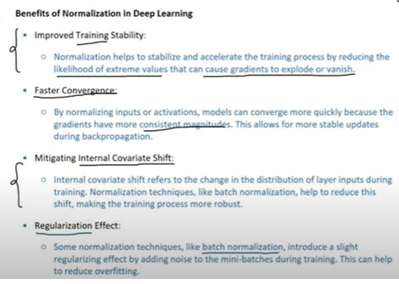
Model Challenges
Overfitting (High Variance Low bias) Prevention:
Regularization
Dropout
Early stopping halts training when validation loss
plateaus
Normalization
Underfitting (High Bias Low variance) Prevention
Increase model complexity, add more layers, or use more sophisticated architectures.
Bias Variance tradeoff (Both low are required but are inversely proportional to each other)
Model Drift

Slide 7
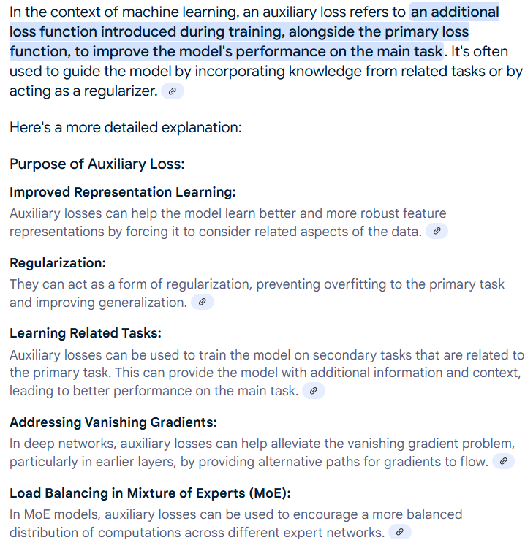

Slide 8
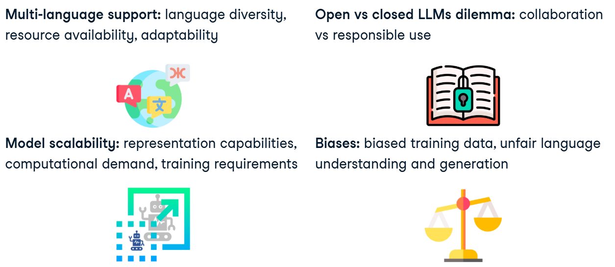

LLM Challenges

Slide 9
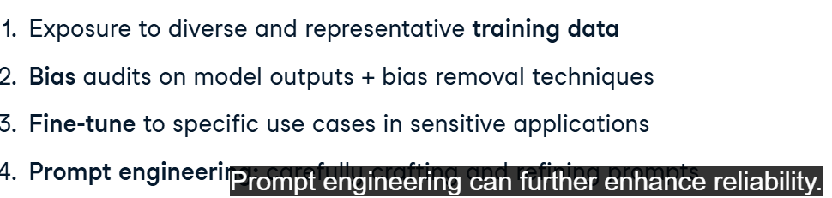
Hallucinations Mitigation
5. KG RAG

Slide 10
Responsible AI
Fairness, Transparency, Privacy, Security, Accountability

Slide 11
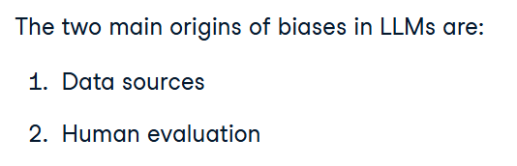
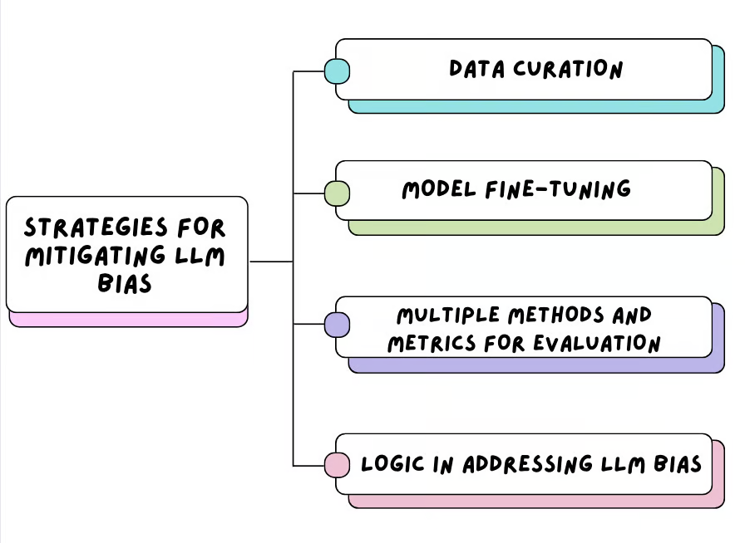
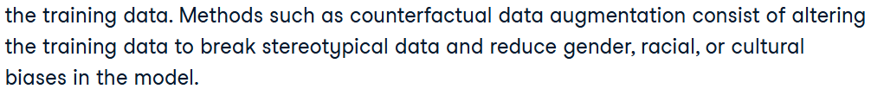
Fairness
AI Bias:
Data Bias:
Sampling bias: Doesn’t represent entire population: Hallucinations due to insufficient data
Confirmation bias: Societal Prejudices (Hiring, Criminal Justice): Bias drift
Development Bias: Algorithmic design flaw
Interaction Bias: Human errors, Data labelling errors
Mitigation:
Bias detection tools (Fairness metrics)
Data quality
Monitoring, retraining and adaptive models

Slide 12
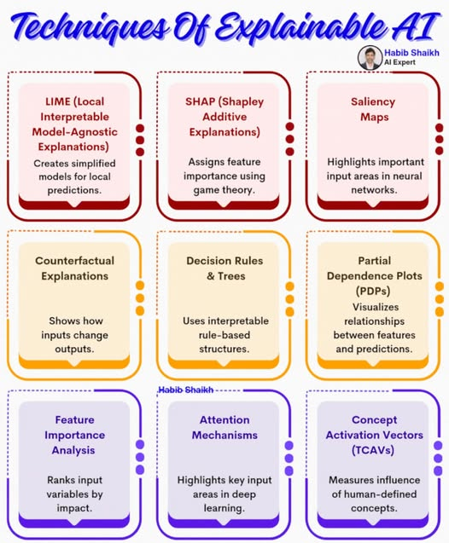
Transparency
Interpretability vs. explainability
Methods for explaining black-box models (e.g., SHAP, LIME)
For NN: Feature Visualizations
For LLMs: Attention and feature visualizations both

Slide 13
Privacy
Data minimization
Informed consent
Data Anonymization
Differential privacy (Mathematical framework add calibrated noise to balance privacy and data utility)
Federated Learning (Data on users devices and only sharing model updates)

Slide 14
Security
Model Security: Secure coding practices
Adversarial Attacks: Adversarial input leading to undesirable behaviour
Data poisoning: Malicious data leading to inaccurate results
Supply-chain attacks: Libraries corrupted
Model Thefts:
Data Security: Data validation, Integrity checks
Data breaches
Data integrity
Operational Security: IDS
AI system's infrastructure, including servers, networks, and cloud environments

Slide 15
Accountability
Ensure following
Ethical guidelines
EU's AI Ethics Guidelines, IEEE AI Ethics Guidelines
Privacy Laws:
HIPAA, GDPR

Slide 16
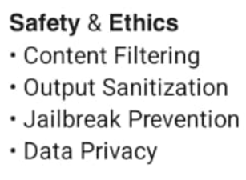
LLMs Ethics

Slide 17
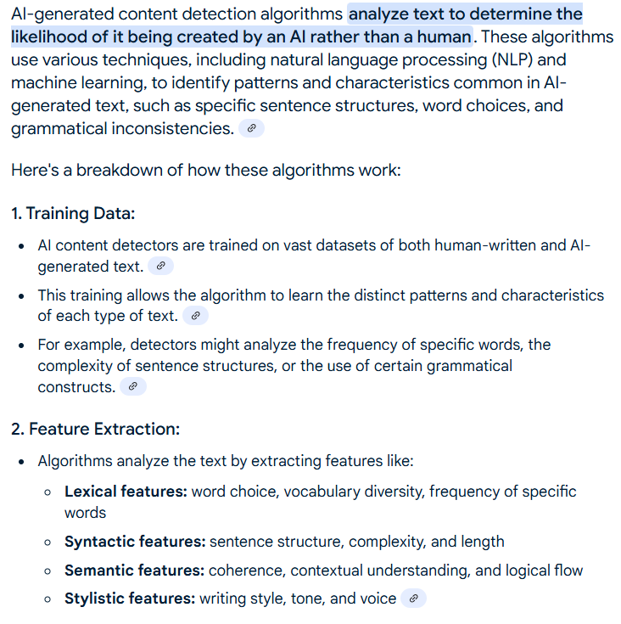
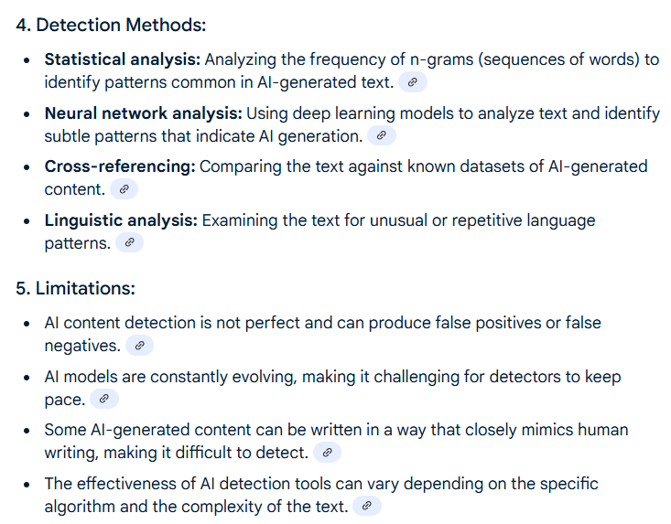
AI Content Detection

