Slide 1
Artificial Intelligence
DSCN
Deep Learning

Slide 2
Data Preprocessing
Computer Vision
Data Augmentation: DL benefits from techniques like random rotations, flips, or shifts and noise removal of images to increase the diversity and size of the training set.
Normalization/Scaling: Techniques like batch normalization are used within the network itself to normalize activations.
Data Shuffling
NLP:
Focuses on cleaning and structuring text data through techniques like stop word removal,stemming, tokenization,and vectorization(embeddings).

Slide 3
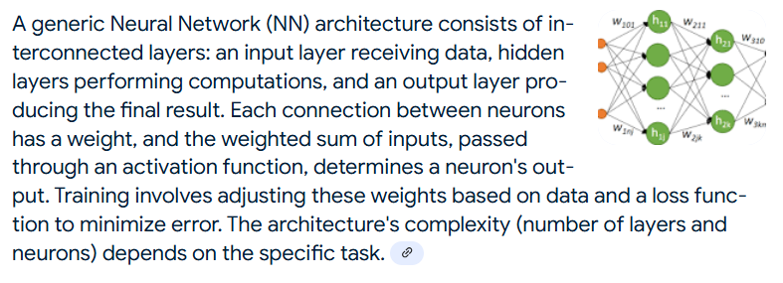
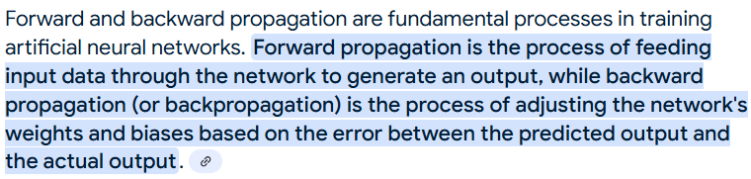
Neural Networks

Slide 4
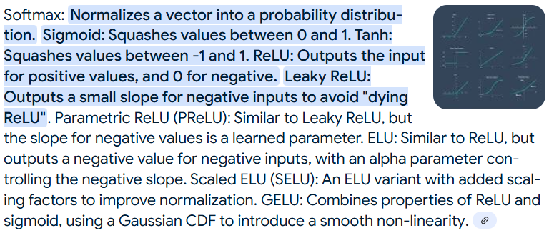
Activation Functions
Softmax
Sigmoid
Tanh
ReLU: Leaky, Parametric, ELU,Scaled ELU
GeLU

Slide 5
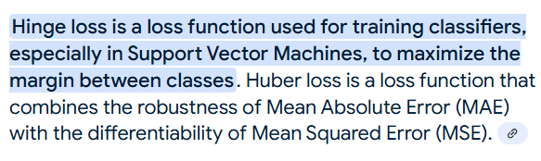
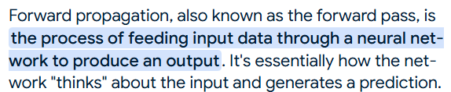
Forward Propagation (Loss)
Classification Loss: Binary loss, Categorical entropy loss, Hingeloss
Focal loss is a modified version of cross-entropy that addresses class imbalance by down-weighting easy examples.
Regression Loss: MAE, MSE, Huber loss
Similarity Loss: Contrastive, Triplet
Segmentation Loss: Dice, Jaccard, IoU
Generation Loss: KL-divergence, ELBO,Wasserstein

Slide 6
Back Propagation (Optimization)
Exponentially weighted moving average SGD: Calculates a weighted average of past gradients for smoother updates.
Momentum SGD: Adds a fraction of the previous update to the current update, accelerating descent in consistent directions.
Nesterov accelerated gradient: Looks ahead by a momentum term before computing the gradient, improving responsiveness.
Adagrad: Adapts the learning rate for each parameter based on the sum of squared gradients.
RMSprop: Adapts the learning rate using an exponentially decaying average of squared gradients.
Adam: Combines momentum and adaptive learning rates, using exponentially decaying averages of both first and second moments of the gradients.
LARS: LARS is based on the Heavy-ball momentum method. Best suited for large-batch training, especially in convolutional neural networks (CNNs).
LAMB (Layerwise Adaptive Moments optimizer): optimizer is primarily used for large batch training in deep learning models, particularly in Natural Language Processing (NLP) tasks. It is designed to handle large batch sizes effectively, allowing for faster training and improved convergence. LAMB combines ideas from LARS and Adam, automatically scaling the learning rate for each layer and adapting to the layer-wise weight and gradient norms. Works well for both large and small batch training, especially for transformer models, and combines benefits of LARS with momentum-based updates.

Slide 7
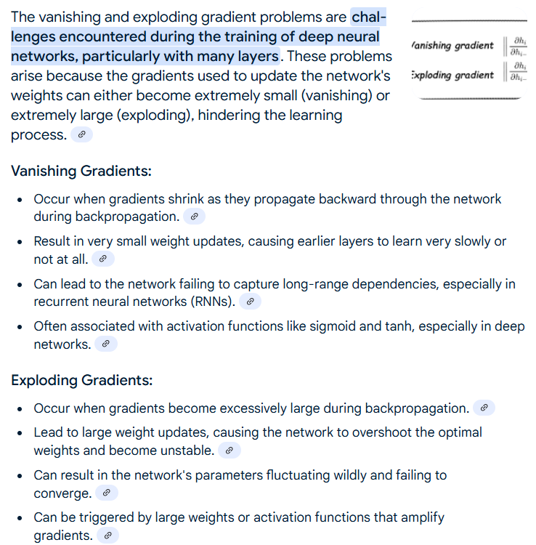

Slide 8
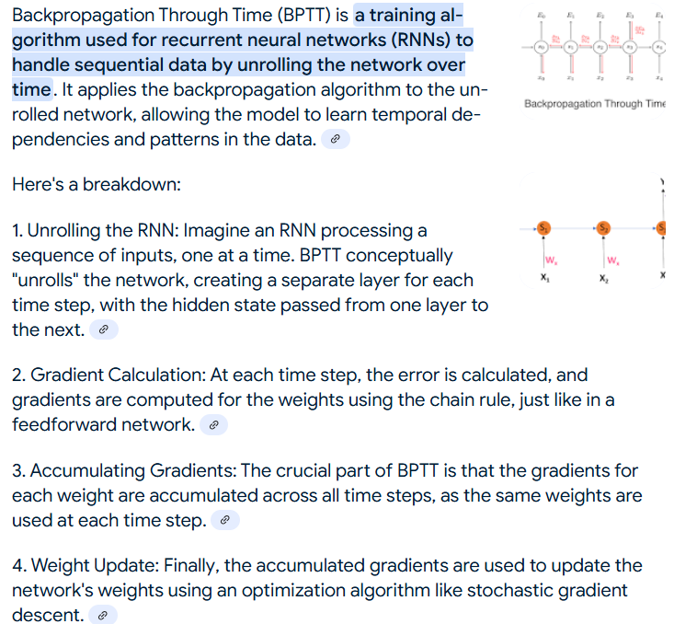
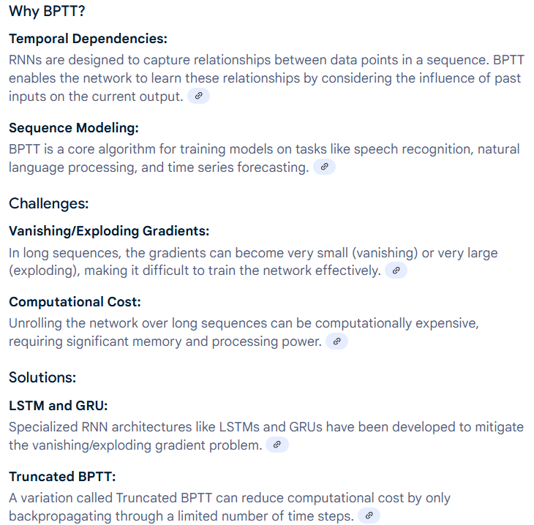

Slide 9
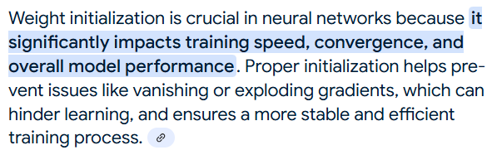
Weight Initialization
Xavier/Glorot and HE/Kaiming initialization is a weight initialization method that scales weights according to the number of input and output units to maintain variance across layers, preventing gradients from vanishing or exploding.
Xavier initialization is generally better for sigmoid and tanh activations, while He initialization is preferred for ReLU and its variants. The key difference lies in the scaling factor used to initialize the weights, which is tailored to the properties of each activation function.

Slide 10
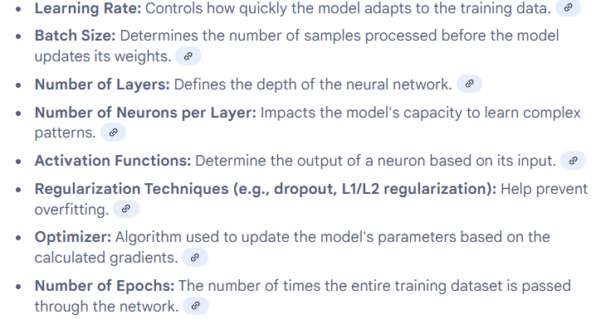

HyperParameters
Hyperparameter tuning:
Keras Tuner
Weights and biases
Neural Architecture Search (NAS) is a cutting-edge technique in the field of automated machine learning (AutoML) that aims to automate the design of neural networks. Traditional neural network architecture design often relies on human expertise, which is a time-consuming process. NAS automates this by using search algorithms to explore and discover optimal neural network architectures for specific tasks. It involves defining a search space of possible architectures and then employing optimization methods, such as random search, bayesian optimization, evolutionary/genetic algorithms or reinforcement learning, to find the most effective architecture. NAS has shown promising results in outperforming manually designed networks in various tasks, including image recognition and natural language processing.

Slide 11
Performance Improvement
Bias Variance tradeoff (Both low are required but are inversely proportional to each other)
Overfitting (High Variance Low bias) Prevention:
Regularization (Weight decay): A form of L2 regularization applied during optimization.
Dropout randomly drops neurons during training. DropConnect is similar to dropout, but instead of dropping neurons, it drops connections by zeroing out random weights in the weight matrix.
Early stopping halts training when validation loss plateaus
Batch Normalization normalizes layer inputs to stabilize training
Underfitting (High Bias Low variance) Prevention
Increase model complexity, add more layers, or use more sophisticated architectures.

Slide 12
Use cases
The activation functions can vary depending on the specific architecture.
The loss function is highly dependent on the exact nature of the task and the output space.
Optimizers such as Adam and RMSprop are typically preferred for deep learning models due to their adaptive learning rates.

Slide 13
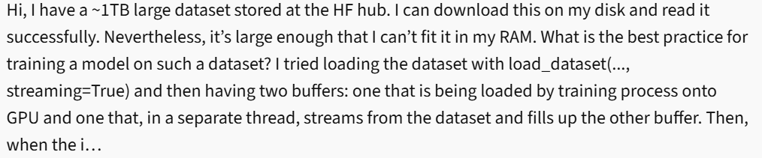

Slide 14
Task | Activation Functions | Optimizers | Loss Functions
Regression | ReLU, Leaky ReLU, Tanh, Sigmoid | Adam, SGD, RMSprop, Adagrad | MSE (Mean Squared Error), MAE (Mean Absolute Error)
Classification | Softmax, Sigmoid, ReLU, Tanh | Adam, SGD, RMSprop, Adagrad | Cross-Entropy Loss, Binary Cross-Entropy Loss
Object Detection | ReLU, Sigmoid, Tanh | Adam, SGD, RMSprop | YOLO Loss, Focal Loss, Hinge Loss
Semantic Segmentation | ReLU, Softmax, Sigmoid | Adam, SGD, RMSprop | Dice Loss, Jaccard Loss
Image Segmentation | ReLU, Softmax, Sigmoid | Adam, SGD, RMSprop | Dice Loss, Jaccard Loss
Recognition | ReLU, Softmax, Sigmoid | Adam, SGD, RMSprop | Cross-Entropy, Triplet Loss
Tracking | ReLU, Sigmoid, Tanh | Adam, SGD, RMSprop | Intersection over Union (IoU), Cross-Entropy Loss

Slide 15
Task | Activation Functions | Optimizers | Loss Functions
Pose Estimation | ReLU, Sigmoid, Tanh | Adam, SGD, RMSprop | MSE (for coordinates), Hinge Loss
RNNs (Recurrent Neural Networks) | Tanh, Sigmoid, ReLU | Adam, SGD, RMSprop | Cross-Entropy, MSE
Transformers | ReLU, GELU, Softmax | Adam, SGD, LAMB, AdamW | Cross-Entropy, MSE
GANs (Generative Adversarial Networks) | Tanh, Sigmoid | Adam, RMSprop, SGD | Binary Cross-Entropy, Wasserstein Loss
Autoencoders | ReLU, Sigmoid, Tanh, Softmax | Adam, RMSprop | MSE, Binary Cross-Entropy
Diffusion Models | GELU, Tanh, Sigmoid | Adam, AdamW, LAMBDA | MSE, KL-Divergence, ELBO

Slide 16
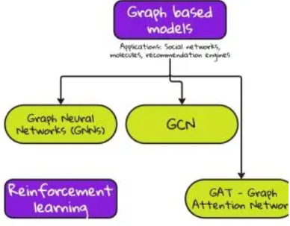
Graph

