Slide 1
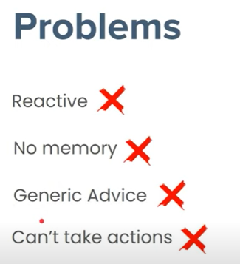
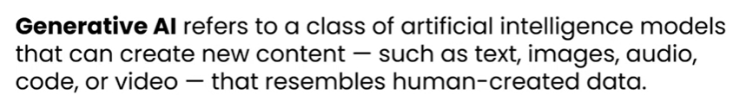
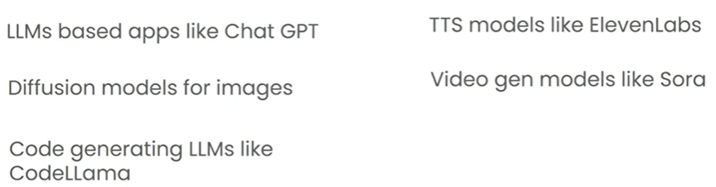
Artificial Intelligence
GenAI

Slide 2
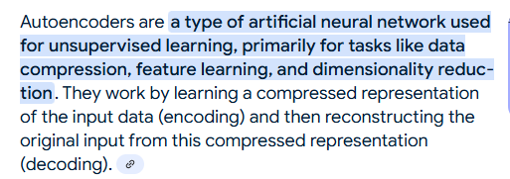
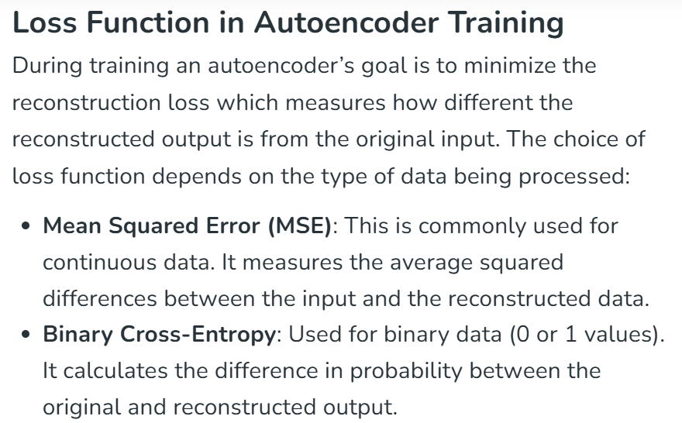
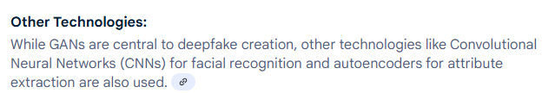
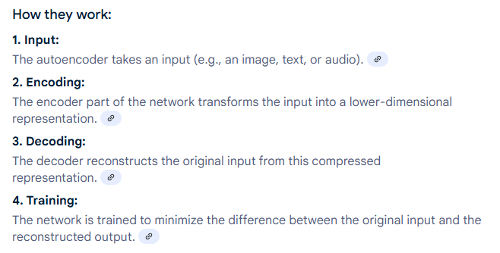
AUTO ENCODERS

Slide 3
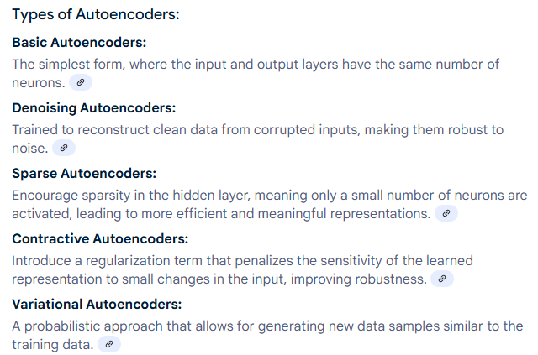
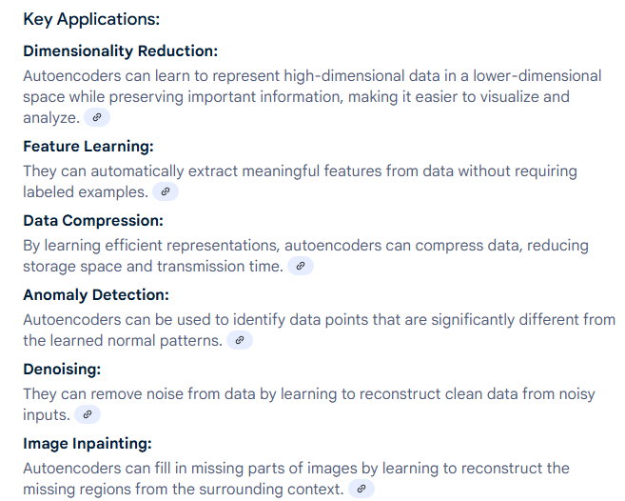
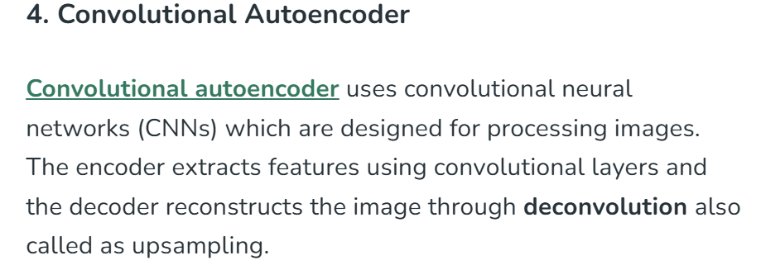

Slide 4
Efficient Representations in Autoencoders
Constraining an autoencoder helps it learn meaningful and compact features from the input data which leads to more efficient representations. After training only the encoder part is used to encode similar data for future tasks. Various techniques are used to achieve this are as follows:
Keep Small Hidden Layers: Limiting the size of each hidden layer forces the network to focus on the most important features. Smaller layers reduce redundancy and allows efficient encoding.
Regularization: Techniques like L1 or L2 regularization add penalty terms to the loss function. This prevents overfitting by removing excessively large weights which helps in ensuring the model to learns general and useful representations.
Denoising: In denoising autoencoders random noise is added to the input during training. It learns to remove this noise during reconstruction which helps it focus on core, noise-free features and helps in improving robustness.
Tuning the Activation Functions: Adjusting activation functions can promote sparsity by activating only a few neurons at a time. This sparsity reduces model complexity and forces the network to capture only the most relevant features.

Slide 5
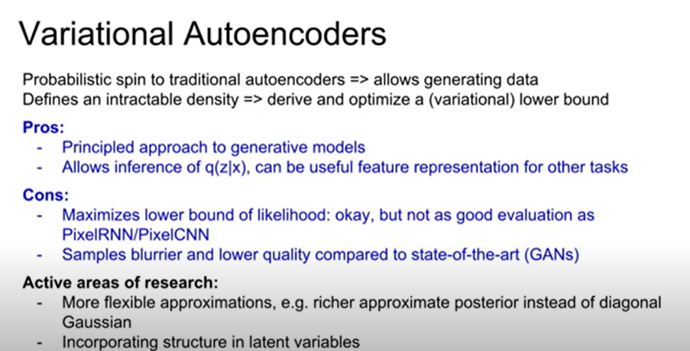
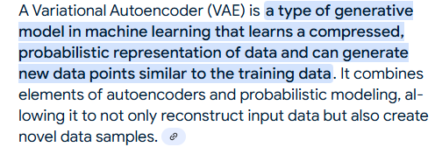

Slide 6
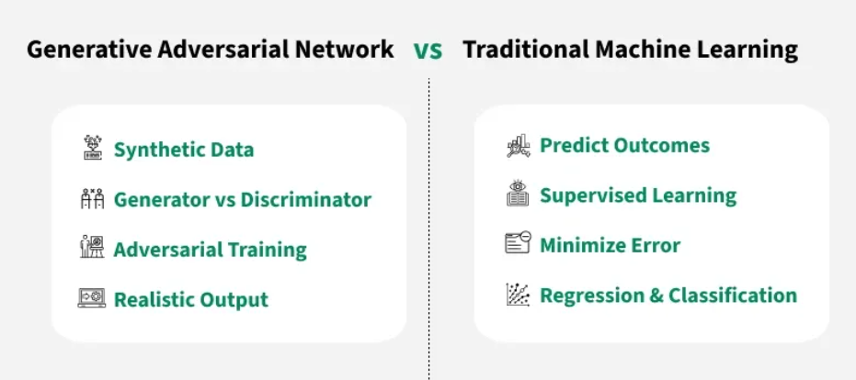
GANS

Slide 7
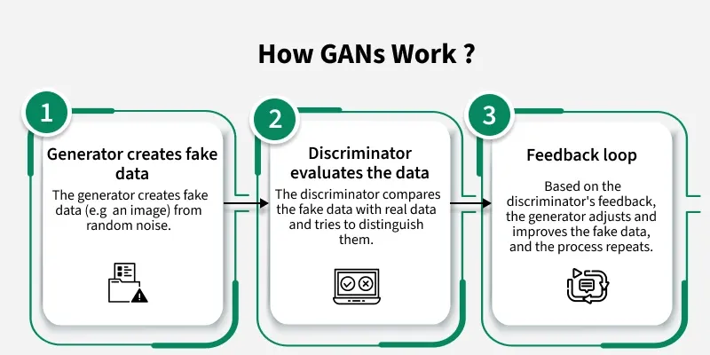
Minmax loss between generator and discriminator
Adversarial Learning: adversarial_loss = nn.BCELoss()
Adam Optimizer
Leaky ReLU activation

Slide 8
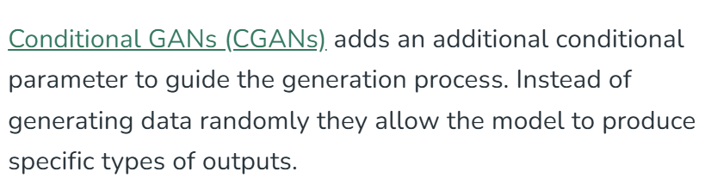
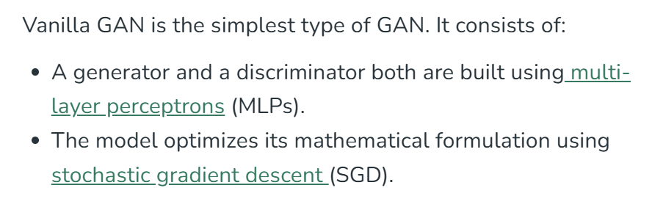

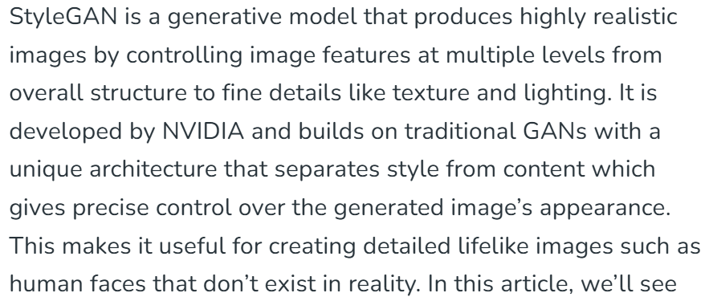
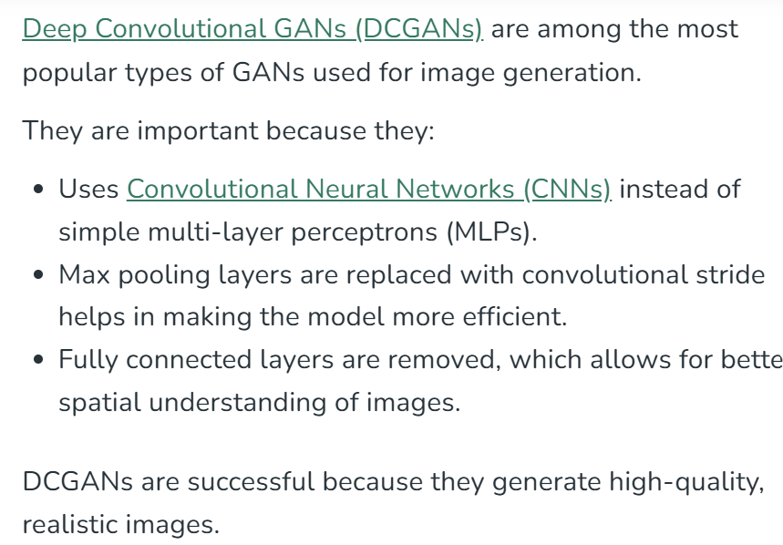
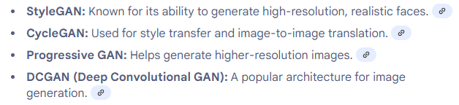
Types
Media Industry

Slide 9
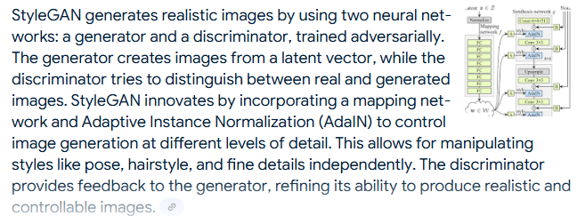
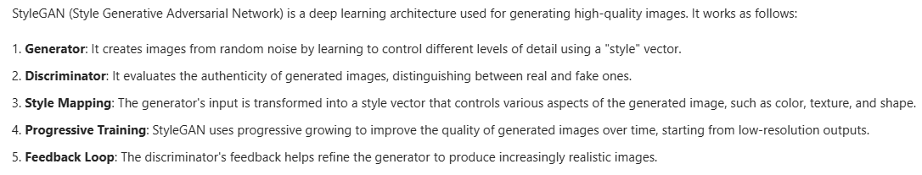
Use Cases
Generating new images
Data augmentation
Creating 2D and 3D models
Producing training data
Filling data gaps
Image-to-Image Translation
Text-to-Image Synthesis
High-Resolution Image Enhancement
video enhancement
text-to-speech synthesis
style transfer, and
deep-fake generation
gene expression analysis

Slide 10

Challenges
Model collapse: This occurs when the generator starts producing a limited variety of outputs or even the same output repeatedly, rather than a diverse range of outputs that accurately reflects the distribution of the training data.
Non-convergence: In this situation, the training process fails to reach a stable solution, with the generator and discriminator continuously oscillating or failing to improve over time.
Instability: Training GANs can be highly unstable, with small changes in parameters or architecture—or the training process leading to significantly different outcomes. This instability makes it challenging to design and train GANs effectively.

Slide 11
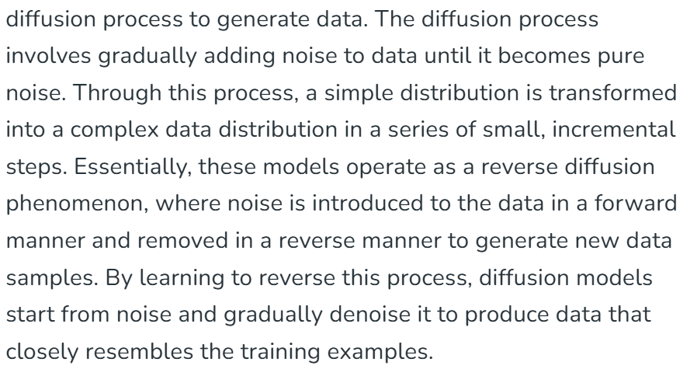
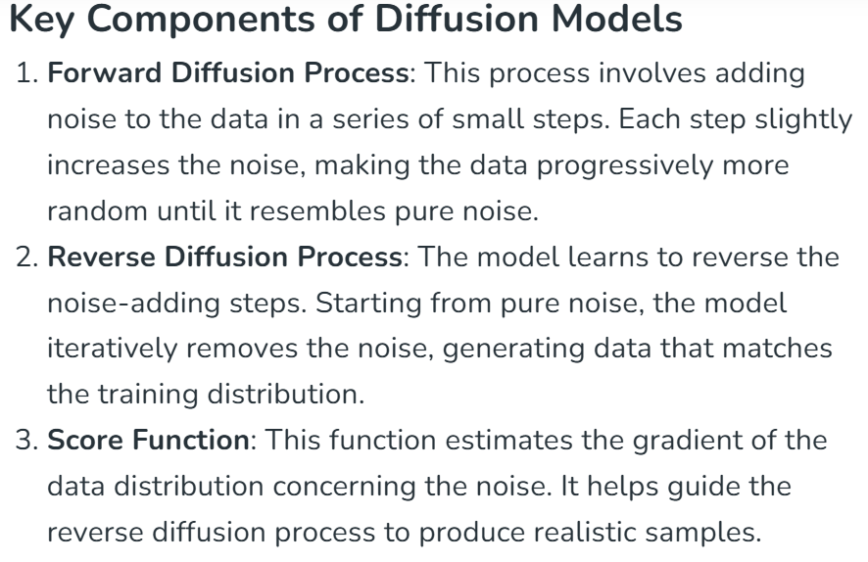
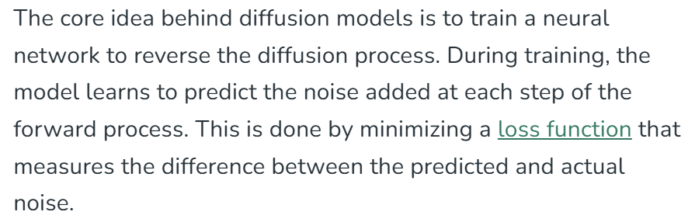
DIFFUSION MODELS

Slide 12
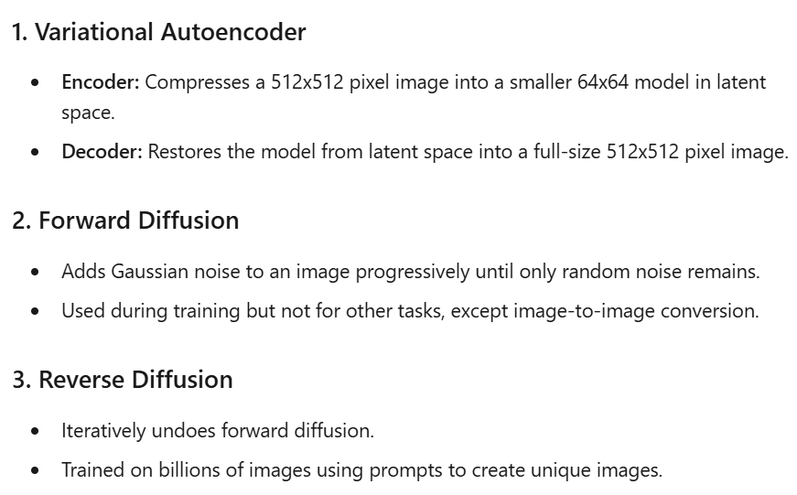
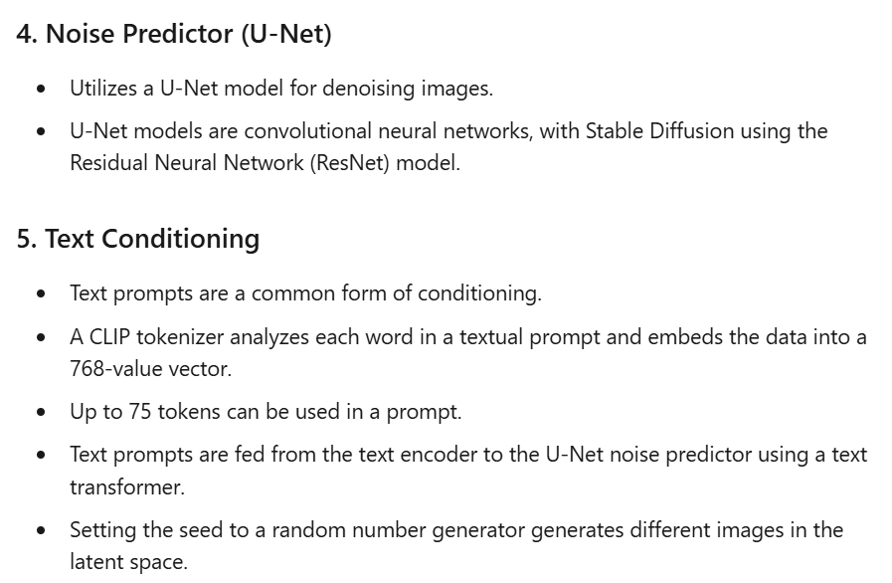
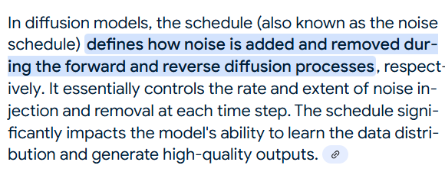
Stable Diffusion (Latent diff model)

Slide 13
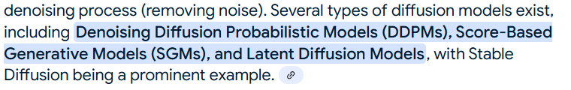
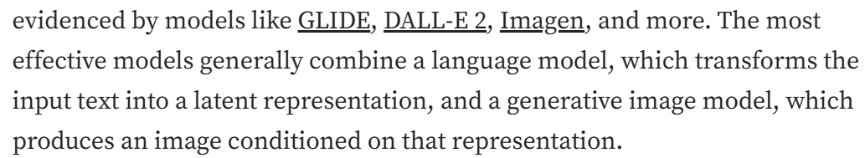
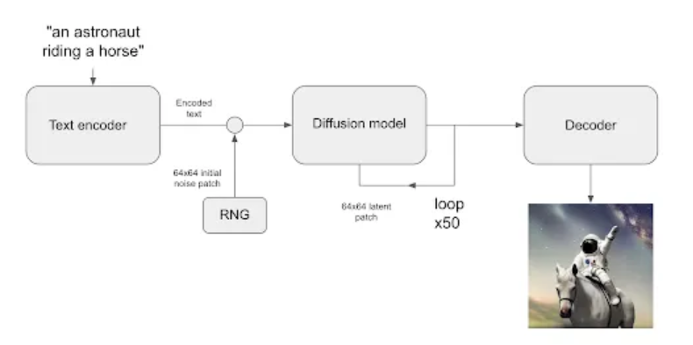

Slide 14
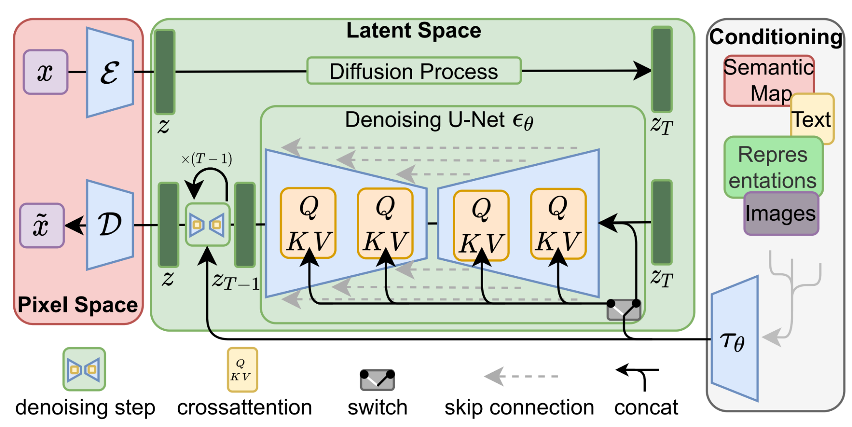
Transformer based Diffusion model

Slide 15
Use cases
Advantages
Flexibility: They can model complex data distributions without requiring explicit likelihood estimation.
High-Quality Generation: Diffusion models generate high-quality samples, often surpassing other generative models like GANs.
Stable Training: Unlike GANs, diffusion models avoid issues like mode collapse and unstable training dynamics.
Theoretical Foundations: Based on well-understood principles from stochastic processes and statistical mechanics.
Scalability: Can be effectively scaled to high-dimensional data and large datasets.
Image Generation: Diffusion models can generate high-quality, realistic images from random noise. They have been used to create diverse datasets for training other machine learning models.
Speech Synthesis: These models can generate human-like speech by modelling the distribution of audio signals.
Data Augmentation: Diffusion models can be used to augment existing datasets with new, synthetic samples, improving the performance of machine learning models.
Anomaly Detection: By modelling the normal data distribution, diffusion models can help identify anomalies that deviate from this distribution.

Slide 16
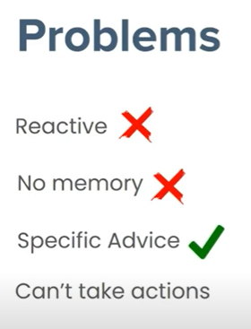
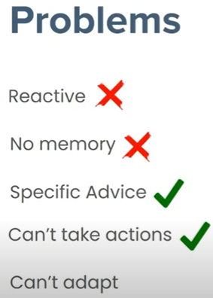
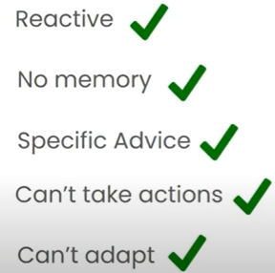
Towards Agentic AI
To cater genai llms static & generic nature, agentic rag came into picture
RAG
Tool augmented RAG
AI Agent (Plans for goal & adapt by continuous learning through RL feedback)

