Slide 1
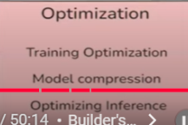
Performance Optimization of AI models

Slide 2
Performance Metrics (Classification)
Accuracy
Precision
Recall
F1-score
AUC-score

Slide 3
Performance Metrics (Regression)
Mean Absolute Error (MAE)
Mean Squared Error (MSE)
R-squared (R²) Score
Root Mean Squared Error (RMSE)

Slide 4
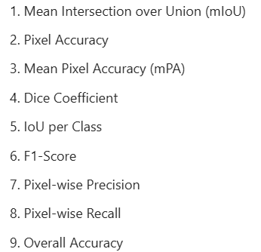
Performance Metrics (CV)
Object Detection:
IoU
Mean average precision (mAP)
Image Segmentation:
Dice coefficient (F1-score)
Jaccard Index (IoU)
Pixel Accuracy
Image Generation:
Inception Score: Measures the quality of generated images based on the classification confidence
Frechet Distance: Computes the distance between feature representations of real and generated images
Sliced Wasserstein Distance: Measures the distance between distributions of real and generated samples
Semantic segmentation

Slide 5
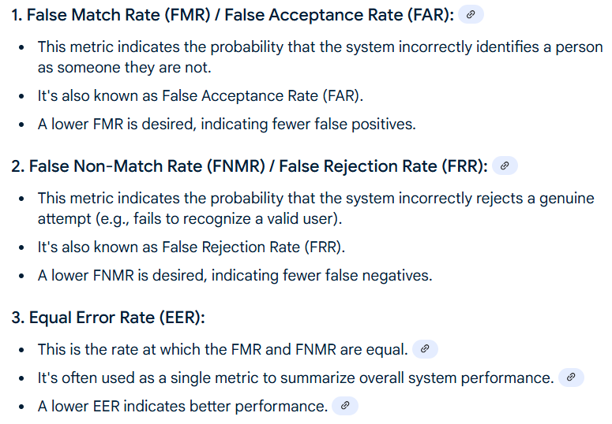
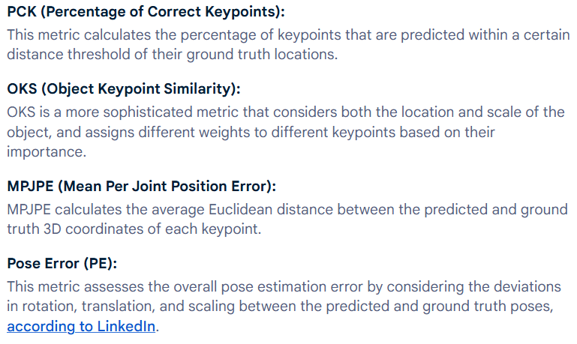
Face Recognition
Pose Estimation

Slide 6
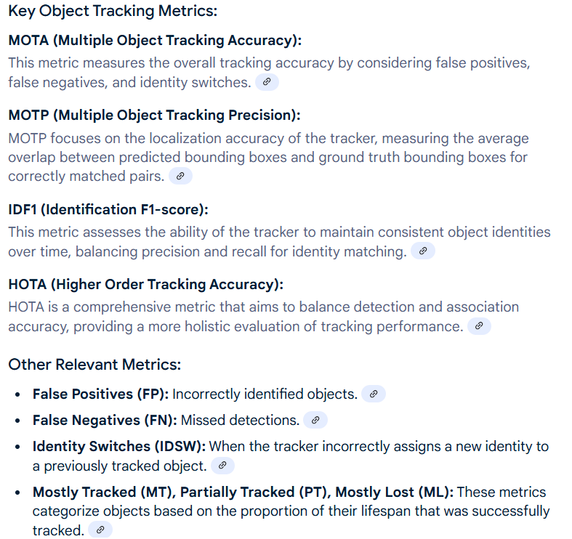

Slide 7
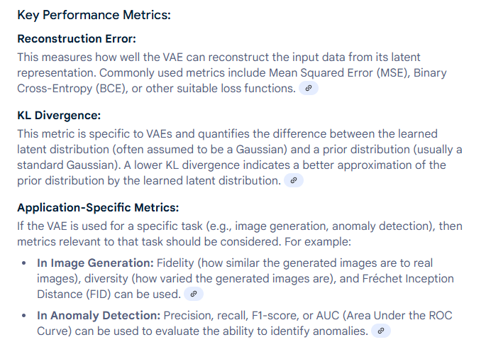
Performance Metrics (Var Autoencoders)

Slide 8
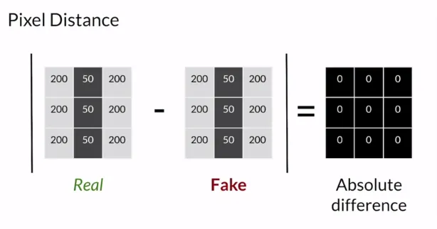
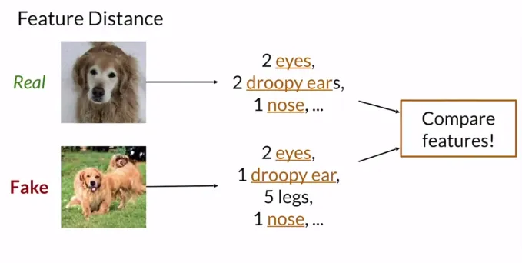
Performance Metrics (GANS)
Fidelity: The quality of the generated images (i.e., how realistic they are)
Diversity: A good generator should also produce a good variety of images
Pixel Distance
Feature Distance
Precision & Recall

Slide 9
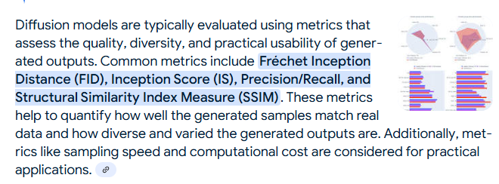
Performance Metrics (Diffusion Models)

Slide 10
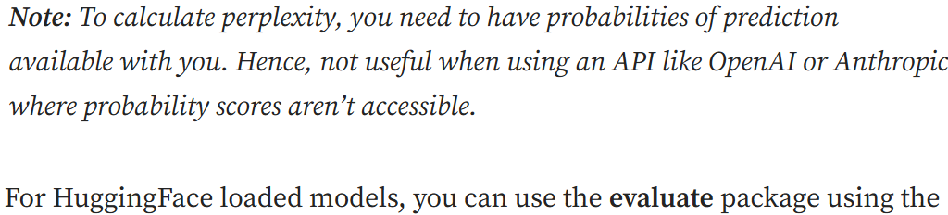
Performance Metrics (NLP)
Evaluation metrics:
Accuracy, precision, F1 score,
BLEU for translation: n-gram overlap between the output and the reference ground truth sentence
ROUGE for summarization: words a model recall (TP/ TP+FP)
Perplexity: Language Generation models: how confused an NLP model is about next word, derived from cross-entropy
Human Evaluation: Bias
Latency measures the time taken by the system to generate a response.
Efficiency evaluates the computational resources used.
Evaluation Benchmarks/Frameworks:
GLUE test general language understanding.
SQuAD focuses on reading comprehension and question answering.

Slide 11
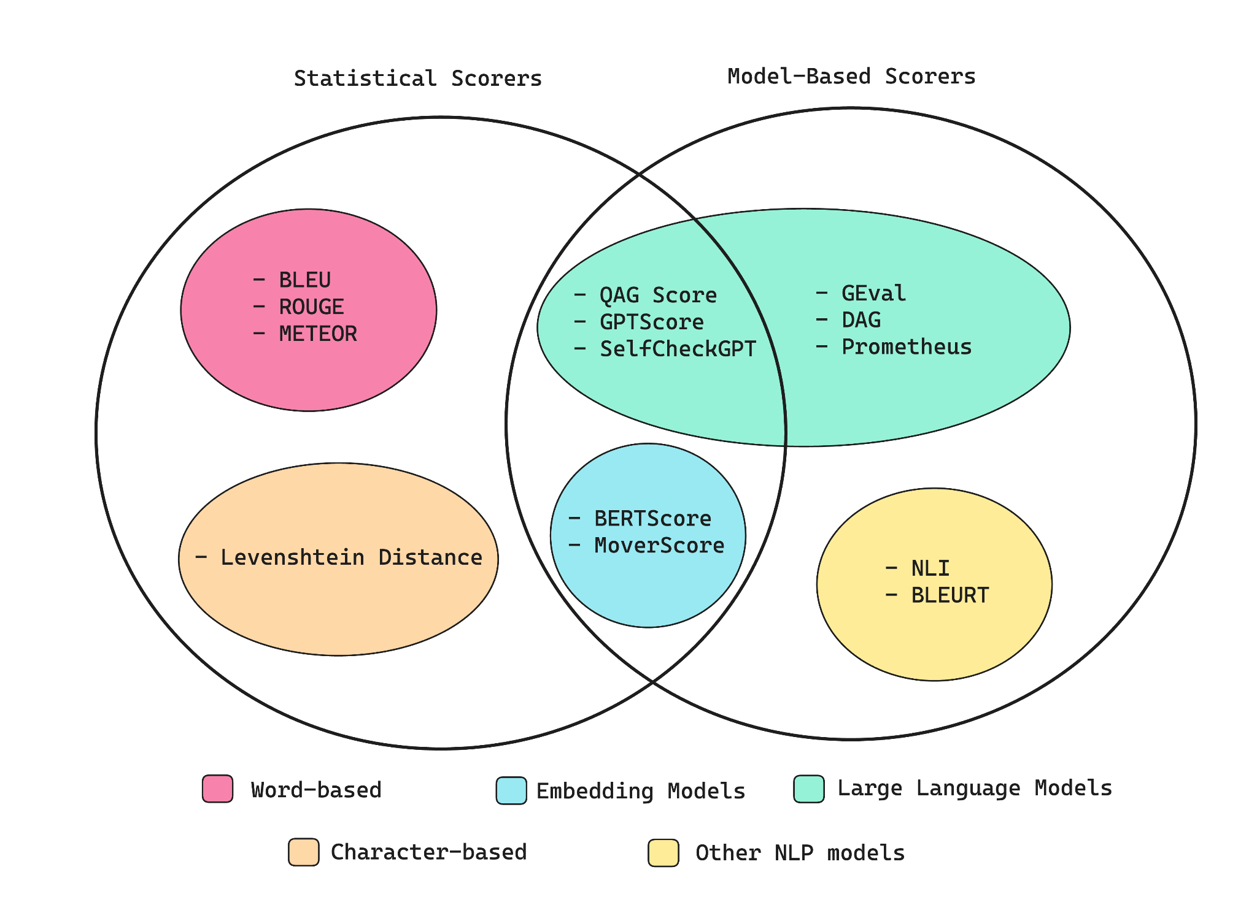
Performance Metrics (LLMs)
Generation Quality
Rogue
Bleu
Perplexity
MRR
BERT Score
https://medium.com/data-science-in-your-pocket/llm-evaluation-metrics-explained-af14f26536d2

Slide 12
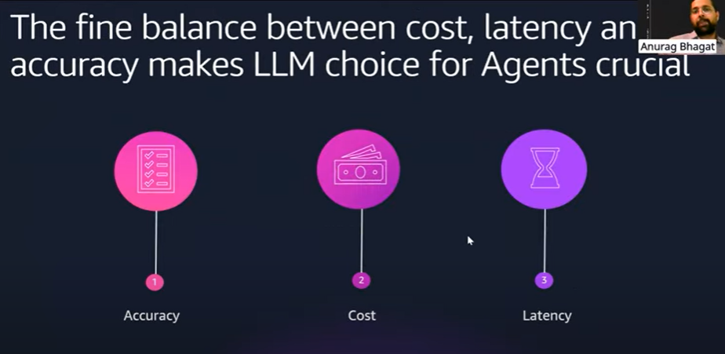
Performance Metrics (Agents)
Accuracy:
Accuracy Rate: The percentage of correct responses to total attempts.
Task Completion Rate: The percentage of workflows successfully completed.
Error Rate: The percentage of requests resulting in errors.
Error Recovery: The ability to handle errors successfully.
Hallucination Detection: Identifying and minimizing fabricated or incorrect responses.
Efficiency:
Latency: The time it takes for the agent to respond.
Throughput: The number of queries or tasks the agent can handle per second.
Token Usage: A measure of resource consumption, particularly for language models, where more tokens can lead to higher costs.
Response Time: How quickly an agent can complete a task.
Security

Slide 13
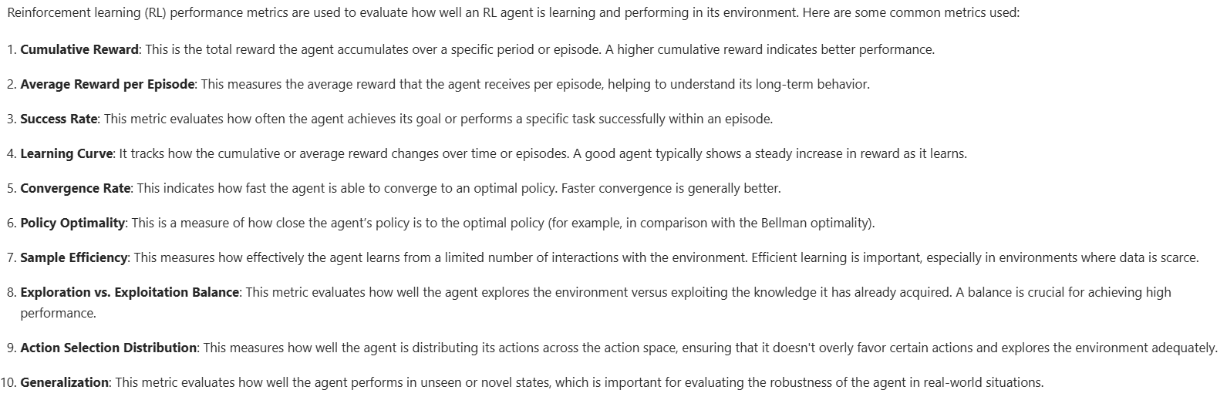

Slide 14
Optimization
DeepSpeed, Hugging Face Transformers, JAX, PyTorch, and TensorFlow to improve model performance

Slide 15
Accuracy Optimization (Traditional AI)
Right hardware infrastructure
Data quality: Class-balancing
Fine-tune model selection
Hyperparameter tuning (Grid search, Random search, Bayesian Optimization)
Regularization techniques (L1/L2, dropout, Batch normalization, Early stopping, Noise injection)
Cross validation
Model’s Robustness:
Validation loss and accuracy
Synthetic noise testing

Slide 16
Accuracy Optimization (Agentic AI)
Prompt Engg
RAG
Fine Tuning (Full parameter, PEFT, RLHF)
In-context learning: Prompts
Retrieval-based in-context learning: External source or database
Fine-tuning based learning: Specific dataset that includes labeled examples of tool usage, decision-making processes, or reasoning steps.

Slide 17
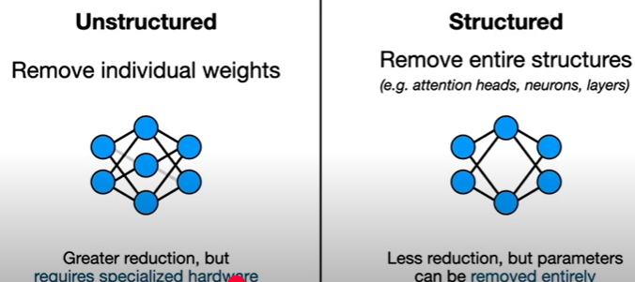
Efficiency optimization: Size of the model
Compression
Low-rank factorization: Sparsity optimization: SVD: LoRA
Quantization: Lowering the precision of model (LLMs)
Post-training quantization: FP32 to INT8: QLoRA
Quantization-aware-training: 4 bit and lower : 1 bit LLM
c. Pruning: Removing unnecessary components from model (Games)

Slide 18
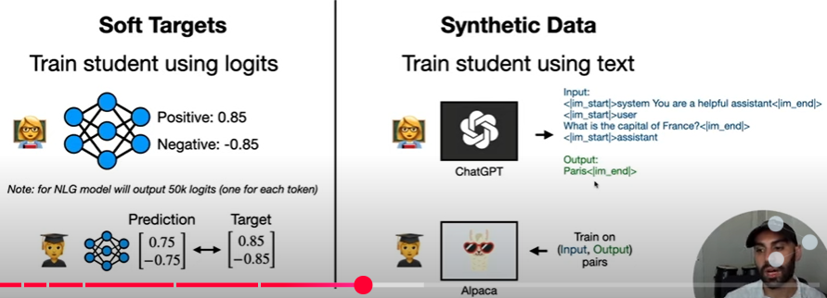
d. Knowledge distillation: Transfer from larger (teacher) model to smaller (student) model
Bits and Bytes Quantize

Slide 19
Monitoring model performance in production
Drift detection
Bias Audits
A/B testing (RLHF)

