Slide 1
Artificial Intelligence
Data Preprocessing & Feature Engineering

Slide 2
Data Analysis & Preprocessing

Slide 3
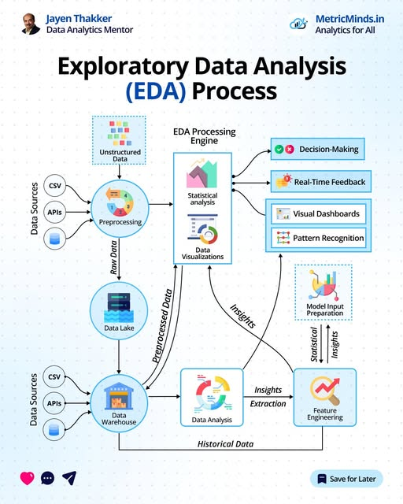

Slide 4
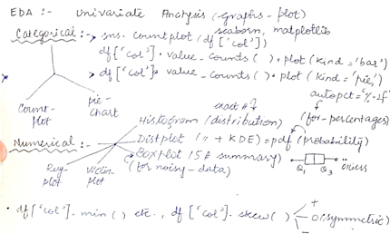
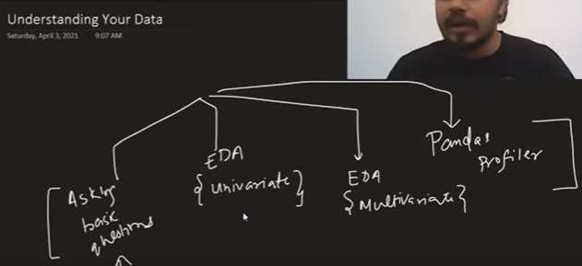
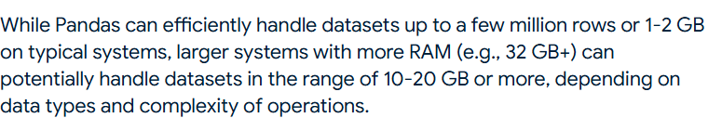
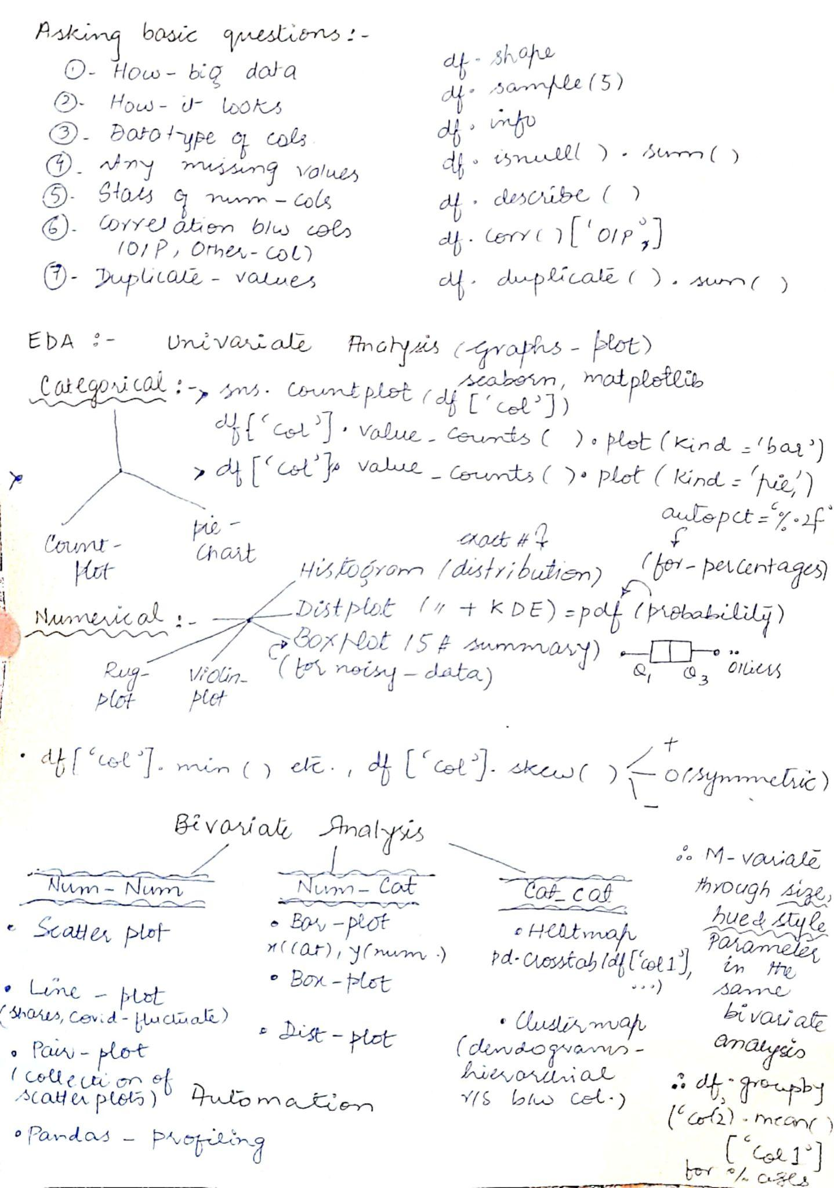
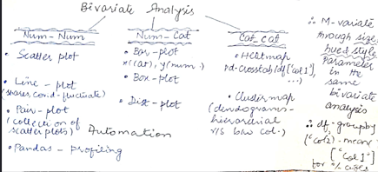
Data Analysis
1.PANDAS

Slide 5
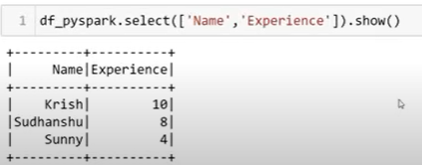
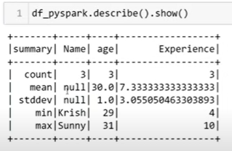
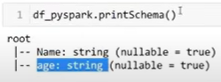
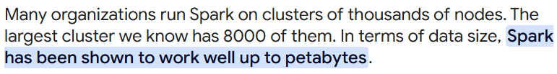


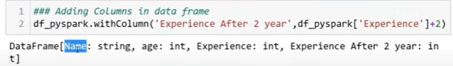


2. Pyspark
Show selected columns
Getting dataframe stats
Cols info:
Rows info
Getting dtypes of columns

Slide 6


Slide 7
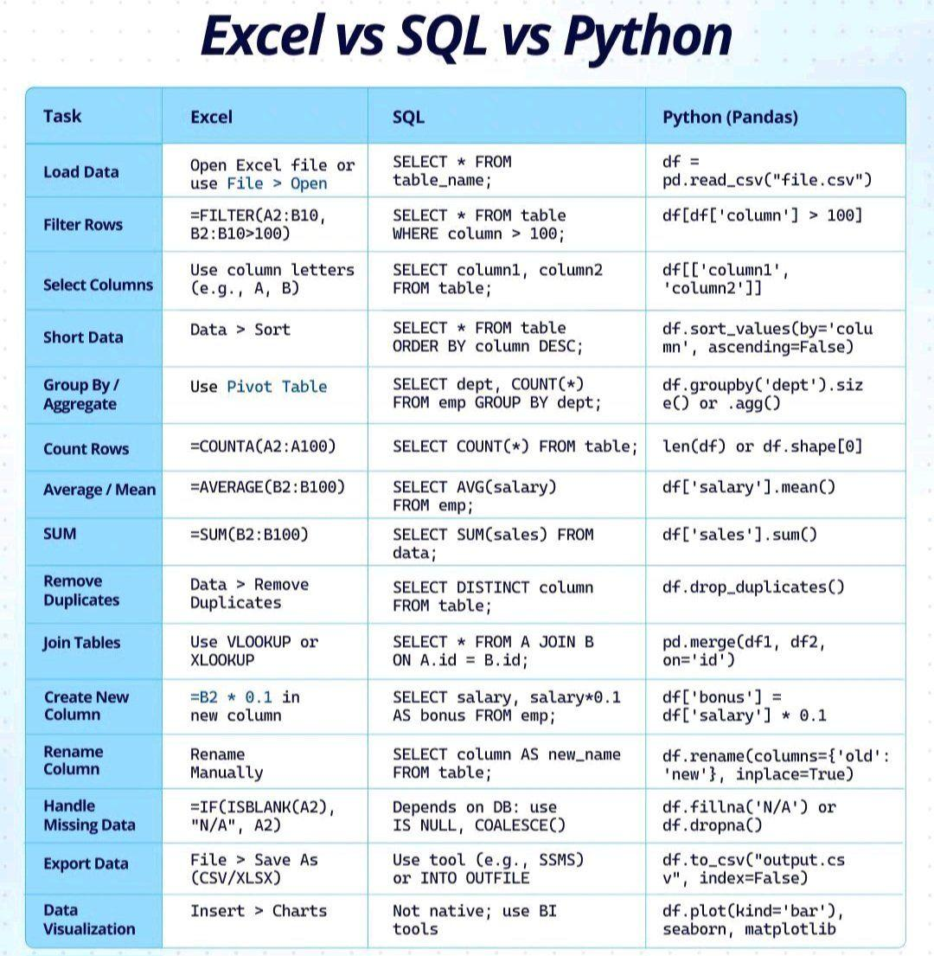

Slide 8
Feature Engineering
Getting features from raw data.
Feature Transformation
Feature Extraction (Programmatically)
Feature Construction/Splitting
Feature Selection
Just the first step of transformation is done in DL

Slide 9
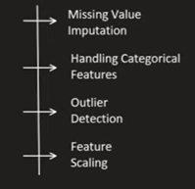
Feature Transformation (Structuring/Cleaning data)

Slide 10
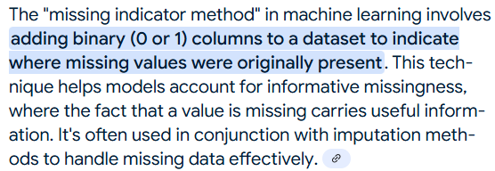
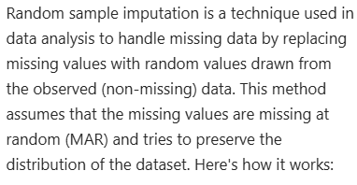
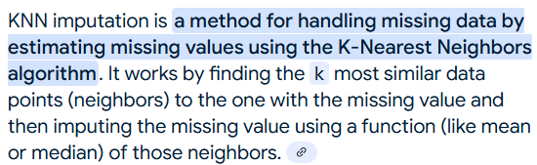
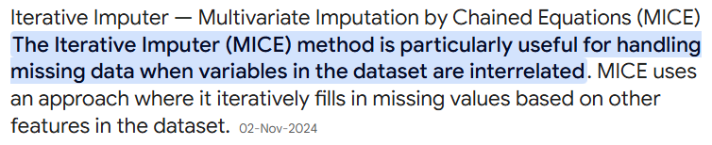
Missing values imputation
Simple Imputer
Categorical (Most repeated)
Numerical (mean, mode, median)
Missing Indicator
Random Sample Imputation
Multivariate Imputer
kNN
Chained Equations/Iterative Imputer

Slide 11




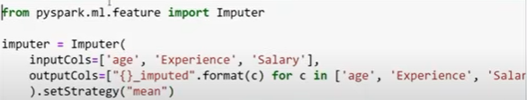

Slide 12
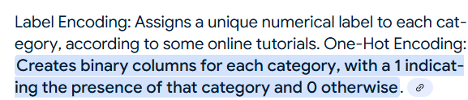

b. Encoding categorical features
Ordinal/Label Encoding
One Hot Encoding

Slide 13
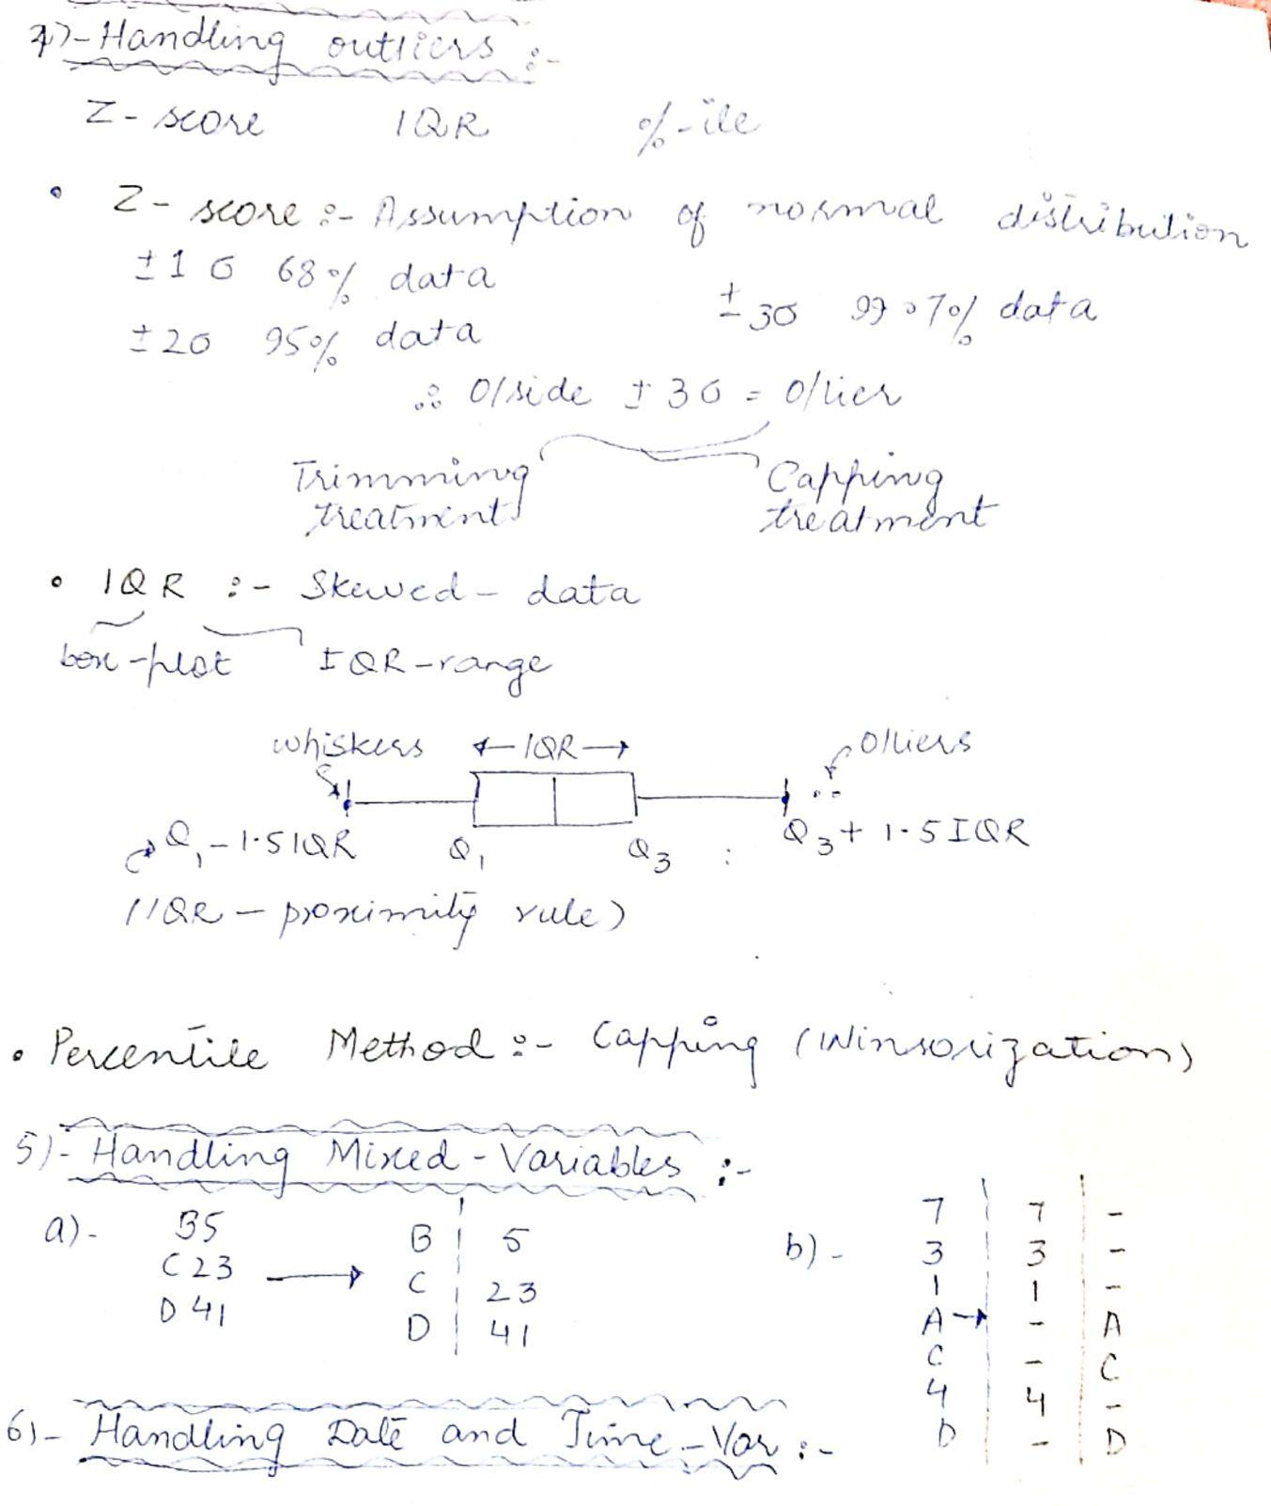
c. Outlier handling

Slide 14
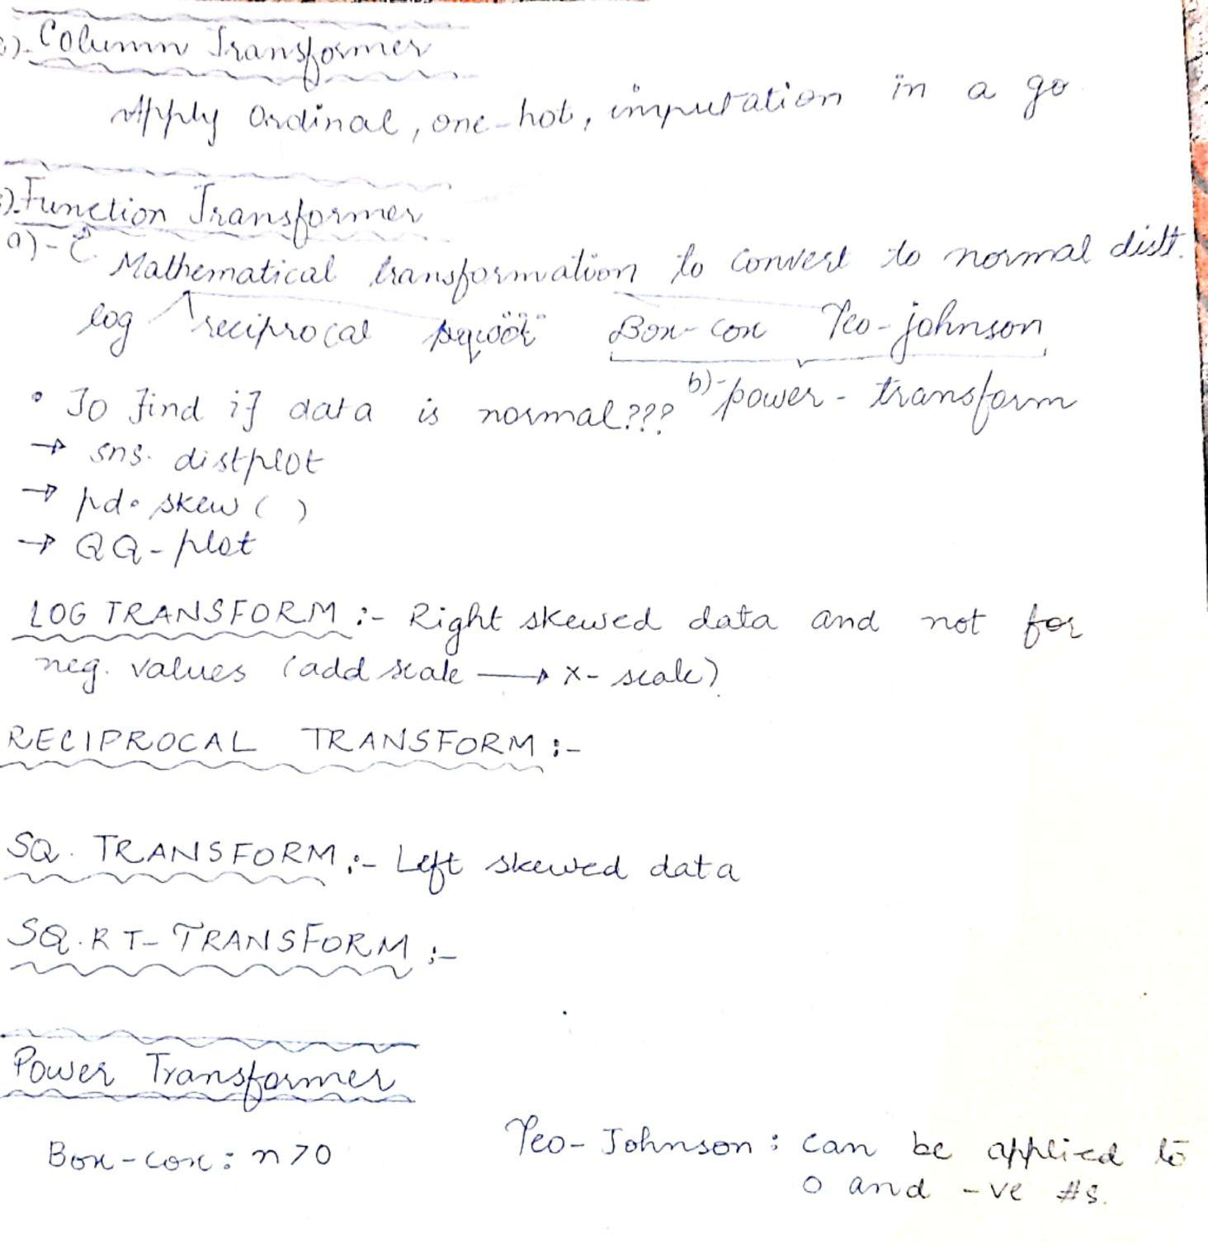
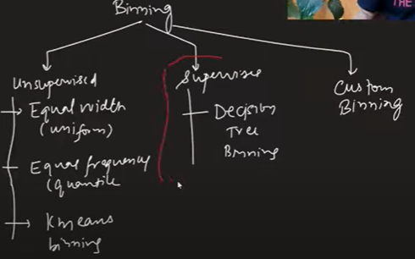

d. Transformations
Quantile Binning/Discretization/Binarization
(transform continuous features into discrete ones)

Slide 15
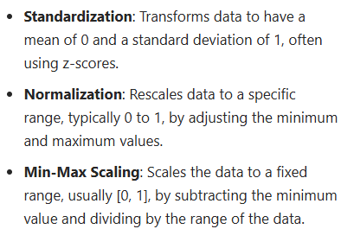
e. Feature Scaling
Standardization
Normalization
Minmax scaling

Slide 16
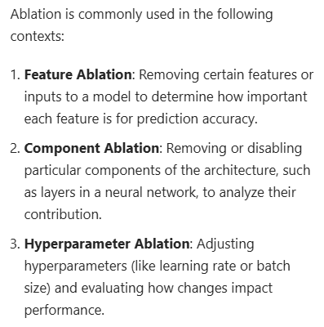
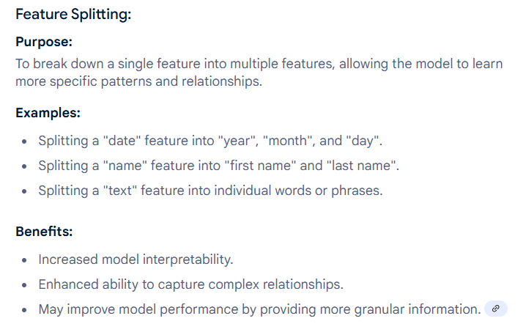
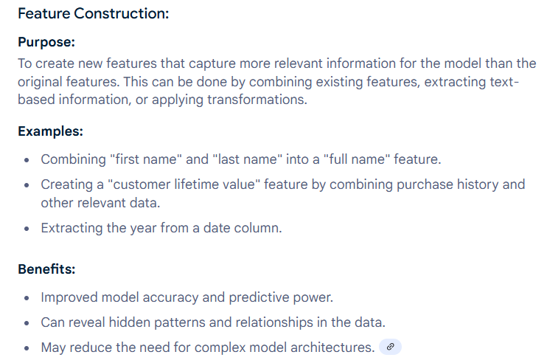
2. Feature Extraction & Construction/Splitting
PCA, LDA, NN etc.

Slide 17
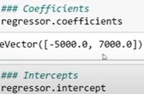







Slide 18
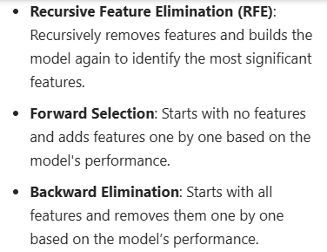
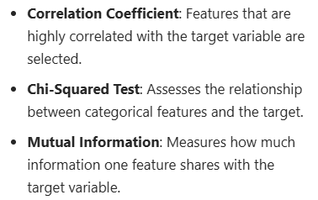
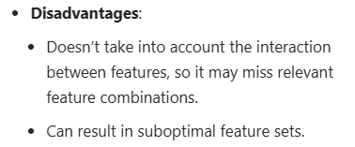
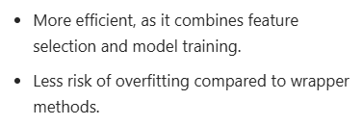
3. Feature Selection
2. Wrapper (Greedy Search based)
Filter (Stats-based)
3. Embedded (Model Training based)
Variance Threshold:It removes all features whose variance doesn’t meet some threshold
Lasso, RF, Gradient boosting

Slide 19
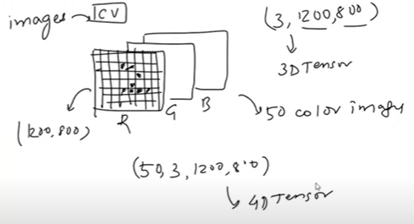
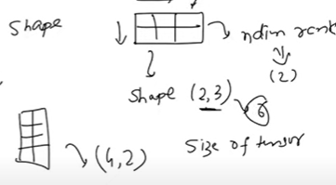
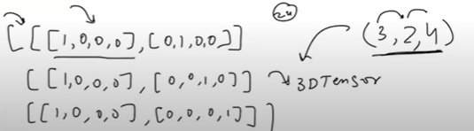

Feature Vectors/Tensors
0D tensor: Scalar
1D tensor: Vector: Collection of scalars: Input
2D tensor: Matrix: Collection of vectors: Tabular (Input, Output)
3D tensor: Collection of matrices: NLP
4D tensor: Collection of 3D tensors: Images
5D tensor: Video
Rank: dim of tensor: no. of axis
NUMPY

Slide 20
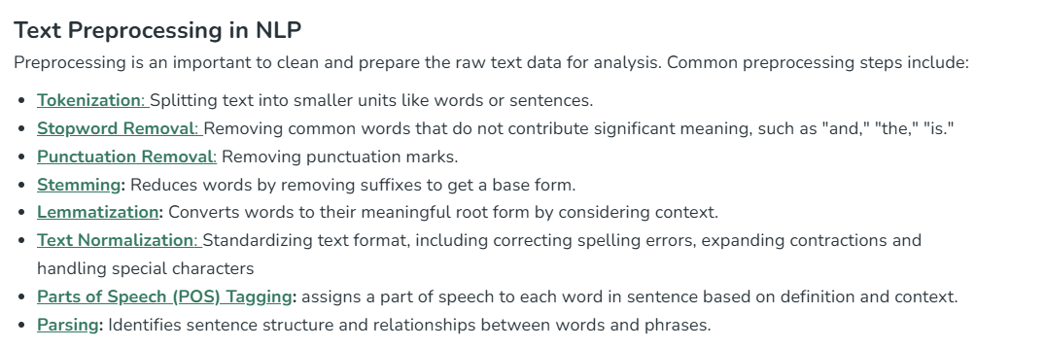
NLP- Text Preprocessing

Slide 21
CV-Image Preprocessing

