Slide 1
Artificial Intelligence
Data Privacy

Slide 2
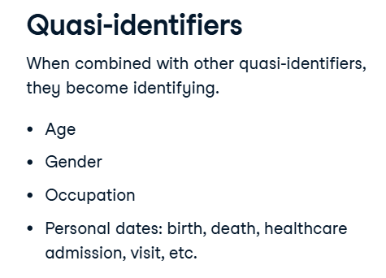
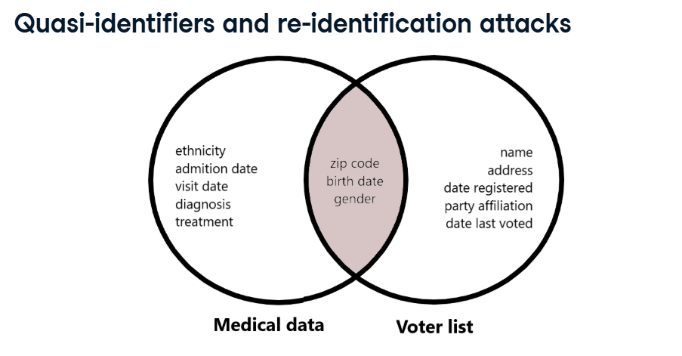
Data Types
Sensitive PII
Examples include full names, Social Security Numbers, financial information, or medical records. It must be inaccessible to outside parties unless permission is granted. If not, regulations such as the General Data Protection Regulation, or GDPR, can fine companies for up to €20 million or 4% of their annual turnover.
Non-sensitive PII
Non-Sensitive PII is data that cannot be used alone to trace a person, such as gender, occupation, zip code, or city of birth. However, these examples contain quasi-identifiers that can still be used with other PII to identify someone. Such as President of America born in NY etc.

Slide 3
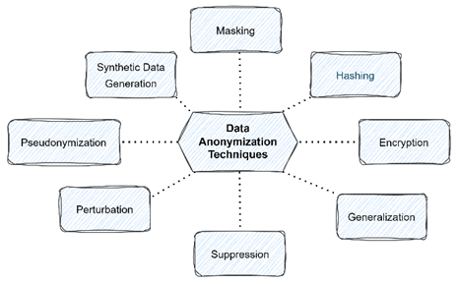
Anonymization techniques
data suppression,
masking,
data generation, and
generalization.

Slide 4
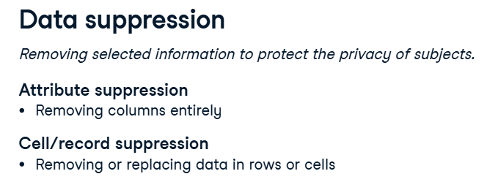
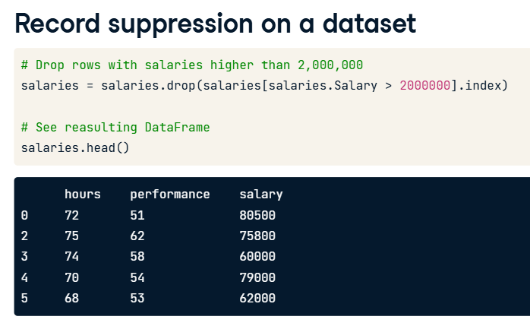
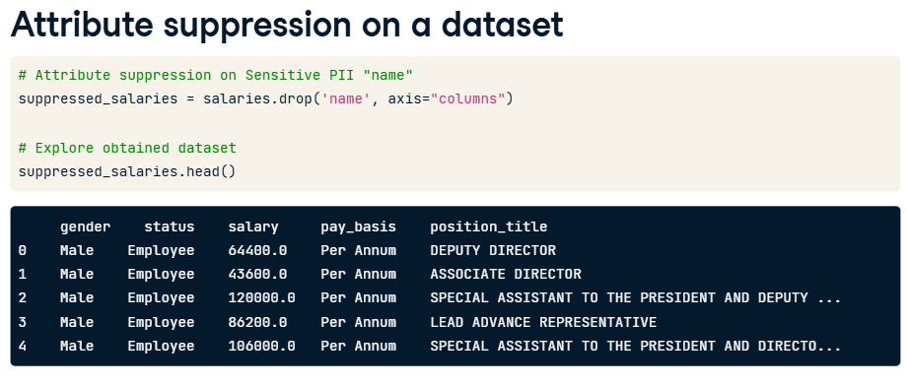

Slide 5
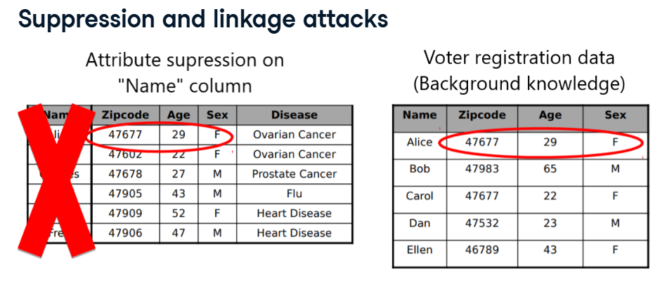
Suppression can fail for linkage or re-identification attacks. That's when your dataset is linked to other public data sources. Here, even after suppression, we can link the voter registration data with medical records and discover Alice's disease.

Slide 6
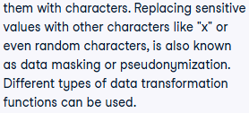

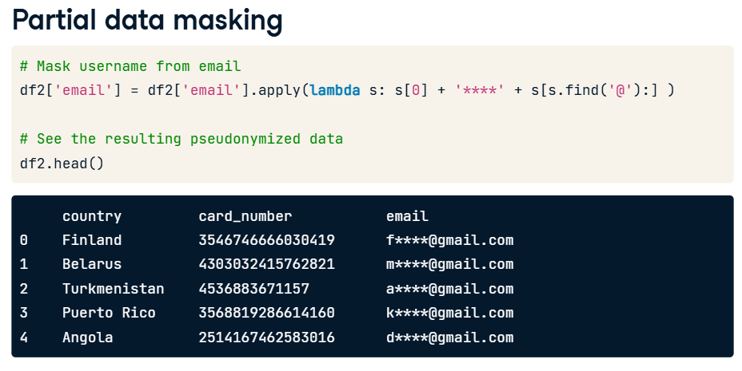
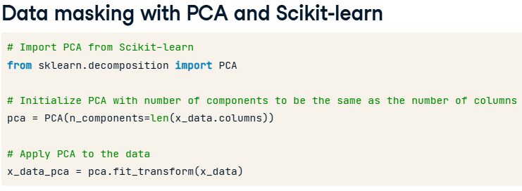
Data Masking

Slide 7
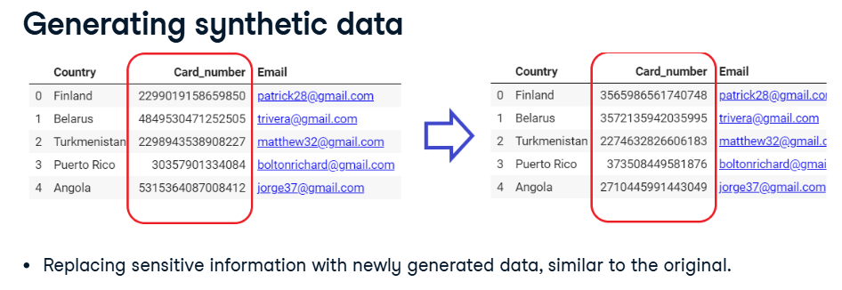
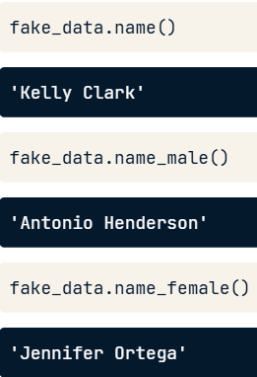

Slide 8
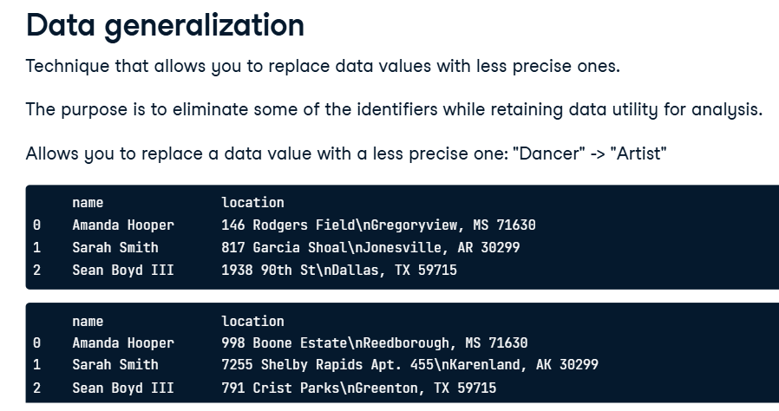
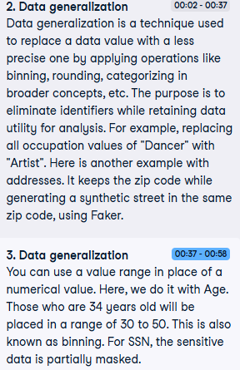
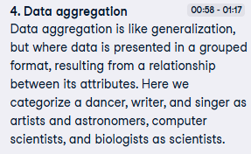
Categorization
Binning

Slide 9

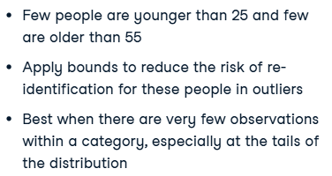
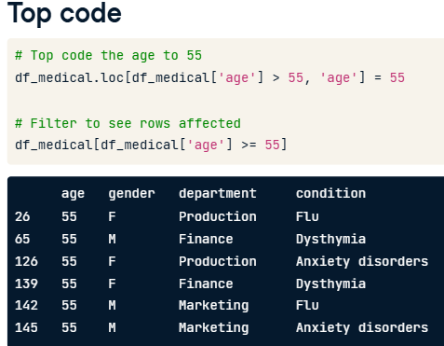
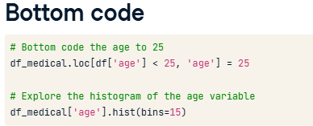

Slide 10
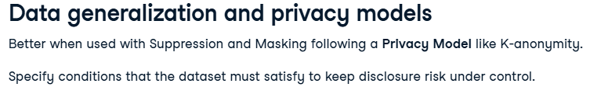
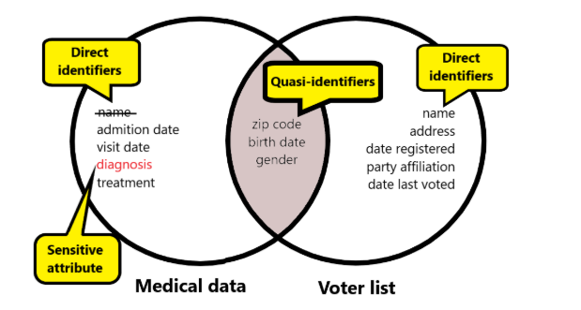
1. K Anonymity
prevent linkage or re-identification attacks and use hierarchies to perform data generalization in categorical variables.

Slide 11
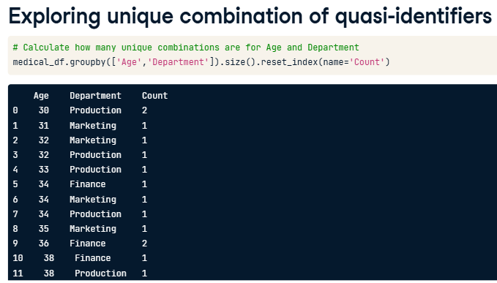
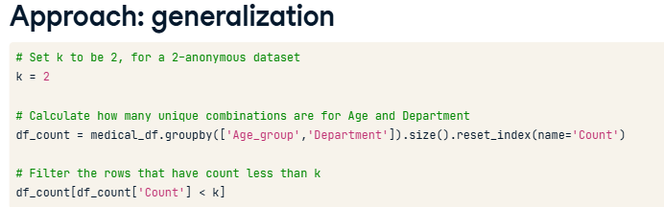

Slide 12
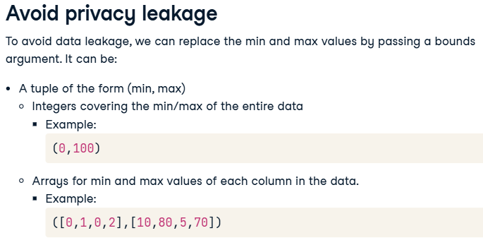

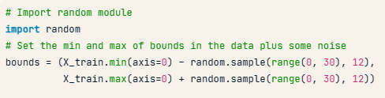
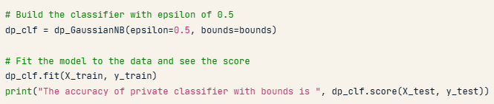

2. Differential Privacy (Classification)
Local
Global
Differentially private systems are assessed by a value represented by the Greek letter epsilon (diffprivlib). Differentially private machine learning models can still capture some underlying distributions corresponding to large datasets while still guaranteeing privacy with respect to individuals in data.

Slide 13
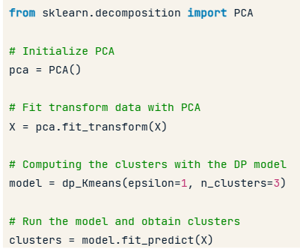
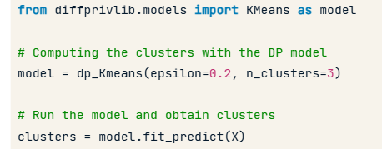
2. Differential Privacy (Clustering)

Slide 14
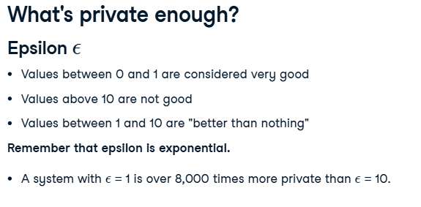
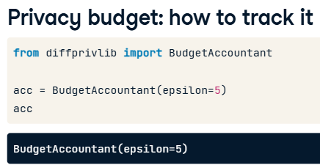
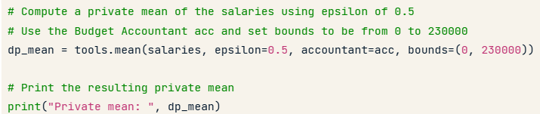
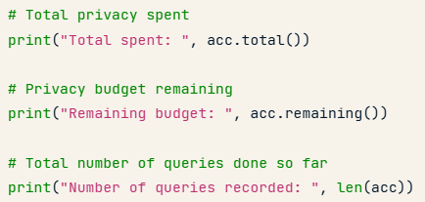

Slide 15
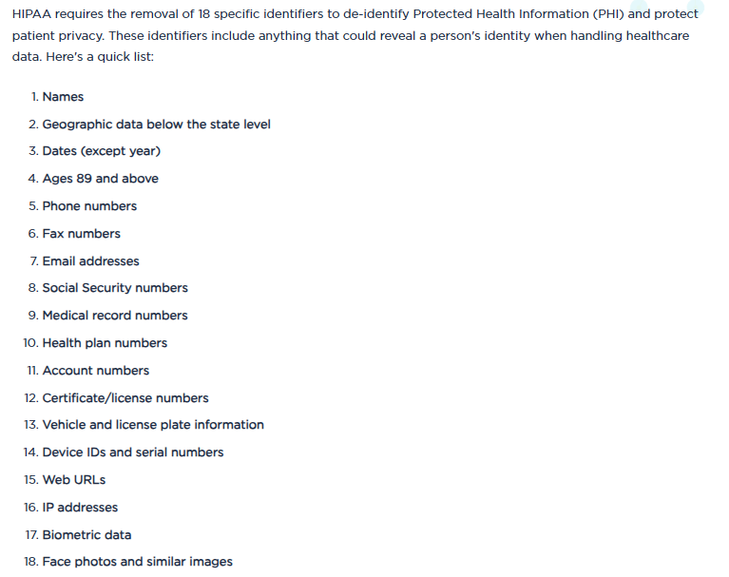

Slide 16
