Slide 1
CYBERSECURITY INTERNSHIP PROJECT
Suricata IDS Monitoring
& Dashboard
A test lab for intrusion detection, plus a dashboard built from scratch to view and manage the alerts.
Sameeha Shahid | BSCS23157

Slide 2
INTRODUCTION

Slide 3
OVERVIEW
What this project covers
Three parts: a live detection lab, a rule dataset built from scratch, and a dashboard to read and validate what the lab finds.
01
02
03
Detection Lab
Rule Dataset
Dashboard
3-VM isolated network on VMware (attacker, target, sensor)
Suricata 8.0.6 monitoring the shared subnet
Real malware PCAPs replayed end-to-end (C2, recon, exfiltration)
~70,000 ET Open rules scraped from proof point for full metadata
88,391 rules from community sources sampled from OISF's public feeds
Two JSON datasets, ready to query or enrich with
Built from scratch with Streamlit, not an off-the-shelf tool
SQLite database so alerts persist, not just in memory
Every alert enriched with its rule's message & severity

Slide 4
LAB ARCHITECTURE
The isolated 3-VM detection lab
The environment was deliberately separated from the host network: VMnet1 carried the attack/test traffic while each VM retained NAT for package updates and internet access.
VMnet1 — Host-only detection network | 192.168.93.0/24
Kali
Ubuntu-Suricata
Ubuntu-Benign
Attacker SSH + traffic generation
Sensor Suricata / ens34
Target Apache + vsftpd

Slide 5
SURICATA BASICS
Installing and configuring Suricata
Installed from OISF's official PPA for a current, maintained version.
Set HOME_NET and pointed capture at the correct network interface, so Suricata sees real traffic between the attacker and target.
Downloaded the rule set with suricata-update (Emerging Threats Open by default), added rules from 14 other sources afterwards.
Tested the config before running it live.
Ran it in the background and confirmed alerts by scanning the target from Kali.
137,759
Active rules loaded in Suricata
8.0.6
Suricata version
192.168.93.0/24
monitored subnet

Slide 6
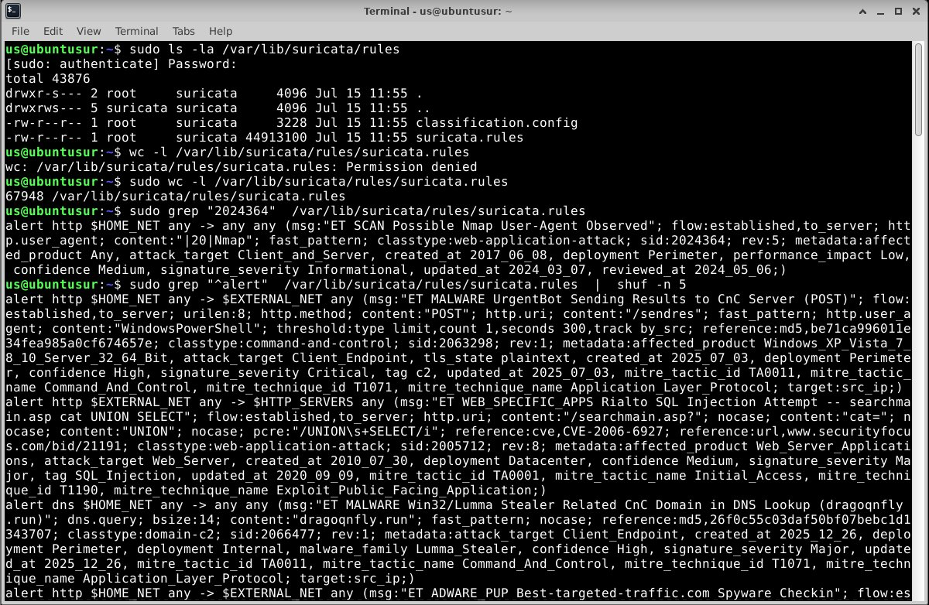
SURICATA RULES
Parts of a rule
A rule has two parts: a header, and a set of options inside the parentheses. Example below is a real rule that fired on my own Nmap traffic.
HEADER — before the parentheses
OPTIONS — inside the parentheses, separated by semicolons
ACTION PROTOCOL SRC_IP SRC_PORT DIRECTION DST_IP DST_PORT
msg / sid / rev
Description, unique ID, and revision number
content / pcre / nocase
The exact text or pattern to match in the traffic
flow / flowbits
Connection conditions, e.g. only established traffic
fast_pattern
The fastest field to check first, out of total rules
metadata / reference
This rule, straight from suricata.rules on the sensor VM
Severity, tags, and links back to CVEs
threshold
Limits repeat alerts, e.g. once per source per 5 min
All six rows above are options — they live inside the parentheses, after the header.

Slide 7
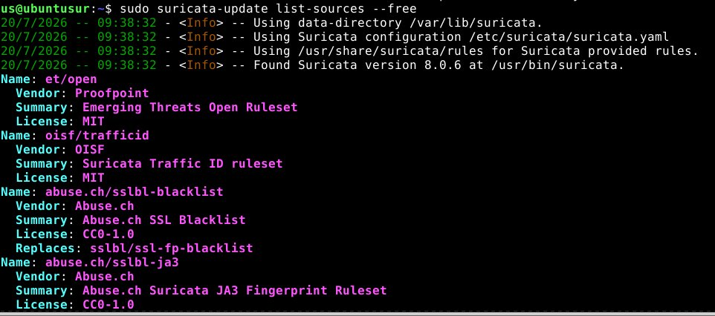
RULE SOURCES
Where rules come from
suricata-update list-sources shows 15 free rule feeds which we added during configuration of suricata
Enabled every free source at once, about 153,746 total rules combined.

Slide 8
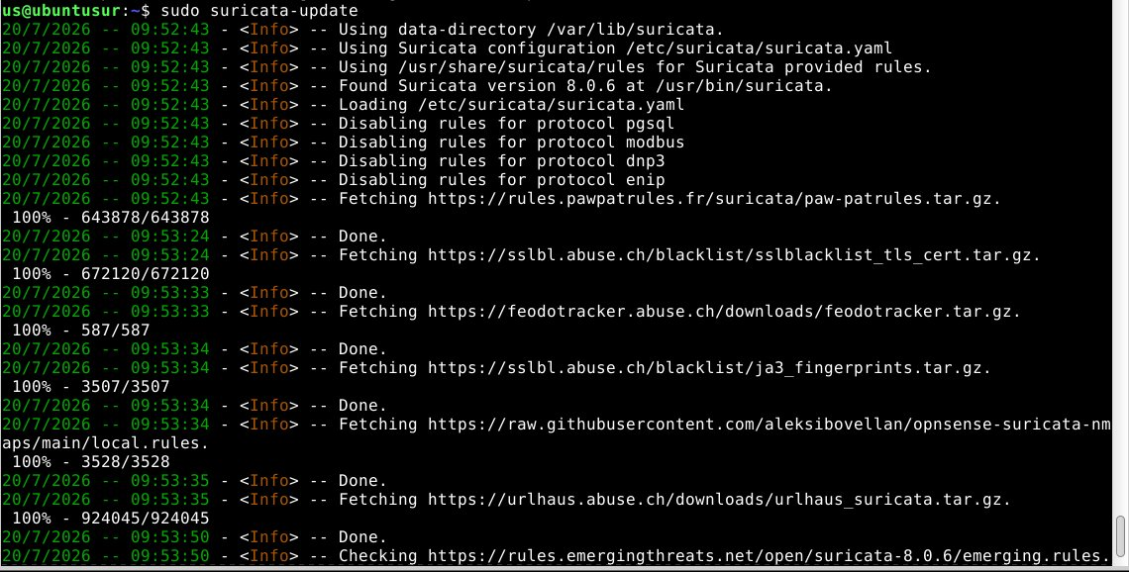
SIDS
How SIDs work
SID = Signature ID, a rule's own tracking number. It is not the same as a CVE — the two are linked through the rule's reference field.
Each vendor has a reserved SID range, e.g. 2,000,000+ is Emerging Threats, 3,100,000+ is Stamus.

Slide 9
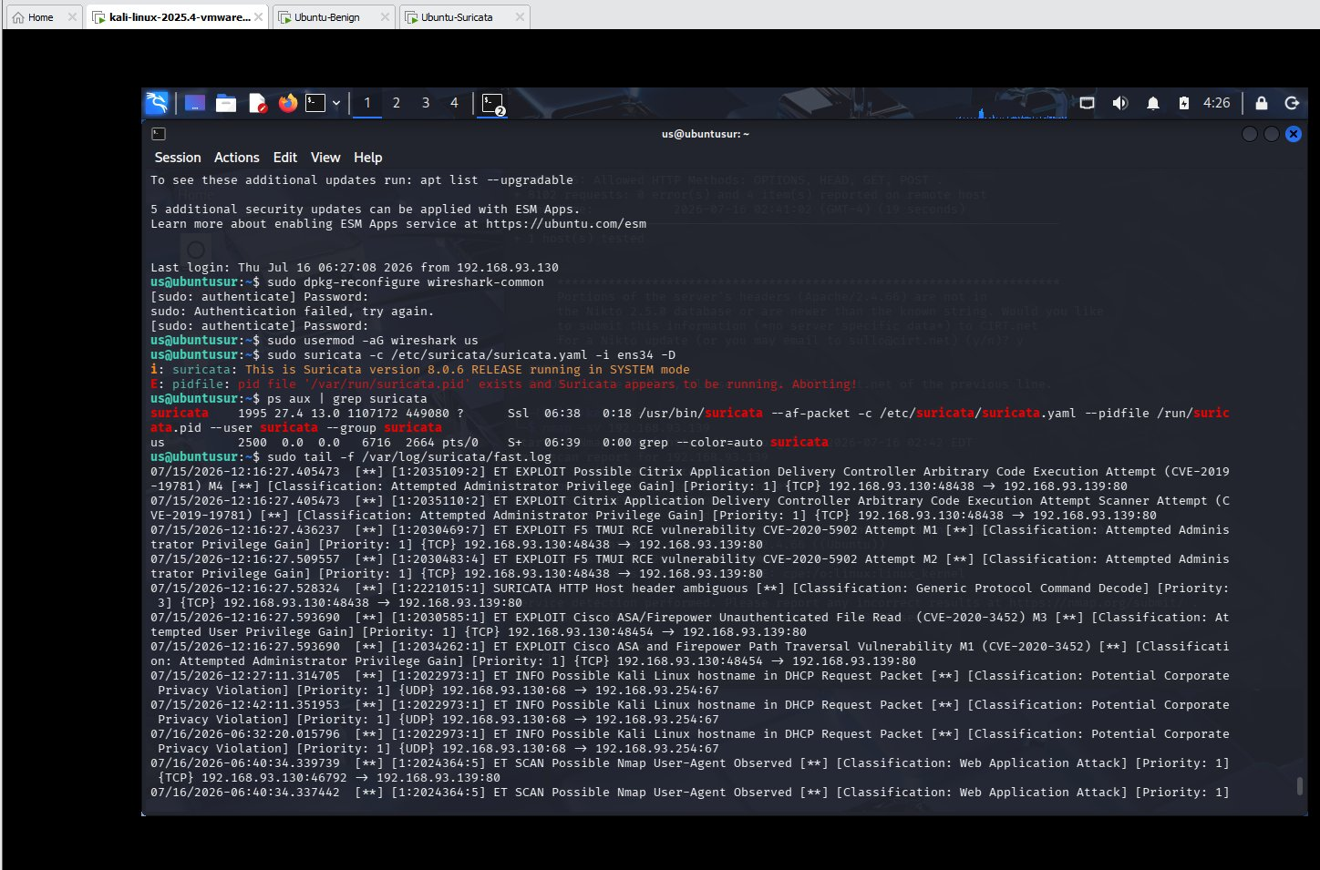
HOW IT WORKS
How a packet becomes an alert
1
2
3
4
5
→
→
→
→
Capture
Decode
Fast filter
Full match
Alert + log
Traffic reaches the sensor's network card
Ethernet, IP, TCP, then the protocol
Quickly narrows down which rules to check
Checks the rest of that rule's conditions
Saved to fast.log and eve.json
Example: an Nmap scan from Kali put “Nmap” in its User-Agent. The rule matched on that field and fired within about a second.
Why replay methodology matters
This same pipeline is what every replayed attack PCAP has to pass through later in the project — capture, decode, fast filter, full match, alert. Validating it here on live Kali traffic is what made the PCAP replay results trustworthy.
Live alerts, straight from fast.log during testing

Slide 10
JSON DATASETS

Slide 11
RULES DATASET
Turning rule files into JSON dataset
SOURCES INCLUDED
Wrote scripts (generate_rules_json.py & et_scraping.py) to scrape rules from proof point for ET and from .rules files for the other 14 sources.
Pulled out sid, message, category, flow, and references into one consistent format for every source.
Result: searchable JSON files covering malware, phishing, recon, and SQLi rules.
aleksibovellan/nmap
abuse.ch/urlhaus
abuse.ch/feodotracker
stamus/lateral
tgreen/hunting
ipfire/dbl
pawpatrules
et/open
etnetera/aggressive
abuse.ch/sslbl-ja3
abuse.ch/sslbl-blacklist
oisf/trafficid
ptrules/open
the-hunters-ledger/open
julioliraup/antiphishing

Slide 12
WEB SCRAPING DETAILS
Getting extra detail for Emerging threat rules
A rule file only has a short message. Proofpoint's own site has more: severity, category, and a full description for each rule.
Rule list
Scraper
Made it reliable
Read all ~70,000 rule IDs from sid-msg.map
Built with Playwright + BeautifulSoup
Visits each rule's page and pulls its details
Saves progress every 25 rules, so it can resume if interrupted
Recovered a corrupted save file by rebuilding it from backups
Verified complete: all 70,991 SIDs accounted for, 0 failed, checkpoint and output cross-checked byte-for-byte on a 500-record sample.
70,991
3
25
0
rule IDs read in
Page tabs checked per rule
rules saved per checkpoint
failed SIDs, final run

Slide 13
DASHBOARD ENRICHMENT
Attaching rule context to every alert on the dashboard
Both datasets now feed the dashboard directly. Every alert shows its rule's own message, classification, and severity, not just the raw signature ID.
suricata_et_rules.json
One SID-keyed dictionary for dashboard enrichment
~70,000 ET rule records
merge on sid →
O(1) lookup — one dict access per alert, not a per-render search
Built once at load time and cached, so the alerts table stays fast
Falls back cleanly to “N/A” for any SID outside both datasets
suricata_community_sample.json
OISF Free-source rule sample
2
70k+
88k+
O(1)
JSON datasets merged
ET SIDs available
OISF SIDs available
lookup per alert

Slide 14
DASHBOARD

Slide 15
DASHBOARD
How the dashboard is built
Started as a simple script that read alerts into memory. Now it's a Streamlit app backed by a real database, so nothing is lost on refresh or restart.
app.py
ingestor.py
alert_store.py
Main app, layout, and tabs
Reads alerts into the database
Updates review status
data_loader.py
filters.py
charts.py
Loads the rules catalog
Sidebar filter logic
Traffic charts

Slide 16
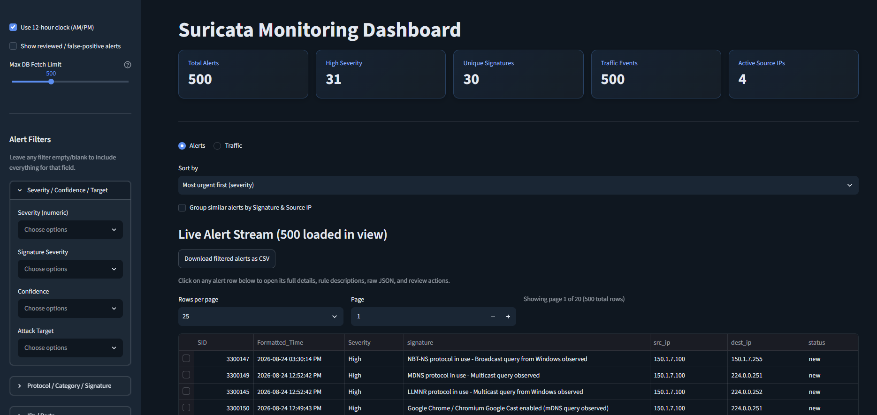
DASHBOARD
What the dashboard looks like

Slide 17
DASHBOARD
What the dashboard can do
1
Review workflow
2
Sort by urgency
Mark alerts as reviewed or false positive, and reopen them later
Sorts by severity, with 1 as most severe
3
Group repeat alerts
4
Search with regex
Combines repeated alerts into one row with a count
Optional regex search on signature and IP filters
5
More filters
6
Cleaner look
Severity, confidence, target, direction, and more, in the sidebar
Color-coded severity, KPI row, consistent theme
7
Export to CSV
8
Traffic charts
Download filtered results from either tab
Traffic over time, top talkers, protocol breakdown

Slide 18
DASHBOARD
Making it fast and reliable
A live dashboard polling a growing database creates its own problems. These are the ones that came up, and the fixes.
1
Live auto-refresh
2
Render caching
Streamlit doesn't rerun on new rows by itself — added @st.fragment(run_every=...) so the alert table ticks on its own.
Re-parsing and re-sanitizing raw JSON on every refresh caused visible lag; now cached per alert ID so it's only done once.
3
Database locking
4
Log rotation
Multiple readers/writers on SQLite caused timeouts; fixed with a busy timeout and WAL mode so reads and writes don't block each other.
Suricata rotates eve.json daily; the dashboard's own SQLite table rotates at 25k rows so it doesn't grow unbounded.

Slide 19
DATA INTEGRITY
Checking the dashboard against the database
Cross-checked filtered counts shown in the dashboard against a direct SQL query on alerts.db.
Learned Suricata's severity is inverted from what's intuitive: 1 is most severe, 3 is least — confirmed by checking the raw alert metadata, not assumed.
Verified the ET scrape output against the checkpoint file to confirm no SIDs were silently dropped.
Example check
sqlite3 alerts.db "SELECT COUNT(*) FROM
alerts WHERE severity = 1;"
Result compared line-for-line against what the dashboard's own severity filter reported for the same query — confirms the filter logic matches the data, not just the display.

Slide 20
ATTACK SIMULATION

Slide 21
ATTACK SIMULATION
Turning real malware traffic into lab traffic
PCAPs sourced from real captured campaigns on malware-traffic-analysis.net's training exercises
1
2
3
4
5
Capture
Verify
Remap
Recalc
Replay
tcpdump
tshark
tcprewrite
--fixcsum
tcpreplay
Baseline traffic captured (or a public PCAP used directly)
Confirms the original capture's source/destination IP footprint
Maps source & destination IPs into the lab's actual subnet
Recalculates IP/TCP checksums — skip this and Suricata drops every packet as corrupted
Injects the traffic onto the wire for Suricata to see live

Slide 22
BASELINE TEST
Nikto web scan replay
First replay test, run before the malware PCAPs, to prove the capture → remap → replay pipeline actually produces real Suricata alerts.
Captured a Nikto web scan against a target with tcpdump into sample_attack.pcap
Remapped source IPs into 15 simulated external attackers (10.0.0.0/28)
Remapped destination IPs across 5 targets on the real lab subnet
Replayed with tcpreplay and confirmed Suricata alerts matched the expected web-scan signatures
Why start with Nikto
A known, well-documented scan gives an easy pass/fail check on the whole remap+replay methodology before trusting it on real malware captures, where a mistake would be harder to spot.
Result: pipeline validated, moved on to the three malware attack flows next.

Slide 23
ATTACK FLOW 1
Formbook / XLoader — C2 traffic
Commodity infostealer, command-and-control communication
Formbook (also distributed as XLoader) is a widely-used infostealer sold as malware-as-a-service, commonly delivered through phishing.
The replayed capture carries its C2 check-in traffic — the callback pattern the infected host uses to reach its command server.
Chosen as attack flow 1 because C2 beaconing is one of the most common alert categories in a real SOC feed, a good baseline malware family to validate against.
Source: real capture from malware-traffic-analysis.net, remapped and replayed through the lab exactly like the Nikto baseline.

Slide 24
ATTACK FLOW 2
Web recon & exploitation probes
Reconnaissance and exploitation-attempt traffic, distinct from Nikto's baseline scan
Deliberately chosen as a different traffic category from the Nikto baseline test and from the C2 flow — recon/exploitation probing rather than a single scanner's signature or a beacon.
Represents the “looking for a way in” stage of an attack: probing for exposed endpoints and testing exploitation attempts against them.
Useful contrast for the dashboard: this traffic produced a burst of related alerts.
Source: real capture from malware-traffic-analysis.net, remapped and replayed through the lab exactly like the Nikto baseline.

Slide 25
ATTACK FLOW 3
GuLoader → AgentTesla, FTP exfiltration
Multi-stage loader chain ending in data exfiltration
GuLoader is a downloader stage, typically delivered via phishing, whose job is to fetch and launch the next-stage payload.
That payload is AgentTesla, an infostealer that harvests credentials and system data from the infected host.
The distinguishing piece of this flow: AgentTesla exfiltrates what it collects over FTP — the only one of the three flows with a visible data-exfiltration stage, not just infection or C2.
Source: real capture from malware-traffic-analysis.net, remapped and replayed through the lab exactly like the Nikto baseline.

Slide 26
MULTI-ATTACKER SIMULATION
Five source IPs, one subnet
Same remap + replay methodology, distributed across 5 simulated attacker IPs hitting the lab subnet concurrently instead of one attacker at a time.
Why test this
Result
The earlier flows tested detection one source at a time
Real environments see multiple attackers, or one attacker across multiple IPs, at once
Directly stresses the dashboard features built to handle exactly this: grouping repeat alerts and filtering by source
Suricata alerted correctly across all 5 simulated sources hitting the subnet at once, and the dashboard's grouping view collapsed the resulting repeat alerts into countable rows instead of a flood of individual lines — exactly the workflow it was built for.

Slide 27
ATTACK SIMULATION
Getting the replayed traffic right
The remap step in the replay pipeline had its own issues
Targeted mapping didn't work
Wildcard mapping fixed it
Tried mapping the Kali VM's own IP as the source in third-party PCAPs — it never matched anything, since those captures don't contain that IP at all.
Switched to tcprewrite --srcipmap="0.0.0.0/0:$attacker/32", which reassigns any source IP in the capture to the simulated attacker — confirmed working end-to-end.
Flow-split bug
Paced replay
Using 0.0.0.0/0 for both source and destination map broke Suricata's flow tracking — same host ended up with two different fake identities.
Full-speed replay risked resource exhaustion on the sensor VM; capped with tcpreplay --pps=200 for a steady, realistic pace.

Slide 28
RECAP
The whole system, in one view
Detection pipeline
Kali
(attacker)
PCAP replay
(remapped)
Suricata
(sensor)
eve.json /
fast.log
Dashboard
(live view)
→
→
→
→
Rule intelligence pipeline
index.yaml /
sid-msg.map
Scraper
(Playwright)
JSON
datasets
Merge
on sid
Enriched
alerts
→
→
→
→
The two pipelines meet at the dashboard — live alerts, enriched with rule context.

Slide 29
WHAT I LEARNED
Skills built this internship
Network security
Data engineering
Suricata rule engine internals & SID system
Packet capture/replay methodology (tcpdump, tshark, tcprewrite, tcpreplay)
Resilient async scraping at scale (checkpointing, retries, recovery)
Building structured datasets out of unstructured/scraped sources
Full-stack app dev
Debugging under constraints
Streamlit + SQLite, from a memory-only script to a persistent app
Designing a review workflow around real analyst needs
Diagnosing corrupted files, concurrent writes, and resource limits
Verifying data integrity rather than assuming a pipeline worked

Slide 30
Thank you
Suricata IDS Monitoring, Rule Dataset & Attack Simulation
github.com/Sameeha135/suricata-dashboard
github.com/Sameeha135/suricata-ids-lab

