Slide 1
Limitations of an Array
We cannot store different class objects into the same array as it stores only one data type of elements
Adding the object at then end of an array is easy. But inserting and deleting the elements in the middle of the array is difficult.
Retrieving the elements from an array is easy but after retrieving the elements, if we want to process them, then there are no methods available to carry out this.
To overcome all those we have Collection Object or Container Object

Slide 2
The Java Collection
A Collection framework is a class library to handle groups of Objects. Collection framework implemented in java.util package.
Objects
Collection Object
Q: Does a Collection Object store copies of other Object or their references ?

Slide 3
The Java Collection
There are a few basic operations we will normally use with collections:
Add objects to the collection.
Remove objects from the collection.
Find out if an object (or group of objects) is in the collection.
Retrieve an object from the collection (without removing it).
Iterate through the collection, looking at each element (object) one after another.

Slide 4
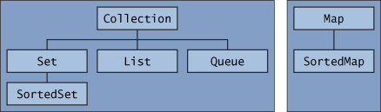
Topic Name - The Java Collection
Interfaces
The core collection interfaces encapsulate different types of collections.
Core collection interfaces are the foundation of the Java Collections Framework.
A Set is a special kind of Collection, a SortedSet is a special kind of Set, and so forth.
The hierarchy consists of two distinct trees — a Map is not a true Collection.
All the core collection interfaces are generic.

Slide 5
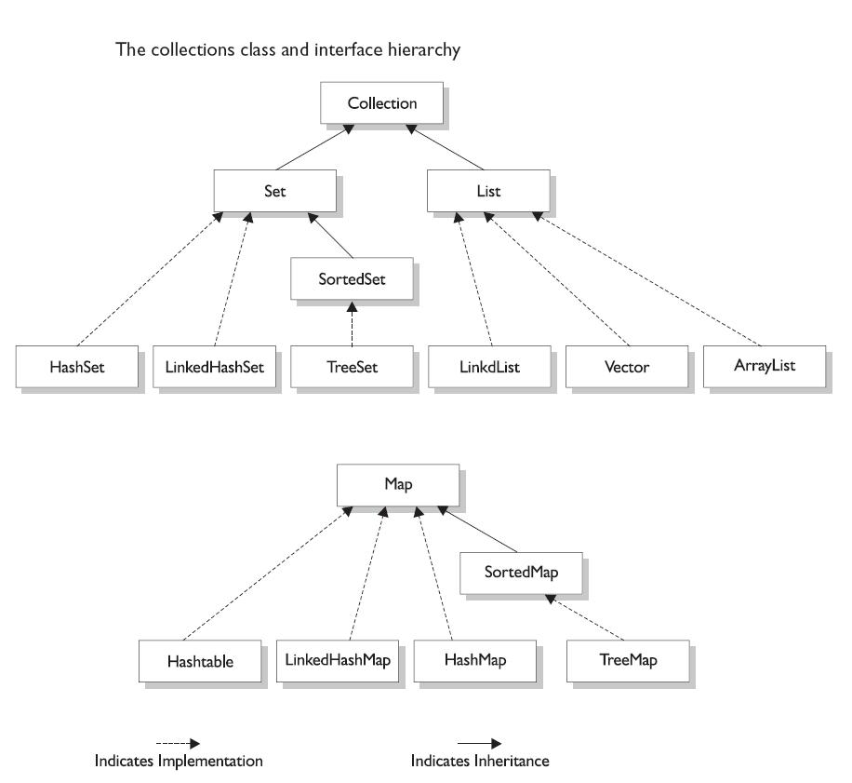
Topic Name - The Java Collection

Slide 6
The Java Collection
Interface Type | Implementation Classes
Set <T> | HashSet<T> LinkedHashSet<T>
List <T> | Stack<T> LinkedList<T> ArrayList<T> Vector<T>
Queue<T> | LinkedList<T>
Map<K,V> | HashMap<K,V> Hashtable<K,V>

Slide 7
The Java Collection
Set : A Set represents a group of elements arranged just like an array. The set will grow dynamically when the elements are stored into it. A set will not allow duplicate elements.
List: List are like Sets. They store a group of elements. But lists allow duplicate values to be stored.
Queue: A Queue represents arrangement of elements in FIFO order. This means that an element that is stored as a first element into the queue will be removed first from the Queue.
Map: Maps store elements in the form of key and value pairs. If the key is provided then its corresponding value can be obtained. Of course the keys should have Unique values.
Q: Can we store a primitive data type into a Collection ?

Slide 8
Retrieving elements from Collections
Following are the 4 ways to retrieve any element from a Collection Object
Using for-each loop
It looks like a for loop which repeatedly executes a group of statements for each element of the Collection.
for (variable : collection-object) {
statements;
}
Using Iterator interface
Iterator is an interface that contains methods to retrieve the elements one by one from a Collection Object. It has 3 methods:
- boolean hasNext()
- element next()
- void remove()

Slide 9
The Java Collection
Using ListIterator interface
ListIterator is an interface that contains methods to retrieve the elements from a collection object, both in forward and backward directions. It has following methods:
- boolean hasNext()
- boolean hasPrevious()
- element next()
- element previous()
- void remove()
Using Enumeration interface
This interface is useful to retrieve one by one the elements like the iterator. It has 2 methods:
- boolean hasMoreElements()
- element nextElement()
Q: Difference between Iterator and ListIterator?
Q: Difference between Iterator and Enumeration?

Slide 10
HashSet class
A HashSet represents a Set of elements (objects). It does not guarantee the order of elements and doesn’t allow the duplicate elements to be stored.
class HashSet<T> where <T> represents the generic type parameter. It represents which type of elements are being stored into HashSet.
Ex: HashSet<String> hs = new HashSet<String>();
Constructors:
HashSet();
HashSet(int capacity)
HashSet (int capacity, float loadfactor)
Methods:
boolean add(obj)
boolean remove(obj)
void clear()
contains(obj)
isEmpty()
size()

Slide 11
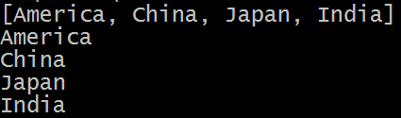
HashSet Example
import java.util.*;
class HS {
public static void main (String[] args) {
HashSet<String> hs = new HashSet<String>();
hs.add("India");
hs.add("America");
hs.add("Japan");
hs.add("China");
hs.add("America");
System.out.println(hs);
Iterator itr = hs.iterator();
while (itr.hasNext())
System.out.println(itr.next());
}
}

Slide 12
LinkedHashSet
This is a subclass of HashSet class and does not contain any additional members on its own. It is a generic class that has the declaration:
Class LinkedHashSet<T>
Here <T> represents the generic type parameter. It represents the data type of elements being stored into the LinkedHashSet. The internal data structure is linked list to store the elements.

Slide 13
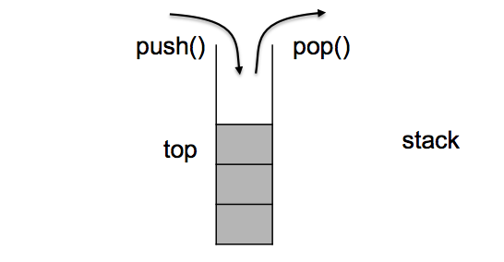
Stack class
A Stack represents a group of elements stored in LIFO (Last In First Out) order. This means that the element which is stored as a last element into the stack will be the first element to be removed from the stack. Inserting elements into the stack is called Push Operation and removing element from stack is called Pop Operation. Searching for an element in the stack is called Peep Operation.
Ex: Stack<Integer> obj = new Stack<Integer>();
Methods():
boolean empty()
element peek()
element pop()
element push(element obj)
int search(Object obj)

Slide 14
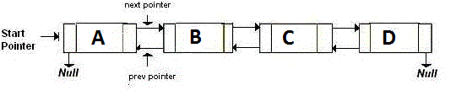
LinkedList class
A LinkedList contains a group of elements in the form of nodes. Each node will have three fields – the data field contains data and the link fields contain references to previous and next nodes.
It is very convenient to store data. Inserting the elements into the linked list and removing the elements from the linked list is done quickly and takes the same amount of time.
Ex: LinkedList<String> list = new LinkedList<String>();

Slide 15
ArrayList class
An ArrayList class is like an array, which can grow in memory dynamicaaly. It means that when we store elements into the ArrayList, depending on the number of elements, the memory is dynamically allotted and re-allotted to accommodate all the elements. ArrayList is not synchronized.
Ex: ArrayList<String> list = new ArrayList<String>();
It constructs an ArrayList with a default initial capacity of 10. or we can mention the capacity at the time of creating ArrayList object as:
ArrayList<Double> list = new ArrayList<Double>(50);
Ex: list.add(“Apple”);
list.add(“Mango”);
list.add(“Orangle”);
list.add(“Guava”);

Slide 16
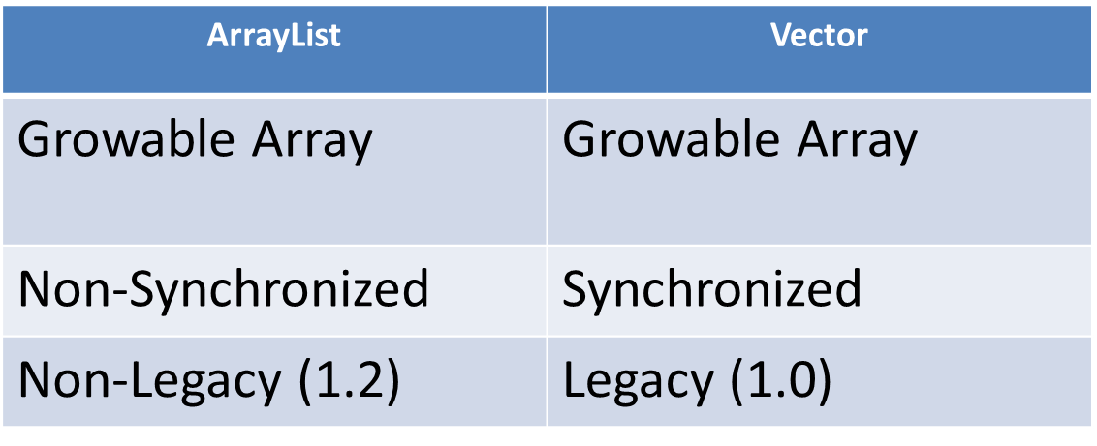
Vector class
A Vector also stores elements(objects) similar to ArrayList. But Vector is Synchronized.
Ex: Vector<Float> v = new Vector<Float>();
Ex:
Vector<Integer> v = new Vector<Integer> ();
int x[] = {23,34,45,56,43,54,52,96};
for(int i=0; i<x.length; i++)
v.add(x[i]);
ListIterator litr = v.listIterator();
while (litr.hasNext())
System.out.println(litr.next());
while(litr.hasPrevious())
System.out.println(litr.previous());

Slide 17
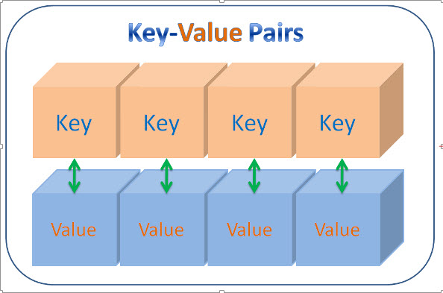
HashMap Class
A HashMap is a collection that stores elements in the form of Key-Value pairs. Keys should be unique. HashMap is not synchronized and hence while using multiple threads on HashMap object , we get unreliable results.
class HashMap<K,V>
Ex: HashMap<String, Integer> hm = new HashMap<String,Integer)();
get()
isEmpty()
size()
remove()
containsKey()
containsValue()
clear()
keySet()
values()
entrySet()

Slide 18
For further info please visit www.techstratinc.com
Thank You

