Slide 1

CONTROL STATEMENTS LOOPS
TRAINING & RECRUITMENT
OFFSHORE DEVELOPMENT
IDENTITY MANAGEMENT
PORTAL DEVELOPMENT
APPLICATION DEVELOPMENT
5th Floor , V.V.Vintage-Boulevard, Somajiguda
Hyderabad – 500082 INDIA
Tel: 040-30605533

Slide 2
TOPICS TO BE COVERED
if else
switch
while
do while
for
break
continue

Slide 3
if-else
If Else statement consists of one if condition and one else part. It encloses some code which is executed only if the if condition is true, if its false then the else part of the code will be executed.
Simple if statement
if-else statement
if-else-if
Nested if-statement
Syntax:-
if(conditional_statement)
{
statement to be executed if conditions becomes true
}
else
{
statements to be executed if the above condition becomes false
}

Slide 4
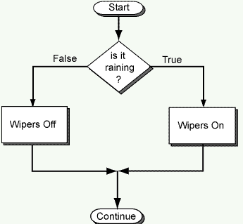
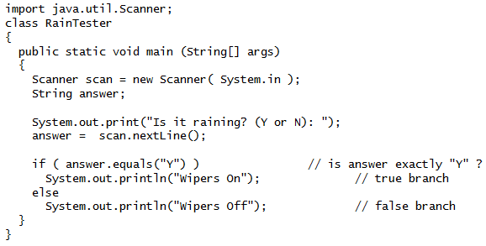
if-else

Slide 5
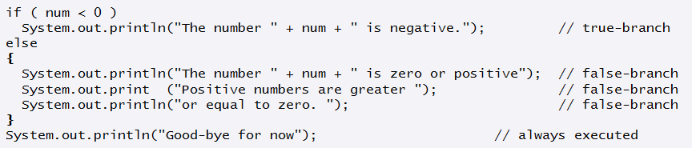
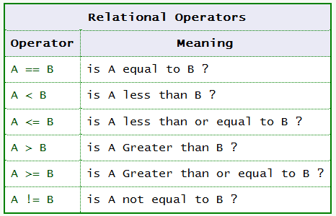
Boolean Expressions

Slide 6
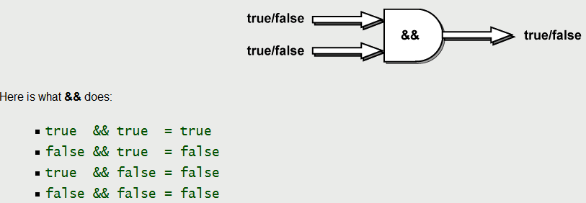
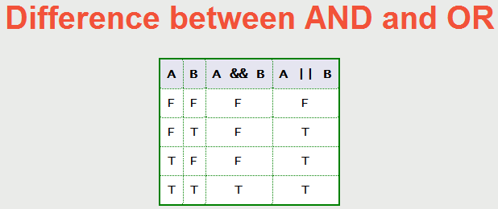
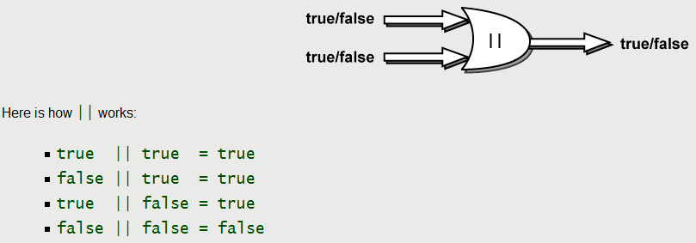
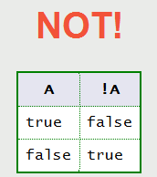
Boolean Expressions

Slide 7
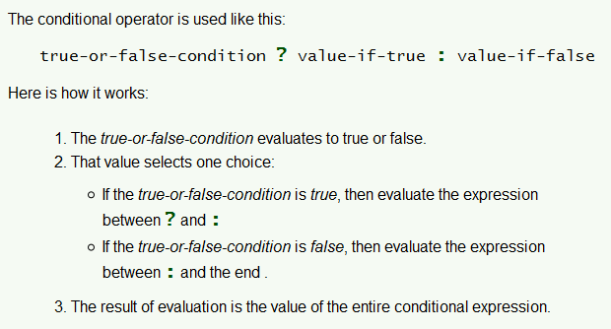
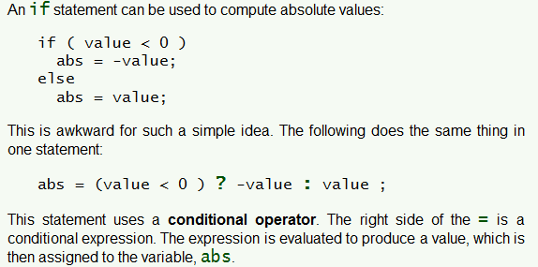
Conditional Operator (? :)

Slide 8
switch
Unlike if-then and if-then-else statements, the switch statement can have a number of possible execution paths.
Syntax:-
switch (variable)
{
case c1: statements // they are executed if variable == c1
break;
case c2: statements // they are executed if variable == c2
break;
default: statements //they are executed if none of the above case is satisfied
break;
}
Notes:
Java was conceived by james gosling,patrick naughton….
Java was initially called as Oak..
But renamed as java in 1995
Standard edition, management edition, enterprise edition (used for adv.. Java concepts)
You can write the java program in any editors, notepads. But it will be easy if you use editplus

Slide 9
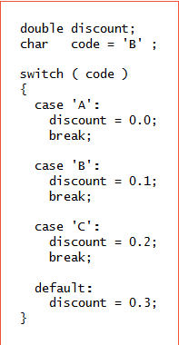
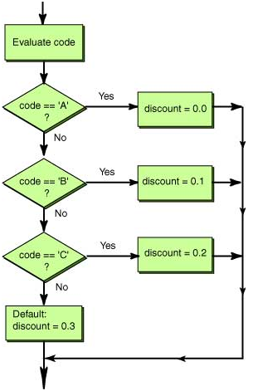
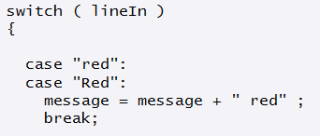
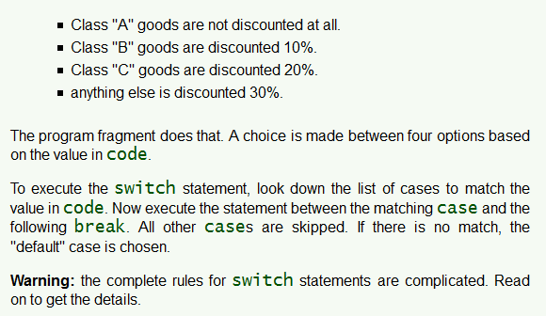
switch

Slide 10
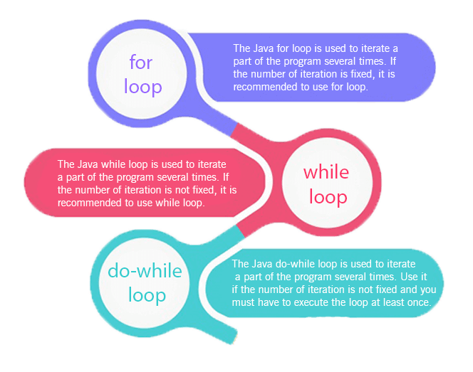
LOOPS

Slide 11
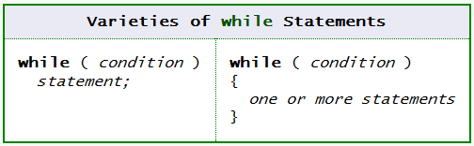
while - loop
While statement is useful when you want to execute something till a particular condition is true.
Syntax:-
while(condition_statement → true)
{
Statements to be executed when the condition becomes true and execute them repeatedly until condition becomes false.
}
Ex:-
int x =2;
while(x<5){
system.out.println(“value of x:”+x);
x++;
}

Slide 12
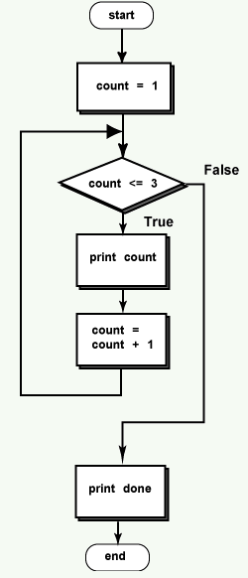
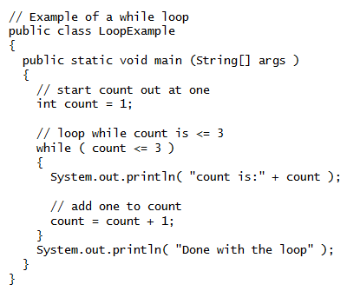
while - loop

Slide 13
do while - loop
The difference between do-while and while is that do-while evaluates its expression at the bottom of the loop instead of the top. Therefore, the statements within the do block are always executed at least once.
do
{
statements to be executed at least once without looking at the condition.
The statements will be executed until the condition becomes true.
}
while (condition_statement);

Slide 14
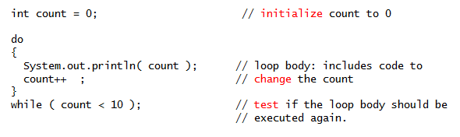
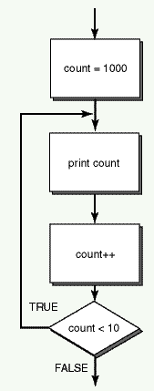
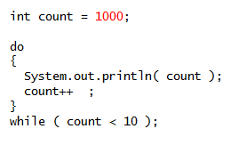
do while - loop

Slide 15
for - loop
for loop is used when you want to iterate over a range of value.
Syntax:-
for(initialization; condition; increment/decrement)
{
statements to be executed until the condition becomes false
}
E.x:-
for(int x=0; x<10;x++)
{
System.out.println(“value of x:”+x);
}

Slide 16
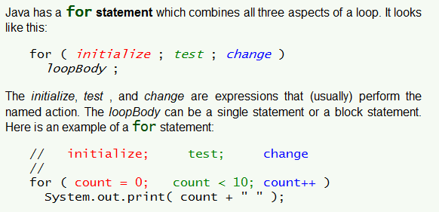
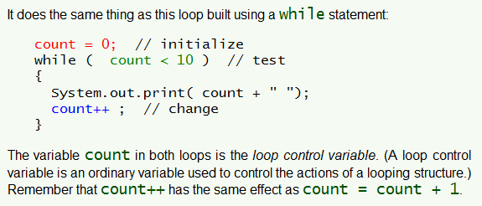
for - loop
Using for
Using while

Slide 17
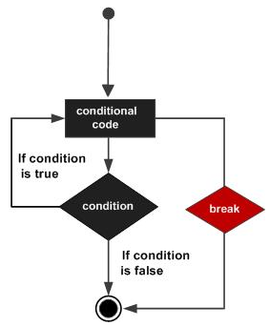
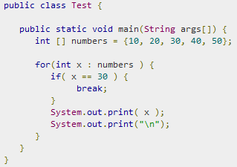
break
The break statement in Java programming language has the following two usages: When the break statement is encountered inside a loop, the loop is immediately terminated and program control resumes at the next statement following the loop

Slide 18
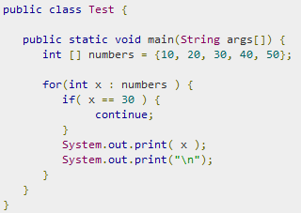
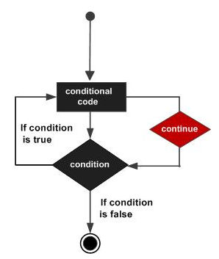
continue
Continue statement is used when we want to skip the rest of the statement in the body of the loop and continue with the next iteration of the loop.
Notes:
Due to the simillarities of java with C++ it si called “Internet version of C++”
Based on C/C++

Slide 19
For further info please visit www.techstratinc.com
Thank You

