Slide 1


Slide 2
Course Topics
JDBC Fundamentals
What is the JDBC API
Why JDBC API developed
JDBC Driver Types
Making a Connection
Sending Sql Statements
ResultSet
Data Types of SQL and Java
Creating/Updating tables from JDBC
Using Prepared Statements
Using Callable Statements
Scrollable Result Sets
Transactions
Batch Processing

Slide 3
JDBC
JDBC stands for Java Database Connectivity, which is a standard Java API for database-independent connectivity between the Java programming language and a wide range of databases.
The JDBC library includes APIs for each of the tasks mentioned below that are commonly associated with database usage.
  Making a connection to a database.
  Creating SQL or MySQL statements.
  Executing SQL or MySQL queries in the database.
  Viewing & Modifying the resulting records.
Fundamentally, JDBC is a specification that provides a complete set of interfaces that allows for portable access to an underlying database. Java can be used to write different types of executable, such as −
  Java Applications
  Java Applets
  Java Servlets
  Java Server Pages (JSPs)
  Enterprise JavaBeans (EJBs).
JDBC provides the same capabilities as ODBC, allowing Java programs to contain database-independent code.

Slide 4
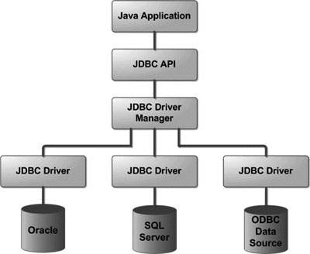
JDBC

Slide 5
Common JDBC Components
DriverManager: This class manages a list of database drivers. Matches connection requests from the java application with the proper database driver using communication sub protocol. The first driver that recognizes a certain subprotocol under JDBC will be used to establish a database Connection.
Driver: This interface handles the communications with the database server. You will interact directly with Driver objects very rarely. Instead, you use DriverManager objects, which manages objects of this type. It also abstracts the details associated with working with Driver objects.
Connection: This interface with all methods for contacting a database. The connection object represents communication context, i.e., all communication with database is through connection object only.
Statement: You use objects created from this interface to submit the SQL statements to the database. Some derived interfaces accept parameters in addition to executing stored procedures.
ResultSet: These objects hold data retrieved from a database after you execute an SQL query using Statement objects. It acts as an iterator to allow you to move through its data.
SQLException: This class handles any errors that occur in a database application.

Slide 6
Understanding SQL
Structured Query Language (SQL) is a standardized language that allows you to perform operations on a database, such as creating entries, reading content, updating content, and deleting entries.
SQL is supported by almost any database you will likely use, and it allows you to write database code independently of the underlying database.
This chapter gives an overview of SQL, which is a prerequisite to understand JDBC concepts. After going through this chapter, you will be able to Create, Read, Update, and Delete (often referred to as CRUD operations) data from a database.

Slide 7
Stages in JDBC Application
Import the packages: Requires that you include the packages containing the JDBC classes needed for database programming. Most often, using import java.sql.* will suffice.
Register the JDBC driver: Requires that you initialize a driver so you can open a communication channel with the database.
Open a connection: Requires using the DriverManager.getConnection() method to create a Connection object, which represents a physical connection with the database.
Execute a query: Requires using an object of type Statement for building and submitting an SQL statement to the database.
Retrieve data from result set: Requires that you use the appropriate ResultSet.getXXX() method to retrieve the data from the result set.
Clean up the environment: Requires explicitly closing all database resources versus relying on the JVM's garbage collection.

Slide 8
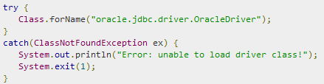
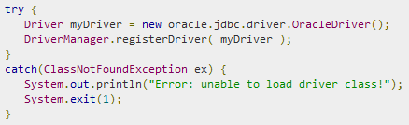
Register the JDBC driver
Approach I - Class.forName()
Approach II - DriverManager.registerDriver()

Slide 9
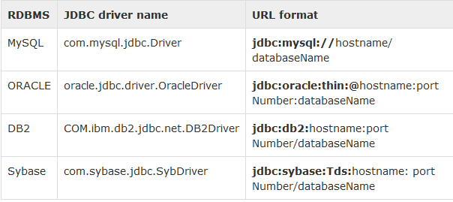
JDBC
Open a connection
After you've loaded the driver, you can establish a connection using the DriverManager.getConnection() method.
For easy reference, we have three overloaded DriverManager.getConnection() methods −
getConnection(String url)
getConnection(String url, Properties prop)
getConnection(String url, String user, String password)

Slide 10
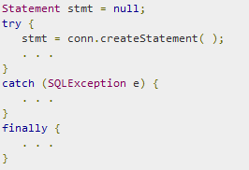
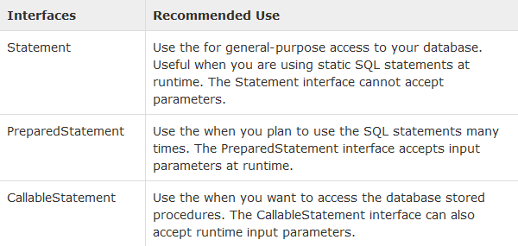
JDBC
Execute a query
Select * from emptab;
Statement stmt = con.createStatement();
ResultSet rs = stmt.executeQuery(“select * from emptab”);

Slide 11
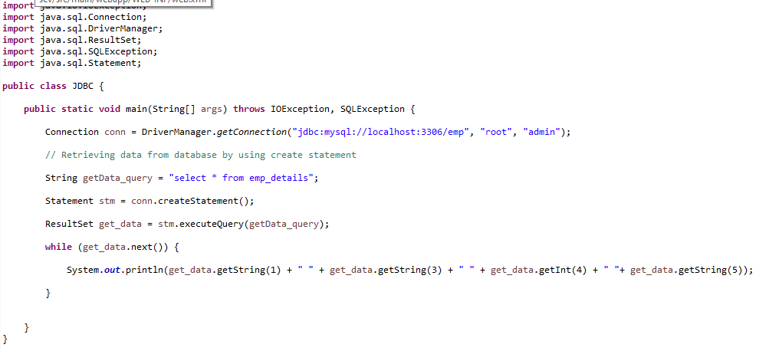
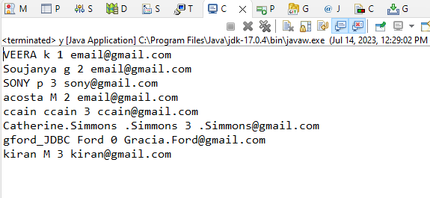
JDBC Example

Slide 12
JDBC Driver Types
JDBC technology drivers fit into one of four categories
JDBC-ODBC Bridge Driver (Type1 driver)
native-API partly Java technology-enabled driver (Type2 driver)
net-protocol fully Java technology-enabled driver (Type3 driver)
native-protocol fully Java technology-enabled driver (Type4 driver)

Slide 13
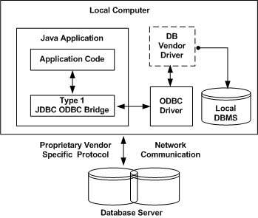
JDBC Drivers Types
JDBC driver implementations vary because of the wide variety of operating systems and hardware platforms in which Java operates. Sun has divided the implementation types into four categories, Types 1, 2, 3, and 4, which is explained below −
Type 1: JDBC-ODBC Bridge Driver
In a Type 1 driver, a JDBC bridge is used to access ODBC drivers installed on each client machine. Using ODBC, requires configuring on your system a Data Source Name (DSN) that represents the target database.

Slide 14
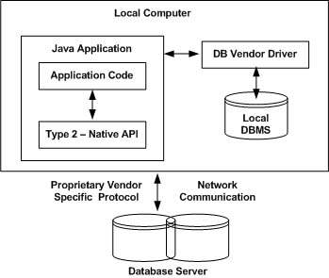
JDBC Drivers Types
Type 2: JDBC-Native API
In a Type 2 driver, JDBC API calls are converted into native C/C++ API calls, which are unique to the database. These drivers are typically provided by the database vendors and used in the same manner as the JDBC-ODBC Bridge. The vendor-specific driver must be installed on each client machine.
If we change the Database, we have to change the native API, as it is specific to a database and they are mostly obsolete now, but you may realize some speed increase with a Type 2 driver, because it eliminates ODBC's overhead.

Slide 15
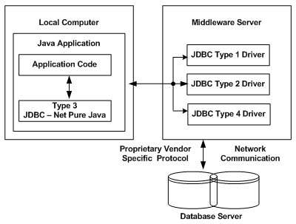
JDBC Drivers Types
Type 3: JDBC-Net pure Java
In a Type 3 driver, a three-tier approach is used to access databases. The JDBC clients use standard network sockets to communicate with a middleware application server. The socket information is then translated by the middleware application server into the call format required by the DBMS, and forwarded to the database server.
This kind of driver is extremely flexible, since it requires no code installed on the client and a single driver can actually provide access to multiple databases.

Slide 16
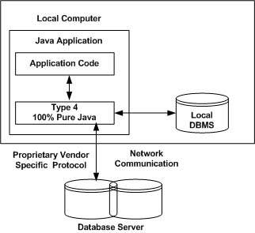
JDBC
Type 4: 100% Pure Java
In a Type 4 driver, a pure Java-based driver communicates directly with the vendor's database through socket connection. This is the highest performance driver available for the database and is usually provided by the vendor itself.
This kind of driver is extremely flexible, you don't need to install special software on the client or server. Further, these drivers can be downloaded dynamically.

Slide 17
What is the JDBC API?
The JDBC API consists of a set of classes and interfaces written in the Java programming language that provide a standard API for tool/database developers
The JDBC API makes it easy to send SQL statements to relational database systems and supports all dialects of SQL.
The JDBC API making it possible to interact with other kinds of data sources, such as files containing tabular data.
With the JDBC API, it isn't necessary to write separate program to access different types of database.
the JDBC API makes it possible to publish a web page containing an applet that uses information obtained from a remote data source
In simplest terms, a JDBC technology-based driver ("JDBC driver") makes it possible to do three things:
Establish a connection with a data source.
Send queries and update statements to the data source.
Process the results.

Slide 18
Making a Connection
Connection over View:
A Connection object represents a connection with a database.
A single application can have one or more connections with a single database, or it can
have connections with many different databases.
A user can get information about a Connection object's database by invoking the
Connection.getMetaData method.
This method returns a Database Metadata object that contains information about the
database's tables
Opening a Connection:
The following is an example to create connection.
  String url = "jdbc:odbc:dsn";
  Connection con = DriverManager.getConnection(url, “username", "password");
Once a connection is established, it is used to pass SQL statements to its underlying database.
The JDBC API provides three interfaces for sending SQL statements to the database

Slide 19
Sending SQL Statements
Statement :-
created by the Connection.createStatement methods. A Statement object is used for sending SQL statements with no parameters.
PreparedStatement :-
created by the Connection.prepareStatement methods. A PreparedStatement object is used for precompiled SQL statements.
These can take one or more parameters as input arguments (IN parameters).
PreparedStatement has a group of methods that set the value of IN parameters, which are sent to the database when the statement is executed.
PreparedStatement extends Statement and therefore includes Statement methods.
A PreparedStatement object has the potential to be more efficient than a Statement object because it has been precompiled and stored for future use.
Therefore, in order to improve performance, a PreparedStatement object is sometimes used for an SQL statement that is executed many times.

Slide 20
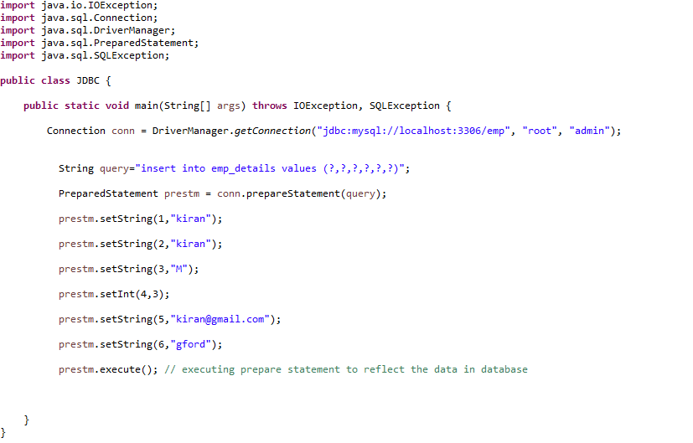

Slide 21
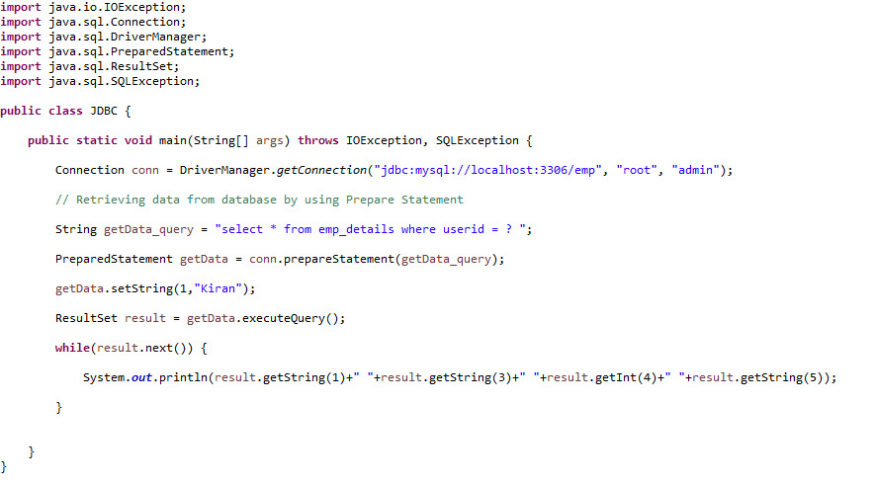
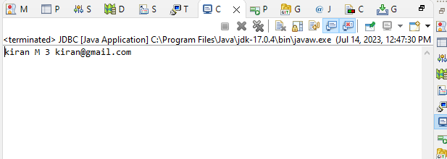

Slide 22
CallableStatement :-
created by the Connection.prepareCall methods.
CallableStatement objects are used to execute SQL stored procedures-a group of SQL
statements that is called by name, much like invoking a function.
A CallableStatement object inherits methods for handling IN parameters from
preparedStatement; it adds methods for handling OUT and INOUT parameters.
The following list determine which Connection method is appropriate for creating different
types of SQL statements:
createStatement methods- for a simple SQL statement.
prepareStatement methods-for an SQL statement that is executed frequently.
prepareCall methods-for a call to a stored procedure .

Slide 23
Above statements returns ResultSet object.It contains results of executing an SQL query
The statement object contains two methods to process SQL statements
.executeQuery(sql statement)
.executeUpdate(sql statement)
.execute(sql statement)
When we use executeUpdate (…)
executeUpdate will process the following sql statements
Create/Alter/Delete Table
Insert/Update/Delete data in table
When we use executeQuery (…)
It simply processes the sql select statements and returns ResultSet Object.
The general form of a result set is a table with column headings and the corresponding values returned by a query.
A ResultSet object maintains a cursor, which points to its current row of data. The cursor moves down one row each time the method next is called.

Slide 24
ResultSet
When a ResultSet object is first created, the cursor is positioned before the first row, so the first call to the next method puts the cursor on the first row, making it the current row.
A cursor remains valid until the ResultSet object or its parent Statement object is closed.
The following terms describe characteristics of a ResultSet:
scrollability :
Whether the cursor can move forward, backward, or to a specific row.
updatability :
Whether the cursor can be used to update or delete rows. This characteristic does not apply to a ResultSet that is returned from a stored procedure, because a stored procedure ResultSet cannot be updated.
holdability :
Whether the cursor stays open after a COMMIT.
Result Set Methods:
When a ResultSet object is first created, the cursor is positioned before the first row. To move the cursor, you can use the following methods:

Slide 25
next() - moves the cursor forward one row. Returns true if the cursor is now positioned on a row and false if the cursor is positioned after the last row.
previous() - moves the cursor backwards one row. Returns true if the cursor is now positioned on a row and false if the cursor is positioned before the first row.
first() - moves the cursor to the first row in the ResultSet object. Returns true if the cursor is now positioned on the first row and false if the ResultSet object
does not contain any rows.
last() - moves the cursor to the last row in the ResultSet object. Returns true if the cursor is now positioned on the last row and false if the ResultSet object
does not contain any rows.
beforeFirst() - positions the cursor at the start of the ResultSet object, before the first row. If the ResultSet object does not contain any rows, this method has
no effect.
afterLast() - positions the cursor at the end of the ResultSet object, after the last row. If the ResultSet object does not contain any rows, this method has no effect.

Slide 26
relative(int rows) - moves the cursor relative to its current position.
absolute(int n) - positions the cursor on the n-th row of the ResultSet object.
Retrieving Column Values:
The ResultSet.getXXX methods provide the means for retrieving column values from the current row.
Either the column name or the column number can be used to designate the column from which to retrieve data.
The following example will retrieve the value stored in table’s column
String s = rs.getString(2); // It returns second coloumn value in current row
String s = rs.getString("TITLE"); // It returns title coloumn value in current row
Note that columns are numbered from left to right starting with column 1. Also, column names used as input to getXXX methods are case insensitive
If the name of a column is known but not its index, the method findColumn can be used to find the column number.

Slide 27
Types of Result Sets:
The ResultSet interface provides methods for retrieving and manipulating the results of executed queries, and ResultSet objects can have different functionality and characteristics. These characteristics are result set type, result set concurrency, and cursor holdability.
The type of a ResultSet object determines the level of its functionality in two areas: the ways in which the cursor can be manipulated, and how concurrent changes made to the underlying data source are reflected by the ResultSet object.
The sensitivity of the ResultSet object is determined by one of three different ResultSet types:
TYPE_FORWARD_ONLY - the result set is not scrollable i.e. the cursor moves only forward, from before the first row to after the last row.
TYPE_SCROLL_INSENSITIVE - the result set is scrollable; its cursor can move both forward and backward relative to the current position,
and it can move to an absolute position.
TYPE_SCROLL_SENSITIVE — the result set is scrollable; its cursor can move both forward and backward relative to the current position, and it can move to an absolute position. Concurrency Types

Slide 28
Basic JDBC Types :
CHAR, VARCHAR, and LONGVARCHAR –
The JDBC types CHAR, VARCHAR, and LONGVARCHAR are closely related. CHAR represents a small, fixed-length character string, VARCHAR represents a small, variable-length character string, and LONGVARCHAR represents a large, variable-length character string.
BINARY, VARBINARY, and LONGVARBINARY –
The JDBC types BINARY, VARBINARY, and LONGVARBINARY are closely related. BINARY represents a small, fixed-length binary value, VARBINARY represents a small, variable-length binary value, and LONGVARBINARY represents a large, variable-length binary value.
BIT –
The JDBC type BIT represents a single bit value that can be zero or one.
TINYINT –
The JDBC type TINYINT represents an 8-bit integer value between 0 and 255 that may be signed or unsigned.
SMALLINT –
The JDBC type SMALLINT represents a 16-bit signed integer value between -32768 and 32767.

Slide 29
INTEGER –
The JDBC type INTEGER represents a 32-bit signed integer value ranging between -2147483648 and 2147483647.
BIGINT –
The JDBC type BIGINT represents a 64-bit signed integer value between -9223372036854775808 and 9223372036854775807.
REAL –
The JDBC type REAL represents a "single precision" floating point number that supports seven digits of mantissa.
DOUBLE –
The JDBC type DOUBLE represents a "double precision" floating point number that supports 15 digits of mantissa.
FLOAT –
The JDBC type FLOAT is basically equivalent to the JDBC type DOUBLE. We provided both FLOAT and DOUBLE in a possibly misguided attempt at consistency with previous database APIs. FLOAT represents a "double precision" floating point number that supports 15 digits of mantissa.

Slide 30
DATE, TIME, and TIMESTAMP –
There are three JDBC types relating to time:
The JDBC DATE type represents a date consisting of day, month, and year. The corresponding SQL DATE type is defined in SQL-92, but it is implemented by only a subset of the major databases. Some databases offer alternative SQL types that support similar semantics.
The JDBC TIME type represents a time consisting of hours, minutes, and seconds. The corresponding SQL TIME type is defined in SQL-92, but it is implemented by only a subset of the major databases. As with DATE, some databases offer alternative SQL types that support similar semantics.
The following code fragment is an example of converting a java.sql.Timestamp object to a java.util.Date object that is accurate to within one millisecond.
  Timestamp t = new Timestamp(98724573287540L);java.util.Date d;d = new java.util.Date(t.getTime() + (t.getNanos() / 1000000));

Slide 31
The JDBC TIMESTAMP type represents DATE plus TIME plus a nanosecond field. The corresponding SQL TIMESTAMP type is defined in SQL-92, but it is implemented by only a very small number of databases.
Because the standard Java class java.util.Date does not match any of these three JDBC date/time types exactly (it includes both DATE and TIME information but has no nanoseconds), JDBC defines three subclasses of java.util.Date to correspond to the SQL types. They are:
java.sql.Date for SQL DATE information. The hour, minute, second, and millisecond fields of the java.util.Date base class should be set to zero. If the number of milliseconds supplied to the java.sql.Date constructor is negative, the driver will compute the date as the number of milliseconds before January 1, 1970. Otherwise, the date is computed as the specified number of milliseconds after January 1, 1970.
java.sql.Time for SQL TIME information. The year, month, and day fields of the java.util.Date base class are set to 1970, January, and 1. This is the "zero" date in the Java epoch.
java.sql.Timestamp for SQL TIMESTAMP information. This class extends java.util.Date by adding a nanoseconds field.

Slide 32
Advanced JDBC Data Types :
BLOB –
The JDBC type BLOB represents an SQL3 BLOB (Binary Large Object).
CLOB –
The JDBC type CLOB represents the SQL3 type CLOB (Character Large Object).
ARRAY –
The JDBC type ARRAY represents the SQL3 type ARRAY.
STRUCT –
The JDBC type STRUCT represents the SQL3 structured type. An SQL structured type, which is defined by a user with a CREATE TYPE statement, consists of one or more attributes. These attributes may be any SQL data type, built-in or user-defined.
REF –
The JDBC type REF represents an SQL3 type REF<structured type>. An SQL REF references (logically points to) an instance of an SQL structured type, which the REF persistently and uniquely identifies. In the Java programming language, the interface Ref represents an SQL REF.

Slide 33
Creating/Updating tables from JDBC
Alter/Update/Insert SQL statements are acceptable here. Otherwise It causes an exception
We can create/update table/table rows from java program by sending query through executeUpdate(‘query…’) on statement object
Example:
Class.forName(driverName).newInstance();
Connection con = DriverManager.getConnection(url+dbName, userName, password);
Statement st = con.createStatement();
String query = "CREATE TABLE Employee11(EID integer, Ename varchar(10))";
st.executeUpdate(query);
Alter/Update/Insert SQL statements are acceptable here. Otherwise It causes an exception

Slide 34
Handling SQL Exceptions
SQLException is thrown at any situation due to SQLstatement error or connection problem.and remaining part of statements will be ignored.Hense connection will not be closed.To improve application performance,connection should be closed.
To handle this situation,all statements related to JDBC must be enclosed in try catch and finally blocks.
Following is an example that shows how to handle when SQLException occurred
Example:
    Connection con;
    Statement st;
    Try{
    Class.forName(driverName).newInstance();
    con = DriverManager.getConnection(url+dbName, userName, password);
    st = con.createStatement();
    String query = "CREATE TABLE Employee11(EID integer, Ename varchar(10))";
    st.executeUpdate(query);
    }catch(SQLException e){
    St.close();
    Con.rollback();
    Con.close();
    }finally(){
    Con.close();
    }

Slide 35
Using Prepared Statements
public interface PreparedStatement extends Statement
An object that represents a precompiled SQL statement.
A SQL statement is precompiled and stored in a PreparedStatement object. This object can then be used to efficiently execute this statement multiple times.
Note: The setter methods (setShort, setString, and so on) for setting IN parameter values must specify types that are compatible with the defined SQL type of the input parameter. For instance, if the IN parameter has SQL type INTEGER, then the method setInt should be used.
In the following example of setting a parameter, con represents an active connection:
//To update coloumn values in table
PreparedStatement pstmt = con.prepareStatement("UPDATE EMPLOYEES SET SALARY = ?
WHERE ID = ?");
//To insert a row in table
PreparedStatement pstmt = con.prepareStatement("INSERT INTO EMPLOYEES VALUES(?,?)");
pstmt.setBigDecimal(1, 153833.00);
pstmt.setInt(2, 110592);

Slide 36
Depending upon query, Use either .executeUpdate (…) or .executeQuery (…).
PreparedStatement executes the statement many times and it reduces the time duration of execution.
PreparedStatement uses the '?' with SQL statement that provides the facility for setting an appropriate conditions in it.
data types of MySQL and java programming language are not same but we need some mechanism for transferring the data to each other Java and MySQL.
  Java data type MySQL data type
  int integer (INTEGER)
  double double, float (DOUBLE, FLOAT)
  float real (REAL)
Set Date by using the Prepared Statement :
if we want to insert the data into database table with date this will provide a setDate method to set the date in table.

Slide 37
Example:
PreparedStatement pstmt = con.prepareStatement("INSERT INTO TABLE_NAME VALUES(?,?,?)");
pstmt.setInt(1,001);
pstmt.setString(2,“Joy");
pstmt.setDate(3,date.valueOf("1985-07-06"));
Note:-
Date Format is different for different databases.
MySQL takes yyyy-mm-dd format
Set Time by using the Prepared Statement
Suppose you want to insert the actual time in a table, here you will provide a setTime method for setting the time.
Example:
PreparedStatement prest = con.prepareStatement(“UPDATE EMP_LOGIN SET LAST_LOGIN_TIME=?
Where EMP_ID=?”);
prest.setString(“EMP_ID”,“Joy”);
prest.setTime(“LAST_LOGIN_TIME”,time.valueOf("1:59:59"));

Slide 38
Using Callable Statements
Using CallableStatement methods to call stored procedures
To call stored procedures, you invoke methods in the CallableStatement class. The basic steps are:
Invoke the Connection.prepareCall method to create a CallableStatement object.
Invoke the CallableStatement.setXXX methods to pass values to the input (IN) parameters.
Invoke the CallableStatement.registerOutParameter method to indicate which parameters are output-only (OUT) parameters, or input and output (INOUT) parameters.
Invoke one of the following methods to call the stored procedure:
  CallableStatement.executeUpdate
  Invoke this method if the stored procedure does not return result sets.
  CallableStatement.executeQuery
  Invoke this method if the stored procedure returns one result set.
  CallableStatement.execute
  Invoke this method if the stored procedure returns multiple result sets.

Slide 39
Handling Multiple ResultSets :
CallableStatement cstmt;
ResultSet rs;
boolean resultsAvailable = cstmt.execute(); // Call the stored procedure
while (resultsAvailable) // Test for result sets
{
ResultSet rs = cstmt.getResultSet(); // Get a result set
....... // process ResultSet
resultsAvailable = cstmt.getMoreResults(); // Check for next result set
}

Slide 40
Scrollable Result Sets
Based on the capabilities of scrollability and sensitivity to changes, there are three types of result sets available with the JDBC 2.0 core API.
TYPE_FORWARD_ONLY
The result set is non scrollable; its cursor moves forward only, from top to bottom.
The view of the data in the result set depends on whether the DBMS materializes results
incrementally.
TYPE_SCROLL_INSENSITIVE
The result set is scrollable: Its cursor can move forward or backward and can be moved
to a particular row or to a row whose position is relative to its current position.
The result set generally does not show changes to the underlying database that are
made while it is open.
The membership, order, and column values of rows are typically fixed when the result
set is created.

Slide 41
TYPE_SCROLL_SENSITIVE
The result set is scrollable; its cursor can move forward or backward and can be moved
to a particular row or to a row whose position is relative to its current position.
The result set is sensitive to changes made while it is open.
If the underlying column values are modified, the new values are visible, thus providing a dynamic view of the underlying data.
The membership and ordering of rows in the result set may be fixed or not, depending on the implementation.
A transaction is a set of one or more statements that are executed together as a unit, so either all of the statements are executed, or none of the statements is executed.
Disabling Auto-commit Mode :
When a connection is created, it is in auto-commit mode. This means that each individual SQL statement is treated as a transaction and is automatically committed right after it is executed.

Slide 42
Transactions
The way to allow two or more statements to be grouped into a transaction is to disable auto-commit mode. This is demonstrated in the following line of code, where con is an active connection
Committing a Transaction :
Once auto-commit mode is disabled, no SQL statements are committed until you call the method commit explicitly. All statements executed after the previous call to the method commit are included in the current transaction and committed together as a unit.
In addition to grouping statements together for execution as a unit, transactions can help to preserve the integrity of the data in a table.
To avoid conflicts during a transaction, a DBMS uses locks, mechanisms for blocking access by others to the data that is being accessed by the transaction.
Once a lock is set, it remains in force until the transaction is committed or rolled back.
One example of a transaction isolation level is TRANSACTION_READ_COMMITTED, which will not allow a value to be accessed until after it has been committed.

Slide 43
Batch Processing
One of the most advanced feature of JDBC 2.0 is the ability to submit multiple update statements to the database for processing as a single unit.
This batch updating can be significantly more efficient compared to JDBC 1.0, where each update statement has to be executed separately.
Before carrying out a batch update, it is important to disable the auto-commit mode by calling setAutoCommit(false).
This way, you will be able to rollback the batch transaction in case one of the updates fail for any reason.
If any of the updates fail to execute within the database, a BatchUpdateException is thrown in response to it.
In case there is a problem in returning the update counts of each SQL statement, a SQLException will be thrown to indicate the error.
Example :
    try {
    Connection con=DriverManager.getConnection(url,uid,pwd);
    con.setAutoCommit(false);

Slide 44
    Statement stmt= con.createStatement();
    stmt.addBatch("INSERT INTO TABLE_NAME "+
    "VALUES (1007, 'Satyam, 1,2,{d '1999-01-01'})");
    stmt.addBatch("INSERT INTO TABLE_NAME "+
    "VALUES (1008,’wipro’, 3,1,{d '1999-01-01'})");
    stmt.addBatch("INSERT INTO TABLE_NAME "+
    “VALUES (1009,’TCS’,2,2,{d '1999-01-01'})");
    int[] updCnt = stmt.executeBatch();
    con.commit();
    } catch (BatchUpdateException be) {
    con.rollback();
    } catch (SQLException e) {
    con.rollback();
    }

Slide 45
For further info please visit www.techstratinc.com
Thank You
Object Oriented Programming using JAVA

