Slide 1

TRAINING & RECRUITMENT
OFFSHORE DEVELOPMENT
IDENTITY MANAGEMENT
PORTAL DEVELOPMENT
APPLICATION DEVELOPMENT
Core Java
Object oriented Programming
5th Floor , V.V.Vintage-Boulevard, Somajiguda
Hyderabad – 500082 INDIA
Tel: 040-30605533

Slide 2
Object Oriented program
Java is an Object-Oriented Language. As a language that has the Object Oriented feature, Java supports the following fundamental concepts:
Classes
Objects
Method
Polymorphism
Inheritance
Encapsulation
Abstraction

Slide 3
Introduction
Java is a true OO language and therefore the underlying structure of all Java programs is classes.
Anything we wish to represent in Java must be encapsulated in a class that defines the “state” and “behavior” of the basic program components known as objects.
Classes create objects and objects use methods to communicate between them. They provide a convenient method for packaging a group of logically related data items and functions that work on them.

Slide 4
Defining Classes
Class is nothing but a grouping data along with its functionalities.
A class definition must have the following:
The keyword "class" followed by the name of the class
The class body
Before the keyword "class" is the optional modifier "public"
If a class is public, it must be defined within a file which is the same name as the class with a ".java" extension.
i.e. Classname.java
eg. HelloWorld.java, Account.java, Ledger.java, Transaction.java
most classes are declared public
The class body contains:
Zero or more instance variables
Zero or more methods

Slide 5
Class
A class is a collection of fields (data) and methods (procedure or function) that operate on that data.
The basic syntax for a class definition:
Bare bone class – no fields, no methods
class ClassName [extends SuperClassName]
{
[fields declaration]
[methods declaration]
}
public class Circle {
// my circle class
}

Slide 6
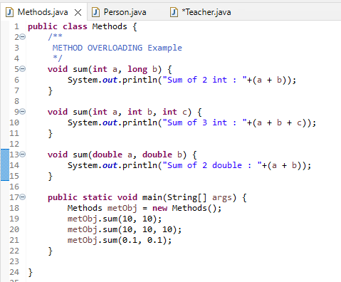
Object
What Is an Object?
Object is an instance of a class. Each object has a class which defines its data and behavior.
Software objects are conceptually similar to real-world objects:
They too consist of state and related behavior. An object stores its state in fields (variables in some programming languages) and exposes its behavior through methods (functions in some programming languages).

Slide 7
Object Creation
Object Declaration
To declare an object give the object a name and specify what type (i.e. class) the object will be.
The syntax
<class name> <object name>;
Example
MyObject object = new MyObject();
Ex: Player player = new Player();
Declaring an object does not create an object. It simply sets up a named location in memory that stores a reference (address) to that object.
You can only declare an object once.
The following is WRONG and will generate a compiler error:
Player player; // declares object named player Player player; // declares object named player again!
But the following is ok because the objects are different:
Player player1; // declares object named player1 Player player2; // declares different object named player2

Slide 8
Class
CLASS
Class is blue print or an idea of an Object.
“Object” is an instance of a class. Each object has a class which defines its data and behavior.
From One class any number of Instances can be created.
Class
Shape
Ob1
Ob3
SQUARE
Ob2
CIRCLE
RECTANGLE

Slide 9
What is a method?
A Method provides information about, and access to, a single method on a class or interface. The reflected method may be a class method or an instance method (including an abstract method).
A Java method is group of statements used together to perform an action.

Slide 10
Method Declaration
Here is an example of a typical method declaration:
public double add(int x, int y) {
//do the calculation here
}
The only required elements of a method declaration are the method's return type, name, a pair of parentheses, (), and a body between braces, {}.

Slide 11
Encapsulation
The concept of binding the data along with its corresponding functionalities is called Encapsulation.
Encapsulation came into existence in order to provide security for the data present inside the program.
Any object oriented programming language file looks like a group of classes everything is encapsulated nothing is outside the class.
Encapsulation is the backbone of oops language.
Java supports all the oops concepts. So it is called Object orient programming language.

Slide 12
Abstraction
Abstraction is process of hiding the implementation details and showing only the functionality. Abstraction in java is achieved by using interface and abstract class.
The abstract keyword is a non-access modifier, used for classes and methods:
Abstract class: is a restricted class that cannot be used to create objects (to access it, it must be inherited from another class).
Abstract method: can only be used in an abstract class, and it does not have a body. The body is provided by the subclass (inherited from).

Slide 13
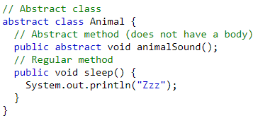
Abstract Classes & Methods
abstract keyword
Contains method Declarations only
can not create object of it
Abstract & non abstract methods
Should override method in derived class

Slide 14
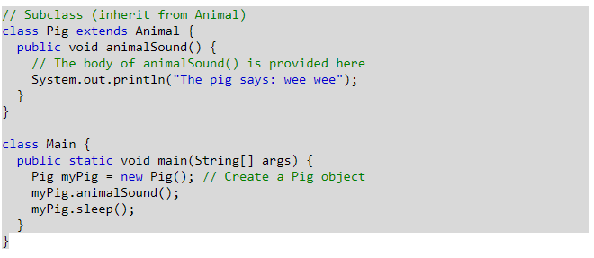
Normal class extends abstract class as below
OUTPUT:
The pig says: wee wee Zzz

Slide 15
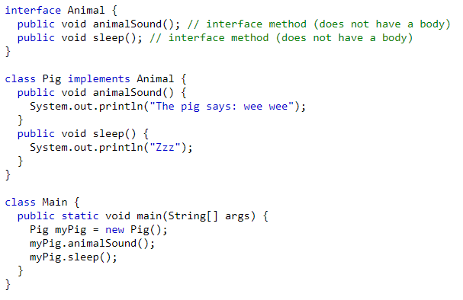
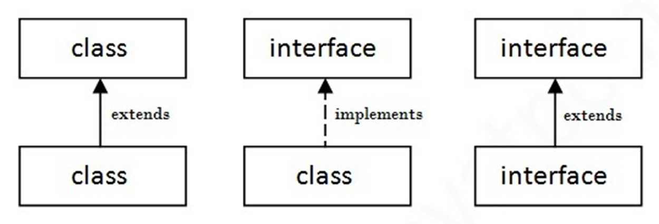
Interface
Another way to achieve abstraction in Java, is with interfaces.
To access the interface methods, the interface must be "implemented" (like inheritace) by another class with the implements keyword (instead of extends). The body of the interface method is provided by the "implement" class.
Like abstract classes, interfaces cannot be used to create objects
On implementation of an interface, you must override all of its methods.
Interface Methods are by default abstract and public.
A class can implement multiple interfaces. To implement multiple interfaces, separate them with a comma .
OUTPUT:
The pig says: wee wee Zzz

Slide 16
Inheritance
Inheritance is a mechanism of acquiring the features and behaviors of a class by another class.
subclass (child) - the class that inherits from another class
superclass (parent) - the class being inherited from
Advantages:
Reusability -- facility to use public methods of base class without rewriting the same
Data hiding -- base class can decide to keep some data private so that it cannot be altered by the derived class
Overriding--With inheritance, we will be able to override the methods of the base class so that meaningful implementation of the base class method can be designed in the derived class.

Slide 17
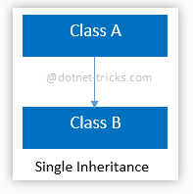
Types of Inheritance
Single inheritance:
In this inheritance, a derived class is created from a single base class.

Slide 18
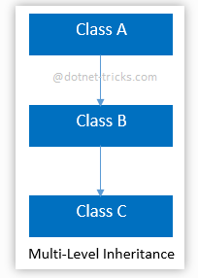
Multi-level inheritance
In this inheritance, a derived class is created from another derived class.

Slide 19
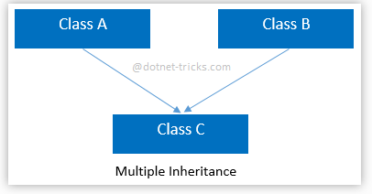
Multiple inheritance
In this inheritance, a derived class is created from more than one base class. This inheritance is not supported by .NET Languages like C#, F# etc.

Slide 20
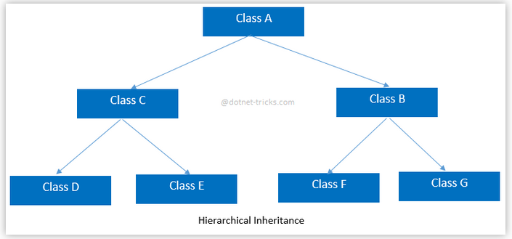
Hierarchical inheritance
In this inheritance, more than one derived classes are created from a single base.

Slide 21
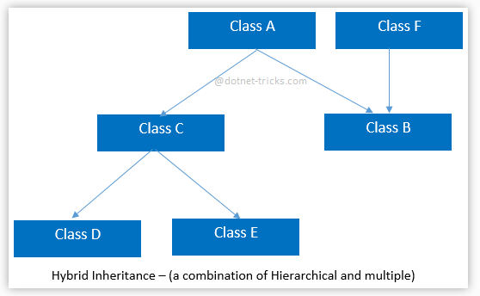
Hybrid inheritance
This is combination of more than one inheritance. Hence, it may be a combination of Multilevel and Multiple inheritance or Hierarchical and Multilevel inheritance or Hierarchical and Multipath inheritance or Hierarchical, Multilevel and Multiple inheritance.

Slide 22
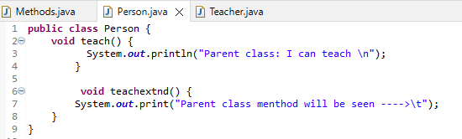
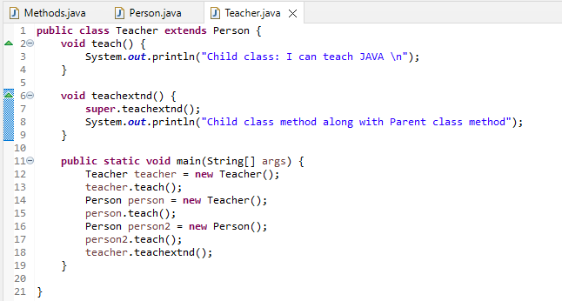
Inheritance Example
Super Class:
Sub Class:

Slide 23
Polymorphism
Polymorphism is the capability of a method to do different things based on the object that it is acting upon.
Different types of polymorphism in java. 1) Method Overloading
2) Method Overriding

Slide 24
Method Overloading
In Java, it is possible to define two or more methods of same name in a class, provided that there argument list or parameters are different. This concept is known as Method Overloading.
Ex1: methodName(int a int b)
Ex2: methodName(int a String b)
Ex3: methodName(int a, int b, int c)
Ex4: methodName(int b, int a, int c)

Slide 25
Method Overriding
Child class has the same method as of base class. In such cases child class overrides the parent class method without even touching the source code of the base class. This feature is known as method overriding.
Rules for Method Overriding:
Applies only to inherited methods
Object type (NOT reference variable type) determines which overridden method will be used at runtime
Overriding method can have different return type.
Overriding method must not have more restrictive access modifier
Abstract methods must be overridden
Static and final methods cannot be overridden
Constructors cannot be overridden

Slide 26
For further info please visit www.techstratinc.com
Thank You

