Slide 1

Packages
TRAINING & RECRUITMENT
OFFSHORE DEVELOPMENT
IDENTITY MANAGEMENT
PORTAL DEVELOPMENT
APPLICATION DEVELOPMENT
5th Floor , V.V.Vintage-Boulevard, Somajiguda
Hyderabad – 500082 INDIA
Tel: 040-30605533

Slide 2
Topics
Packages
Import Keyword
Package Scope

Slide 3
Introduction
Packages are nothing more than the way we organize files into different directories according to their functionality, usability as well as category they should belong to .
A Java package is a Java programming language mechanism for organizing classes into namespaces.

Slide 4
Introduction
Java source files belonging to the same category or providing similar functionality can include a package statement at the top of the file to designate the package for the classes the source file defines.
Java packages can be stored in compressed files called JAR files.
An obvious example of packaging is the JDK package from SUN (java.xxx.yyy) as shown below:

Slide 5
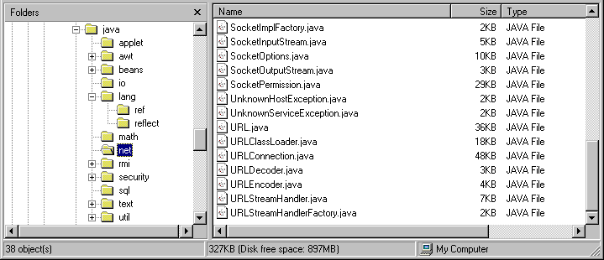
Introduction

Slide 6
Introduction
Packaging also help us to avoid class name collision when we use the same class name as that of others.
For example, if we have a class name called "Vector", its name would crash with the Vector class from JDK. However, this never happens because JDK uses java.util as a package name for the Vector class (java.util.Vector ).
Understanding the concept of a package will also help us manage and use files stored in jar files in more efficient ways.

Slide 7
Using Packages
To use a package inside a Java source file, it is convenient to import the classes from the package with an import statement.
import java.awt.event.*;
The above statement imports all classes from the java.awt.event package.

Slide 8
Package access protection
Classes within a package can access classes and members declared with default access and class members declared with the protected access modifier.
Default access is enforced when neither the public, protected nor private access modifier is specified in the declaration.

Slide 9
Package Naming Conventions
Packages are usually defined using a hierarchical naming pattern, with levels in the hierarchy separated by periods (.) .
Although packages lower in the naming hierarchy are often referred to a "subpackages" of the corresponding packages higher in the hierarchy, there is no semantic relationship between packages.

Slide 10
Coding and Compiling
At the top of each of your source files (before any imports or anything else other than comments), you should have a package declaration. For example, CompanyApp.java would start with: package com.mycompanypackage;

Slide 11
Package Declaration
Package declaration is file based;
All classes in the same source file belong to the same package.
Each source file may contain an optional package declaration in the following form.
Package packagename;
Let us consider the source file ElevatorFrame.java, for example.
Package elevator;
Public class ElevatorFrame
{
public double x; //……..
}

Slide 12
Using Packages
Class in a named package can be referred to in two different ways
Using the fully qualified name packagename.ClassName
We can refer to the ElevatorPanel class in package elevator as
elevator.ElevatorPlanel

Slide 13
Importing a class in the package
Importing the class using the simple class name
We can import a class or all the classes in the designated package using
Import packagename.ClassName;
Import packagename.*;
The ElevatorPanel class in package elevator can simply be referred to as elevator when either of the following import clauses occurs at the top of source file
Import elevator.ElevatorPanel;
Import elevator.*;

Slide 14
Package scope
Java provides 4 access modifiers to set access levels for classes, variables, methods and constructors. They are:
Default: Visible to the package. No modifiers are needed.
Public: Visible to the world.
Private: Visible to the class only.
Protected: Visible to the package and all subclasses

Slide 15
Default
Default:
Default access modifier means we do not explicitly declare an access modifier for a class, field, method, etc. which we can use anywhere within package
The fields in an interface are implicitly public static final and the methods in an interface are by default public.

Slide 16
Public
Public:
A class, method, constructor, interface etc declared public can be accessed from any other class. Therefore fields, methods, blocks declared inside a public class can be accessed from any class belonging to the Java Universe.
However if the public class we are trying to access is in a different package, then the public class still need to be imported.

Slide 17
Private
Private:
Methods, Variables and Constructors that are declared private can only be accessed within the declared class itself.
Private access modifier is the most restrictive access level. Class and interfaces cannot be private.
Variables that are declared private can be accessed outside the class if public getter methods are present in the class.
Using the private modifier is the main way that an object encapsulates itself and hide data from the outside world

Slide 18
Protected
Protected:
Variables, methods and constructors which are declared protected in a superclass can be accessed only by the subclasses in other package or any class within the package of the protected members class.
The protected access modifier cannot be applied to class and interfaces. Methods, fields can be declared protected, however methods and fields in a interface cannot be declared protected.

Slide 19
Access modifier private

Slide 20
Default access modifier

Slide 21
Access modifier protected

Slide 22
Access modifier public

Slide 23
For further info please visit www.techstratinc.com
Thank You

