Slide 1
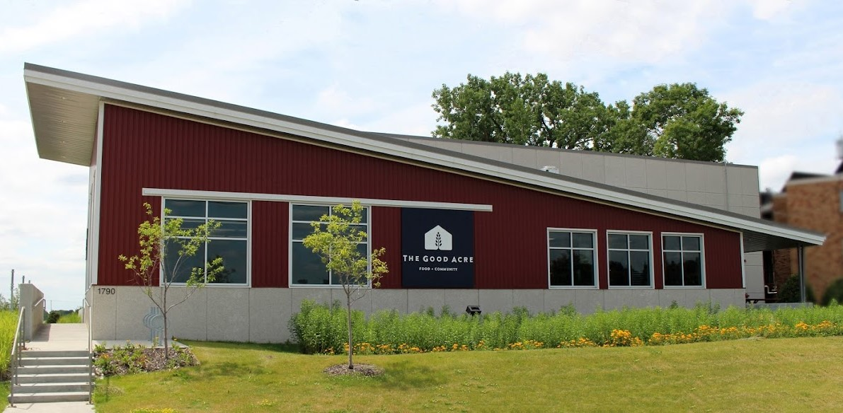

Driving TGA’s Growth: A Data-Driven Approach to Selecting the Ideal Warehouse Location
Live Case Presentation-Fall 2024 Team Green (Group-11)
Abdihakem Bashe, Avnee Satija, Jacob Battles, Sameeksha Mohan & Yaoting Huang

Slide 2




Introduction: Expanding TGA’s Impact Across Minnesota
Over the years, TGA has successfully connected over 150 farmers to broader markets, enabling the distribution of sustainable produce in Minnesota.
Expanding to a new warehouse would significantly enhance TGA's ability to expand its reach, boost sales, and further support the farming community.
TGA faces the challenge of determining the most critical factors to evaluate in selecting the ideal location for a new warehouse among five potential sites in Minnesota. This decision is crucial to achieving their goals of expanding reach, increasing revenue, and better supporting the farming community.
After a thorough analysis and careful consideration of TGA's priorities, we have identified three key metrics to guide our recommendation for the optimal warehouse location.

Slide 3



Key Metrics for Optimal Warehouse Location
Our analysis centers on three critical factors that are deeply aligned with TGA’s mission:
Farmer Reach
Revenue Potential
Inclusivity

Slide 4
Rationale Behind Factor Selection
 | TGA’s Focus | Our Approach
Farmer Reach
Enhancement of small-scale farmers' livelihoods, striving to provide them with the network, resources, and market access needed to sell their products at optimal prices.
Recognized locations which can benefit highest number of small and medium sized farm operations to maximize impact.

Slide 5
Farmer Reach - Targeting Farm Operations Under 180 Acres
Following are the different sizes of farm operations recognized across the 5 counties:
1 to 9.9 Acres
10 to 49.9 Acres
50 to 179 Acres
180 to 219 Acres
220 to 259 Acres
260 to 499 Acres
500 to 999 Acres
1000 or more Acres
Farm Size Categories:
Small: Less than 50 acres
Medium: 50 to 180 acres
Large: Over 180 acres
For our analysis, we are considering small and medium sized farm operations i.e., operations with size less than 180 acres, prioritizing them to maximize reach and impact for these farm operations.

Slide 6
Rationale Behind Factor Selection
 | TGA’s Focus | Our Approach
Farmer Reach
Enhancement of small-scale farmers' livelihoods, striving to provide them with the network, resources, and market access needed to sell their products at optimal prices.
Recognized locations which can benefit highest number of small and medium sized farm operations to maximize impact.
Maximizing TGA’s profitability, to further grow and continue its mission of improving farmers' well-being.
Considered locations with highest number of farm operations growing the top 10 high revenue generating commodities.
Revenue Potential

Slide 7
Top 10 Highest Revenue generating commodities
Top 10 commodity | 2024 Min Est Revenue | % of Total Est Revenue
Eggs | $271,333.80 | 15.3%
Tomato | $130,584.00 | 7.3%
Greens | $126,920.50 | 7.1%
Pepper | $98,827.25 | 5.6%
Beans | $97,402.55 | 5.5%
Onion | $66,254.50 | 3.7%
Carrot | $64,842.50 | 3.6%
Potatoes | $57,194.90 | 3.2%
Chicken | $57,186.37 | 3.2%
Cucumber | $56,368.00 | 3.2%
Top 10 Commodity combined Revenue | $1,026,914.37 | 57.7%
2024 Total Min. Est. Revenue | $1,777,771.96 | 100.0%
Est. Rev. from the Top 10 Commodities accounts for
57.7%
of the total est. revenue

Slide 8
Rationale Behind Factor Selection
 | TGA’s Focus | Our Approach
Farmer Reach
Enhancement of small-scale farmers' livelihoods, striving to provide them with the network, resources, and market access needed to sell their products at optimal prices.
Recognized locations which can benefit highest number of small and medium sized farm operations to maximize impact.
Maximizing TGA’s profitability, to further grow and continue its mission of improving farmers' well-being.
Considered locations with highest number of farm operations growing the top 10 high revenue generating commodities.
Revenue Potential
Inclusivity
Ensuring diverse farming communities benefit from its initiatives.
Evaluated the ethnic diversity of farmers in each county to prioritize locations with more diversity.

Slide 9
Inclusivity - Benefiting BIPOC Communities
In 2023, TGA purchased 83% of its produce from BIPOC (Black, Indigenous and people of color) community farmers.
Aim to increase this percentage to benefit more diverse farming communities.
BIPOC percentage calculation:
Measures the percentage of BIPOC community farmers within a specified radius of the location.
From the data in the government census dataset , BIPOC communities considered:
American Indian or Alaska Native
Asian
Black
Hispanic
Native Hawaiian or Other Pacific Islander

Slide 10







Mapping Success: Farmer, Revenue & Inclusivity
3
Datasets
Used Ethnicity metric to analyze the diverse famer communities that could benefit
Identify location with highest number of diverse farmer ethnic groups
Government Census Data
1
Recognized locations with highest number of small and medium sized farm operations across the 5 locations
Ideal Warehouse Location
2
TGA Sales & Purchase Data
Identified top 10 High Revenue generating commodities
Filter farm operations that grow the top 10 identified commodities

Slide 11
Evaluation of the metrics
We are evaluating the five counties based on 3 key ranking criteria for a given radius:
The number of small and medium scale farm operations present.
The number of farm operations producing the 10 key high-revenue commodities.
The percentage of BIPOC representation.
An aggregate ranking will be calculated by combining these 3 individual rankings to determine the overall suitability of each county.

Slide 12
Comparison Matrix for 75-mile radius
County | # of small and medium farms (Rank) | # of key commodity farms (Rank) | BIPOC% within the area (Rank) | Final Rank
Fergus Falls Otter Tail | 5,542 (3) | 809 (4) | 1.82% (3) | 4
Wilmar Kandiyohi | 11,683 (1) | 1,679 (1) | 0.83% (5) | 2
Rochester Olmsted | 3,978 (4) | 624 (5) | 0.97% (4) | 5
Duluth St. Louis | 1,419 (5) | 817 (3) | 2.86% (1) | 3
Owatonna Steele | 7,896 (2) | 1600 (2) | 2.16% (2) | 1

Slide 13
Recommendation & Conclusion
Based on the evaluation, Owatonna, located in Steele County, stands out as the most suitable location for the new warehouse, given a practical coverage radius of 75 miles.
This radius effectively accounts for factors such as drive time for farmers and the lifespan of perishable goods.
Within this area, Owatonna provides access to 7,896 small and medium sized farm operations, includes 1,600 farms producing the top 10 high-revenue commodities, along with a BIPOC representation of 2.16%.

Slide 14
Thank you

