Slide 1
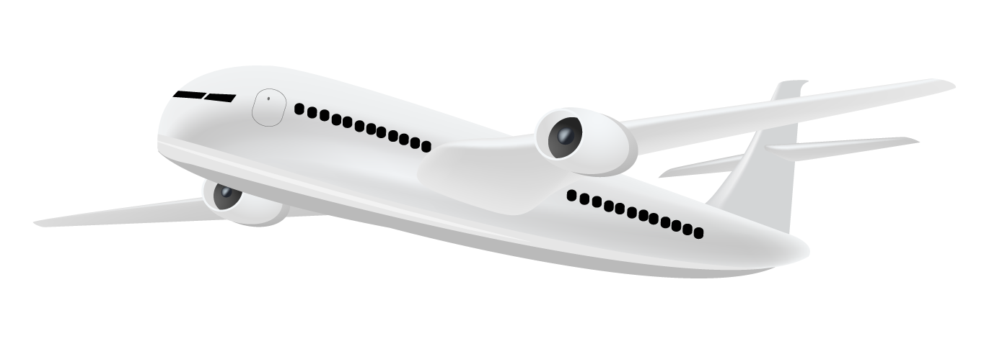
AI Lifecycle Aviation Accident
MSO4803 – Sameeksha Mathur

Slide 2

Table of Contents
Slide | Title | Content
3 | Introduction + Use Case | Why aviation safety matters, your two objectives
4 | Domain Knowledge | Real IATA/aviation stats, problem context
5 | Data Preparation | Prepare recipe steps, what was removed and why
6 | Split Strategy | Split screenshot, 80/20, seed 42, why
7 | Visualizations | Charts 1-5 + Insight
10 | Model 1 - Severity | 3 algorithms, results, confusion matrix, metrics table
12 | Model 2 - Survivor Location | 3 algorithms, results, confusion matrix, metrics table
14 | Clustering | Heatmap, cluster profiles, what clusters mean
16 | Model Limitations | Class imbalance, synthetic data, SMOTE proposal
17 | Future - Product/Automation | Risk scoring dashboard proposal
18 | Conclusion | Tie back to objectives
19 | References | Harvard style citations

Slide 3
Introduction + Use-case
Aviation accidents cause significant loss of life and economic damage. This project applies the full Data Science Lifecycle to identify patterns in accident data, predict severity outcomes, and identify survivor locations – enabling airlines and regulators to make data-driven safety decisions.
Severity
Majority_Survivor_Location
Classify Accident Severity (Minor vs. Severe)
Identifying which conditions (weather, aircraft type, pilot experience, altitude) are most predictive of a severe outcome.
Predict Survivor Location
Determining whether survivors are concentrated in specific aircraft zones to enable more targeted emergency response planning.
Clustering_analysis
A supplementary clustering analysis groups accidents by shared risk profiles, providing actionable insights for safety regulators and airline operations teams.

Slide 4
Domain Knowledge
Scale of Problem
Commercial aviation has seen significant long-term reduction in accident rates, from 3.72 accidents per million sectors in 2005 to 1.13 in 2024 (IATA, 2024a). Despite this progress, there were 244 on-board fatalities in 2024, compared to a five-year average of 144 (IATA, 2024b). Economically, the average annual cost of general aviation accidents ranges between $1.64 and $4.64 billion USD, encompassing medical costs, aircraft damage, legal claims, and investigation expenses (Sheffield, Lee and Zhang, 2025).
Key Accident Causes
Pilot error accounts for approximately 53% of aircraft accidents, followed by mechanical failure (21%) and weather conditions (11%) (IATA, 2024a). In 2024 specifically, abrupt aircraft control was a contributing factor in 26% of accidents, unstable approach in 26%, and aircraft malfunction and adverse weather each in 22% (ICAO, 2025).
The Role of Predictive Analytics
Machine learning has become an increasingly valuable tool in aviation safety, enabling analysts to process large volumes of historical data and surface patterns that traditional investigation methods may miss (Demir, Moslem and Duleba, 2024). Research has confirmed the algorithms used in this project are well suited to the task—decision tree, logistic regression, and random forest have all been applied to aviation accident data sets, with logistic regression achieving a ROC index of 0.945 in one general aviation study (Baugh, 2020).

Slide 5
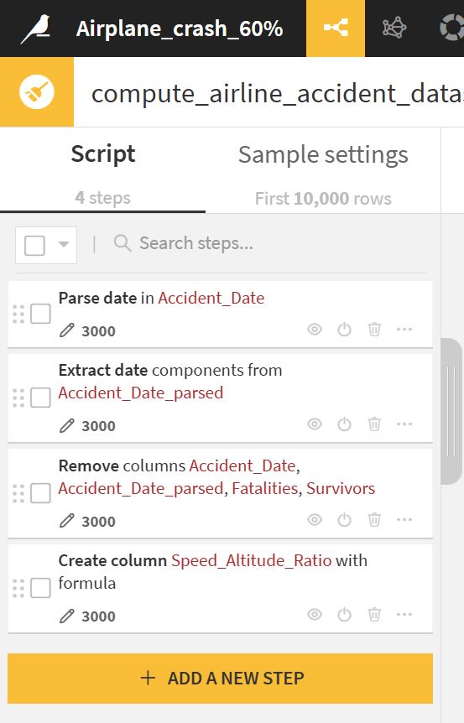
Data Preparation – Prepare Recipe in Dataiku
Step 1
Parse date in Accident_Date – Standardized to dd/MM/yyyy format
Step 2
Extract date components from Accident_Date_parsed – created Accident_Year and Accident_Month as separate columns to capture seasonal patterns
Step 3
Remove columns – Accident_Date, Accident_Date_parsed, Fatalities, and Survivors dropped. The date columns were replaced by the extracted components; Fatalities and Survivors were removed to avoid data leakage
Step 4
Create column Speed_Altitude_Ratio – Engineered feature combining speed and altitude to better capture their interaction at the time of the accident

Slide 6
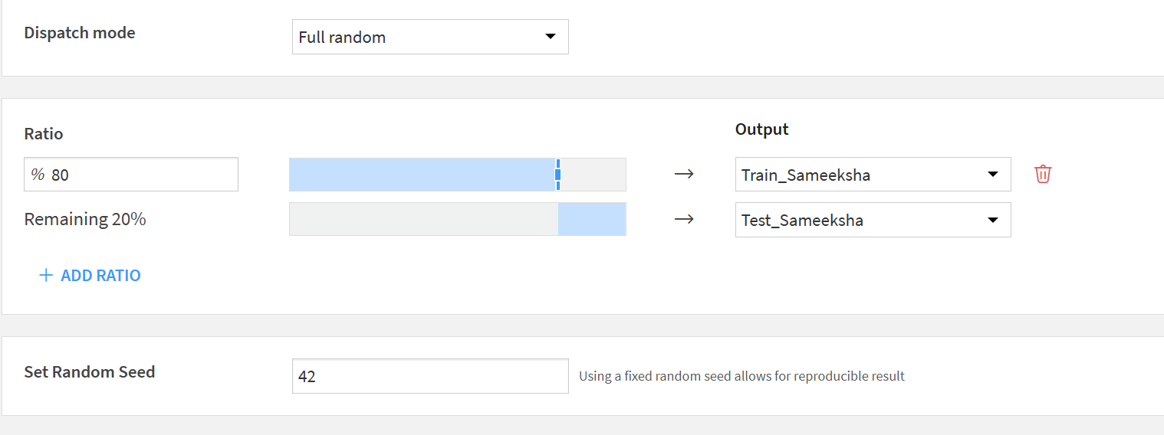
Train/Test Split – Dataiku Split Recipe
Method:
Full Random Dispatch
Ratio:
80% Train/ 20% Test
Random Seed:
42
Output datasets:
Train_Sameeksha (2,400 rows) | Test_Sameeksha (600 rows)
Why 80/20
An 80/20 Split is the standard approach for data sets of this size dash it gives the models enough data to learn from while keeping a meaningful held out set for evaluation
Why seed 42?
Fixing the random seed ensures the split is reproducible—every time the recipe runs, the same rows go to test and train. An important step for comparing models fairly, as all three algorithms are evaluated on identical data.

Slide 7
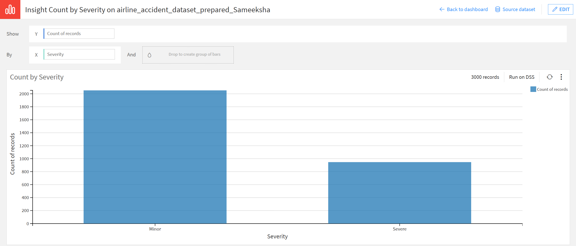
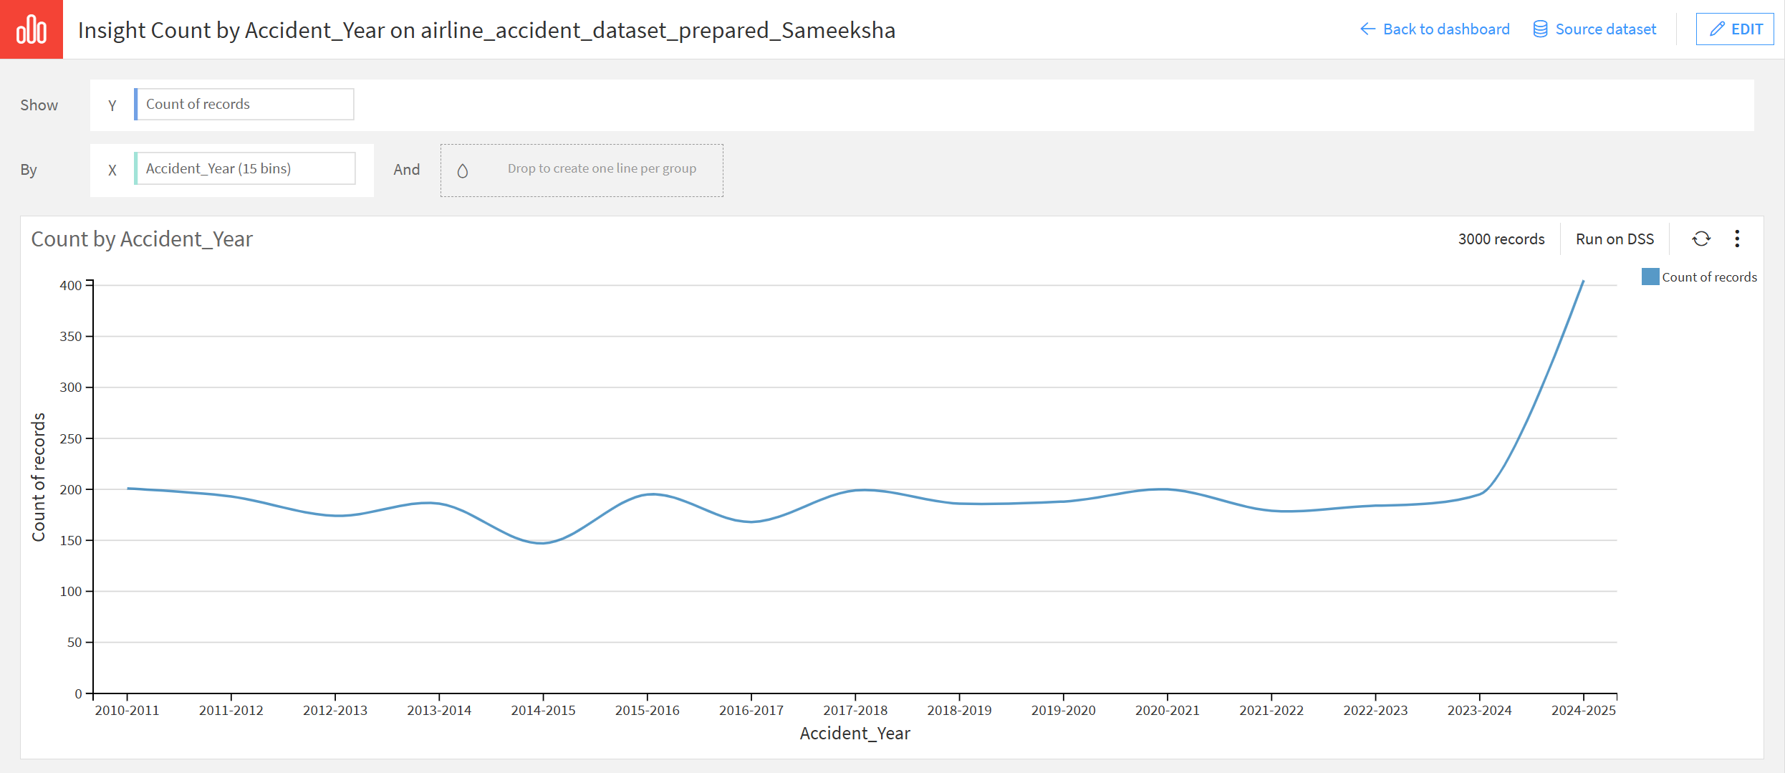
Visualizations
Chart 1: Count by severity
The data set is imbalanced—approx. 2,050 minor cases versus 950 severe. This 2:1 ratio is important context for model evaluation and is revisited in the limitations slide
Chart 2: Count by Accident year
Accident frequency remained stable between 2010-2023, averaging around 175-200 records per year. The sharp spike in 2024-2025 is likely a data artifact and should be interpreted with caution.

Slide 8
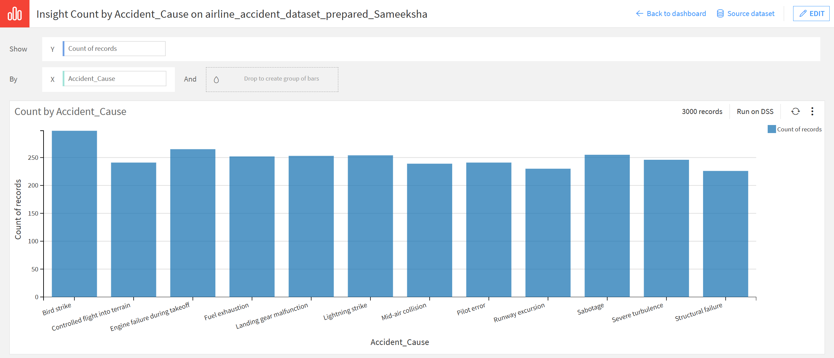
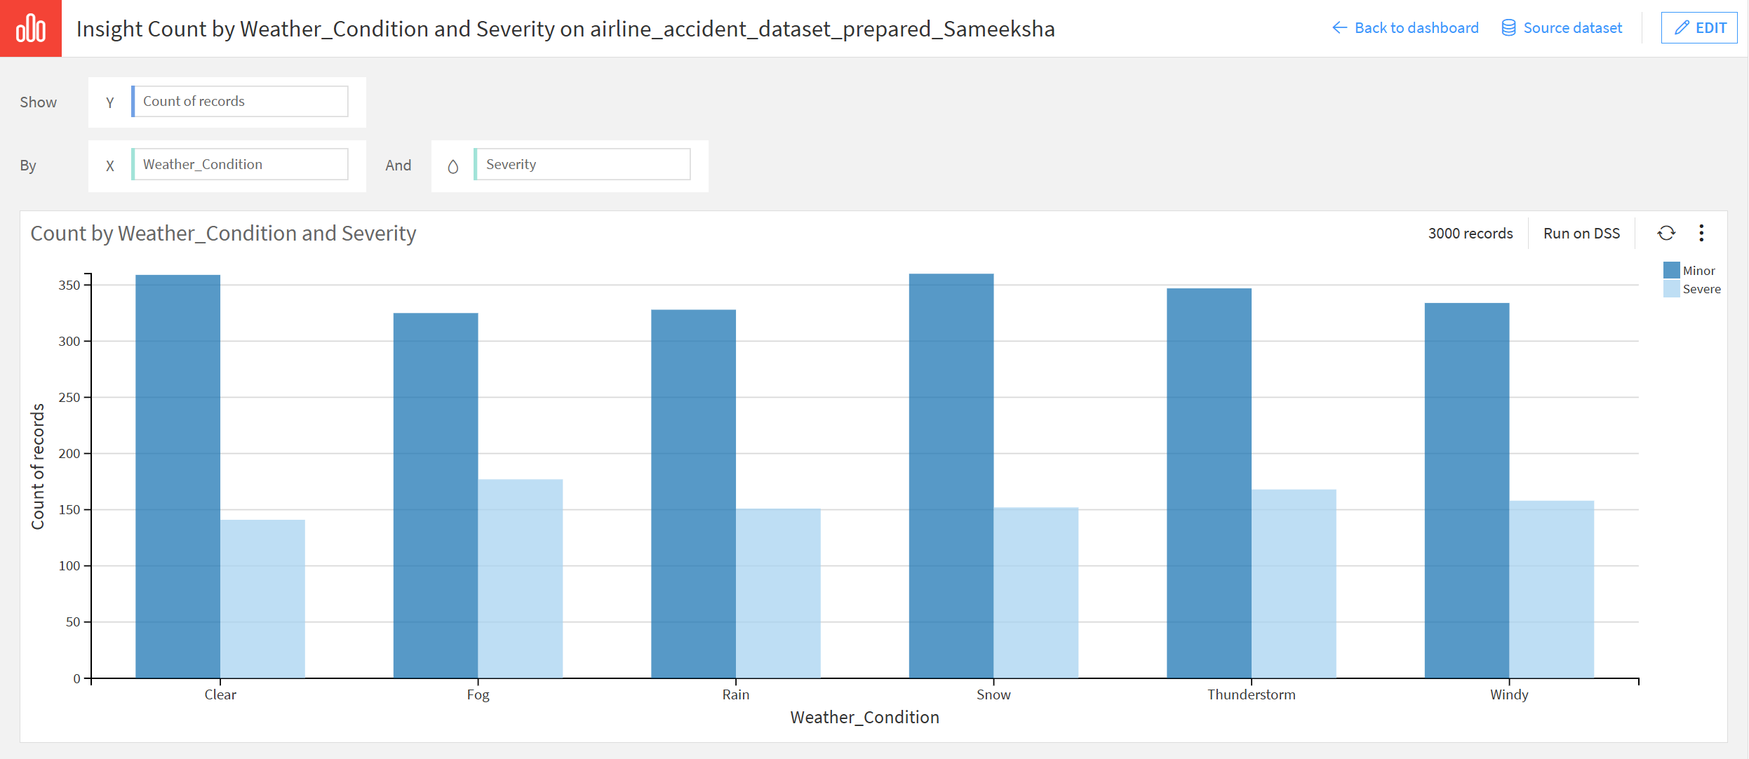
Visualizations
Chart 3: Count by Accident Cause
All 12 accident causes are near equally distributed (225-285 records each), with bird strike marginally the most frequent. This even spread is atypical of real-world aviation data, with pilot error and mechanical failure tend to dominate, potentially limiting the predictive power of accident cause as a feature.
Chart 4: Weather Conditions by Severity
Minor accidents consistently outnumbered severe across all weather conditions. Fog shows the highest proportion of severe outcomes relative to minor, suggesting some weather influence on severity—though the effect is modest across conditions.

Slide 9
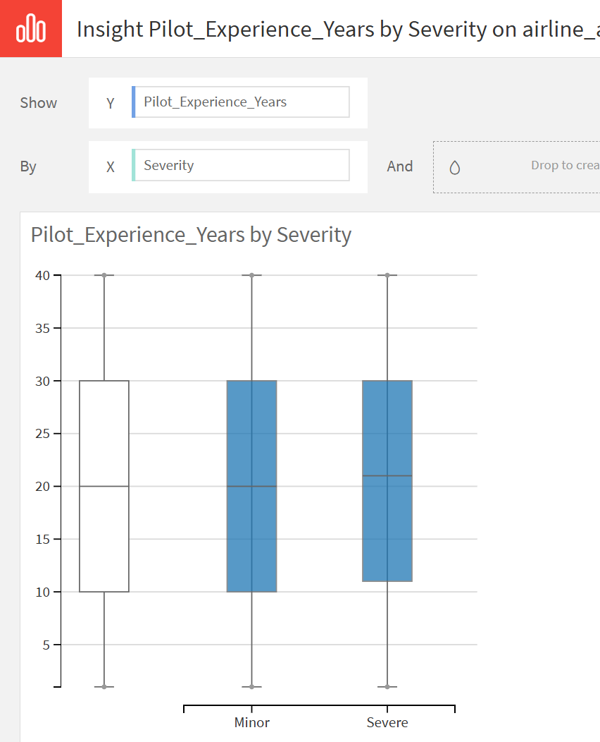
Visualizations
Chart 5: Pilot Experience by Severity
Both minor and severe accidents show similar median experience levels (20 years). This challenges the assumption that less experienced pilots are involved in more severe accidents.
Key Insight:
Severity is not strongly predicted by any single variable in isolation. Pilot experience, weather, and accident cause all show limited individual influence, suggesting that Severity outcomes are likely driven by a combination of factors rather than one dominant cause. This reinforces the need for a multi-variable machine learning approach.

Slide 10
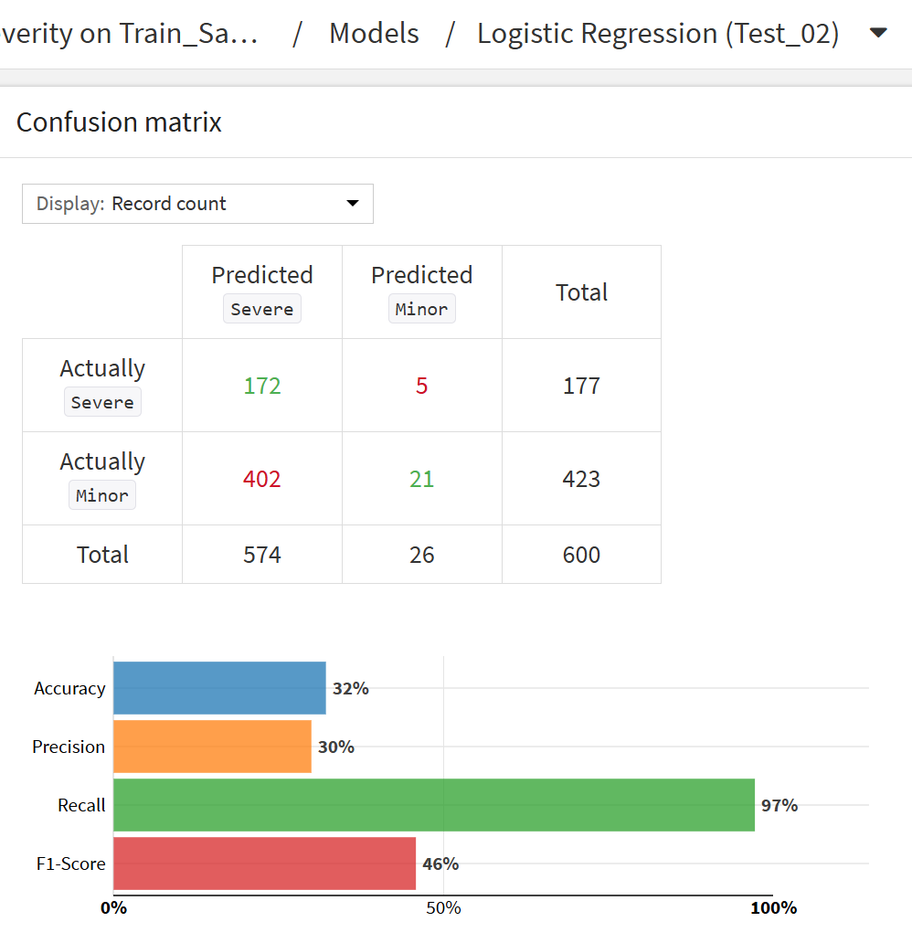
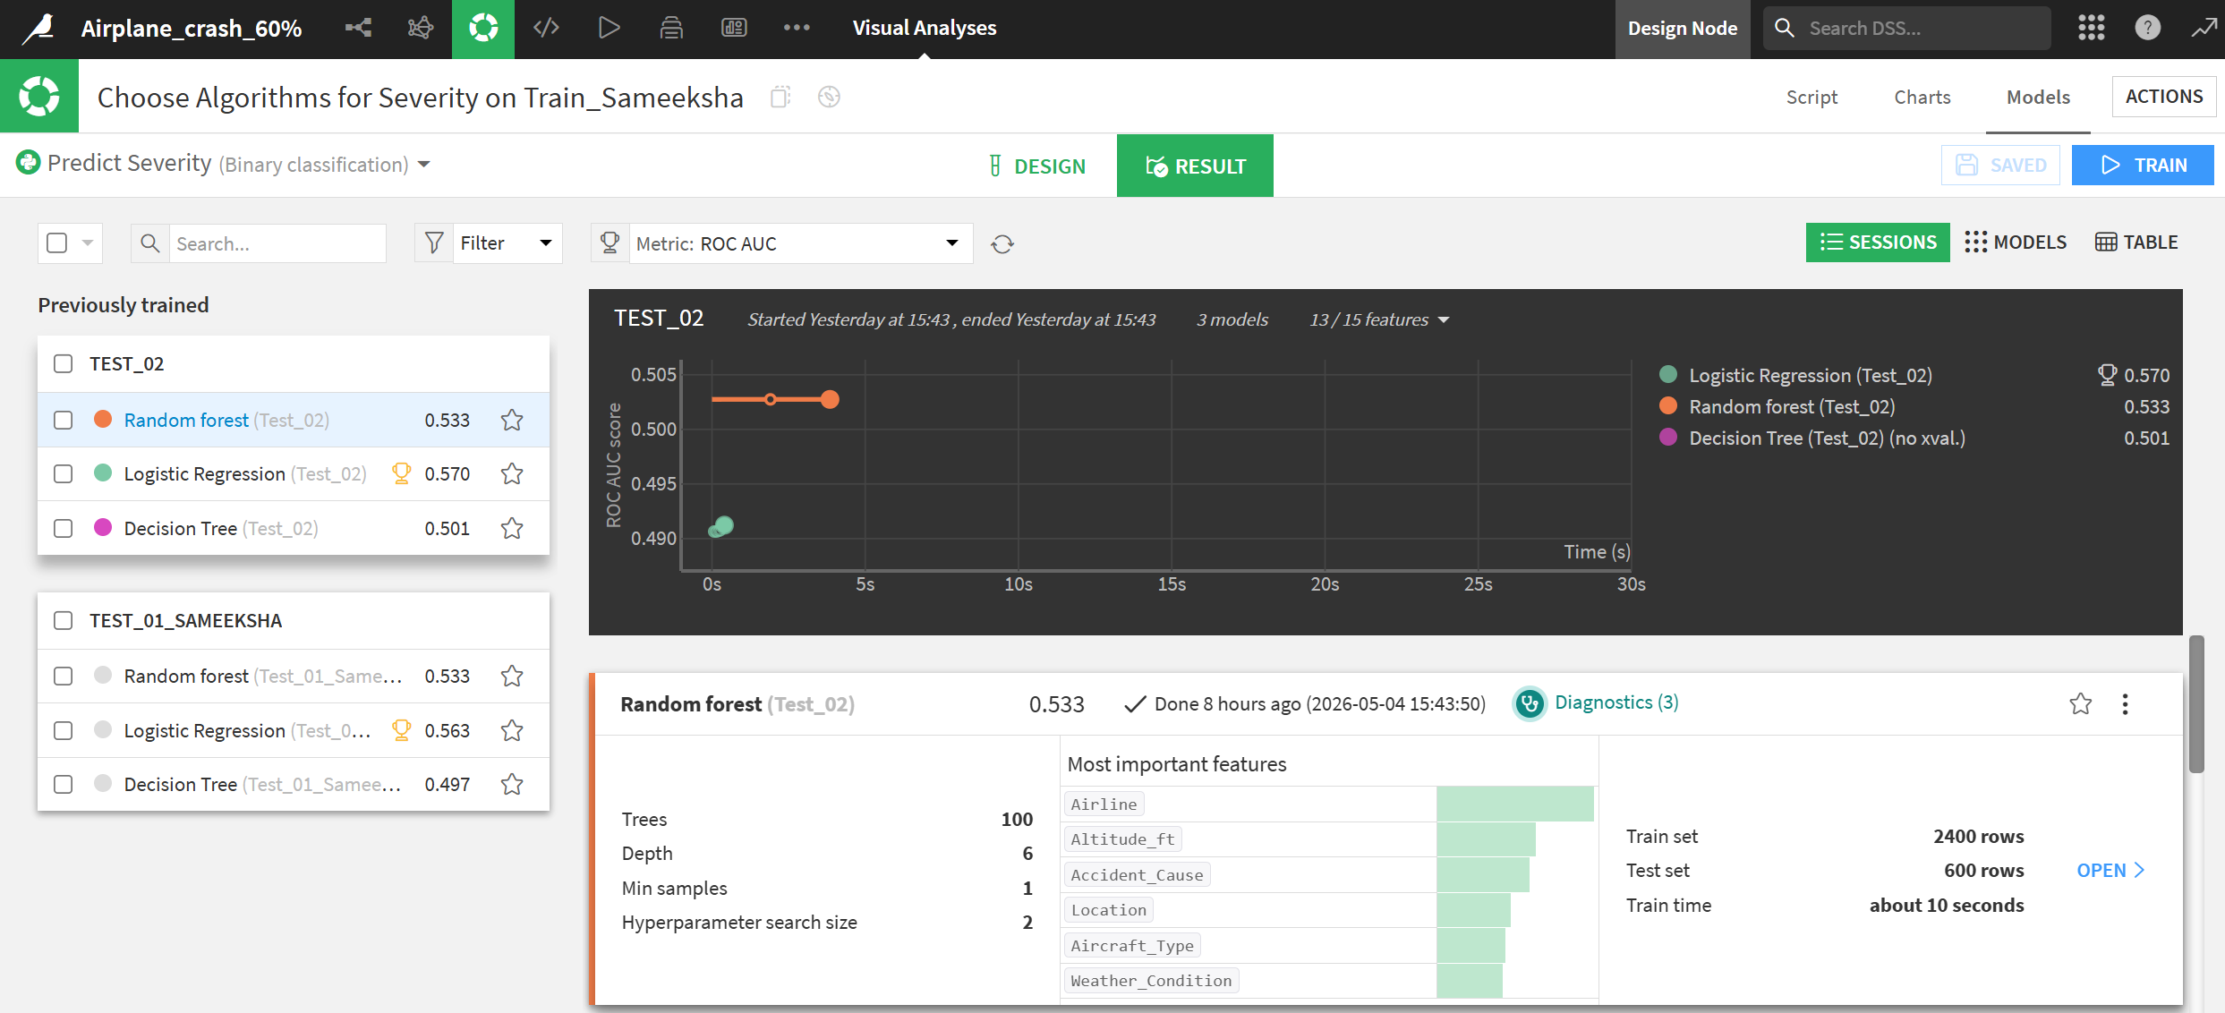
Model 1 – Severity Prediction
Logistic regression was selected as the best performing model with a ROC AUC 0.570. The confusion matrix shows the model correctly identified 172 severe cases but misclassified 402 minor cases as severe; reflecting the model’s tendency to over predict the majority class due to class imbalance.

Slide 11
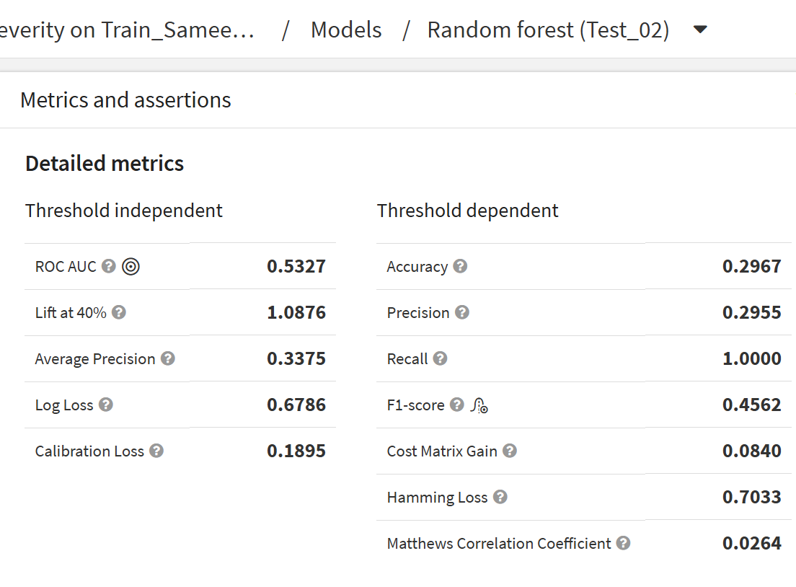
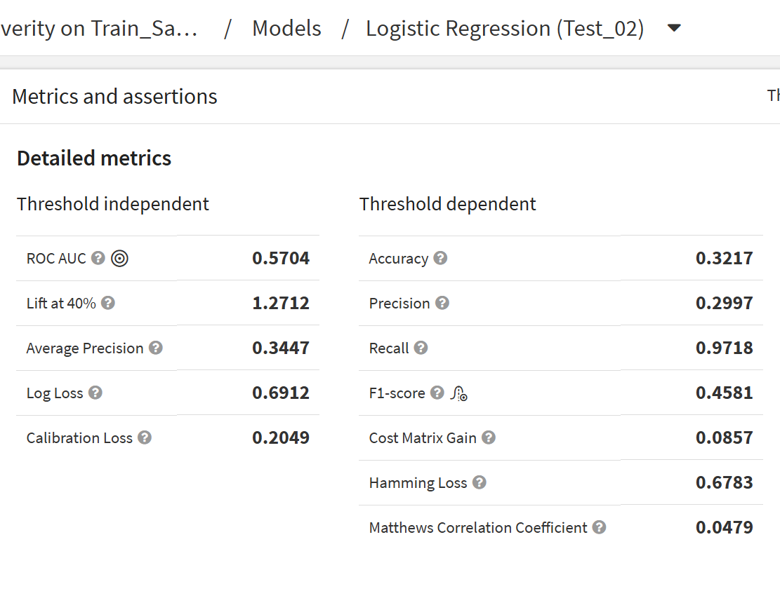
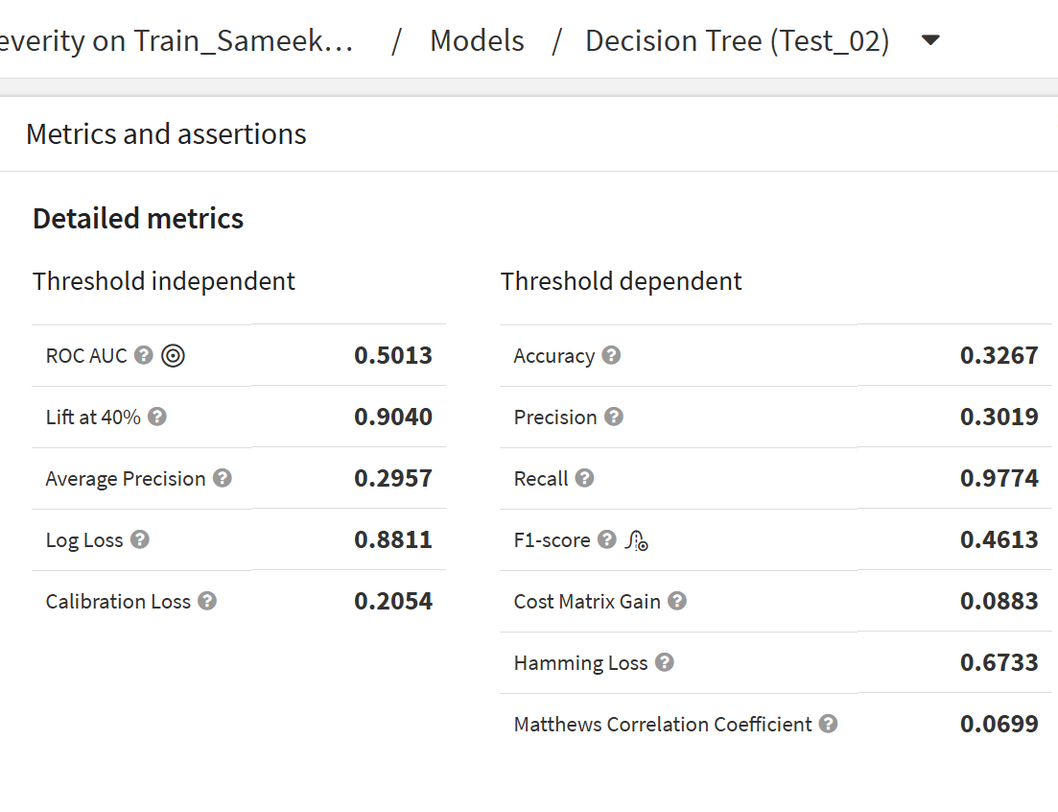
Random Forest
Logistic Regression
Decision Tree
ROC AUC: 0.533
Perfect recall (1.0) but lowest accuracy, defaulting to predicting Severe for nearly every record
ROC AUC: 0.570
Best overall performer, selected as deployed model
ROC AUC: 0.501
Marginally above random chance, highest Matthews Correlation Coefficient (0.0699)
Why these algorithms? Decision tree was selected for its interpretability, Logistic Regression as a proven baseline for binary classification, and Random Forest to test whether an ensemble approach could improve performance. That said, severity prediction is inherently complex— the overlap in pilot experience across severity classes and the even distribution of accident causes suggest no single feature carries enough signal to cleanly separate outcomes. The models are reflecting genuine data complexity rather than simply underperforming.

Slide 12
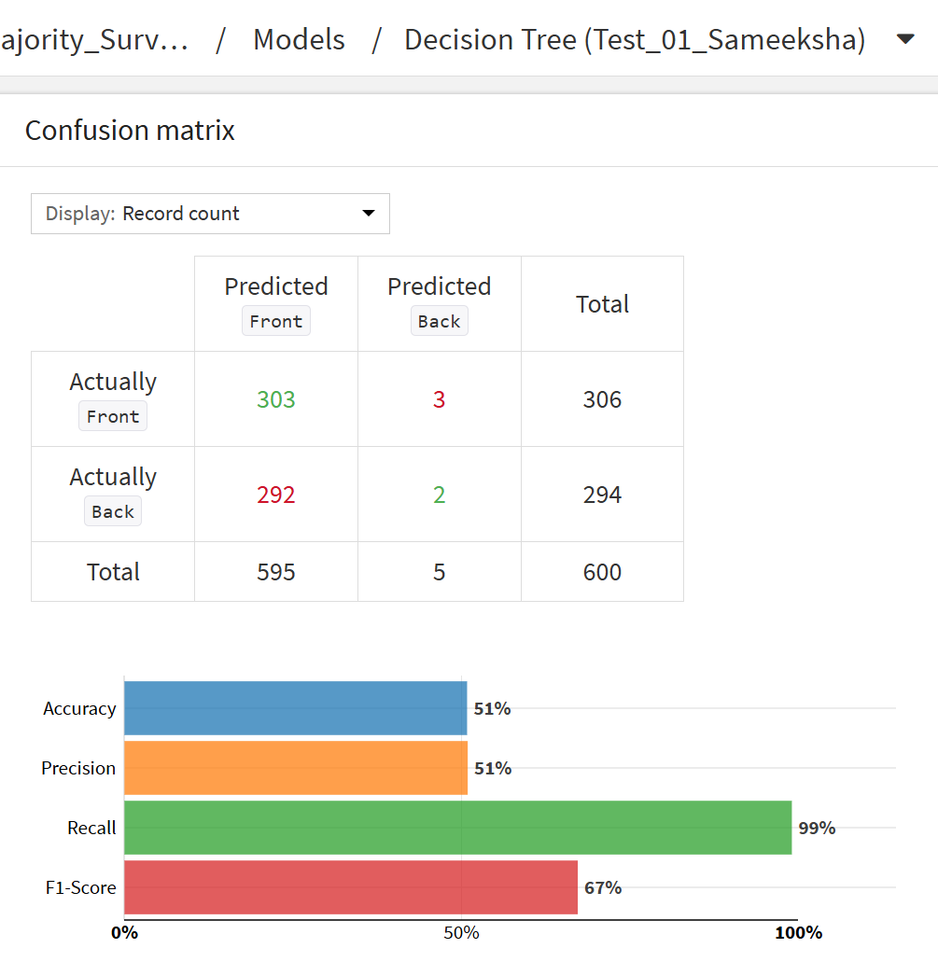
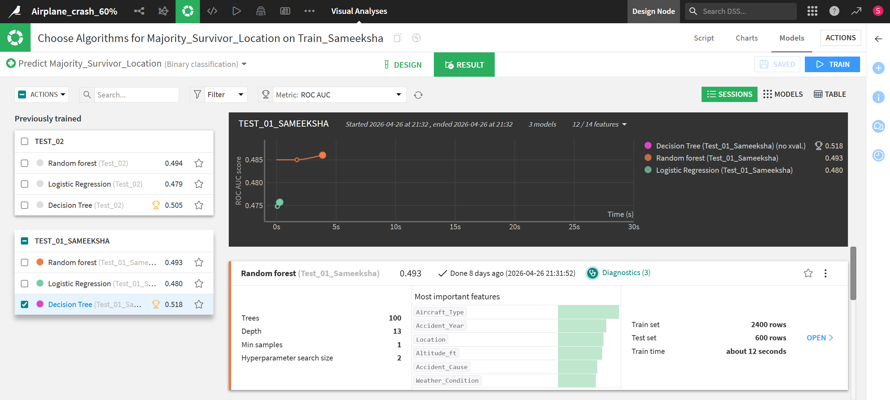
Model 2 – Majority Survivor Location
Decision Tree was selected as the best performing model with a ROC AUC of 0.518. The confusion matrix shows the model correctly identified 303 Front cases but misclassified 292 Back cases as Front — the same pattern of over-predicting the majority class seen in Model 1.
- A second session (Test_02) was run after introducing the engineered feature Speed_Altitude_Ratio to test whether combining altitude and speed into a single interaction variable would improve predictive performance. It did not, Test_01 outperformed Test_02 (ROC AUC: 0.518 vs 0.505), so Test_01 was selected as the deployed model.

Slide 13
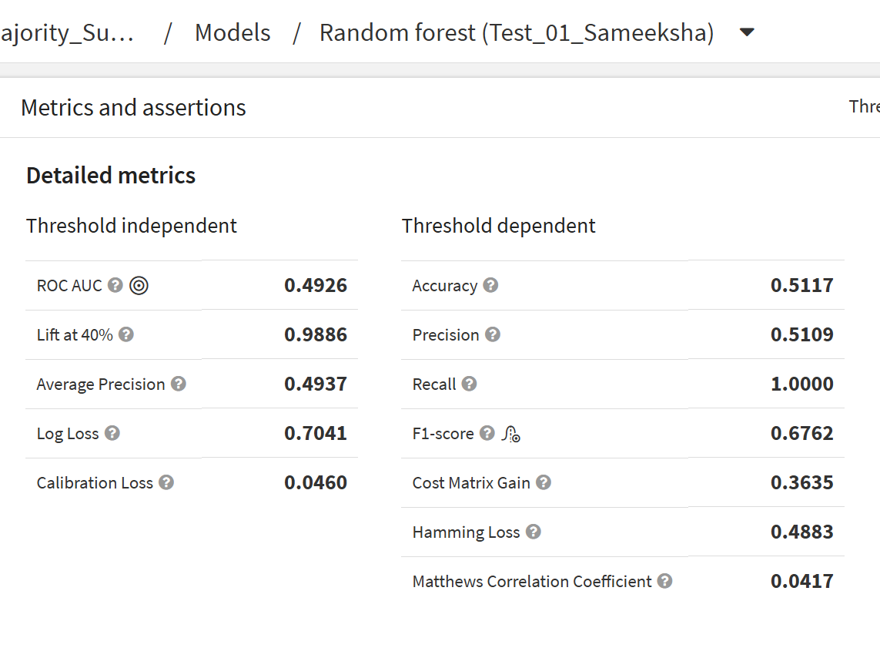
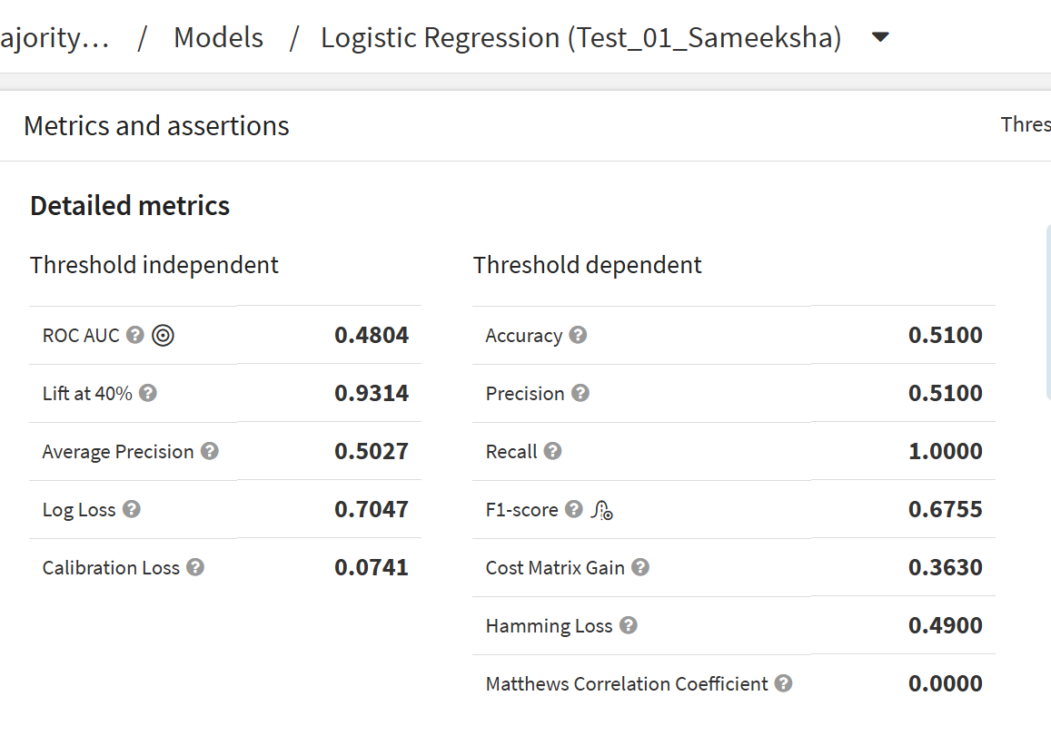
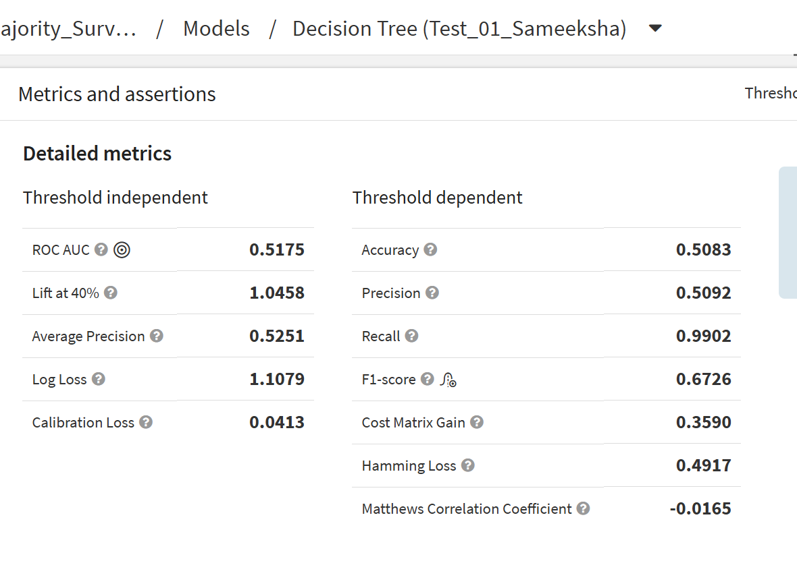
Random Forest
Logistic Regression
Decision Tree
ROC AUC: 0.493
Perfect recall but effectively no discriminative ability, predicting Front for nearly every record
ROC AUC: 0.480
MCC of 0.000 no meaningful distinction between classes
ROC AUC: 0.518
Best overall performer, selected as deployed model
Predicting survival location is an inherently difficult classification problem, in real world aviation accidents, survival zone is influenced by factors like impact angle, structural integrity, and seat positioning that are not available in this data set. The model’s tendency to predict front predominantly might reflect a real pattern in the data, front is the majority survival location, but without richer features, the algorithms cannot go beyond that surface level observation.

Slide 14
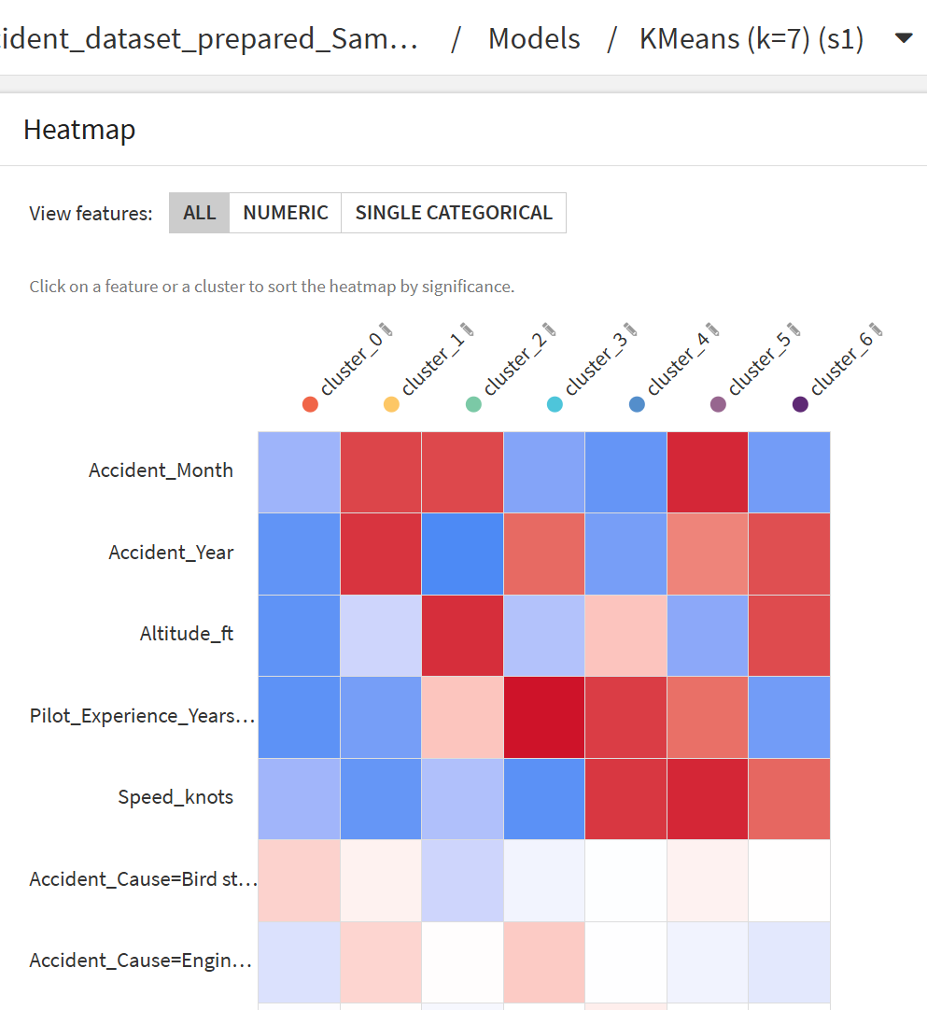
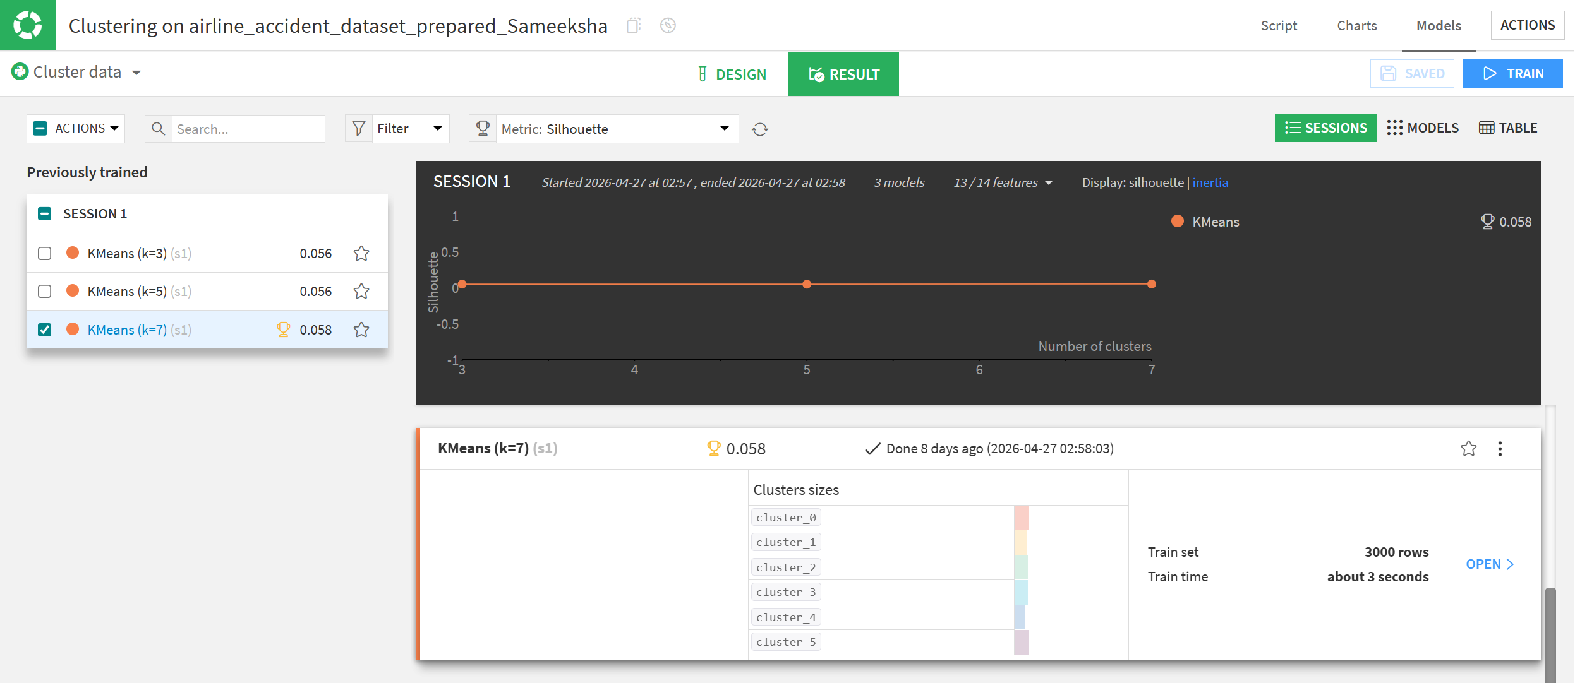
Clustering
Model Selection
K=7 was selected over k=3 and k=5 based on the highest silhouette score (0.058 vs 0.056). Three configurations were tested in a single session.
Heatmap Insight
The heatmap confirms that clusters are primarily differentiated by continuous numerical variables — Accident_Month, Accident_Year, Altitude_ft, Pilot_Experience_Years, and Speed_knots show clear variation across clusters, while categorical variables show minimal differentiation.

Slide 15
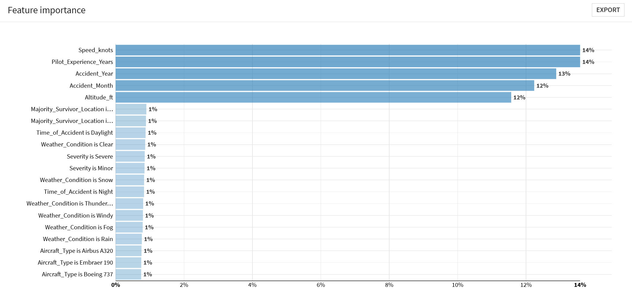
Clustering
Cluster Profiles & Key Insight:
The clusters reveal three broad risk profiles, low-experience pilots at lower speeds (clusters 0, 1, 6), experienced pilots at high speeds (clusters 4, 5), and a mid-experience transitional group (clusters 2, 3). This points to speed and experience as the two most actionable variables for targeted safety interventions.
Feature Importance:
Speed_knots and Pilot_Experience_Years are the strongest drivers of cluster separation (14% each), followed by Accident_Year (13%), Accident_Month (12%), and Altitude_ft (12%). Categorical variables contributed only 1% each.

Slide 16
Model Limitations
Class imbalance
Both models showed high recall but poor precision, defaulting to the majority class. Threshold optimization was applied in Dataiku (0.375 for Model 1, 0.200 for Model 2) as an initial fix SMOTE is proposed as a stronger future solution, it generates synthetic minority class samples to rebalance training data and would be implemented via a Python recipe in Dataiku.
Synthetic dataset
The perfectly even spread of accident causes across all 12 categories is atypical of real-world data, limiting how generalizable these findings are to actual aviation contexts.
Limited feature set
Critical real-world predictors like impact angle, seat positioning, and maintenance history are absent. Without them, the models are working with an incomplete picture of what actually drives accident outcomes.

Slide 17
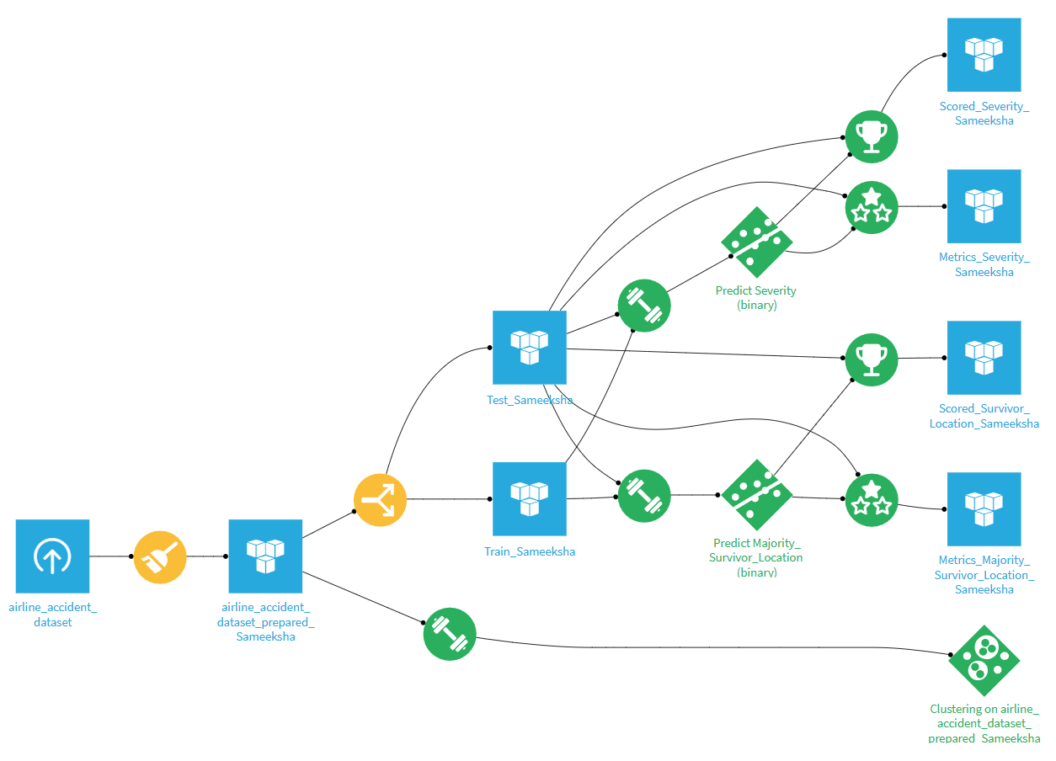
Future Product Automation
The Complete Pipeline
The Dataiku flow shows the full data science lifecycle in action—starting from the raw data set, through preparation, splitting, model training for both objectives, and clustering, all connected in a single reproducible pipeline.
Evaluate Receipe
Rather than relying on training metrics, to evaluate recipe was used to score both deployed models against the unseen test set — producing formal metrics data sets as outputs this ensures everything reported in this presentation reflects how the models actually perform on data never seen before, which is the only honest way to measure a model.
Future Automation Opportunities
New accident records could be fed directly into the deployed models for real-time severity and survivor location predictions
A Python recipe could be inserted before the split stage to apply SMOTE and rebalance classes before retraining
Scored outputs could be connected to Power BI for operational dashboards and automated safety alerts

Slide 18
Conclusion
Objectives revisited
This project applied the full data science lifecycle in Dataiku to predict accident severity, survival location, and identify risk profiles through clustering.
What was achieved
Logistic regression was the best severity model (ROC AUC: 0.570), Decision Tree for survivor location (ROC AUC: 0.518).
K-Means (k=7) identified 7 risk profiles – Speed and Pilot Experience were the dominant differentiating factors.
Threshold optimization was applied to partially address class imbalance.
Key Takeaway
The models reflect genuine complexity in aviation accident data rather than failure, consistent with domain research showing accidents are multi causal. The pipeline built here is scalable and could deliver real predictive value when applied to richer, real world data.

Slide 19
References
Baugh, B.S. (2020) Predicting General Aviation Accidents Using Machine Learning Algorithms. Doctoral dissertation. Embry-Riddle Aeronautical University. Available at: https://commons.erau.edu/edt/545/ (Accessed: 5 May 2026).
Demir, G., Moslem, S. and Duleba, S. (2024) 'Artificial Intelligence in Aviation Safety: Systematic Review and Biometric Analysis', International Journal of Computational Intelligence Systems, 17(1), article 279. DOI: https://doi.org/10.1007/s44196-024-00671-w
IATA (2024a). 2024 Full Year Accident Update. [online] Available at: https://www.iata.org/contentassets/4d18cb077c5e419b8a888d387a50c638/iata-safety-report-2024-fy_final.pdf.
IATA (2024b). IATA Releases 2024 Safety Report. [online] Iata.org. Available at: https://www.iata.org/en/pressroom/2025-releases/2025-02-26-01/.
International Civil Aviation Organization (ICAO) (2025) Report of the twenty third meeting of the Asia Pacific Regional Aviation Safety Team (APRAST/23). Bangkok: ICAO Asia and Pacific Office. Available at: https://www.icao.int/sites/default/files/APAC/Meetings/2025/2025%20APRAST23/1-Report/Final-Report-of-the-APRAST23.pdf (Accessed: 4 May 2026).
Sheffield, E., Lee, S.-Y. and Zhang, Y. (2025). A systematic review of general aviation accident factors, effects and prevention. Journal of Air Transport Management, [online] 128, p.102859. DOI: https://doi.org/10.1016/j.jairtraman.2025.102859

Slide 20
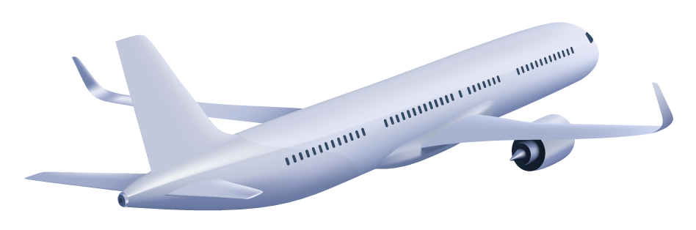
0.058
Thank You
Thank you for flying with MSO4803 Analytics — we hope your experience was smooth and your data was clean.

