Slide 1
NEHA
NEED FOR HELP APP
HACKING SQUAD

Slide 2
INTRODUCTION
In this emerging technological world there is drastic use of mobile applications for everything.
Ex:
To eat food in late night we have SWIGGI, ZOMATO, FOOD PANDA, etc,….
To travel longer distance OLA, UBER, etc,…
Similarly, To help the people who are in emergencies we have our app called as “NEHA”.

Slide 3

WHAT IS NEHA?
“NEED FOR HELP APP”
This app is developed to help the people like,
Pregnant Women
Persons with disabilities
Senior Citizens
And Persons with special needs.

Slide 4

SCENARIO!
Let’s consider one scenario where the lady wants to go back to home after regular check up but, this time she doesn’t have anyone with her like family members or friends ?
She can’t walk for a longer distance.
She don’t even remember route also.

Slide 5


What is the solution?
That’s where our app play important role.
Now she is having two things in her hand.
Smart phone
Money

Slide 6
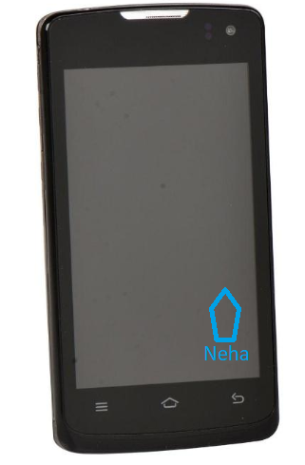
HOW IT WORKS?
Step 1:
If in case she is new member
She just have to sign in
Or else
The only thing she have to do is what type help she needs and mention her current location and on GPS to track her location.
Step 2:
Based on her request, some volunteers will there to help her and sends the acceptance message based on volunteers review she will select the volunteers.

Slide 7
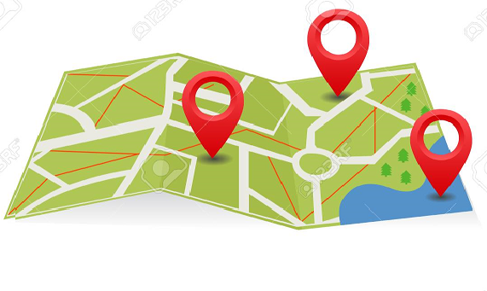

Step 3:
Locations of customer is mapped with volunteers based on there distance between them.
Once it is short those volunteers who accepted the customer request those volunteers details are sent to customer.
Then customer will select the volunteer.

Slide 8

Doubts?
THANK YOU

