Slide 1


Vivekananda College of Engineering & Technology
[A Unit of Vivekananda Vidyavardhaka Sangha Puttur®] Affiliated to Visvesvaraya Technological University
Approved by AICTE New Delhi & Recognised by Govt of Karnataka
A Internship Presentation
“SUBJECT: Research Internship/ Industry Internship Subject Code : 21CS82”
13 Dec 2024 – 02 Apr 2025
Internship Guided :
PROF. THAPASWINI P S
Presented by:
SAMEEKSHA
4VP21CS078
25-05-2025
Department. of Computer Science and Engineering
1

Slide 2
COMPANY PROFILE
Company Name: Rooman Technologies
Main Office: 30, 12th Main Rd, 1st Stage, Rajajinagar, Bengaluru, Karnataka 560010
Email: online@rooman.net
Year Stand Up: 1999
Company Category: IT training, certification, and services.

Slide 3
TOPICS COVERED
ROOMAN INTERLEAP INTERNSHIP
WADHWANI INTERNSHIP
IBM INTERNSHIP
PROJECT

Slide 4
1.ROOMAN INTERLEAP INTERNSHIP
Python Programming Basics: Learn foundational to intermediate Python concepts for AI and data handling.
Prompt Engineering & AI Assistants: Explore crafting effective prompts and using AI coding tools like GitHub Copilot and ChatGPT.
Linux & Networking Essentials: Understand basic Linux commands and networking principles for development environments.
Database Management: Introduction to SQL and NoSQL databases for storing and querying structured data.
Flask Web Development: Build and deploy simple web apps using the Flask framework in Python.
Cloud & Orchestration Platforms: Overview of cloud services (AWS, Azure, GCP) and orchestration tools like Docker & Kubernetes.
Data Analysis with Python: Analyze datasets using Pandas, NumPy, and Matplotlib for insights.
Power BI for Data Analytics: Visualize and interpret data with Power BI, from basic dashboards to machine learning integration.

Slide 5
2. WADHWANI INTERNSHIP
Communication Skills: Improved listening, speaking, reading, and professional writing.
Digital Literacy & Ethics: Gained awareness of social media, cybersecurity, and responsible digital behavior.
Career & Team Orientation: Explored career goals and embraced organizational teamwork.
Managerial & Leadership Skills: Built capabilities in planning, leadership, and empathy.
Entrepreneurship & Design Thinking: Fostered innovation and problem-solving through design thinking.

Slide 6
3. IBM INTERNSHIP
Program Orientation & Pre-Project Development: Introduction to the course structure, tools, and objectives.
Pre-requisites of AI:Covers Python, statistics, and machine learning basics required for AI.
Introduction to Data Quality:Understanding what data quality is and why it matters in healthcare AI.
Data Preprocessing and Cleaning:Techniques to clean, format, and prepare raw healthcare data.
Data Quality Metrics and Measurement:Learn to evaluate data using metrics like completeness and accuracy.
Quality in Data Engineering and Machine Learning:Ensuring consistent data flow and quality in ML and data pipelines.
Advanced Data Quality Strategies: Use of NLP for advanced cleaning like deduplication and entity correction.
Project Work:Build and present the automated data cleansing system using NLP for healthcare records.

Slide 7
4. PROJECT
Title: Automating Data Cleansing for Healthcare Records with NLP
Organization: Rooman Technologies
Domain: Healthcare + Natural Language Processing (NLP)
Tools and Technologies
Languages: Python, JavaScript
Libraries: Pandas, scikit-learn, spaCy, TextBlob
Backend: Node.js + Express
Frontend: HTML, CSS, Bootstrap, Chart.js

Slide 8
PROBLEM STATEMENT
Healthcare data is often messy, incomplete, and unstructured.
Sources: Clinical notes, EHRs, prescriptions.
Manual cleaning is time-consuming and error-prone.
Need for an automated, intelligent solution to clean healthcare text data.

Slide 9
PROJECT OBJECTIVES
Automatically clean and standardize healthcare data using NLP.
Handle missing values, duplicate records, and ambiguous text.
Encode variables for use in ML models.
Output clean, structured, and usable datasets.

Slide 10
METHODOLOGY
Use Python, Pandas, and LabelEncoder for preprocessing.
Apply NLP (regex, sentiment analysis, NER).
Build API using Node.js + Express.
Visualize using HTML, Bootstrap, Chart.js.

Slide 11
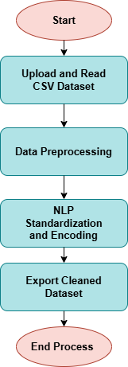
FLOWCHART
Figure 1: Flowchart of the Project

Slide 12
IMPLEMENTATION STEPS
Load Dataset using Pandas
Detect & Fill Missing Values
NLP on Symptom:
Use regex or spaCy to extract entities like "fever", "fatigue"
Encode categorical columns with LabelEncoder
Export final CSV

Slide 13
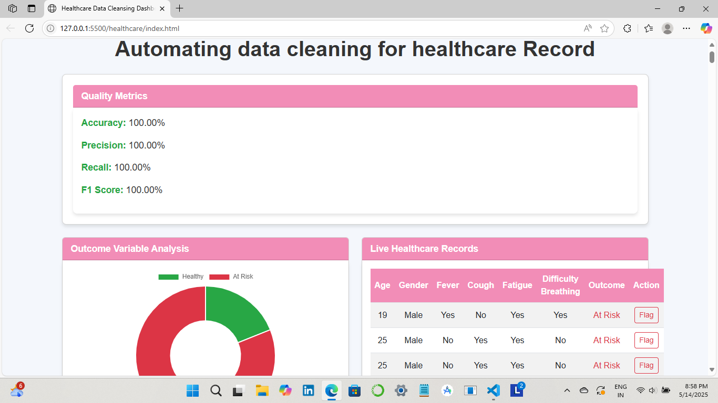
SCREENSHOTS
Figure 2: Dashboard Interface for Automated Healthcare Data Cleansing

Slide 14
OUTCOMES & BENEFITS
Automated and repeatable data cleaning
Converts messy medical text into structured features
NLP adds deeper insight into patient descriptions
Prepares datasets for ML, analytics, or dashboards

Slide 15
CONCLUSION
NLP enables automated healthcare data cleaning by turning unstructured medical text into structured insights ready for analysis. This improves the accuracy and reliability of downstream machine learning models. The system demonstrates how AI can streamline healthcare data workflows efficiently.

Slide 16
REFERENCES
[1] Shi, Xi, Charlotte Prins, Gijs Van Pottelbergh, Pavlos Mamouris, Bert Vaes, and Bart De Moor. "An automated data cleaning method for Electronic Health Records by incorporating clinical knowledge." BMC Medical Informatics and Decision Making 21 (2021): 1-10.
[2] Leema, A. Anne, and M. Hemalatha. "Data Cleaning Framework for Healthcare Applications." Bonfring International Journal of Research in Communication Engineering 1 (2011): 31.
[3] , MD RUSSEL, ESRAT ZAHAN SNIGDHA, and SHOHONI MAHABUB."AI-Driven Data Optimization: Automating Cleaning, Feature Engineering, and Augmentation for Superior Machine Learning Performance in Digital Health Care System." Journal of Computer Science and Technology Studies 5, no. 4 (2023): 218-228.
[4] Liu, Mingxuan, Siqi Li, Han Yuan, Marcus Eng Hock Ong, Yilin Ning, Feng Xie, Seyed Ehsan Saffari et al. "Handling missing values in healthcare data: A systematic review of deep learning-based imputation techniques." Artificial intelligence in medicine 142 (2023): 102587.
[5] Sarafidis, Michail, Marilena Tarousi, Athanasios Anastasiou, Stavros Pitoglou, Efstratios Lampoukas, Athanasios Spetsarias, George K. Matsopoulos, and Dimitrios D. Koutsouris. "Data Quality Challenges in a Learning Health System." In MIE, pp. 143-147. 2020.

Slide 17
Thank You!!

