Slide 1

Blur Detection with OpenCV and Flask
Bringing Clarity to Your Images Through Computer Vision

Slide 2

The Problem: Blurry Photos - A Universal Annoyance
The Scale
The Impact
Thousands of photos in personal galleries are blurry due to motion, focus issues, or poor lighting conditions.
Blurriness impacts user experience in applications like photo organization, facial recognition, and e-commerce platforms.
The Example
Adrian Rosebrock's personal experience with over 6,000 blurry photos of his dog illustrates the scale of the problem.

Slide 3
The Solution: Detecting Blur with OpenCV
Laplacian Variance Method
Fast Fourier Transform (FFT)
A fast and lightweight approach that's perfect for most applications.
A more robust method for complex scenarios requiring higher precision.
Convert image to grayscale for analysis
Apply the Laplacian filter to detect edges
Compute variance of the filtered result
Low variance indicates a blurry image
Analyzes frequency distribution in images
Less sensitive to manual threshold tuning
Better for varied lighting conditions
More computationally intensive
Source: PyImageSearch (Adrian Rosebrock), Analytics Vidhya

Slide 4

Sharp vs. Blurry: The Visual Difference
Computer vision algorithms can automatically distinguish between clear and blurry images, enabling automated quality control.

Slide 5




Building the Web Application: Flask as the Bridge
Flask Framework
A lightweight Python web framework that simplifies creating web endpoints for blur detection logic.
Interface Layer
Acts as the bridge between user interface and computer vision backend processing.
Real-time Streaming
WebSockets or MJPEG streaming provides instant feedback without page reloads.
Example: Tanish-Sarkar's "Real-time Facial Detection" project uses Flask for MJPEG streaming.

Slide 6

Project Showcase: Furkan-Gulsen's Blur Detection Web App
A practical implementation demonstrating how blur detection using OpenCV and Flask can identify blurry photos in real-time.
Technology Stack
Python (66.6%) - Core logic and OpenCV integration
HTML (33.4%) - User interface and display
Flask - Web framework and API endpoints
Live Demo: ap-webapp-frontend.herokuapp.com/blur_detection
Repository: github.com/Furkan-Gulsen/Blur-Detection-Web-App

Slide 7

Web App Interface in Action
The application analyzes uploaded images in real-time, providing immediate feedback on image quality with blur scores and visual indicators.

Slide 8

Key Components & Workflow
Webcam Capture
OpenCV captures frames from a live video stream or uploaded image file.
Grayscale Conversion
Converts the image to grayscale to simplify analysis and reduce processing time.
Blur Detection Algorithm
Applies Laplacian variance or FFT method to calculate blur metrics.
Annotation
Adds bounding boxes, blur scores, and visual indicators to the analyzed frame.
Flask Streaming
Sends annotated frames to browser for real-time display and user feedback.
Example Architecture: Tanish-Sarkar's project outlines a clear pipeline from capture to display.

Slide 9
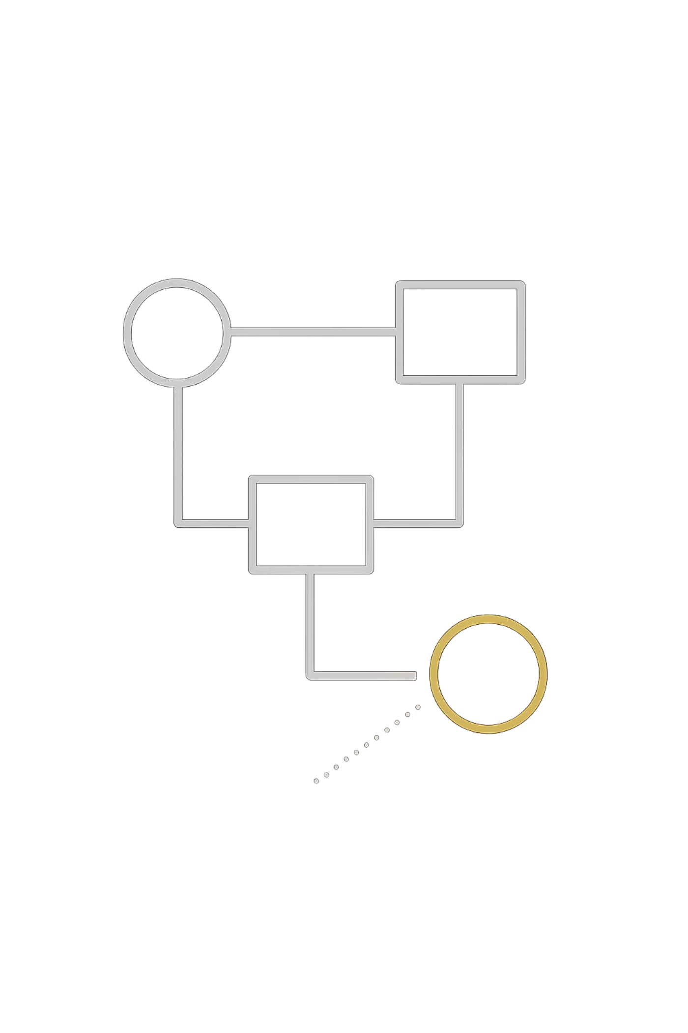
Applications and Impact
Photo Management
Automatically filter and organize large photo libraries, identifying blurry images for deletion or retaking.
Quality Control
Ensure high-quality images in e-commerce, social media, and professional photography workflows.
Real-time Systems
Enhance facial recognition, OCR, and surveillance by processing only clear frames for accurate results.
User Experience
Prevent users from uploading blurry images, improving overall application quality and satisfaction.

Slide 10

The Future: Sharper Vision, Smarter Applications
Integration
Deep Learning
Enhanced Applications
Combine blur detection with other computer vision tasks like face detection or object detection for comprehensive analysis.
Explore deep learning approaches using TensorFlow for more nuanced and context-aware blur analysis.
Build more robust and user-friendly web applications for automated image quality assessment across industries.

