Slide 1

Project Presentation ON FACIAL ANALYSIS POWERED VIRTUAL HEALTHCARE BY
Team members:
Sameeksha-4VP21CS086
Swasthika Rai B S-4VP21CS105
Thanmayee J-4VP21CS106
Pooja A-4VP22CS406
Under the guidance of:
Prof. Thapaswini P S

Slide 2
CONTENTS
1.INTRODUCTION
2.PROBLEM STATEMENTS
3.LITERATURE SURVEY
4.OBJECTIVES
5.METHODOLOGY
6.IMPLEMENTATION
7.OUTCOMES
8.SNAPSHOTS
9.CONCLUSION
10.REFERENCES

Slide 3
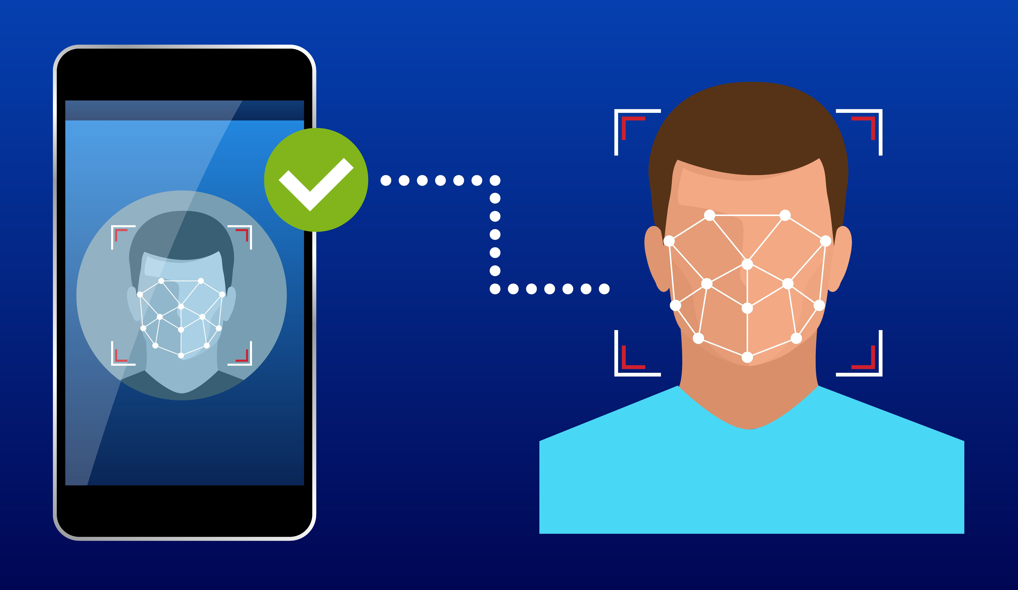
INTRODUCTION
Facial recognition technology is used to detect emotions and track mental well-being.
Subtle facial changes help identify early signs of any specified mental health issues.
Chatbot support adds real-time, empathetic interaction for users.
The system makes healthcare more accessible, personalized, and timely.

Slide 4
PROBLEM STATEMENT
"To design and implement a model that predicts depression based on facial expressions and speech recognition, complemented by a chatbot for maintaining virtual healthcare support."

Slide 5
LITERATURE SURVEY
SL No. | Reference Paper | Dataset | Observation | Limitation
1. | Sharma, Archana, Anuradha Saxena, Ashok Kumar, and Divyansh Singh. “Depression Detection using multimodal analysis with chatbot support” IEEE, 2024. | Custom dataset (facial, audio, text via chatbot). | Multimodal approach to improve detection accuracy and chatbot to enhance user engagement. | Small dataset, limited generalizability, cultural bias in emotion recognition, and chatbot did not become a substitute for clinical diagnosis.
2. | Yu, Jiawei, and Heysem Kaya. “Using Emotionally Rich Speech Segments for Depression Prediction.” IEEE, 2025. | DAIC-WOZ and CMDC datasets | Leveraged emotionally rich speech segments to enhance depression prediction accuracy, achieved F1 scores of 79% on DAIC-WOZ and 90.53% on CMDC. | Limited generalizability due to dataset constraints and potential challenges in real-world applicability.
3. | Shukla, Devesh, Rajni Kumari, and A. Bhargavi. “Human Face Detection and Emotion Recognition Using OpenCV through AI.” IEEE, 2024. | Likely custom or real-time webcam data is used. | Utilized OpenCV for real-time face detection and emotion recognition, demonstrated effectiveness in controlled environments. | Lack of publicly available dataset, limited testing on diverse populations, and potential challenges in varying lighting conditions and facial orientations.
4. | Nirupa, V., G. B. Renuka, B. Naga Lakshmi, C. P. Sumanth Kumar, A. Rudra Sekhar Reddy, and J. Paramesh. "Chatbot Based on Emotions Using Deep Learning." IEEE, 2023 | FER 2013 (Kaggle) + Custom Dataset (2000+ images) | The study achieved 85%+ accuracy in emotion detection using CNN (VGG-Face), with tailored chatbot responses and improved adaptability through hybrid training (pre-trained + fine-tuning). | The study's limitations include a small custom dataset (2000 images) restricting generalization, reliance on static images without dynamic emotion tracking, and limited diversity (6 basic emotion types).
5. | Sharma, Akshita, Vriddhi Bajaj, and Jatin Arora. "Machine learning techniques for real-time emotion detection from facial expressions." IEEE, 2023 | standard datasets like CK+, JAFFE, FER2013 | The paper compares ML methods for emotion detection, with Random Forest (97.17% accuracy) performing best the and, followed by the CNN/Eigenface (~96%). | No dataset specifics; unaddressed challenges (lighting, occlusion, aging); lacks experimental validation on unified data.

Slide 6
OBJECTIVES
To detect and analyse face.
To detect depression thoughts using facial emotions and voice assistant.
To provide virtual communication using chatbot functionalities.

Slide 7
METHODOLOGY
The patient’s face and voice is being detected and recognized with concerned emotions to find out any depression thoughts.
It also provides chatbot application as a virtual communication which helps the patient to clear their queries.

Slide 8
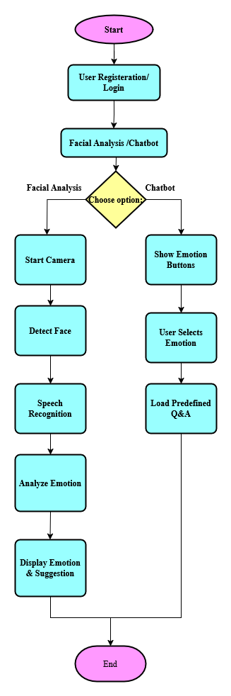
IMPLEMENTATION
Figure 2: Implementation of the project

Slide 9
OUTCOMES
Detects early signs of depression through facial emotion recognition, voice analysis interaction.
Provides personalized mental health support and suggestions in real-time using chatbot functionalities.
Assists counsellors in triaging cases efficiently, improving access in remote areas.

Slide 10
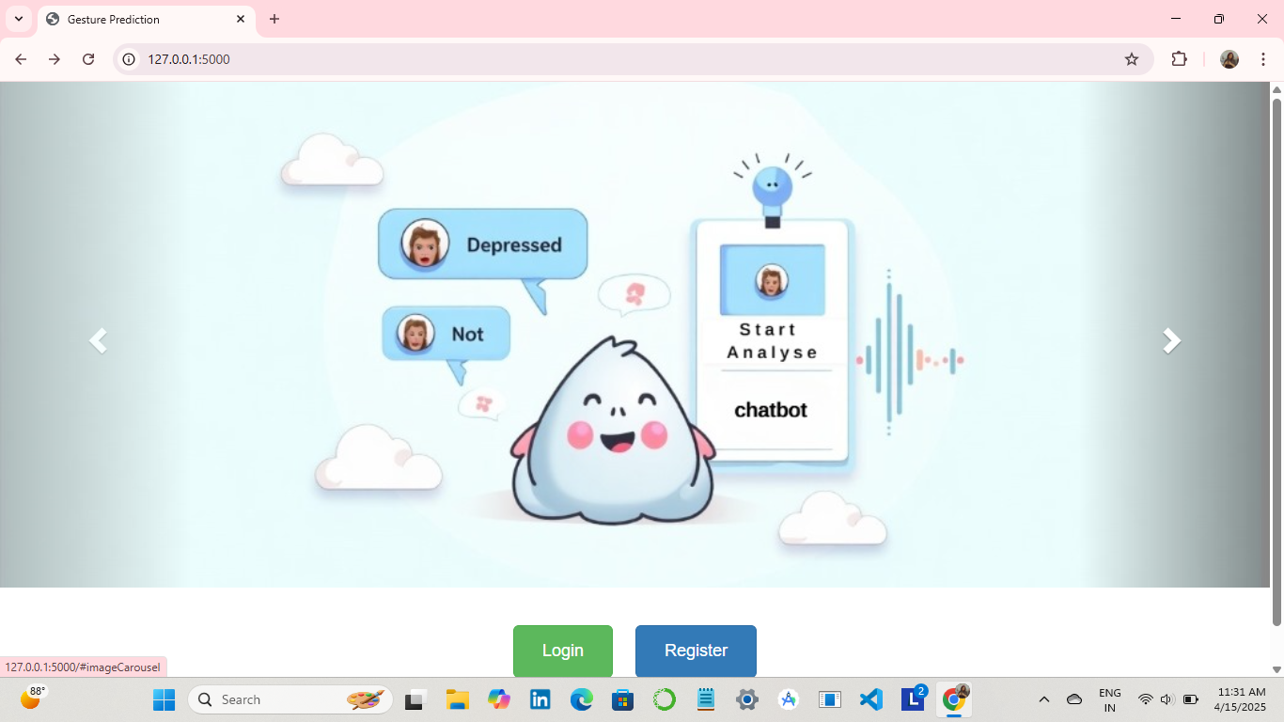
Snapshots
Figure 3: Home page

Slide 11
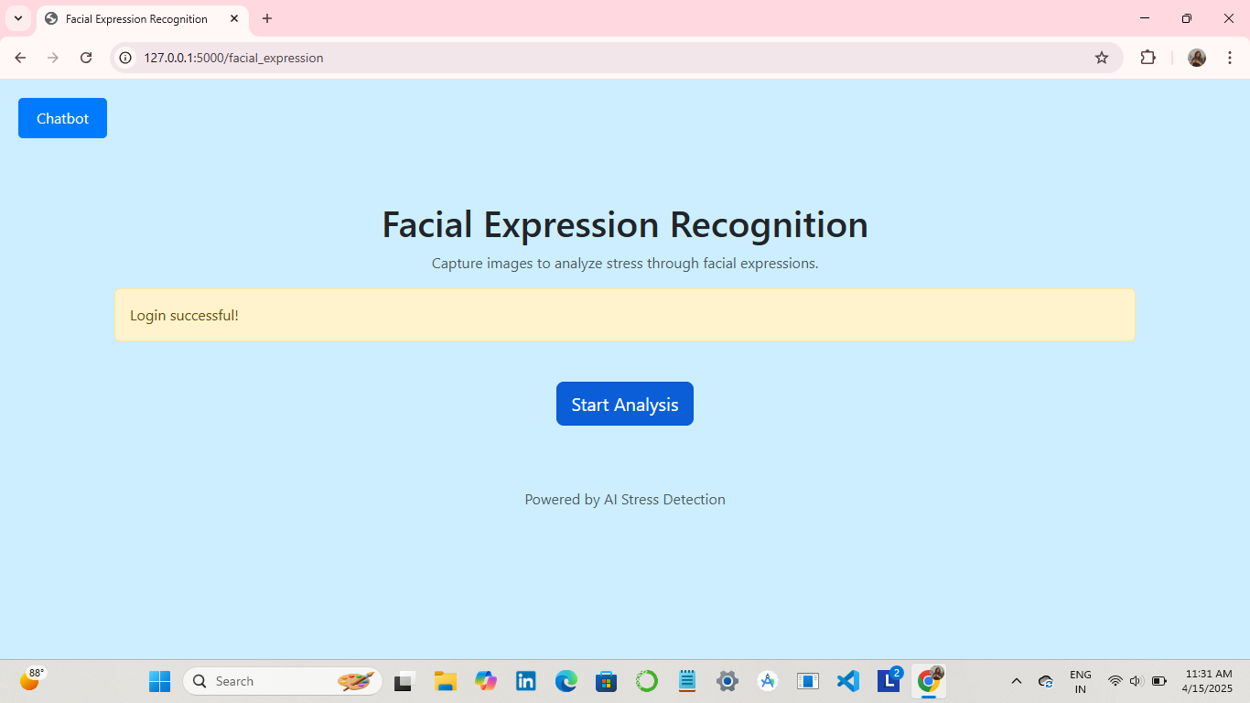
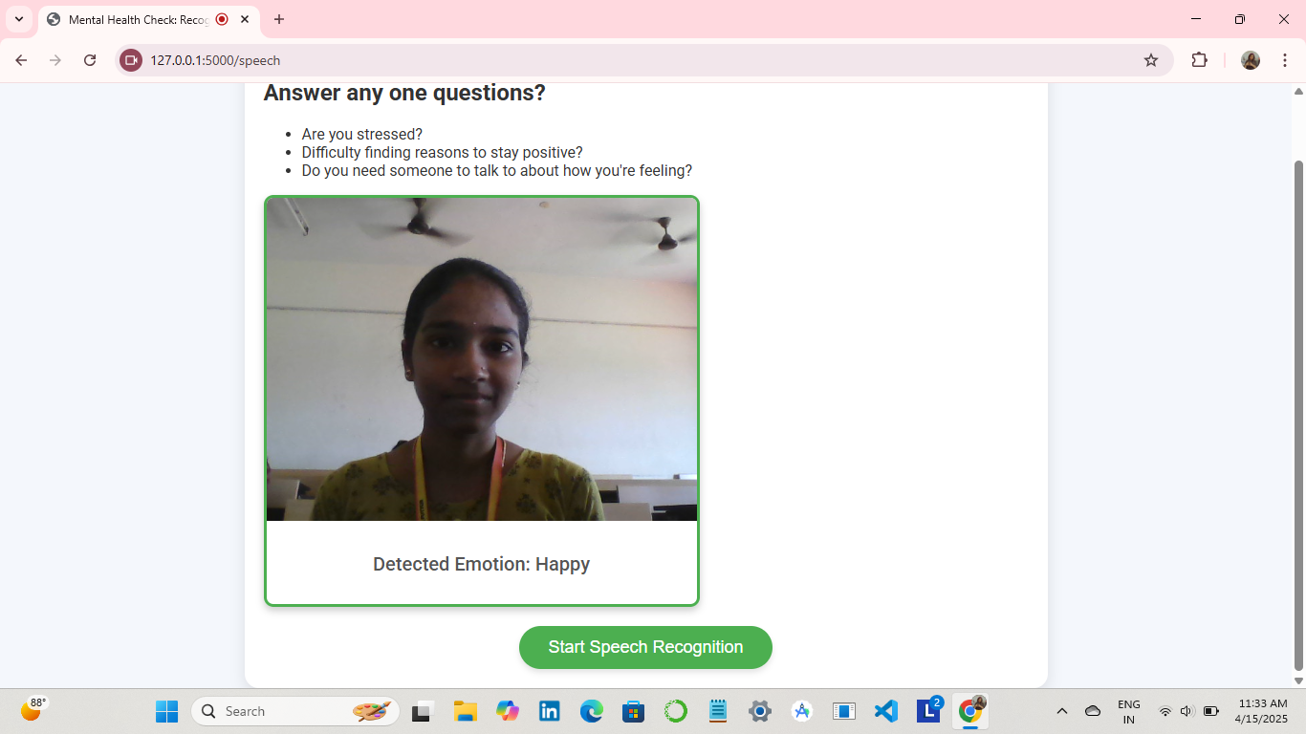
Figure 4: Screenshot of the Dashboard
Figure 5:Facial Analysis and Speech Recognition

Slide 12
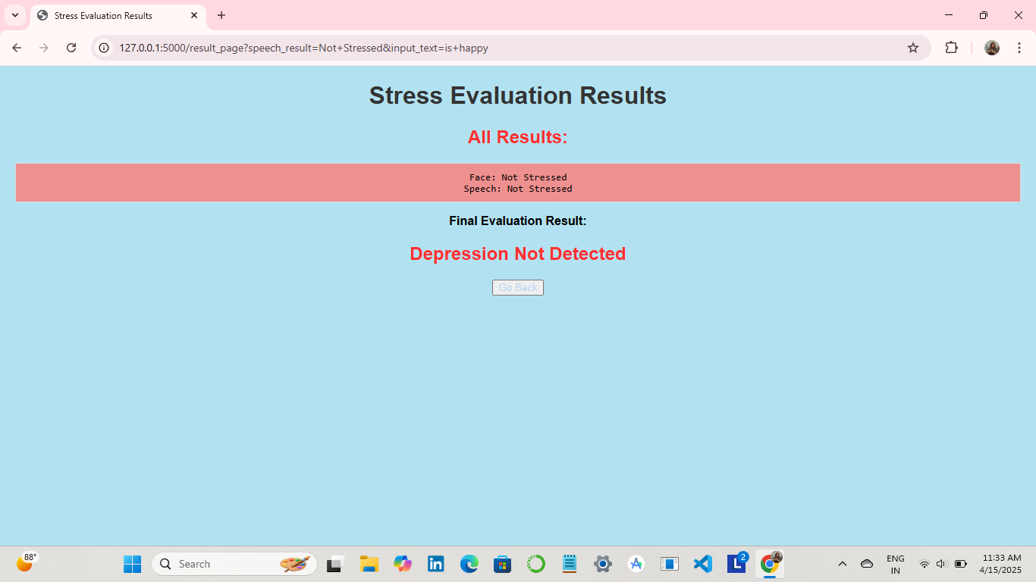
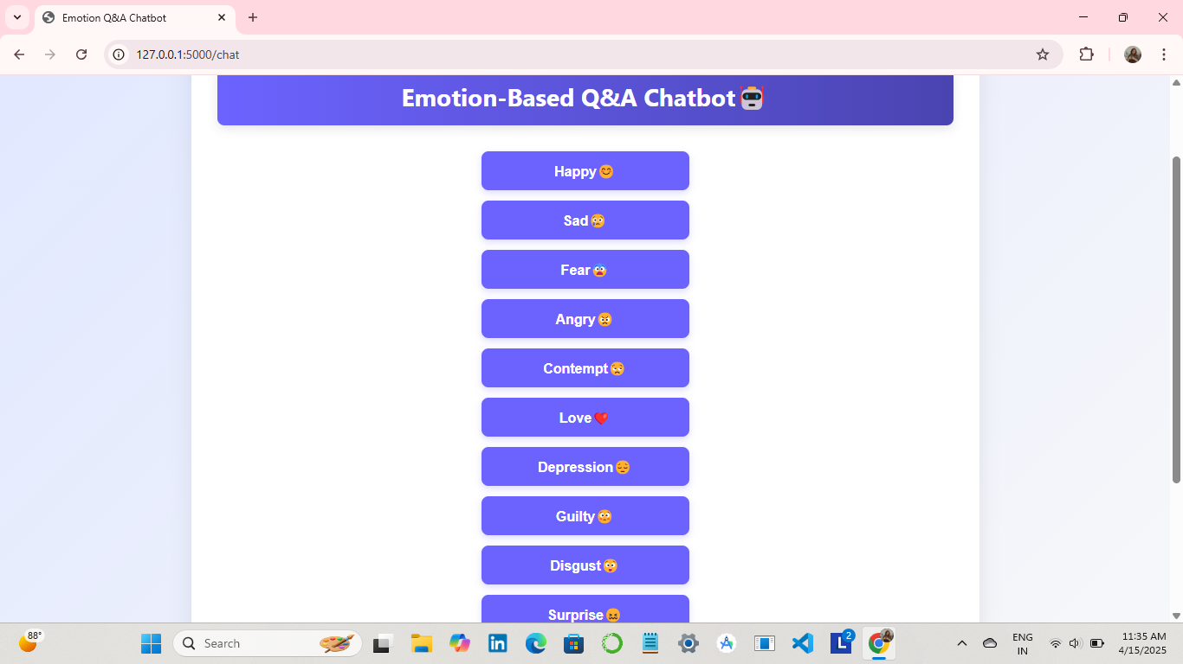
Figure 6: Result for Facial Analysis
Figure 7: Emotion-Based Q&A Chatbot

Slide 13
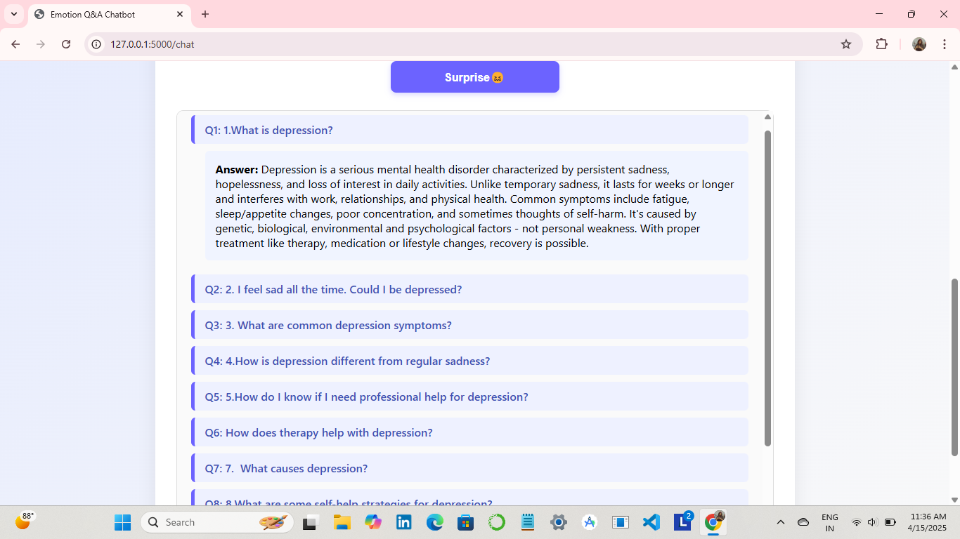
Figure 8: Chatbot Predefined Q&A’s

Slide 14
CONCLUSION
Helps detect depression thoughts issues early through facial expressions and voice.
Gives instant support like meditation tips or counselling suggestions.
Makes mental health help easier to access, especially for people in remote areas.
Supports doctors by helping them focus on patients who need care the most.

Slide 15
REFERENCES
[1] Sharma, Archana, Anuradha Saxena, Ashok Kumar, and Divyansh Singh. "Depression
detection using multimodal analysis with chatbot support." In 2024 2nd International
Conference on Disruptive Technologies (ICDT), pp. 328-334. IEEE, 2024.
[2] Yu, Jiawei, and Heysem Kaya. "Using Emotionally Rich Speech Segments for Depression
Prediction." In ICASSP 2025-2025 IEEE International Conference on Acoustics, Speech and
Signal Processing (ICASSP), pp. 1-5. IEEE, 2025.
[3] Shukla, Devesh, Rajni Kumari, and A. Bhargavi. "Human Face Detection and Emotion
Recognition Using OpenCV through AI." In 2024 12th International Conference on Internet
of Everything, Microwave, Embedded, Communication and Networks (IEMECON), pp. 1-5.
IEEE, 2024.

Slide 16
[4] Nirupa, V., G. B. Renuka, B. Naga Lakshmi, C. P. Sumanth Kumar, A. Rudra Sekhar Reddy, and
J. Paramesh. "Chatbot Based on Emotions Using Deep Learning." In 2023 1st International
Conference on Optimization Techniques for Learning (ICOTL), pp. 1-5. IEEE, 2023.
[5] Sharma, Akshita, Vriddhi Bajaj, and Jatin Arora. "Machine learning techniques for real-time
emotion detection from facial expressions." IEEE, 2023.

Slide 17
Thank you

