Slide 1
IMAGE CLASSIFICATION · PROJECT VIVA
IndiSign: recognizing hand-sign letters with a CNN
From raw sign photos to a tested prediction pipeline.

Slide 2
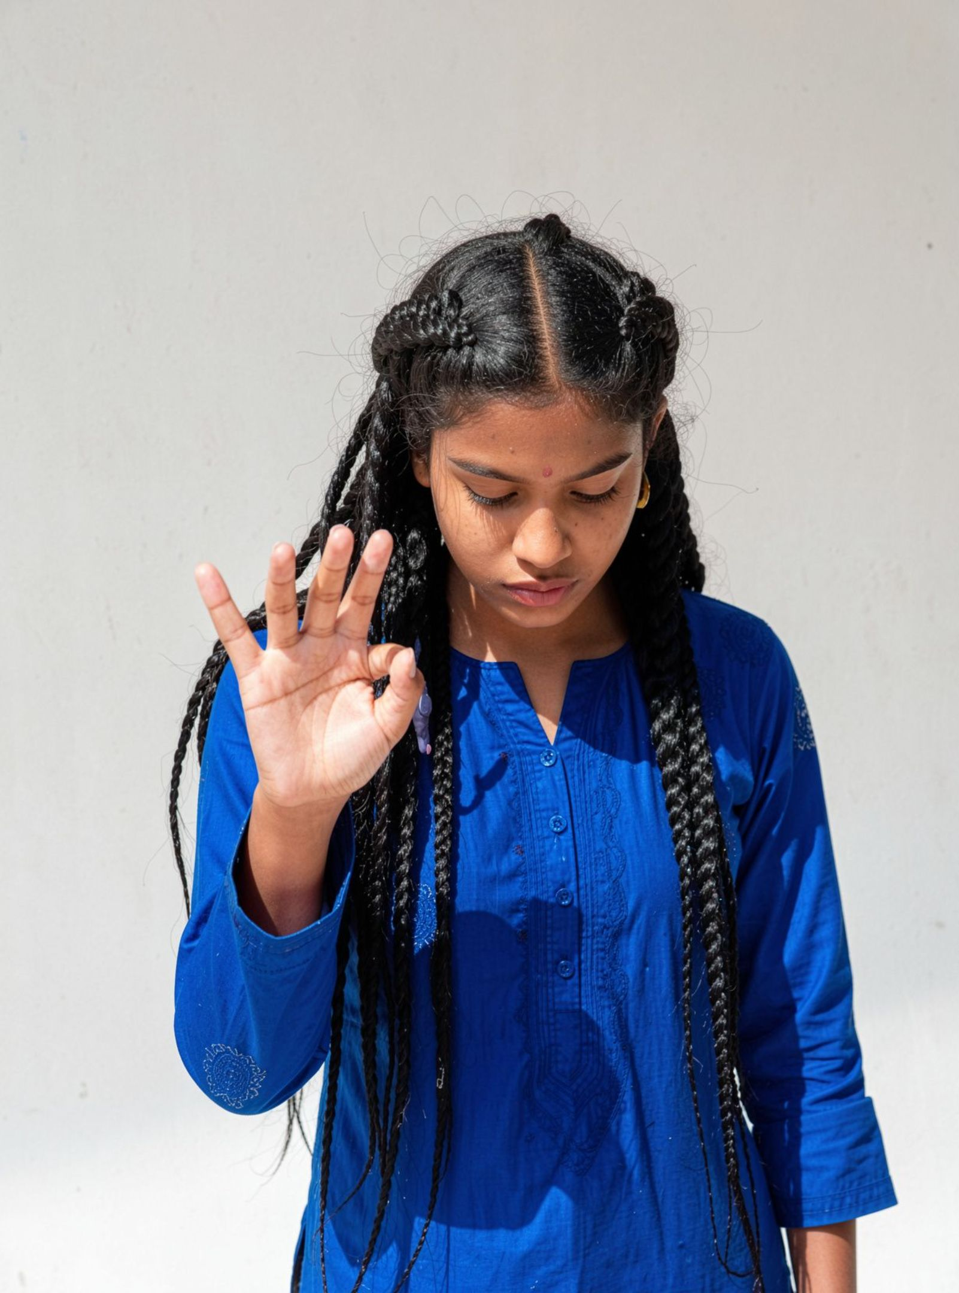
01 · THE TASK
The project turns a hand photo into a letter prediction
Goal: predict which letter a hand-sign photo represents.
Two project goals: build image preprocessing and a model that predicts the sign.
01
02
03
Input
Model
Output
Hand photo
CNN learns patterns
Letter prediction
02

Slide 3
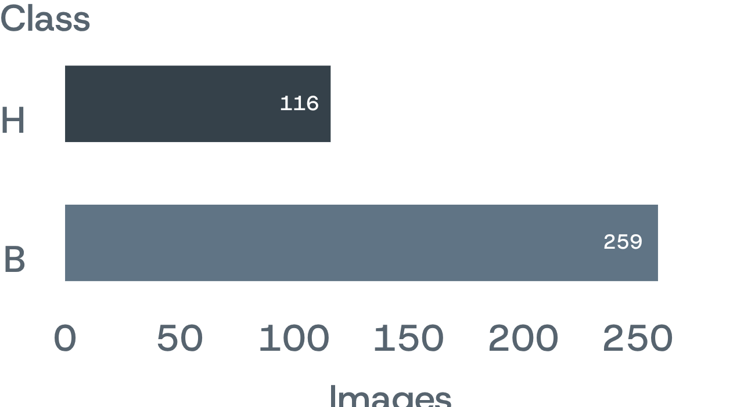
02 · THE DATA
The dataset contains 4,972 images across 24 sign classes
4,972
24
images
sign classes
Folders such as A, B, C become numeric labels for model training.
Integrity: every image is opened and verified; no corrupt files are reported.
Balance: class counts range from H with 116 images to B with 259, a 2.23:1 imbalance ratio.
03

Slide 4
03 · PREPROCESSING
Preprocessing makes every image comparable
One repeatable transformation turns varied photos into model-ready tensors.
01
02
03
04
Convert
Resize
Normalize
Store
Convert each image to RGB.
Resize it to 128 × 128 pixels.
Normalize pixel values from 0–255 to 0–1.
Store images as X with shape (images, 128, 128, 3), labels as y, and original paths for traceability.
04

Slide 5
04 · EVALUATION DESIGN
Stratified splitting protects the evaluation
70%
15%
15%
Train
Validation
Test
Learn visual patterns.
Guide tuning and model selection.
Final held-out estimate.
Stratification keeps each sign represented in the same proportions.
Class weights give rarer signs more influence during training.
05

Slide 6
05 · AUGMENTATION
Augmentation adds variation without changing the sign
Training images receive random rotation, shifts, and zoom.
01
02
03
Rotate
Shift
Zoom
Adds angle variation.
Changes position.
Changes framing.
No flip: Flipping is intentionally excluded because a mirrored hand may not represent the same valid sign.
Result: the model is trained for changes in angle, position, and framing rather than memorizing one pose.
06

Slide 7
06 · MODEL
The baseline CNN learns from edges to finger patterns
01
02
03
04
Input
Feature extraction
Decision
Training
Augmented 128 × 128 RGB image.
Three Conv2D + MaxPooling rounds move from edges to shapes to finger patterns.
Flatten → Dense(128) → Dropout(0.5) → Softmax with 24 outputs.
Adam optimizer with sparse categorical cross-entropy.
Edges
Shapes
Fingers
07

Slide 8
07 · TRAINING CONTROL
Training controls overfitting and keeps the best checkpoint
01
02
03
Monitor
Adapt
Preserve
Early stopping halts training when validation loss stops improving.
ReduceLROnPlateau lowers the learning rate when progress stalls.
ModelCheckpoint preserves the best version.
30
Best checkpoint means the final model is the strongest saved version, not simply the last version trained.
baseline training cap · epochs
08

Slide 9
08 · HYPERPARAMETER SEARCH
Random search tests the choices that matter most
SEARCH SPACE
TRADE-OFF
SELECTION RULE
Five choices
8
Validation accuracy
Convolution filters
Dense units
Dropout
Learning rate
Batch size
random trials
The winning settings are selected using validation accuracy, not the test set.
Instead of evaluating all 96 combinations.
Principle: search the decisions that affect learning, then keep the test set untouched.
09

Slide 10
09 · FINAL EVALUATION
Evaluation looks beyond a single accuracy number
Model comparison
Per-sign metrics
Confusion matrix
Misclassified images
Use precision, recall, and F1 to see whether performance is consistent across signs.
Read the confusion matrix, weakest F1 classes, most confused pairs, and misclassified images to understand failure modes.
Compare baseline and final models on validation and test sets.
Understand failure modes.
10

