Slide 1
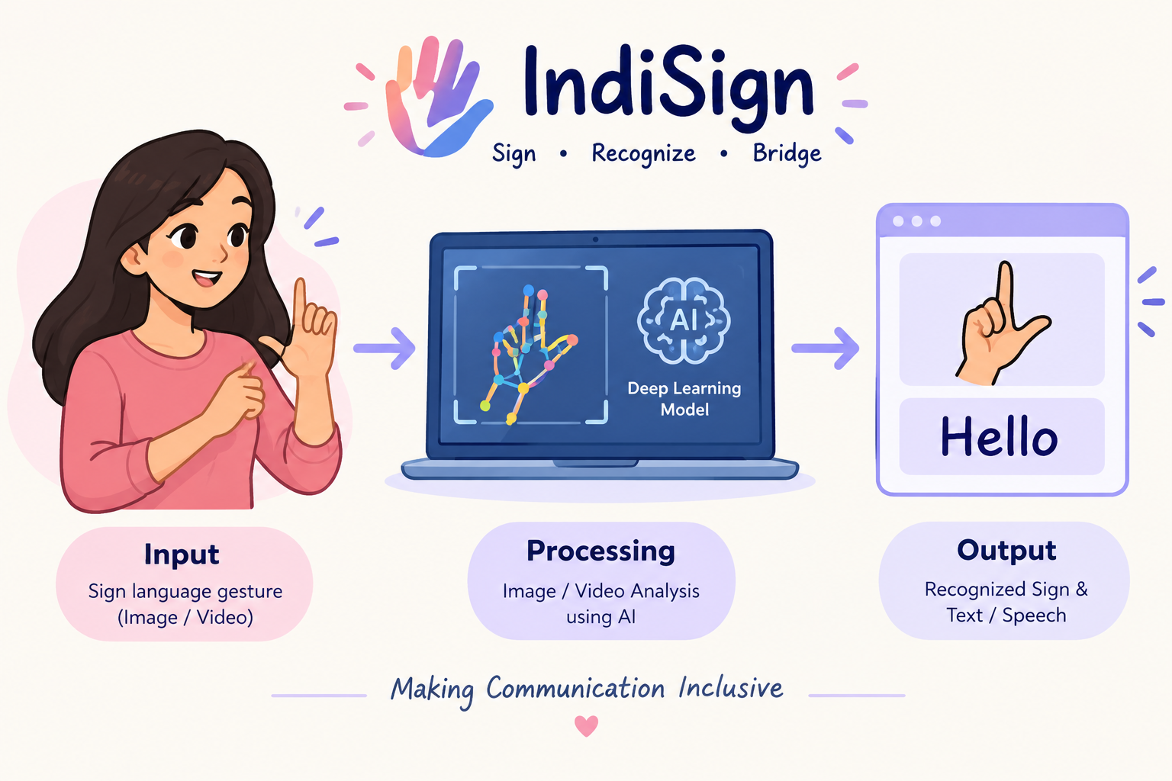
ARTIFICIAL INTELLIGENCE CAPSTONE PROJECT – PRAICP-1000: INDIAN SIGN LANGUAGE (ISL) RECOGNITION
Dataset: IndiSignLang (DataMites Capstone Project)
Team Code: PTID-AIE-JUL-26-11142
Submitted By: Sameeksha

Slide 2
TABLE OF CONTENTS
01 Problem Statement & Objective
02 Dataset Overview
03 Exploratory Data Analysis (EDA)
04 Image Preprocessing
05 Train / Validation / Test Split
06 Data Augmentation
07 Baseline CNN Model
08 Hyperparameter Tuning
09 Final CNN & Model Comparison
10 Best Model Evaluation & Prediction
11 Business Insights & Challenges
12 Project Links & Conclusion

Slide 3
1. PROBLEM STATEMENT & PROJECT OBJECTIVE
The Problem:
Sign language is the primary medium of communication for many deaf and hard-of-hearing people, but most people do not understand it.
This creates a communication barrier in education, healthcare, public services and everyday life.
Business Objective:
Build a CNN-based model that looks at a photograph of a hand sign and automatically predicts which Indian Sign Language (ISL) sign it represents.
Project Goals:
Image preprocessing – convert raw, variable-resolution photographs into a clean, consistent format (resize, normalise, augment).
ML model – build, tune and evaluate a CNN that classifies each image into its sign class.
Approach:
Explore data, preprocess, split, augment, build a baseline CNN, tune with Keras Tuner, then evaluate the final model.

Slide 4
2. DATASET OVERVIEW
1. Data Source: DataMites Capstone Project Dataset – IndiSignLang (one directory per sign, directory name = class label).
2. Dataset Size: 4,972 images across 24 sign classes (letters A–Y, without J and Z).
3. Data Quality: All files are RGB JPEG; no corrupt or unreadable images were found.
4. Why a CNN: Sign meaning is carried by hand shape – finger positions, thumb placement and palm orientation – spatial patterns a CNN learns directly from pixels.
Key Details:
Single hand on a plain background
Static signs only – J and Z need motion, so they are not in the class list
Resolutions: 640×480 (3,963), 1920×1088 (830), 1088×1920 portrait (179)
Class sizes: smallest H (116), largest B (259)
Imbalance ratio ≈ 2.2 : 1

Slide 5
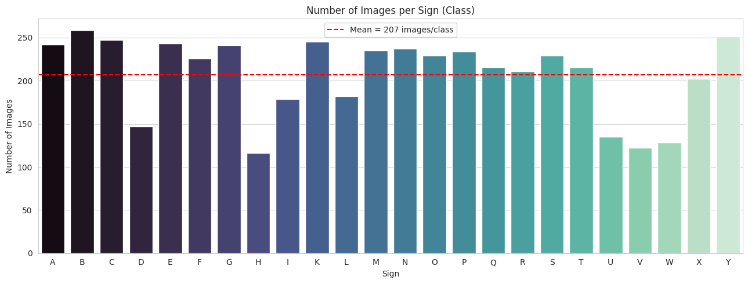
3. EXPLORATORY DATA ANALYSIS (EDA) – CLASS DISTRIBUTION
Moderate imbalance: 116 images (H) to 259 images (B), mean ≈ 207 images per class.

Slide 6
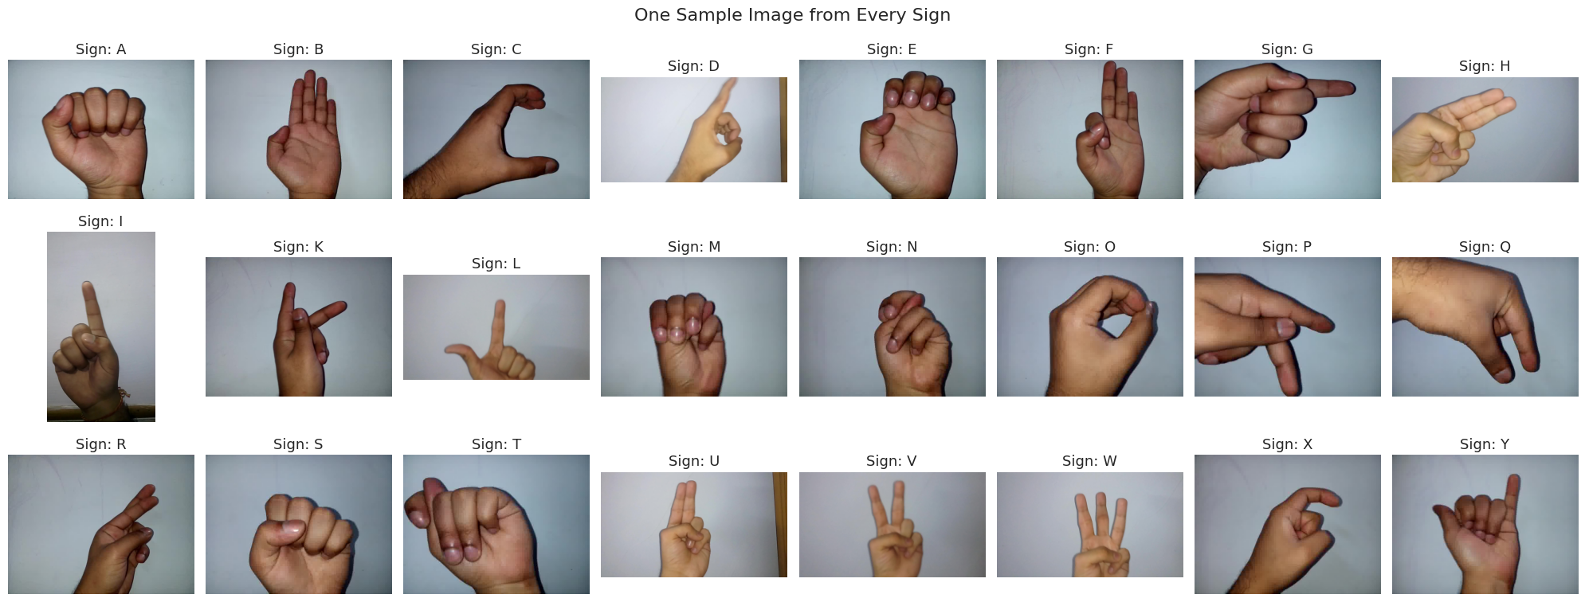
3. EDA – SAMPLE IMAGES FROM EVERY SIGN
One sample per sign – single hand on a plain background, with variation in angle, size and sharpness.

Slide 7
3. EDA SUMMARY – KEY FINDINGS
1. 24 classes, 4,972 images: all RGB JPEG files with no corrupt images.
2. Moderate class imbalance (≈ 2.2 : 1): handled with stratified splitting and class weights.
3. Three resolutions: 640×480, 1920×1088 and 1088×1920 – confirms the need for resizing to a fixed input size.
4. Natural variation within a class: hand size, skin tone, camera angle, position and motion blur – supports data augmentation.
5. Similar-looking signs: closed-fist or curled-finger signs are expected to be the hardest to separate.

Slide 8
4. IMAGE PREPROCESSING
1. Resize: every image is converted to RGB and resized to 128 × 128 pixels, giving a 128 × 128 × 3 array. This keeps finger details visible while keeping training fast.
2. Normalise: pixel values (0–255) are divided by 255 so they lie between 0 and 1, making gradient-based training faster and more stable.
3. Same pipeline for new images: one preprocess_image() function is reused at prediction time so training and new images are treated identically.
4. Final arrays: X shape = (4972, 128, 128, 3), pixel range 0.0 – 1.0.
Original → resized → pixel-value distribution before and after normalisation.

Slide 9
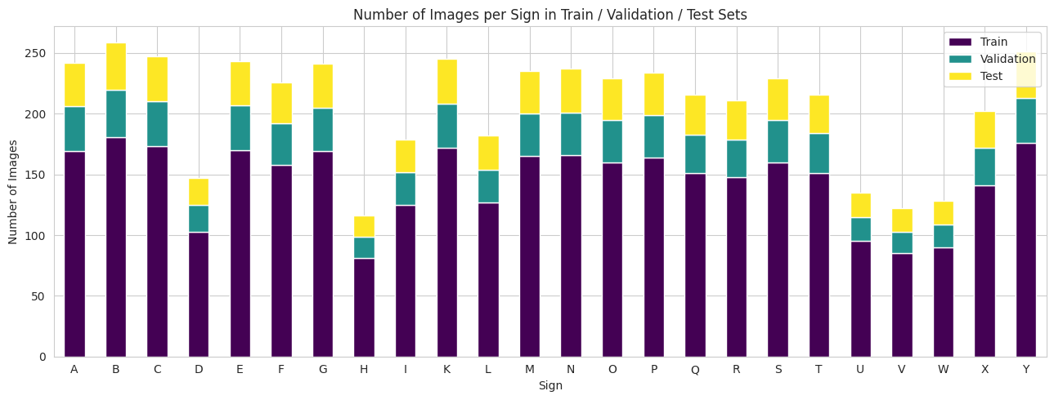
5. TRAIN / VALIDATION / TEST SPLIT
1. Training set (70%) – 3,480 images: the images the CNN learns from.
2. Validation set (15%) – 746 images: used during development for early stopping and hyperparameter selection.
3. Test set (15%) – 746 images: kept untouched until the end for the final, unbiased evaluation.
4. Stratified split: every set keeps the same proportion of each sign.
5. Class weights: computed from training labels only – small classes get extra importance (H = 1.79, V = 1.71, W = 1.61, U = 1.53).

Slide 10
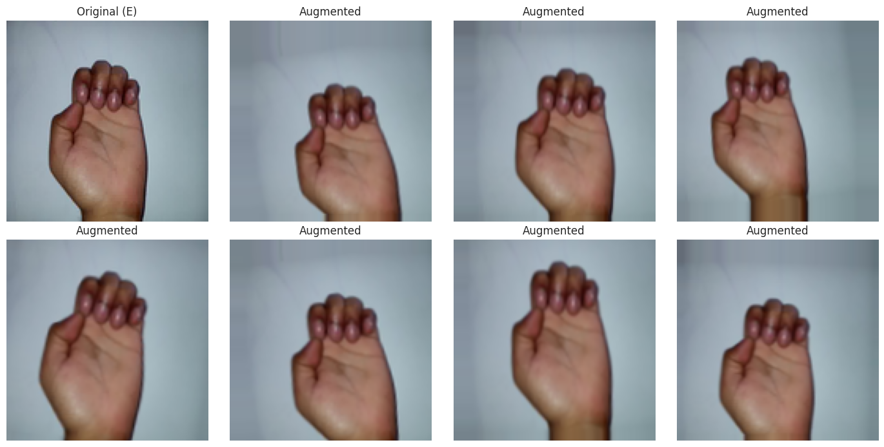
6. DATA AUGMENTATION
1. Why: with only ~3,500 training images a CNN can memorise photos instead of learning sign shapes (overfitting).
2. Rotation: up to about ±14° (hand tilted).
3. Translation: up to 10% horizontally and vertically (hand not centred).
4. Zoom: up to 10% (hand closer to or further from the camera).
5. No horizontal flip: a mirrored hand may not be a valid example of the same sign.
6. Training only: layers sit at the start of the model and are switched off for validation, testing and prediction.

Slide 11
7. BASELINE CNN MODEL
Architecture:
Conv2D (32 → 64 → 128 filters, 3×3): learn edges, then finger shapes and hand structure.
MaxPooling2D (2×2): shrinks feature maps, keeps strongest responses.
Flatten + Dense (128): combine features to decide between signs.
Dropout (0.5): reduces overfitting.
Softmax (24): one probability per sign.
Training Setup:
Optimiser: Adam (lr = 0.001)
Loss: sparse categorical cross-entropy
Epochs: up to 30, batch size 32
EarlyStopping and ReduceLROnPlateau
Total parameters: 3,307,736
Result:
Validation accuracy: 99.46%
Test accuracy: 99.33%

Slide 12
8. HYPERPARAMETER TUNING
1. Approach: Keras Tuner RandomSearch – 8 random trials (up to 15 epochs each), ranked by validation accuracy; the test set is not used.
2. Why random search: trying all 96 combinations would be very slow.
3. Search space: filters 1 (32, 64), filters 2 (64, 128), dense units (128, 256), dropout (0.3–0.5), learning rate (0.001, 0.0001), batch size (16, 32).
4. Best validation accuracy in search: 99.60%.
Optimal Hyperparameters:
Conv layer 1 filters: 32
Conv layer 2 filters: 64
Dense units: 256
Dropout rate: 0.3
Learning rate: 0.001
Batch size: 32

Slide 13
9. FINAL CNN MODEL
1. Rebuilt with best hyperparameters and trained again from scratch for up to 40 epochs.
2. Callbacks: EarlyStopping (patience 6) and ReduceLROnPlateau monitor the validation set.
3. Model size: 6,522,200 parameters.
4. Result: validation accuracy 99.87%, test accuracy 100%.

Slide 14
10. MODEL PERFORMANCE COMPARISON
Model / Set | Accuracy | Precision (macro) | Recall (macro) | F1-Score (macro)
Baseline CNN – Validation | 0.9946 | 0.9944 | 0.9932 | 0.9937
Baseline CNN – Test | 0.9933 | 0.9936 | 0.9921 | —
Final Tuned CNN – Validation | 0.9987 | 0.9980 | 0.9978 | —
Final Tuned CNN – Test | 1.0000 | 1.0000 | 1.0000 | 1.0000
Best model selected using validation accuracy (not test accuracy): Final Tuned CNN.
Tuning improved validation accuracy from 99.46% to 99.87%.

Slide 15
11. BEST MODEL – DETAILED EVALUATION
Test accuracy: 100% (746 / 746 images correct).
Macro precision, recall and F1-score: 1.00.
Every sign has F1 = 1.00; no misclassified test images.
Confusion matrix is perfectly diagonal.
Confusion matrix – Final Tuned CNN (test set).

Slide 16
12. PREDICTING THE SIGN OF A NEW IMAGE
Pipeline:
New hand image → Resize → Normalise → CNN → Probability for each sign → Highest probability → Predicted ISL sign
Output:
Predicted sign, model confidence (softmax probability) and top-3 most likely signs.
Demo on 4 unseen test images (Q, K, P, A): all predicted correctly with ~100% confidence.
Confidence is the model's own estimate, not a guarantee of correctness.
Saved Model:
IndiSignLang_CNN_Model.keras (78.3 MB) with class-name JSON; reloaded model gives identical predictions.

Slide 17
13. BUSINESS INSIGHTS & ACTIONABLE IMPACT
1. Assistive Communication Tool: a phone or web app can turn a hand-sign photo into a predicted letter instantly, helping schools, hospitals, banks and public offices.
2. Preprocessing Enables Real-World Use: resizing and normalising lets one model handle photos from different cameras consistently.
3. Confusion Analysis Guides Improvement: confusing signs are the best targets for collecting more varied photos.
4. Tuning Adds Measurable Value: the tuned model is openly compared with the baseline on the same data.
5. Scope: the model recognises static letters only; motion-based signs and full words need further work.

Slide 18
14. CHALLENGES FACED & SOLUTIONS
1. Different Sizes and Orientations: three resolutions converted to 128×128 RGB; fast JPEG draft decoding speeds up large images.
2. Moderate Class Imbalance: stratified splitting, class weights and macro-averaged metrics.
3. Visually Similar Signs: confusion matrix and classification report examined sign by sign.
4. Overfitting on a Small Dataset: augmentation, dropout, early stopping and learning-rate reduction; no horizontal flipping.
5. Avoiding Information Leakage: hyperparameters and the best model chosen on validation data; test set used only for the final score.

Slide 19
15. CONCLUSION & PROJECT LINKS
Project Conclusion:
Built a CNN that recognises 24 Indian Sign Language signs from images, covering preprocessing and prediction.
Tuned CNN reached 100% test accuracy and 1.00 macro F1 on 746 unseen images.
Future work: more varied photos, transfer learning, two-hand and motion-based signs.
Code & Artifact Repositories:
GitHub Repository: https://github.com/Sameekshagithub/PRAICP-1000-Indian-Sign-Language-ISL-Recognition-Using-CNN.git
Google Drive Folder: https://drive.google.com/drive/folders/1uiFsyNDpfCWIWidHgfDLZDjr36PixxGG?usp=drive_link

Slide 20
THANK YOU!!

