Slide 1

ARTIFICIAL INTELLIGENCE CAPSTONE PROJECT – PRAICP-1002: TRAFFIC SIGN DETECTION & CLASSIFICATION
Dataset: TrafSignDetc (DataMites Capstone Project)
Team Code: PTID-AIE-JUL-26-11142
Submitted By: Sameeksha

Slide 2
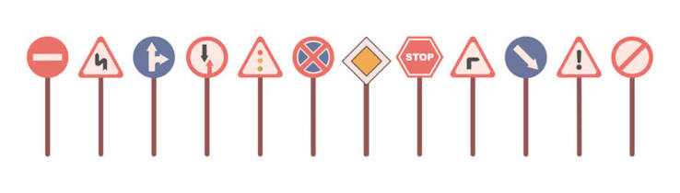
TABLE OF CONTENTS
01 Problem Statement & Objective
02 Dataset Overview
03 Exploratory Data Analysis (EDA)
04 Image Preprocessing
05 Train / Validation / Test Split
06 Data Augmentation
07 Baseline CNN Model
08 Hyperparameter Tuning
09 Final CNN & Model Comparison
10 Best Model Evaluation & Prediction
11 Business Insights & Challenges
12 Project Links & Conclusion

Slide 3
1. PROBLEM STATEMENT & PROJECT OBJECTIVE
The Problem:
Traffic signs tell drivers what to do, what not to do and what dangers lie ahead.
Missing or misreading a sign (stop, speed limit, warning) is a common cause of road accidents.
Driver-assistance and self-driving systems need to recognise signs automatically from camera images.
Business Objective:
Build a CNN that predicts which traffic sign is shown in a photograph, helping to improve road safety.
Project Goals:
Image preprocessing – convert variable-resolution photographs into a clean, consistent format (resize, normalise, augment).
ML model – build, tune and evaluate a CNN that classifies each image into its traffic sign class.
Approach:
Explore data, preprocess, split, augment, build a baseline CNN, tune with Keras Tuner, then evaluate the final model.

Slide 4
2. DATASET OVERVIEW
1. Data Source: DataMites Capstone Project Dataset – TrafSignDetc (one directory per sign, directory name = class label).
2. Dataset Size: 39,209 images in the full dataset across 43 traffic sign classes (numbered 0–42).
3. Working Subset: a random 400 images per class (memory-safe strategy) = 15,460 images.
4. Data Quality: all files are RGB PNG; no corrupt or unreadable images were found.
5. Why a CNN: signs follow strict visual rules – shape, border colour and the pictogram or number inside – patterns a CNN learns directly from pixels.
Key Details:
Full dataset imbalance: 10.7 : 1 (class 0 = 210, class 2 = 2,250)
Working subset imbalance: 1.9 : 1
Image size: 25×25 up to 224×219 pixels
2,066 different resolutions (median ≈ 44×43)
Signs are photographed from moving vehicles

Slide 5
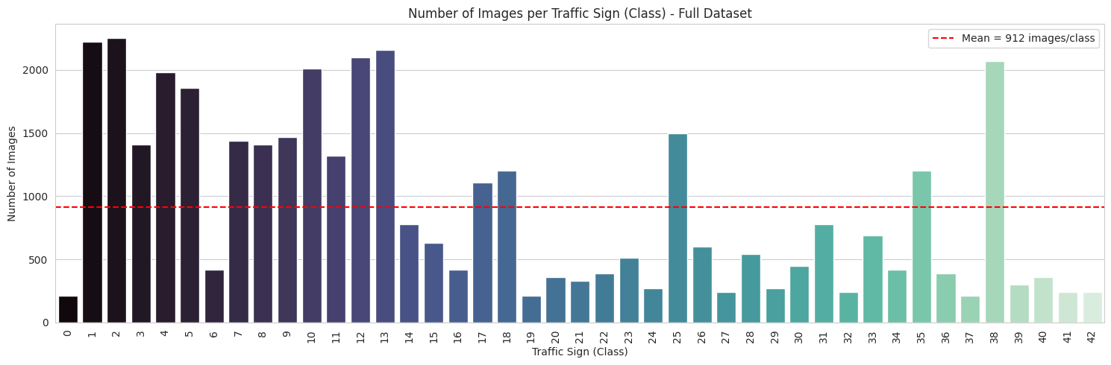
3. EXPLORATORY DATA ANALYSIS (EDA) – CLASS DISTRIBUTION

Slide 6
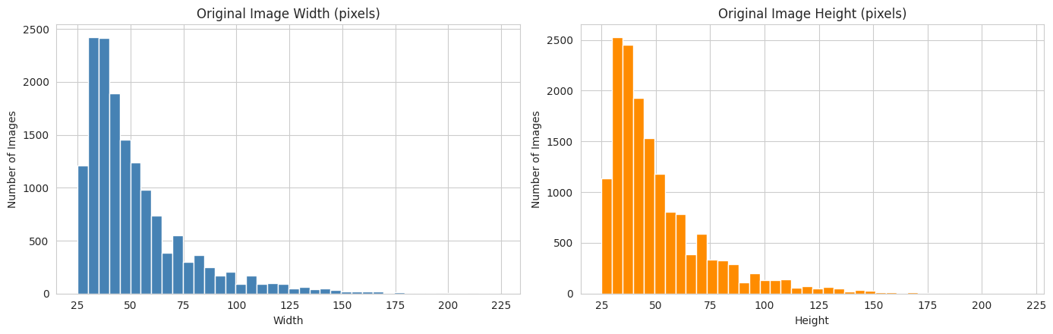
3. EDA – IMAGE RESOLUTIONS
Original width and height distribution – many small images, from 25×25 up to 224×219 pixels.

Slide 7
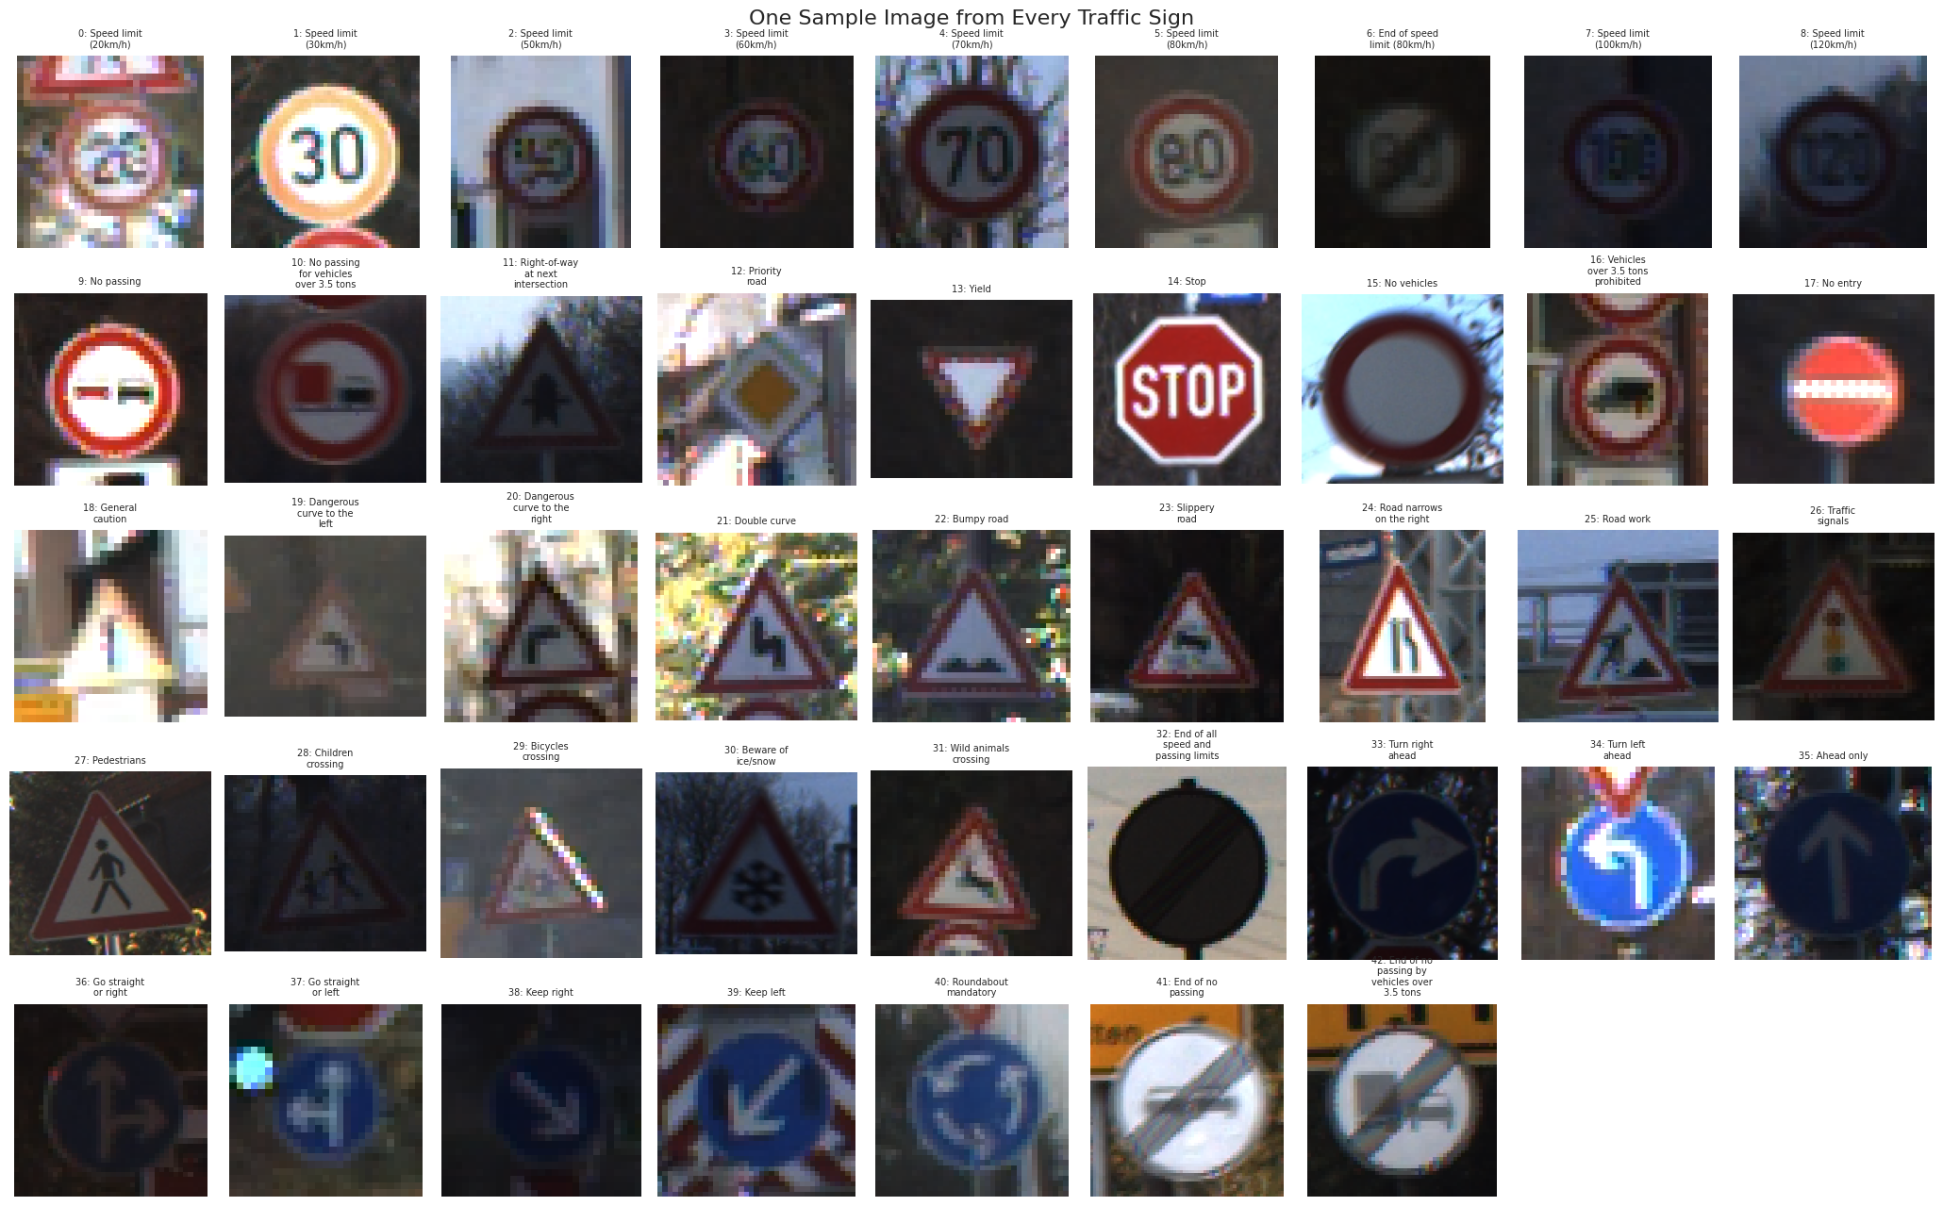
3. EDA – SAMPLE IMAGES FROM EVERY TRAFFIC SIGN
One sample per class – variation in lighting, blur, size and viewing angle.

Slide 8
3. EDA SUMMARY – KEY FINDINGS
1. 43 classes, 39,209 images: working subset of 15,460 RGB PNG images with no corrupt files.
2. Unequal class sizes (10.7 : 1): handled by capping images per class, stratified splitting and class weights.
3. Many resolutions, mostly small: 2,066 different sizes confirm the need for resizing to a fixed input.
4. Natural variation within a class: brightness, sharpness, size, angle and background – supports data augmentation.
5. Similar-looking signs: speed-limit signs differ only by the number inside the circle and are expected to be the hardest to separate.

Slide 9
4. IMAGE PREPROCESSING
1. Resize: every image is converted to RGB and resized to 64 × 64 pixels (64 × 64 × 3 array) – keeps shape, colour and symbol visible while saving memory and time.
2. Normalise: pixel values (0–255) are divided by 255 using a Rescaling(1/255) layer inside the CNN; arrays are stored as uint8 (4× smaller than float32).
3. Same pipeline for new images: preprocess_image() is reused at prediction time, so new images are treated exactly like training images.
4. Final arrays: X shape = (15460, 64, 64, 3), using only 190 MB of memory.
Original → resized → pixel-value distribution before and after normalisation.

Slide 10
5. TRAIN / VALIDATION / TEST SPLIT
1. Training set (70%) – 10,822 images: the images the CNN learns from.
2. Validation set (15%) – 2,319 images: used during development for early stopping and hyperparameter selection.
3. Test set (15%) – 2,319 images: kept untouched until the end for the final, unbiased evaluation.
4. Stratified split: every set keeps the same proportion of each sign.
5. Class weights: computed from training labels only – small classes get extra importance (classes 0, 19 and 37 = 1.71; classes 27, 32, 41 and 42 = 1.50).

Slide 11
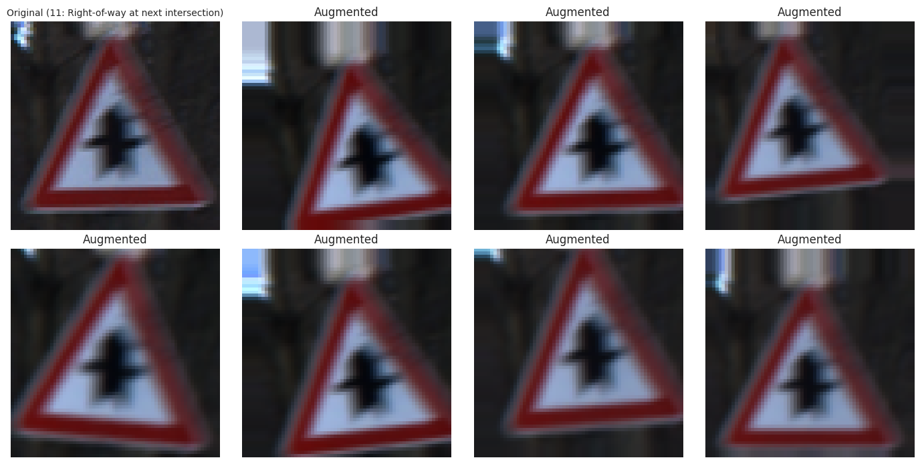
6. DATA AUGMENTATION
1. Why: stops the CNN from memorising training photos instead of learning the general appearance of each sign.
2. Rotation: up to about ±11° (camera or sign slightly tilted).
3. Translation: up to 10% horizontally and vertically (sign not centred).
4. Zoom: up to 10% (sign closer to or further from the camera).
5. Contrast: up to 20% (bright sunlight, shade or dusk).
6. No horizontal flip: turn left / turn right and keep left / keep right are mirror images – flipping would change the class.

Slide 12
7. BASELINE CNN MODEL
Architecture:
Augmentation + Rescaling (1/255): training-only variations, then normalisation.
Conv2D (32 → 64 → 128 filters, 3×3): learn edges, then shapes, then symbols and numbers.
MaxPooling2D (2×2): shrinks feature maps, keeps strongest responses.
Flatten + Dense (128) + Dropout (0.5): combine features and reduce overfitting.
Softmax (43): one probability per sign.
Training Setup:
Optimiser: Adam (lr = 0.001)
Loss: sparse categorical cross-entropy
Up to 30 epochs, batch size 32
EarlyStopping, ReduceLROnPlateau
Total parameters: 688,747
Result:
Validation accuracy: 99.14%
Test accuracy: 99.35%

Slide 13
8. HYPERPARAMETER TUNING
1. Approach: Keras Tuner RandomSearch – 8 random trials (up to 15 epochs each), ranked by validation accuracy; the test set is not used.
2. Why random search: trying all 96 combinations would be very slow.
3. Search space: filters 1 (32, 64), filters 2 (64, 128), dense units (128, 256), dropout (0.3–0.5), learning rate (0.001, 0.0001), batch size (16, 32).
4. Best validation accuracy in search: 99.18%.
Optimal Hyperparameters:
Conv layer 1 filters: 32
Conv layer 2 filters: 128
Dense units: 128
Dropout rate: 0.4
Learning rate: 0.001
Batch size: 16

Slide 14
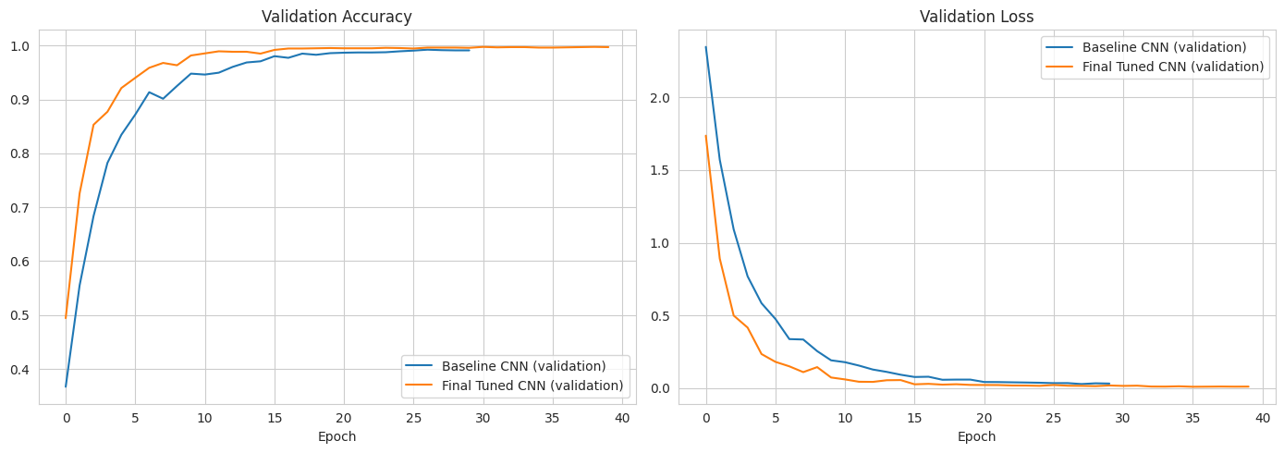
9. FINAL CNN MODEL
1. Rebuilt with best hyperparameters and trained again from scratch for up to 40 epochs.
2. Callbacks: EarlyStopping (patience 6) and ReduceLROnPlateau monitor the validation set.
3. Model size: 780,971 parameters (2.98 MB).
4. Result: validation accuracy 99.61%, test accuracy 99.53%.
Accuracy and loss curves of the final (tuned) CNN – training vs validation.

Slide 15
10. MODEL PERFORMANCE COMPARISON
Model / Set | Accuracy | Precision (macro) | Recall (macro) | F1-Score (macro)
Baseline CNN – Validation | 0.9914 | 0.9920 | 0.9918 | 0.9918
Baseline CNN – Test | 0.9935 | 0.9941 | 0.9939 | 0.9940
Final Tuned CNN – Validation | 0.9961 | 0.9964 | 0.9960 | 0.9961
Final Tuned CNN – Test | 0.9953 | 0.9957 | 0.9957 | 0.9957
Best model selected using validation accuracy (not test accuracy): Final Tuned CNN.
Tuning improved validation accuracy from 99.14% to 99.61%.
Test-set comparison chart: Baseline CNN vs Final Tuned CNN.

Slide 16
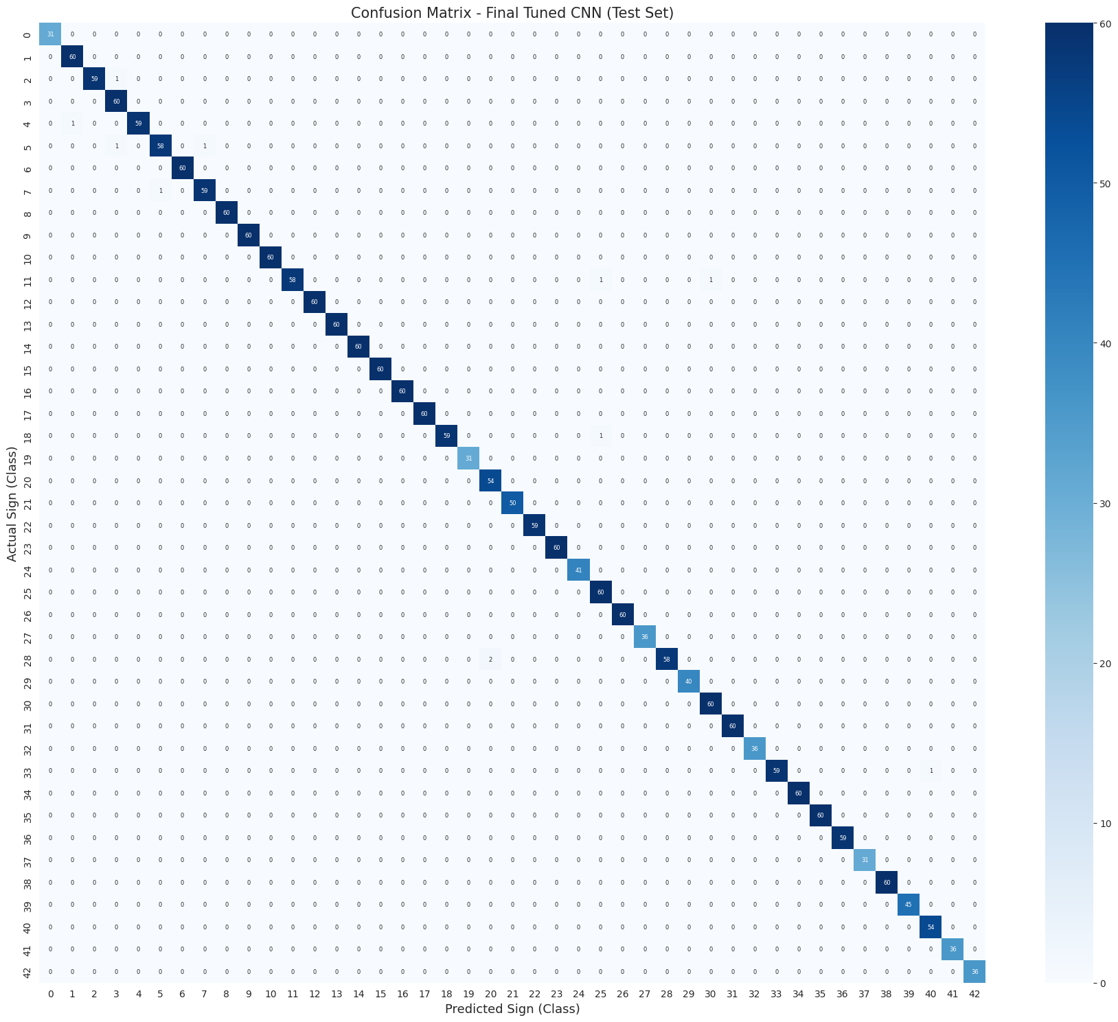
11. BEST MODEL – DETAILED EVALUATION
Test accuracy: 99.53% – only 11 of 2,319 test images misclassified.
Macro precision, recall and F1-score: 0.9957.
Weakest signs: 5 Speed limit 80 (0.97), 20 Dangerous curve right (0.98), 28 Children crossing (0.98).
Most confused: Children crossing → Dangerous curve right; Speed limit 50 → 60; Speed limit 80 ↔ 100.
Confusion matrix – Final Tuned CNN (test set).

Slide 17
12. PREDICTING THE TRAFFIC SIGN OF A NEW IMAGE
Pipeline:
New sign image → Resize → CNN (normalise inside) → Probability for each sign → Highest probability → Predicted traffic sign
Output:
Predicted sign, model confidence (softmax probability) and top-3 most likely signs.
Demo on 4 unseen test images (Bicycles crossing, Double curve, Children crossing, Right-of-way): all correct, 99.9–100% confidence.
Confidence is the model's own estimate, not a guarantee of correctness.
Saved Model:
TrafficSign_CNN_Model.keras (9.4 MB) with class-name JSON; reloaded model gives identical predictions.

Slide 18
13. BUSINESS INSIGHTS & ACTIONABLE IMPACT
1. Road Safety & Driver Assistance: alerts drivers to speed limits, stop signs and hazards they may have missed, helping reduce accidents.
2. Foundation for Autonomous Vehicles: a reliable sign classifier is a building block for self-driving systems.
3. Preprocessing Enables Real-World Use: resizing and normalising handles photos from different cameras consistently.
4. Confusion Analysis Guides Improvement: look-alike signs such as speed limits need more varied photos; these errors matter most for safety.
5. Tuning Adds Measurable Value: the tuned model is openly compared with the baseline on the same data.

Slide 19
14. CHALLENGES FACED & SOLUTIONS
1. Dataset Too Large: read the ZIP index without extracting, used 400 random images per class, 64×64 size and uint8 arrays.
2. Different Sizes and Quality: all images converted to 64×64 RGB; contrast augmentation added for lighting changes.
3. Class Imbalance: per-class sampling, stratified splitting, class weights and macro-averaged metrics.
4. Similar and Mirror-Image Signs: no horizontal flipping; confusion matrix checked sign by sign.
5. Risk of Overfitting: augmentation, dropout, early stopping and learning-rate reduction.
6. Avoiding Information Leakage: model and hyperparameters chosen on validation data; test set used only at the end.

Slide 20
15. CONCLUSION & PROJECT LINKS
Project Conclusion:
Built a CNN that recognises 43 traffic sign classes, covering image preprocessing and sign prediction.
Tuned CNN reached 99.53% test accuracy and 0.9957 macro F1 on 2,319 unseen images.
Future work: full dataset, transfer learning, a detection stage for full road scenes, real-time camera recognition.
Code & Artifact Repositories:
GitHub Repository: https://github.com/Sameekshagithub/PRAICP-1002-Traffic-Sign-Detection-Using-Deep-Learning.git
Google Drive Folder: https://drive.google.com/drive/folders/1pcADNaZ2l3gGNx7uDhTEBlcqMi5VIEOh?usp=drive_link

Slide 21
THANK YOU!!

