Slide 1
PRAICP-1002 · TRAFSIGNDETC
Traffic Sign
Detection and
Classification Using CNN
ARTIFICIAL INTELLIGENCE CAPSTONE PROJECT
Notes:
This project presents an end-to-end convolutional neural network pipeline for classifying traffic-sign images. The current scope is image classification, while full-scene detection remains future work.

Slide 2



The project turns a traffic-sign image into a class prediction
PIPELINE.TXT
Problem
Lighting, blur, viewing angle, and sign variation make recognition difficult.
Solution
An end-to-end CNN pipeline performs image classification.
Scope
Classify an image containing a sign; full-scene detection is future work.
Notes:
The central task is a controlled classification problem. The model receives an image containing a traffic sign and returns a class prediction. Full-scene object detection is deliberately outside the current scope.

Slide 3

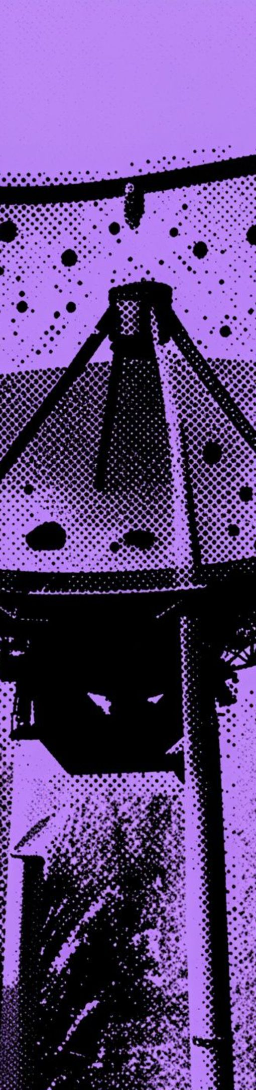

DATASET / EDA
The dataset contains 43 classes and real-world variation
43
TRAFFIC-SIGN CLASSES
DataMites TrafSignDetc dataset with separate class directories
Varied image resolutions, lighting, and viewing angles
EDA checked readability, dimensions, colour modes, class counts, and sample images
Memory-efficient loading and class weights addressed practical constraints
Notes:
The dataset combines 43 classes with the variation expected in real images. Exploratory analysis checked both the labels and the image properties before training, while memory-efficient loading and class weights addressed practical constraints.

Slide 4
Preprocessing creates a consistent learning input
Every image follows the same path before optimization.
01
02
03
04
05
Resize
Convert
Normalize
Augment
Protect meaning
Every image becomes 64 × 64 pixels.
RGB with three channels.
Pixel values move from 0–255 to 0–1.
Rotation ±11°, translation and zoom up to 10%, contrast up to 20%.
No horizontal flipping because it can change sign meaning.
Notes:
Preprocessing standardizes the tensor entering the network while preserving sign semantics. Augmentation adds controlled variation, but horizontal flipping is excluded because it can change the meaning of a sign.

Slide 5
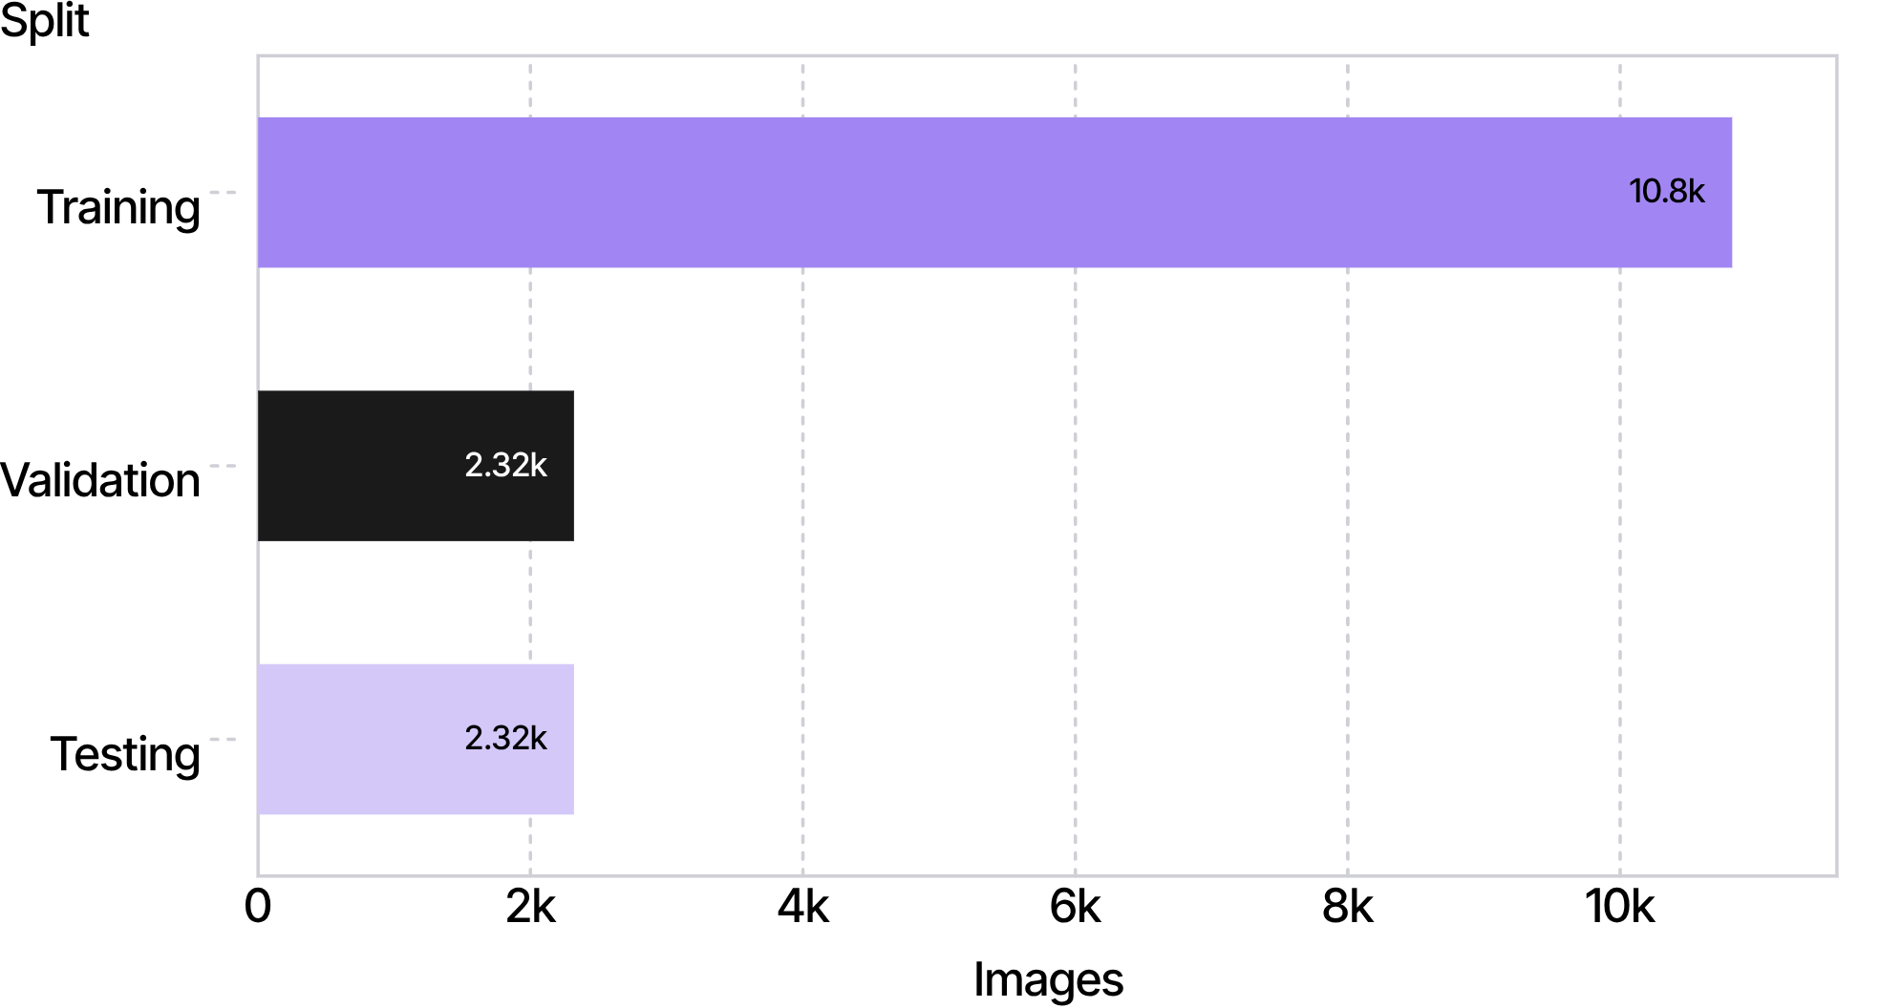
A stratified split protects the final evaluation
DATASET_SPLIT.PLT
Training receives most images while validation and test remain equal-sized.
TOTAL WORKING DATASET: 15,460 IMAGES
TRAINING 70% · VALIDATION 15% · TESTING 15%
Notes:
The split keeps the final evaluation separate and preserves the intended proportions. Training receives 10,822 images, while validation and testing each contain 2,319 images.

Slide 6
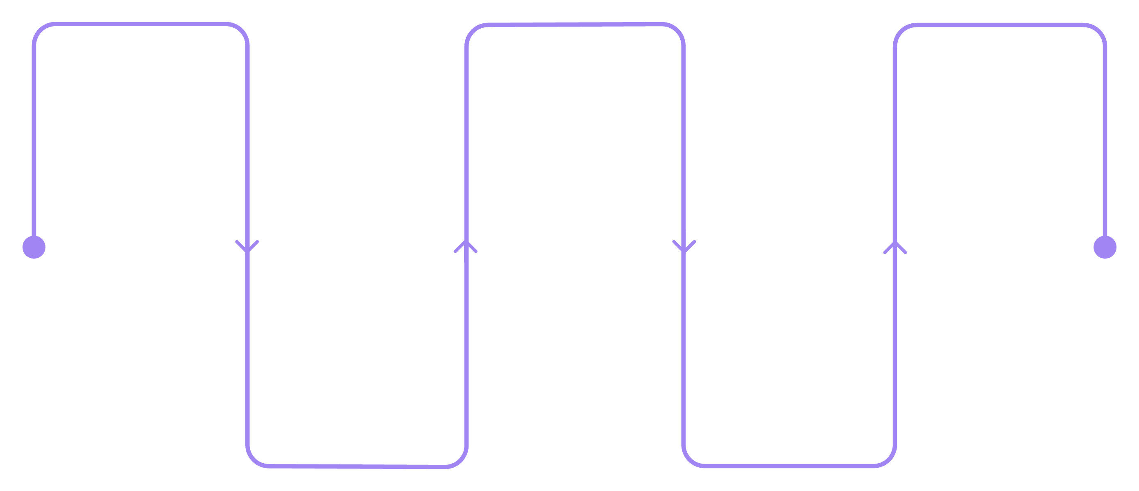
The CNN learns visual features before predicting 43 classes
Input
Max Pooling
Softmax
64×64×3 image
Reduce feature-map dimensions
Probabilities for 43 classes
Convolution
Dense Layers
Learn edges, shapes, colours
Learn class-specific patterns
FEATURE EXTRACTION PRECEDES CLASS PREDICTION.
Notes:
The architecture moves from the image tensor to learned visual features, then to class patterns and probabilities. The five stages make explicit what the network does before the final 43-class prediction.

Slide 7
Hyperparameter tuning selected the final configuration
BASELINE.CONFIG
TUNED.CONFIG
Baseline
Best configuration
Convolution, pooling, dense layers
Dropout and early stopping
Learning-rate reduction
Keras Tuner Random Search tested eight combinations.
32 first-layer filters · 128 second-layer filters · 128 dense units
Dropout 0.4 · learning rate 0.001 · batch size 16
Notes:
The baseline established the training controls. Keras Tuner Random Search then tested eight combinations, selecting the configuration with 32 and 128 convolution filters, 128 dense units, dropout 0.4, learning rate 0.001, and batch size 16.

Slide 8
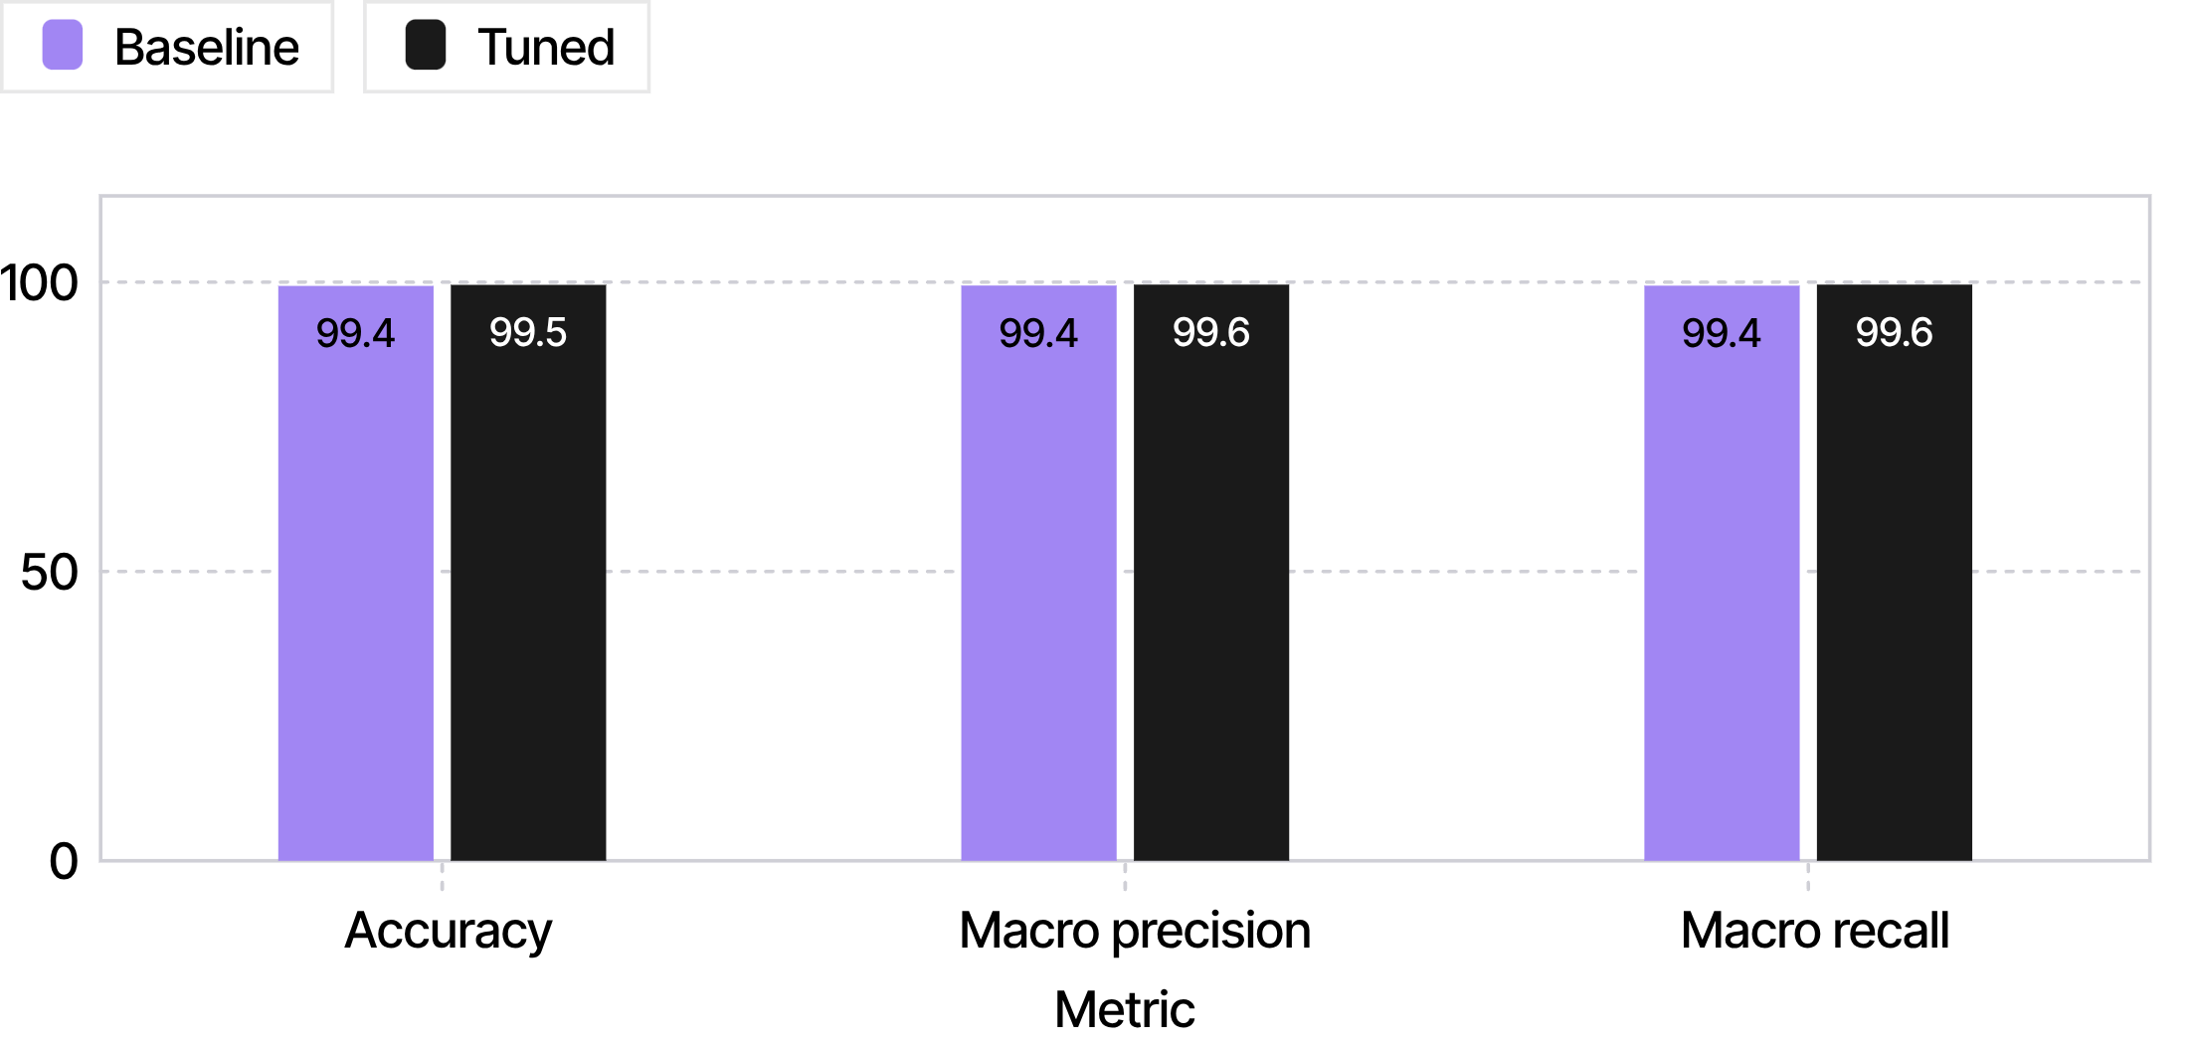
The tuned CNN reached 99.53% test accuracy
MODEL_COMPARISON.PLT
TUNED MODEL
99.53%
TEST ACCURACY
+0.18 PERCENTAGE POINTS
MACRO PRECISION: 99.41% → 99.57% · MACRO RECALL: 99.39% → 99.57%
Notes:
The tuned model improves every reported test metric. Accuracy rises from 99.35% to 99.53%, while macro precision and macro recall both reach 99.57%.

Slide 9
ERROR_ANALYSIS.LOG
Reliable at scale.
Still worth inspecting.
11
2,308
2,319
TEST IMAGES REVIEWED
MISCLASSIFIED IMAGES
CLASSIFIED CORRECTLY
CLASSIFICATION REPORTS · CONFUSION MATRIX · PER-CLASS F1-SCORES · VISUAL INSPECTION
Notes:
Error analysis combined classification reports, a confusion matrix, per-class F1-scores, and visual inspection. Of 2,319 test images, 2,308 were classified correctly and 11 were misclassified.

Slide 10
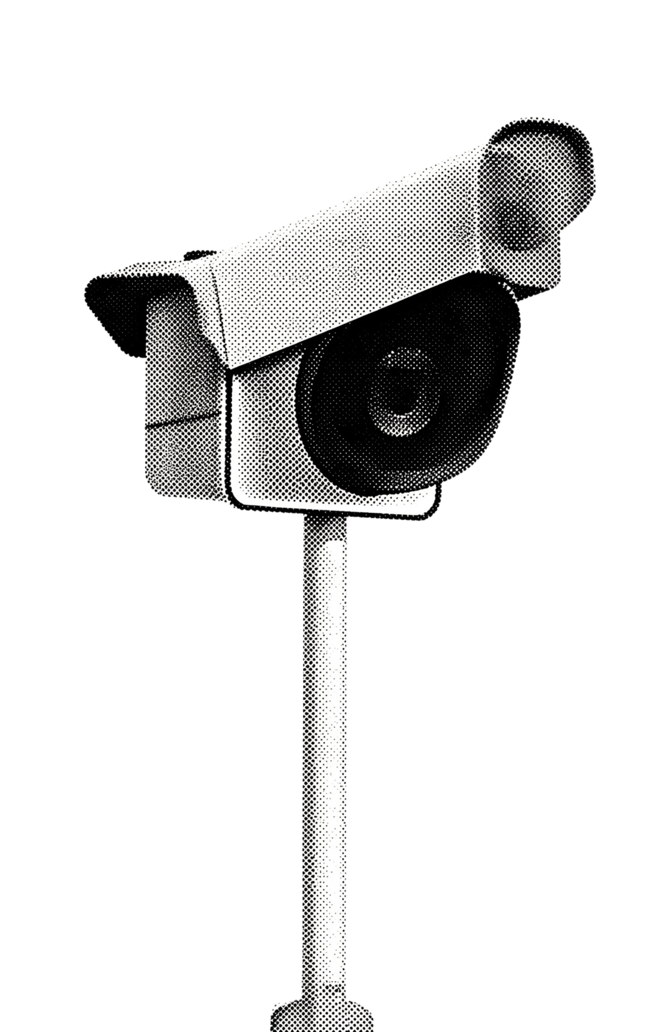
REUSABLE INFERENCE / FUTURE SCOPE
The project is reusable today and extensible tomorrow
PREDICT_SIGN().PY
predict_sign() preprocesses an image and returns the predicted sign, confidence, and top-three candidates.
TrafficSign_CNN_Model.keras
TrafficSign_class_names.json
Future scope
Live camera input · full-scene object detection · web/mobile deployment · broader real-world validation
Notes:
The project already exposes a reusable prediction function and saved model artifacts. The next extensions are live camera input, full-scene object detection, web or mobile deployment, and broader validation in real-world conditions.

