Slide 1

PRAICP-1004: Rainfall Time Series Forecasting
Artificial Intelligence capstone: monthly rainfall at Changi Climate Station (1982–2020). 462 monthly observations. Objective: produce reliable forecasts for the next 12 months — both total monthly rainfall and the highest daily rainfall per month.

Slide 2

Problem Statement & Objectives
Primary objectives
Supporting goals
1) Forecast total monthly rainfall for next 12 months. 2) Forecast highest single-day rainfall within each month for the same horizon.
Conduct EDA, preprocess time-series data, engineer features, compare statistical and ML models, tune the best model, and extract business insights.
Audience use-cases
Reservoir management, flood preparedness, infrastructure planning and seasonal resource allocation.

Slide 3

Data & Ingestion
Files merged
rainfall-monthly-total.csv — total monthly rainfall
rainfall-monthly-highest-daily-total.csv — monthly max daily rainfall
rainfall-monthly-number-of-rain-days.csv — rainy days per month
Process: extract ZIP → read CSVs → merge on month → convert month → datetime → sort → set monthly DateTime index (freq = M).

Slide 4

Data Quality Checks (cell-wise)
01
02
Initial inspection
Integrity checks
head(), tail(), shape, columns, dtypes, info() and describe() to validate format and value ranges.
Missing values, duplicates, start/end dates and expected monthly calendar comparison (no missing months detected).
03
Decision
No imputation required — chronological continuity verified, proceed to EDA and feature engineering.

Slide 5
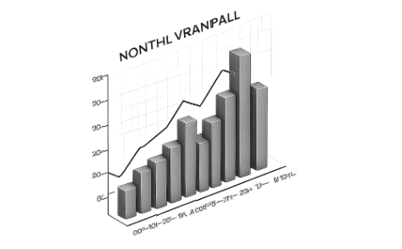
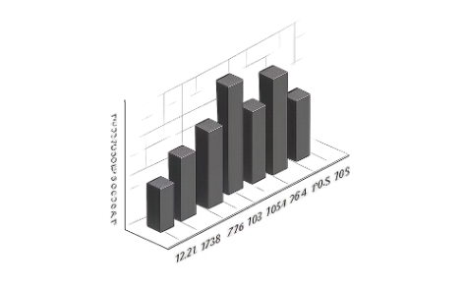
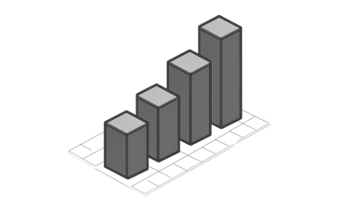
Exploratory Data Analysis — Key Visuals
Historical trend
Seasonality
Distributions
Monthly total rainfall vs time — reveals long-term trend, seasonality and extreme events (spikes).
Average by calendar month — confirms a 12-month repeating seasonal pattern (monsoon cycles).
Histograms for total, max-daily and rainy-day counts show skew and frequency of extreme values.

Slide 6
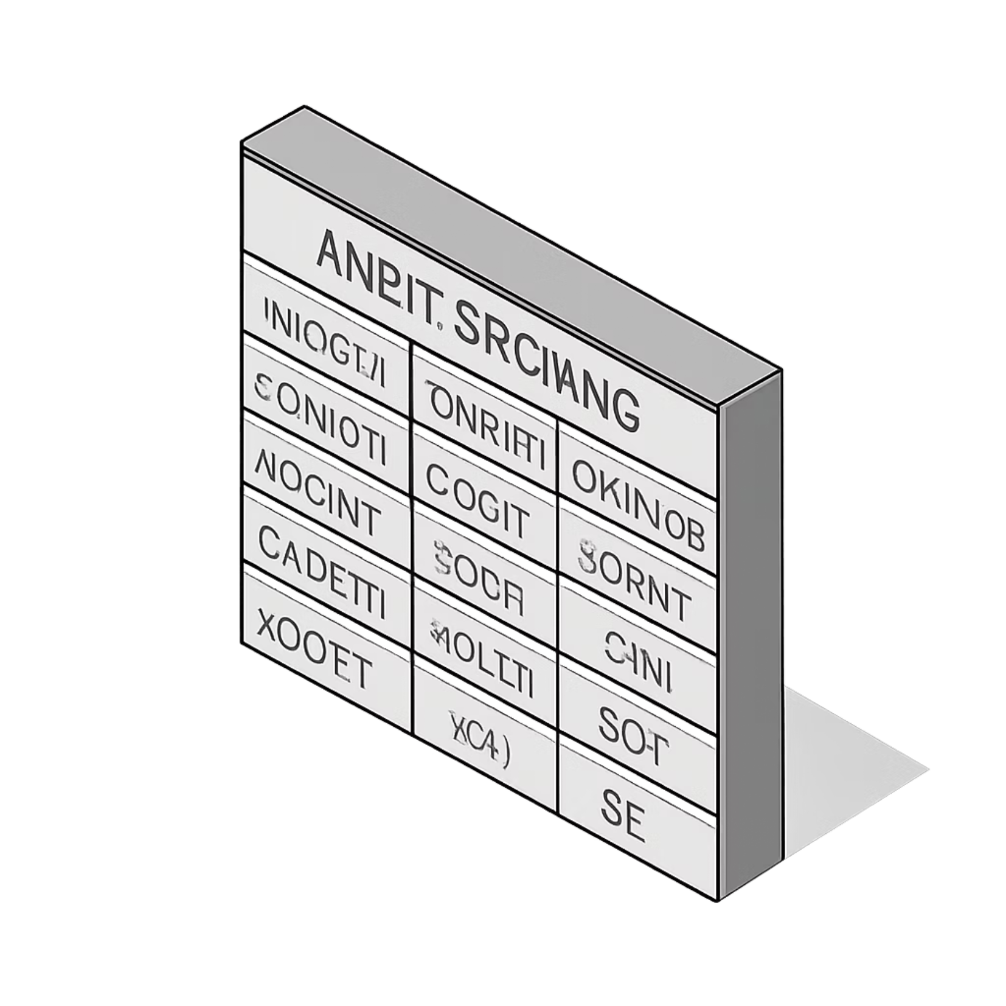

Decomposition & Stationarity
Stationarity check
Augmented Dickey–Fuller (ADF) test used to assess stationarity. If non-stationary, apply differencing prior to SARIMA or use trend-removal for ML features.
Observed
Trend
Seasonality
Residual
The decomposition isolates long-term trend, repeating 12-month seasonality and residual noise for model selection.

Slide 7



Feature Engineering for ML
1
2
Time features
Lag features
month_num, year — encode seasonal position and long-term progression.
lag_1, lag_2, lag_3, lag_12 — capture short-term autocorrelation and yearly seasonality.
3
Rolling statistics
rolling_mean_12 — smooths past year behaviour to provide stable seasonal context.

Slide 8



Models & Evaluation Strategy
Evaluation & Tuning
Chronological train/test split (no shuffle). Metrics: MAE, RMSE, R². Hyperparameter tuning with GridSearchCV using TimeSeriesSplit to avoid leakage.
SARIMA
Seasonal statistical model (captures AR, I, MA + seasonality). Strong candidate given 12-month cycle.
ML regressors
Linear Regression, Random Forest, Gradient Boosting, XGBoost — use engineered features to predict next-step values.

Slide 9



Multi-step Forecasting Approaches
SARIMA (direct multi-step)
Refit on full history and forecast 12 future months directly from the model’s seasonal structure.
ML: Recursive forecasting
One-step model used recursively: predict month t+1 → feed prediction as lag to produce t+2 … until month t+12. Be aware of error accumulation.

Slide 10

Results, Business Insights & Next Steps
Key findings
Business impact
Future enhancements
SARIMA captured seasonal cycles most reliably; ML models offered flexible nonlinear fits but required careful recursive forecasting and tuning.
Use forecasts for reservoir management, flood preparedness, infrastructure scheduling and seasonal planning. Highest-daily forecasts support flash-flood risk mitigation.
Move to daily data, add external climate indices (ENSO), automate pipeline and retrain models, deploy forecasting API for operational use.
Viva-ready summary: Load → Preprocess → EDA → Stationarity & decomposition → Feature engineering → SARIMA + 4 ML models → TimeSeriesSplit tuning → 12-month forecasts (totals + highest daily)

