Slide 1
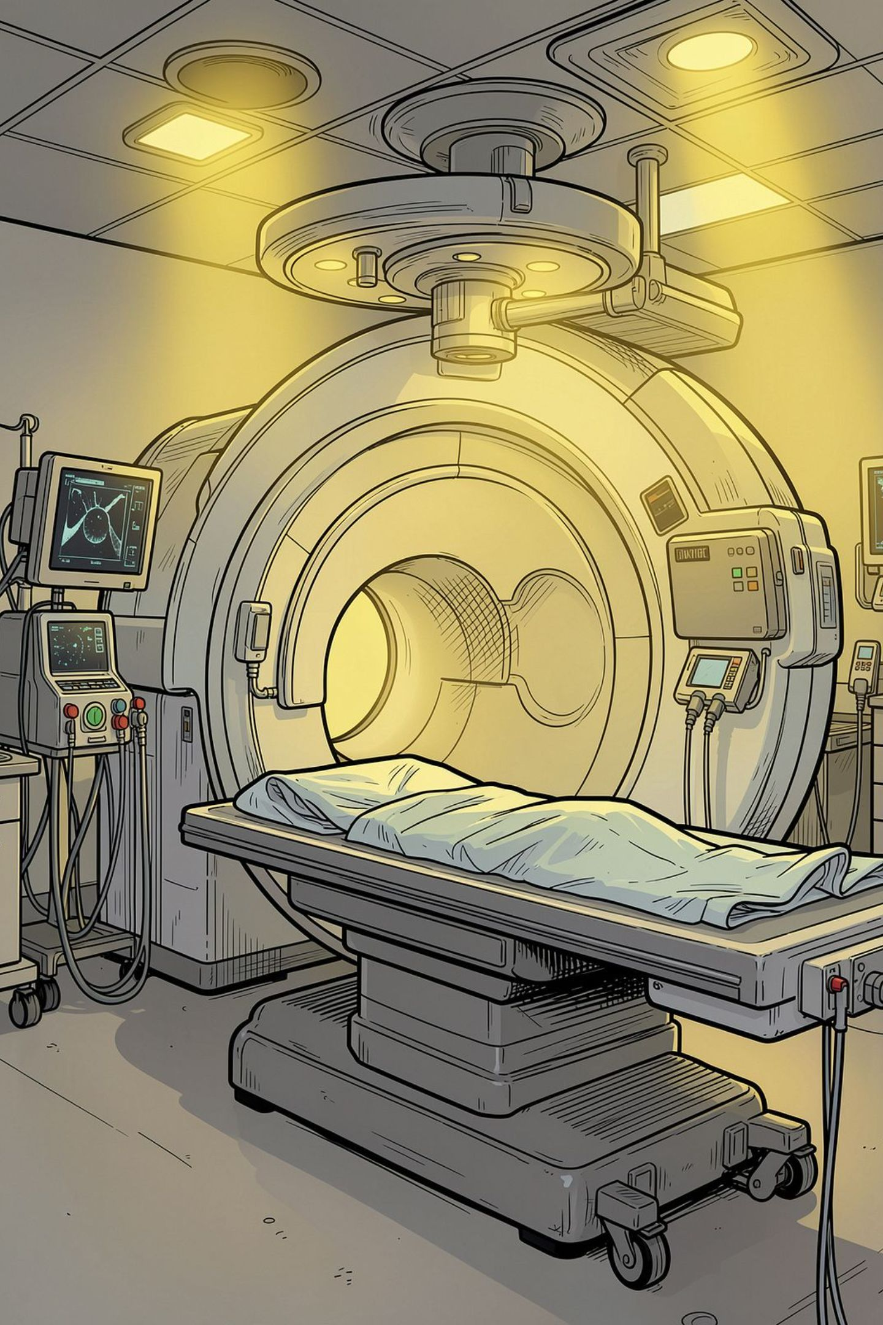
Automated Pneumonia Detection from Chest X‑rays
Practical guide and results from PRAICP-1012: building, comparing, and selecting CNN models to classify chest X‑rays as NORMAL or PNEUMONIA. Audience: ML practitioners & data scientists in medical imaging.

Slide 2
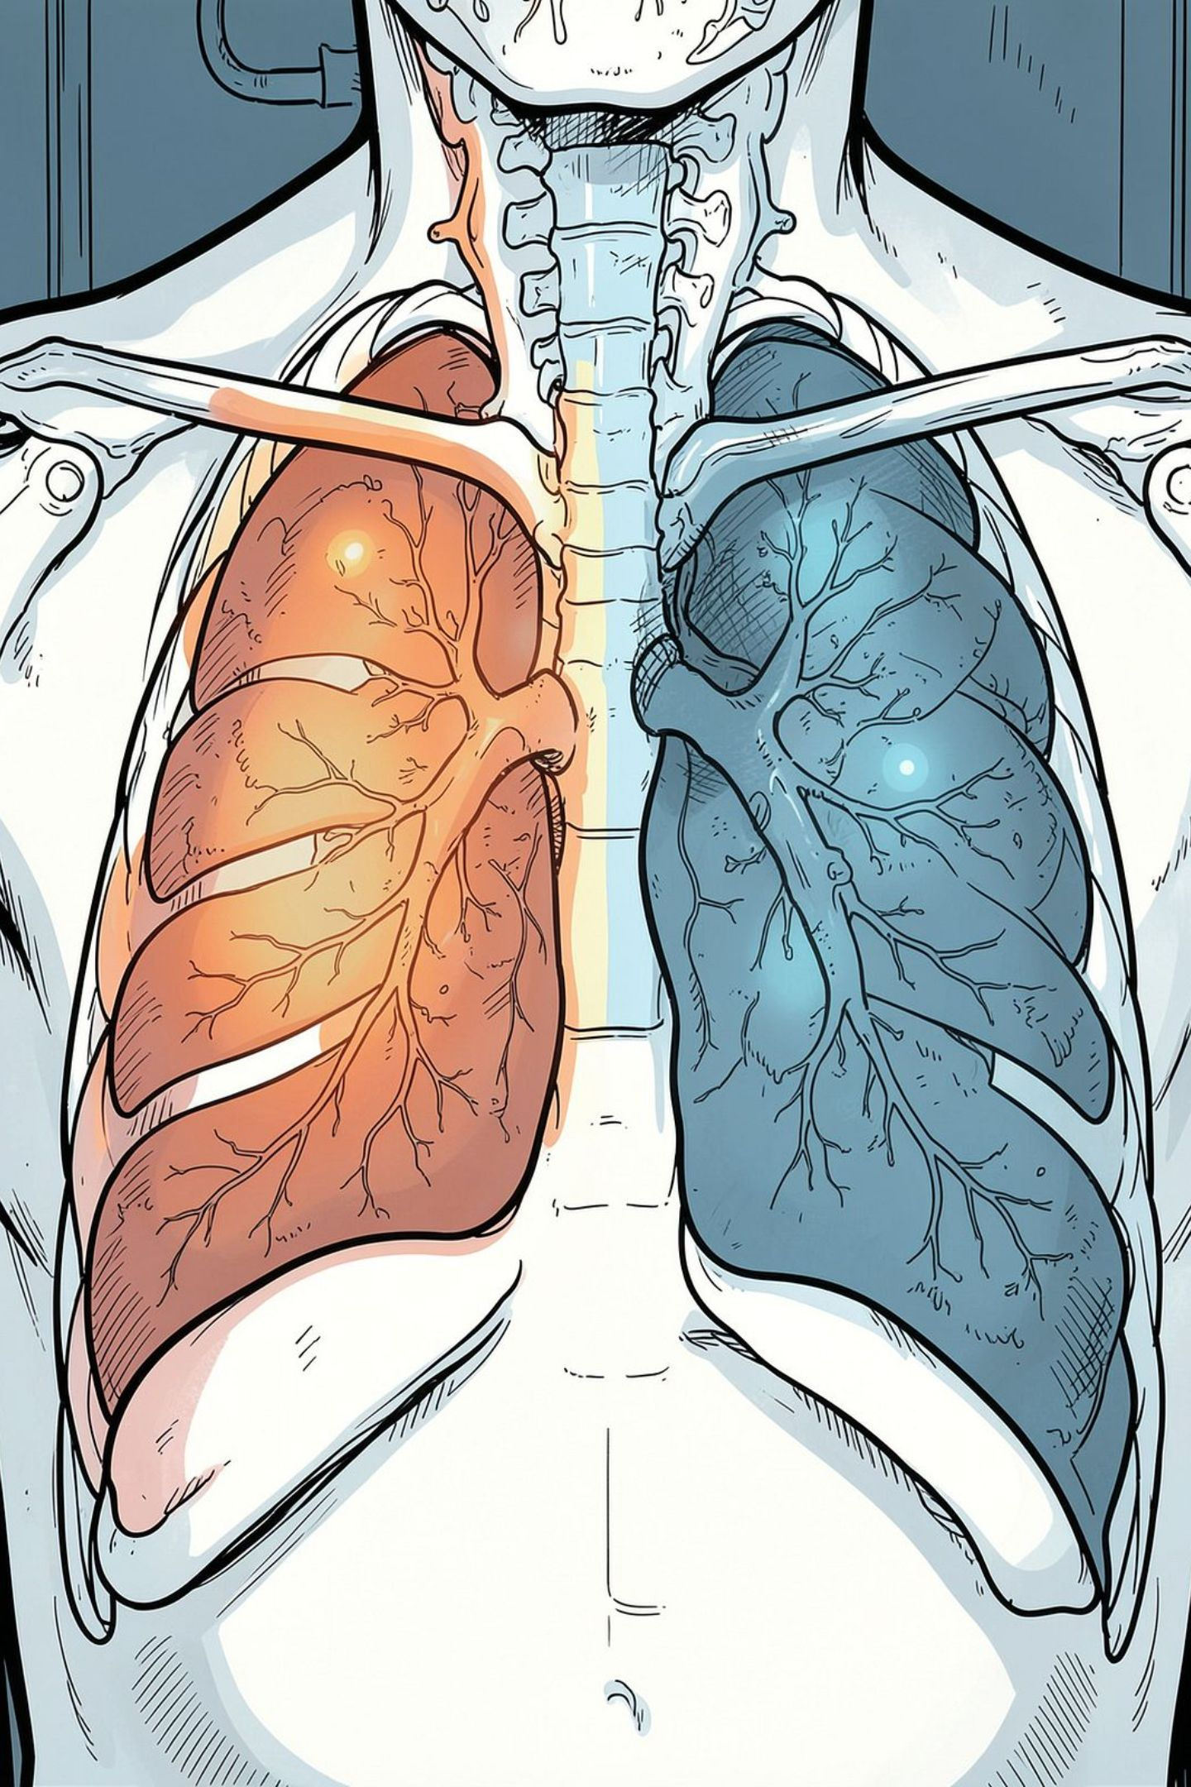

Problem & Objective
Problem: Radiologist-dependent pneumonia diagnosis is time-consuming and variable. Objective: Develop a CNN pipeline to classify X‑rays as NORMAL or PNEUMONIA, compare multiple model families, and select a production-ready model prioritizing clinical safety (Recall).
Primary metric: Recall (minimize missed pneumonia cases).

Slide 3
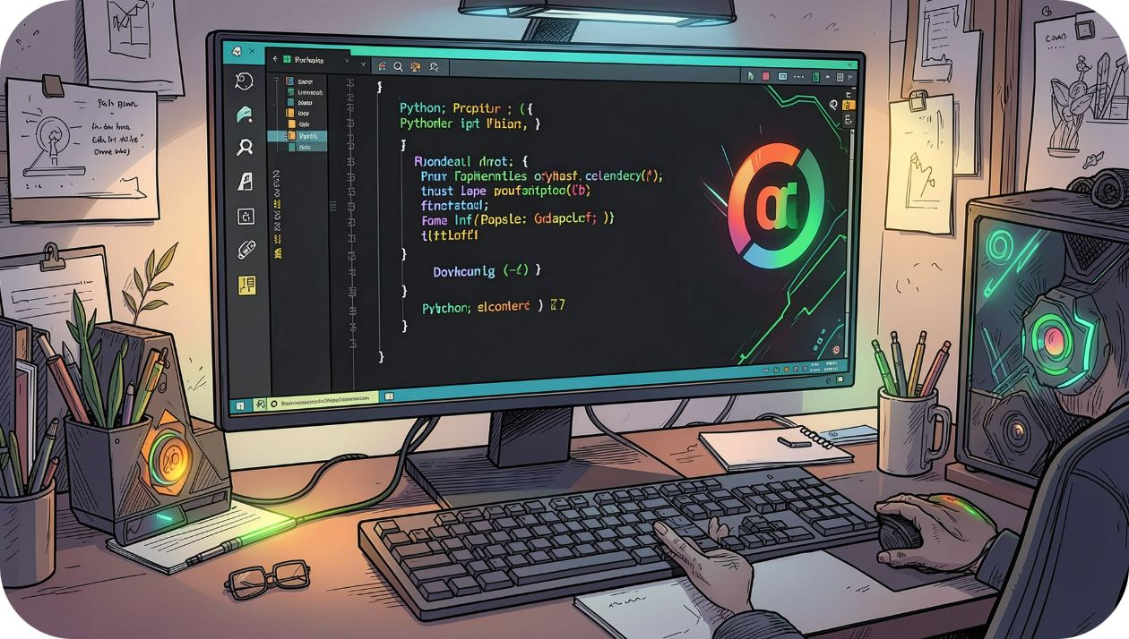
Libraries & Runtime Checks
Core tools loaded in the notebook:
TensorFlow / Keras — model building & training
PIL / OpenCV — image I/O & preprocessing
NumPy / Pandas — data handling
Matplotlib / Seaborn — EDA & plots
scikit‑learn — metrics, confusion matrix, ROC
Also: GPU availability check — strongly recommended for training speed and reproducibility.

Slide 4
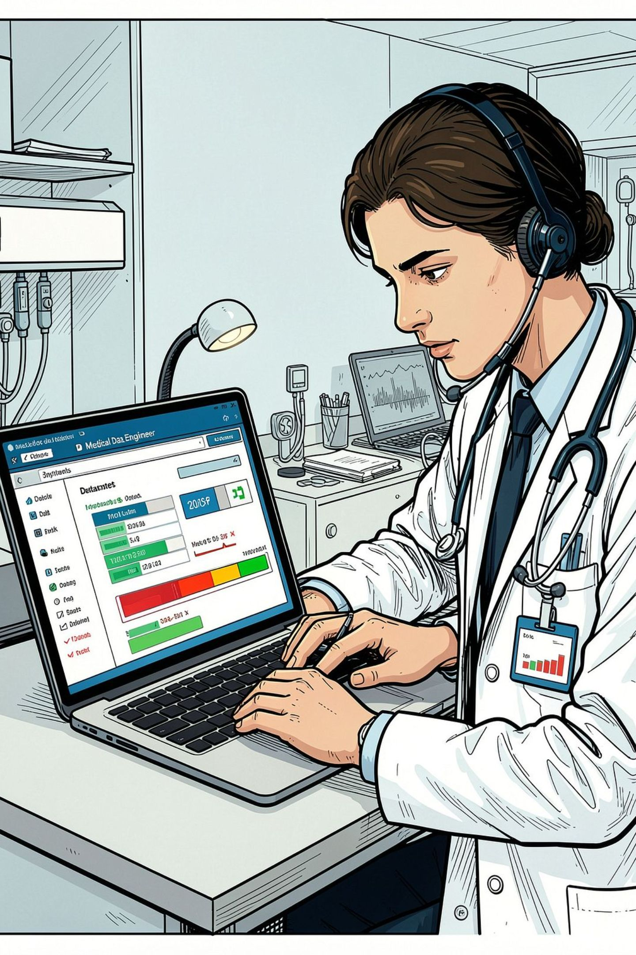
Dataset Upload & Domain Analysis
Actions taken:
Download & extract ~1.5GB chest X‑ray dataset; detect standard folder layout: train / val / test with NORMAL and PNEUMONIA subfolders.
Domain note: Pneumonia appears as localized or diffuse white opacities; CNNs can learn these visual patterns if data is well preprocessed.

Slide 5
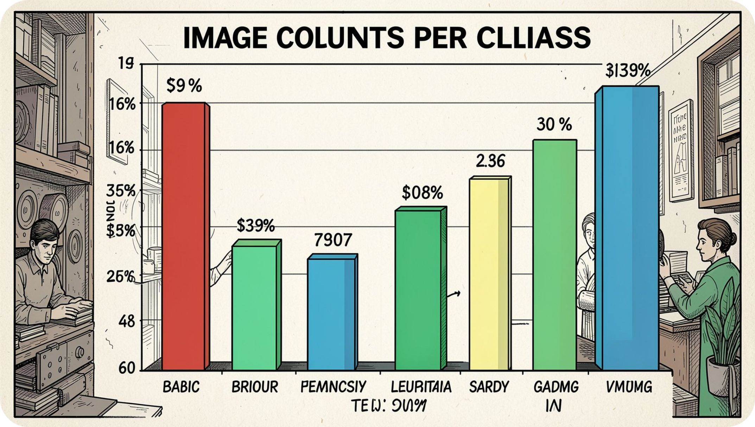
Basic Sanity Checks
Checks performed:
Class counts by split (train/val/test)
Detect corrupted/unreadable files and remove them
Assess class imbalance → compute class weights for training
Outcome: Imbalance present; class weights and augmentation planned to compensate.

Slide 6
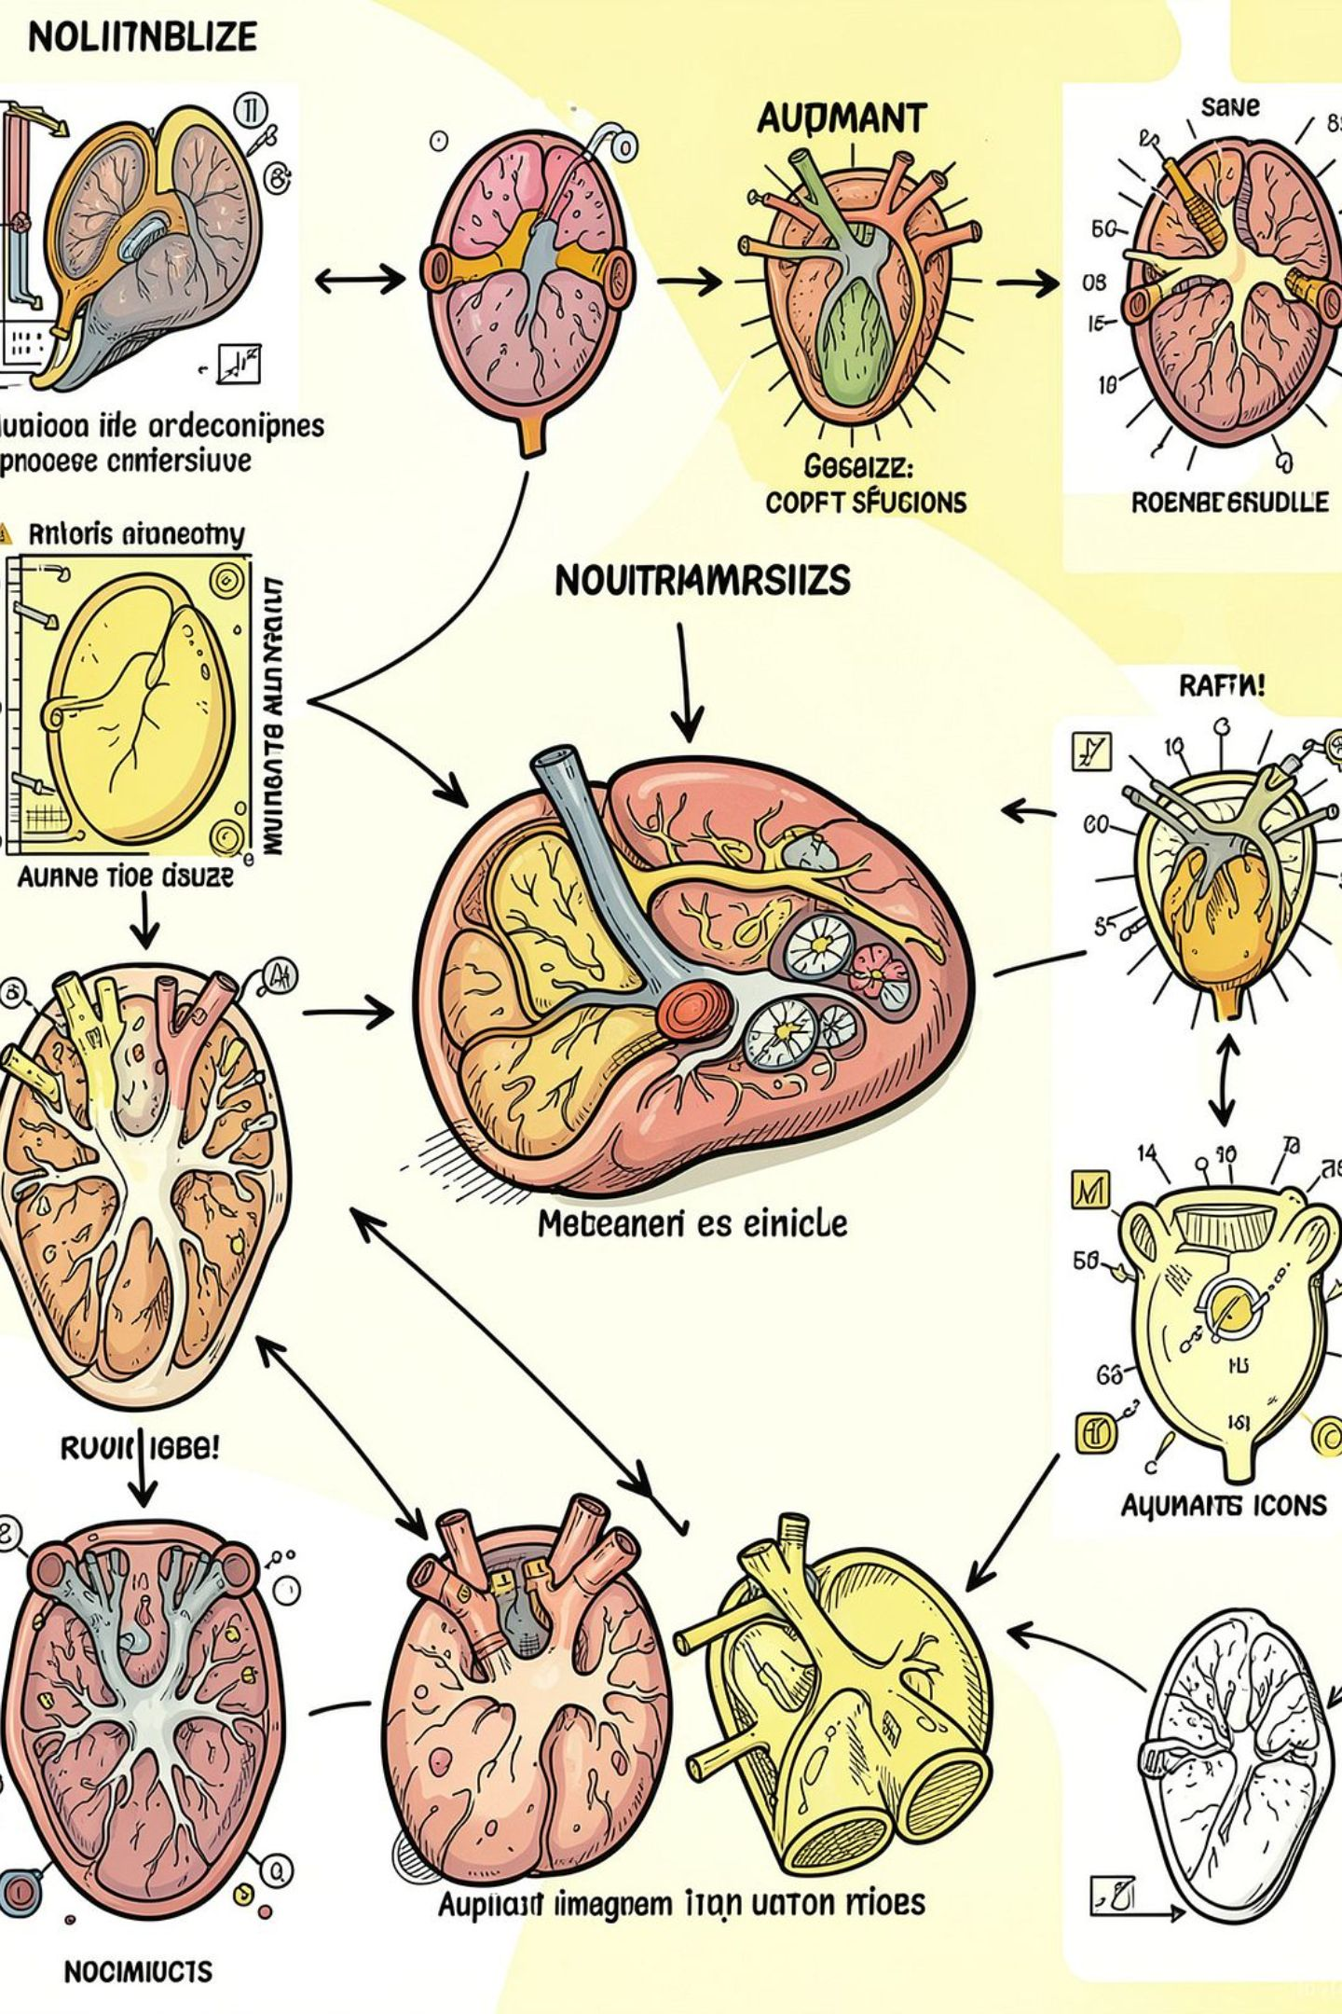

Data Preprocessing
Pipeline steps:
Resize images to 150×150px and rescale pixel values to [0,1].
Training-only augmentation: random rotations, zoom, horizontal flips to improve generalization.
Compute and apply class weights during training to reduce bias toward majority class.
Keep augmentation realistic for X‑rays — avoid transforms that alter clinical markers (no color shifts, conservative rotations).

Slide 7
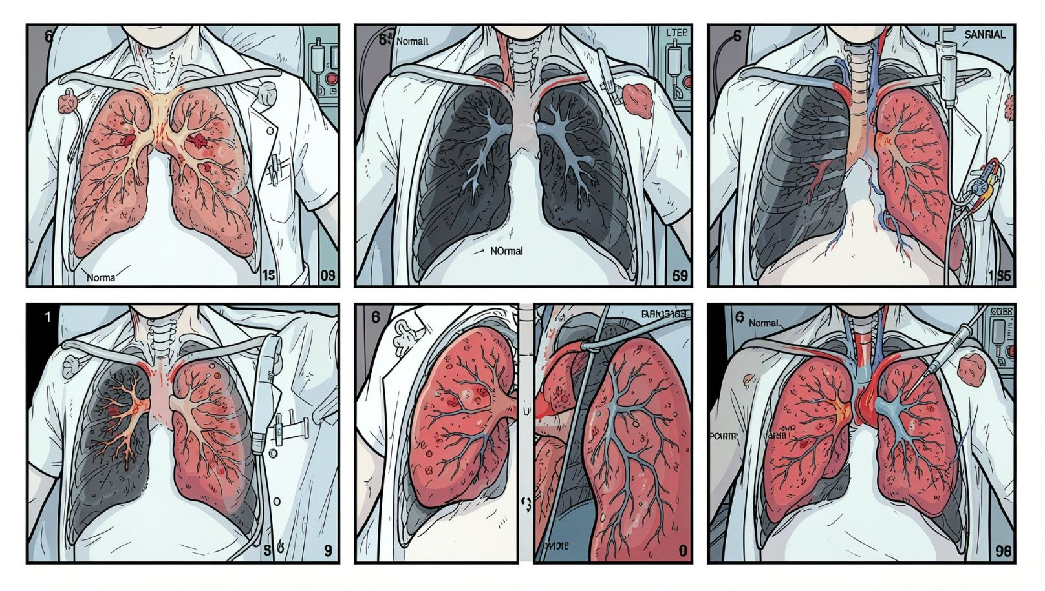
Exploratory Data Analysis (EDA)
Key EDA visuals:
Class-count bar chart across train/val/test (verifies splits)
Sample images per class to inspect visual patterns
Distribution of original image dimensions — justifies fixed resize
Average-image comparison (NORMAL vs PNEUMONIA) highlighting opacity differences
Insight: Visual differences are consistent and learnable; preprocessing preserves critical features.

Slide 8
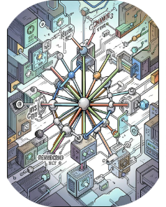
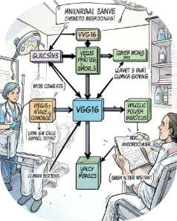
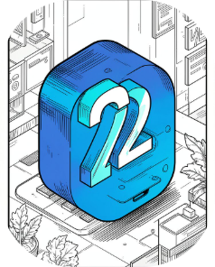
Modeling Strategy — Models Trained
Custom CNN
VGG16 (Transfer Learning)
MobileNetV2 (Transfer Learning)
Several conv + pooling layers trained from scratch. Useful baseline; more parameters but tailored to dataset size.
Frozen ImageNet encoder + new dense head. Data‑efficient, strong feature extractor for texture-based medical patterns.
Lightweight, fast inference—good candidate for edge deployment or low-resource hospitals.
Training tactics: EarlyStopping and ReduceLROnPlateau callbacks for efficient convergence and overfitting control.

Slide 9


Fine‑Tuning & Hyperparameter Notes
Approach:
Choose top-performing transfer-learning model from initial runs.
Unfreeze a few higher layers and retrain with a very small LR to adapt filters to X‑ray characteristics.
Monitor validation Recall and ROC‑AUC; use early stopping to avoid catastrophic forgetting.
Select Model
Unfreeze Layers
Retrain Low LR
Fine-tuning typically yields modest but clinically meaningful gains when dataset is medium-sized.

Slide 10
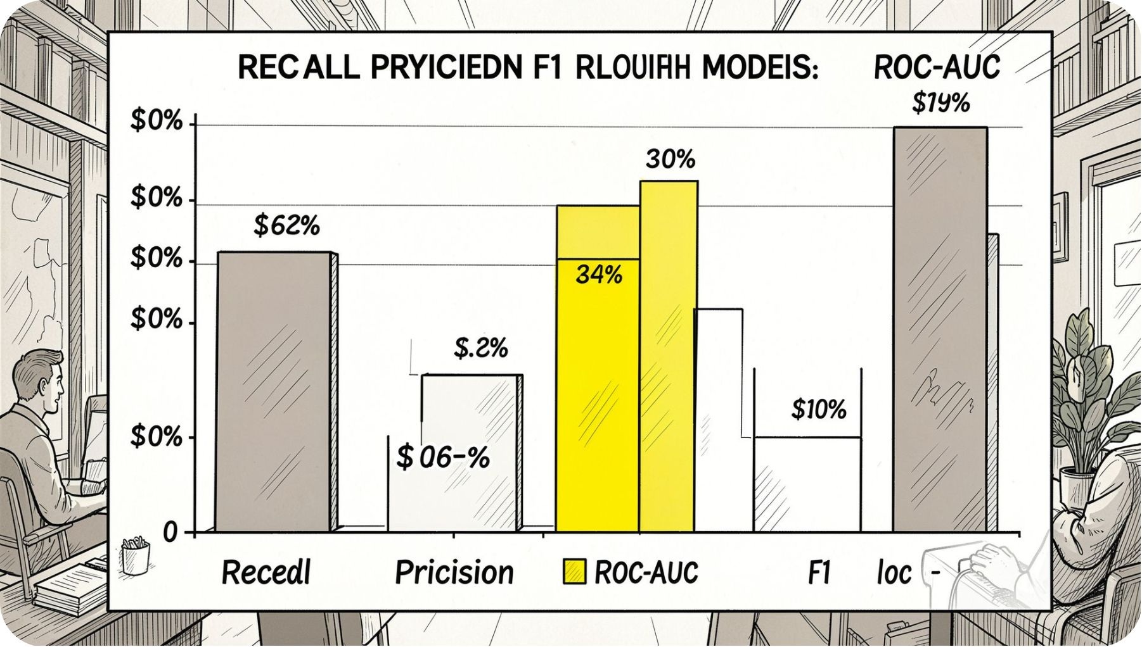
Model Comparison & Final Recommendation
Comparison highlights (sorted by Recall):
Fine‑tuned transfer model: Highest Recall and ROC‑AUC — recommended primary screening model.
MobileNetV2: Near-top performance, much faster inference — recommended for edge deployment.
VGG16: Strong baseline but heavier; good for server-side inference.
Custom CNN: Useful baseline; often lower generalization without more data or regularization.
Final recommendation: Deploy the fine‑tuned transfer model as clinical triage (first‑pass). Use MobileNetV2 variant where compute is constrained. Continue monitoring Recall and false positive rates in real deployments.

