Slide 1
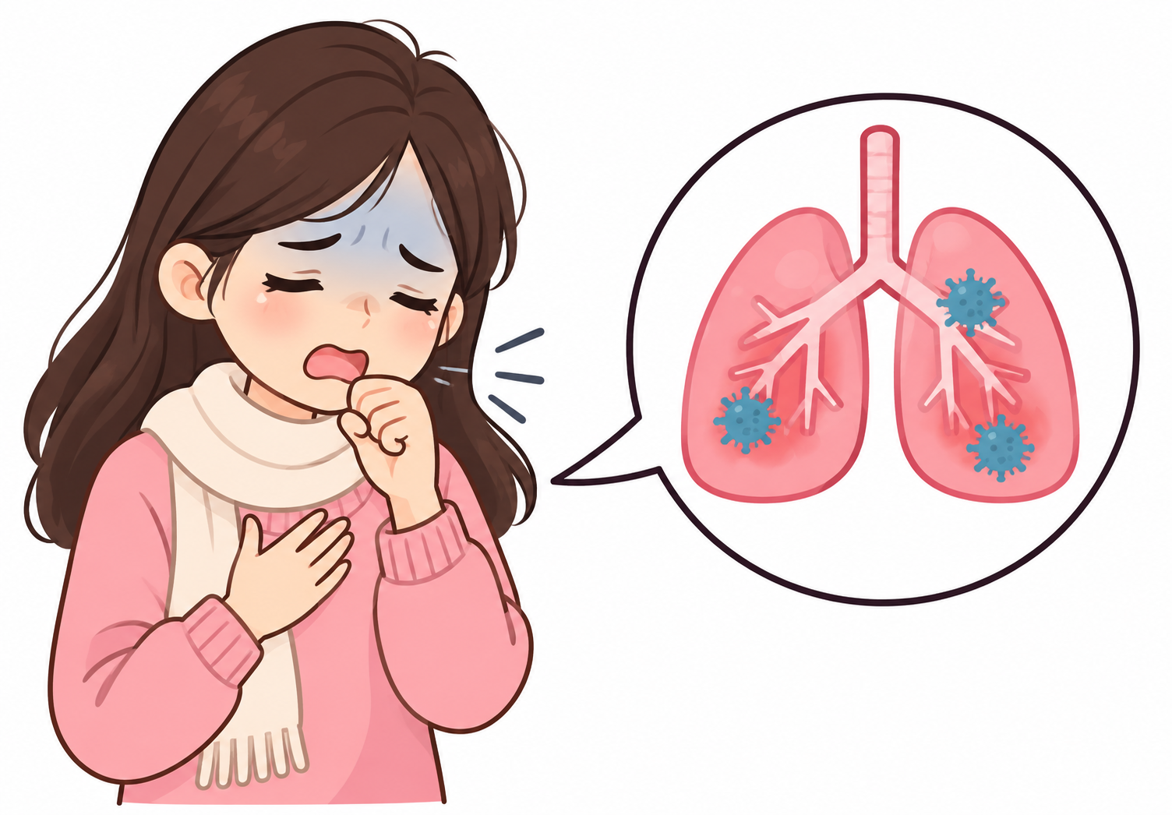
Pneumonia Detection from Chest X-Ray Images Using
Convolutional Neural Networks (CNN)
Artificial Intelligence Capstone Project – PRAICP-1012
Submitted By: Sameeksha

Slide 2
TABLE OF CONTENTS
1. Problem Statement
2. Dataset Overview
3. Class Categories
4. Project Workflow
5. Exploratory Data Analysis (EDA)
6. Image Preprocessing
7. Train–Validation–Test Split
8. Data Augmentation
9. Deep Learning Models (CNN, VGG16 & MobileNetV2)
10. CNN Architecture
11. Transfer Learning & Fine-Tuning
12. Challenges Faced
13. Model Comparison
14. Best Model Selection
15. Applications
16. Future Scope
17. Conclusion
18. Model Output & Predictions

Slide 3
1. PROBLEM STATEMENT
1. Problem Statement
  Pneumonia is diagnosed by a radiologist visually inspecting a chest X-ray for areas of increased lung opacity.
  Manual screening is:
    Time-consuming
    Dependent on radiologist availability
    Subject to inter-observer variability
2. Project Goal – Develop a CNN-based image classification system to automatically detect Pneumonia from chest X-ray images.
3. Objectives
  Analyze the chest X-ray dataset
  Build deep learning classification models
  Apply image augmentation and class-weighting techniques
  Compare multiple CNN models
  Select the best-performing model, prioritizing Recall

Slide 4
2. DATASET OVERVIEW
1. Dataset Information
  Total Images: ~5,863
  Classes: 2 (NORMAL, PNEUMONIA)
  Splits: train / val / test folders
  Dataset Type: Imbalanced (more PNEUMONIA than NORMAL)
2. Class Categories
  NORMAL
  PNEUMONIA
3. Dataset Characteristics
  Grayscale X-ray images (loaded as RGB)
  Different image resolutions
  No corrupted images (verified)
4. Challenge
  Class imbalance and a very small original validation split
5. Dataset Link: DataMites Capstone Project Dataset (Chest-Xray-2.zip)

Slide 5
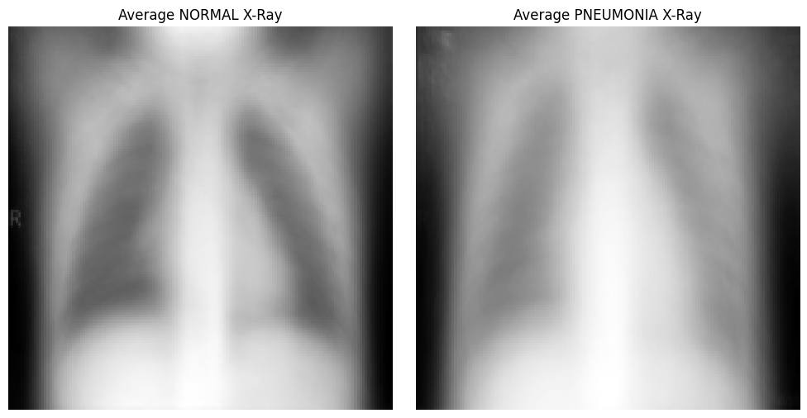
3. CLASS CATEGORIES
Chest X-Ray Classes
1. NORMAL
  Clear, dark (air-filled) lung fields
  Well-defined vascular markings
2. PNEUMONIA
  Areas of increased opacity (whiteness) in the lung fields
  Caused by fluid / inflammatory exudate filling the alveoli
  Can be subtle, localized, or affected by patient positioning

Slide 6
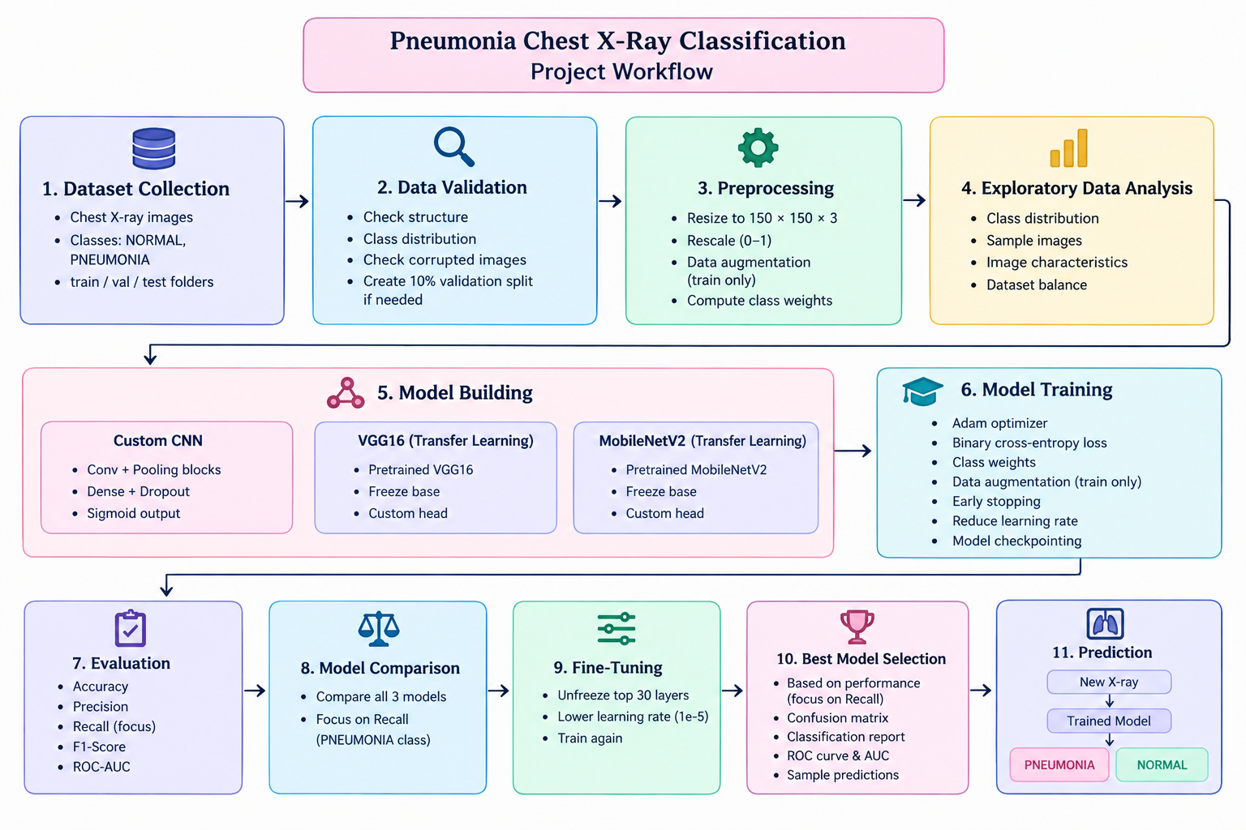
4. PROJECT WORKFLOW
Project Pipeline
Download & Extract Dataset
Auto-detect Train / Val / Test Folders
Basic Checks (class counts, corrupt images)
Image Preprocessing & Augmentation
Compute Class Weights
Exploratory Data Analysis (EDA)
Build CNN, VGG16 & MobileNetV2 Models
Train & Validate Models
Evaluate on Test Set
Fine-Tune Best Transfer Model
Compare Models & Select Best
Predict Pneumonia vs Normal

Slide 7
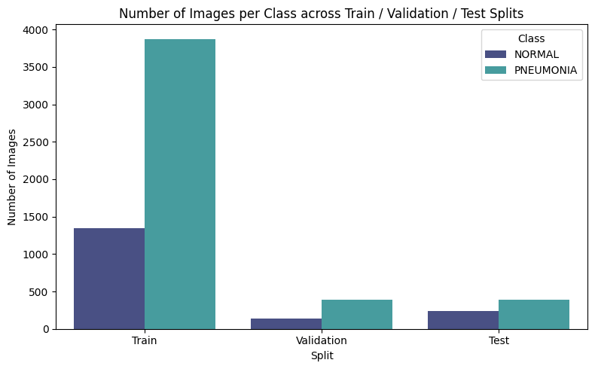
5. EXPLORATORY DATA ANALYSIS (EDA)
1. Dataset Analysis
  Performed detailed dataset analysis before model training.
2. Analysis Performed
  Class distribution across splits
  Sample image visualization
  Image dimension distribution
  Average pixel-intensity comparison (NORMAL vs PNEUMONIA)
  Corrupted image detection
3. Findings
  Class imbalance (more PNEUMONIA images)
  Image dimensions vary — resizing required
  Visible opacity/texture difference between classes

Slide 8
6. IMAGE PREPROCESSING
1. Image Preprocessing Steps
  Download & extract dataset archive
  Auto-detect NORMAL / PNEUMONIA class folders
  Resize all images to 150 × 150
  Load images as 3-channel RGB
  Rescale pixel values between 0 and 1
  Stream images in batches via ImageDataGenerator
2. Purpose – To create a clean, standardized, memory-efficient dataset for CNN training.

Slide 9
7. TRAIN–VALIDATION–TEST SPLIT
1. Dataset Splitting
  Train / Test folders provided by the dataset structure
  Original validation folder too small (~16 images)
  Validation Set: auto-generated as 10% of training data
2. Why Split the Dataset?
  Training: learn image patterns
  Validation: tune model performance / early stopping
  Testing: evaluate final, unbiased performance
3. Class Weights
  Computed on the training set (‘balanced’) to counter class imbalance

Slide 10
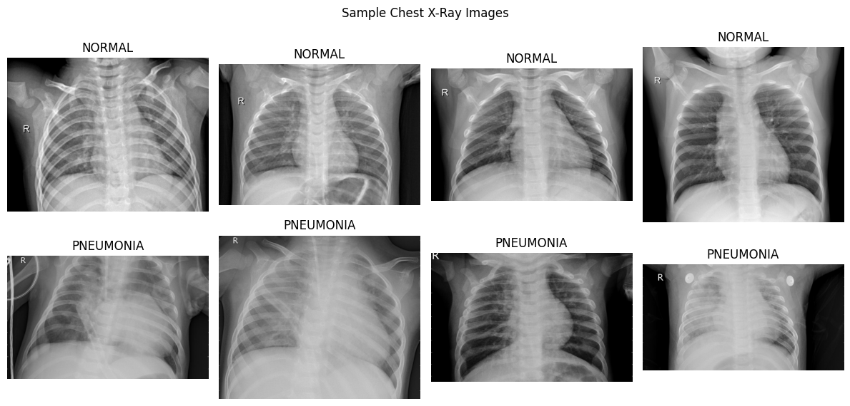
8. DATA AUGMENTATION
1. Why Data Augmentation?
  The training set is imbalanced and limited in size.
  Augmentation increases image diversity and reduces overfitting.
2. Techniques Used
  Rotation (±10°)
  Width Shift
  Height Shift
  Shear
  Zoom
  Horizontal Flip
  Rescaling
3. Not Used – Vertical Flip (unrealistic chest X-ray orientation)

Slide 11
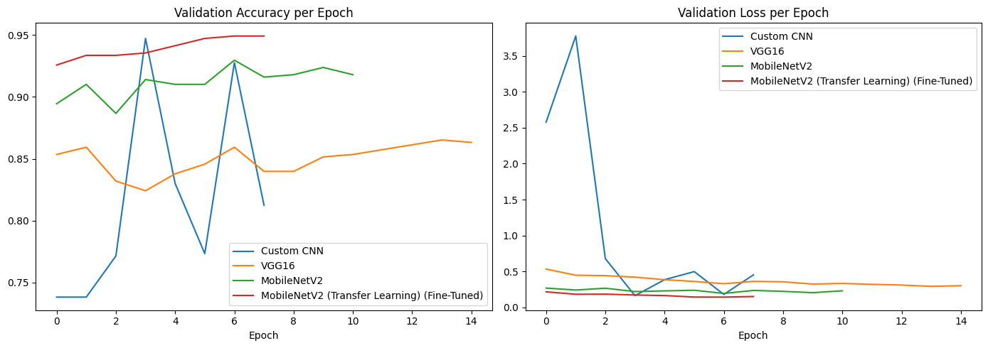
9. MODELS USED
Three Deep Learning Models
1. Model 1 – Custom CNN
  Built from scratch
  Benchmark model
  Learns features directly from training images
2. Model 2 – VGG16
  Transfer Learning, pretrained on ImageNet
  High accuracy, larger model size
3. Model 3 – MobileNetV2
  Transfer Learning, lightweight architecture
  Fast inference, suitable for edge / mobile deployment

Slide 12
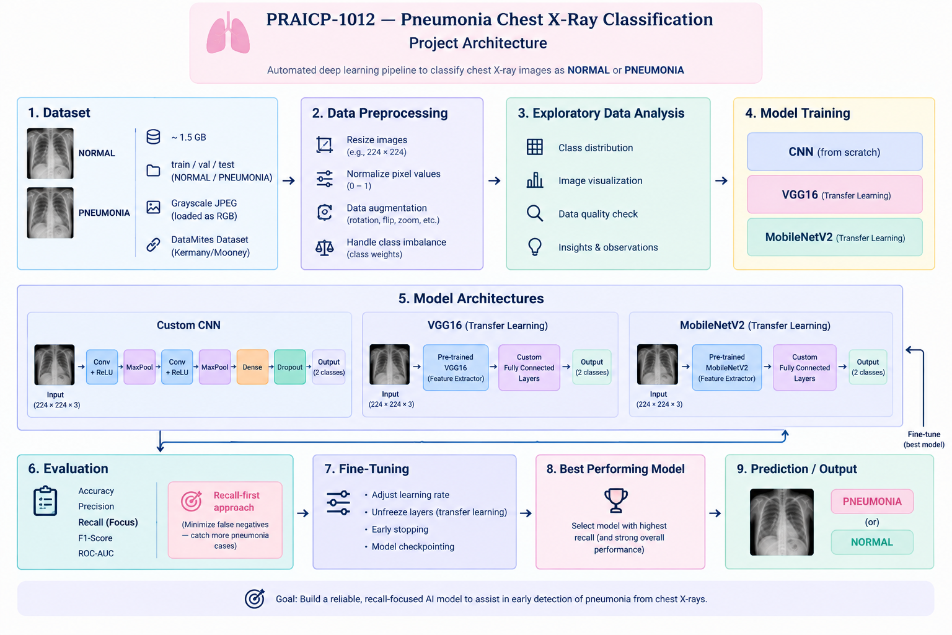
10. CNN ARCHITECTURE

Slide 13
11. TRANSFER LEARNING & FINE-TUNING
1. Why Transfer Learning?
  The chest X-ray dataset is small relative to ImageNet.
  Training deep CNNs from scratch risks overfitting.
  Pretrained ImageNet models improve performance and training speed.
2. Benefits
  Faster training
  Better feature extraction
  Higher accuracy
  Reduced overfitting
3. Fine-Tuning Strategy
  Unfreeze the top 30 layers of the best transfer model
  Retrain with a much smaller learning rate (1e-5)

Slide 14
12. CHALLENGES FACED
1. Challenges
2. Solutions
Large dataset size (~1.5 GB)
Class imbalance
Very small original validation split
Risk of overfitting on a domain-specific dataset
Varying image resolutions
Streamed images via flow_from_directory generators
Computed balanced class weights
Auto-generated a validation split (10% of train)
Data augmentation, Dropout, BatchNorm, EarlyStopping
Resized every image to a fixed 150×150 input

Slide 15
13. MODEL COMPARISON
MODEL | ADVANTAGE | LIMITATION
Custom CNN | Simple architecture, fast to train | Lower recall, more prone to overfitting
VGG16 | High accuracy, strong feature extraction | Large model size, slower inference
MobileNetV2 | Lightweight, fast, good accuracy | Slightly less capacity than VGG16
Fine-Tuned (Best) | Highest Recall on PNEUMONIA class | Needs longer, careful low-LR training

Slide 16
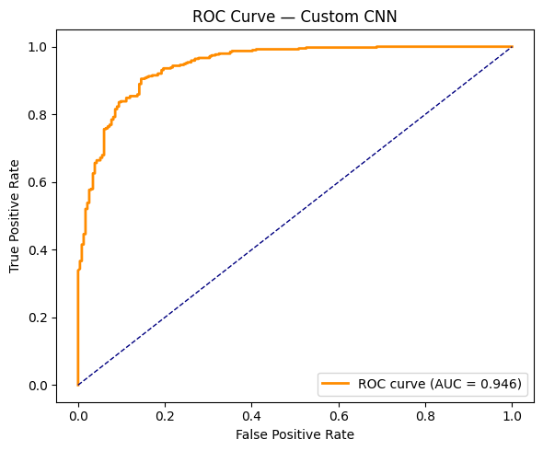
14. BEST MODEL SELECTION
Best Model: CNN
1. Reasons
  Highest Recall (Sensitivity) on the PNEUMONIA class
  Strong overall Accuracy, Precision, F1-Score and ROC-AUC
  Benefited from ImageNet-pretrained features + fine-tuning
  Good generalization on the held-out test set
  Practical for deployment as a screening-assistance tool

Slide 17
15. APPLICATIONS
1. Real-World Applications
Assistive radiology screening tool
Telemedicine & remote diagnosis support
Rural / low-resource clinic triage
Hospital workflow prioritization (flagging likely-positive cases)
Mobile / point-of-care diagnostic apps
Clinical decision-support systems

Slide 18
16. FUTURE SCOPE
1. Future Improvements
Collect larger, more diverse chest X-ray datasets
Extend to multi-class diagnosis (bacterial vs. viral pneumonia)
Add Grad-CAM / saliency maps for explainability
Validate on external, out-of-distribution datasets
Deploy as a web or mobile inference application
Explore ensemble methods across all trained models
Pursue clinical validation and regulatory review

Slide 19
17. CONCLUSION
Successfully developed a deep learning system for chest X-ray Pneumonia classification.
Performed data preprocessing, augmentation, class-weighting, and exploratory data analysis.
Built and compared three deep learning models: Custom CNN, VGG16 and MobileNetV2.
Fine-tuning the best transfer-learning model further improved Recall on the PNEUMONIA class.
Recall was prioritized over raw accuracy, reflecting the clinical cost of missed diagnoses.
The proposed solution can support faster, more consistent preliminary screening — assisting, not replacing, radiologists.

Slide 20
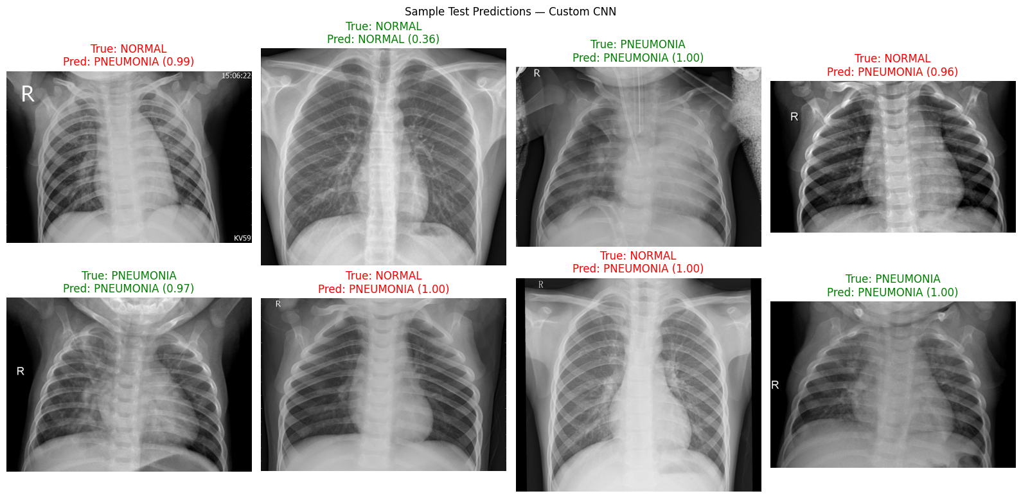
18. MODEL OUTPUT & PREDICTIONS

Slide 21
THANK YOU!!

