Slide 1
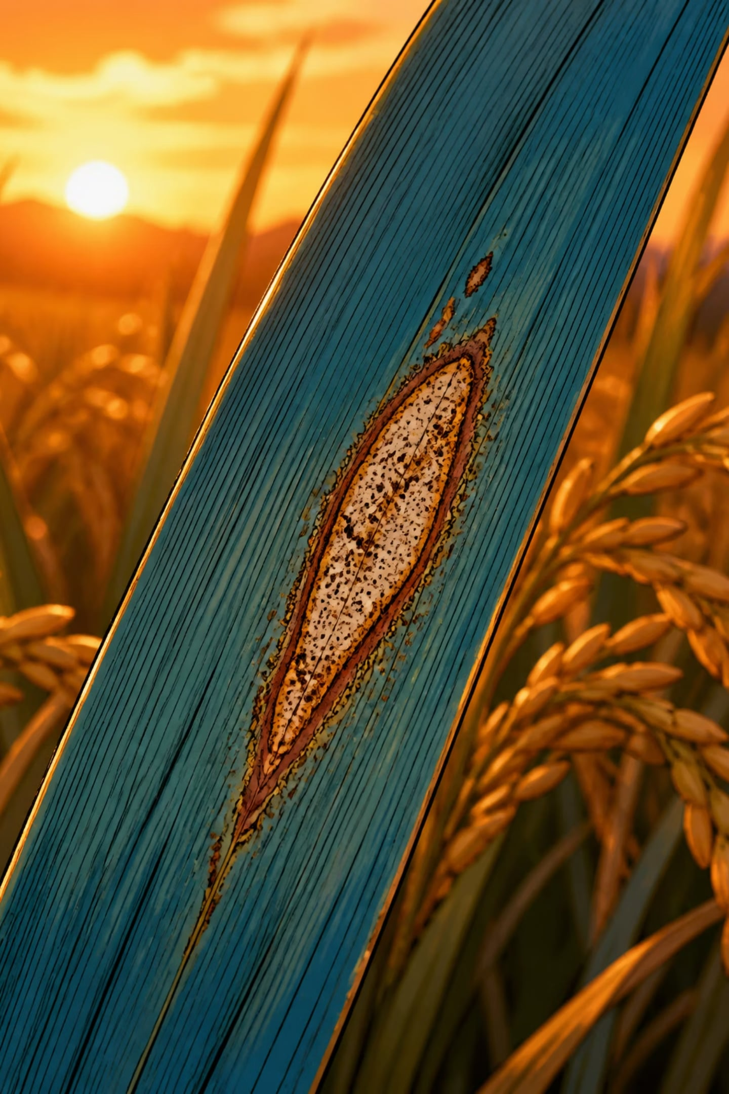
Rice Leaf Disease Detection Using CNN
Data Science Capstone — PRCP-1001
Submitted by: Sameeksha

Slide 2
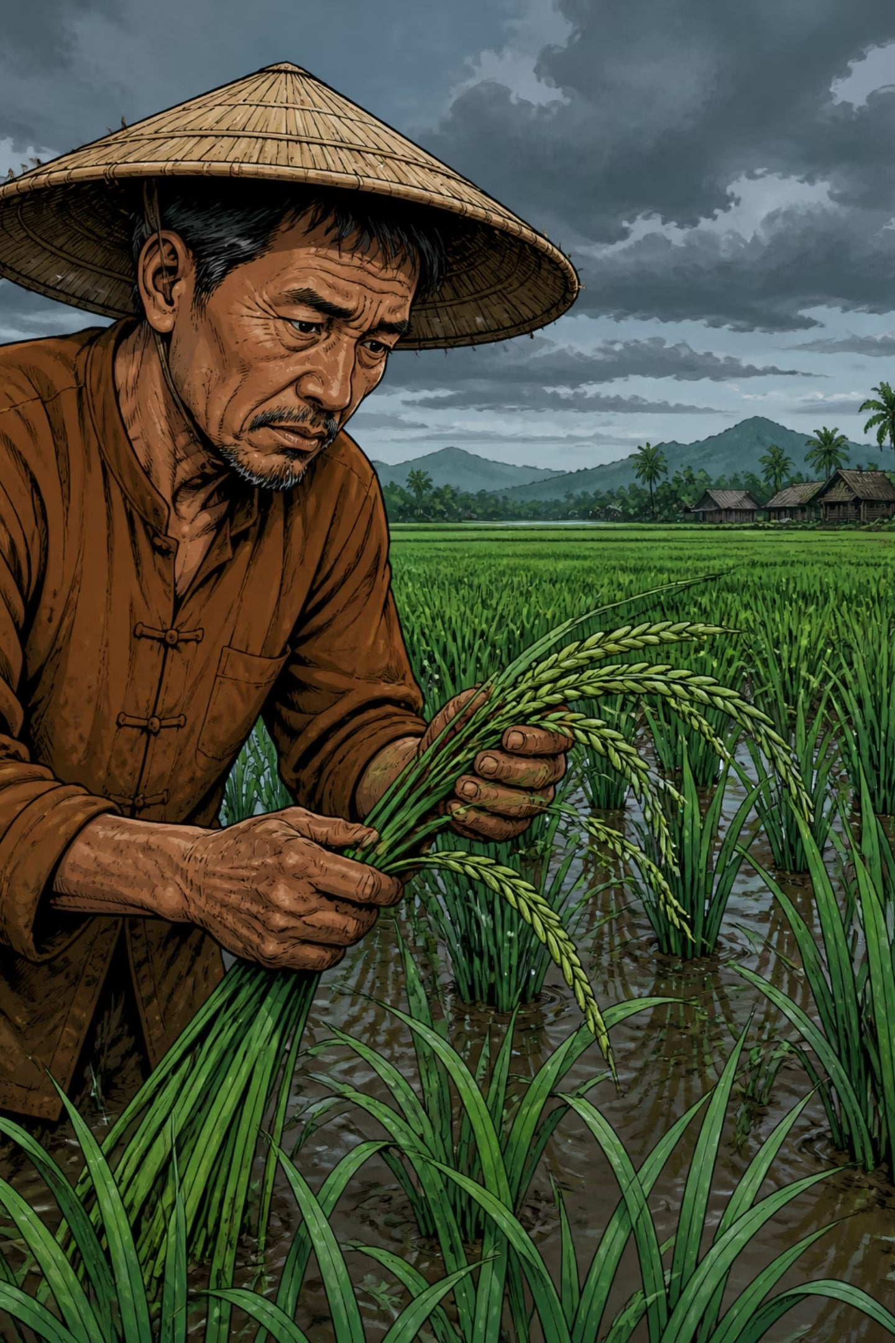
Problem Statement
Impact
Diagnosis Gap
Rice leaf diseases cause substantial yield loss globally and directly affect food security and farmer income.
Manual diagnosis is slow, subjective and requires domain expertise—not scalable for field deployment.
Objective
Develop an automated CNN classifier to identify three major rice leaf diseases from photos.

Slide 3
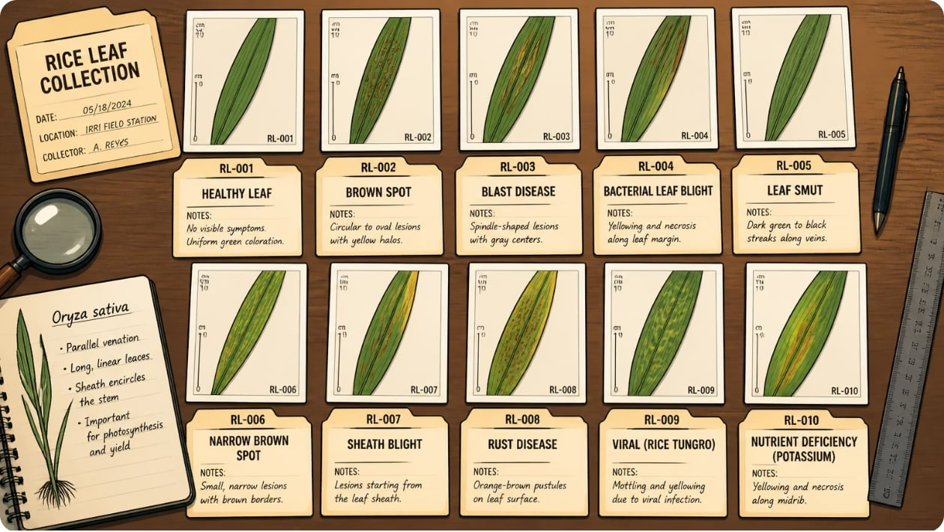
Dataset Overview
120 images total — perfectly balanced: 40 images per class. Source: DataMites Capstone dataset (Google Drive export).
Bacterial Leaf Blight — long pale stripes along veins
Brown Spot — small round brown lesions
Leaf Smut — tiny dense black speckled dots
Images varied in resolution and required consistent preprocessing (resized to 224×224).

Slide 4
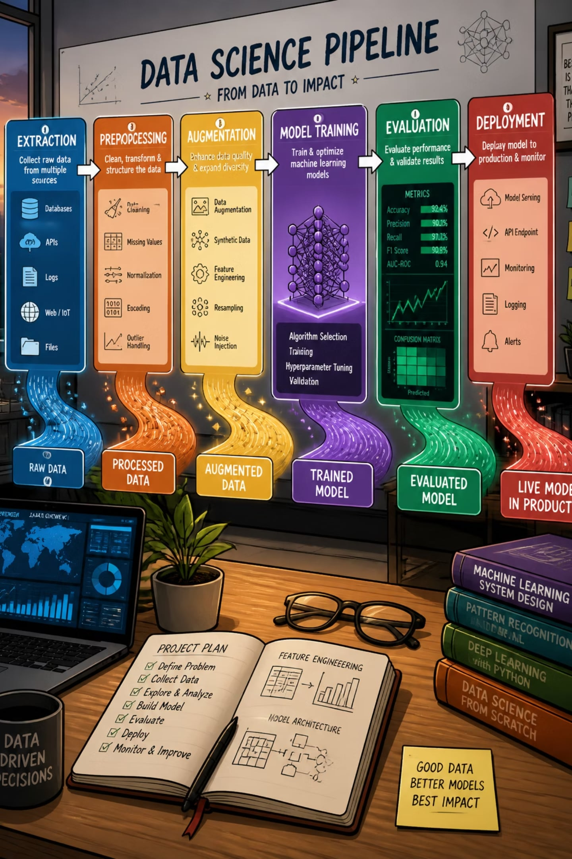
Project Pipeline
01
Data extraction & organisation
Two-stage nested zip extraction, careful folder structure for class labels.
02
EDA & preprocessing
Inspect resolutions, remove corrupt files, resize to 224×224, normalise pixels.
03
Split & augment
Single clean split (70/15/15), augmentation only on training data.
04
Model training & comparison
Train 3 models, evaluate on the same held-out test set, select production model.

Slide 5


Data Analysis — Key Findings
Class distribution: balanced (40/class). No corrupt images found. Resolutions varied — images standardised to 224×224. Visual differences exist (shape, colour, texture), but the dataset is very small — a primary risk for overfitting.
Small sample size (120 images) drives modelling and evaluation choices — transfer learning and strong validation are necessary.

Slide 6
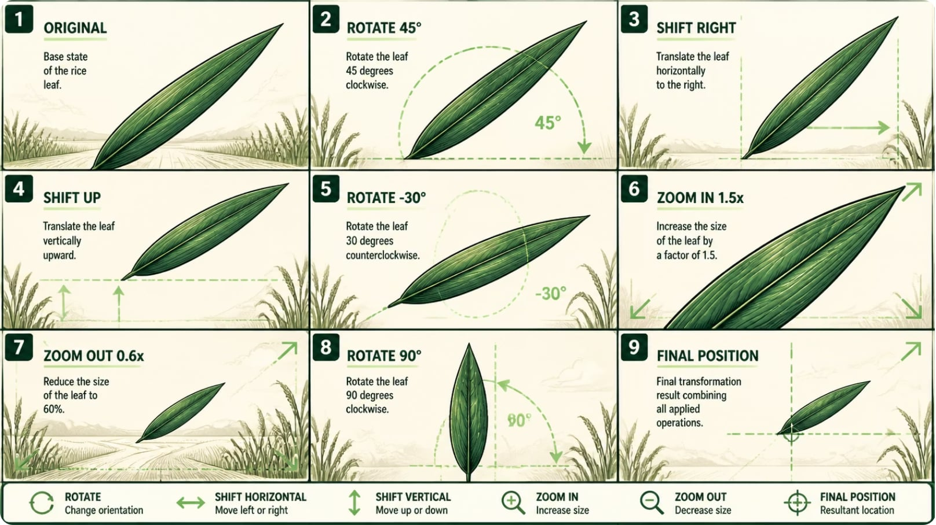
Data Augmentation Strategy
Purpose: expand effective training variety to mitigate overfitting given ~84 training images.
Applied transforms: rotation, width/height shift, shear, zoom, horizontal flip, rescaling
Excluded vertical flip to preserve natural leaf orientation
Augmentation applied only to training dataset; validation/test remain unaugmented
Careful parameter ranges ensured realistic variations without creating label noise.

Slide 7
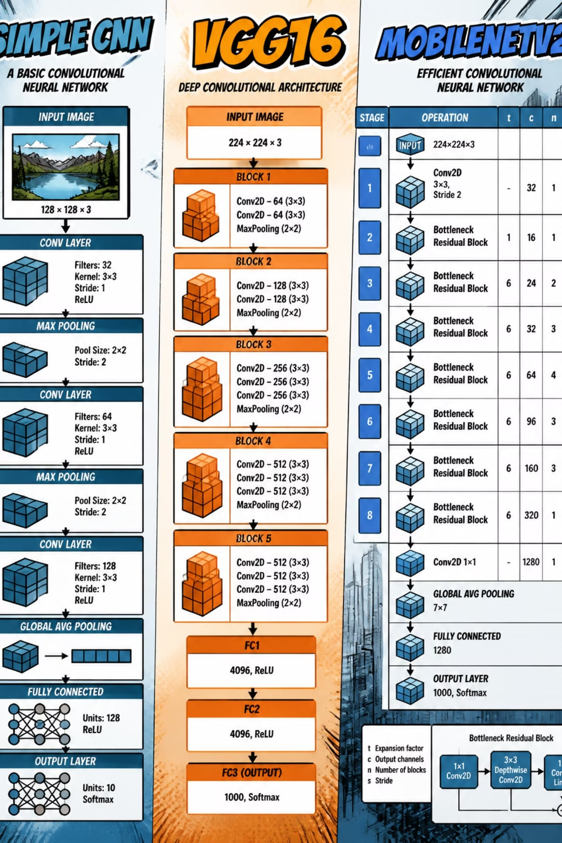



Model Development
Baseline CNN
Trained from scratch as a benchmark. Fast to iterate but highly prone to overfitting on small data.
VGG16 (Transfer Learning)
Frozen ImageNet base with custom classifier head. Strong accuracy but large parameter count and slow inference.
MobileNetV2 (Transfer Learning)
Lightweight, efficient architecture. Best balance between accuracy, size and inference speed — recommended for deployment.

Slide 9



Why Early Predictions Were Unreliable
1
2
Overfitting
Label-index mismatch
Baseline CNN memorised training images due to very small dataset.
Class indices were hardcoded rather than dynamically read from the generator, causing incorrect mapping of outputs to labels.
3
Data leakage risk
Multiple train/test splits performed accidentally; resolved by performing a single clean split prior to augmentation.

Slide 10
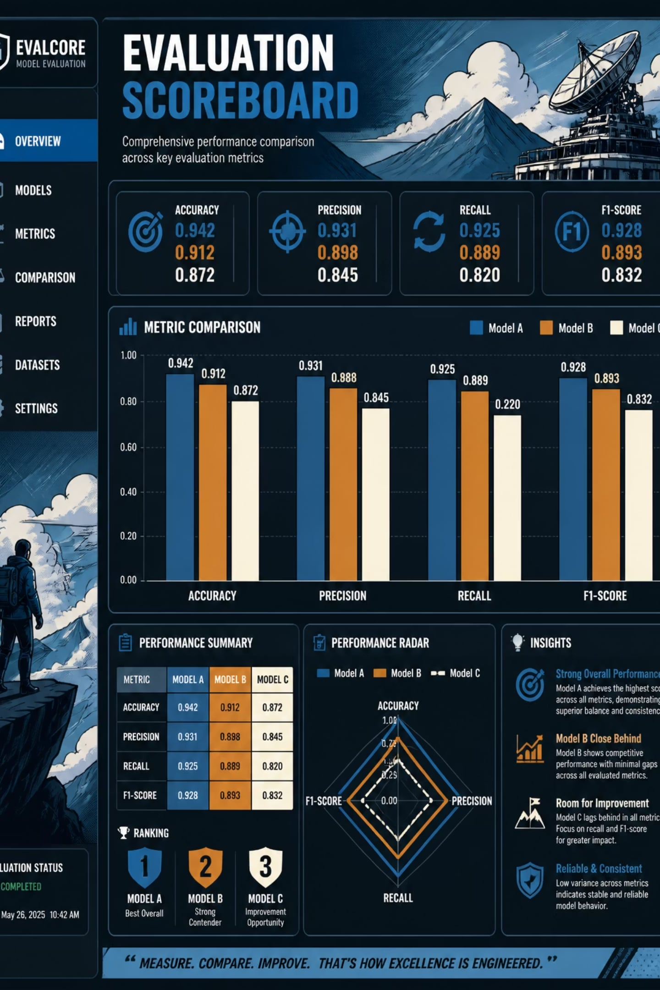
Model Comparison & Results Summary
All models evaluated on the same held-out test set using accuracy, precision, recall, F1-score, training time and parameter count.
Baseline CNN
Lowest accuracy; fast training but poor generalisation.
VGG16
High accuracy but heavy and slow; suitable when accuracy outweighs resource constraints.
MobileNetV2
Strong accuracy with small footprint and fast inference — best trade-off for production deployment.

Slide 11
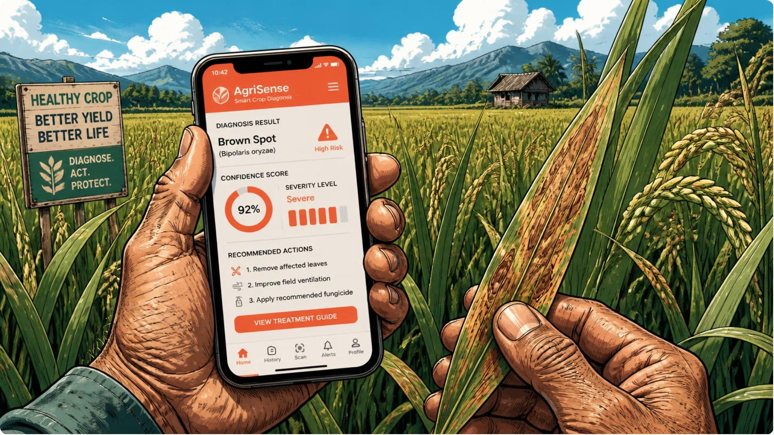

Conclusions, Recommendations & Next Steps
Conclusion: Implemented augmentation and transfer learning to overcome small-sample limitations; MobileNetV2 recommended for production.
Production: Deploy MobileNetV2 in a lightweight mobile/web app for in-field diagnosis.
Data: Prioritise collecting a larger, geographically diverse dataset with controlled labelling to reduce class confusion.
Evaluation: Use cross-validation and external validation sets; report per-class precision/recall to detect confusion patterns.
Engineering: Quantise and optimise MobileNetV2 for on-device inference; implement on-device preprocessing to standardise images.
Future work: active learning pipeline to collect misclassified samples and iteratively improve the model.

