Slide 1
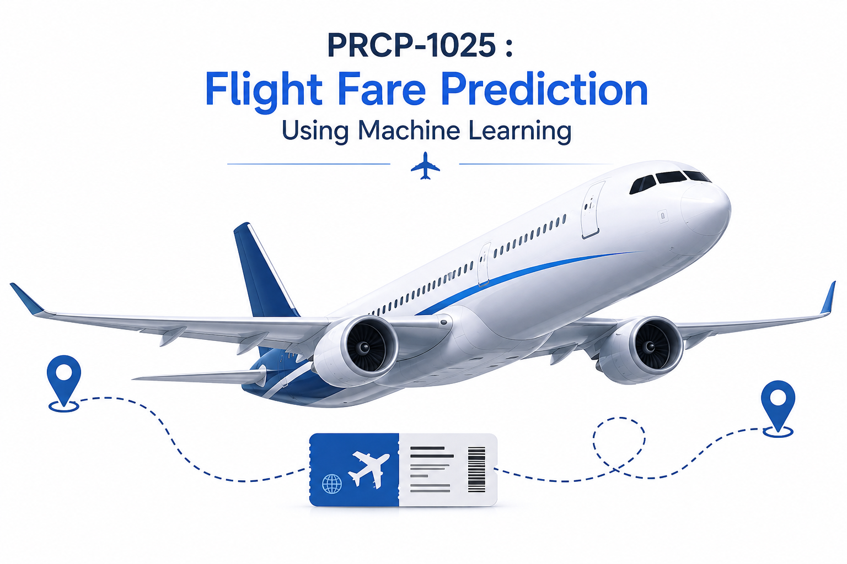
PRCP-1025 : FLIGHT FARE PREDICTION USING MACHINE LEARNING
Team Code: PTID-AIE-JUL-26-11142
Submitted By: Sameeksha

Slide 2
TABLE OF CONTENTS
Problem Statement
Project Workflow
Dataset Overview
Exploratory Data Analysis (EDA)
Data Preprocessing
Feature Engineering
Machine Learning Models
Model Evaluation & Performance Comparison
Hyperparameter Tuning
Challenges Faced
Conclusion
Future Scope

Slide 3
1. PROBLEM STATEMENT
Problem
Flight ticket prices change frequently based on multiple factors, making it difficult for customers to estimate the correct fare.
Objective
Analyze historical flight data
Build multiple regression models
Predict flight ticket prices accurately
Compare model performances
Select the best model

Slide 4
2. PROJECT WORKFLOW
Dataset Collection
Data Understanding
EDA
Data Preprocessing
Feature Engineering
Train-Test Split
Model Building
Model Evaluation
Hyperparameter Tuning
Best Model Selection
Flight Fare Prediction

Slide 5
3. DATASET OVERVIEW
Dataset Details
Source: DataMites
File: Flight_Fare.xlsx
DATASET LINK: https://d3ilbtxij3aepc.cloudfront.net/projects/CDS-Capstone-Projects/flight-fare.zip
Features
Airline
Date of Journey
Source
Destination
Route
Duration
Total Stops
Additional Info
Price (Target)

Slide 6
4. EXPLORATORY DATA ANALYSIS
Performed
Dataset Information
Missing Value Analysis
Duplicate Removal
Statistical Summary
Univariate Analysis
Bivariate Analysis
Correlation Analysis
Outlier Detection
Key Findings
Few missing values
Right-skewed price distribution
Airline and duration strongly affect ticket price
Longer duration generally increases fare

Slide 7
5. DATA PREPROCESSING
Steps
Removed Missing Values
Removed Duplicates
Feature Engineering
Converted Dates
Converted Time Features
Duration Conversion
Label Encoding
One-Hot Encoding
Train-Test Split
Feature Scaling (where required)

Slide 8
6. FEATURE ENGINEERING
Created new numerical features
Journey Day
Journey Month
Departure Hour
Departure Minute
Arrival Hour
Arrival Minute
Duration Minutes
Total Stops (Ordinal)
Dropped
Route
Additional Info

Slide 9
7. MACHINE LEARNING MODELS
Regression Algorithms Used
Linear Regression
Decision Tree Regressor
Random Forest Regressor
Gradient Boosting Regressor
XGBoost Regressor
AdaBoost Regressor
Evaluation Metrics
MAE
RMSE
R² Score

Slide 10
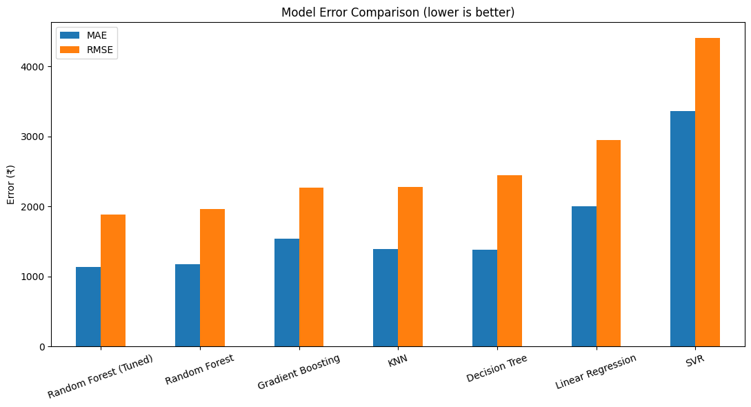
8. MODEL COMPARISON

Slide 11
9. HYPERPARAMETER TUNING
Performed GridSearchCV
Optimized
n_estimators
max_depth
min_samples_split
Result
Improved Random Forest Performance

Slide 12
10. CHALLENGES FACED
Mixed date and time formats
Duration conversion
Feature engineering
Categorical encoding
Model overfitting
Hyperparameter tuning

Slide 13
11. CONCLUSION
Successfully built multiple regression models.
Random Forest produced the best prediction performance.
Feature engineering significantly improved accuracy.
Machine learning can estimate flight fares effectively.
The model can support customers and airline businesses in price estimation.

Slide 14
12. FUTURE SCOPE
Real-time API integration
Live airline pricing
Deep Learning models
Web Application Deployment
Cloud Deployment
Price Alert System

Slide 15
THANK YOU!!

