Slide 1

Flight Fare Prediction Using Machine Learning
PRCP-1025 Capstone Project — concise pipeline from raw bookings to a production-ready fare predictor. Audience: data science students and project evaluators.

Slide 2

Problem Statement
Flight ticket prices are volatile and opaque: the same route may cost ₹4,500 today, ₹5,700 tomorrow or ₹3,900 next week. The project predicts continuous price values from booking features so travellers and airlines can make informed decisions.

Slide 3
Project Goals
1 — EDA
2 — Modeling
3 — Comparison
Thorough exploratory analysis to surface distributions, outliers and correlations.
Train multiple regression algorithms and build a reproducible training pipeline.
Evaluate with MAE, MSE, RMSE and R² to select the best candidate for production.
4 — Reporting
Document techniques, challenges and next steps in a single Jupyter Notebook.
All deliverables packaged in one notebook for reproducibility and review.

Slide 4
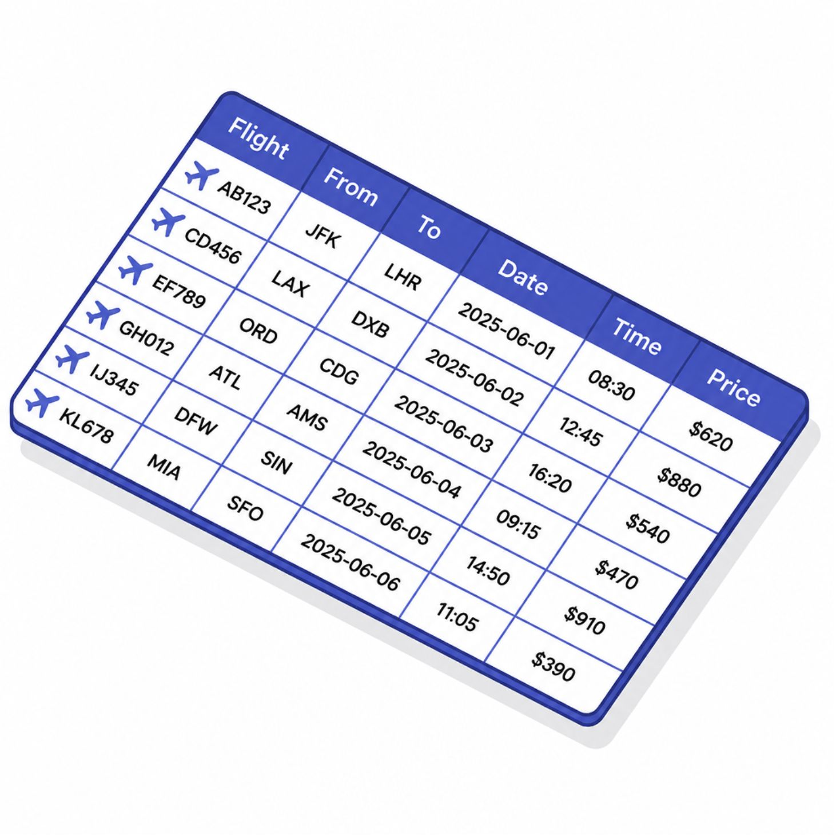
The Dataset
~10,700 historical booking records. Key columns used:
Airline, Source, Destination, Route
Date of Journey, Departure Time, Arrival Time, Duration
Total Stops, Additional Info
Price — target variable (continuous)
Data quality checks: schema, missing values, duplicates and basic sanity checks.

Slide 5

Exploratory Data Analysis (EDA)
Steps and findings:
Inspected shape, dtypes and missingness; removed duplicates.
Visualised price distribution — skew and long-tail outliers present.
Compared price by Airline, Stops and Source cities to find systematic differences.
Checked feature correlations; identified non-linear relationships with price.

Slide 6

Feature Engineering — From Raw Text to Model-ready Inputs
01
02
Temporal features
Duration
Journey Day, Journey Month, Departure Hour/Minute extracted from Date/Time fields.
Converted "2h 50m" to total minutes for numeric modelling.
03
Categorical encoding
One‑hot encoding for Airline, Source, Destination. Total Stops → ordinal.

Slide 7

Data Challenges & Decisions
High-cardinality Route
Dominant Additional Info
Dropped Route to avoid sparse encoding; used Source + Destination + Stops instead.
Feature provided little variance; removed to reduce noise.
Outliers
Missing values
Investigated but retained premium/long-haul fares as valid observations.
Imputed or dropped depending on column and impact on downstream models.

Slide 8
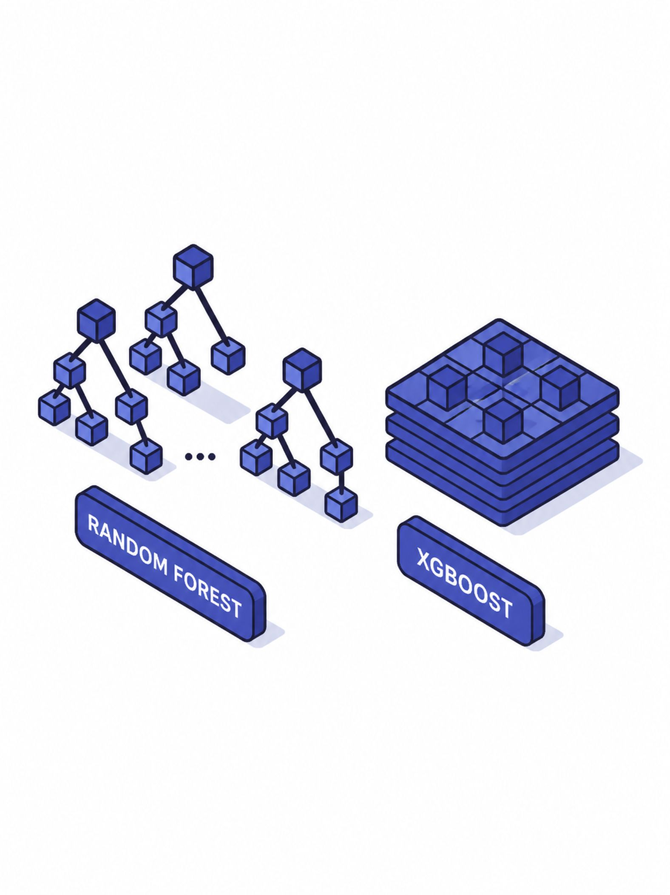
Models Trained
Seven regressors trained with standard pipeline (preprocessing → train/test split → CV):
Linear Regression
Decision Tree Regressor
Random Forest Regressor
Extra Trees Regressor
Gradient Boosting Regressor
AdaBoost Regressor
XGBoost Regressor
Hyperparameters tuned for ensembles using grid/random search where applicable.

Slide 9
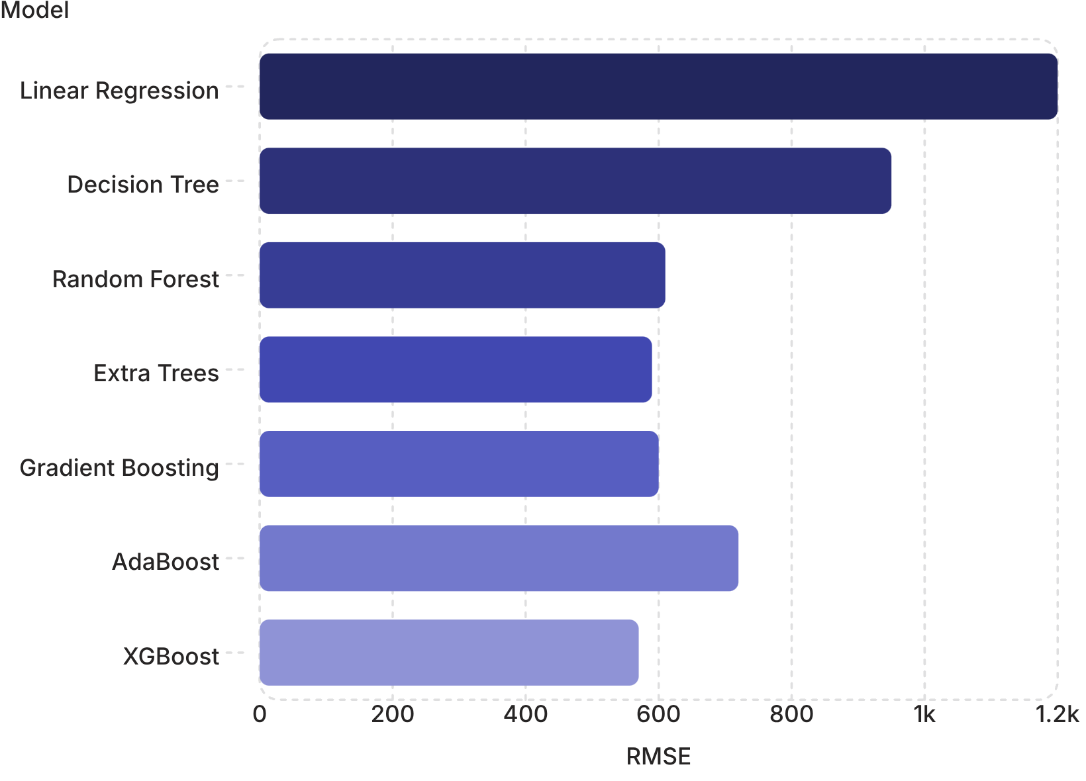
Evaluation & Key Finding
Evaluation metrics: MAE, MSE, RMSE and R² used. Findings:
Tree-based ensembles (Random Forest, Extra Trees, XGBoost, Gradient Boosting) outperform linear models.
Best performer: XGBoost / Extra Trees family (lowest RMSE, highest R²).
Reason: pricing relationships are non-linear and interact across categorical features.

Slide 10





Business Value & Next Steps
For Customers
For Airlines
Predictive guidance on best booking windows to save money.
Feature importance insights to inform dynamic pricing and yield management.
Next Steps
Productionise with scheduled retraining, real-time feature refresh and calibration to seasonal demand.
Notebook includes code, model artefacts and instructions for retraining. Recommended: deploy best ensemble with monitoring on RMSE drift.

