Slide 1

Advanced Database Management COEN 380 Group 4
Final Project : Flight Management System
Dhruvinkumar Ghadiya- W1588377
Jayesh Pokharkar- W1587206
Jeet Patel- W1588240
Sameeksha Raj SB - W1588408
Surbhi Hajela- W1588405
Vidisha Gummadi - W1588713

Slide 2
Overview
Dataset
Queries (Oracle SQL and Hive)
Oracle Query Plans
Hive Query
Running time for Oracle and Hive
Challenges
Conclusion

Slide 3
Project Idea:
The project focuses on Flight Management System which will allow the track of all the Flight schedules, their route and passenger details. This will also allow the Flight Administrator to manage, edit and add routes. Also, we can add new passenger and edit ticket details. This System simplifies the Flight management by maintaining all the records.
Implementation Details:
Hive/Hadoop section: We ran the queries on the hadoop cluster where data is stored using Hive QL on the design center account provided. Using this we noted the time taken for the queries to execute on hive.
Oracle DB & Explain plan: We installed Oracle 12c version on the local desktop and executed all the queries to see the performance difference. We also executed the explain plan which is a tool that you can use to have Oracle explain to you how it plans on executing your query. This is useful in tuning queries to the database to get them to perform better. Once you know how Oracle plans on executing your query, you can change your environment to run the query faster.

Slide 4
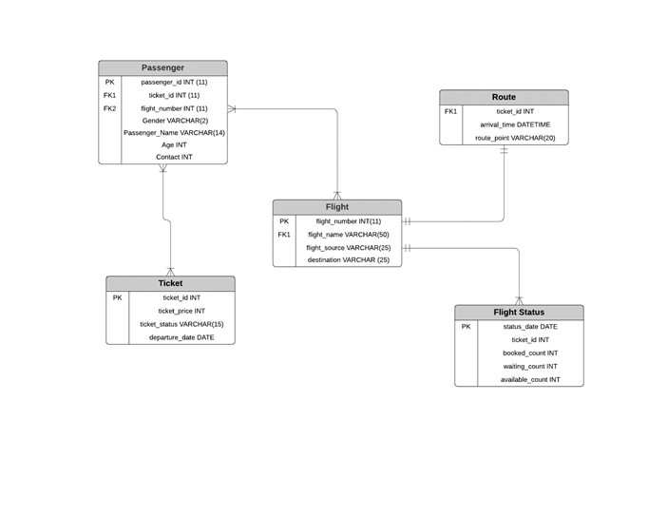
Schema

Slide 5
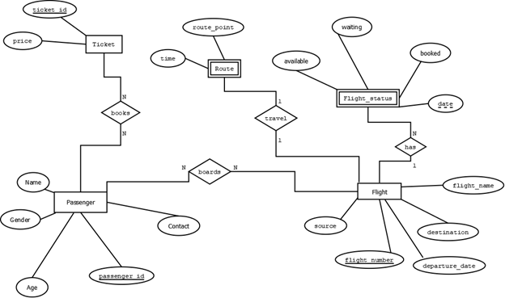
ER Diagram

Slide 6
Oracle Explain Plan
The EXPLAIN PLAN statement displays execution plans chosen by the Oracle optimizer for SELECT,
UPDATE, INSERT, and DELETE statements.
The EXPLAIN PLAN helps you to understand the optimizer decisions, such as why the optimizer chose a
nested loops join instead of a hash join, and lets you understand the performance of a query.
The optimizer performs the following steps:
1. The optimizer generates a set of potential plans for the SQL statement based on available access
paths and hints.
2. The optimizer estimates the cost of each plan based on statistics in the data dictionary. Statistics
include information on the data distribution and storage characteristics of the tables, indexes, and
partitions accessed by the statement.
3. The optimizer compares the plans and chooses the plan with the lowest cost.

Slide 7
Queries

Slide 8
Create Table as SELECT
CREATE TABLE myFlightinfo AS SELECT
ticket_id, p.flight_number, gender, passenger_name, age, destination
FROM passenger p LEFT JOIN Flight t on p.FLIGHT_NUMBER = t.FLIGHT_NUMBER;

Slide 9
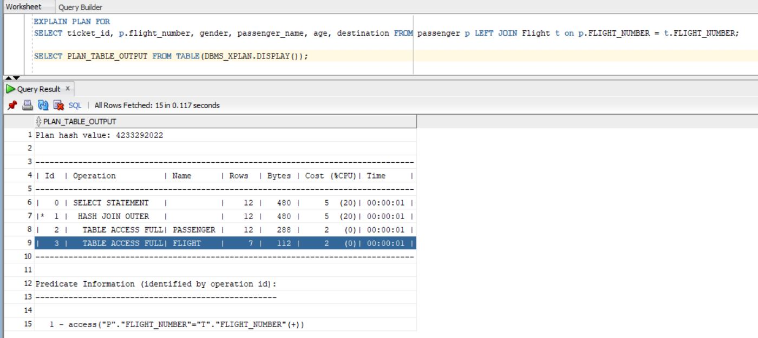
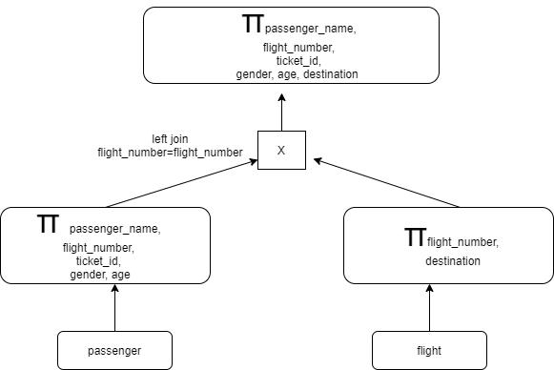
Oracle Explain Plan

Slide 10
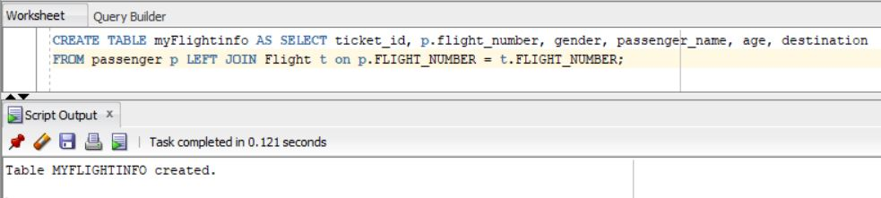
Oracle Output

Slide 11
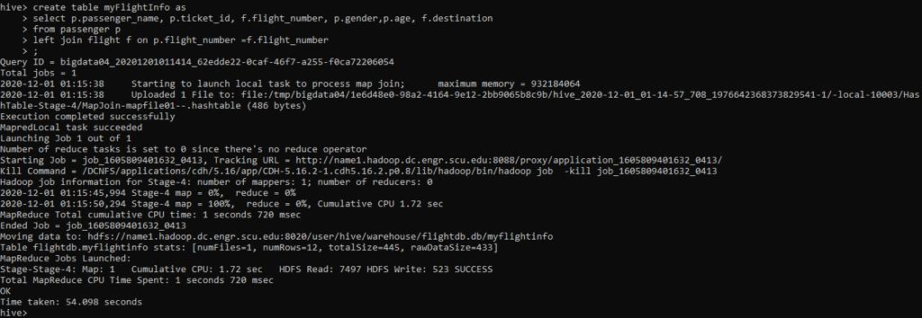
Hive Query and Output
Oracle time: 0.035 secs
Hive time: 54.098 secs

Slide 12
2. Calculate Gender Ratio
SELECT gender, Count(*) / (select count(*) FROM Passenger) AS Sex_Ratio FROM passenger GROUP BY gender;

Slide 13
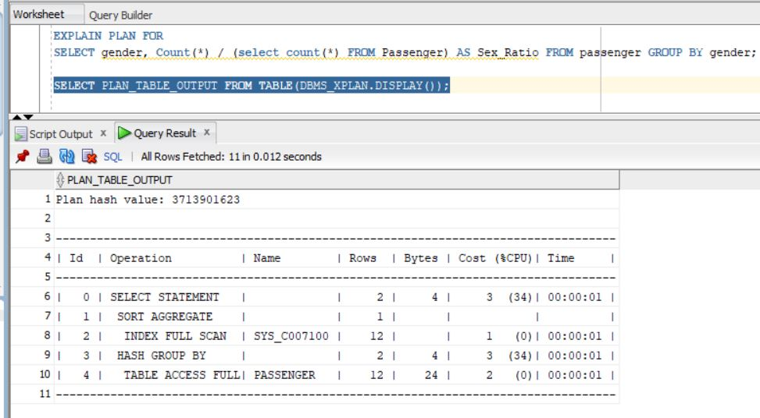
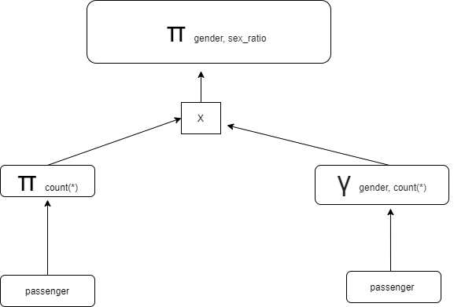
Oracle Explain Plan

Slide 14
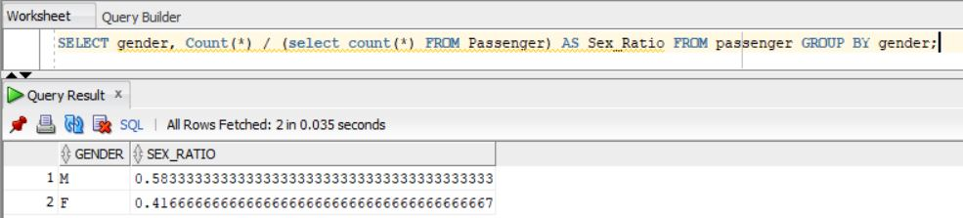
Oracle Output

Slide 15
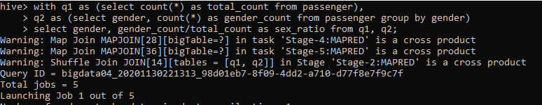

Hive Output
Oracle time: 0.035 secs
Hive time: 83.313 secs

Slide 16
3. Flight Name which has route point at SF ( Nested Queries )
SELECT Flight_name FROM Flight
WHERE FLIGHT_NUMBER IN
(SELECT FLIGHT_NUMBER FROM route WHERE route.route_point='San Francisco');
Notes:
SELECT train_name FROM train WHERE t.train_id IN (SELECT route.train_id FROM route WHERE route.route_point="San Francisco");

Slide 17
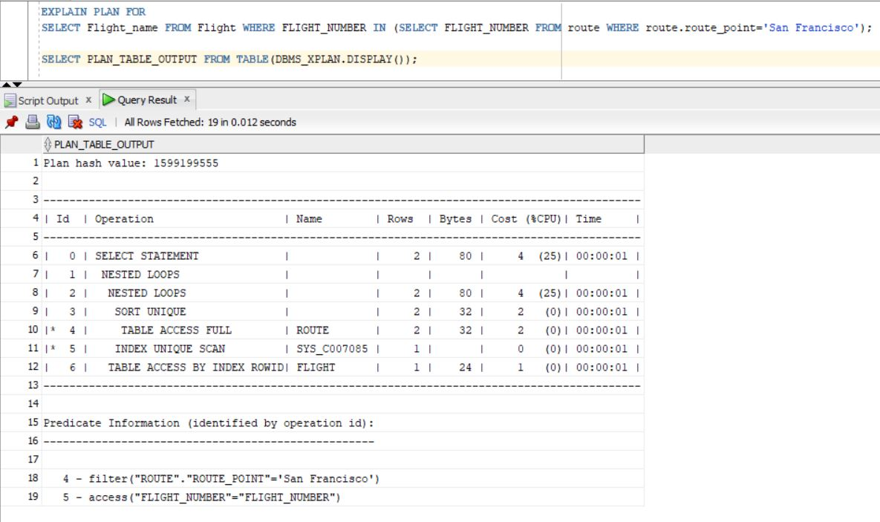
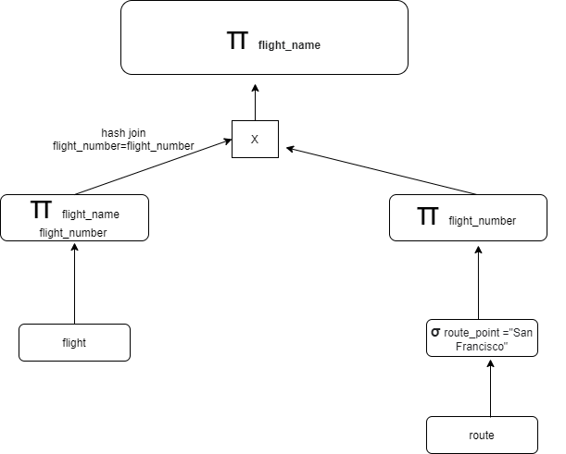
Oracle Explain Plan

Slide 18
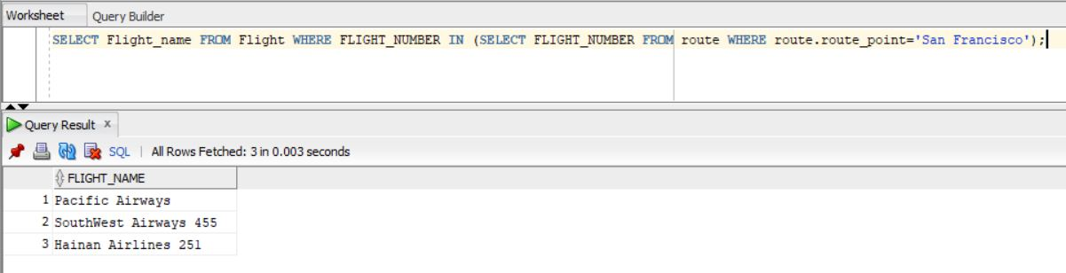
Oracle Output

Slide 19
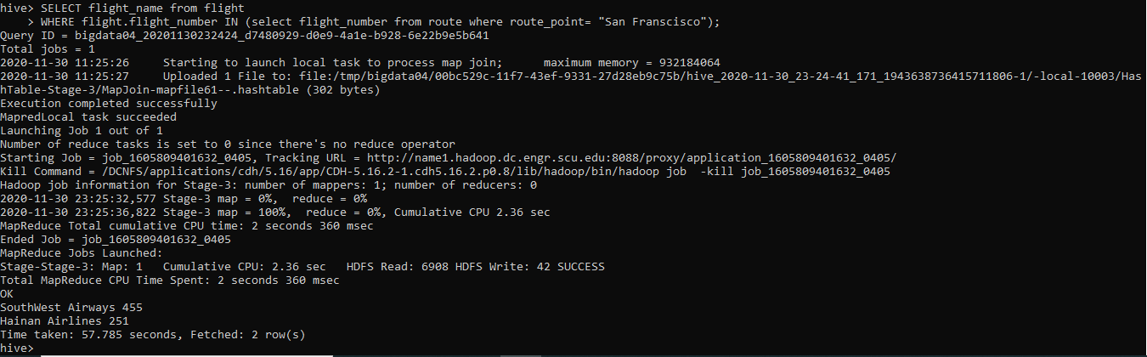
Hive Output
Oracle time: 0.003 secs
Hive time: 57.785 secs

Slide 20
4. Distinct Female Passengers (3 way join)
SELECT distinct(Passenger_name) FROM passenger p INNER JOIN Flight t ON p.FLIGHT_NUMBER = t.FLIGHT_NUMBER INNER JOIN route r ON p.FLIGHT_NUMBER = r.FLIGHT_NUMBER WHERE gender='F';

Slide 21
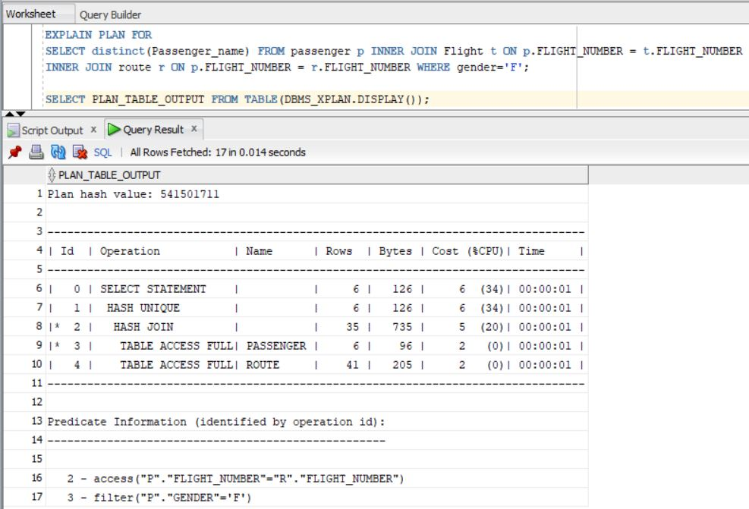
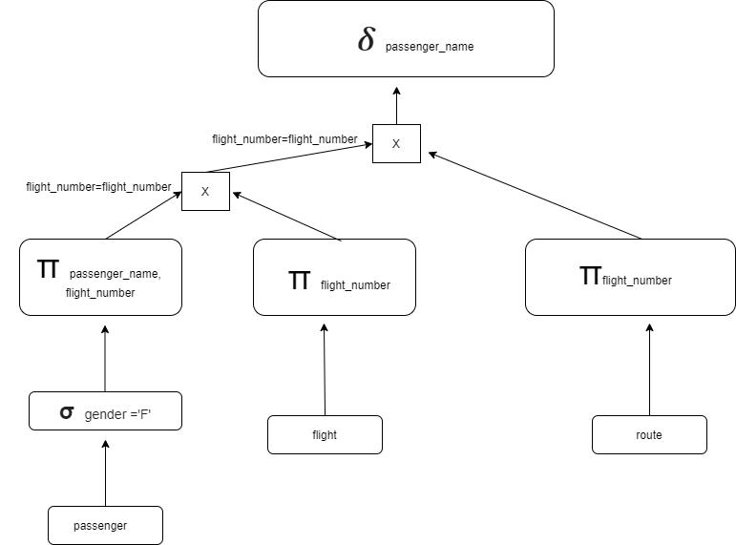
Oracle Explain Plan
Proposed Query Plan

Slide 22
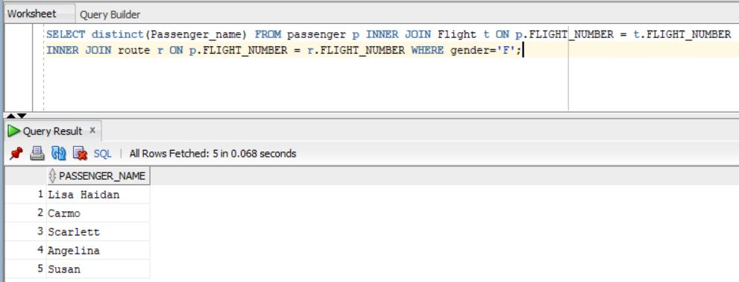
Oracle Output

Slide 23
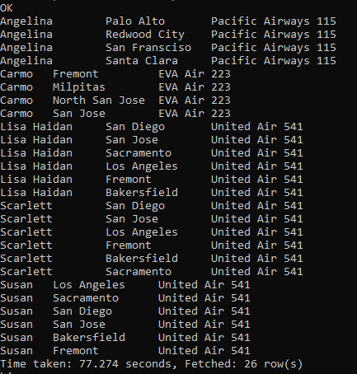
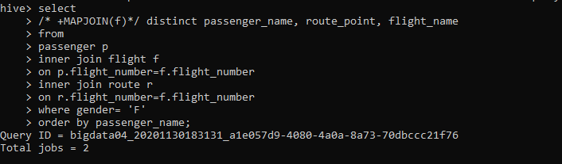
Hive Output
Oracle time:0.068 secs
Hive time: 77.274 secs
2 mappers and 2 reducers

Slide 24
5. Count number of Flight Stops for each flight
SELECT r.FLIGHT_NUMBER, count(r.ROUTE_POINT) as FlightStops FROM Flight t INNER JOIN Route r on t.FLIGHT_NUMBER = r.FLIGHT_NUMBER group by t.FLIGHT_NUMBER ;

Slide 25
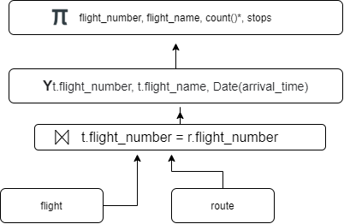
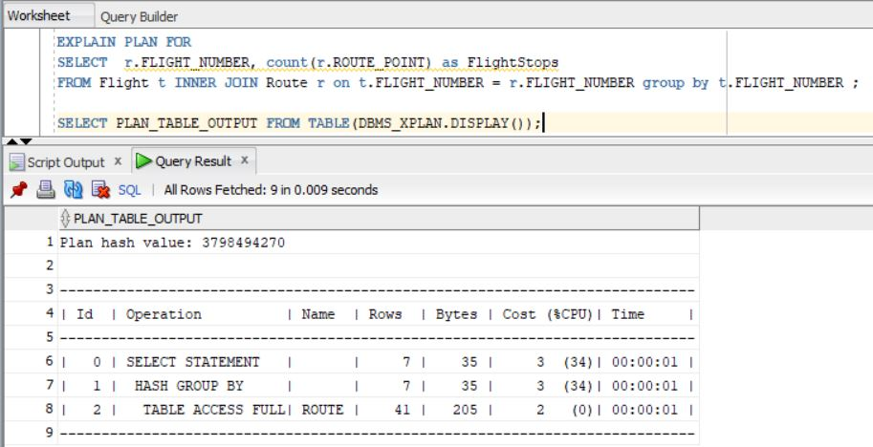
Oracle Explain Plan

Slide 26
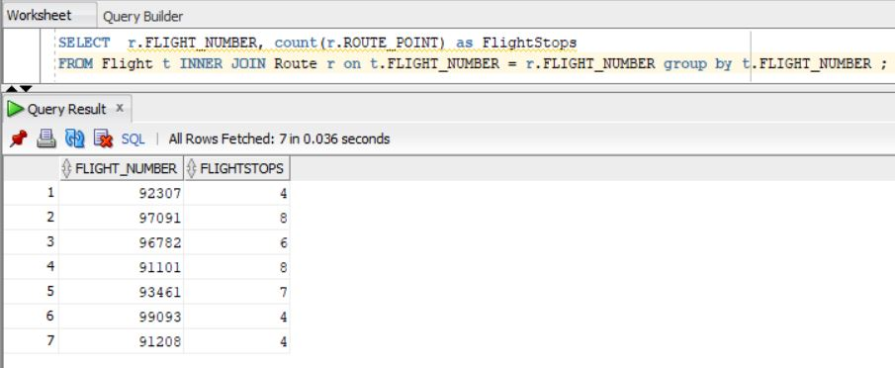
Oracle Output
Oracle Time: 0.11 secs
Hive Time: 61.207 secs

Slide 27
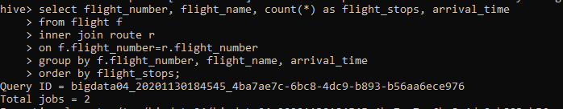
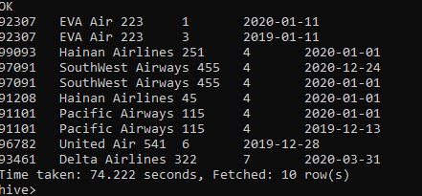
Hive Output
Oracle time: 0.035 secs
Hive time: 74.222 secs

Slide 28
6. Multiple Table Insert
create table flightnbr(fl_number int) row format delimited fields terminated by ',';
create table flightname(fl_nm string) row format delimited fields terminated by ',';
create table flight_sr_des(sr string, des string) row format delimited fields terminated by ',';
from flight
> insert overwrite table flightnbr
> select flight_number
> insert overwrite table flightname
> select flight_name
> insert overwrite table flight_sr_des
> select flight_source, destination ;

Slide 29
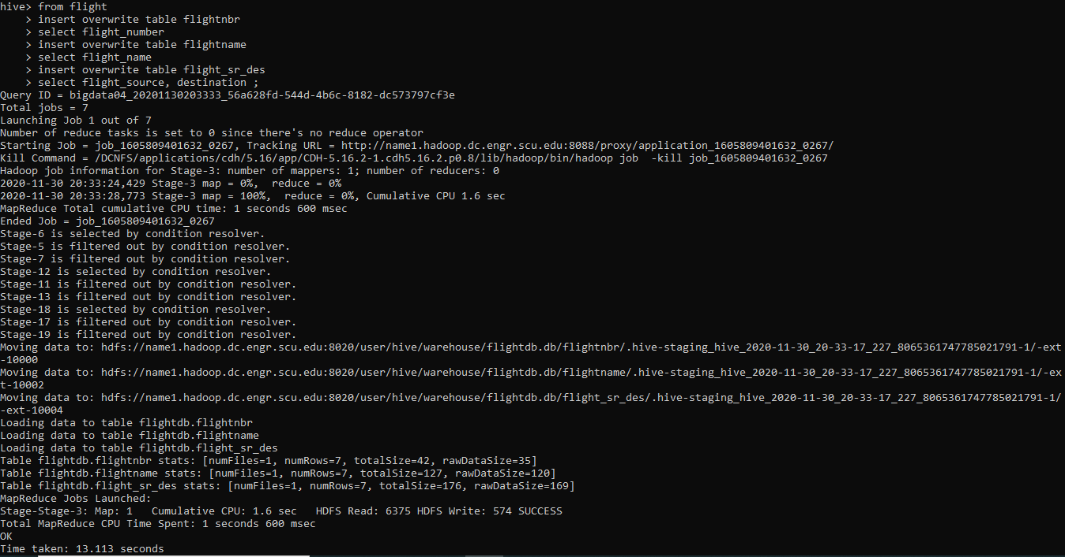
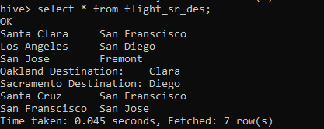
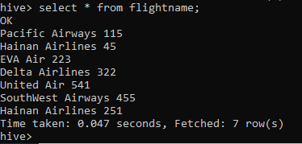
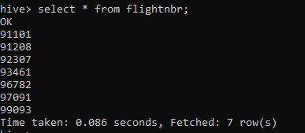
Hive Output

Slide 30
7. (4 Way Join )
SELECT DISTINCT(Passenger_name), Flight_name, Ticket_price, ti.Ticket_id, Ticket_status, Status_date FROM Passenger p INNER JOIN Flight t ON t.FLIGHT_NUMBER = p.FLIGHT_NUMBER INNER JOIN Ticket ti ON ti.ticket_id = p.ticket_id INNER JOIN FlightStatus ts ON t.FLIGHT_NUMBER = ts.FLIGHT_NUMBER WHERE Ticket_price = 35;

Slide 31
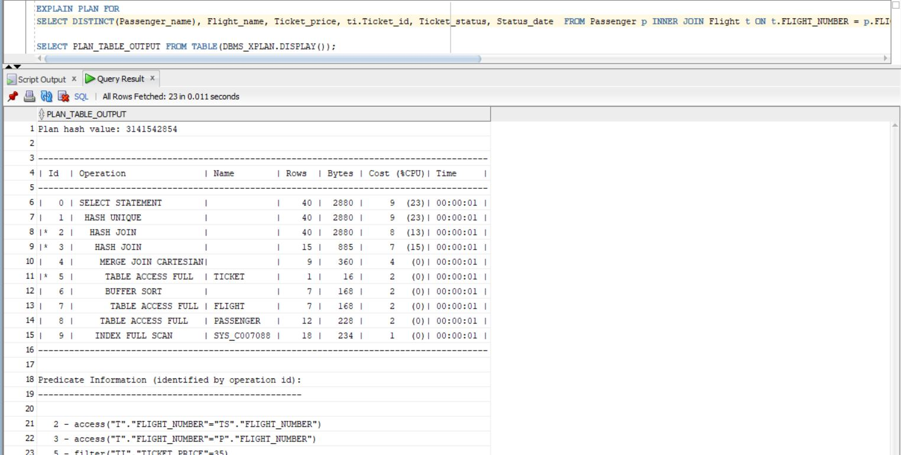
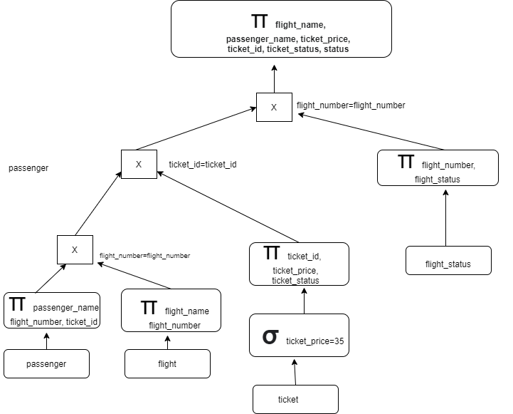
Oracle Explain Plan

Slide 32
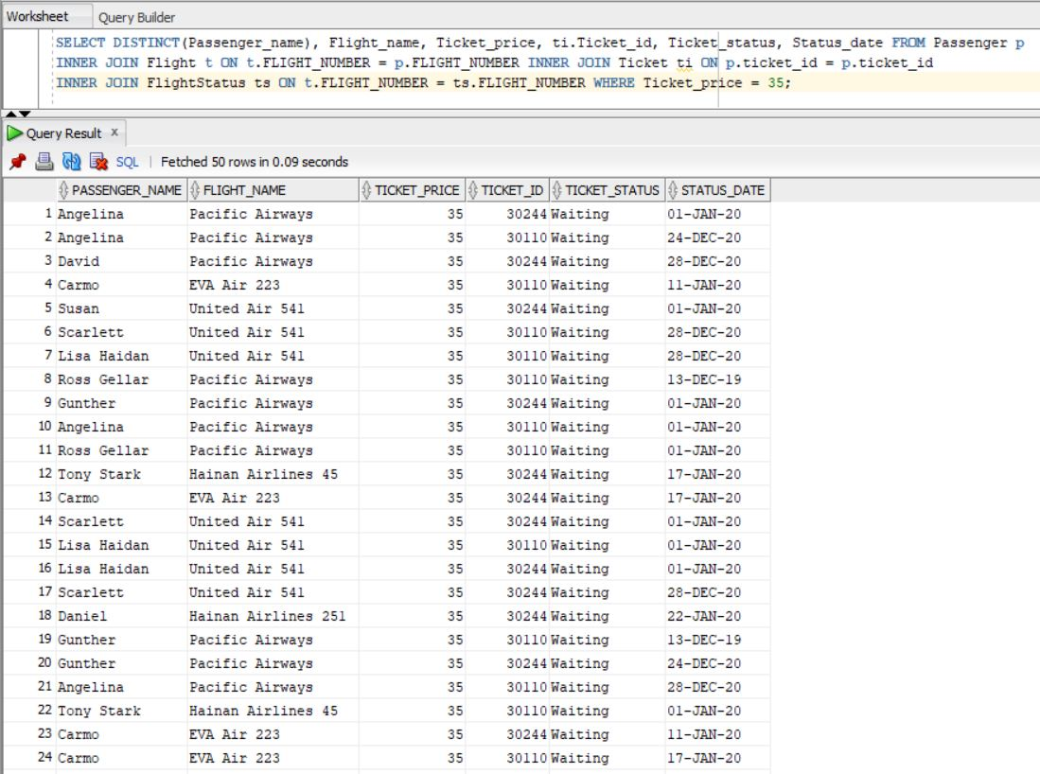
Oracle Output

Slide 33
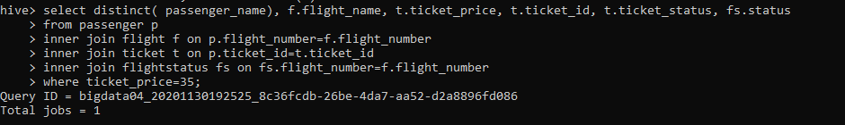
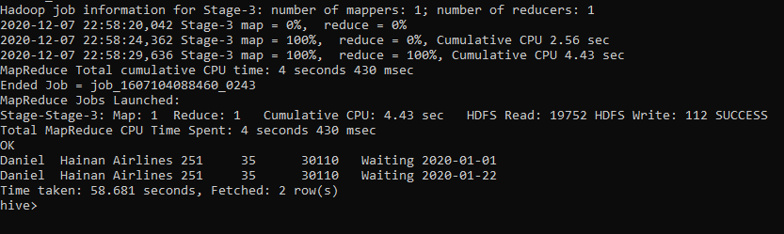
Hive Output
Oracle time: 0.09 secs
Hive time: 58.681 secs

Slide 34
8. Create views to demonstrate all stops taken by each flight
CREATE VIEW FlightStops AS SELECT t.FLIGHT_NUMBER, t.FLIGHT_NAME, listagg(r.route_point, ', ') within group (order by r.route_point)AS Routes FROM route r INNER JOIN Flight t ON t.FLIGHT_NUMBER = r.FLIGHT_NUMBER GROUP BY t.FLIGHT_NUMBER,t.FLIGHT_NAME;

Slide 35
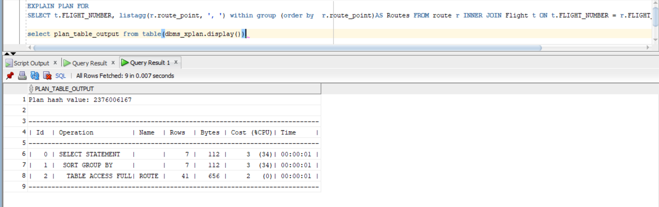
Oracle Explain Plan

Slide 36
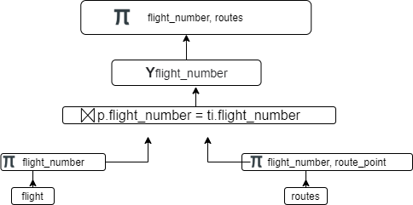
Proposed Query Plan

Slide 37
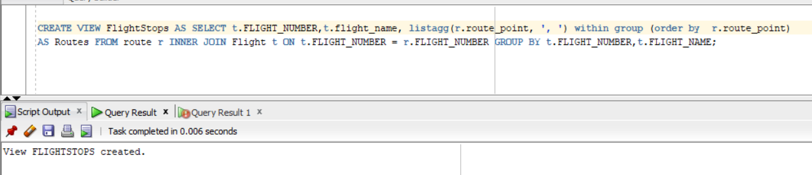
Oracle Output

Slide 38
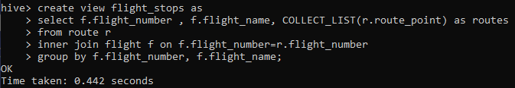
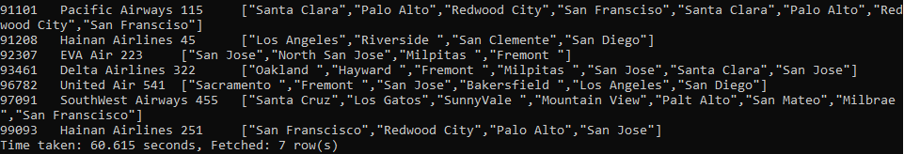
Hive Output
Oracle Time: 0.006 secs
Hive Time: 0.442 secs

Slide 39
9. Create view and Join it with any table
select fl.FLIGHT_NUMBER, fl.FLIGHT_NAME, count(p.PASSENGER_ID) from FlightStops fl inner join passenger p on p.FLIGHT_NUMBER = fl.FLIGHT_NUMBER group by fl.FLIGHT_NUMBER,fl.FLIGHT_NAME;

Slide 40
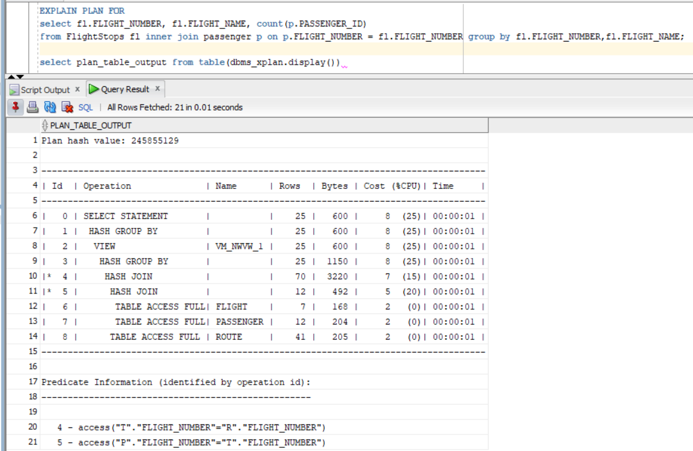
Oracle Explain Plan

Slide 41
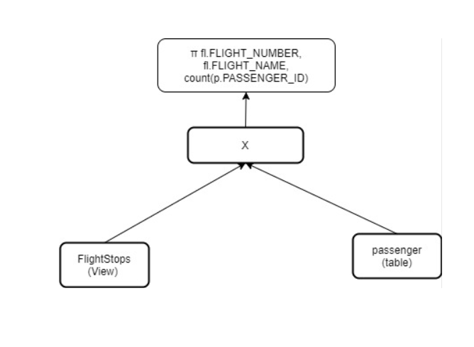
Proposed Query Plan

Slide 42
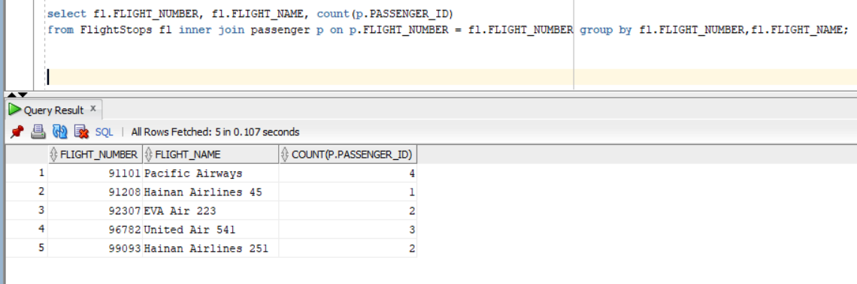
Oracle Output

Slide 43
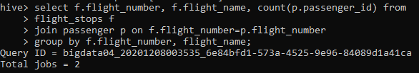
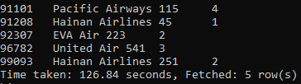
Hive Output
Oracle Time: 0.107 secs
Hive Time: 126.84 secs

Slide 44
10. Self Join- to identify subsequent flights
select a.flight_number, a.flight_source, a.destination, b.flight_number, b.flight_source, b.destination
from flight a join flight b ON a.destination = b.flight_source AND a.flight_number != b.flight_number;

Slide 45
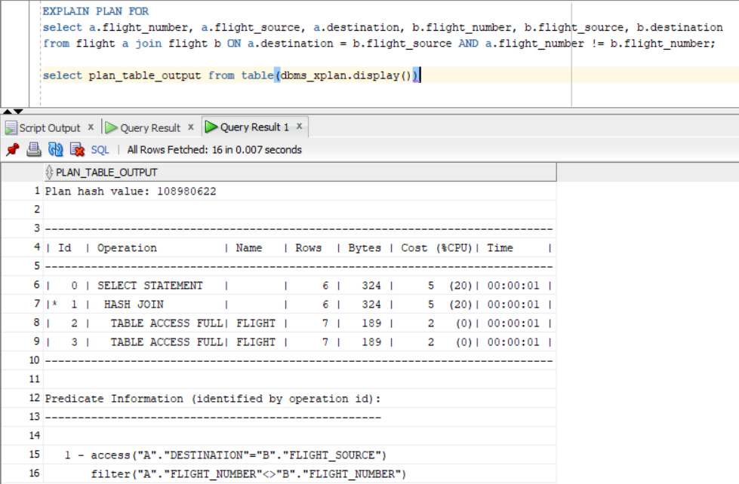
Oracle Explain Plan

Slide 46
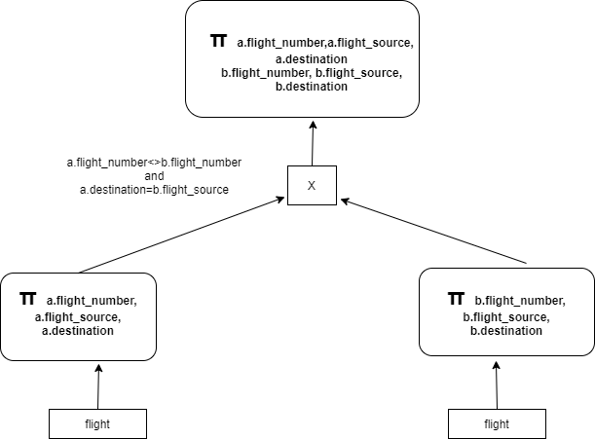
Proposed Query Plan

Slide 47
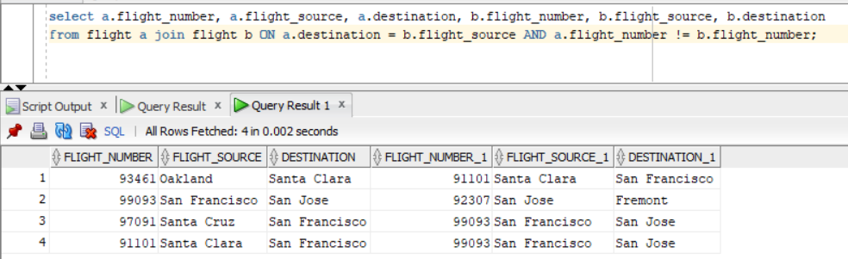
Oracle Output

Slide 48


Hive Output
Oracle Time: 0.002 secs
Hive Time: 62.869 secs

Slide 49
CHALLENGES FACES
● Data cleaning
● Data generation
● Comparing proposed query plan with the Oracle
generated plan

Slide 50
CONCLUSION
● Oracle SQL is more efficient for most of our queries if compared to hive.
● Hive-Hadoop does not enforce any constraints on table/data while writing into tables but it does while reading, hence it is called schema on read.
● Oracle is highly efficient to work on small datasets and row level DML operations than Hive-Hadoop.

Slide 51
Q&A

