Slide 1


The Complete Machine Learning Pipeline
How Real AI Systems Are Built — Using the AQI Prediction Project
SHINE INTERNSHIP COHORT 9
DATA SCIENCE

Slide 2









ML Is More Than Training Models
Most real-world ML effort goes into data and deployment — not model training.
Business Problem
Data Collection
EDA
Feature Engineering
Feature Store
Model Training
Evaluation
Deployment
Monitoring

Slide 3
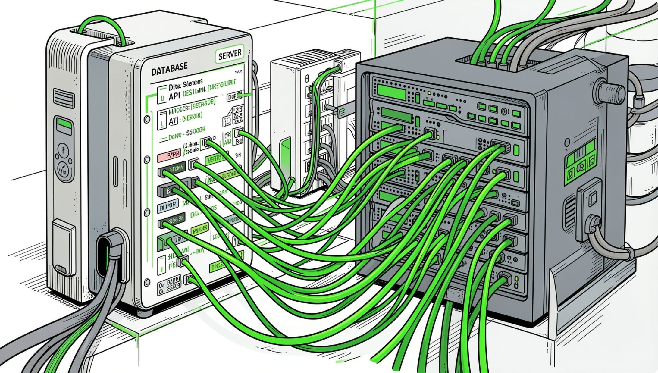
Business Understanding & Data Collection
Start with the Question
Define the business problem clearly
Identify inputs (features) and outputs (target)
Collect historical data from APIs
AQI Project Example
Goal: Predict AQI for the next 3 days
Inputs: Weather + pollution data from external APIs
Key rule: Historical data must be collected before any training begins

Slide 4
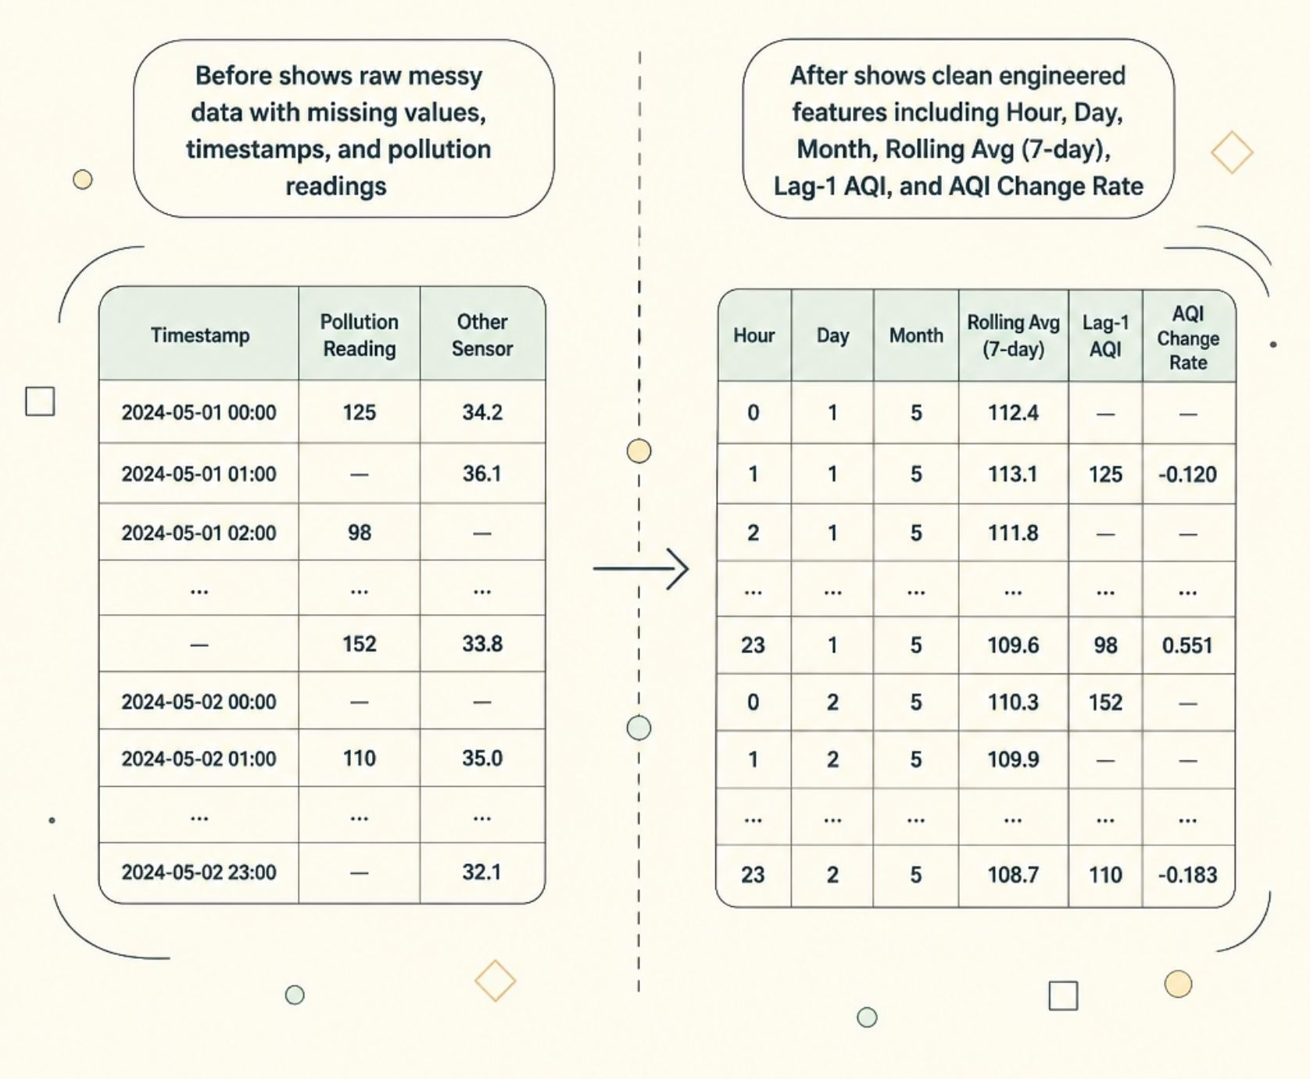
Exploratory Data Analysis & Feature Engineering
From Raw Data → Engineered Features
Clean, explore, and transform raw data into signals the model
can learn from.
Handle missing values & outliers
Explore trends, seasonality, and correlations
Create time-based features: Hour, Day, Month
Build rolling averages and lag features
Compute AQI change rate

Slide 5
Feature Store & Model Training
🗄️ Feature Store
🌲 Random Forest
🚀 XGBoost
A centralized repository where engineered features are stored, versioned, and reused — eliminating redundant work across teams and experiments.
Robust baseline — handles non-linearity and feature interactions well.
Gradient boosting — often the strongest tabular model in production.
📈 Linear Regression
🧠 LSTM
Simple, interpretable — useful as a performance floor baseline.
Neural network — captures sequential patterns in time-series AQI data.

Slide 6
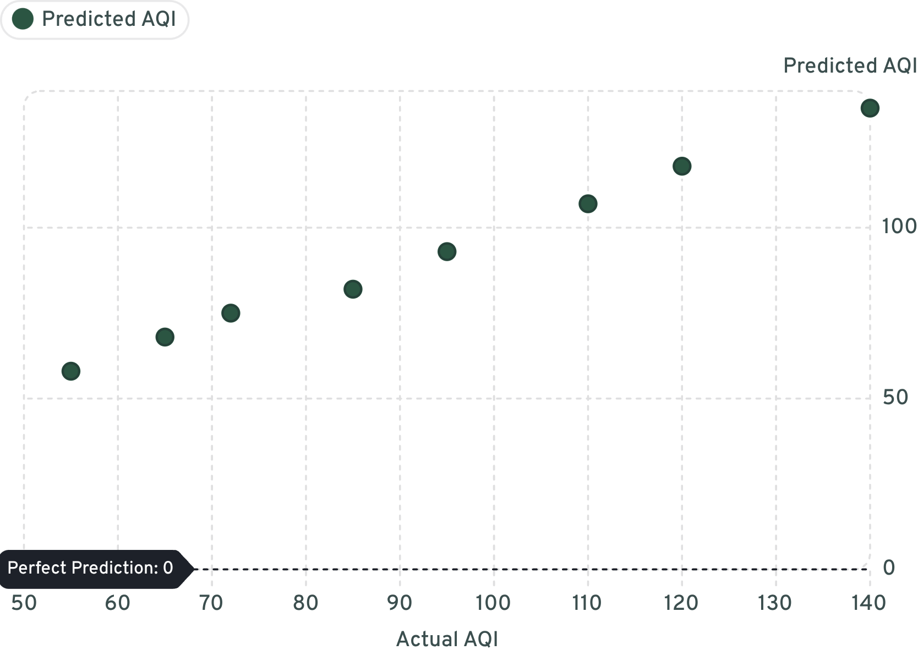
Model Evaluation & Model Registry
Evaluation Metrics
MAE — Average prediction error magnitude
RMSE — Penalizes larger errors more heavily
R² — Proportion of variance explained by the model
Model Registry
Track every model version with metadata, metrics, and artifacts. Enables rollback, comparison, and audit trails.
01
02
03
Version 1
Version 2
Version 3
Initial baseline
Improved features
Production-ready

Slide 7

Deployment — Where Models Create Value
A model only creates value when users can access its predictions.
User Request
API Processing
Model Prediction
Real-time Result
The prediction flows from the user's request through the API and model, then back as a real-time result.
Streamlit
FastAPI
Flask
Rapid dashboard prototyping
Lightweight, async REST API
Simple, flexible web framework

Slide 8
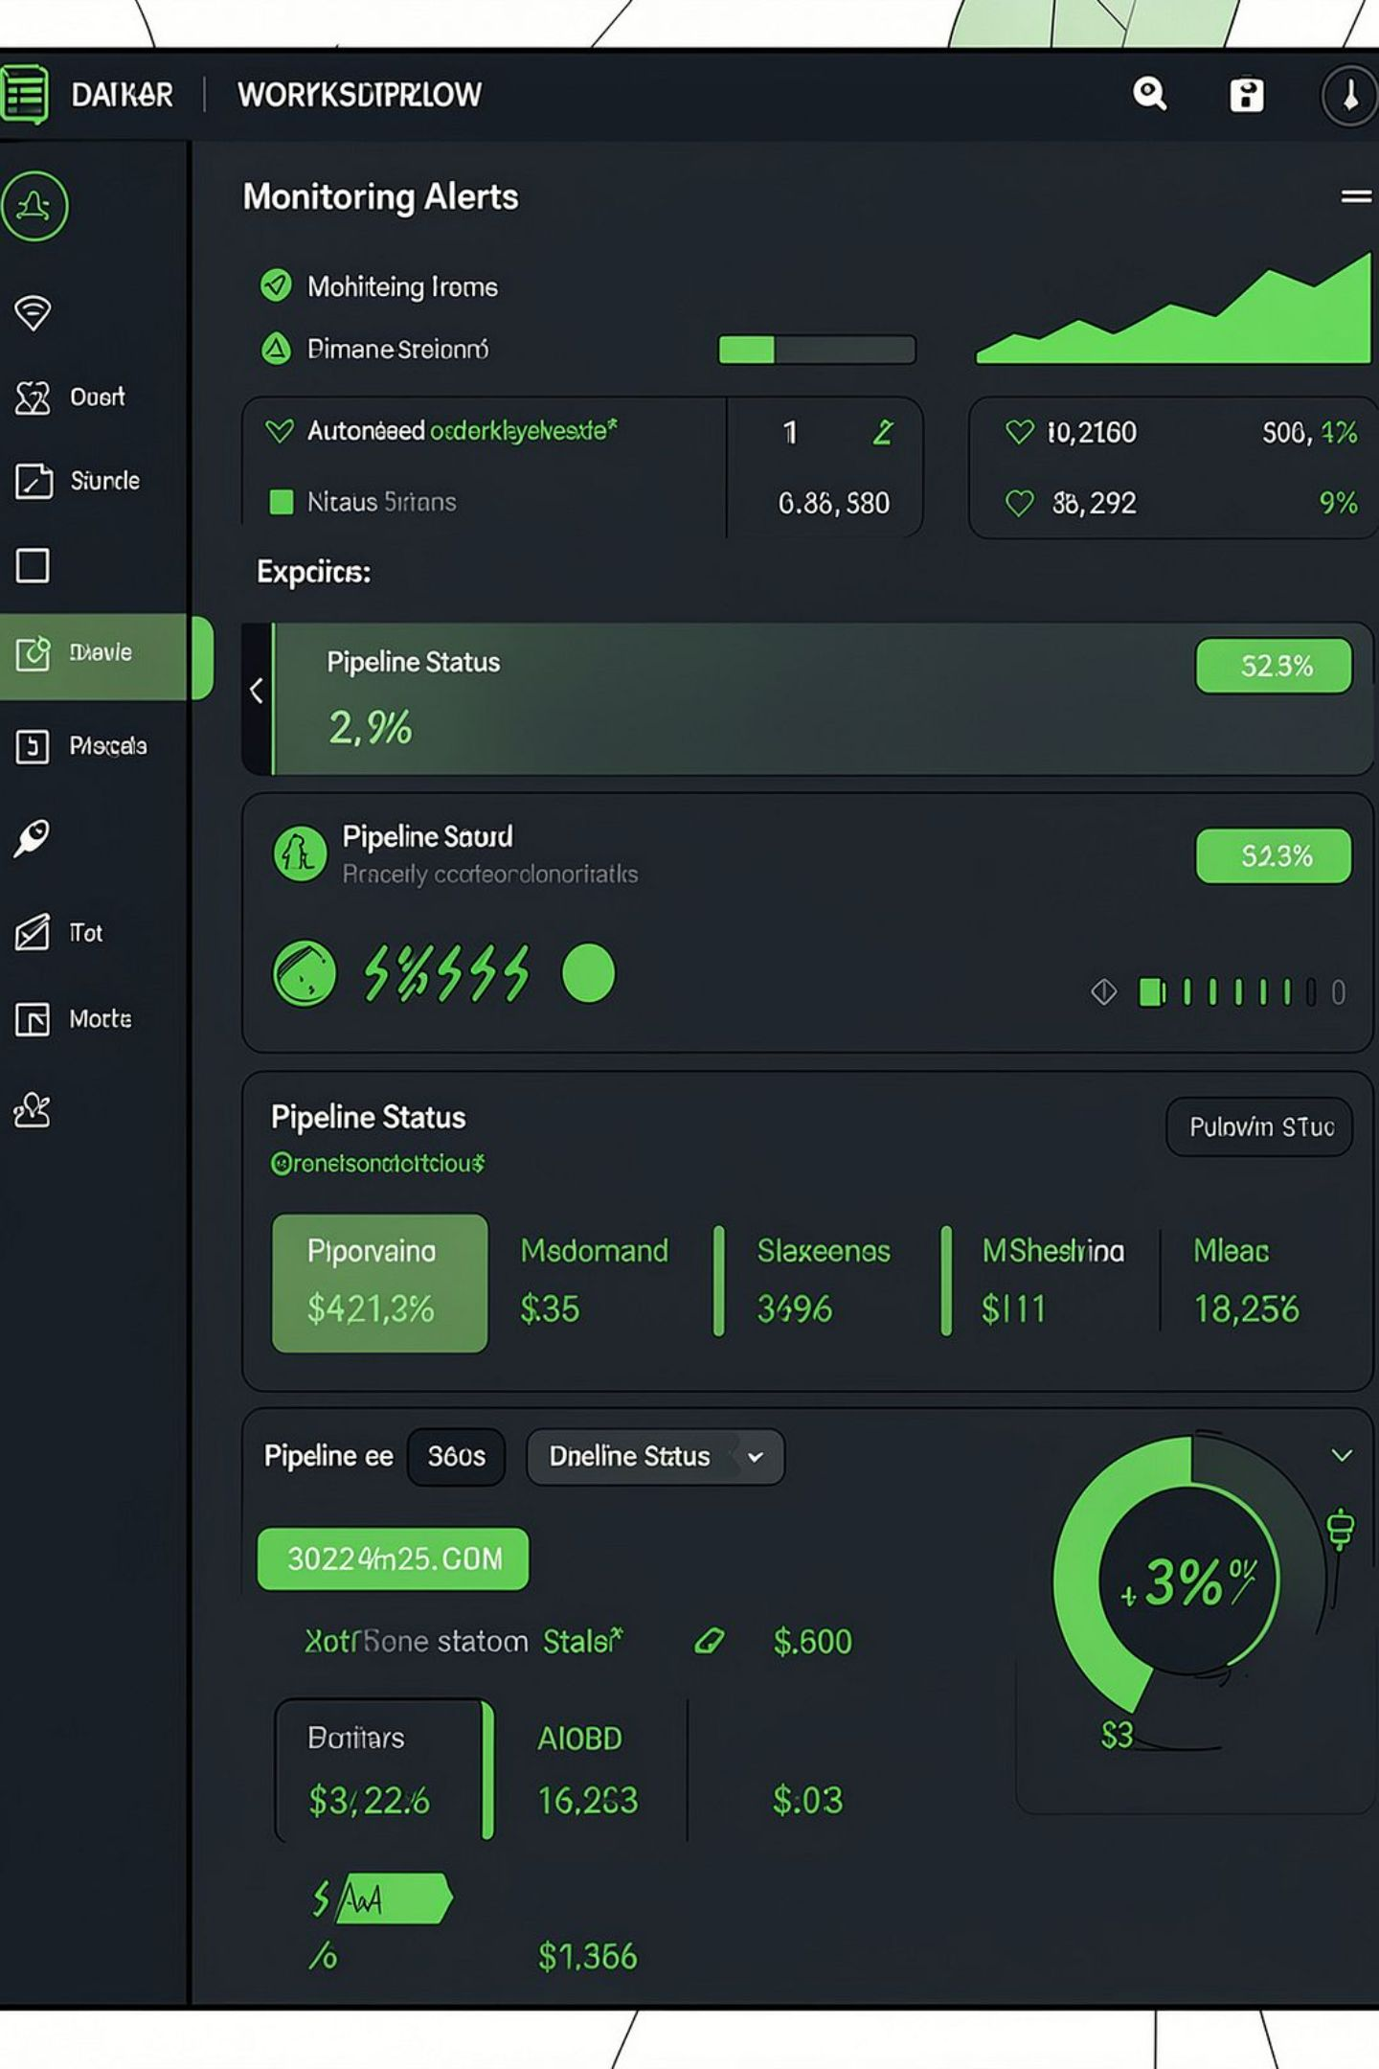

Automation & Monitoring
Auto Data Collection
Scheduled API calls keep data fresh without manual intervention.
Auto Feature Generation
Pipeline transforms raw data into features on every run.
Auto Retraining
Models retrain on schedule or when performance degrades.
Drift Monitoring
Alerts trigger when data drift or performance drops below threshold.
Tools: GitHub Actions, Apache Airflow, Evidently AI for drift detection

Slide 9

Your 7-Week Internship Journey
Each week maps directly onto a stage of the ML pipeline.
Week 1
Week 3
Week 5
Week 7
Data Collection & APIs
Feature Store Setup
Evaluation & Registry
Automation & Monitoring
1
2
3
4
5
6
7
Week 2
Week 4
Week 6
EDA & Feature Engineering
Model Training
Deployment
By the end, you'll have a fully automated, deployed ML system — not just a Jupyter notebook.

Slide 10

Key Takeaways
🔍 Problem First
Always start with the business question — not the algorithm.
📦 Features Matter
Quality features often beat complex models.
🚀 Deploy to Deliver
A model creates value only when users can access it.
🔄 Automate Everything
Automation and monitoring make ML systems production-ready.
"Machine learning is not a one-time event — it's a continuous system that evolves with your data."

