Slide 1
Titanic Survival Prediction
Machine Learning Project
Sameen Chowdhury

Slide 2

Objective: To predict survival on the Titanic using different machine learning models.
The Titanic dataset, sourced from Kaggle, contains detailed information about the passengers aboard the Titanic, the British passenger liner that sank in 1912 after hitting an iceberg.
Key Features Included:
Passenger Information: Name, Age, Sex, Ticket Class (Pclass), and Fare
Family Information
Port of Embarkation
Notes:
The primary goal is to predict whether a passenger survived the disaster using the given features, using various machine learning techniques.

Slide 3

Data Processing
Handle Missing Values:
Fill missing Age with the median age
Fill missing Embarked with 'S' since the majority of passengers embarked from Southampton
Dropped the Cabin column due to a high number of missing values
Removed outliers from the Fare and Age

Slide 4

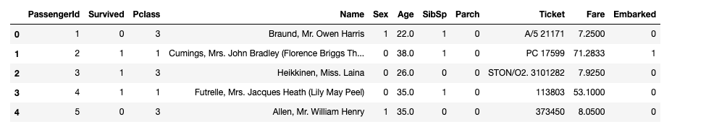
Feature Engineering
Manually Encode Categorical Variables:
The Sex column is encoded as:
1 for 'male'
0 for 'female'
The Embarked column is encoded as:
0 for 'S' (Southampton)
1 for 'C' (Cherbourg)
2 for 'Q' (Queenstown)
The data is split into training and testing sets using an 80-20 split.

Slide 5
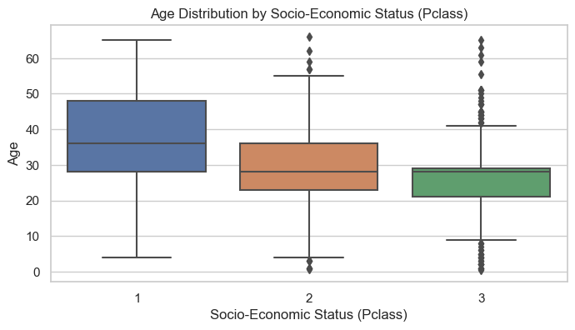
Socio-Economic Status and Age
Objective: To understand how the age distribution varies across different socio-economic statuses (Pclass).
Upper-Class Passengers (Pclass 1): Tend to be older compared to other classes.
Middle-Class Passengers (Pclass 2): Have a more varied age distribution, including many children and middle-aged passengers.
Lower-Class Passengers (Pclass 3): Mostly younger passengers, including many children.

Slide 6
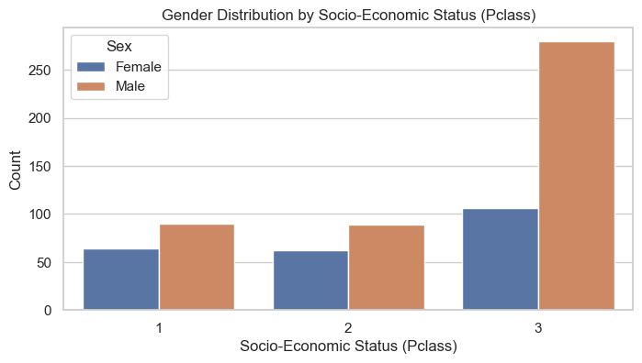
Socio-Economic Status and Gender
Objective: To understand the gender distribution across different socio-economic statuses (Pclass).
Upper and Middle Class Passengers: Has a balanced gender distribution, with higher male.
Lower-Class Passengers (Pclass 3): Male are more than double the female.

Slide 7
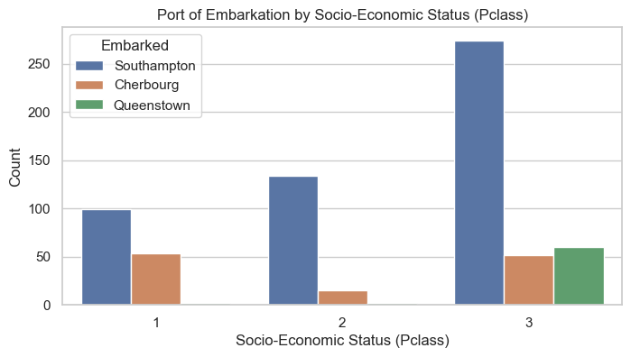
Socio-Economic Status and Port of Embarkation
Objective: To understand how the port of embarkation varies across different socio-economic statuses (Pclass).
Upper-Class Passengers (Pclass 1): Most upper-class passengers embarked from Southampton
Middle-Class Passengers (Pclass 2): The majority of middle-class passengers also embarked from Southampton.
Lower-Class Passengers (Pclass 3): Most interesting finding is that all passengers from Queenstown are lower-class passengers.

Slide 8
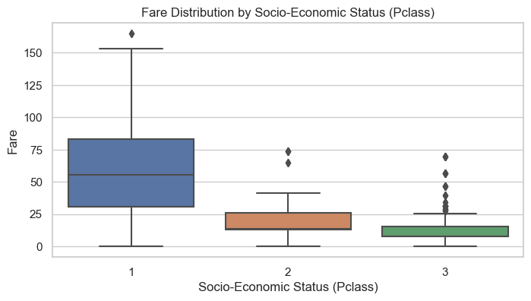
Socio-Economic Status and Fare
Objective: To understand how fare prices vary across different socio-economic statuses (Pclass).
Upper-Class Passengers (Pclass 1): Paid significantly higher fares, with a wider range of fares.
Middle-Class Passengers (Pclass 2): Paid moderate fares, with some overlap with Pclass 1 and Pclass 3.
Lower-Class Passengers (Pclass 3): Paid the lowest fares, with less variability.

Slide 9
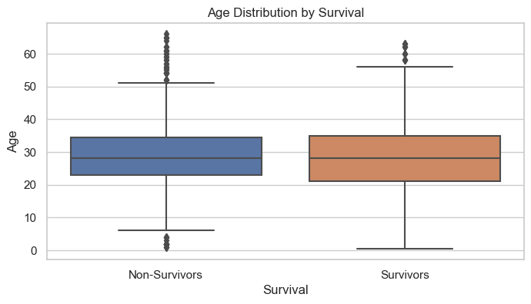
Relationship Between Survival and Age
Objective: To understand how age impacts survival
The age distribution indicates that younger passengers might have had a higher chance of survival, but age was not the sole determining factor.

Slide 10
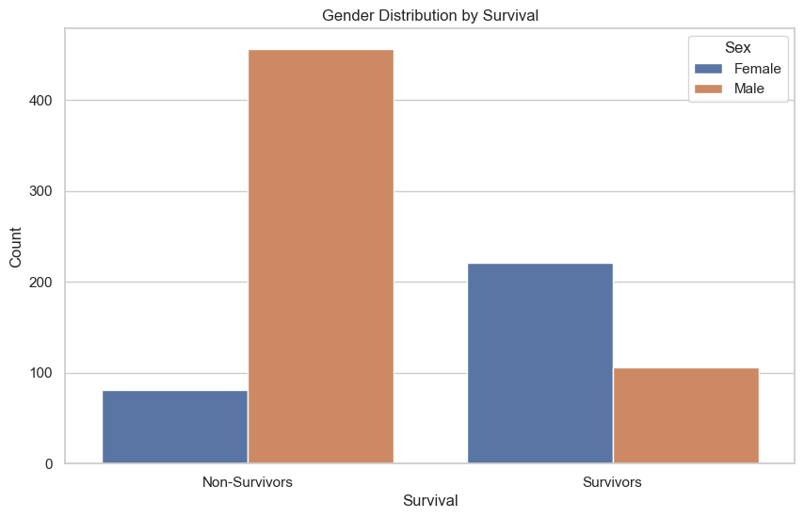
Relationship Between Survival and Gender
Objective: To understand how gender impacts survival.
A higher proportion of female passengers survived compared to male passengers, with a significantly higher proportion of male passengers not surviving.

Slide 11
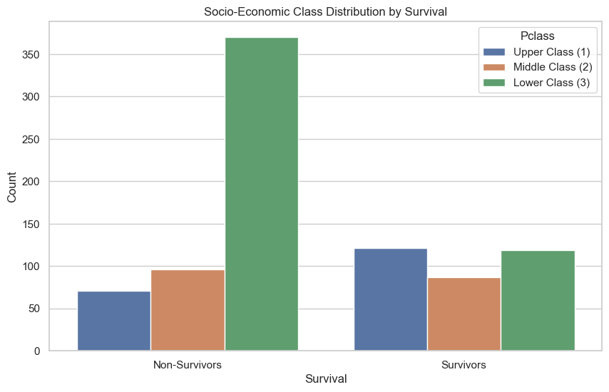
Relationship Between Survival and Socio-Economic Class
Objective: To understand how socio-economic class impacts survival.
Upper-class passengers had a significantly higher survival rate compared to middle and lower-class passengers
Lower-class passengers had significantly higher non survival rate

Slide 12

Correlation Analysis
In this section, we analyze the correlations between various features and the target variable (Survived) to identify the most important features for predicting survival on the Titanic.

Slide 13
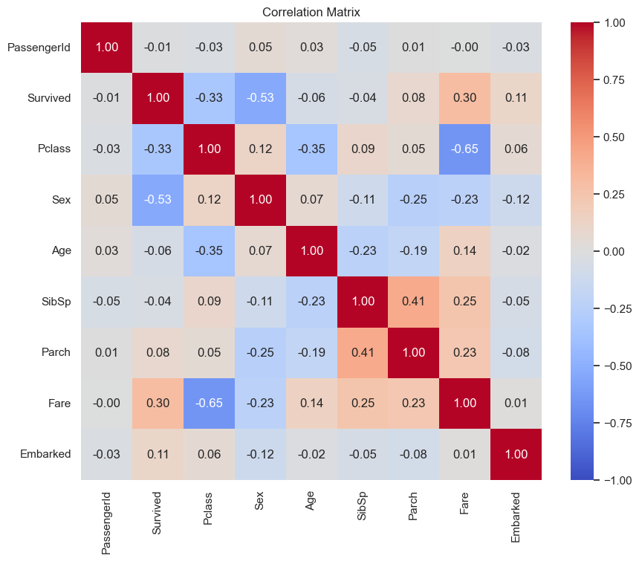
Pclass: Correlation coefficient of -0.33. Suggests that passengers in higher socio-economic classes (lower Pclass value) were more likely to survive.
Sex: Correlation coefficient of -0.53. Meaning that females were more likely to survive.
Fare: Correlation coefficient of 0.30. Suggests passengers who paid higher fares had a higher chance of survival.

Slide 14

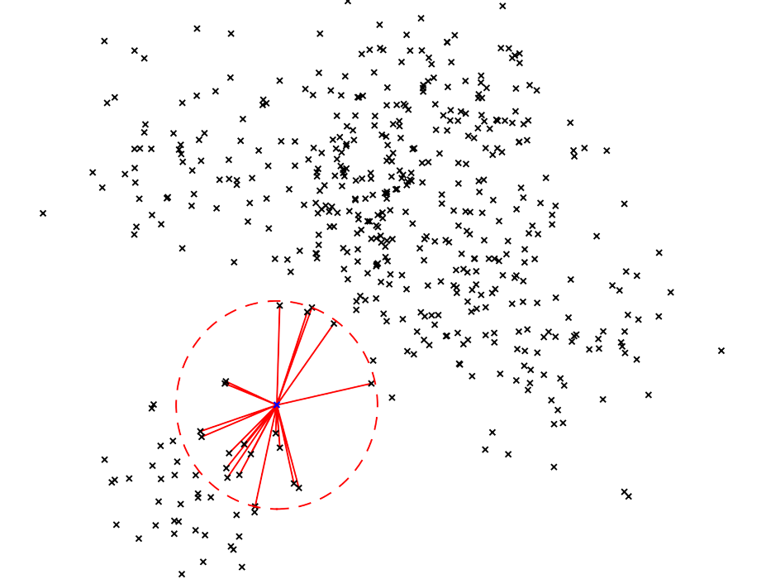

Model Selection
Models Used:
Logistic Regression
Nearest Neighbor Methods
Random Forest

Slide 15
Logistic Regression
Logistic Regression is a statistical method for predicting binary outcomes (such as survival or not). It estimates the probability that an instance belongs to a particular class (e.g., survived) using a logistic function.
Process:
Trained model on the training set and evaluated on the test set.
Results:
Accuracy: 0.734 (73.4% correct predictions)
Precision: 0.701 (70.1% of predicted survivors were actual survivors)
Recall: 0.643 (64.4% of actual survivors were correctly identified)
F1-Score: 0.671 (balance between precision and recall)

Slide 16
Nearest Neighbor Methods
K-Nearest Neighbors (KNN) is an algorithm for classification and regression. It stores all training data and, during prediction, calculates the distance between the test instance and all training instances; then classifies accordingly.
Process:
Trained model on the training set and evaluated on the test set.
Results:
Accuracy: 0.722 (72.2% correct predictions)
Precision: 0.820 82% of predicted survivors were actual survivors)
Recall: 0.438 (43.8% of actual survivors were correctly identified)
F1-Score: 0.571 (balance between precision and recall)

Slide 17
Random Forest
Random Forest is an ensemble learning algorithm that builds multiple decision trees using random subsets of the training data and features. For classification tasks, it makes predictions by taking the majority vote from all the trees.
Process:
Trained model on the training set and evaluated on the test set.
Results:
Accuracy: 0.792 (79.2% correct predictions)
Precision: 0.753 (75.3% of predicted survivors were actual survivors)
Recall: 0.753 (75.3% of actual survivors were correctly identified)
F1-Score: 0.753 (balance between precision and recall)

Slide 18
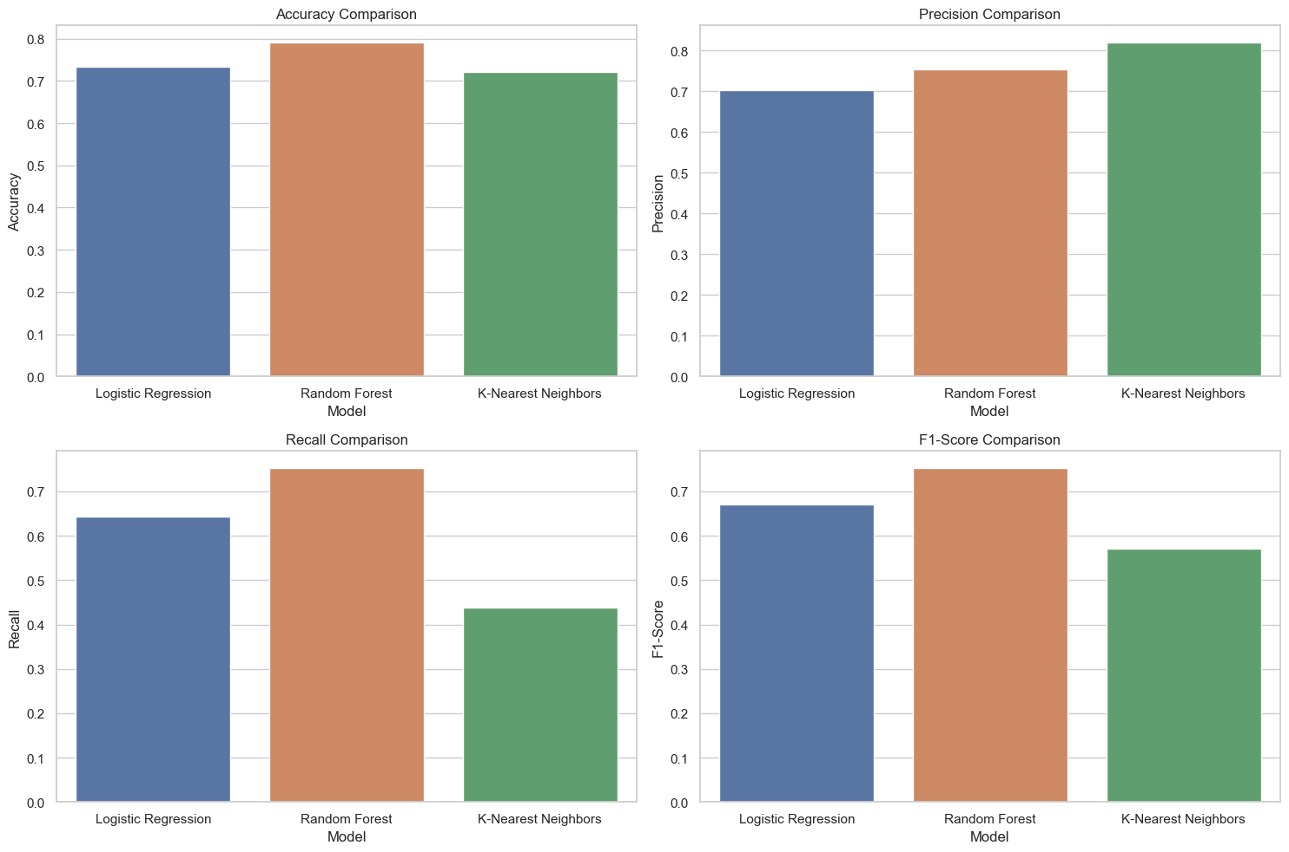

Slide 19
Logistic Regression with Cross-Validation
Steps:
Further Split the Training Data: The initial training data was further split into a new training set and a validation set to ensure better generalization.
Train a new Logistic Regression Model: A new Logistic Regression model was trained on the new training set.
Evaluate on the Validation Set: The model was evaluated on the validation set to check its performance.
Predict on the Test Set: Predictions were made on the test set using the trained model.
Evaluate the Model: The performance of the model was evaluated on the test set

Slide 20
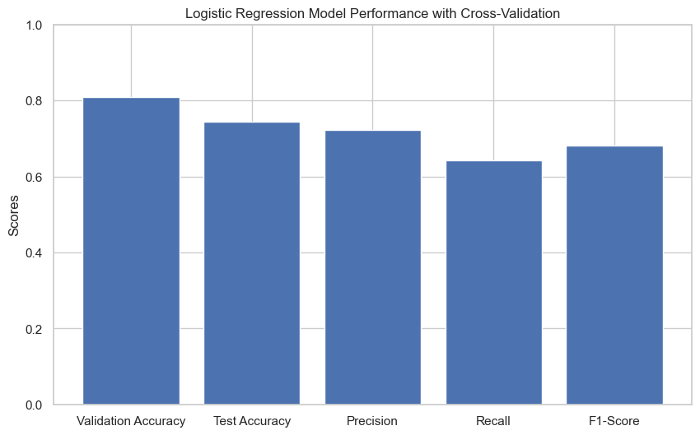
Results:
Validation Accuracy: 0.809 (80.9% correct predictions on the validation set)
Test Accuracy: 0.745 (74.5% correct predictions on the test set)
Precision: 0.723 (72.3% of predicted survivors were actual survivors)
Recall: 0.643 (64.3% of actual survivors were correctly identified)
F1-Score: 0.681 (balance between precision and recall)
Cross-validation improved the test accuracy, precision and F1-score very slightly.
The model's precision improved, but recall slightly decreased, suggesting a focus on correctly identifying survivors at the cost of missing some actual survivors.

Slide 21
Conclusion
Summary:
Random Forest outperformed other models in all aspects.
Logistic Regression showed good validation performance but slightly lower test performance.
K-Nearest Neighbors had the highest precision among the 3 models.
Potential Reasons for Lower Model Accuracy
Imbalanced Data: More non-survivors than survivors.
Model Selection: There could be other models with more suitable algorithms
Data Quality: Subtle outliers can affect performance

