Slide 1
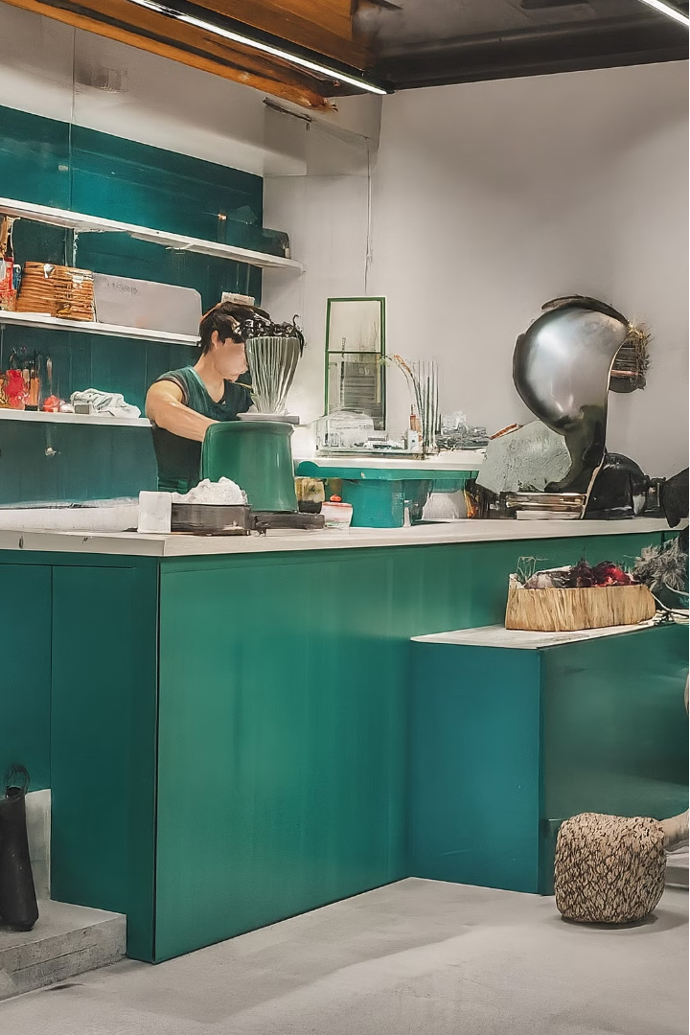


Optimizing the Superstore Product Portfolio
To drive sales growth, the Superstore should focus on optimizing its product portfolio through targeted inventory expansions, strategic product rationalization, and enhancing the overall customer experience.
by Sameen Khurram

Slide 2
Expand Inventory in High-Performing Categories
Technology
Office Supplies
Optimization
Increase inventory in high-demand sub-categories like computers, printers, and computer accessories to meet customer needs.
Expand the selection of popular writing instruments, paper products, and other essential office supplies to cater to the needs of small businesses and professionals.
Leverage data analytics to continuously monitor sales trends and adjust inventory levels in these high-performing categories accordingly.

Slide 3

Address Low-Performing Products
1
Furniture
2
Product Rationalization
Carefully analyze the Furniture category to identify and address underperforming sub-categories, such as tables and chairs, to improve overall margins.
Discontinue or reduce inventory of slow-moving or low-profit products to optimize shelf space and focus resources on higher-performing items.
3
Pricing Adjustments
Implement strategic pricing modifications to improve the profitability of low-performing products and enhance the overall product mix.

Slide 4



Improve Product Mix and Pricing
Product Mix
Pricing Strategies
Promotions
Carefully curate the product assortment to ensure it aligns with customer demand and maximizes profitability.
Leverage targeted promotions and discounts to drive sales and clear out excess inventory of slow-moving products.
Implement data-driven pricing strategies to optimize margins and stay competitive in the market.

Slide 5




Enhance Customer Experience and Engagement
Seamless Shopping
Personalized Service
Loyalty Programs
Community Engagement
Optimize the in-store and online shopping experience to provide customers with a convenient and enjoyable journey.
Empower and train store associates to provide exceptional, personalized customer service that builds brand loyalty.
Introduce and promote customer loyalty programs to incentivize repeat business and foster long-term relationships.
Actively participate in local community initiatives to strengthen the Superstore's brand image and customer connections.

Slide 6

Holistic Approach to Transformation
1
Data-Driven Insights
Leverage in-depth data analysis to gain a deep understanding of customer preferences, sales trends, and operational efficiencies.
2
Cross-Functional Collaboration
Foster a culture of collaboration across all departments to align on a shared vision and execute the transformation strategy seamlessly.
3
Continuous Improvement
Implement a framework for ongoing monitoring, evaluation, and refinement of the product portfolio and customer experience initiatives.

Slide 7


Expand Geographic Reach
Key Regions Focus
New Market Exploration
Deploy targeted marketing campaigns in underperforming 'West Coast' cities like Los Angeles and San Francisco to boost sales.
Investigate emerging rural areas with growing online shopping trends, particularly for home office setups amid remote work trends.
Utilizing targeted marketing campaigns and exploring new emerging markets, the Superstore aims to improve delivery times and drive sales in underperforming regions. Strategic logistics improvements will be made to enhance customer satisfaction.

Slide 8
Thank You
Thank you for your attention and consideration.

