Slide 1
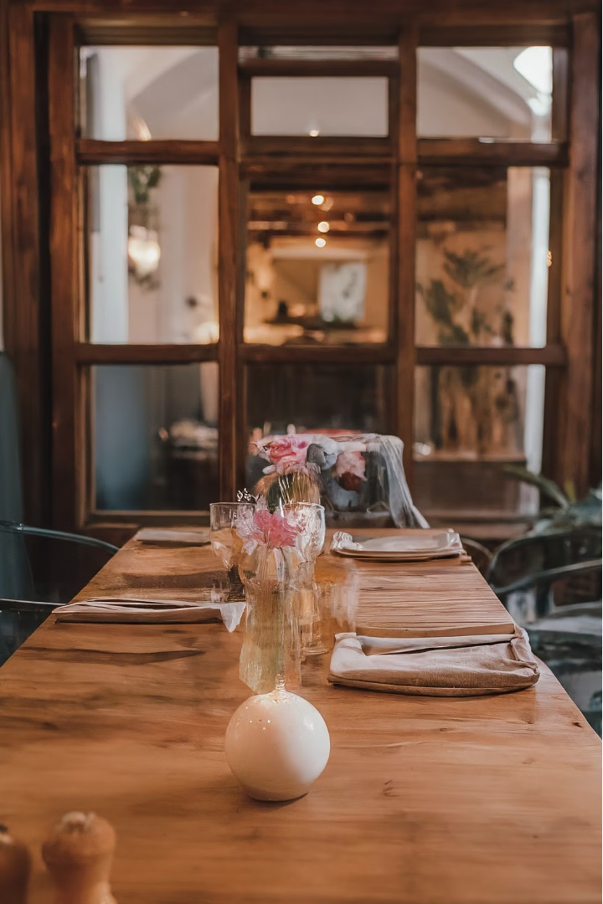

Marketing Campaign Strategies
by Sameen Khurram

Slide 2
Taste of Asia in New Delhi
Introducing New Cuisines
Collaborating with Influencers
Hands-on Experiences
To address the underrepresentation of Southeast Asian cuisines like Vietnamese and Korean, we're launching a "Taste of Asia" festival that will feature a new menu of authentic dishes from these regions. This will allow our customers to explore and discover the vibrant flavors of these emerging culinary trends.
In addition to the new menu, we'll be hosting cooking classes and tasting events featuring guest chefs from Southeast Asia. These interactive experiences will allow our customers to learn about the cultural traditions and techniques behind these delicious dishes firsthand.
To enhance the visibility of this new menu, we'll be partnering with local influencers who specialize in Asian cuisine. Their expertise and social media reach will help us effectively promote the festival and drive excitement among our target audience.

Slide 3
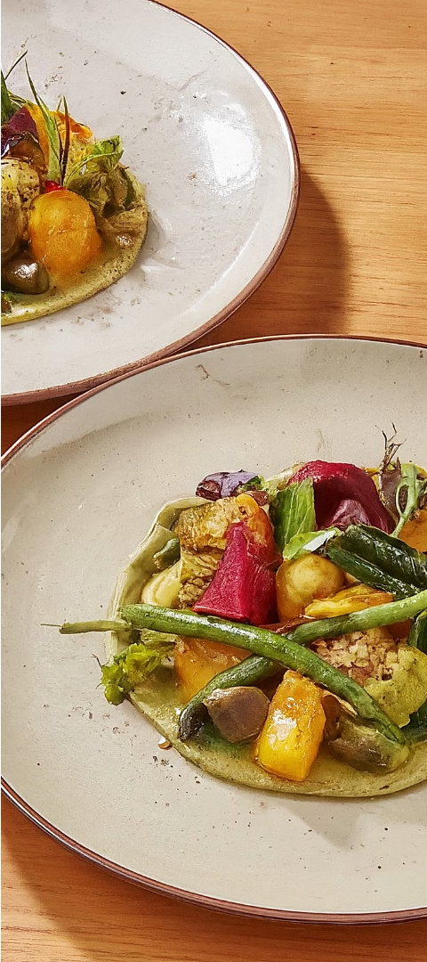
Gourmet Veggie in Mumbai
1
Sophisticated Vegetarian Dining
2
Targeted Social Media Outreach
To address the lack of high-end vegetarian dining options in Mumbai, we're introducing a "Gourmet Veggie" menu that offers sophisticated vegetarian dishes made with organic and locally sourced ingredients. This will cater to the growing demand for upscale, health-conscious dining experiences.
We'll be using targeted ads on social media platforms frequented by vegetarians and health-conscious groups to effectively promote the new "Gourmet Veggie" menu and drive awareness among our target audience.
3
Farm-to-Table Experiences
To further enhance the connection between our customers and the ingredients used in our dishes, we'll be organizing farm-to-table events where customers can visit local farms and then dine on a special menu featuring the very ingredients they saw being grown and harvested.

Slide 4

Smart Dine-In in Bangalore
1
Integrated Digital Experience
To cater to the tech-savvy customers in Bangalore, we're introducing a "Smart Dine-In" experience that allows customers to order from digital menus, customize their dishes interactively, and pay via a dedicated app. This will provide a seamless and integrated dining experience that appeals to our digitally-savvy target audience.
2
Promotional Partnerships
To further enhance the visibility of our "Smart Dine-In" experience, we'll be partnering with local tech companies and startups to offer promotional offers that can be availed through app-based bookings. This will help us tap into the tech-focused community in Bangalore and drive adoption of our digital dining features.
3
Immersive Dining Experiences
In addition to the digital features, we'll be setting up periodic theme nights that use augmented reality to enhance the dining experience, such as a "Virtual Chef" night where customers can interact with a digital chef while enjoying their meal. These innovative experiences will further differentiate our offering in the Bangalore market.

Slide 5




Common Elements Across Cities
Social Media Campaigns
Email Marketing
Community Engagement
Interactive Content
Segmented emails that announce new features, menus, or events, with personalized offers based on past dining history.
Develop virtual tours, behind-the-scenes videos, and tech feature demos to highlight the unique attributes of each campaign.
Tailored ads for each city's campaign, emphasizing unique selling propositions.
Sponsor local events to gain visibility and encourage feedback through digital platforms to refine offerings.

Slide 6
Exclusive Tastings in Mumbai
Building Buzz
Referral Rewards
To generate excitement and word-of-mouth for the new "Gourmet Veggie" menu in Mumbai, we'll be hosting an exclusive tasting event for food critics and bloggers. This will allow us to showcase the quality and creativity of our vegetarian dishes and gain valuable endorsements from influential voices in the industry.
In addition to the exclusive tasting event, we'll be implementing a referral program that encourages our diners to spread the word about the "Gourmet Veggie" menu. By offering discounts to both the referrer and the referee, we can leverage our existing customer base to drive new trial and repeat visits.

Slide 7
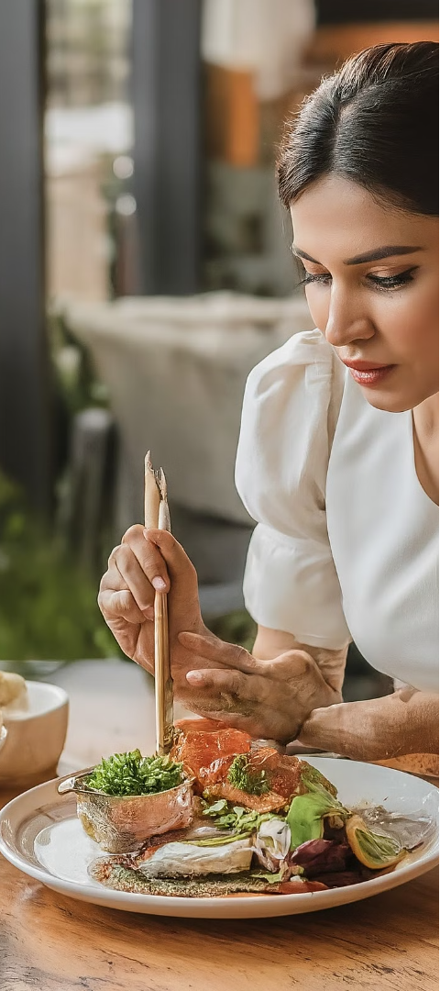



Introductory Discounts in New Delhi
New Menu Launch
To introduce the "Taste of Asia" festival and the new Vietnamese and Korean dishes to our customers in New Delhi, we'll be offering introductory discounts on the menu during the first month.
Loyalty Program
Alongside the discounts, we'll be implementing a point-based loyalty program where diners can earn points for trying the new menu items. These points can then be redeemed against future visits, encouraging repeat business and deeper engagement with the "Taste of Asia" offerings.
Sustained Excitement
By combining the introductory discounts with the loyalty program, we aim to drive initial trial of the new menu and then sustain long-term interest and engagement from our customers in New Delhi.

Slide 8
Integrated Digital Experience in Bangalore
Digital Menus
Customers can browse and order from interactive digital menus, allowing for a seamless and personalized dining experience.
Dish Customization
Diners can customize their dishes directly on the digital platform, catering to their specific preferences and dietary requirements.
App-based Payments
Customers can conveniently pay for their meals through the dedicated app, eliminating the need for cash or card transactions.
Augmented Reality
Periodic theme nights will incorporate augmented reality elements, such as a "Virtual Chef" experience, to enhance the dining experience.

Slide 9
Thank You!

