Slide 1

HANDS ON DATA SCIENCE PROJECT – 2 PROBLEM STATEMENT – 2 GROUP - B FINANCIAL ANALYSTS WOULD WANT TO PREDICT IF THE COMPANY WOULD BE PROFITABLE IN NEXT 5 YEARS OR NO
BY :
Sameep Shah
Professional Diploma in Data Science –
77422376591

Slide 2
UNDERSTNDING PROBLEM
Checking Correlation
Correlation matrix
Number of rows and columns
Data Type
Handling Null Values
Handling Null Values by dropping those rows
Exploring Data
Correct Approach
Type of Model
Type of Evaluation Model
Target Variable
Features
Null values
Data types of features
Converting Data Type from ‘object’ to ‘category’
Data Analysis
Description of data
Description of Categorical Data
Handling Outliers
Correlation of features with target variable
Splitting Train and Test data and choosing the right model
Analysis of other features
Handling outliers not required as there are a lot of outliers and may add bias to the data
Description of Continuous Data
Dummy Data and Scaling
Categorize all the categorical variables using one-hot encoding
Standardizing the numerical(continuous variables)
Splitting data 70% Train and 30% test
Choosing right model with performance parameter “Accuracy” and “F1 Score”

Slide 3
WHAT IS THE OBJECTIVE?
Problem description
Every company aims to achieve and create maximum profits for the continuous success of the company as well as keeping up with the competition in the market. With so many aspects and factors that decide the companies success or failure it is hard to predict the future of the company with evidence, proof and facts that can back these predictions. This is where financial analysts come into picture that use proper machine learning tools to make such predictions based on the past data of the company with many variables considered.
Objective of the problem
A machine learning system that can be used by financial analysts to predict if the company will be profitable in the next five years or not.

Slide 4
DATA EXPLORATION
Number of rows and columns
Rows = 43261 Columns = 16
Data Types of Columns
Float = 8 Integer = 0 Object = 8
Columns with Null Values
Total liabilities/ Total Assets = 7 6. Working Capital/ Total Assets = 7
Current Assets/Short-Term Liabilities = 133 7 . Retained Earning/Total Assets = 12
Sales/Total Assets = 9 8. Equity/Total Assets = 7
4. Powered by Green Energy = 2073 9. (Gross Profit + Interest)/ Total Assets = 6
5. (Total Liabilities*365)/ (Gross Profit + Depreciation) = 36

Slide 5
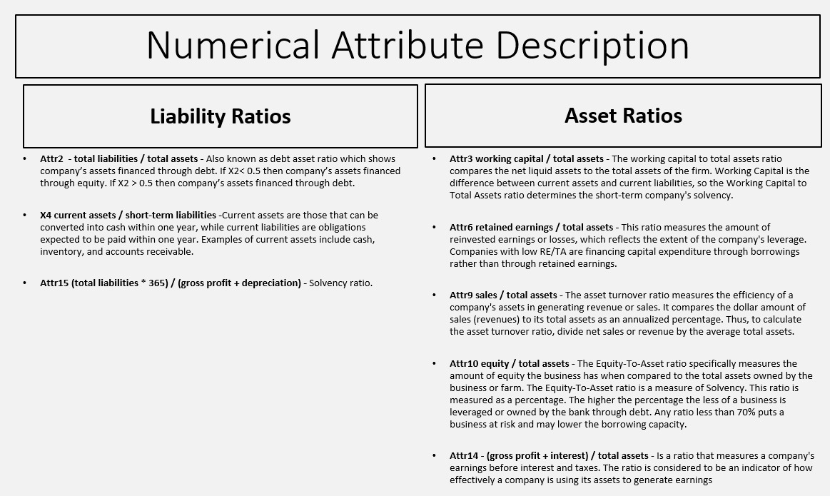

Slide 6
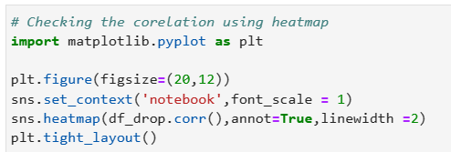
CHECKING CORRELATION
Checking Correlation with Heatmap and dropping the correlated columns using drop( )

Slide 7
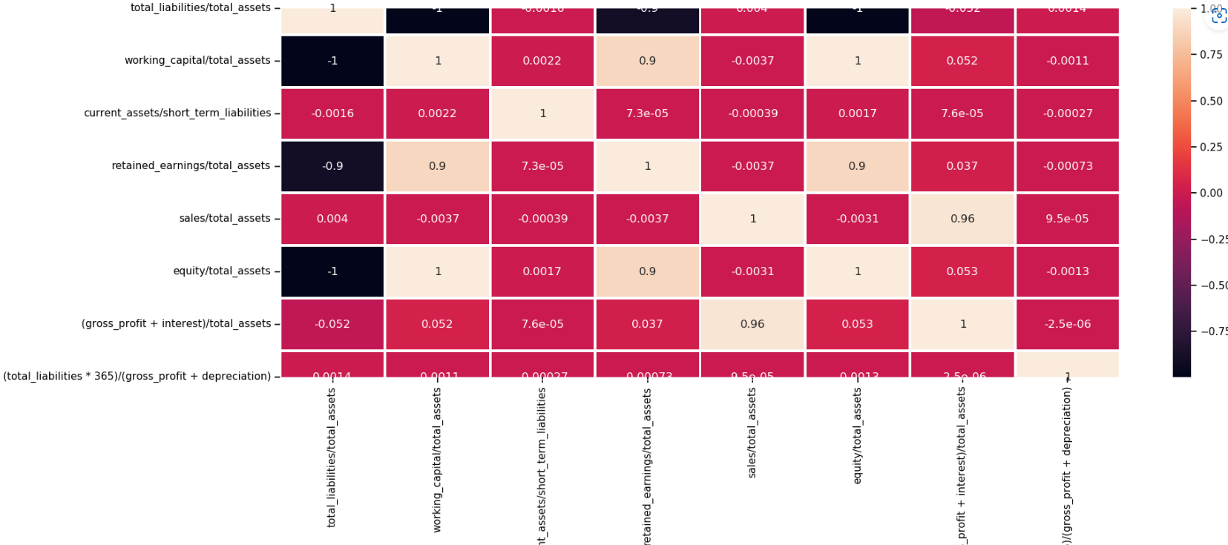

Slide 8
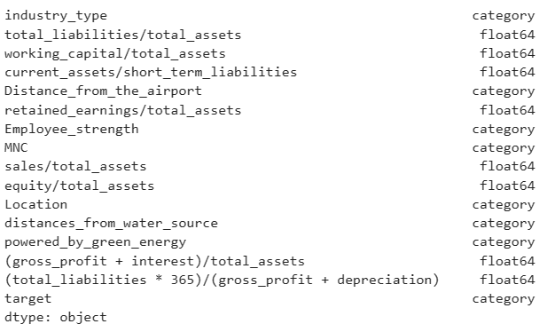
DATA TYPE
Converting ‘object’ datatype to ‘category’
using astype( )

Slide 9
HANDLING NULL VALUES
To handle null values in ‘categorical’ data, we used MODE method to fill the null values with most occurring value in the particular feature.
To handle null values is ‘numerical’ data we use MEDIAN/MEAN method to fill the null values.
In the given current data filling null values is causing a reduction in performance of the model hence the rows having null values have been dropped.

Slide 10
DATA ANALYSIS
Analyze data using the following visualization techniques :
HISTOGRAM
BAR PLOT
HEATMAPS

Slide 11
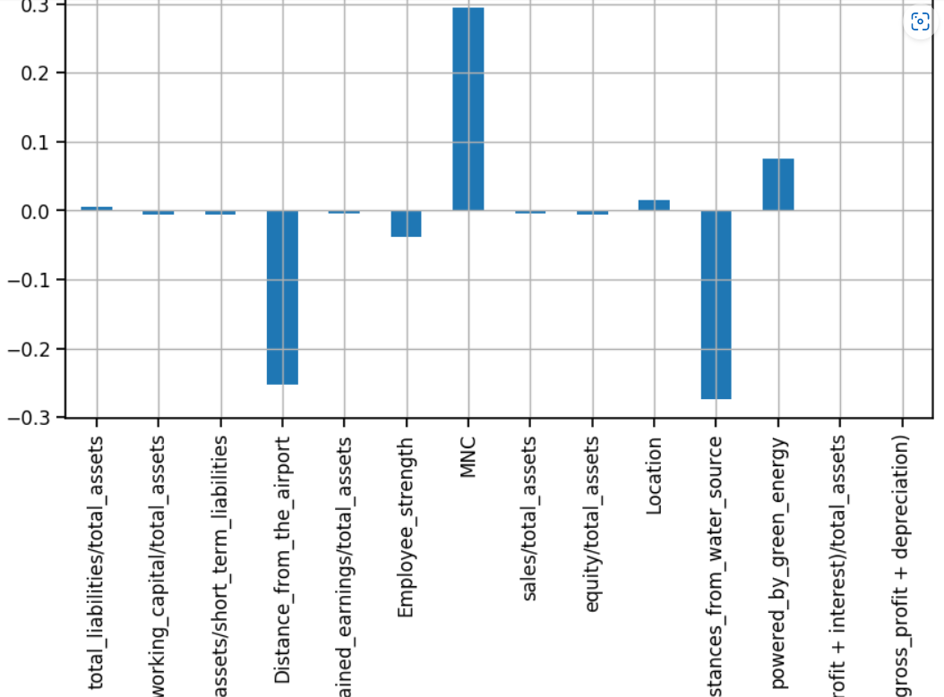
CHECKING CORRELATION OF THE TARGET VARIABLE

Slide 12
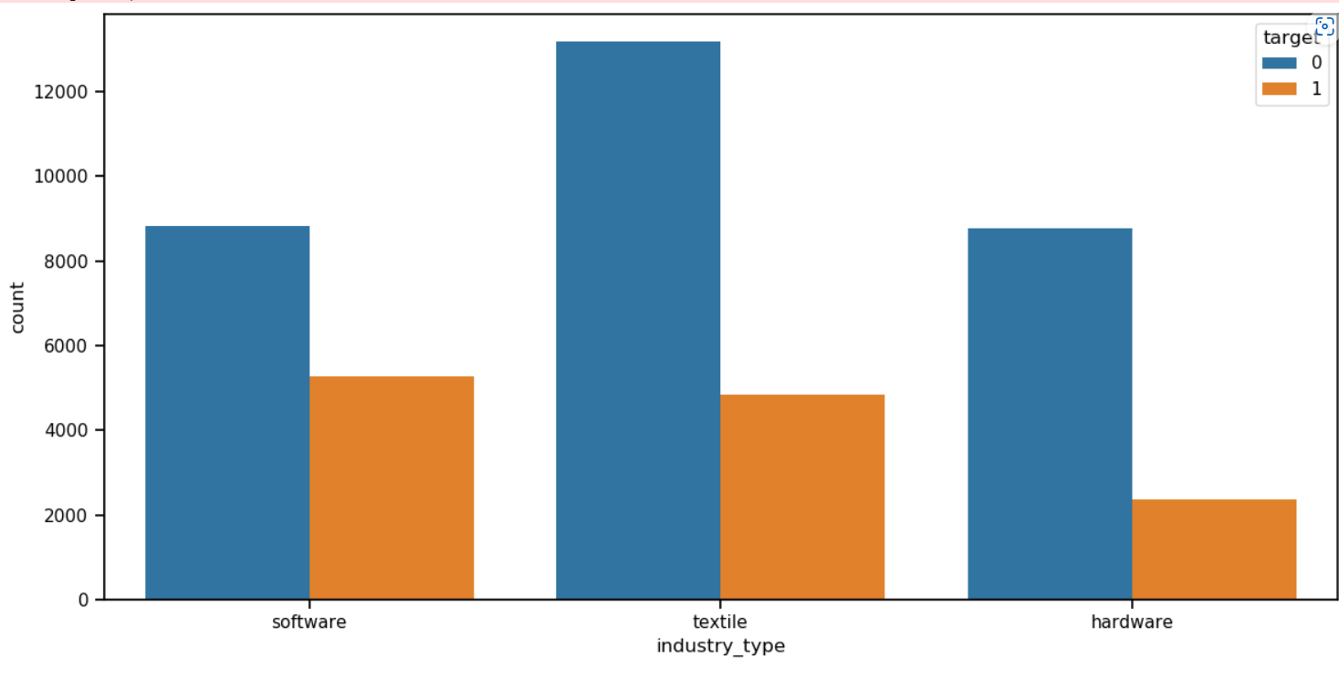
Comparing Industry Type Count with Target

Slide 13
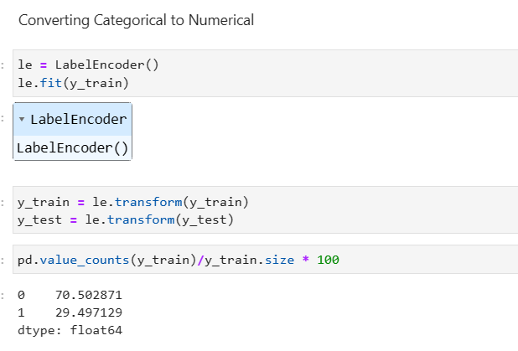
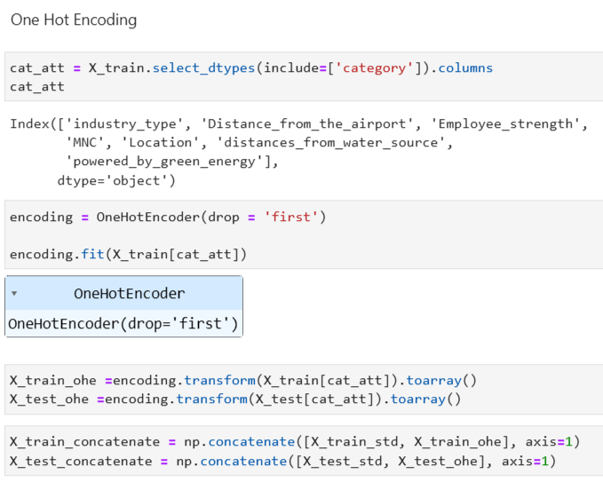
Using Label Encoding and One-Hot Encoding

Slide 14
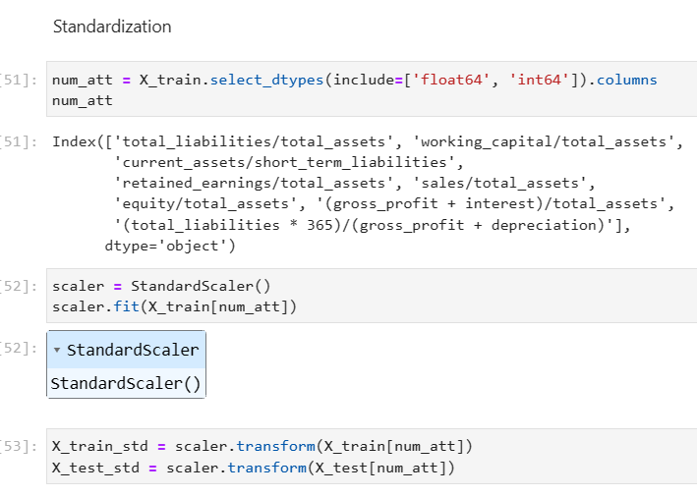
Using Standardization

Slide 15
Splitting train and test data and choosing the model
Splitting the data into TRAIN and TEST by 70% - 30%
Models :
Logistic Regression
Support Vector Machine
Adaboost
Gradient Boosting
Random Forest

Slide 16
Finalize the Best Model
MODEL NO | DESCRIPTION | CONUSION MATRIX | PRECISION | RECALL | ACCURACY | F1 SCORE
1 | Logistic Regression | [[8585 30] [1352 2349]] | 0.987 | 0.634 | 0.882 | 0.772
2 | SVM Algorithm | [[8586 29] [1353 2348]] | 0.987 | 0.634 | 0.887 | 0.772
3 | Random Forest | [[8580 35] [1220 2481]] | 0.986 | 0.670 | 0.898 | 0.798
4 | Adaboost (Ensemble) | - | 0.887 | 0.887 | 0.887 | 0.881
5 | Gradient Boosting (Ensemble) | - | 0.907 | 0.897 | 0.897 | 0.890

Slide 17
Final deliverables
MODEL 5: Gradient Boosting Algorithm with an F1 Score of 0.890

