Slide 1

BOOTCAMP PROJECT PROBLEM STATEMENT – 1 PREDICT IF THE MERCHANT IS FRAUDSTER OR NOT FOR AN E-COMMERCE CLIENT
BY :
Sameep Shah
M.Sc. ARTIFICIAL INTELLIGENCE AND MACHINE LEARNING –
77422376591

Slide 2
UNDERSTNDING PROBLEM
Visualizations
Correlation matrix
Boxplots to check outliers for numerical data
Number of rows and columns
Data Type
Handling Null Values
No null values
Exploring Data
Correct Approach
Type of Model
Type of Evaluation Model
Target Variable
Features
Null values
Data types of features
Converting Data Type from ‘object’ to ‘category’
Dropping Columns with many unique values
Distribution plots for numerical data
Bar Graphs for categorical data
Data Analysis
Description of data
Description of Categorical Data
Handling Outliers
Correlation of features with target variable
Splitting Train and Test data and choosing the right model
Analysis of other features
Handling outliers not required
Description of Numerical Data
Dummy Data and Scaling
Categorize all the categorical variables using one-hot encoding
Standardizing the numerical data
Splitting data 67% Train and 33% test
Choosing right model with performance parameter “F1 Score”

Slide 3
WHAT IS THE OBJECTIVE?
Problem description
As the online giant grows, so has the number of fraudster merchants are. They deliver counterfeits or, in some cases, nothing at all. Such schemes leave customers duped, and place both legitimate merchants and the company itself in a constant battle to rid the marketplace of scammers. Determining this is also important in budgeting for fraud investigation. It's a well-known problem both to the company and to merchants, which they say hasn't effectively addressed the issue. They are serious about it and want to protect themselves from these fraudulent merchants using technology.
Objective of the problem
A machine learning system that can be used by financial analysts to predict if the marchant is fraudulent or not.

Slide 4
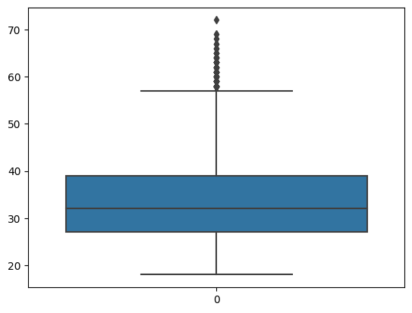
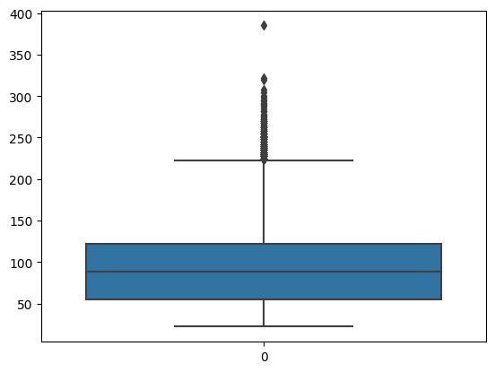
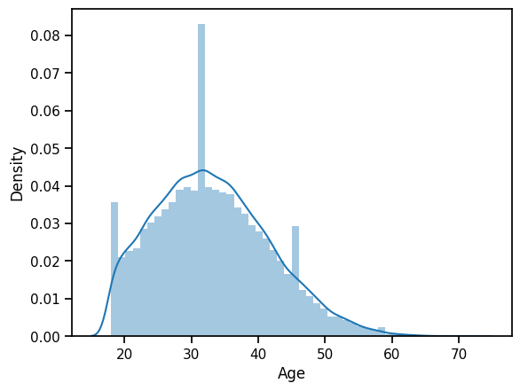
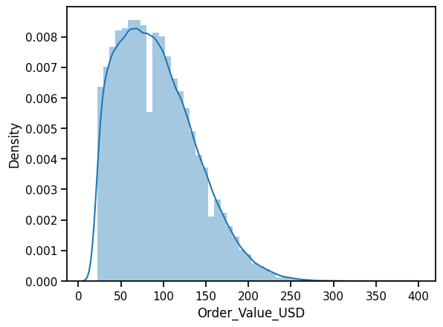
Age
Order Value USD

Slide 5
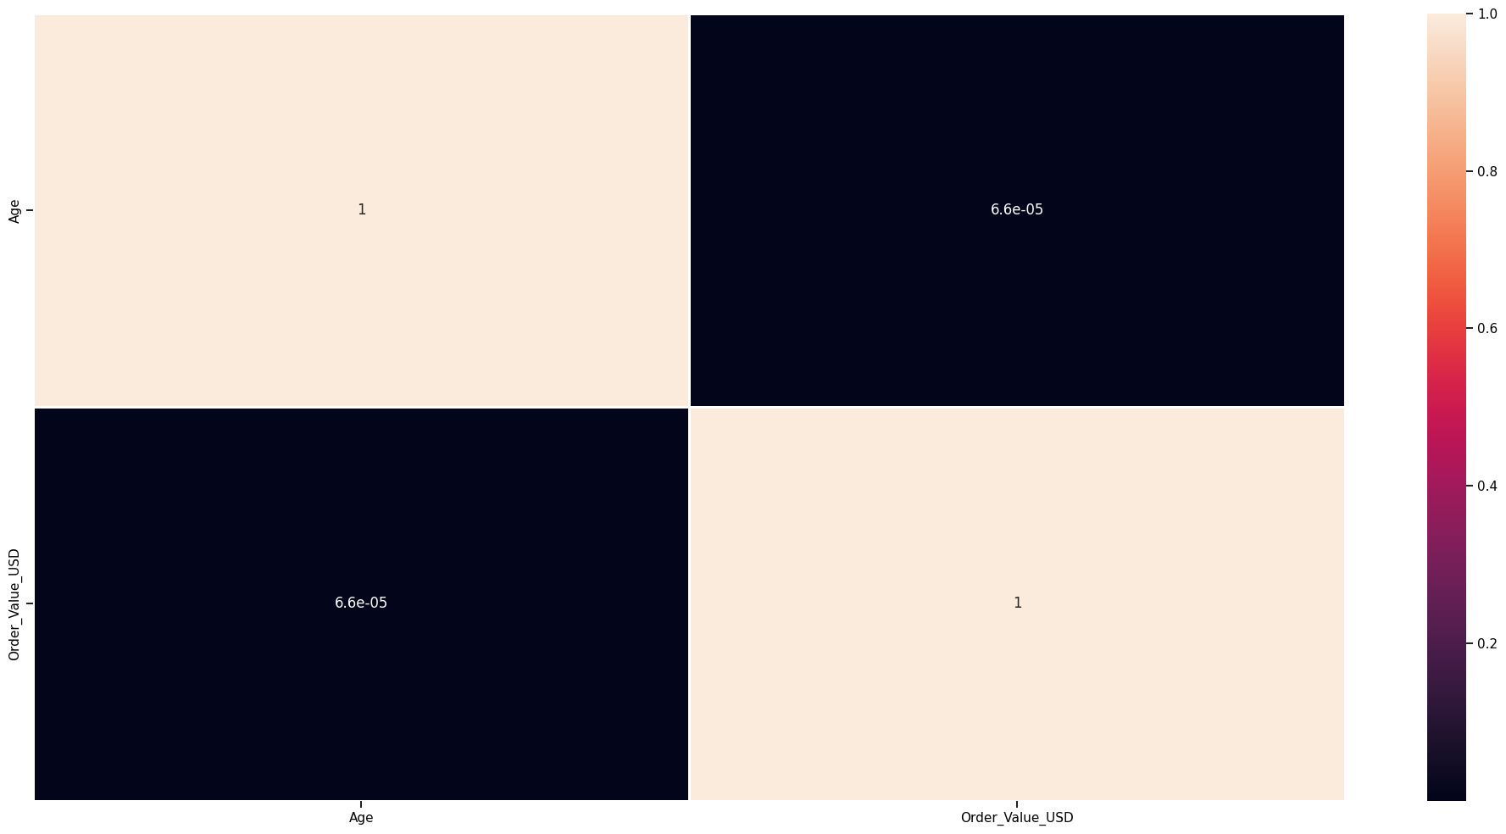

Slide 6
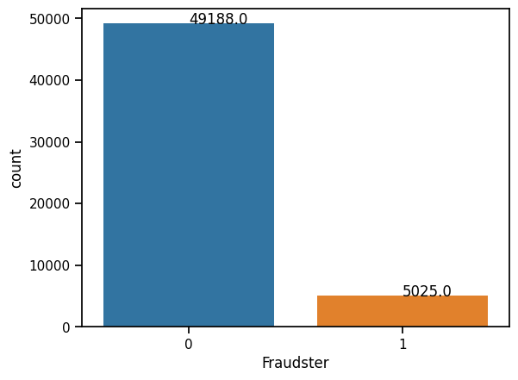
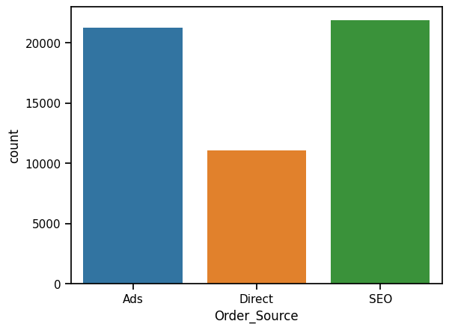
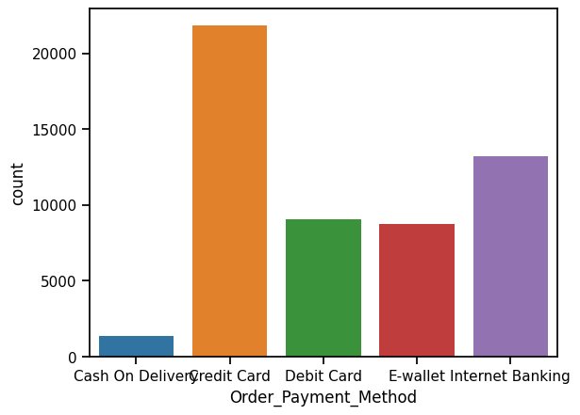
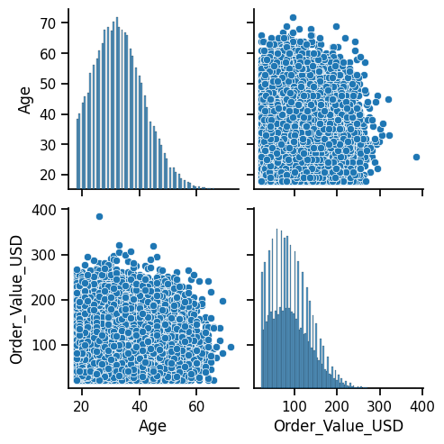

Slide 7
DATA TYPE
Converting ‘object’ datatype to ‘category’
using astype( )
Gender - Category
Age - Numeric
Order_Value_USD - Numeric
Order_Source - Category
Order_Payment_Method - Category
Fraudster - Category

Slide 8
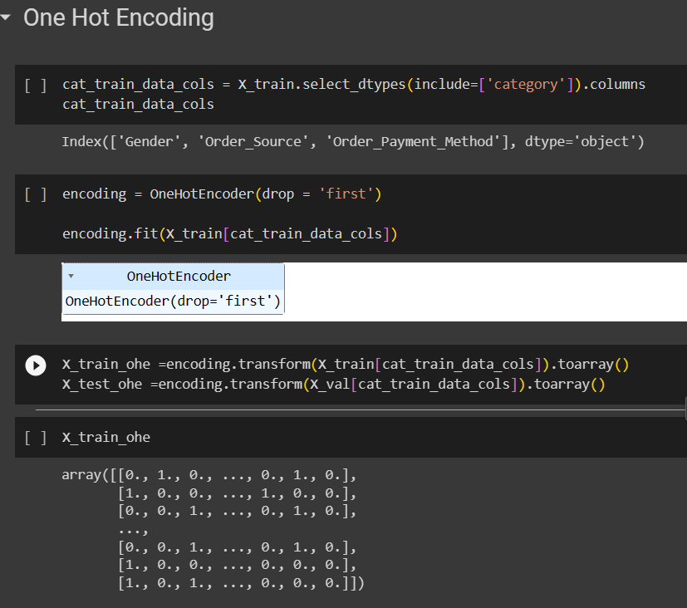
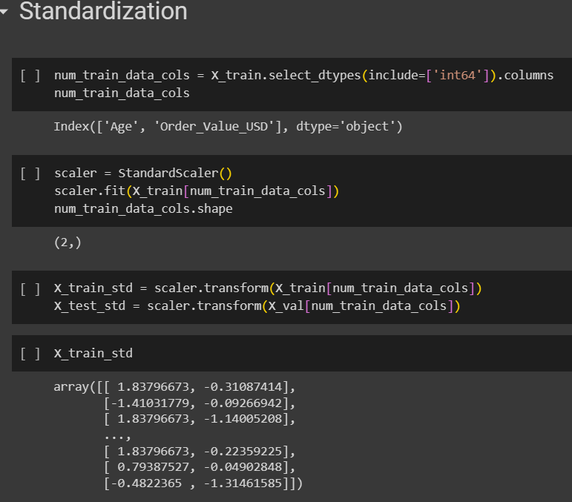
Using One-Hot Encoding and Standard Scaler

Slide 9
Splitting train and test data and choosing the model
Splitting the data into TRAIN and TEST by 67% - 33%
Models :
Logistic Regression
Support Vector Machine
Random Forest
XGBoost

Slide 10
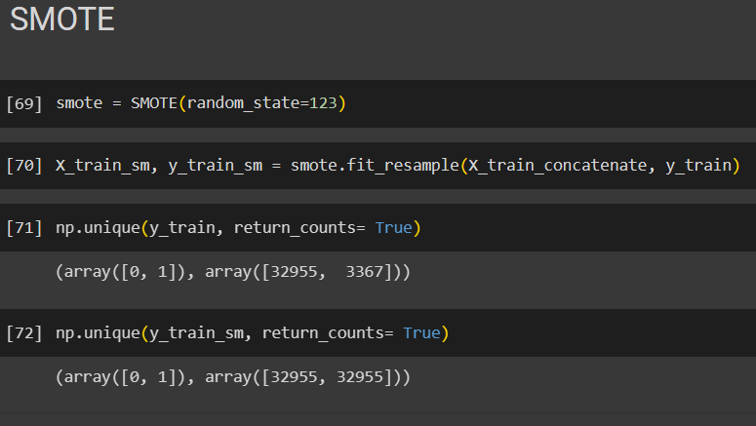
Using SMOTE for Upsampling

Slide 11
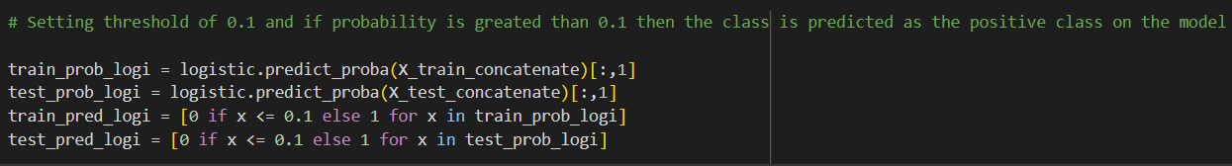
Using Threshold Technique

Slide 12
Finalize the Best Model
MODEL NO | DESCRIPTION | CONUSION MATRIX | PRECISION | RECALL | ACCURACY | F1 SCORE
1 | Logistic Regression[Using Threshold] | [[13375 2858] [ 1332 326]] | 0.102 | 0.196 | 0.765 | 0.134
2 | SVM Algorithm[Using SMOTE] | [[26306 6649] [25273 7682]] | 0.536 | 0.233 | 0.515 | 0.324
3 | Random Forest[Vanilla Model] | [[15663 570] [ 1032 626]] | 0.523 | 0.377 | 0.910 | 0.438
4 | Xgboost[Using Threshold] | [[11354 4879] [ 752 906]] | 0.156 | 0.546 | 0.685 | 0.243

